Slide 1


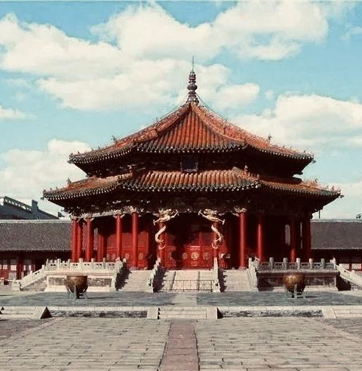
Shengjing Imperial Palace and the integration of Manchu and Han culture
Presenter: 李嫣然

Slide 2


Table of contents
01
02
03
Introduction of the palace
Integragtion of Manchu and Han culture
Reasons behind the palaces’ style

Slide 3


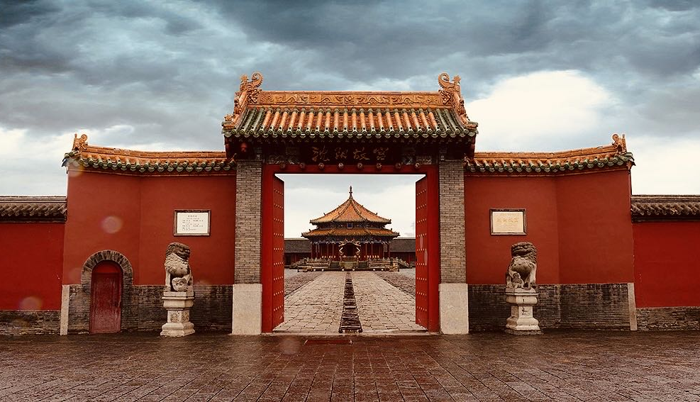
01
Introduction of the palace

Slide 4

Brief Introduction
first built in 1625 by Nuerhachi
extended by Huangtaiji established the Qing Dynasty.
an excellently well-preserved cultural relic
rich cultural heritage of the early Manchu people
the evolution of Manchu culture
integration with Han culture.

Slide 5
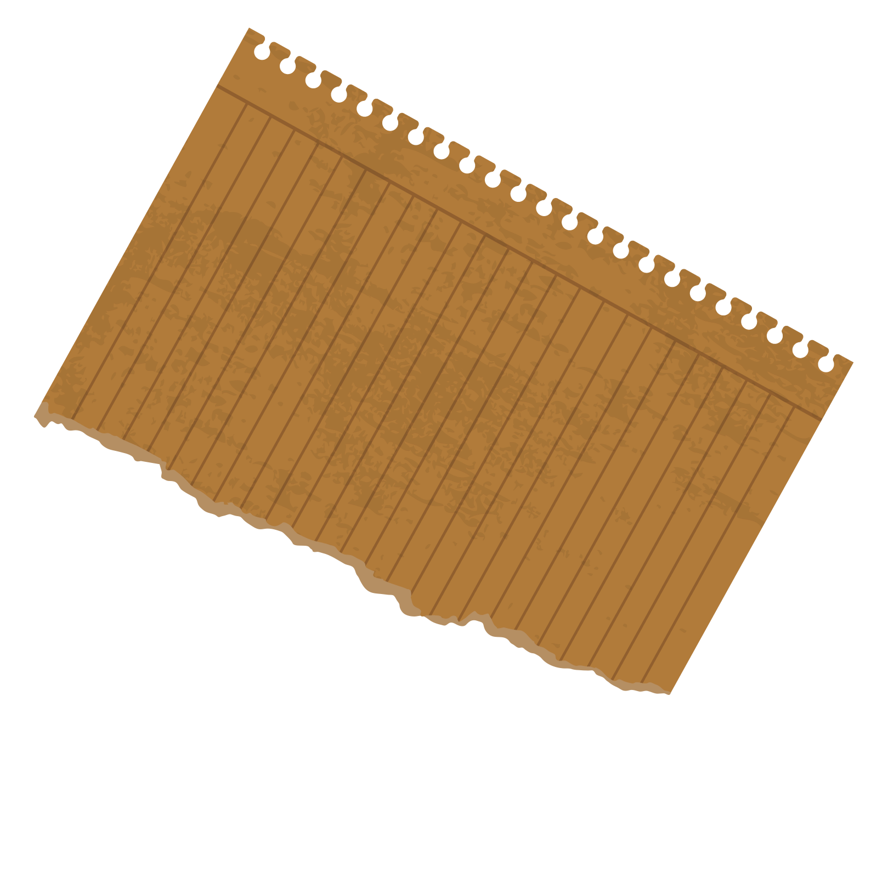
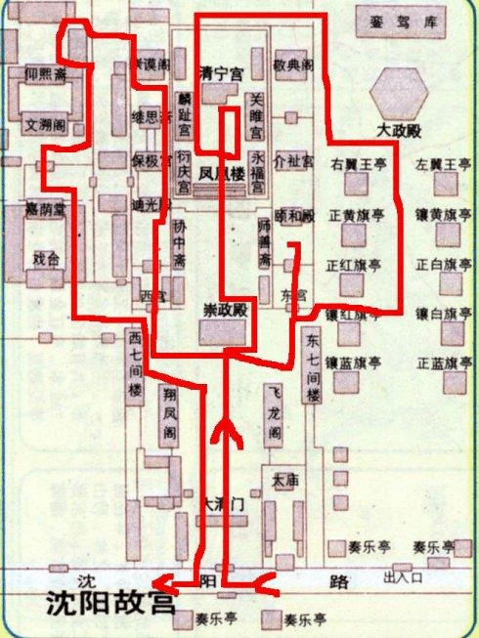
Divisions
Central:
Erected during the reign of Huangtaiji
Fusion of Manchu and Han architectural style
Boasting comprehensive functionalities

Slide 6
Focus
Architectural style
Taking the empress and concubines’ palaces as examples

Slide 7
02
Integration of Manchu and Han culture

Slide 8
Background Information
Five Palaces on the Terrace
Huangtaiji’s view

Slide 9
Five Palaces on the Terrace
Yongfu Palace
Linzhi Palace
Qingning Palace
Yanqing Palace
Guanju Palace

Slide 10
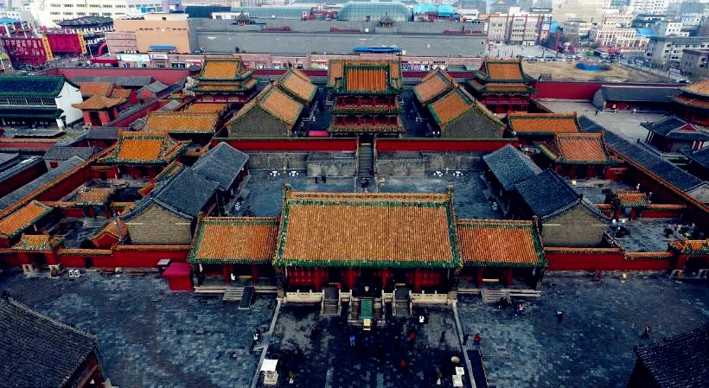
High Palaces Low Halls

Slide 11
Huangtaiji’s view
Inclusiveness
Didn't simply discard the customs and cultural traditions of his own people
transcended the mindset of a regional ruler of the Manchu people
embraced an inclusive and open-minded approach, gathering talents from all walks of life, especially intellectuals among the Han people, to serve his cause of unifying the nation

Slide 12
03
Reasons behind the palaces’ style

Slide 13
Reasons
Manchu culture
Primitive cultural beliefs
Manchu folks
Huangtaiji integrated the beliefs of the Jurchen people into Manchu architectural culure
Examples:
the myth of the Three Fairy Maidens
the young prince of the Jurchen tribe

Slide 14
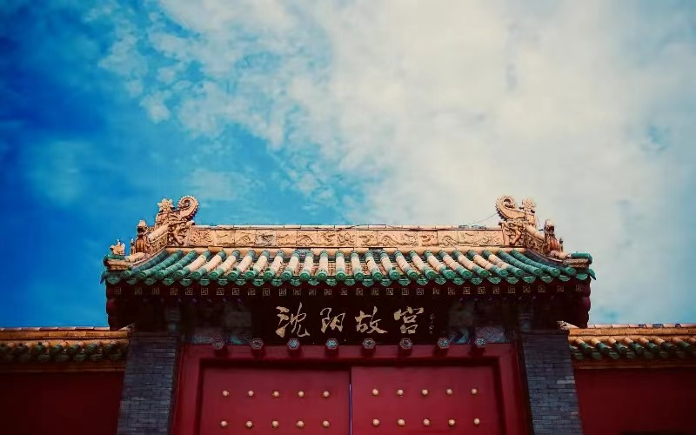
Conclusion
Shengjing Imperial Palace
a striking example of cultural integration
different traditions can blend harmoniously
embracing rather than dominating other cultures
Chinese Culture
remarkable openness to outside influences
Examples: the introduction of Buddhism from India; the adoption of Confucianism from ancient scholars
absorbed and integrated diverse cultural elements

Slide 15
Conclusion
cultural exchange and adaptation
embrace the best of what other cultures have to offer
enriching its own cultural landscape in the process.
In our contemporary society, marked by increasing globalization and interconnection, the imperative to thrive has never been more pressing. Just as Chinese culture has flourished through openness and inclusivity, so too can our modern civilization benefit from embracing the diversity of the world around us.

Slide 16
References
https://www.dpm.org.cn/Uploads/File/2019/12/15/u5df5f080f167c.pdf
https://www.chinahighlights.com/shenyang/attraction/shenyang-imperial-palace.htm
https://en.chinaculture.org/library/2008-02/15/content_34619.htm

Slide 17
Thanks for listening!

