Slide 1




With feats achieved, portrait in Gallery of Merit;
Alone stands General Huo, unmatched in glory.
Han
HUO Qubing
Speaker: Li Yijun
Date：2025.4

Slide 2
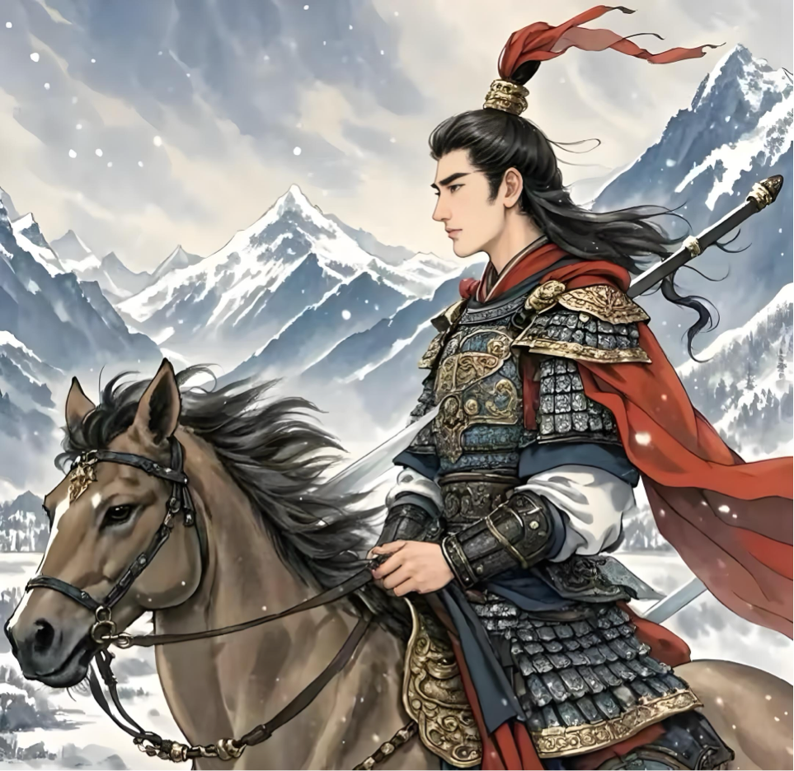
With feats achieved, portrait in Gallery of Merit;
Alone stands General Huo, unmatched in glory.
Many years later as he faced the 24th autumn of his life, the young Champion Marquis Huo Qubing was to remember that distant dawn when he with his troops honored the Mount Langjuxu.

Slide 3
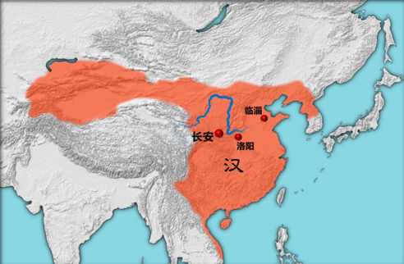
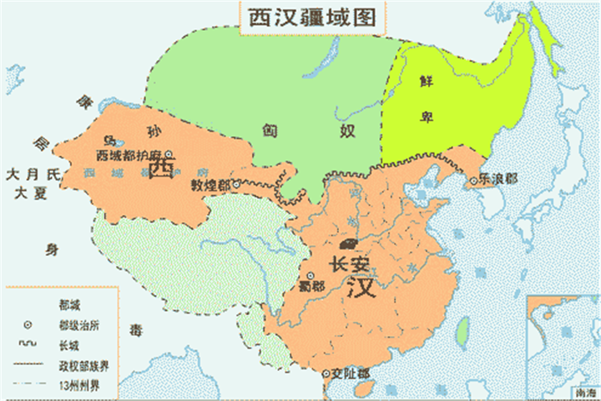

Slide 4
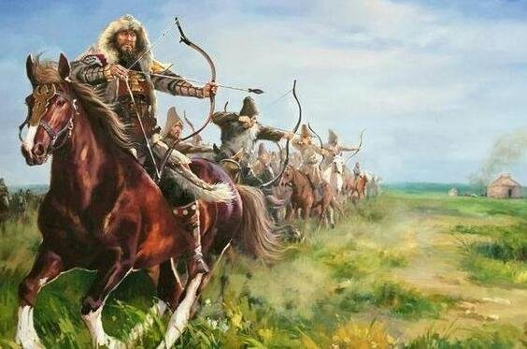
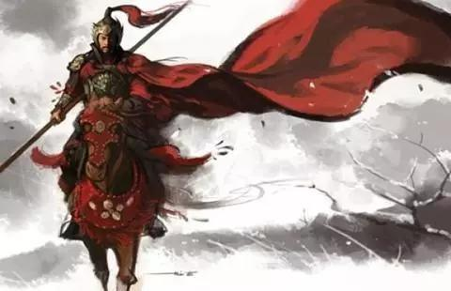

Slide 5



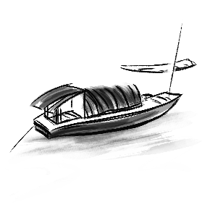
One
National Hero
The Wars

Slide 6
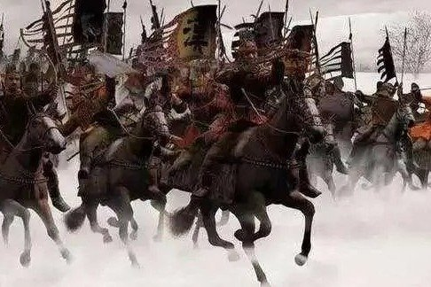
The Mohe War
(123BC)
In the bitter midnight where frost clung to the edges of breath, a young colonel led eight hundred light cavalry in a meteoric charge. Their arrows rained upon the Celestial Wolf (Xiongnu). Their war cries dissolved into the wind’s mournful dirge, as crimson rivers swelled to knee-high tides, each drop a requiem for fallen foes. Deafened by his own pounding heart, the young hero carved his legend: supreme among the three troops, his valor etched in the annals of Han glory.

Slide 7

The Mohe War
Time: in 123 BC
Emperor: Wu of Han (ordered an expedition against the Xiongnu).
General: Wei Qing
Huo Qubing: participated in the war for the first time as the Commander of the Chariots and Cavalry (Piao Yao Xiao Wei).
Main Achievements:
1. demonstrated his astonishing courage and a preference for surprise attacks.
2. left the main army behind and led eight hundred light cavalry alone into the enemy camp, annihilating more than two thousand Xiongnu soldiers with a speed that caught the enemy off guard, causing the enemy’s losses to exceed their own.

Slide 8
The Mohe War
“He captured and killed twenty hundred and twenty-eight enemies, including the Prime Minister, the Doorkeeper, and beheaded the great-grandfather of the Chanyu, Jiruo Hou Chan, and captured his uncle Luo Gu Bi“, as recorded in the “Records of the Grand Historians (Shi Ji)”.
Name a Marquis: after this great victory, Huo Qubing became famous overnight, and Emperor Wu of Han ennobled him as the "Marquis of Champion."

Slide 9
Two Western Corridor Wars
Background: After the Mohe War, the Xiongnu suffered a heavy blow, and their main forces retreated to the northern desert, but they were always planning a counterattack.
Time: in 122 BC
Emperor: Wu of Han (appointed Huo Qubing as the General of the Flying Cavalry, leading ten thousand cavalrymen from Longxi).

Slide 10
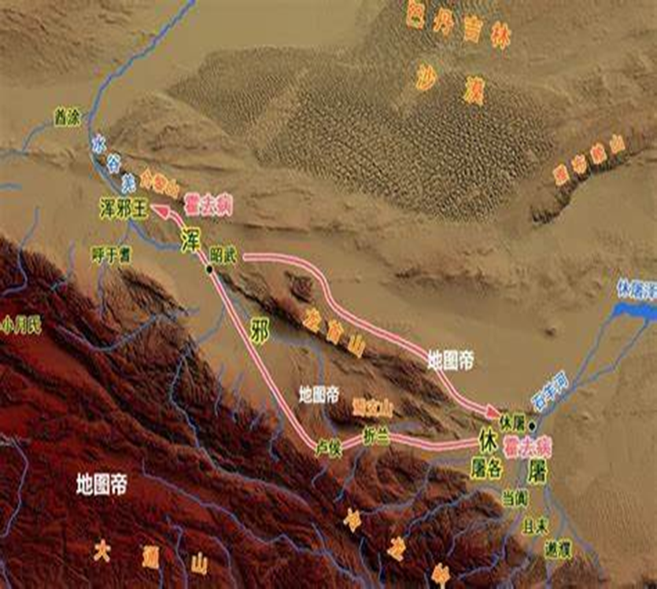
Two Western Corridor Wars
Main Events: Huo Qubing advanced westward, breaking through the enemy lines: "He crossed the Wulu, attacked the Shuopu, crossed the Hunu, and passed through the territories of five kingdoms."

Slide 11
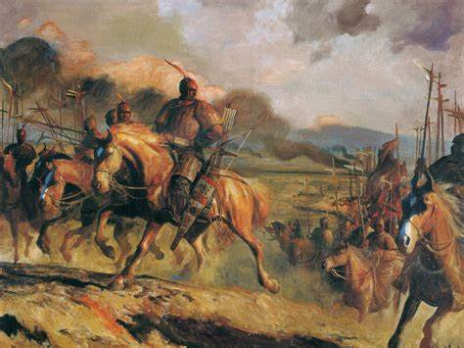
Two Western Corridor Wars
Victory: This war resulted in the annihilation of more than eight thousand enemy soldiers, the death of the Xiongnu's Zhelan King and Lu Hou King, and the capture of the golden statue used for the worship of heaven by the Xiutu tribe. The first Western Corridor War was a great success. This war deepened the Han Dynasty's understanding of the terrain in the Western Corridor, laying the foundation for the Han army to open up the Hexi Corridor.

Slide 12
Two Western Corridor Wars
The Second Western Corridor War: After the first Western Corridor War, in the same summer, Emperor Wu of Han sent Huo Qubing and Gongsun Ao to attack the Western Corridor area for the second time.
Unexpected Courage: Both set out from the northern territories, advancing westward on separate paths. At that time, Huo Qubing advanced deep into the Xiongnu territory ahead of schedule, while Gongsun Ao took the wrong route and failed to meet up with him. With unwavering courage, Huo Qubing resolutely carried out the original plan, adopting a flanking tactic to launch a fierce attack from the side and back of the enemy, ultimately achieving a decisive victory.

Slide 13
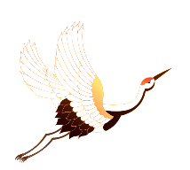
The Northern Desert War
Time: in 119 BC
Emperor: Wu of Han (once again ordered an attack on the Xiongnu, commanding Wei Qing and Huo Qubing to lead their troops into the northern desert).
The two Troops:
1.Wei Qing led Li Guang, Gongsun Ao, and others through the desert for more than a thousand miles to engage in battle with the main force of the Xiongnu, facing more than ten thousand enemy troops with five thousand cavalry.
2.Huo Qubing led five thousand cavalry deep into the heart of the Xiongnu territory, making full use of the mobility and flexibility of the cavalry, crossing the vast desert and fighting over two thousand miles, killing more than seventy thousand enemies, capturing eighty-three people including Xiongnu generals, prime ministers, doorkeepers, and commandants, and causing the Xiongnu Left Worthy King to flee after defeat.

Slide 14
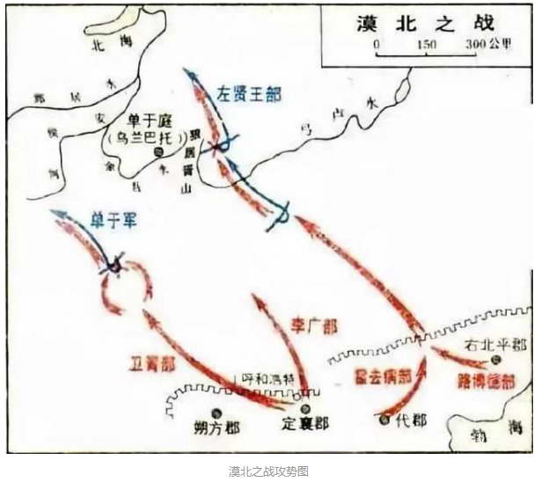
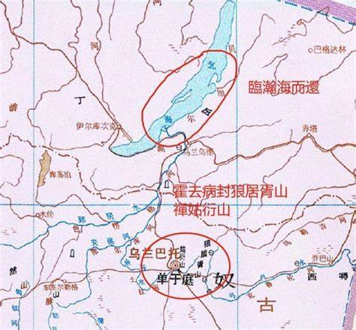
The Northern Desert War

Slide 15
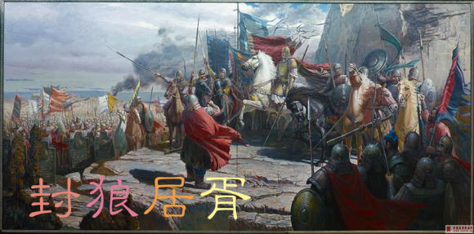
The Northern Desert War
Five thousand cavalry embarked on a thousand-mile lightning strike, like falling meteors shattering the Xiongnu's bone bows—thus
leaving the southern Ordos region devoid of Xiongnu rule.
Feng Langju Xu: Huo Qubing pursued the victory to Mount Langju, where he piled up soil to form a mound and conducted a grand sacrifice to comfort the souls of the soldiers who died in the war. Since then, "Feng Langju Xu" has become a symbol of military achievements in Chinese history, a goal for countless soldiers to strive for.

Slide 16
Two
National Hero
Who is Exactly Huo Qubing?

Slide 17
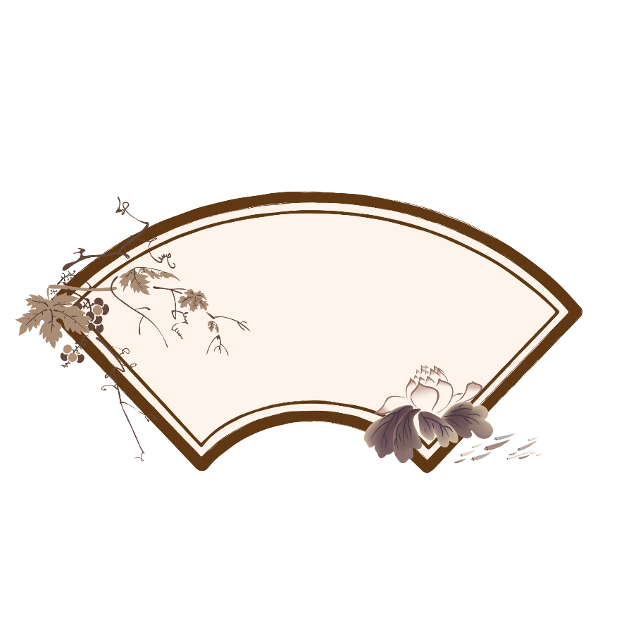
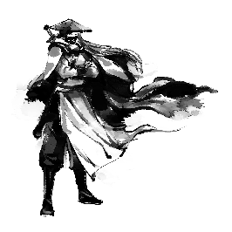
Family Background
His father, Huo Zhongjun, was a county official in Pingyang, and his aunt, Wei Zifu, served in the household of the Marquis of Pingyang and was later favored by Emperor Wu to become the empress.
Later, due to his exceptional military skills and remarkable achievements in war, he was promoted and ennobled, rising swiftly through the ranks to become a Grand General.
With this connection, Huo Qubing grew up in the imperial palace, accompanying Emperor Wu on hunting and horseback riding.

Slide 18

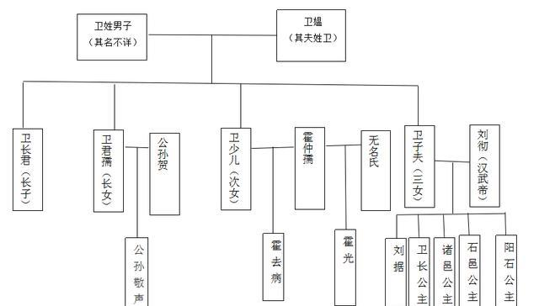
Family Background
Wei Wen
Wei Zifu ( The Second Empress)
The Emperor Wu of Han
Huo Qubing

Slide 19
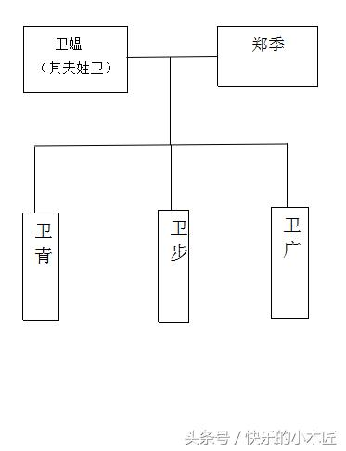
Family Background
Supplement:
Wei Wen
Wei Qing

Slide 20
Three
National Hero
The Strategic and Commanding style of Huo Qubing

Slide 21
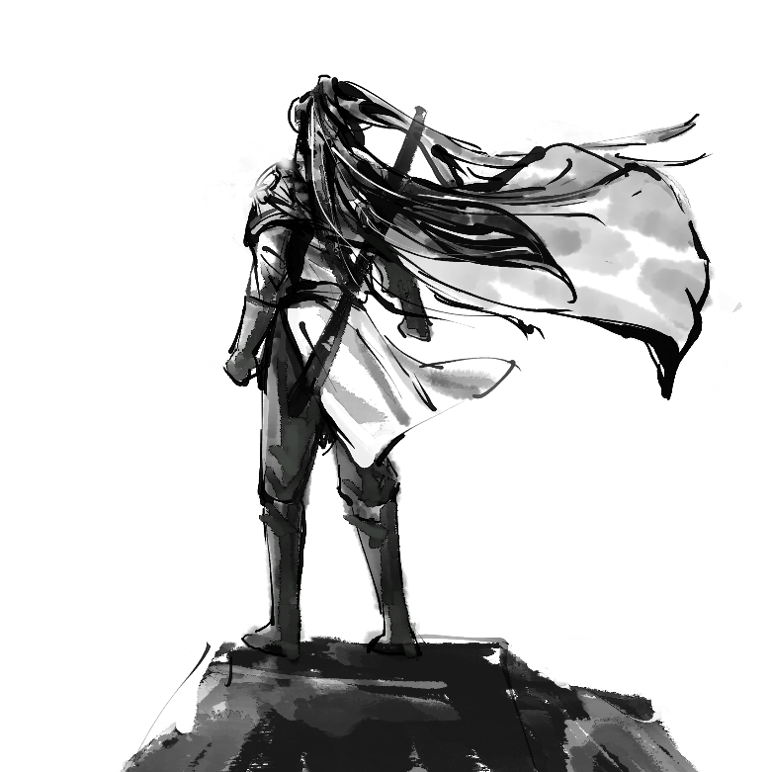
Emphasized the critical role of cavalry
1.Equipment Innovation: His cavalry utilized advanced weaponry (e.g., long spears and swords) and protective gear, such as full-body leather armor, which enhanced survivability during close combat.
2. Tactical Mobility: By focusing on lightweight formations and rapid maneuvers, his troops executed lightning-fast raids across vast terrains, exemplified in campaigns like the Battle of Mobei and the Hexi Corridor conquest.
3. Strategic Selection: Cavalry units were composed of elite soldiers handpicked for endurance and adaptability, supported by superior horse breeds bred from Central Asian stock to balance speed and stamina.

Slide 22
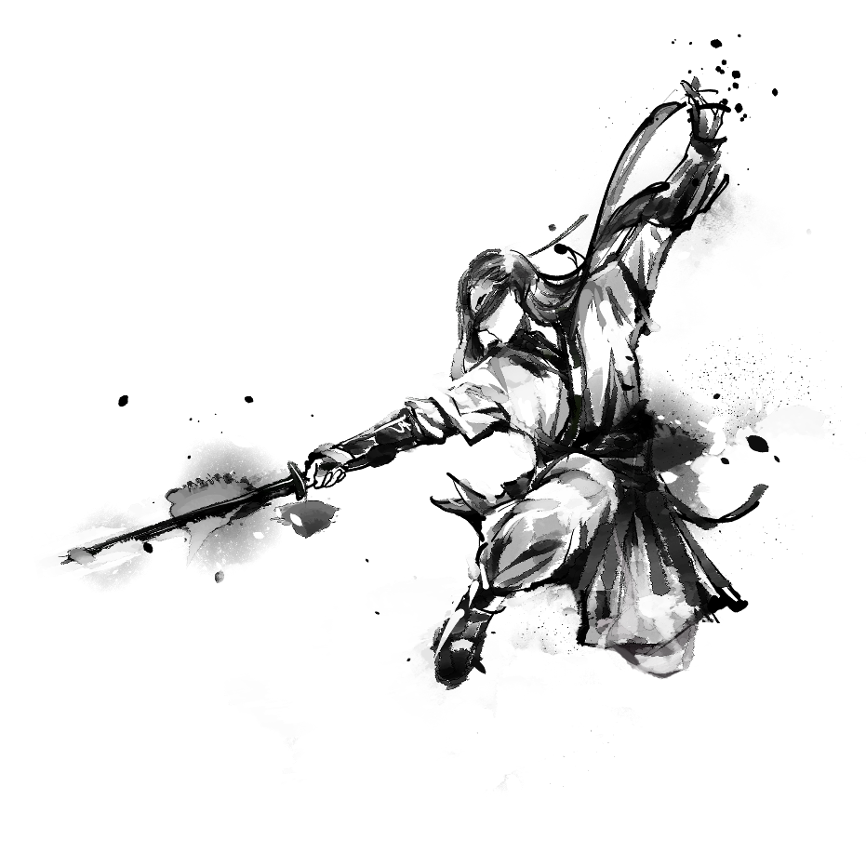

Huo Qubing used blitzkrieg to quickly penetrate the enemy's defense line and quickly strike at the enemy's rear, which was a tactic that could disrupt the enemy's deployment and weaken his morale and combat effectiveness.
blitzkrieg-style tactics

Slide 23

Adopting an aggressive offensive strategy
Huo Qubing implemented rapid strikes and flexible tactical adjustments to disrupt enemy defenses. He excelled in flanking maneuvers and encircling tactics, keeping the adversary at a disadvantage and securing operational dominance on the battlefield.

Slide 24
Four
National Hero
The Legacy of Huo Qubing

Slide 25


Cultural Heritage
Poetry and Prose: Li Bai's "Frontier Songs" ("Bending the bow under the Han moon") and Wang Wei's "Even in death, the hero's bones retain their valor" vividly depict the youthful heroism of Huo Qubing.
Operatic Adaptations: Stage productions like Peking Opera General Huo and Qinqiang Opera Qilian Mountains dramatize his military campaigns.
Folklore: Legends such as "Huo Qubing Crossing the Heavenly Rapids" and "Shooting an Arrow to Create a Spring" are widely circulated in northwestern China, blending into local cultural narratives

Slide 26
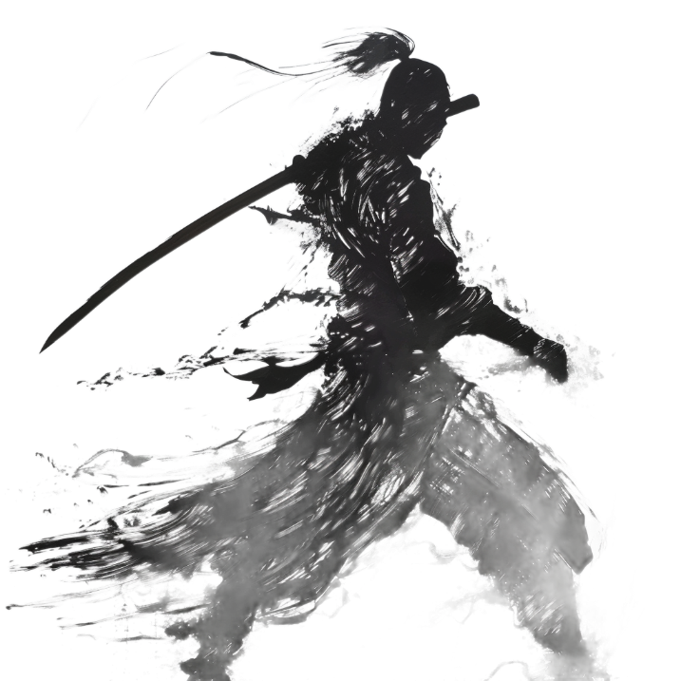
Impact on Future Generations
Inspire the National Generation
Huo Qubing's deeds and thoughts have inspired patriotic people in later generations and have become an important part of the national spirit.
Impact on Military Thought
Huo Qubing's tactical thoughts and cavalry construction had a profound influence on military thought in later generations and were regarded as an important milestone in Chinese military history.

Slide 27


Slide 28
Thank you!

