Slide 1
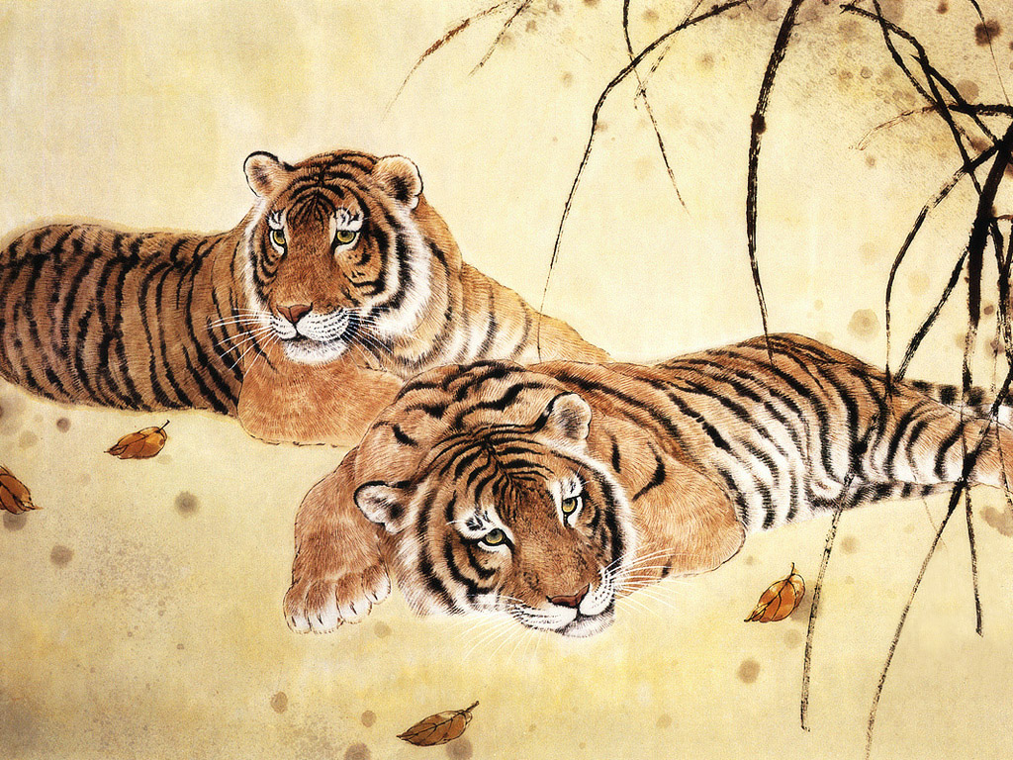
Chinese Literary Societies
Ming to Modern

Slide 2

What Are Literary Societies
A literary society is a group of people interested in literature. In the modern sense, this refers to a society that wants to promote one genre of literature or a specific writer. Modern literary societies typically promote research about their chosen author or genre, publish newsletters, and hold meetings where research findings can be presented and discussed. Some are more academic and scholarly, while others are more social groups of amateurs who appreciate a chance to discuss their favorite writer with other hobbyists.
Notes:
In china litteray societies were eith self procalim or a certain journal or a school with a focus.

Slide 3
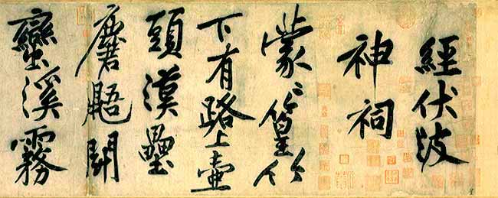
Ming Dynasty ()
Gongan (associated or derived from the Putao she) and Jingling schools
Jiangxi School associated with the followers of Huang Tingjian
Notes:
Jiangxi School
Huang Tingjian (Chinese: 黄庭堅) (1045–1105) was a Chinese artist. He is predominantly known as a calligrapher, but was also admired for his painting and poetry. He was one of the Four masters of the Song Dynasty, and was a student of Su Shi at his school of literati painting.
Huang is generally regarded as the finest and most creative calligrapher of the Song Dynasty. His xingshu displays a sharpness and aggression which is instantly recognisable to the student of Chinese calligraphy.

Slide 4
Gongan and Jingling schools
Gongan
Yuan Zongdao
Yuan Hongdao (1568-1610)
Yuan Zhongdao
Jingling
Zhong Xing
Tan Yuanchun
Notes:
in criticizing those scholars who imitated classical writings blindly.
Representative figures of the Gong'an School are Yuan Zongdao, Yuan Hongdao and Yuan Zhongdao. Yuan Hongdao (1568-1610) is the most famous of the three. The Gong'an School believed that different times have different literature, and objected to the ways the Classical Revival Movement blindly elevated ancient literature and debased current literature. Prose created by the Gong'an School broke the yoke of conventional patterns and developed its own individuality. The language in their prose is simple and plain.
Existing simultaneously with the Gong'an School was also the Jingling School, represented by Zhong Xing and Tan Yuanchun. Like the Gong'an School, the Jingling School also laid claim to expressing the natural character and intelligence of humanity.

Slide 5
Yuan Hongdao Poems
THE CAPITAL
Bright are the city walls of the capital;
Red-robed officials shout on broad streets.
There is a white-headed destitute scholar;
Hanging from his mule's saddle, sheaves of poems.
Clasping his calling card, he knocks on doors for work;
The gate keepers smirk at one another.
Ten try and ten fail;
Walk the streets, his face is haggard.
Always fear in serving the rich;
Sorry your flattery isn't quick enough.
Over an eye a black eyepatch;
Half blind, the fellow is old!
A STRANGE PRIEST
Bought his mantle to escape draft and taxes;
Now he's the head priest amid his splendor.
Recites incantations, but sounds like a bird;
Writes Sanscrit that looks like twisted weeds.
With his begging bowl he distributes food of the spirit;
On his seat he faces the lamp of Buddha;
If you don't devote you whole body and soul,
How can there be anywhere Buddhism at all?

Slide 6
Early to Middle Qing
Banana Garden Poetry Club (Jiaoyuan shi she), late 17th c. women's poetry group
Ten Women Poets of Wu (Wu zhong shi zi), late 19th c. group
Sui Yuan (Followers of Yuan Mei, 1716-1798)
Tongcheng school (mid to late Qing)

Slide 7
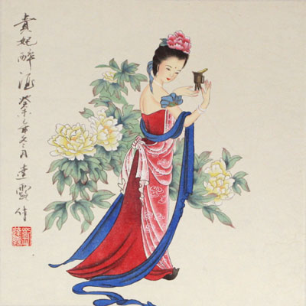
Banana Garden Poetry Club (Jiaoyuan shi she)
Founded by Gu Yurui in 1644
A women only Society
Mostly poetry composition
Notes:
Banana Garden Poetry Club: Founded in 1644, its members consisted of wealth woman who were husbands sister or daughters to wealthy or politically powerful men. They engaged in poetry composition. Became well known throughout the Yangzi delta. When they were the banana garden 7.
Most were from qiantain. Founded by Gu Yurui for her daughter Qian Fenglun. Promoted acquiring graces through education scholarship and learning.

Slide 8
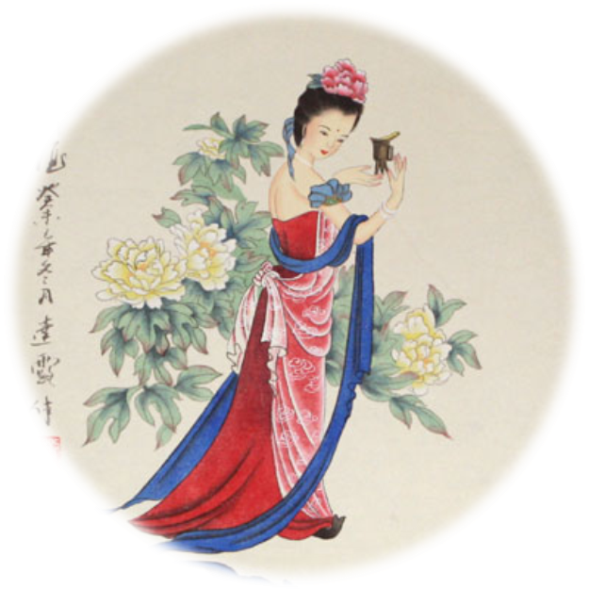
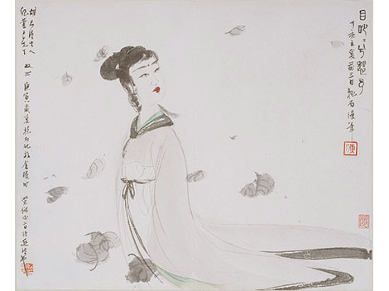
A Winter Day Feast at Chai Jixian’s Place
The stars record that the year is soon over,
The weather is icy, the air cold and desolate.
Shrubs and flowers wither in severe frost,
Heavy dewdrops evaporate in the dawn sun.
Overjoyed to meet with people of pure and simple minds,
We sit together in a beautiful mansion of iris and orchid.
Our merry words and laughter give rise to pleasant countenance and speech,
In harmony we devote ourselves to literary pursuits.
Illustrations and books lie scattered around the chamber,
A table made of yew displays our zithers and lutes.
As the birds disperse the hall becomes subdued,
As the clouds gather the curtains acquire dark shadows.
A life in seclusion keeps the hurly-burly of the world far away,
Standing aloof, our thoughts are idle and carefree.
Time flies like a shuttle on the loom,
I worry that our happy get-together will be over too soon.
Now that we’re tipsy we break into long songs,
Having enjoyed to the full such excellent hospitality!
Notes:
Men where living in a meritocracy while woman were living in a monarchy
The image of the beautiful mansion of iris and orchid in Qian Fenglun’s
poem alludes to the ancient poem ‘Xiang furen’ (‘The Lady of the Xiang’). By
comparing the meeting place of the poetry club, the residence of Chai Jingyi, to
the abode of the Xiang River Goddess, the poem links the pursuit of scholarship
with the world of immortals – a realm that women tended to invoke in their poetry.
In this way Qian’s poem endows the world of learning with the aura of femininity.
Another writer to make explicit the link between women, immortals and literati
learning was the seventeenth-century woman poet Wu Xiao from Changzhou.25

Slide 9
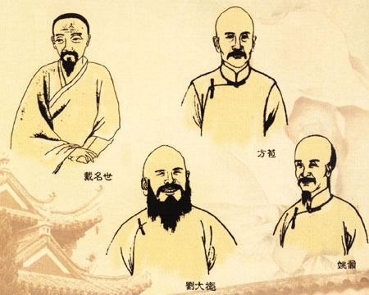
Tongcheng school
Its representative writers include Fang Bao, Liu Dakui and Yao Nai, who are all natives of Tongcheng County in Anhui Province, hence the name Tongcheng School
Notes:
The Tongcheng School is the most distinguished among the mid-Qing Dynasty schools of literature. Its representative writers include Fang Bao, Liu Dakui and Yao Nai, who are all natives of Tongcheng County in Anhui Province, hence the name Tongcheng School. Fang Bao (1668-1749) carried on the tradition of works and made Yi Fa (Yi refers to the central ideas of an article; Fa, to literary forms and artistry) the basic theory of the Tongcheng School's writings.
Works created by the Tongcheng School stressed the elucidation of the article's purpose and didn't encourage loading the writings with fancy phrases; therefore their writings are concise and natural but lack animation.

Slide 10
Late Qing
Southern Society (Nanshe; 1908-22)
Guocui (National essence)
Chunliu she (Spring Willow society)

Slide 11
Southern Society (Nanshe; 1908-22)
founded by Chen Qubing, Gao Kan, Liu Yazi
the Nanshe was sometimes called the "literary arm" of that revolutionary organization, publishing some 22 volumes of poetry, and issues of literary style were hotly debated
Notes:
founded by Chen Qubing, Gao Kan, Liu Yazi and eventually had a membership of over 1,000, with branches in major cities
with a anti-Qing revolutionary platform (the name itself implied the Ming dynasty); these three had been members of the Guocui she (National essence society); founded shortly after the execution of Qiu Jin and Xu Xilin; many members were also members of the Tongmenghui
the Nanshe was sometimes called the "literary arm" of that revolutionary organization, publishing some 22 volumes of poetry, and issues of literary style were hotly debated
after the GMD allied with the CCP, Liu Yazi became "intoxicated" by Marx and Bolshevism; the Nanshe was dissolved and the Xin nanshe (New Southern Society) was established; their forums were the Minguo ribao and the supplement Juewu (edited by Shao Lizi); Chen Qubing rejected this new orientation and set up his own competing Hunan branch of the Nanshe that opposed the New Culture movement being promoted by his erst while colleagues

Slide 12
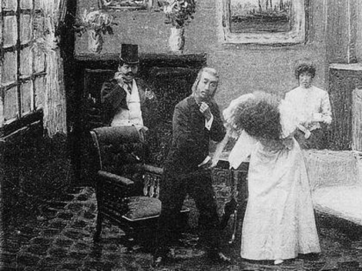
Spring Willow Society (Chunlie She)
1906 or early1907 in Tokyo by a group of Chinese overseas students
the first modern dramatic society
Jisheng she (1908) and Shenyou hui (1909), both established in Japan
Wenyi xin juchang (1910), Xinju tongzhi hui (1912-ca.1915), Wenshe (1913), and Chunliu juchang (1914-1915), founded on the mainland
In 1918/1919 Spring Willow (Chunliu zazhi)
Notes:
1906 or early1907 in Tokyo by a group of Chinese overseas students
formed in Japan in 1908, the first modern dramatic society
These drama societies include Jisheng she (1908) and Shenyou hui (1909), both established in Japan
Wenyi xin juchang (1910), Xinju tongzhi hui (1912-ca.1915), Wenshe (1913), and Chunliu juchang (1914-1915), founded on the mainland
In 1918/1919 one of the founding members of the Spring Willow Society published the magazine Spring Willow (Chunliu zazhi); this magazine was intended by its main editor to revive the spirit of the original society but, as far I can see, was not attached to any drama society

Slide 13
Modern Chinese Literary Societies
Butterfly school
May fourth
conservative groups
Leftist

Slide 14
Conservative Literay groups
Xueheng (Critical Review; 1922-31) Membership: Mei Guangdi, Hu Xiansu (friend and foe of Hu Shi), Wu Mi
Xueheng (Critical Review; 1922-31) Membership: Mei Guangdi, Hu Xiansu (friend and foe of Hu Shi), Wu Mi
Notes:
Xueheng (Critical Review; 1922-31) Membership: Mei Guangdi, Hu Xiansu (friend and foe of Hu Shi), Wu Mi
Position: anti-New Culture; written in wenyan; students of Irving Babbitt (Harvard); neo-classical humanism; rejection of both romanticism and realism; introduced Western classics and Enlightenment writers; favoured criticism of Matthew Arnold (Victorian humanism)
Xueheng (Critical Review; 1922-31) Membership: Mei Guangdi, Hu Xiansu (friend and foe of Hu Shi), Wu Mi
Position: anti-New Culture; written in wenyan; students of Irving Babbitt (Harvard); neo-classical humanism; rejection of both romanticism and realism; introduced Western classics and Enlightenment writers; favoured criticism of Matthew Arnold (Victorian humanism)

Slide 15
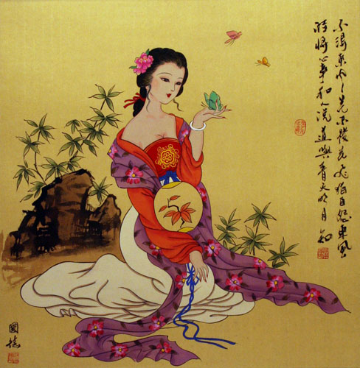
The Mandarin Duck and Butterfly School
Qingshe (Green Society; founded 1922)
this was a Butterfly society formed of Bao Tianxiao, Wang Dungen, Zhou Shoujuan, Li Hanqiu,
published a weekly bulletin called Changqing (Evergreen)
collapse after only one meeting (See Link, p.168)
Xing she (Star society; founded 1922)
published several journals, including Xing bao, Xing guang, Xingxiu hai
Bei pai (Northern group)

Slide 16
Wenxue yanjiu hui
Members: Mao Dun, Zheng Zhenduo, Xu Dishan, Wang Tongzhao, Ye Shaojun, Geng Jizhi, Zhou Zuoren, Sun Fuyuan, Guo Shaoyu, Huang Luyin, Bing Xin
Goals: translations of progressive Western Lit. scientific research of traditional Chinese lit. foster cooperation in literary studies and facilitate the dissemination of knowledge from West and knowledge gained through literary endeavour
Journals
Xiaoshuo yuebao (Shanghai: Commercial Press)
manifesto written by Zhou Zuoren,
Wenxue xunkan
Shi yuekan (Poetry monthly, 1922-)
Publication Series
translation series, creative writing series, humor series, drama series
Tenets:
literature as exposition of real life (not of dao)
opposed view of literature as a diversion for pleasure
concern with social rather than personal problems
opposed notion of inspiration as source of lit.
art for life's sake (realism)
Notes:
(Literary Research Society; 1920-32, th1. Members: Mao Dun, Zheng Zhenduo, Xu Dishan, Wang Tongzhao, Ye Shaojun, Geng Jizhi, Zhou Zuoren, Sun Fuyuan, Guo Shaoyu, Huang Luyin, Bing Xin
2. Goals:
translations of progressive Western Lit.
scientific research of traditional Chinese lit.
foster cooperation in literary studies and facilitate the dissemination of knowledge from West and knowledge gained through literary endeavour
3. Journals
Xiaoshuo yuebao (Shanghai: Commercial Press)
-manifesto written by Zhou Zuoren, published also the constitution of the association, but, according to Hockx, had no official institutional association with the group
Wenxue xunkan (supplement to the Shanghai New Times, then the Chenbao, then published by Beixin shuju, May 1921-)
-this was a more official organ of the group and later become the journal Wenxue after 1922
Shi yuekan (Poetry monthly, 1922-)
-established by Zhu Ziqing, Liu Yanling, and Ye Shengtao
4. Publication Series
translation series, creative writing series, humor series, drama series
5. Tenets:
literature as exposition of real life (not of dao)
opposed view of literature as a diversion for pleasure
concern with social rather than personal problems
opposed notion of inspiration as source of lit.
art for life's sake (realism) (never actually a stated tenet of the societyough publication of the series continued until the late 40s, though organized activity ceased around 1925)

Slide 17
Chuangzuo she (Creation Society)
Chuangzuo she (Creation Society; 1921-29)
Members: Guo Moruo, Yu Dafu, Cheng Fangwu, Zhang Ziping, Tian Han, Feng Yuanjun
Journals:
Chuangzuo jikan (1922-25) and Chuangzuo zhoubao
Chuangzuo yuekan and Hongshui
Wenhua pipan
Tenets:
romanticism (against naturalism)
aestheticism (perfection in beauty)
self-expression: "Our isms, our ideologies are not the same. Niether do we insist they should be the same. The view that we all share is that we should follow the demands from the bottom of the heart and get on with our activities in literature and art" ("Afterword," Chuangzao jikan 1, 2)
source of literature in inspiration and genius
Radicalization of society after 1925 (May 30 Movement)
Important theoretical articles:
"Cong wenxue geming dao geming wenxue" (Cheng Fangwu)
"Xin wenxue de shiming" (Cheng Fangwu)
"Zenyang de jianshe geming wenxue" (Li Chuli)
"Introduction to Sorrows" (Guo Moruo)
Notes:
Chuangzuo she (Creation Society; 1921-29)
1. Members: Guo Moruo, Yu Dafu, Cheng Fangwu, Zhang Ziping, Tian Han, Feng Yuanjun
2. Journals:
Chuangzuo jikan (1922-25) and Chuangzuo zhoubao
Chuangzuo yuekan and Hongshui
Wenhua pipan
3. Tenets:
romanticism (against naturalism)
aestheticism (perfection in beauty)
self-expression: "Our isms, our ideologies are not the same. Niether do we insist they should be the same. The view that we all share is that we should follow the demands from the bottom of the heart and get on with our activities in literature and art" ("Afterword," Chuangzao jikan 1, 2)
source of literature in inspiration and genius
4. Radicalization of society after 1925 (May 30 Movement)
5. Important theoretical articles:
"Cong wenxue geming dao geming wenxue" (Cheng Fangwu)
"Xin wenxue de shiming" (Cheng Fangwu)
"Zenyang de jianshe geming wenxue" (Li Chuli)
"Introduction to Sorrows" (Guo Moruo)

Slide 18
Other may fourth literary groups
Beijing Women's Normal College Women's Writing Group
Chenguang she (Morning Light) and Hupan she (Lakeside)
Misa she (Muse Society)
Qiancao she (Shallow weeds society)
Kuangbiao she (Sturm und Drang society)
Xi she (Sunshine society)
Yusi she (Spinner of Words; 1924-31)
Weiming she (The Unnamed Society; 1925-30)
Xinyue she (The Crescent Moon Society; 1923-31)

Slide 19
Taiyang she
Taiyang she (The Sun Society; 1928)
Members: Qian Xingcun (A Ying), Jiang Guangzi, Yang Cunren.
Journals
Taiyang zhoukan (1928)
Shidai wenyi (short run)
Xin liu (short run)
Tuohuangzhe (short run)
Tenets
radical Marxist organization promoting revolutionary literature
attacked Creation Society and their leadership in the revolutionary lit
together with Creation Society attacked Lu Xun and Yusi as living anachronism
first to propagate literature of the working class
4. Affiliations
all members were members of the CCP
Notes:
Taiyang she (The Sun Society; 1928)
1. Members: Qian Xingcun (A Ying), Jiang Guangzi, Yang Cunren.
2. Journals
Taiyang zhoukan (1928)
Shidai wenyi (short run)
Xin liu (short run)
Tuohuangzhe (short run)
3. Tenets
radical Marxist organization promoting revolutionary literature
attacked Creation Society and their leadership in the revolutionary lit
together with Creation Society attacked Lu Xun and Yusi as living anachronism
first to propagate literature of the working class
4. Affiliations
all members were members of the CCP
5. Debates
at the forefront of the "revolutionary literature" debate, the attack on Lu Xun, etc.

Slide 20
Zuojia zuoyi lianmeng
Zuojia zuoyi lianmeng (League of left-wing writers; 1930-36)
Established by leftist writers in an attempt to end literary bickering and attack the real enemies (Xinyue pai)
promote literature from a Marxist perspective
literature to speak for the proletariat
Important league articles:
inaugural address by Zheng Boqi shows continuing allegiance to romantic elements, such as poets as prophets
"Duiyu zuoyi zuojia lianmeng de yijian" (Lu Xun, Er xin ji), in which he soberly warned romantics of being "salon socialists"
these two speeches mark the tensions that later explode in the League debates
organized three research societies in connection with League
Research Society of Marxist Literary and Art Theories
of International Culture
of Popularization of Literature and Art
Journals:
Beidou
Tuohuang zhe
Shijie wenhua
Mengya yuekan
Dazhong wenyi
Wenxue yuekan
the mimeographed sheet, Wenxue shenghuo, was a kind of internal organization pamphlet
Xiandai xiaoshuo
Notes:
Zuojia zuoyi lianmeng (League of left-wing writers; 1930-36)
1. Established by leftist writers in an attempt to end literary bickering and attack the real enemies (Xinyue pai)
promote literature from a Marxist perspective
literature to speak for the proletariat
2. Important league articles:
inaugural address by Zheng Boqi shows continuing allegiance to romantic elements, such as poets as prophets
"Duiyu zuoyi zuojia lianmeng de yijian" (Lu Xun, Er xin ji), in which he soberly warned romantics of being "salon socialists"
these two speeches mark the tensions that later explode in the League debates
3. organized three research societies in connection with League
Research Society of Marxist Literary and Art Theories
of International Culture
of Popularization of Literature and Art
4. Journals:
Beidou
Tuohuang zhe
Shijie wenhua
Mengya yuekan
Dazhong wenyi
Wenxue yuekan
the mimeographed sheet, Wenxue shenghuo, was a kind of internal organization pamphlet
Xiandai xiaoshuo

Slide 21
War Period
Zhanguo ce (1940-41)
centered around the journal Zhanguo ce (founded in 1940), this group, centered around the ideas of Lei Haizong and composed of Chen Quan and Lin Tongji; the journal also published Liang Zongdai (poetry critic and German trained scholar)
Chen Quan, playwright and novelist, was the central literary figure
influenced by Nietszche and the notion of power politics
Wenyijie kangdi xiehui (All-China Liteary Resistance Associaton (1938-45)
umbrella organization for the cultural world during the Anti-Japanese war
formed in 1938 in Wuhan, then moved to Chongqing in 1939
led trips to the front by writers
official journal Kangzhan wenyi (ed. Mao Dun)

Slide 22
Sources
http://people.cohums.ohio-state.edu/denton2/publications/research/soc.htm
http://en.cnki.com.cn/Article_en/CJFDTOTAL-SHDS200902006.htm
http://history.cultural-china.com/en/50History6377.html
Berg, Daria, and Chloë Starr. The Quest for Gentility in China: Negotiations beyond Gender and Class. London: Routledge, 2007. Print.
http://english.ccnt.com.cn/?catog=literature&file=040101&page=3&ads=service_001
http://unisg.academia.edu/DariaBerg/Papers/1178053/Daria_Berg._Negotiating_Gentility_The_Banana_Garden_Poetry_Club_in_Seventeenth-Century_Jiangnan_

