Slide 1

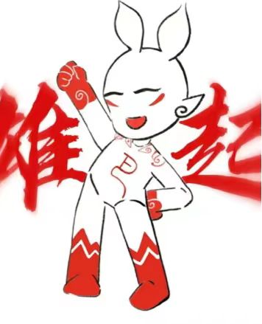


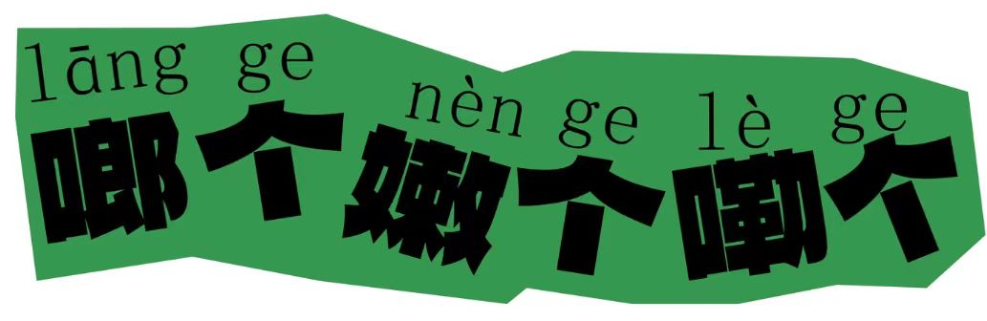
Language:
Chinese Dialects
Chang Sha
Sichuang
Presenter：Mei Xilei
Chong Qing
An Hui

Slide 2

Contents
1
Chinese Dialects Overview
Cantonese Highlights
2
3
Hunan Dialect
4
Significance of Dialects

Slide 3
1
Chinese Dialects Overview

Slide 4


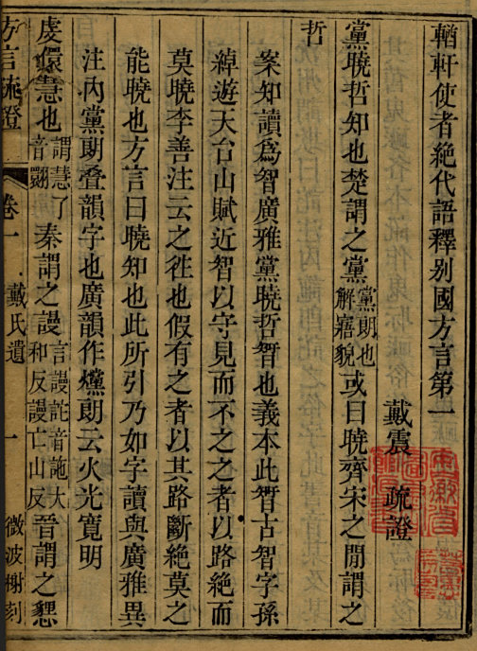
Introduction
Dialects
In China: both a political concept and a linguistic one
In Europe:a linguistic concept
Varieties of Chinese
Yangxiong (53-18)
"Interpretation of Foreign Dialects: Light Xuan"

Slide 5
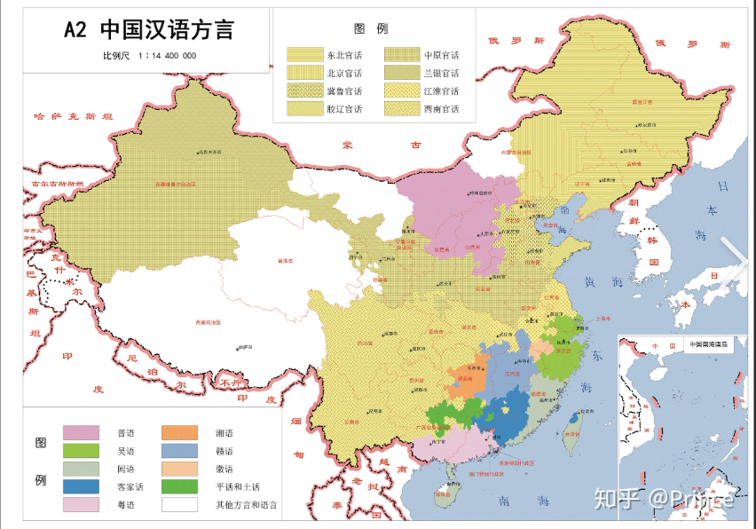
Classification
Official dialects
nine local dialects：Wu, Cantonese, Min, Xiang, Hakka, Gan, Hui, Jin, Pinghua.

Slide 6
2
Cantonese Highlights

Slide 7

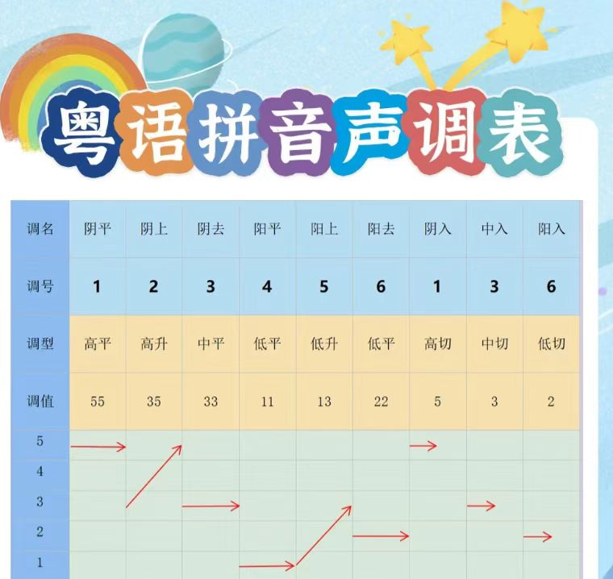
Eason
Cantonese
Yueyu
Status: Mother tongue of Guangfu people, studied by foreign universities.
Features: Nine tones, retains Middle Ancient Chinese features.

Slide 8
3
Hunan Dialect

Slide 9
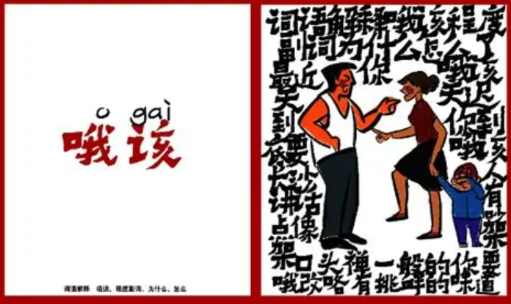
Hunan Dialect
varieties:new-Changsha dialect
old-Shuangfeng dialect
Origin: Ancestor is ancient Chu language (pre-Qin period).
Distribution and number of speakers:
Mainly used in the Xiangjiang river basin.
In Hunan, with an estimated 45 million speakers in 2010.

Slide 10
4
Significance of Dialects

Slide 11


Significance
Chinese dialects are not just ways of speaking; they're treasures carrying history and culture. Each dialect tells a unique story of its region.

Slide 12
Listening challenge
1.么个、古葛分别有几个？
9、4
-怎么了
-没怎么
-没怎么怎么摆脸这个样子
-没怎么我怎么就不能做这个样子，要怎么才可以做这个样子
-没怎么就不要做个这样的脸色，我还以为你怎么了呢
2.么个、古葛分别是什么意思？
怎么
这样

Slide 13

Thanks!

