Slide 1
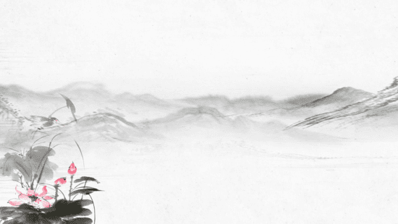
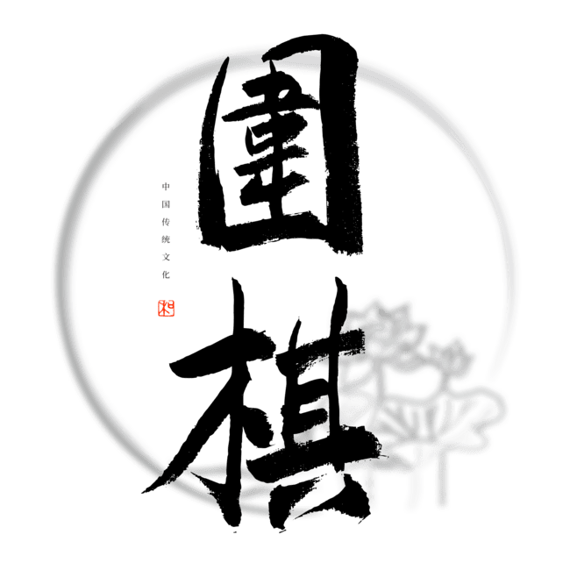

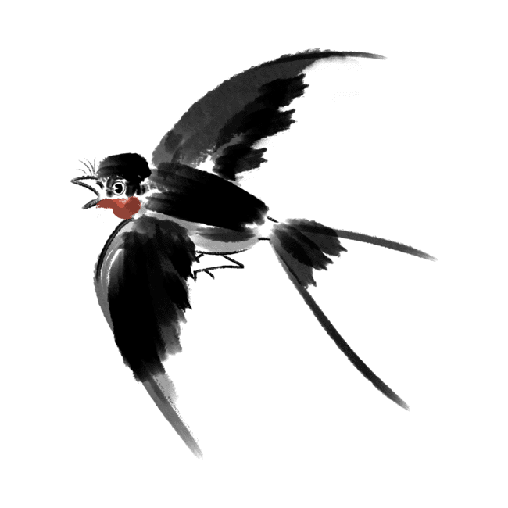
The Translation and Spread of Go(Weiqi)
Zhao Qi
2025.3.21

Slide 2
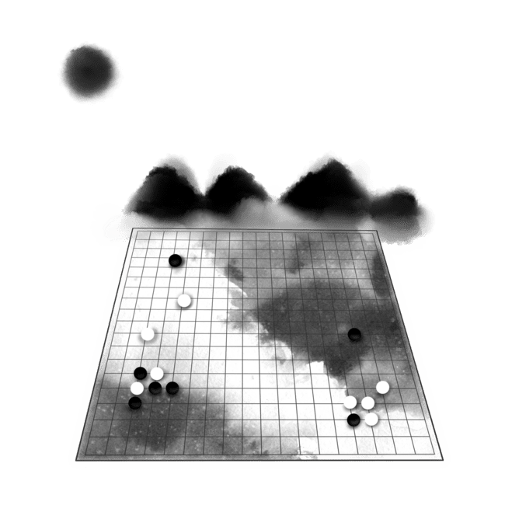
Contents
The Influence of Go on Chinese Language and Culture
The Spread of Go Around the World
How Go Terms Were Translated
Will “Weiqi” Replace “Go” in English?

Slide 3

1
The Influence of Go on Chinese Language and Culture

Slide 4

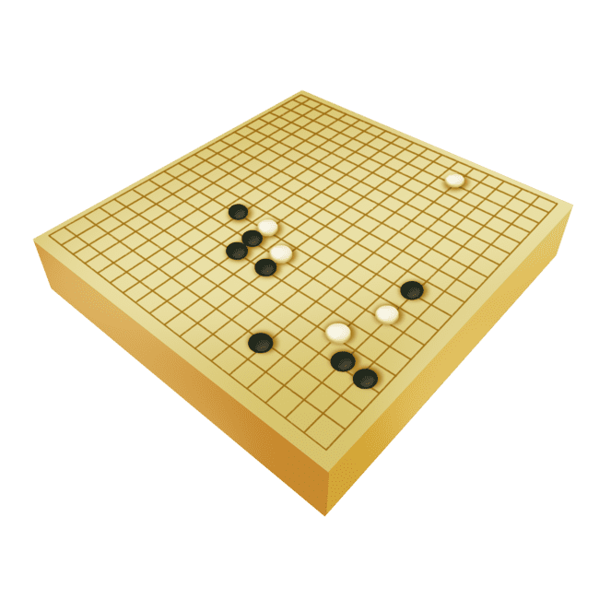
Go-Inspired Chinese Idioms
一着不慎，满盘皆输 “Yī zháo bù shèn, mǎn pán jiē shū”
A single mistake can lead to complete defeat.
棋逢对手 “Qí féng duì shǒu”
An evenly matched contest.
举棋不定 “Jǔ qí bú ding”
Hesitant to make a move.

Slide 5
Go-Inspired Modern Expressions
布局（layout）：The strategic positioning and organization of elements to achieve an optimal outcome.
复盘（review）：A retrospective analysis of past decisions to refine strategies for future success.
大局观（big-picture thinking）：An awareness of the overall situation that helps guide strategic decision-making.

Slide 6
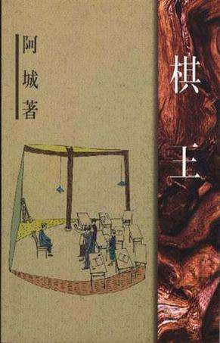

Go-Inspired Literature
Su Shi(苏轼)
*Winning brings joy, but losing is also fine.*
胜固欣然，败亦可喜。
*The Chess Master *《棋王》

Slide 7
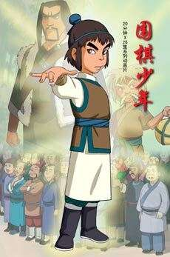
Go-Inspired Other Art
*Chess Player*
《围棋少年》
“Chess Player" (《围棋少年》) is a Chinese animated series that follows the journey of a young prodigy mastering the ancient game of Go, overcoming challenges, and uncovering secrets in a world of strategy and competition.

Slide 8
2
The Spread of Go Around the World

Slide 9
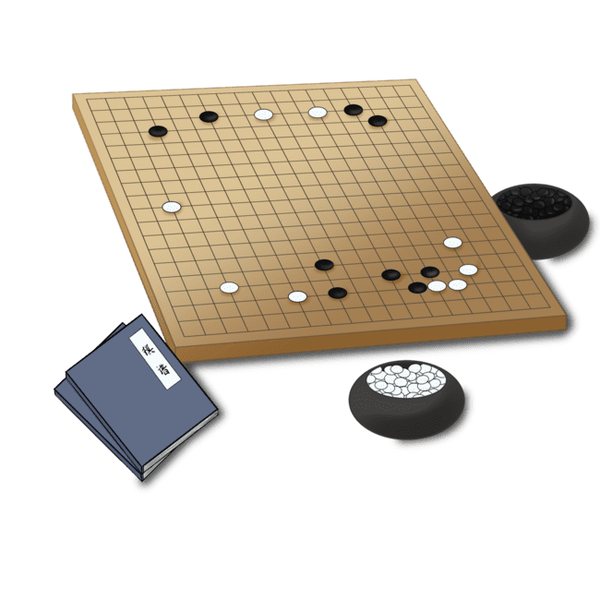
The Spread of Go Around the World
Stage 1
Go spread to Japan and Korea in the 6th-7th century, where it flourished.
It reached the West in the late 19th century, brought by diplomats and missionaries, but remained a niche game.
Stage 2
In the mid-20th century, Go gained more recognition. Wu Qingyuan (吴清源) became a legendary player, drawing global attention.
By the 1960s, the first Go associations appeared in the US and Europe.

Slide 10
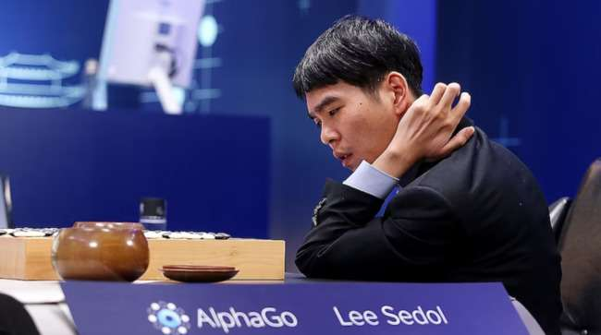
The Spread of Go Around the World
Stage 3
The real turning point was in 2016, when AlphaGo defeated Lee Sedol.
This event shocked the world and introduced Go terms into mainstream English discussions.

Slide 11
3
How Go Terms Were Translated

Slide 12
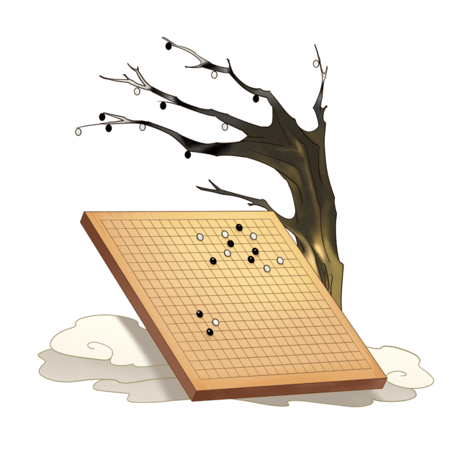
Japanese-based Phonetic Translations
Go (围棋) – 碁
Komi (贴目) –コミ
Joseki (定式) –定石
Atari (打吃) –当たり
Ko (劫) –劫

Slide 13
Borrowing from Chess and Other Games
Black / White (黑棋 / 白棋)
Board (棋盘)
Move (手)
Resign (认输)
Handicap (让子)
Endgame (官子)

Slide 14
Combination
Ko Fight (打劫)

Slide 15
Key Terms from the AlphaGo vs. Lee Sedol Match
Move 37 (第37手)
In Game 2, AlphaGo played an unexpected move at step 37, surprising experts and changing Go strategy.
The Divine Move (神之一手)
Originally, this phrase meant a perfect, god-like move.
In Game 4, Lee Sedol’s move at step 78 turned the game around and was called "The Divine Move of Humans."

Slide 16
4
Will Weiqi Replace "Go" in English?

Slide 17

Will Weiqi Replace "Go" in English?
Large Language Models like ChatGPT and DeepSeek predict:
✅ "Go" will remain the professional term.
✅ "Weiqi" may be used in cultural discussions.
Instead of replacing "Go," "Weiqi" might coexist with it.

Slide 18
Thanks!

