Slide 1
Song: Celadon and the Celadon Song
By: Sun Li Jun

Slide 2

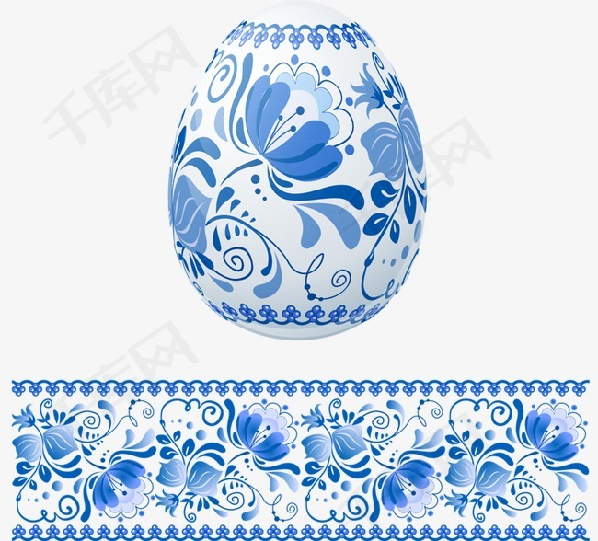
What is Celadon?
Celadon is the most widespread type of ancient Chinese porcelain. It is a mixture of iron oxide with a glaze that results during the firing process. The glaze is the characteristic green tone of the porcelain, which occurs due to the presence of iron in the clay.
Characteristic: bright and stable colors; high rate of firing

Slide 3
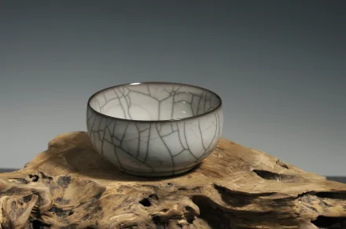
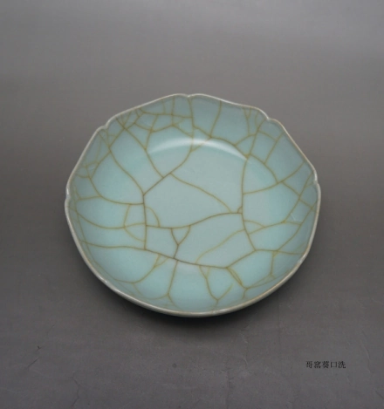
Crackleware（裂纹釉）
One type of celadon, known as “crackleware”, has broad and fine cracks on its surface. These characteristics appear in the glaze as a result of the firing process when the glaze shrinks more than the body of the pottery. The potters from the Song Dynasty cleverly used the crackle in the glaze for a decorative effect.

Slide 4
The Origin of the Name-Celadon
The white-and-blue porcelain got its name “celadon” from a character in a romantic novel written by Honoré d'Urfé(奥诺雷·吴尔夫) which was played on the stages of Paris in the 17th century.
The hero, a shepherd named Celadon in this play, was clad in delicate green.
From then on, the Parisians liked the green porcelain from China so much that they renamed it after the hero of Celadon.

Slide 5
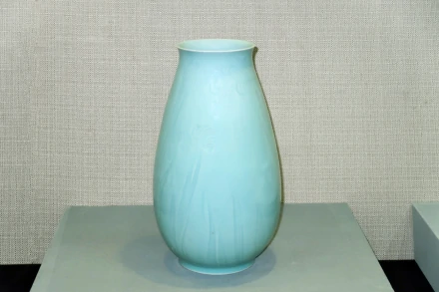
The Development of Celadon
First Appearance: in East China during the Han Dynasty(206BC-25AD)
Maturity: the Tang Dynasty(619-960)
Climax: the establishment of the southern capital in Hangzhou in 1127 during the Song Dynasty
Official kilns in Longquan, southeast Zhejiang

Slide 6

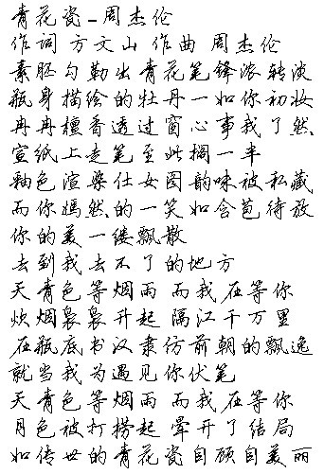

The Celadon Song 《青花瓷》
Written by Fang Wenshan, composed and sung by the music giant Jay Chou, this beautiful song Celadon mainly describes the blue-and-white porcelain, praising the beauty and elegance of it, so that more and more people get to know celadon.
The lyrics are full Chinese style, and show the beauty of Chinese language and characters.

Slide 7
The Celadon Song 《青花瓷》
It is hard to fire the azure-colored glaze, and the potters don’t start the firing process until it rains. The temperature and humidity must be just right and the potters don’t know when it will rain, thus they need to wait here for a while. When it rains, the potters just get down to fire the porcelain, producing the most beautiful blue-sky color.
What the sky is waiting for is the Misty Rain, so you don’t know when your significant other will show up, you can only wait with your life. There must be a moment when you happens to be here, he happen to come, life is full of one encounter after another.

Slide 8
Thanks!

