Slide 1
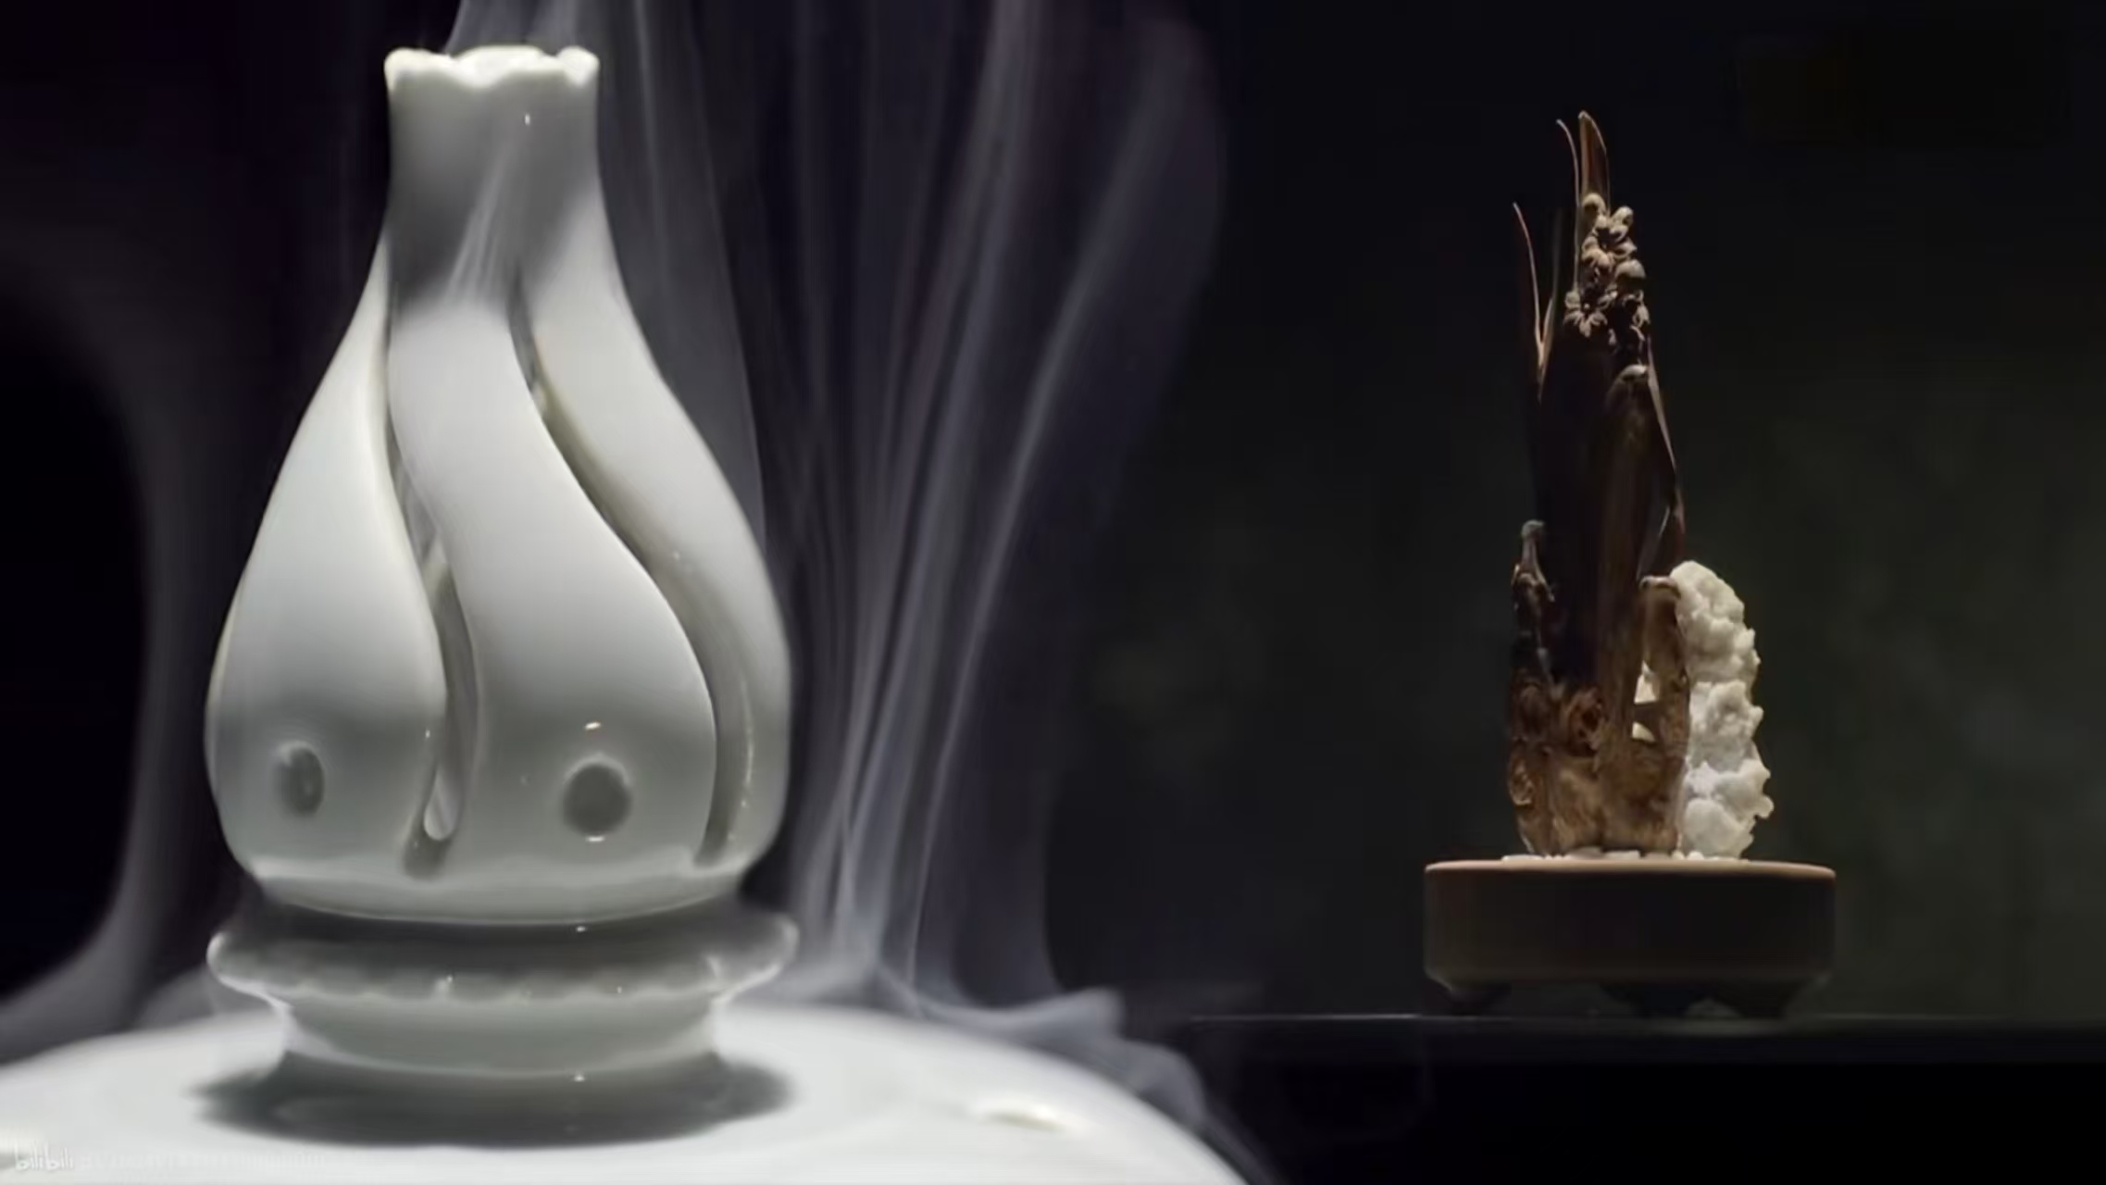

Chinese Incense
Speaker: 唐家华

Slide 2

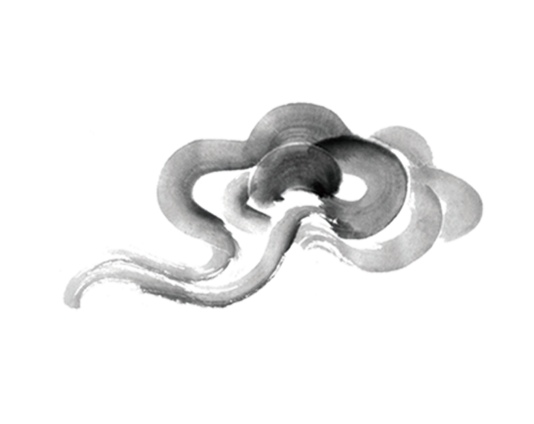
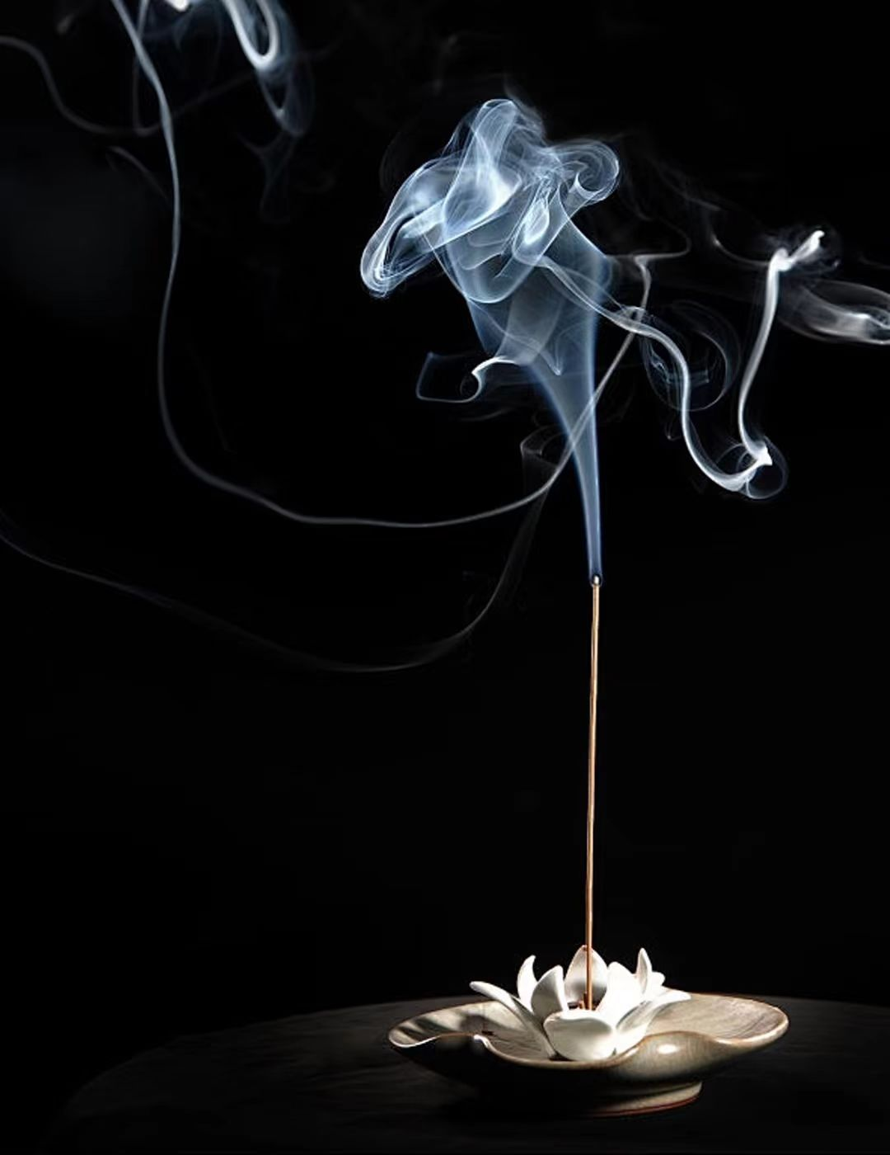
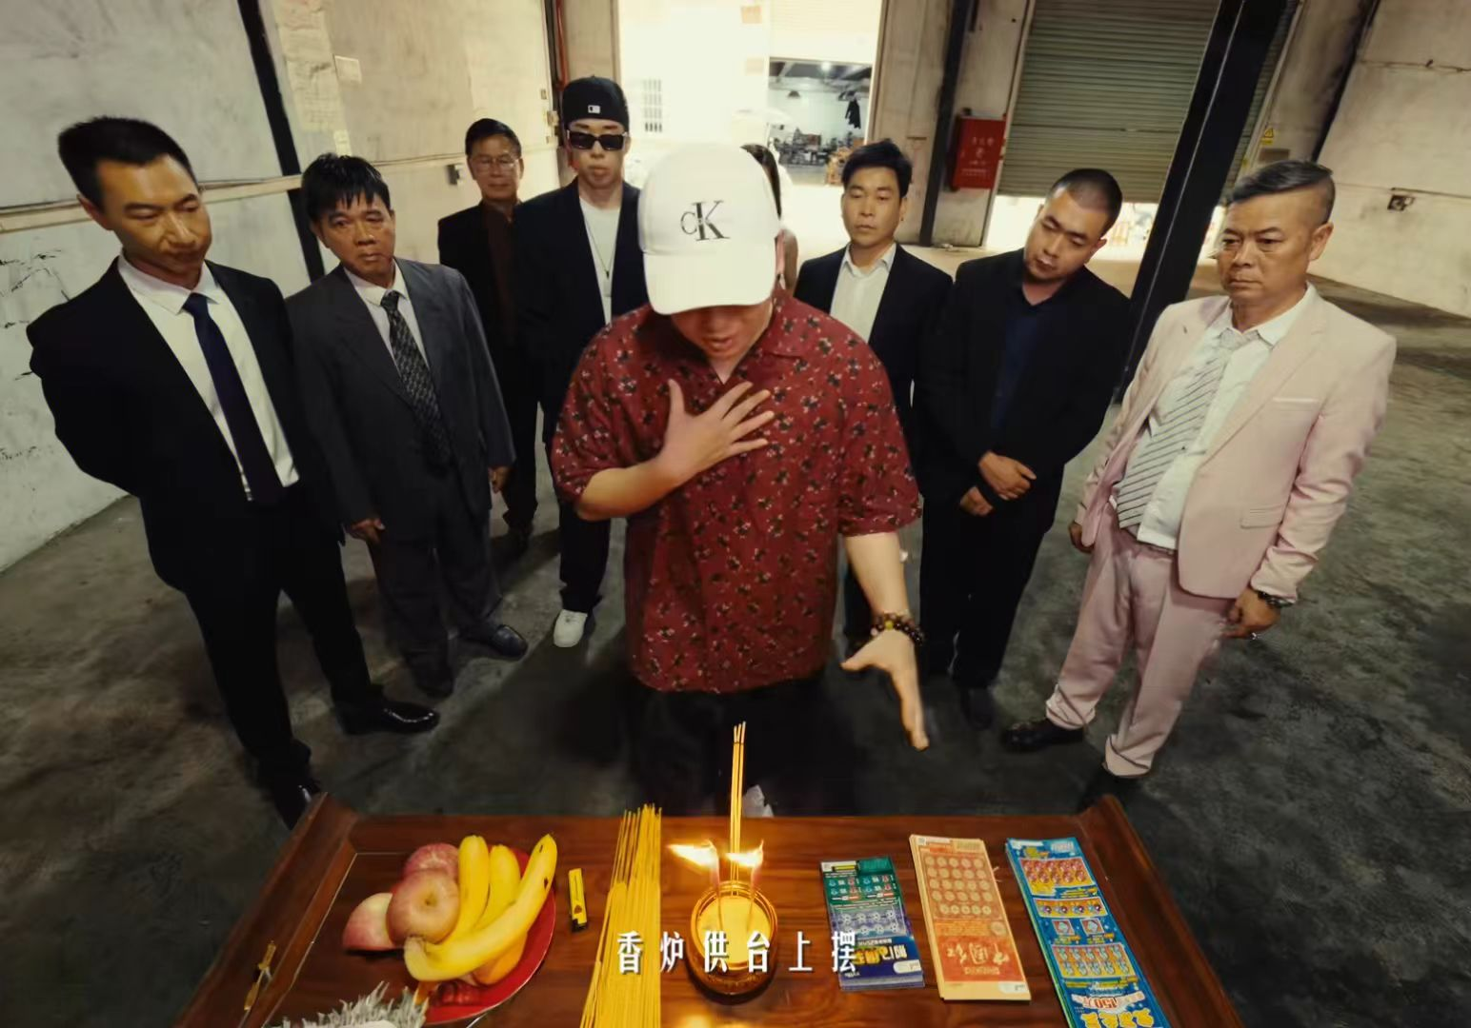


enhance peace of mind and improve concentration
an auspicious object that brings wealth and blessings
“香炉供台上摆，长大才开白黄牌”

Slide 3



CONTENTS
PART ONE
PART TWO
the Origin and Development
the Classification
PART THREE
PART FOUR
the Production
the Cultural Influence

Slide 4

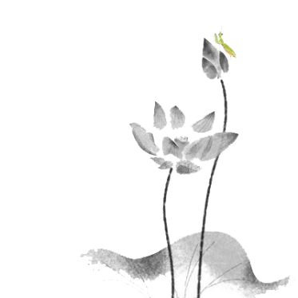

the Origin and Development of Chinese Incense Culture

Slide 5
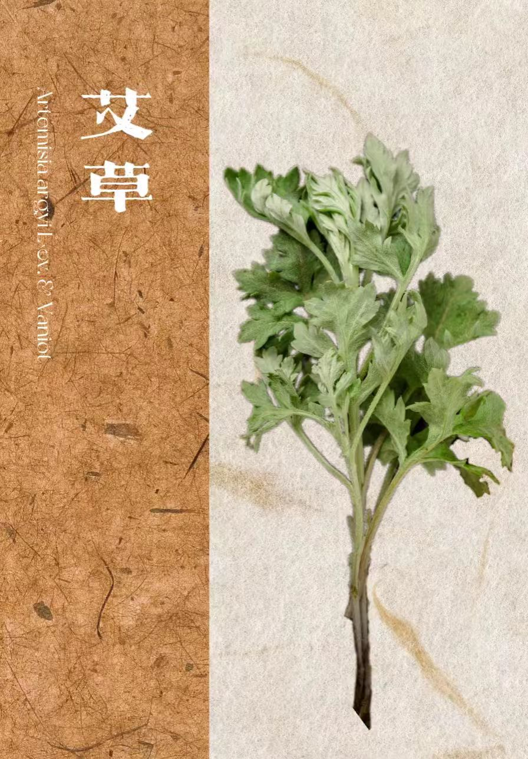
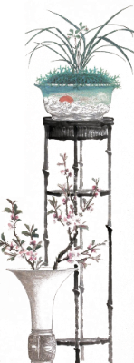
Ancient Times
burn woods to produce smog to pray to the heaven and the earth
used the special odors of plants to drive away mosquitoes and insects

Slide 6
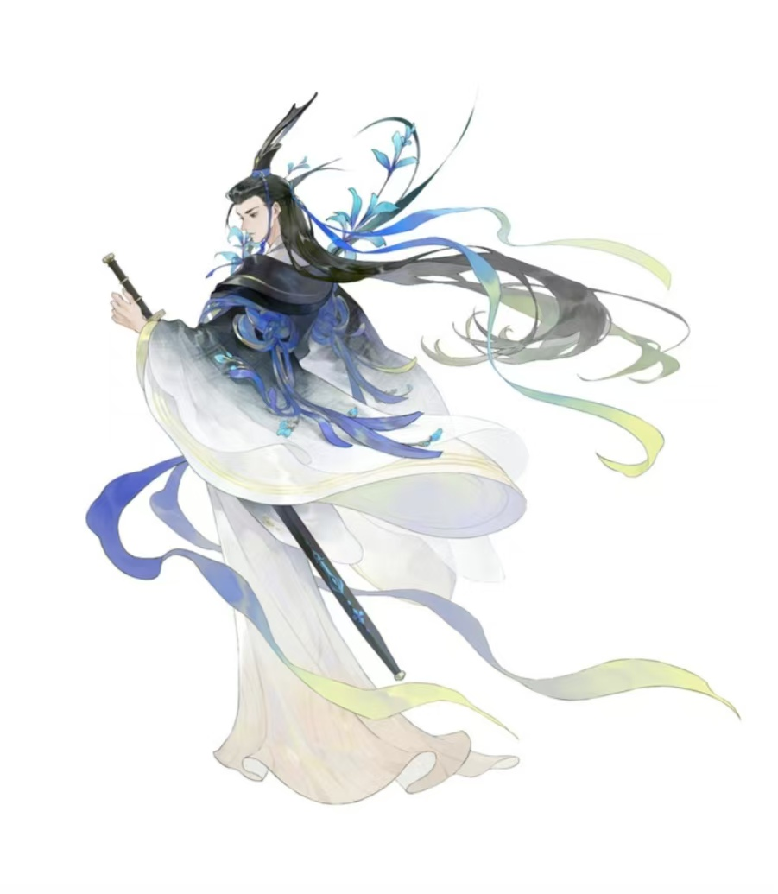

Pre-Qin Period
applied in multiple fields such as sacrifices, food, and decoration
mainly natural herbal incense

Slide 7
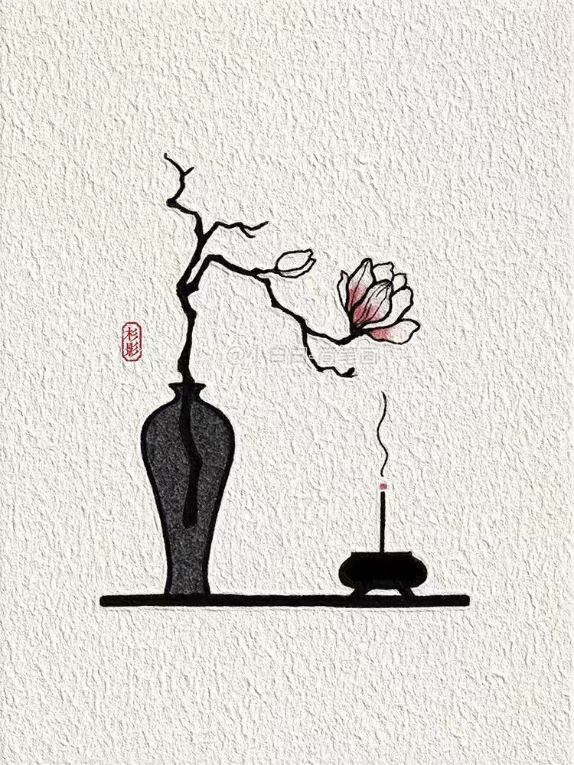
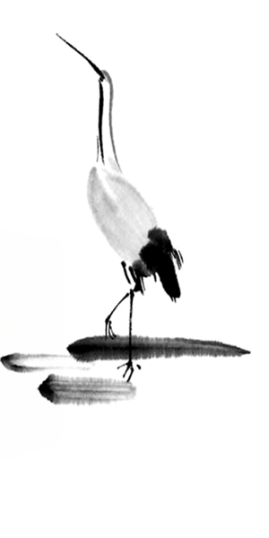
Han Dynasty
popular among the upper classes
incense-making tools became increasingly diverse
the “composite incense” method appeared

Slide 8
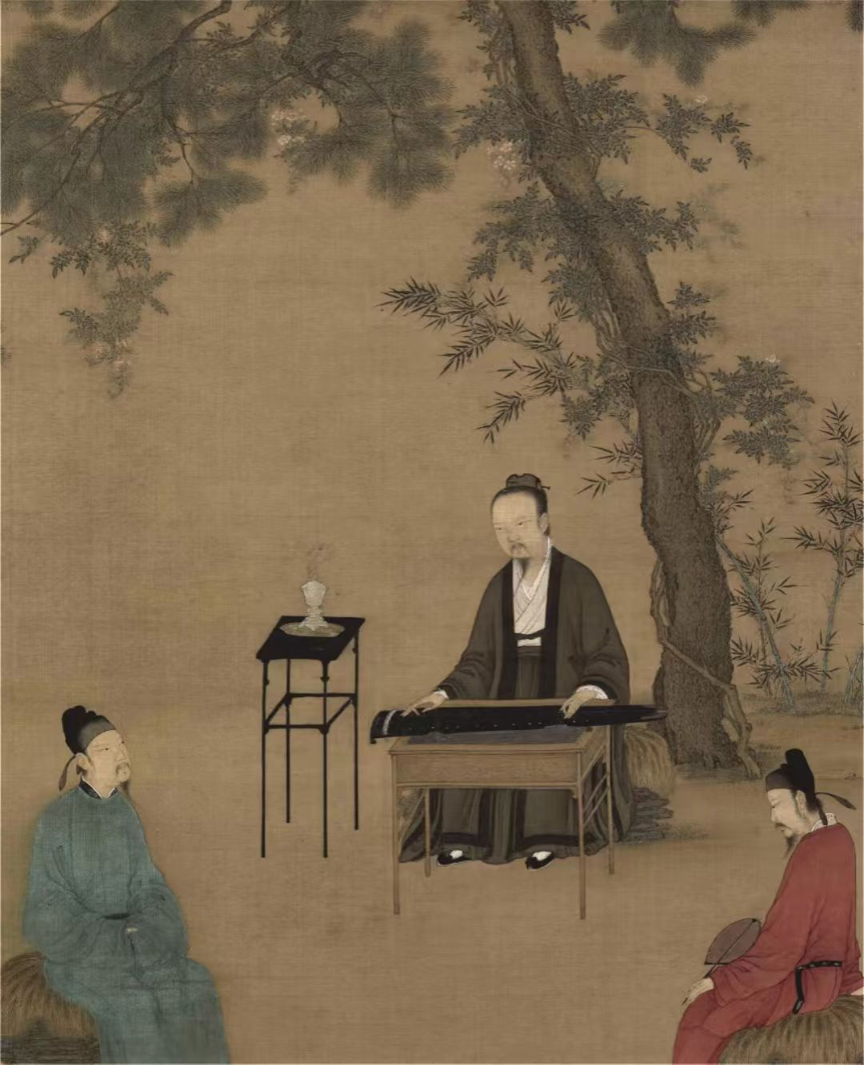

Tang and Song Dynasties
the kinds of incense are more abundant and the production and the use of incense are more elaborate
with the prevalence of Taoism and Buddhism, which led to large-scale use of incense
its functional attributes expanded into people's daily social life

Slide 9
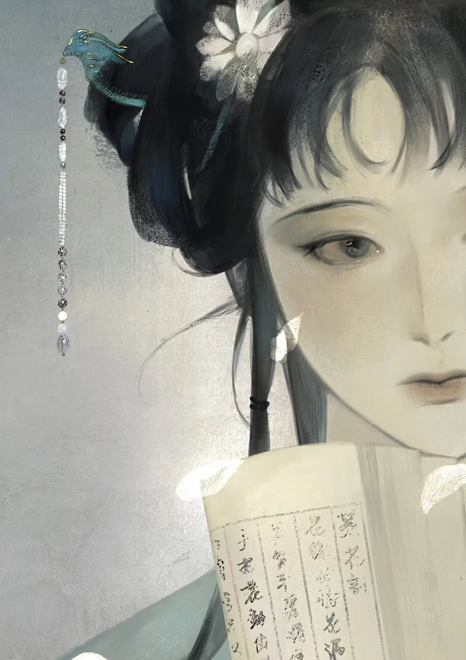
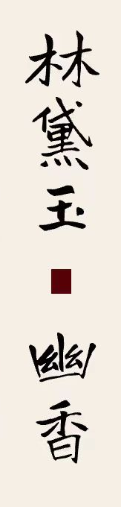
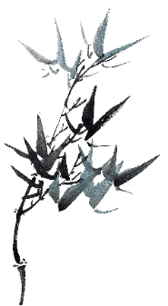
Ming and Qing Dynasties
further popular in society and related classics even appeared
incense culture suffered an unprecedented blow and gradually declined

Slide 10
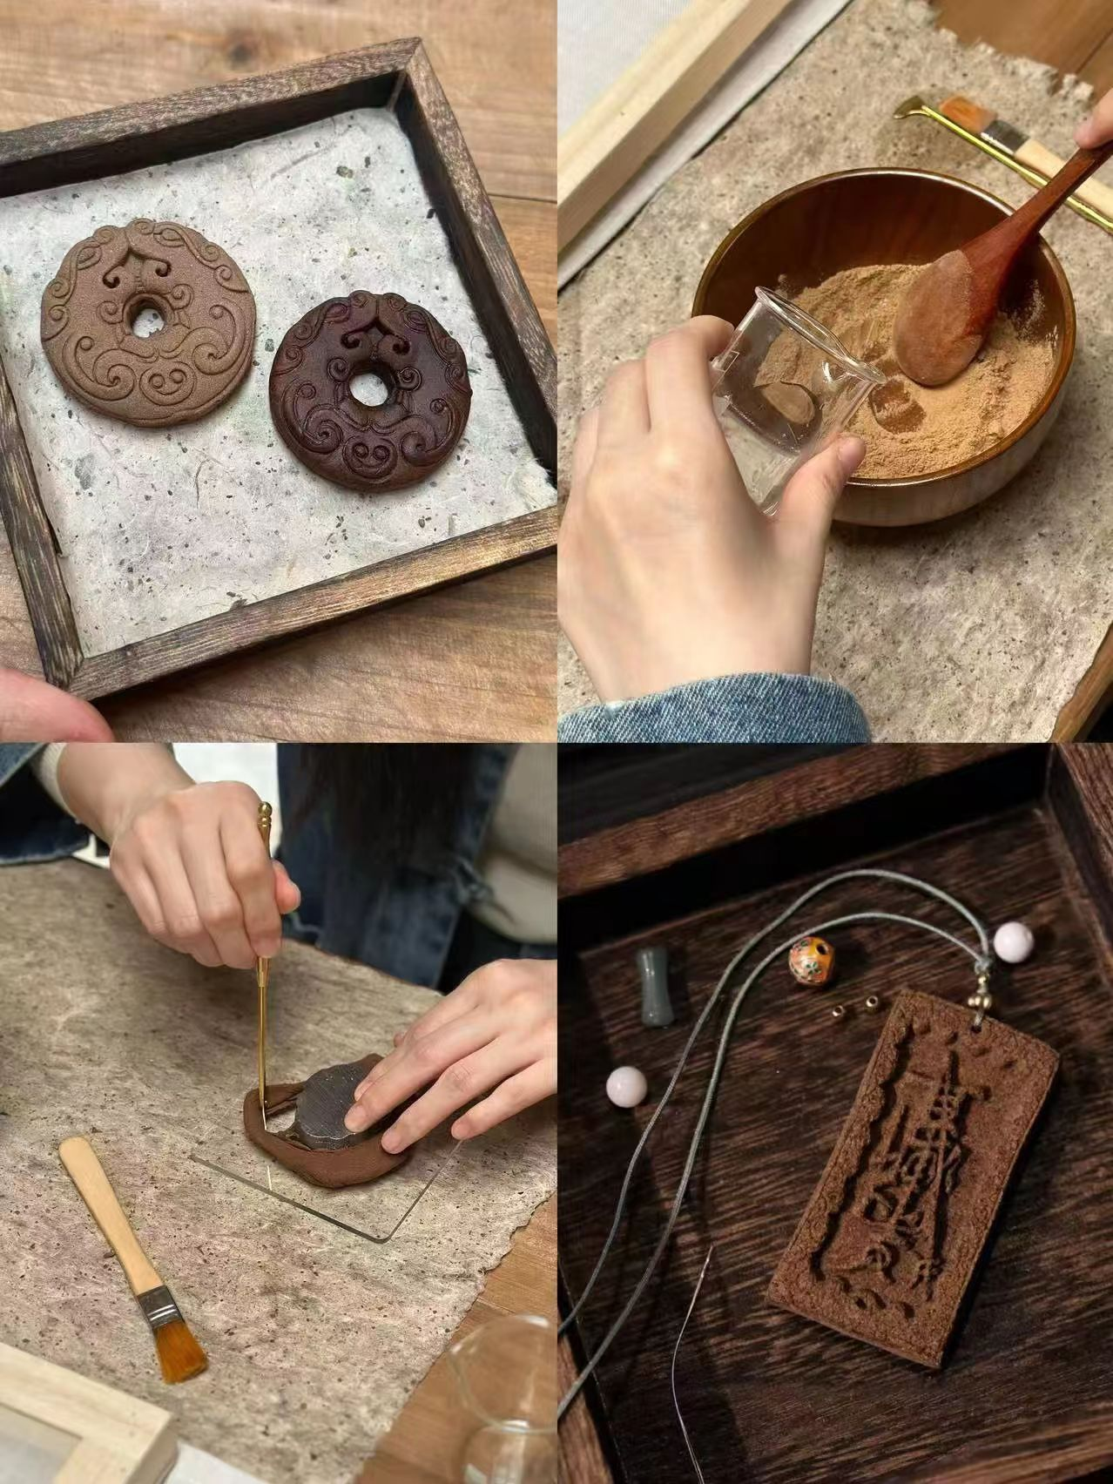
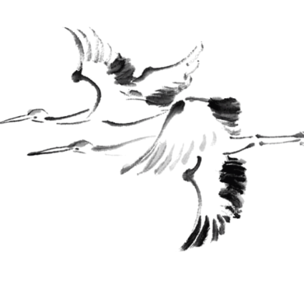
Recent Years
Incense culture-related courses and certificates have promoted the development of related education
The variety of incense has diversified to meet the personalized needs and aesthetic experience of young people

Slide 11
the Classification of Chinese Incense and Some Incense Utensils

Slide 12
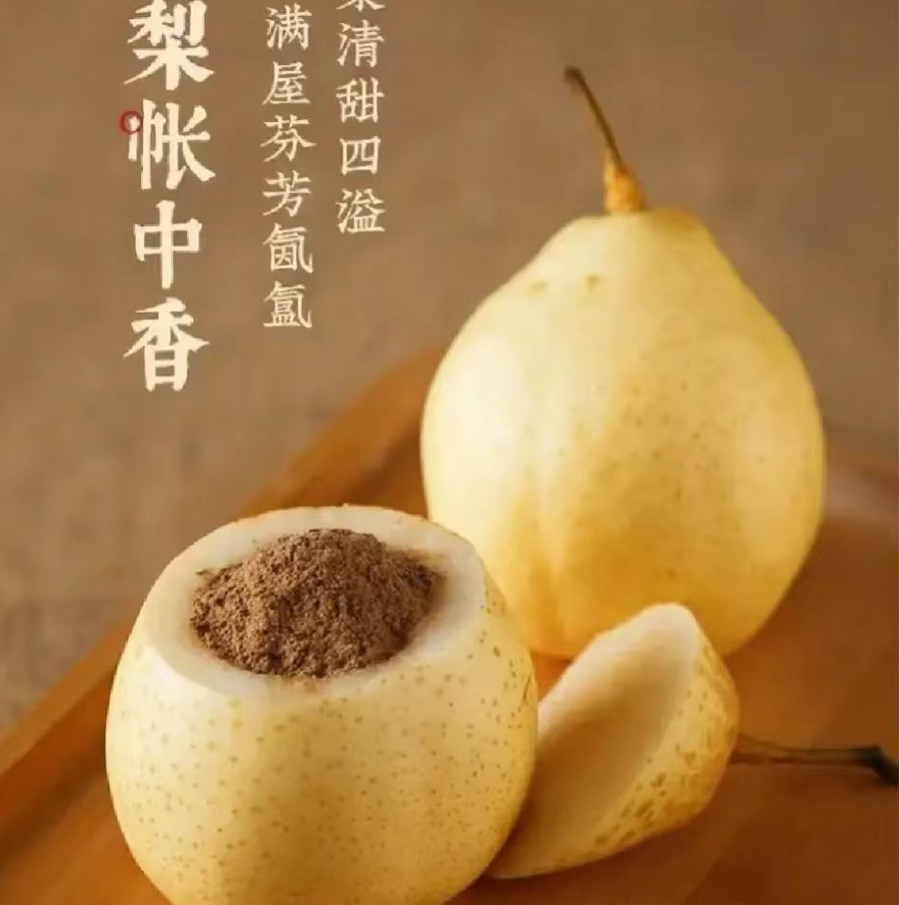
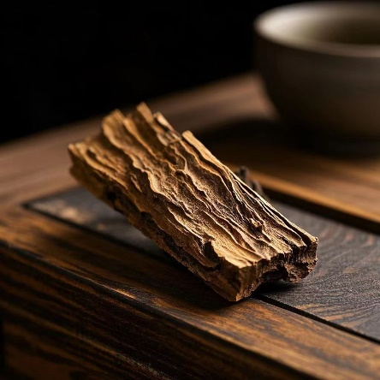
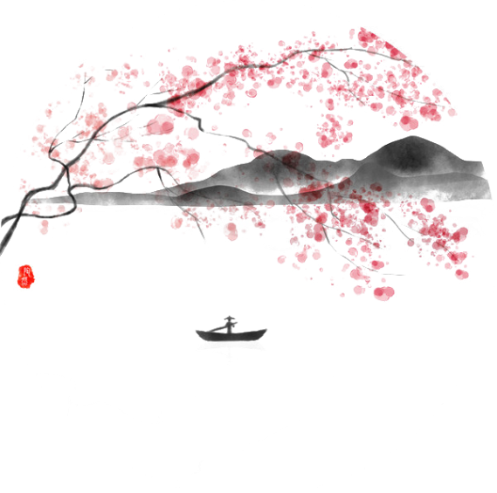
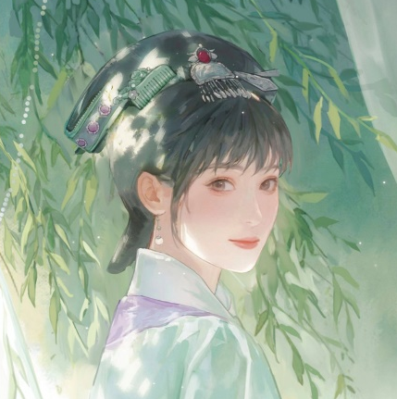
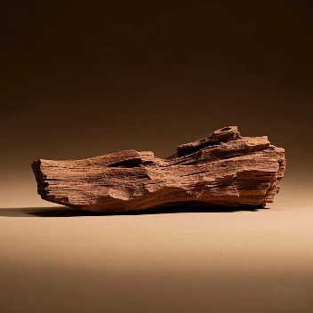
the Number of Incense-Making Materials
Single-Ingredient Incense
Composite Incense

Slide 13
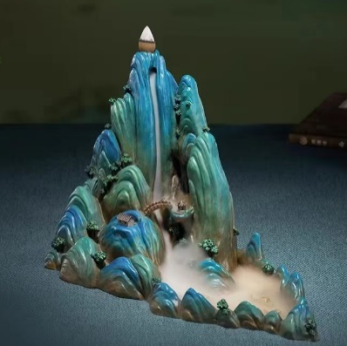
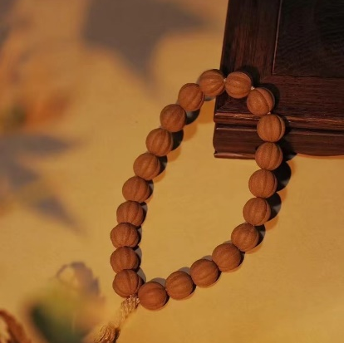
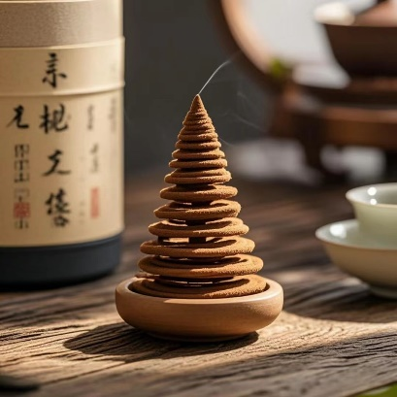
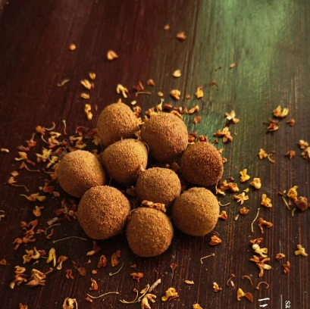
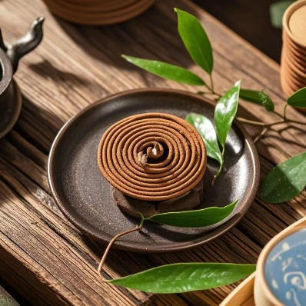
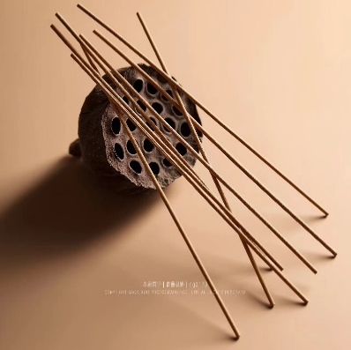
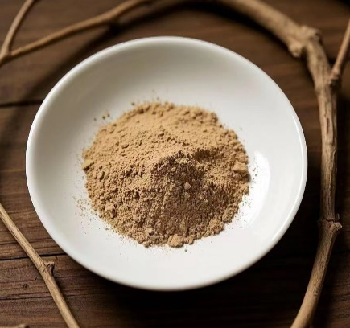
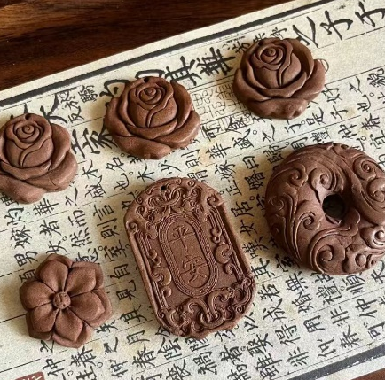
the Form of Chinese Incense

Slide 14




String Incense It has a linear shape and is quite common. It is often used for worshipping Buddha, meditation, and daily fumigation. It burns quickly, usually within twenty to sixty minutes, with moderate smoke.
Dish Incense is coiled into a spiral shape. The mosquito coils we commonly use in summer are of this type. They have a long burning time and produce little smoke.
Reverse Flow Incense It is a type of cone incense. Due to its high tar content during combustion, the smoke it produces is like water, flowing from high to low, hence its name. When used with suitable incense utensils, such as mountain-shaped incense utensils, they create an scene resembling misty mountains, which is highly valuable in terms of aesthetics.

Slide 15
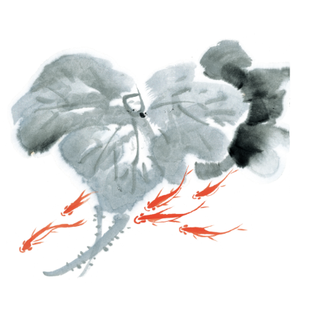
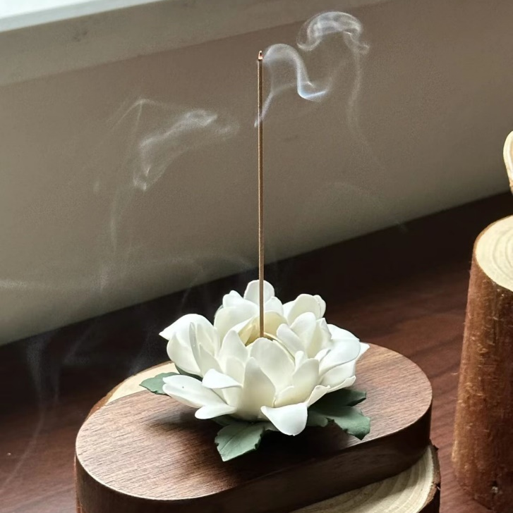
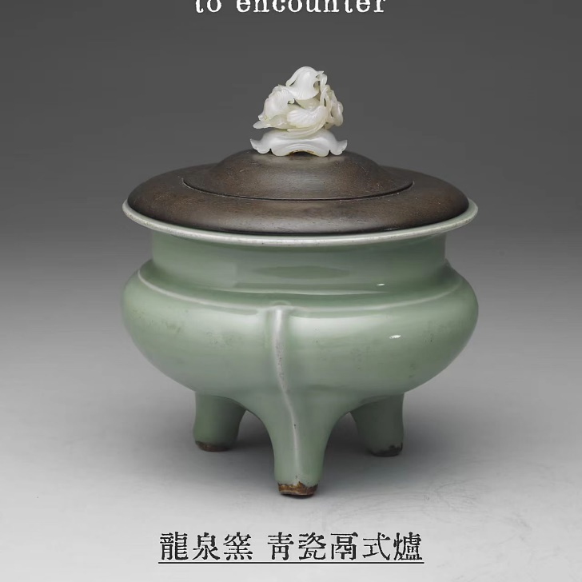
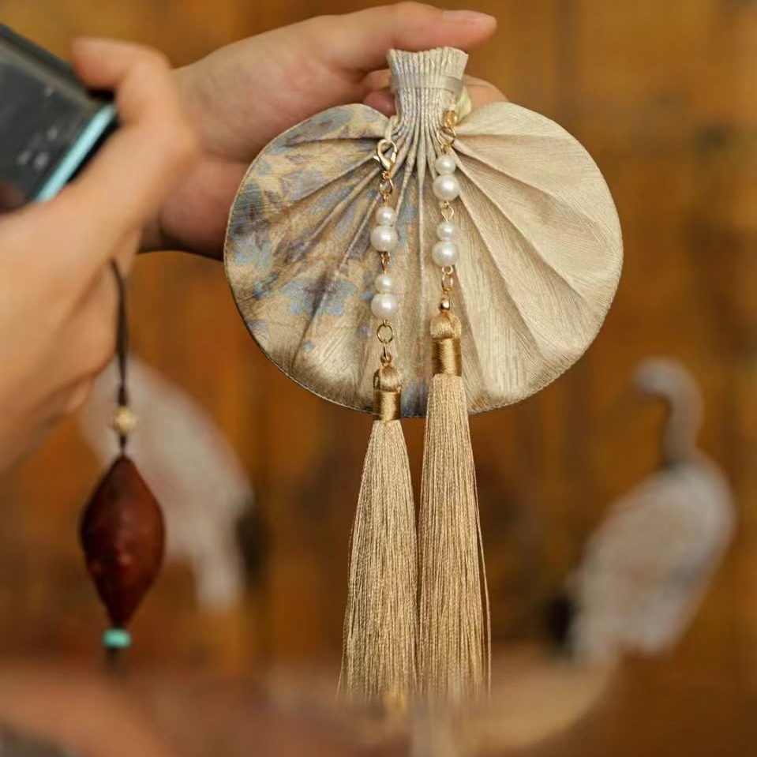
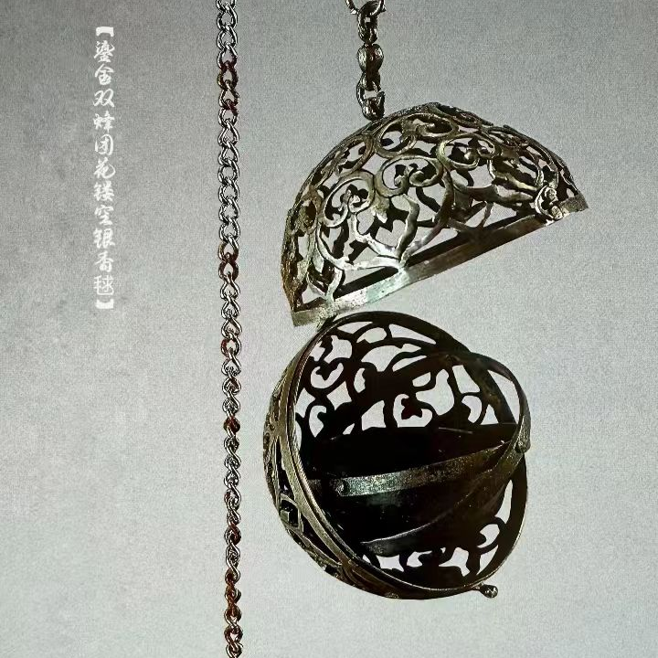
Incense Utensils

Slide 16
the Production of Chinese Incense

Slide 17
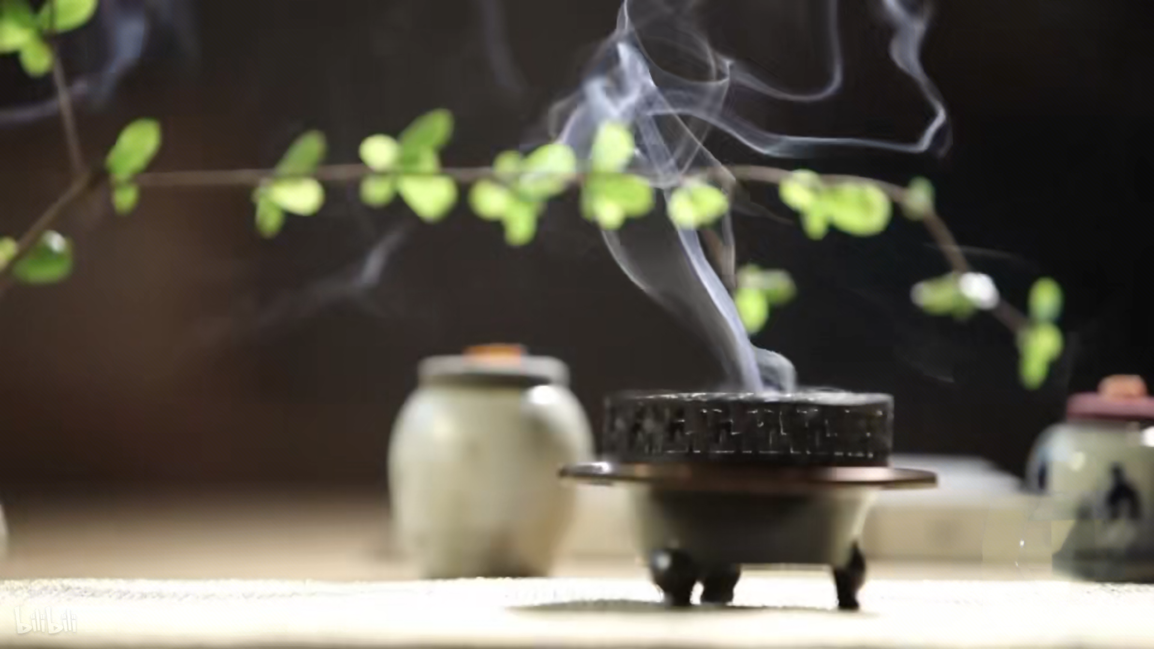




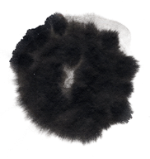
Monarch
1
2
Minister
Assistant
Messenger
3
4

Slide 18
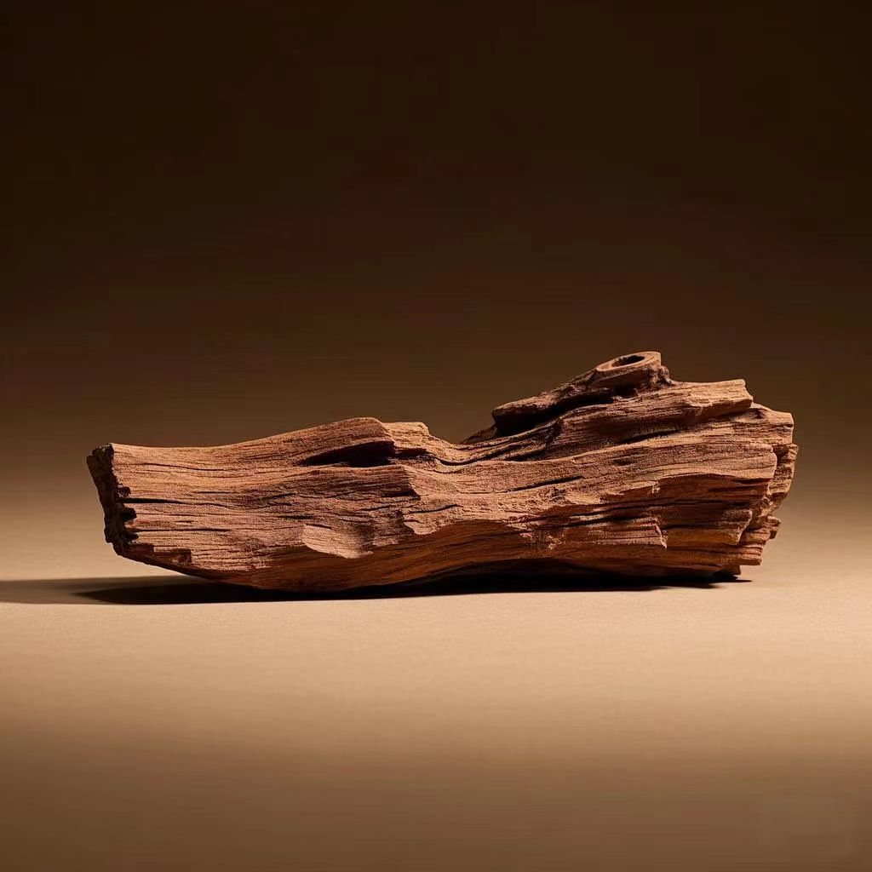
Monarch
have a rich and inclusive fragrance
with a certain degree of explosiveness and a long-lasting scent
usually based on woody spices such as agarwood and sandalwood
generally one to three ingredients are first selected as the base tone of the monarch incense
40%-60% of the mixture

Slide 19
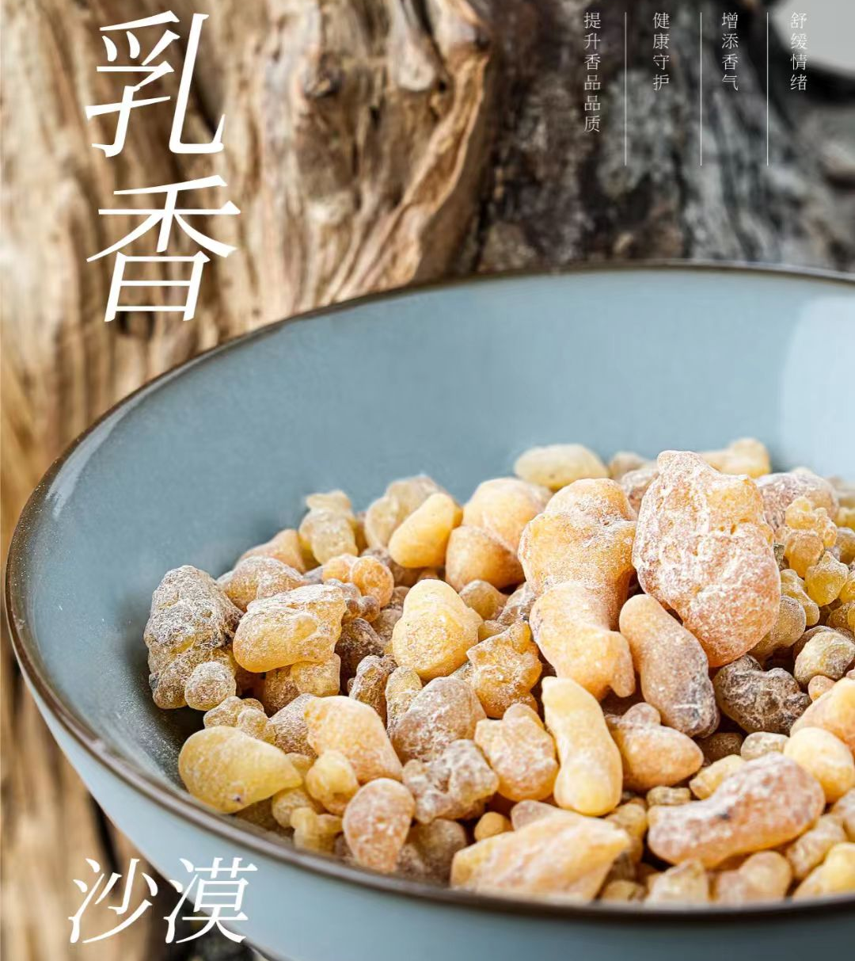
Minister
The minister incense is meant to assist the monarch incense, making up for its shortcomings in enhancing the fragrance and its effects
Common materials include cassia twig and patchouli
20%-30% of the mixture

Slide 20
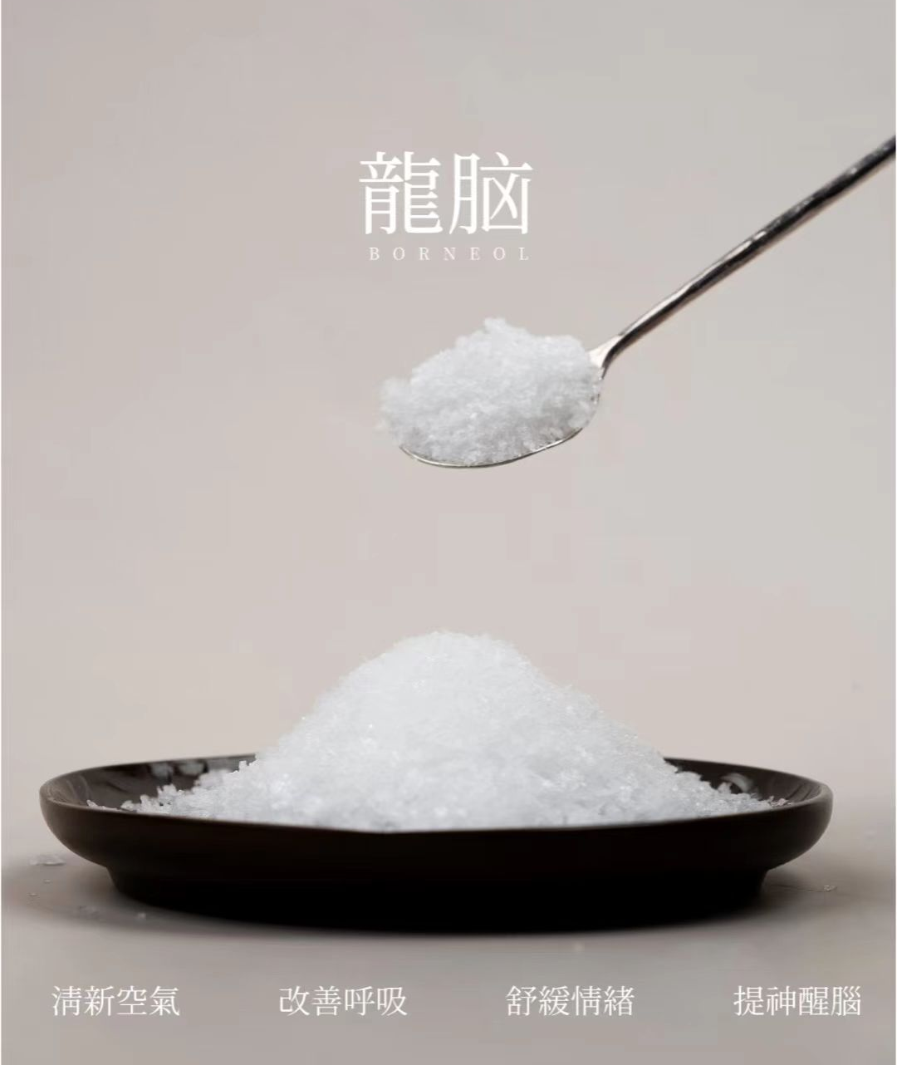
Assistant
refine, balance the fragrance of the monarch and minister incense, and to fix and expand the scent
Common assistants include borneol
around 10%-20%

Slide 21
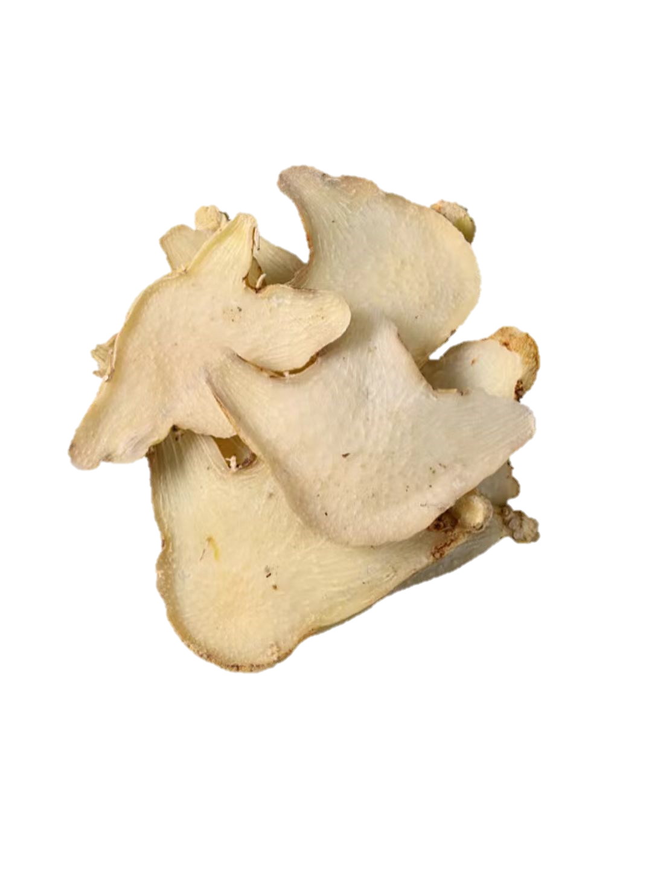
Messenger
guide the release of the fragrance
Common ingredients include Bletilla and refined honey
generally between 1%-5%

Slide 22
the culture influence of Chinese incense

Slide 23

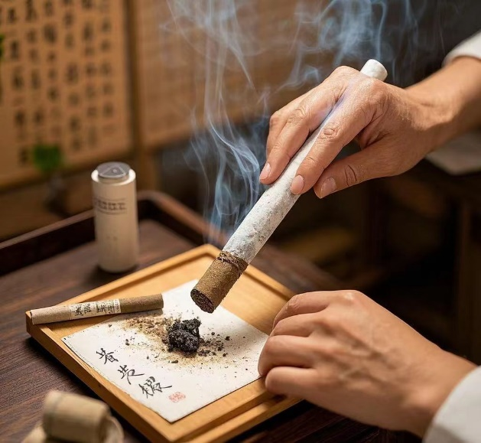
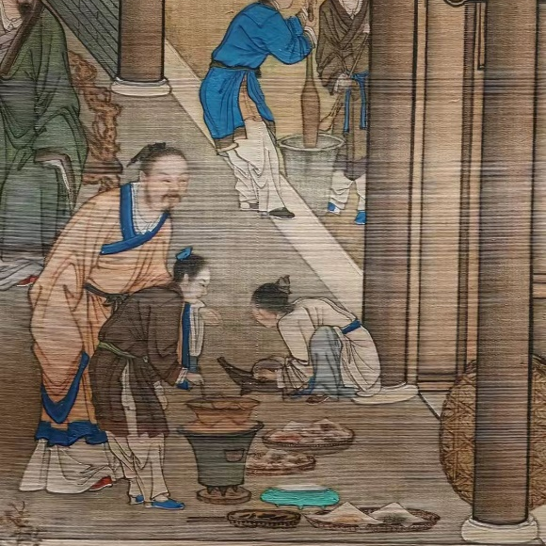
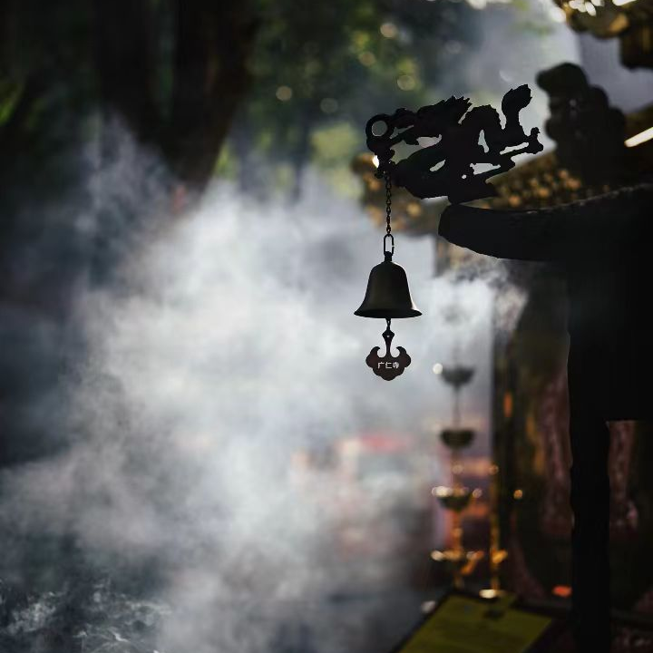
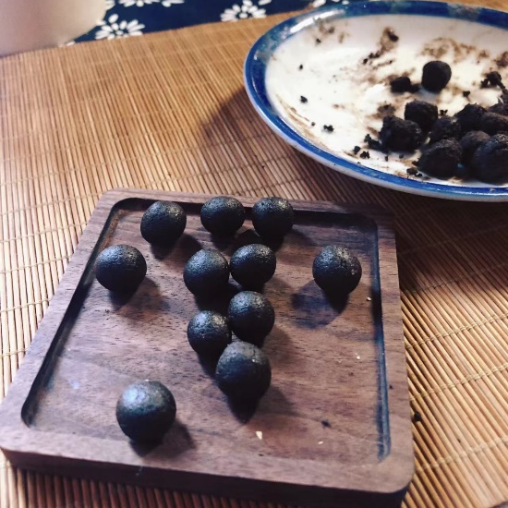
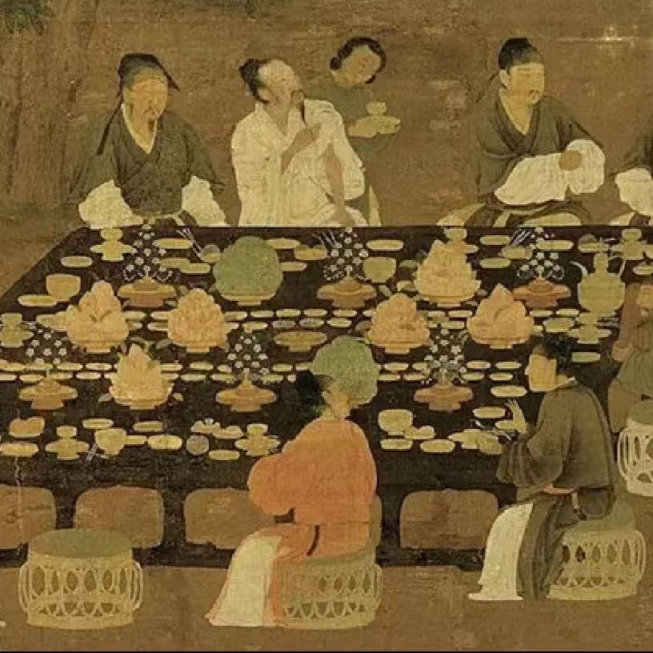
Religious Ceremonies Sacrificial Activities
Traditional Chinese Medicine
Daily Life

Slide 24
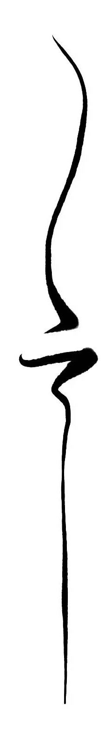
Thank You！

Slide 25

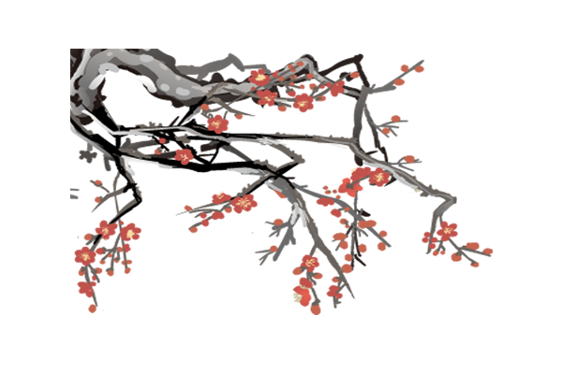





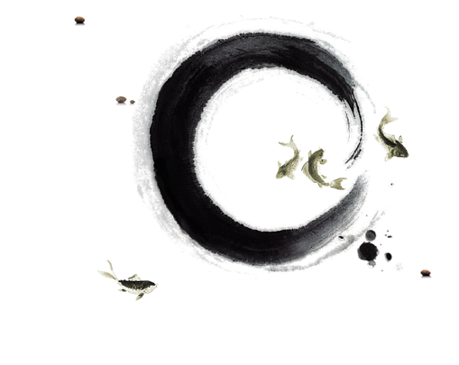
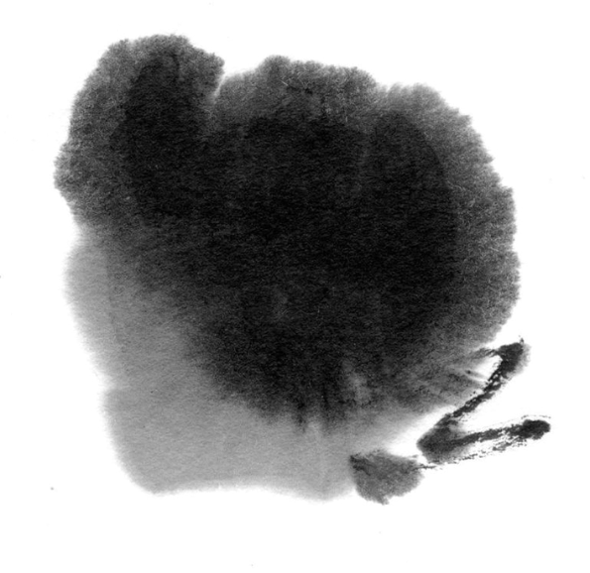

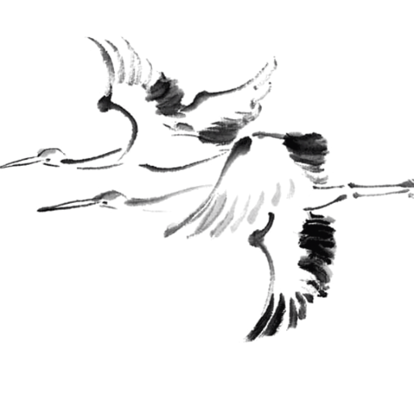












单击添加标题

Slide 26
Pre-Qin period
Han Dynasty
Formed
1
2
Developed
Flourished
3
4
Stabilized declined
Tang and Song Dynasties
Ming and Qing Dynasties

