Slide 1
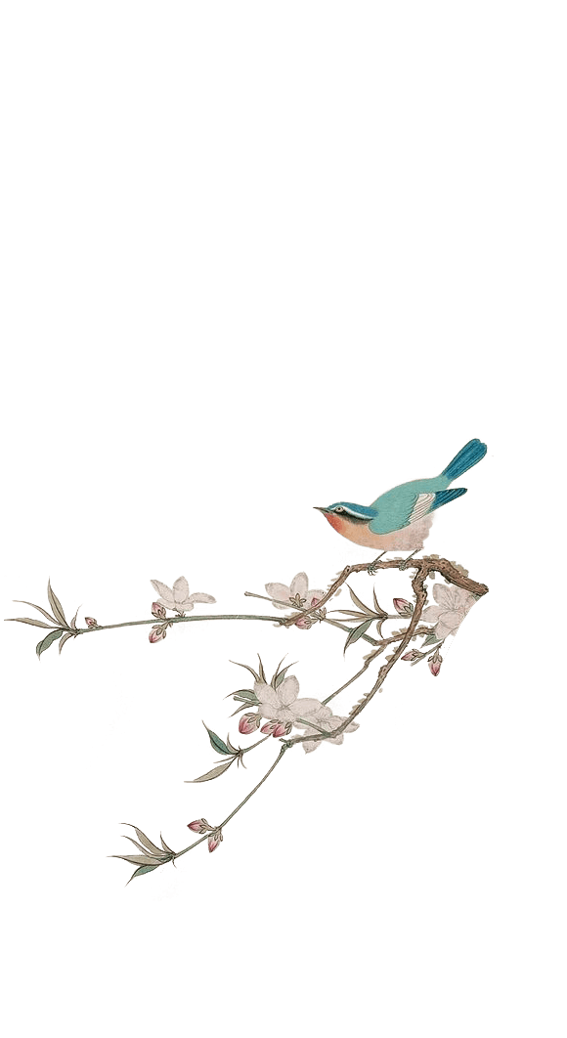
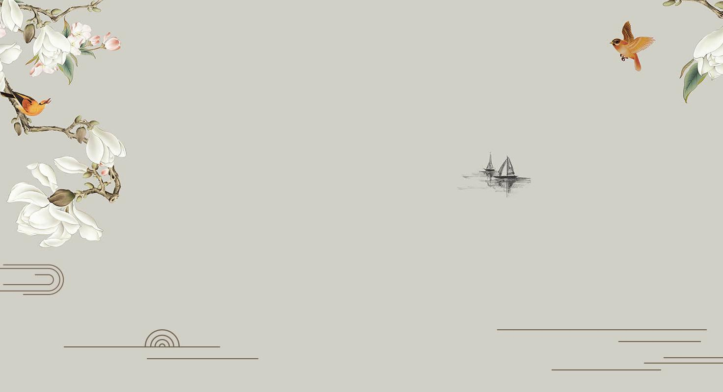
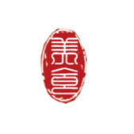
春联
Spring Couplets
刘珍 Liu Zhen

Slide 2
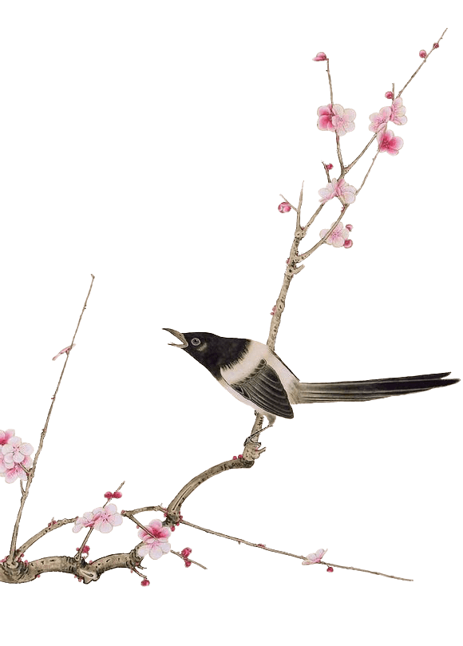
1
What are Spring Festival Couplets?

Slide 3
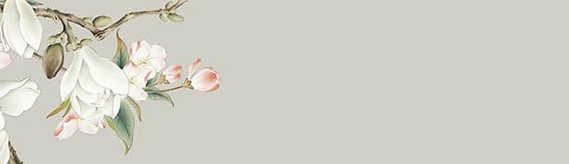
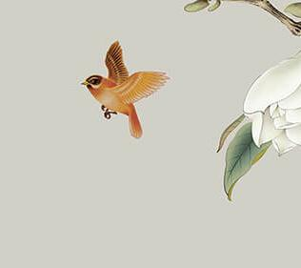
With black or golden characters written on red paper, Spring Festival Couplets are composed of a pair of poetry lines vertically pasted on both sides of the front door and a four-character horizontal scroll affixed above the doorframe. Pasting couplets expresses people’s delight in the festival and wishes for a better life in the coming year.

Slide 4
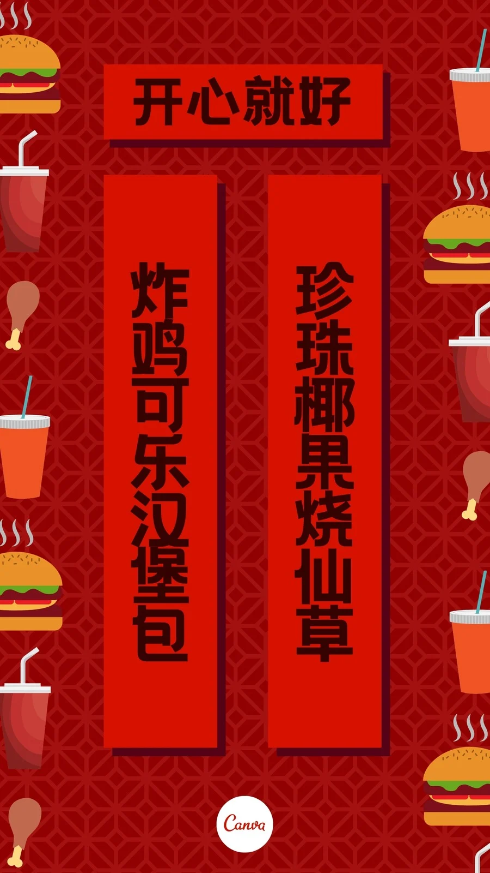
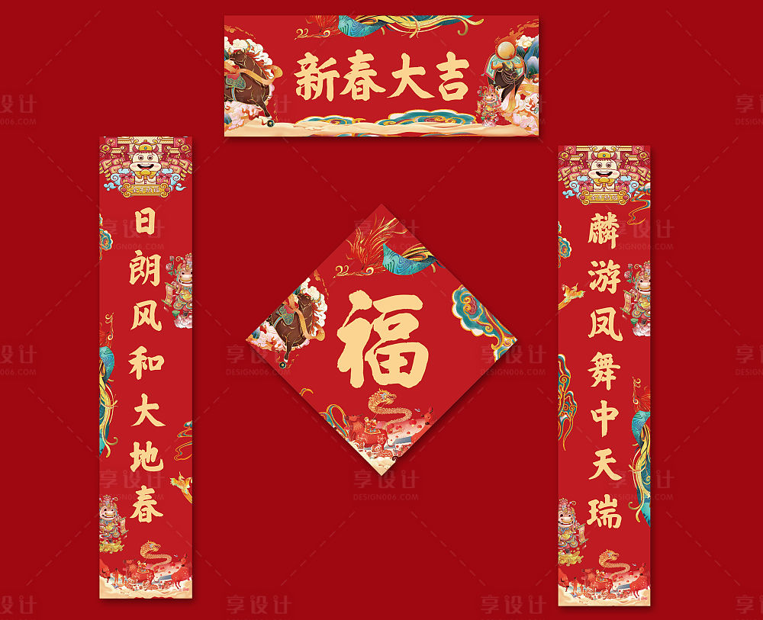

Slide 5
2
Rules of Spring Festival Couplets

Slide 6
A couplet must adhere to the following rules:
Both lines must have the same number of Chinese characters.
The lexical category of each character must be the same as its corresponding character.
The tone pattern of one line must be the inverse of the other. This generally means if one character is of the level (平) tone, its corresponding character in the other line must be of an oblique (仄) tone.

Slide 7
The meanings of the two lines must be related, with each pair of corresponding characters having related meanings too.
The horizontal scroll is a four-character phrase, which sums up the two lines’ meaning.

Slide 8
3
Legend and History
of Spring Festival Couplets?

Slide 9
Spring Couplets originated from Taofu, an inscription on boards made from peach trees in the Zhou Dynasty(1046 - 256 BC). According to the legend, in the ghost world, a rooster perching in a big peach tree will crow at dawn to call all the traveling ghosts back. In front of the entrance of the dark world, there are two guards named Shentu and Yulei. If the ghosts harm any people at night, the guards will kill them as the tiger’s breakfast. People believed that peach trees can scare and subdue evil things, so they hung peach boards in front of the doors with the guards’ names written or inscribed on them.

Slide 10
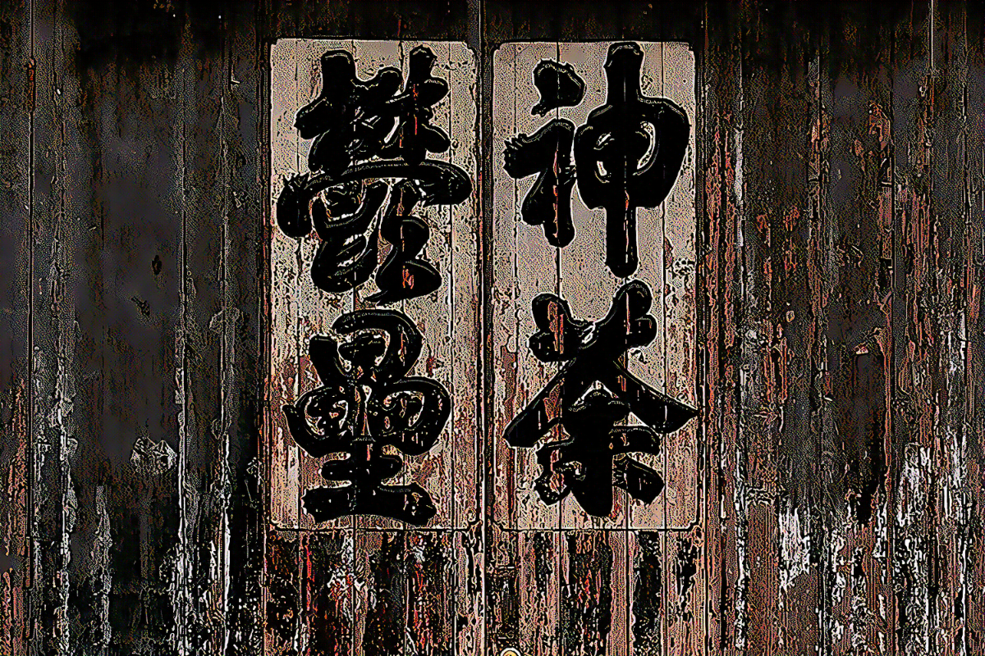

Slide 11
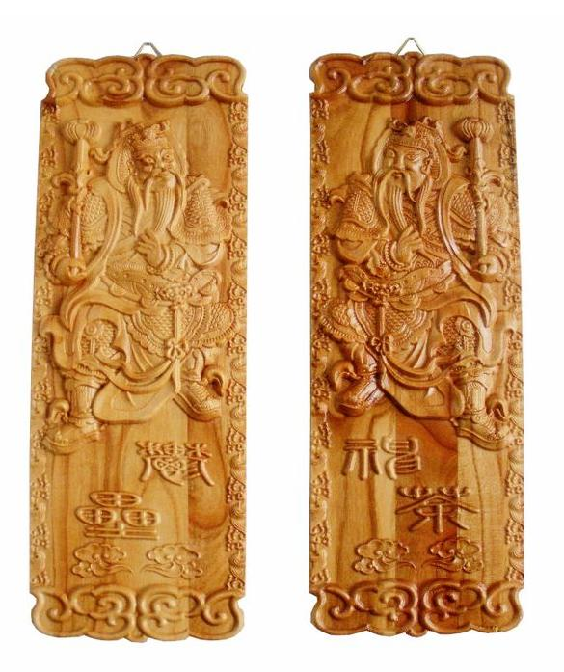

Slide 12
During the Song Dynasty (960 - 1279 AD), the wood board was replaced by paper, and people focused more on bright wishes for the future. The custom became popular in Ming Dynasty (1368 - 1644 AD). When the Emperor Zhu Yuanzhang traveled for inspection, he found those pairs of scrolls interesting. In order to advocate and promote this cultural activity, he ordered all household to paste the scrolls during the Chinese New Year. This tradition continues today.

Slide 13
4
How to Read the Spring Festival Couplets?

Slide 14
First, look at the horizontal scroll.
If thee four characters are written from left to right, the upper scroll will be on the left and lower scroll on the right.
If the characters of the horizontal scroll are reversed, the two side scrolls should be read from right to left.

Slide 15
5
Spring Festival Couplets in Other Countries

Slide 16
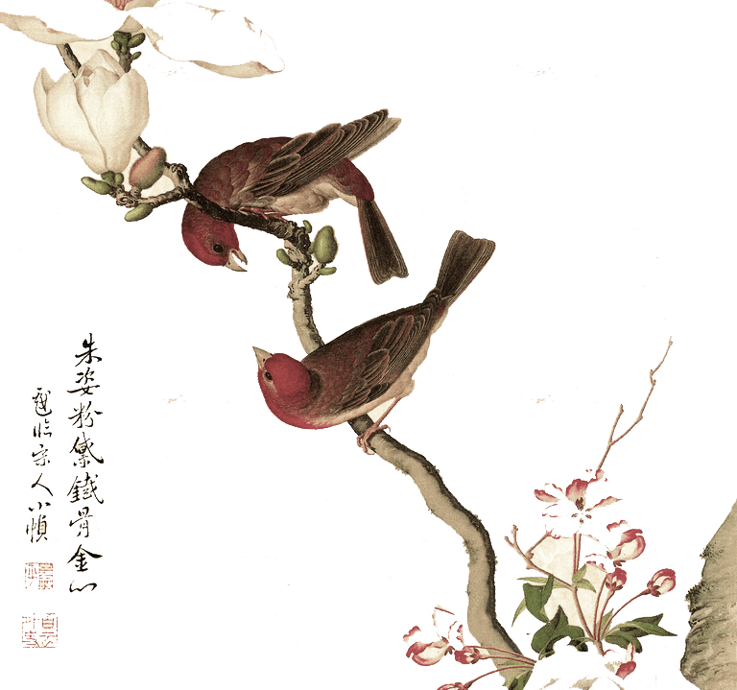
Many other countries will also have the Spring Festival, and the Spring Festival customs of many countries are not much different from those of China.

Slide 17
Korean also post Spring Festival couplets and give out red envelopes, but unlike China, their main color is white, which means that the Spring Festival couplets and red envelopes are all white.

Slide 18
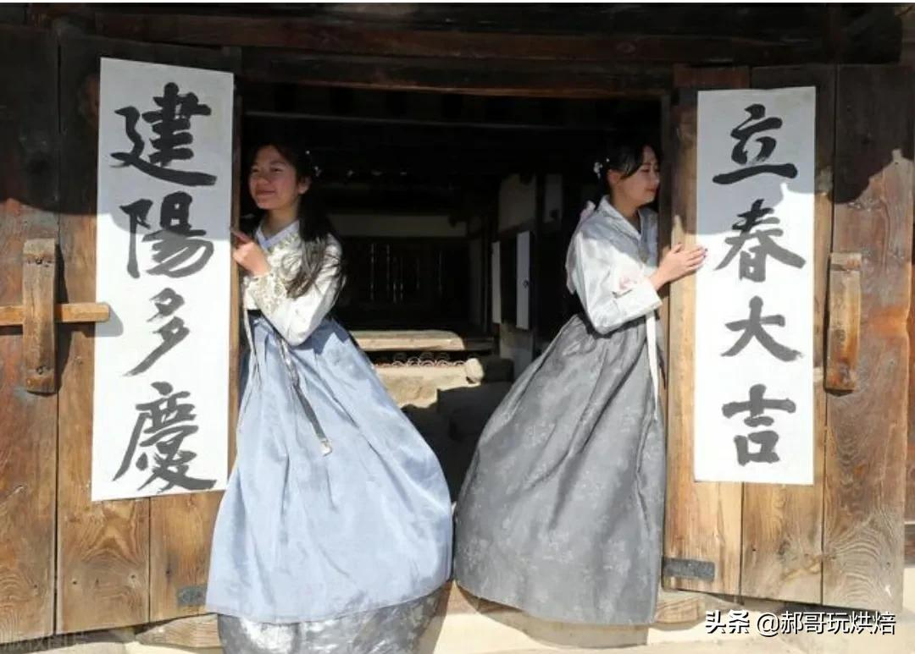

Slide 19
After the demise of the Shang Dynasty, some people came to the Liaodong Peninsula, and were later forced to move to the Korean Peninsula, which is the origin of North Korea. They also retained a lot of the culture of the Shang Dynasty. auspicious. Although in our opinion white is the color of funerals, in Korea, they have the same feeling when they see white couplets as we see red couplets.

Slide 20
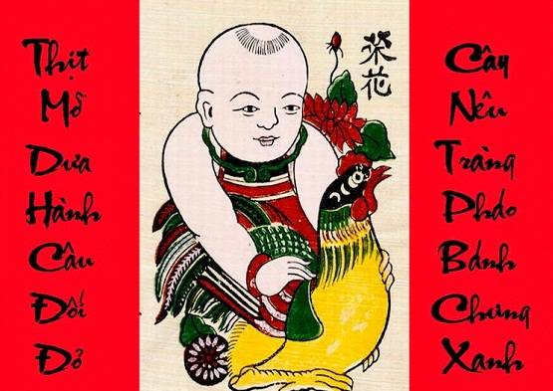

Slide 21
In 1945, Vietnam was founded, and the Declaration of Independence announced the use of Vietnamese as the official language of the country. Since then, fewer and fewer people in Vietnam use Chinese characters, and fewer and fewer people write couplets in Chinese characters

Slide 22
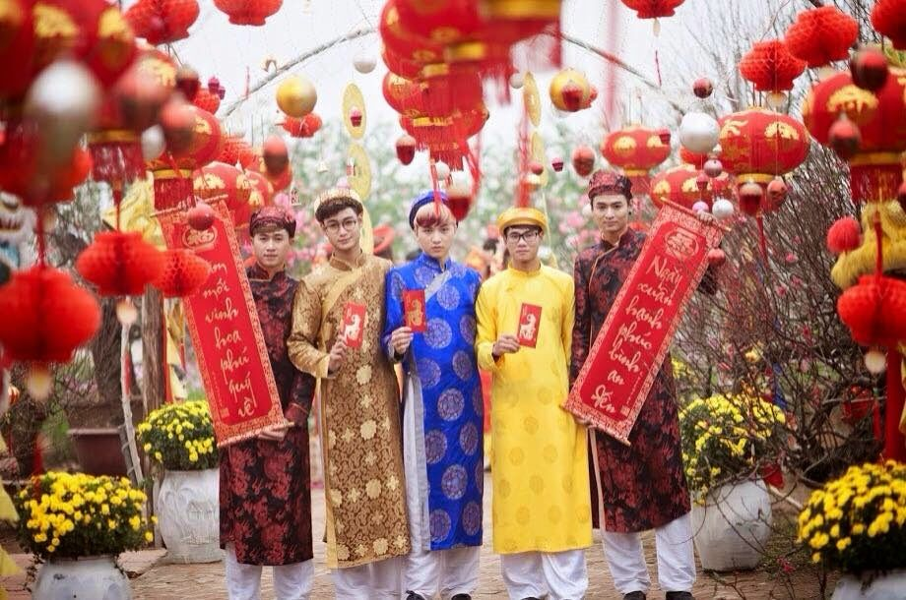

Slide 23
In 1986 Vietnam promulgated the new cultural policy, Vietnamese national language couplets developed greatly during this period. During this period, the Vietnamese government also carried out the "Purification of Vietnamese" campaign, which removed many Chinese words and made it impossible to write proper couplets. Vietnamese antithetical couplets are not only antithetical couplets, but also cultural tools for Vietnam to realize national symbols.

Slide 24
Nowadays, during the Spring Festival in Vietnam, the custom of pasting Spring Festival couplets is different from that in China, but the content of Spring Festival couplets is the same as in China, expressing wishes for the New Year. In addition to Chinese characters, there are also Nan characters and "Vietnamese characters" on Vietnamese Spring Festival couplets. Some of them are in the same Spring Festival couplets, and even two kinds of characters coexist.

Slide 25
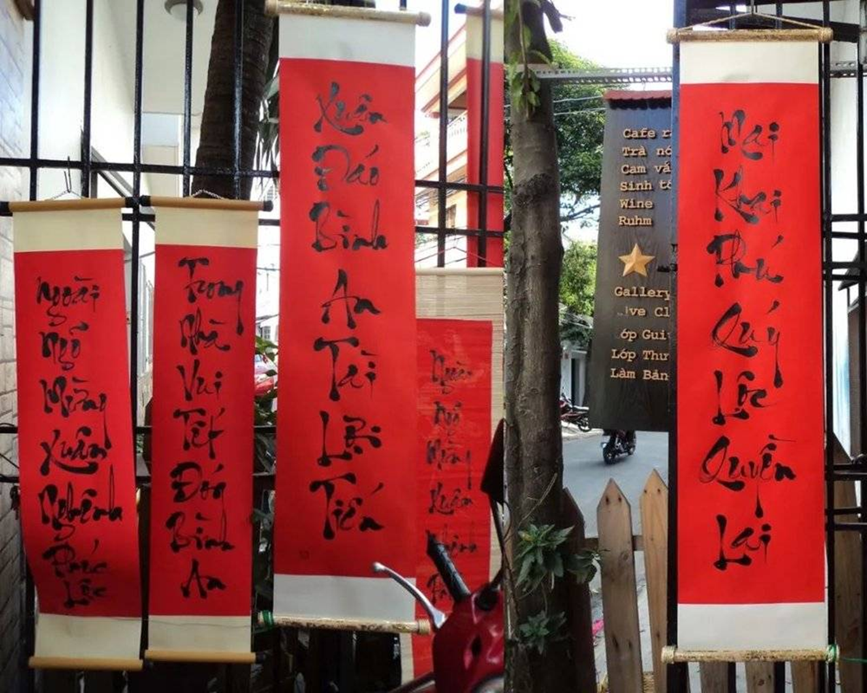

Slide 26
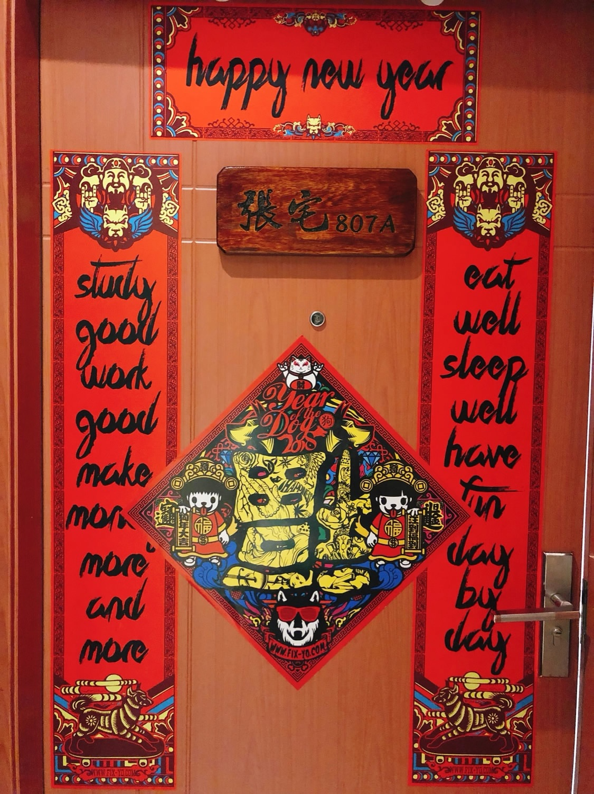

Slide 27
6
Sharing Some Interesting Spring Festival Couplets

Slide 28
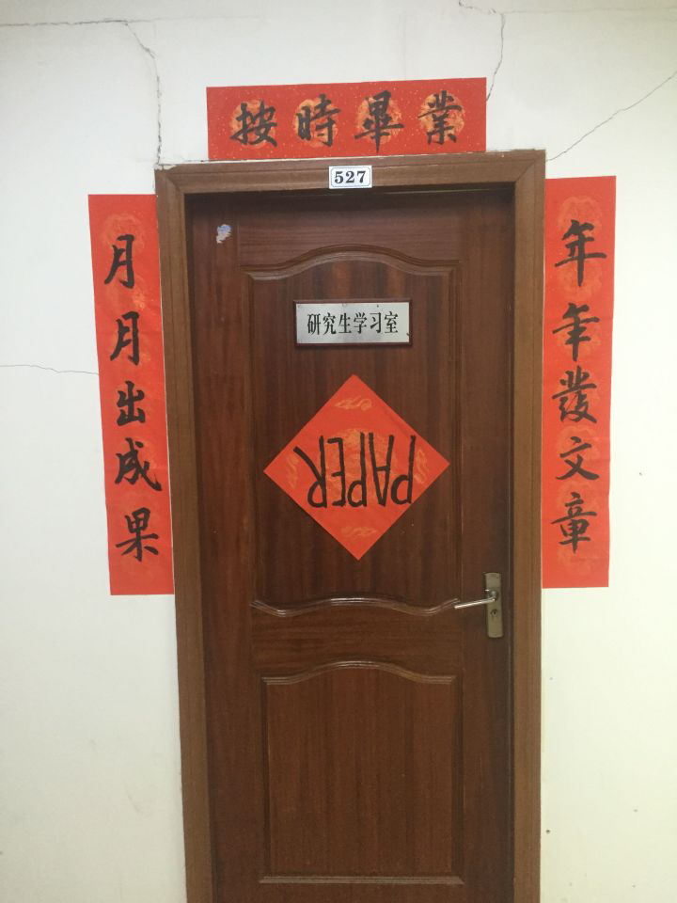

Slide 29
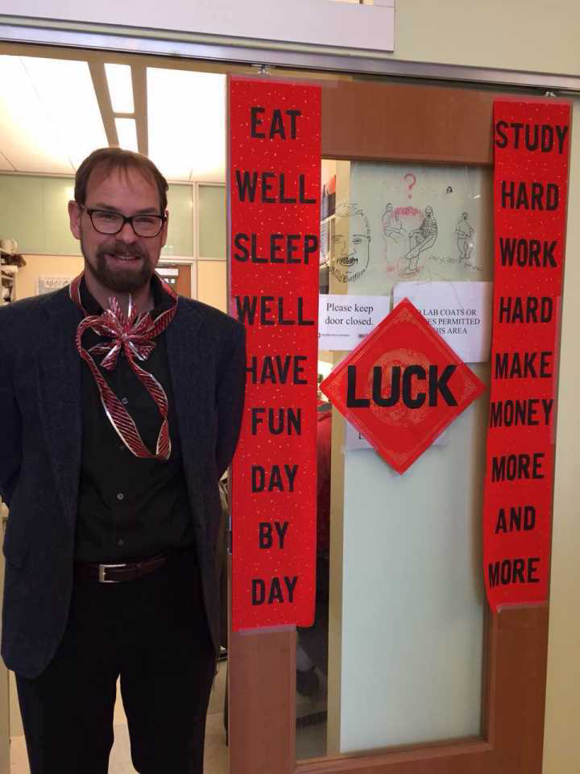
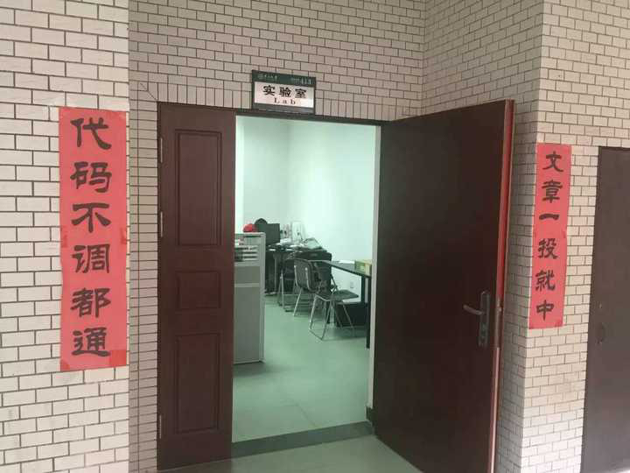

Slide 30
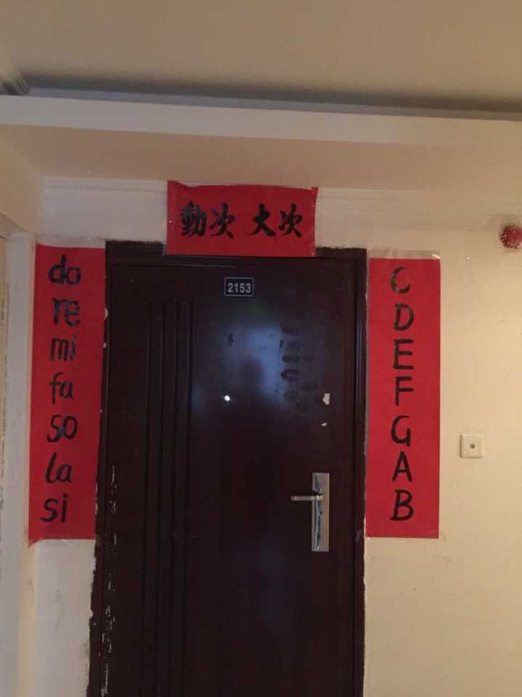

Slide 31
上联：多学习多锻炼多赚钱多多益善
下联：少加班少熬夜少操心少年可期
横批：小康生活

Slide 32
上联：得大自在琴棋书画诗酒花
下联：过小日子柴米油盐酱醋茶
横批：一夜暴富

Slide 33
上联：脱贫脱单不脱发
下联：加官加薪不加班
横批：这 feel 倍爽

Slide 34
上联：有酒有肉有梦想
下联：无忧无虑无牵挂
横批：不负年华

Slide 35
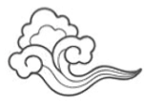
Thanks

