Slide 1
Milk Tea:
From Street Snack to Global Phenomenon
2026.04.16
Xiang Jiaying

Slide 2





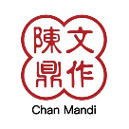
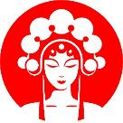
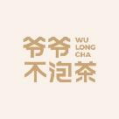

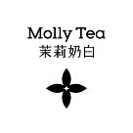




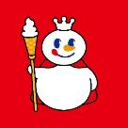

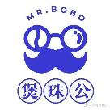
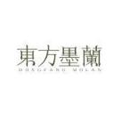
What brand of milk tea do you like to drink?

Slide 3
One Cup, One Portal
More Than Just a Drink
Connecting Tradition
Reflecting Regions
Window to Youth
A contemporary take on Chinese tea culture, presenting an ancient custom to a new generation in a novel form.
Local adaptations honestly reflect regional dietary habits and characteristics, becoming a calling card for cities.
As a social phenomenon among contemporary youth, it transcends the beverage itself to become a lifestyle symbol.
01
02
03

Slide 4
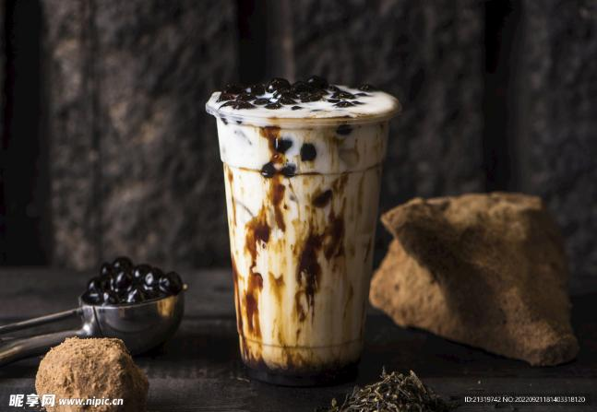
Contents
01
The Journey Begins
A Global Spread
02
03
Pros and Cons
Cultural Meaning
04
05
Conclusion

Slide 5
The Journey Begins
This section explores the origin story of milk tea, tracing its path from ancient traditions to a modern Taiwanese innovation.
3

Slide 6
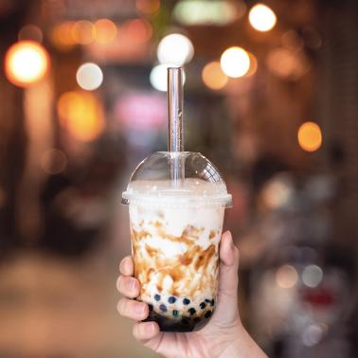
A Taste of Origin------From Frontier to Island
01
Frontier Tradition
Salty milk teas from regions like Mongolia and Tibet, with a history of over a thousand years, served as an energy source for nomadic peoples.
02
Taiwanese Innovation
In 1980s Taiwan, Chun Shui Tang and Hanlin Tea Room pioneered the addition of tapioca pearls, creating a new beverage category.
Fun Fact
The term "Bubble Tea" refers to the foam created by shaking the tea, not the tapioca pearls themselves.
03

Slide 7

A Global Spread
From its Taiwanese roots, milk tea embarked on a global journey, captivating taste buds and creating a multi-billion dollar industry.
3

Slide 8
Taiwan to the World
Market Data
Major Brands
01
02
03
Spread Route
Taiwan
Coastal cities
(Shanghai and Xiamen)
Inland cities
(Changsha)
Global metropolises
(New York and Paris)
The global milk tea market was valued at $2.4 billion in 2020 and is projected to reach $4.3 billion by 2027, with a CAGR of nearly 8%.
Mainland China has seen the rise of renowned chains such as HEYTEA, Mixue Bingcheng, and Cha Yan Yue Se.
4

Slide 9
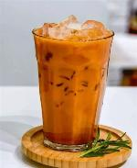
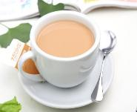
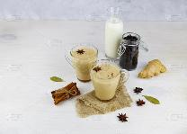
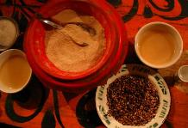
Global Variations------One Drink, Infinite Flavors
Hong Kong Style
Thai Style
01
02
03
Indian Masala Chai
04
Tibetan Butter Tea
Known for its use of evaporated milk and strong tea, creating a distinctively rich and creamy flavor.
Typically includes orange slices and condensed milk, offering a unique, sweet, and citrusy twist.
An infusion of black tea with spices like cardamom, cloves, and cinnamon, providing a warm and aromatic experience.
A traditional beverage made with salt and yak butter, reflecting the local nomadic diet and harsh climate.

Slide 10
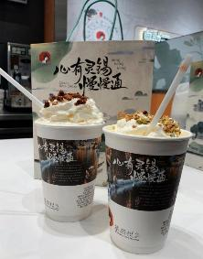
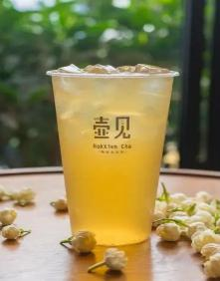
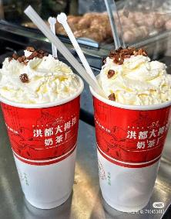
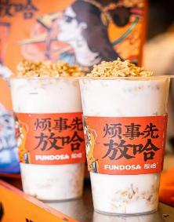
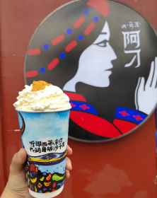
Local Icons------One City, One Cup of Tea
Changsha
Fujian
Jiangxi
Gansu
Xizang
Cha Yan Yue Se(茶颜悦色)
Hu Jian(壶见)
Hong Du Da Mu Zhi
(洪都大拇指)
Fang Ha(放哈)
Adiao Tea
(阿刁茶饮)

Slide 11
Pros and Cons
This chapter examines the dual nature of the milk tea phenomenon, analyzing its cultural and economic benefits alongside its health and environmental costs.
3

Slide 12
The Pros of Milk Tea
Cultural Innovation
Emotional Value
01
02
It revitalizes traditional tea culture in a modern way, making it appealing and accessible to younger generations.
Phrases like "the first cup of milk tea in autumn" have become social memes, giving the drink a currency in emotional exchange.
Economic Driver
Regional Culture
03
04
The industry has fueled the rise of new tea brands, created numerous jobs, and become a significant engine for consumer markets.
A single iconic drink can become a city's "ambassador," such as Cha Yan Yue Se for Changsha, boosting its cultural recognition.

Slide 13
The Cons of Milk Tea
Health Risks
Safety Hazards
01
02
A single cup can contain 30-50 grams of sugar and over 200 calories. Excessive consumption is linked to obesity and high blood sugar.
The tapioca pearls pose a choking hazard, with documented cases of children choking on them.
Cultural Debate
03
Environmental Impact
04
Some argue its high-sugar, high-fat profile contradicts the "pure and serene" spirit of traditional tea culture, potentially diluting its essence.
The widespread use of single-use plastic cups, straws, and packaging contributes significantly to environmental pollution.

Slide 14
Cultural Meaning
Milk tea has transcended its role as a beverage to become a powerful cultural symbol, deeply embedded in the social fabric of modern youth culture.
3

Slide 15
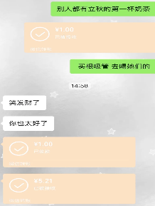


A Cultural Symbol------Milk Tea as Identity Tag
Social Currency
Internet Culture
01
02
The act of "treating someone to milk tea" has become a popular way to express care and strengthen friendships among young people.
Memes like “milk tea freedom" have emerged, integrating the drink into internet subcultures and representing a light-hearted, self-indulgent attitude.
Emotional Symbol
03
In the fast-paced, high-pressure urban life, a cup of milk tea is often seen as a small comfort, a "sweet spot" in a bitter day.

Slide 16
Conclusion
A final reflection on the complex and multifaceted nature of milk tea, recognizing it as a symbol that is both perfectly imperfect and distinctly contemporary.
3

Slide 17
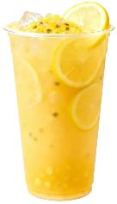
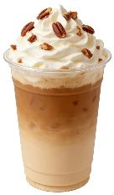
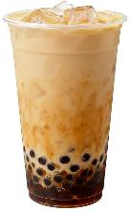
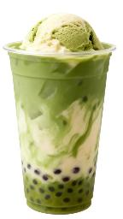
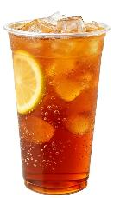
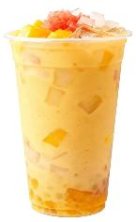
One Cup, Two Faces------The Duality of Milk Tea
The Dual Nature of Tea
01
It is both a cultural symbol that carries tradition and innovation, bringing joy and connection, and a "sweet burden" with hidden health and environmental costs.
Our Perspective
02
We should enjoy the pleasant experience it offers while being clearly aware of its hidden costs. Making wise choices and consuming in moderation is the key to a sustainable relationship with it.

Slide 18
Thank You!
2026.04.16
Xiang Jiaying

