Slide 1

Chinese Martial Arts
By Zhang Hui & Zhao Xiaoyan

Slide 2

Contents
1. Concept of Wushu
4. Chinese famous martial artists
2. The Main Schools
5. Conclusion
3. Tai Chi

Slide 3
Concept of Wushu
Wushu, is also known as kungfu.
Wushu: Boxing and the use of weapons are traditional Chinese sports.
It is a traditional Chinese sport. Wushu has an extremely broad mass foundation, and is a precious cultural heritage that the Chinese people have accumulated and enriched in the long-term social practice.
As early as tens of thousands of years ago in primitive society, there were many beasts and few people, and the natural environment was very harsh. People naturally produced some primary offensive and defensive methods. This is the birth of wushu.

Slide 4
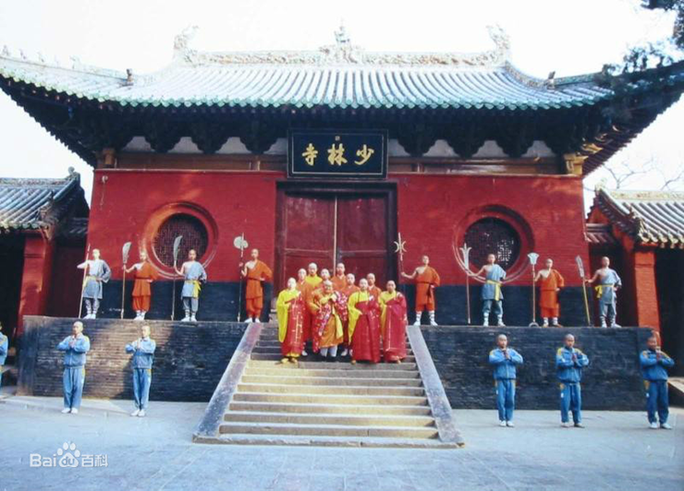
The Main Schools
Chinese kungfu: Wudang, Shaolin, Emei, Southern style boxing.
Shaolin: Originated from the Shaolin Temple in Mt.Song, Henan. The content of Shaolin wushu is extremely rich. Among them, the essence of Shaolin boxing is called "Five Shaolin Boxing", which refers to longquan, huquan, baoquan, shequan and hequan. During the development of Shaolin Boxing for more than a thousand years, it has gradually been divided into Northern Shaolin Boxing and Southern Shaolin Boxing.

Slide 5

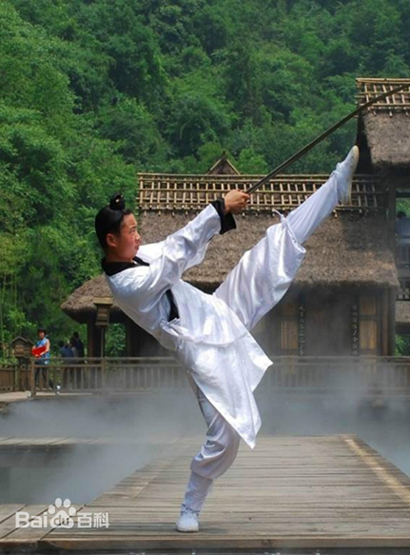
Wudang: It is named after Mountain Wudang which originated in Junxian County, Hubei. Wudang school originated in the late Yuan Dynasty and early Ming Dynasty and prevailed in the late Ming and early Qing Dynasty.

Slide 6
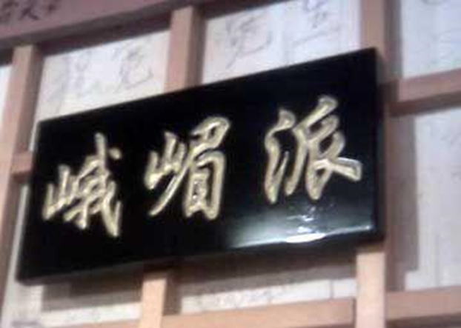
Emei: It originated in Mount Emei in Sichuan and was formed in the Ming Dynasty. Emei Boxing combines the strengths of many families to form a unique technique and style.

Slide 7
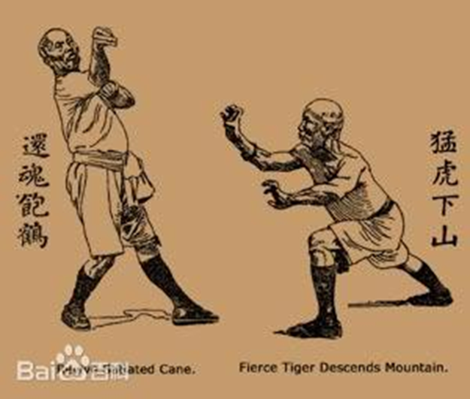
Nanquan: It also known as Southern style boxing, is the general term for the type of boxing popular in the South China since the Ming Dynasty. It is centered in Fujian and Guangdong Provinces, and is widely spread in the south of the Yangtze River, so it is called Nanquan.

Slide 8
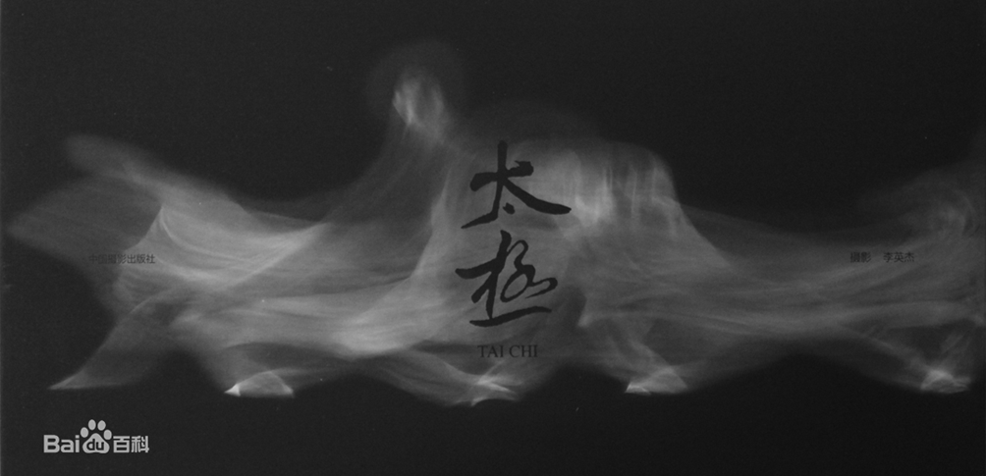
Tai Chi
Tai Chi, a national intangible cultural heritage, is based on the traditional Chinese Confucian and Taoist philosophy, Tai Chi Bagua and the dialectical concepts of Yin and Yang, and has a long history.

Slide 9
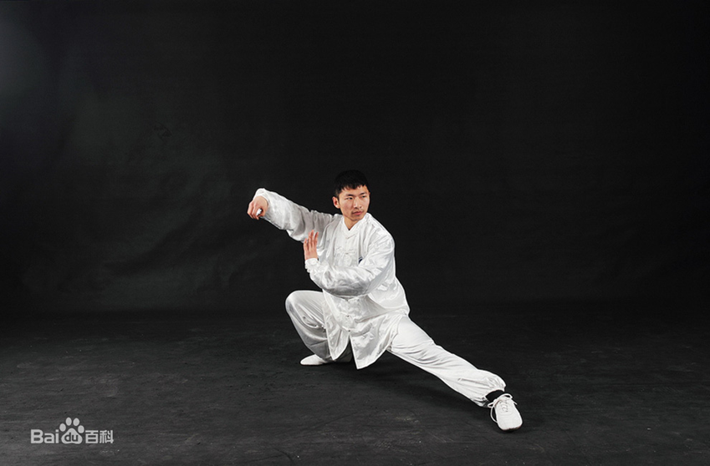
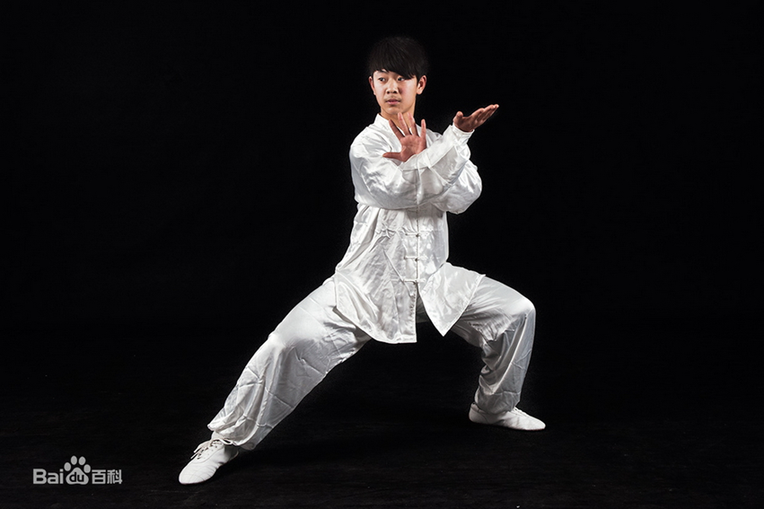
There are many traditional taijiquan schools. The common taijiquan schools include Chen style, Yang style, Wu（吴） style, Wu（武） style, Sun style, and He style. Each school has inherited relationships and learns from each other, and each has its own characteristics. Since Tai Chi is a type of boxing formed in modern times, with many schools and broad masses, it is a very vital group of Chinese wushu.
In 2006, Tai Chi was included in China's first batch of National Intangible Cultural Heritage List.

Slide 10
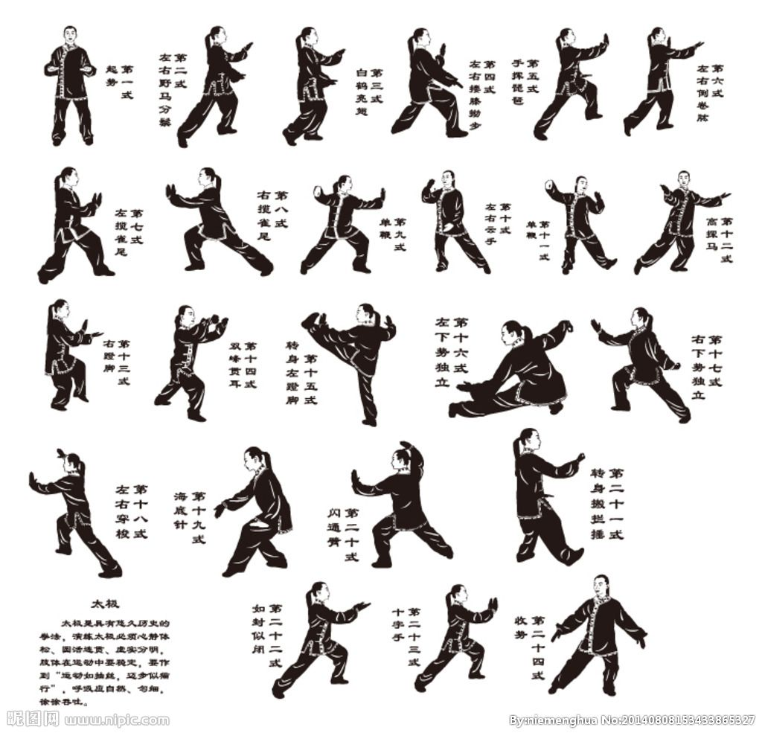
Tai Chi
简化24式太极拳

Slide 11
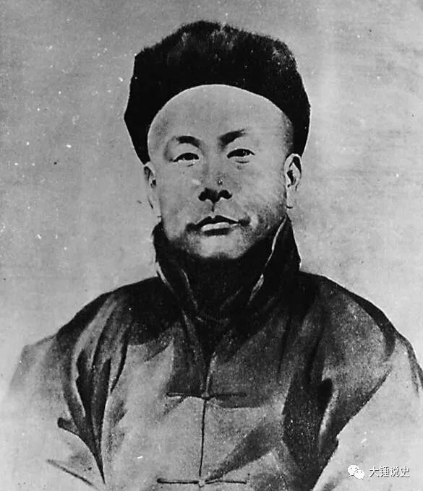
Chinese famous martial artists
Huo Yuanjia（霍元甲）
Sun Yat-sen spoke highly of Huo Yuanjia‘s courage to “strengthen the country with military force”. On the occasion of the 10th anniversary of the establishment of the Jingwu Association, he personally visited the conference and inscribed the four characters “Shang Wu Jing Shen（尚武精神）" to commemorate Huo Yuanjia.

Slide 12
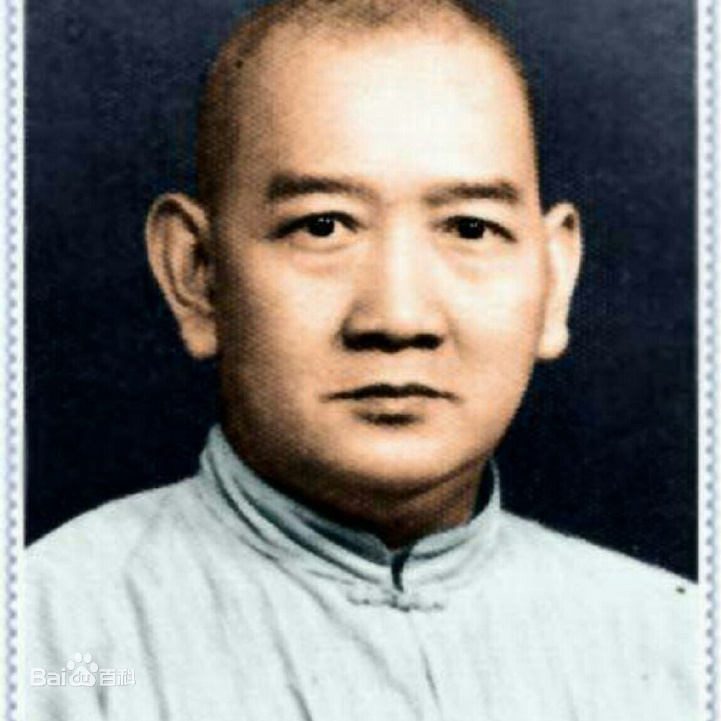
Huang Feihong（黄飞鸿）
Huang Feihong is a representative Hongquan（洪拳） master in the late Qing Dynasty and the early Republic of China.

Slide 13
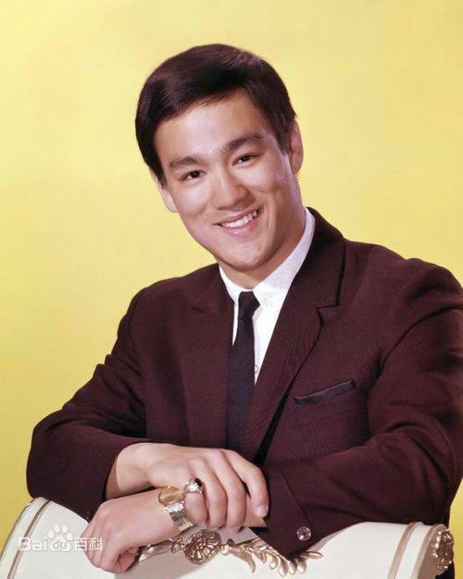
Li Xiaolong (Bruce Li)
Titles: Pioneer of world kungfu revolution, martial arts fighter, martial arts philosopher, father of MMA, martial arts master, pioneer of kungfu movies and founder of Jeet Kune Do（截拳道）, Chinese martial arts film actor, the first global promoter of Chinese Kung Fu, the first Chinese protagonist in Hollywood.

Slide 14
The transliteration in Chinese martial schools
Shaolin school, Wudang school, Emei school,
Nanquan (Southern Boxing), Taijiquan (Chinese shadow boxing).
The literal translation in Chinese wushu
Nanquan emphasizes pile skills（桩功）
sitting piles（坐桩）
Ding piles（丁桩）
kneeling piles（跪桩）
practicing medicine hands（练药手）
sandbags（打砂袋）,
Tie Sha Zhang (Iron Sand Palm)（铁砂掌）
acupoint-pointing skills（点穴功）

Slide 15
Conclusion
After the founding of the People’s Republic of China, wushu has developed vigorously. In 2008 Beijing Olympic Games, wushu became an Olympic event.
Chinese traditional wushu contains the wisdom of the Chinese nation for more than five thousand years, and embodies the unique values, outlook on life and world outlook of the Chinese nation.

