Slide 1
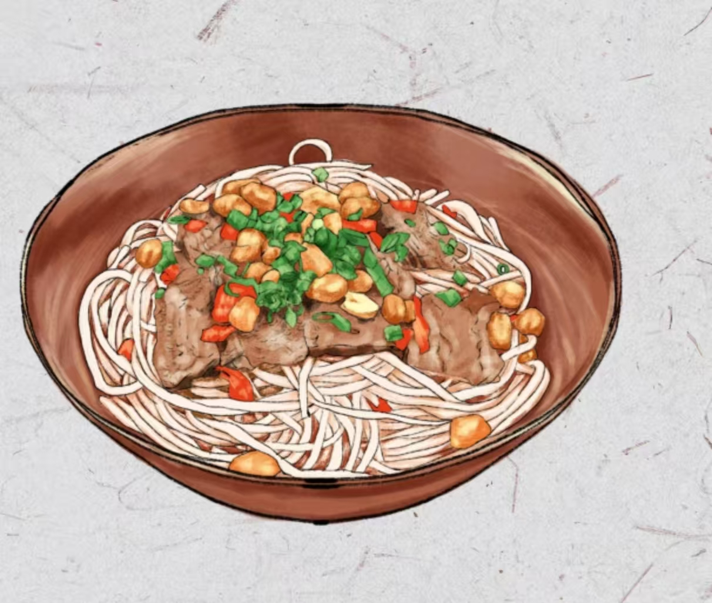
Hunan Rice Noodles
湖南米粉
马一礁

Slide 2
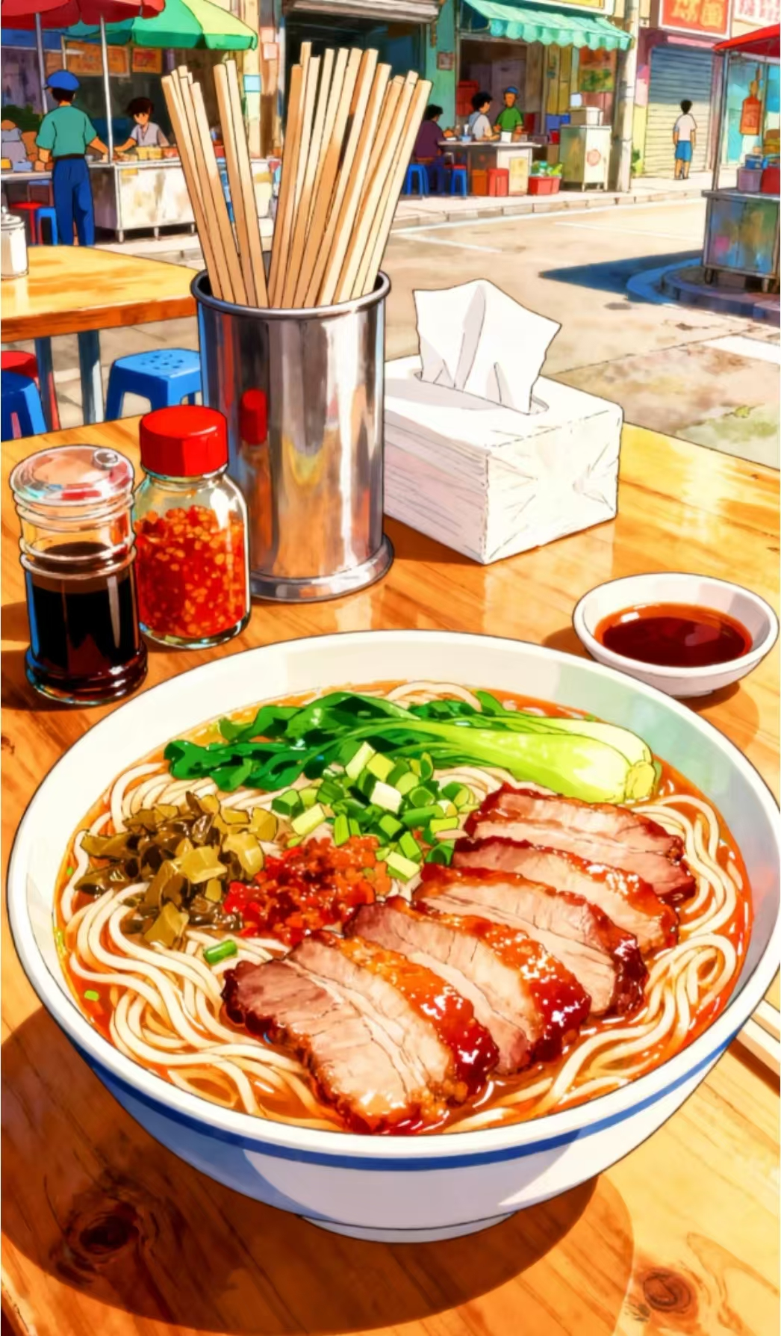
People in Hunan usually start their day with a bowl of hot rice noodles.

Slide 3
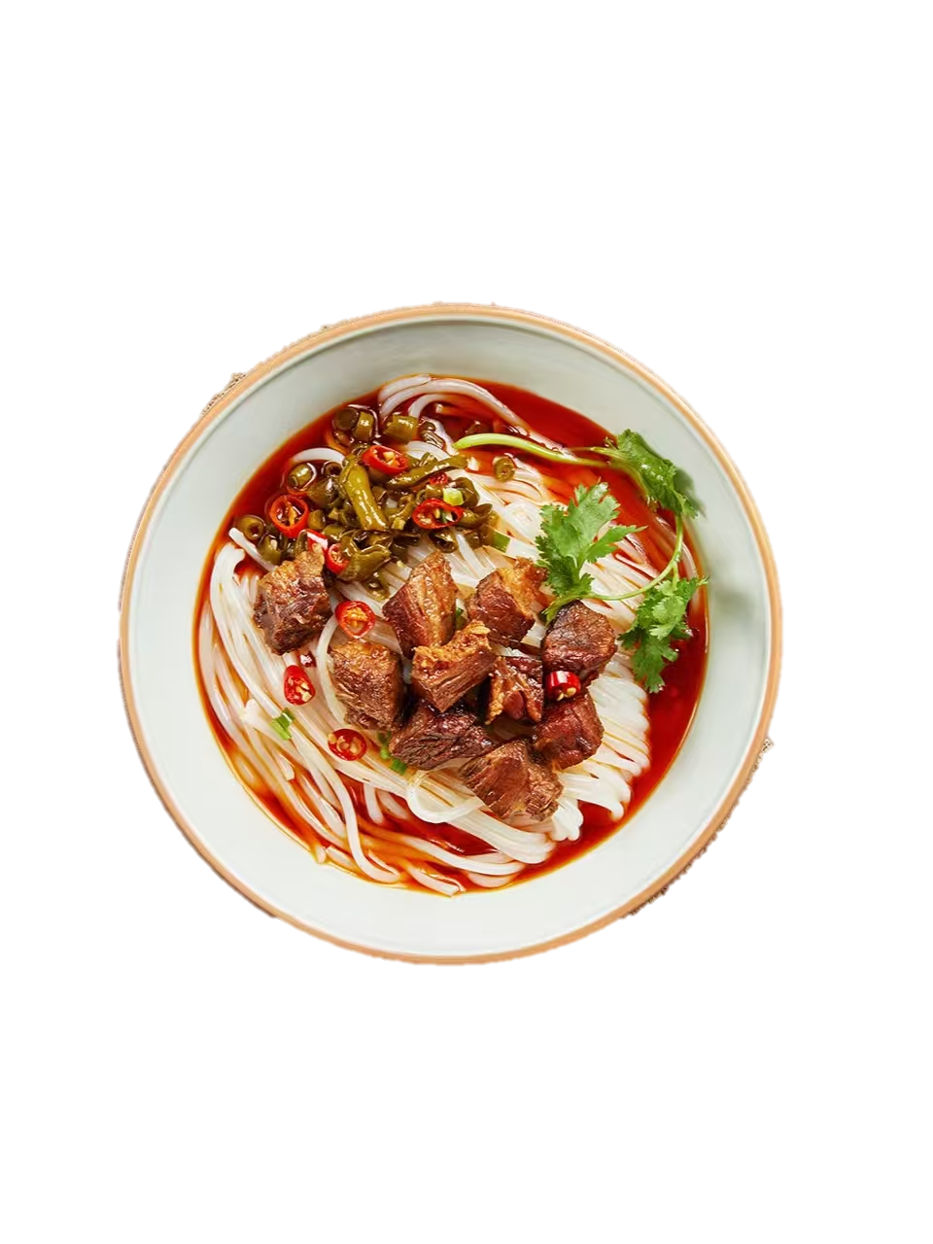
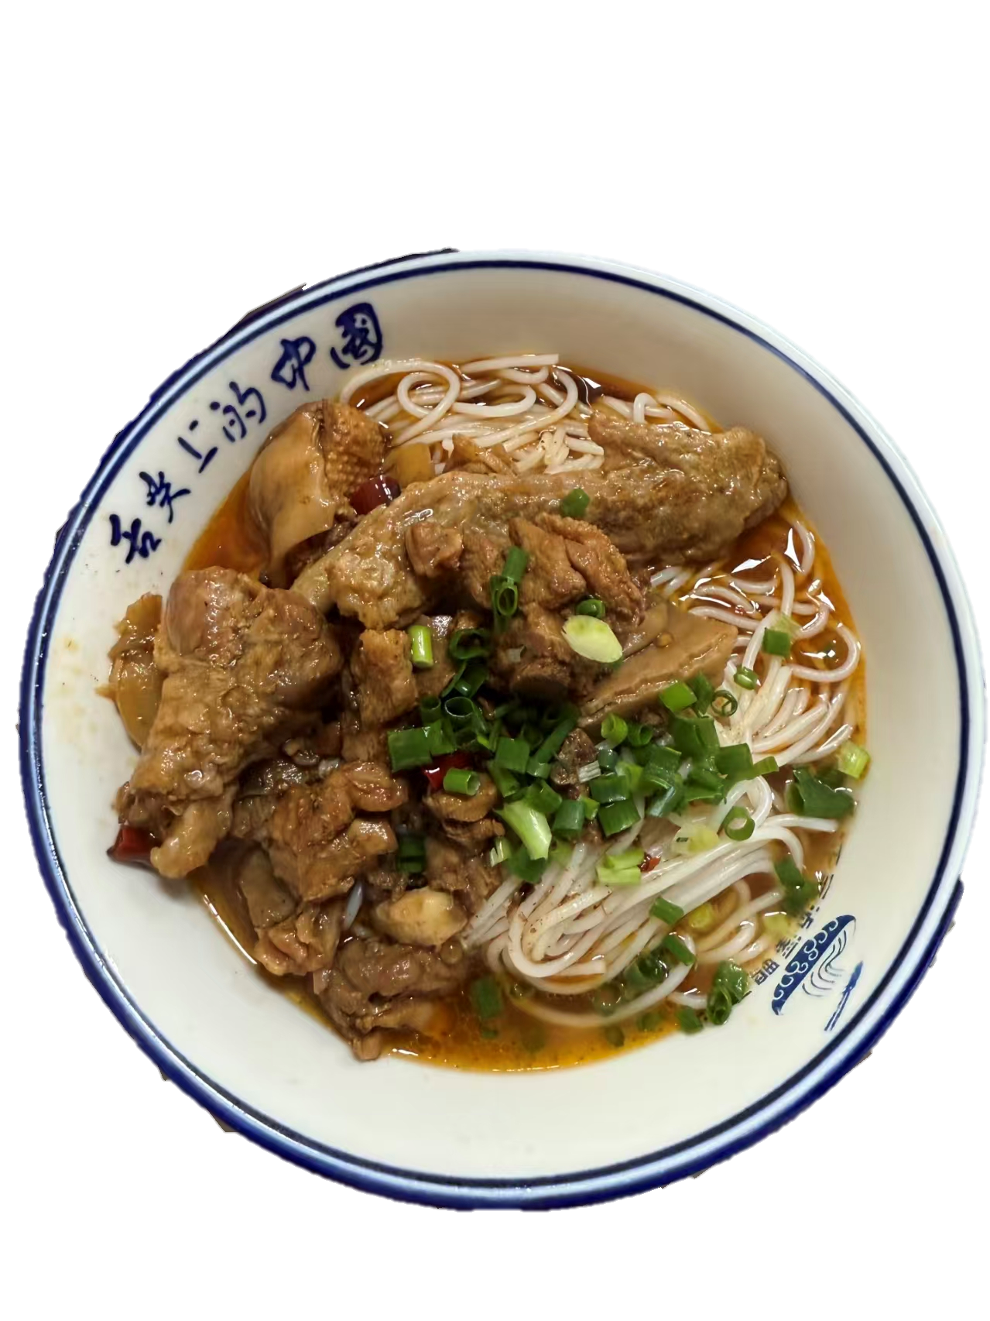
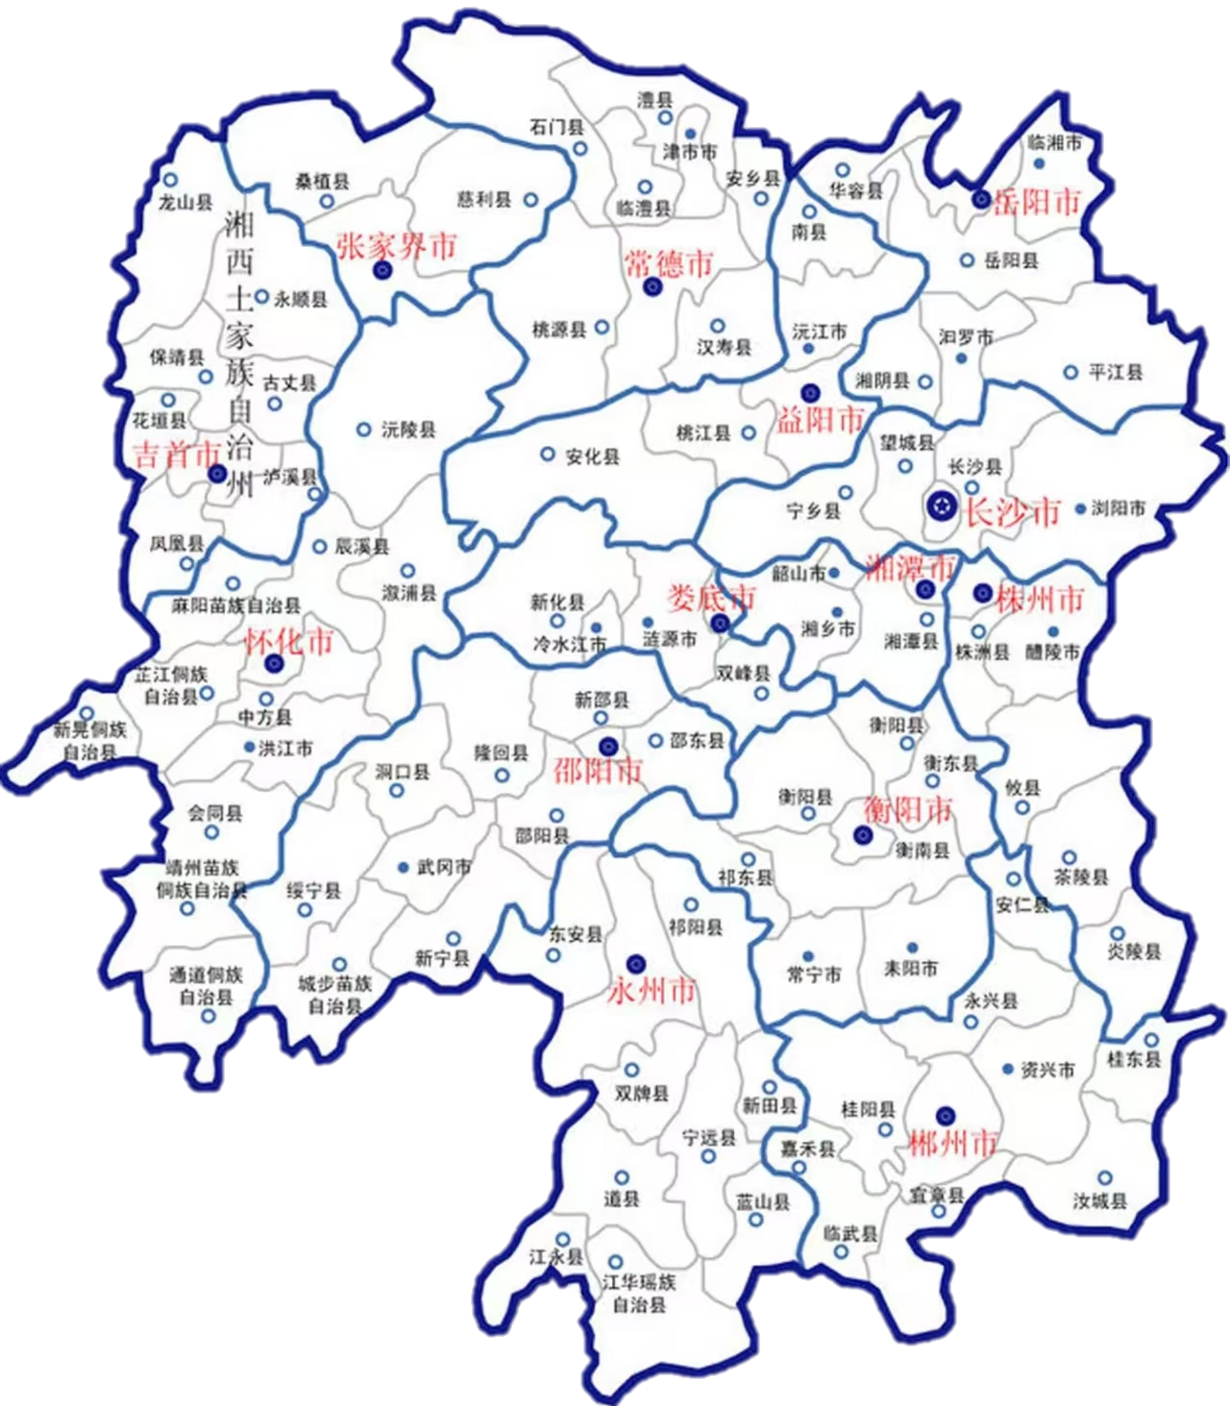
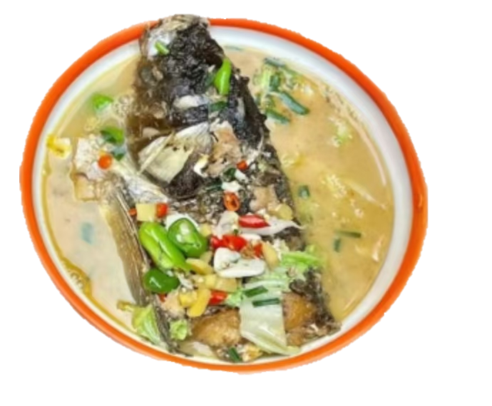
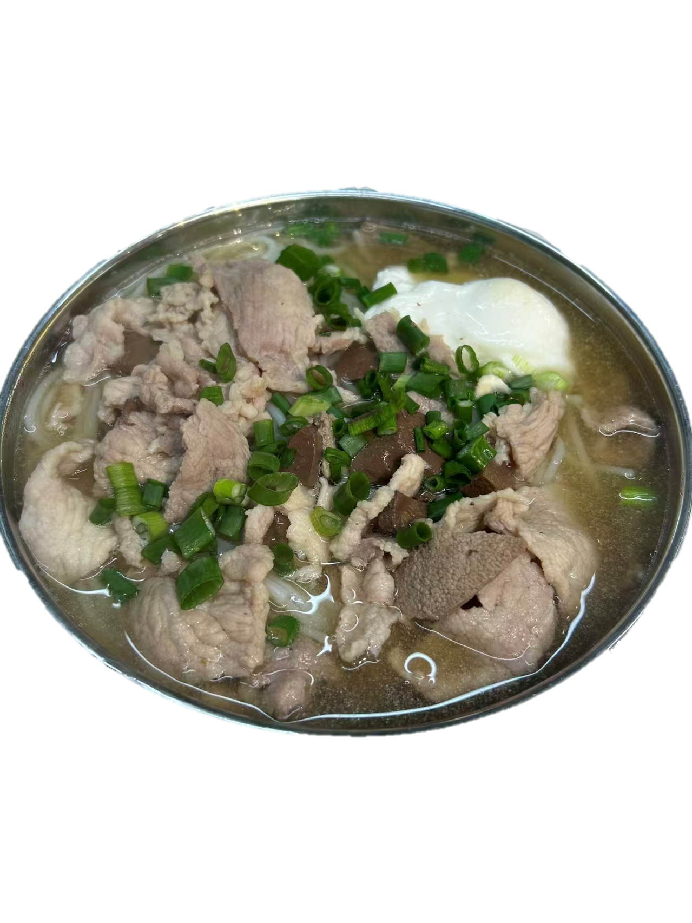
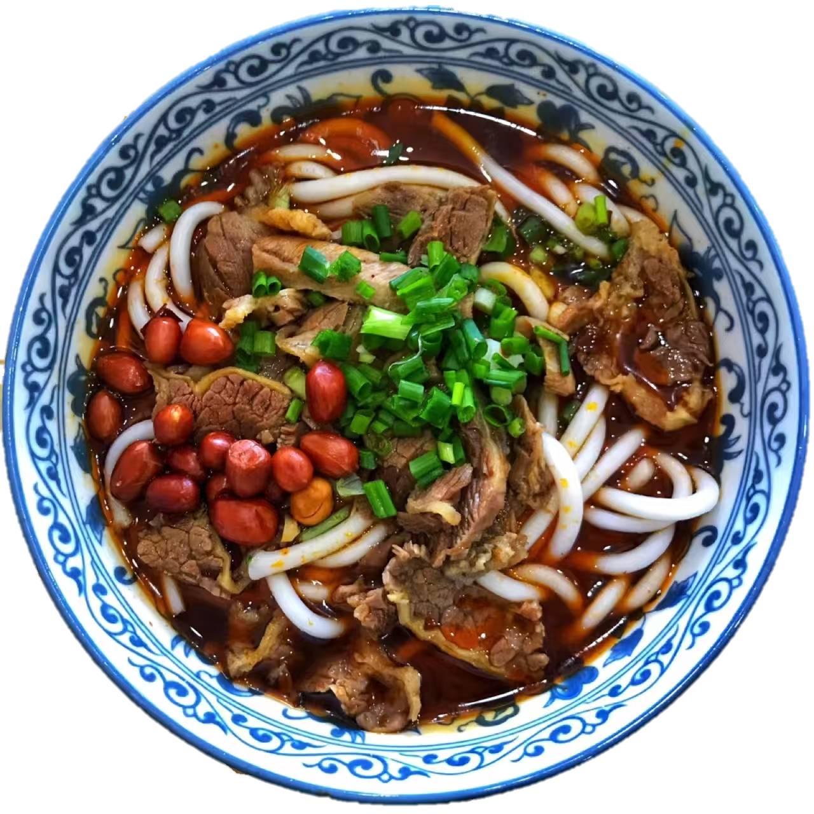
taste journey

Slide 4

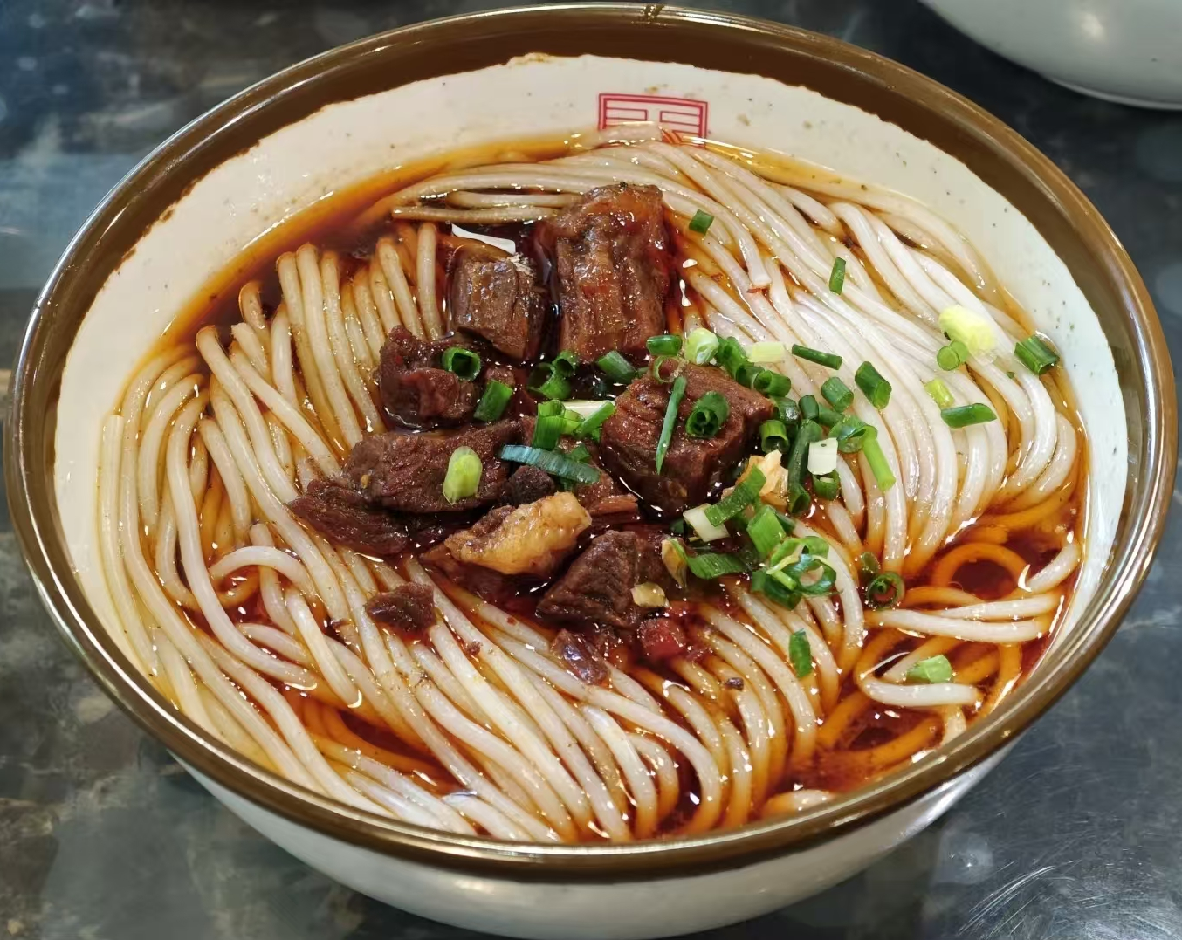
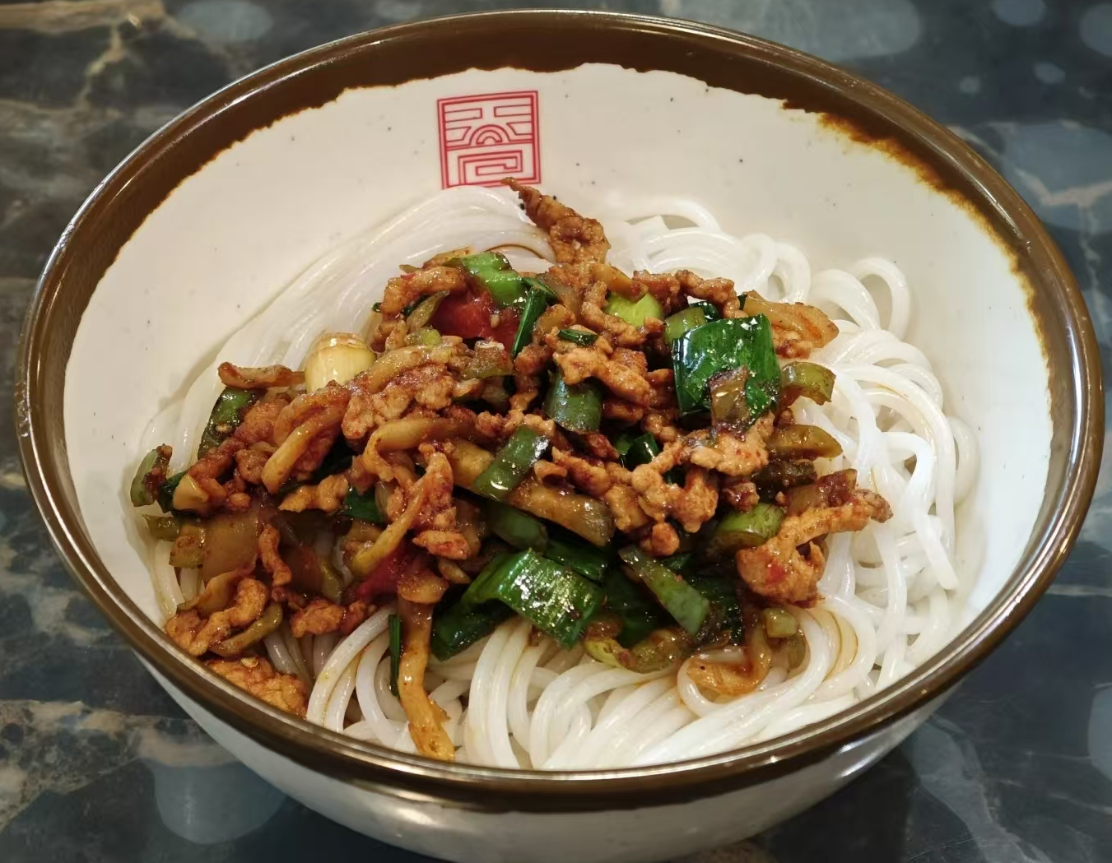
Changde rice noodles
Toppings（浇头）
beef toppings
pork toppings

Slide 5
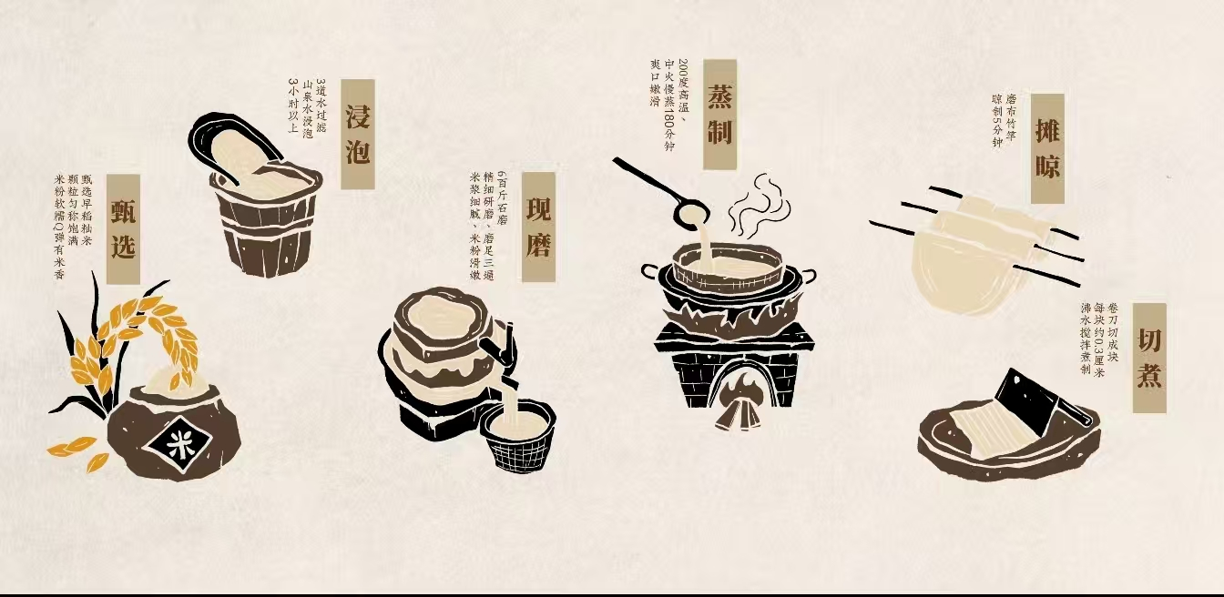
Its production techniques have been listed into the Intangible Cultural Heritage List of Hunan Province (湖南省非物质文化遗产名录 )in 2016.

Slide 6

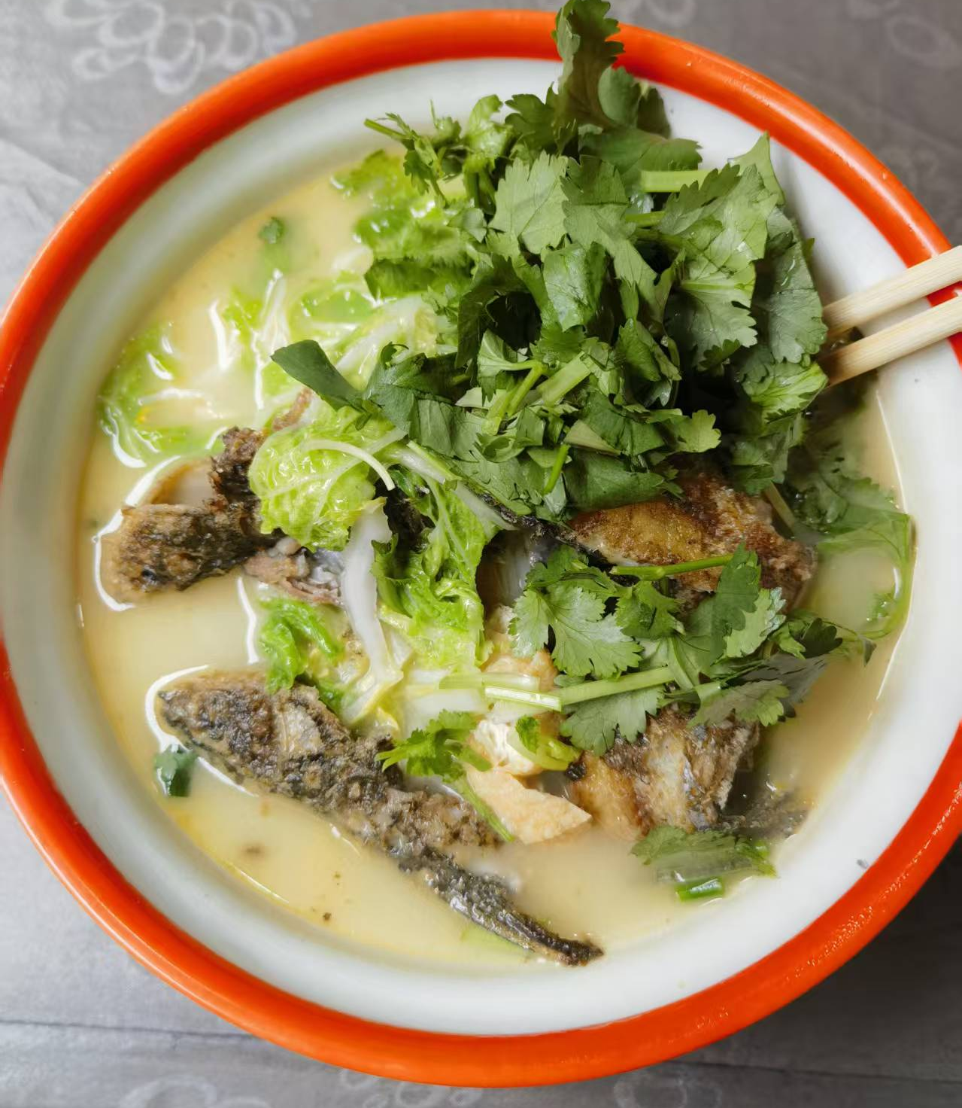
Hengyang fish rice noodles
the richness of the fish soup and the delicacy of the rice noodles

Slide 7

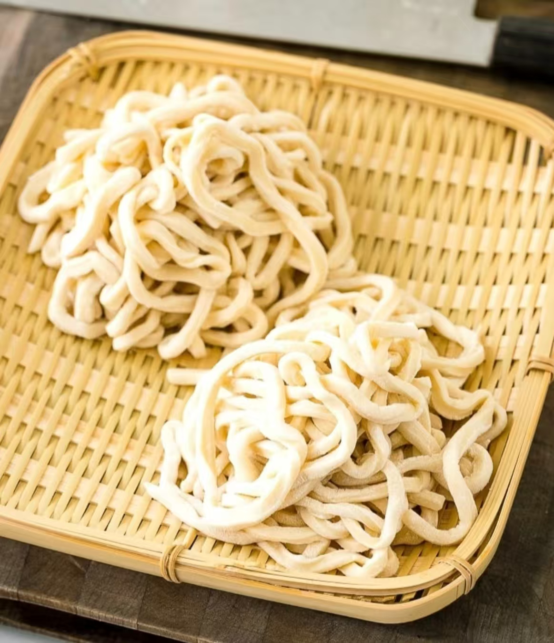
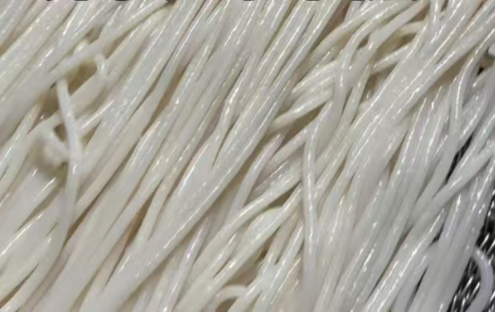
Shaoyang rice noodles
Similar to
thickness and chewiness
udon noodles
乌冬面

Slide 8
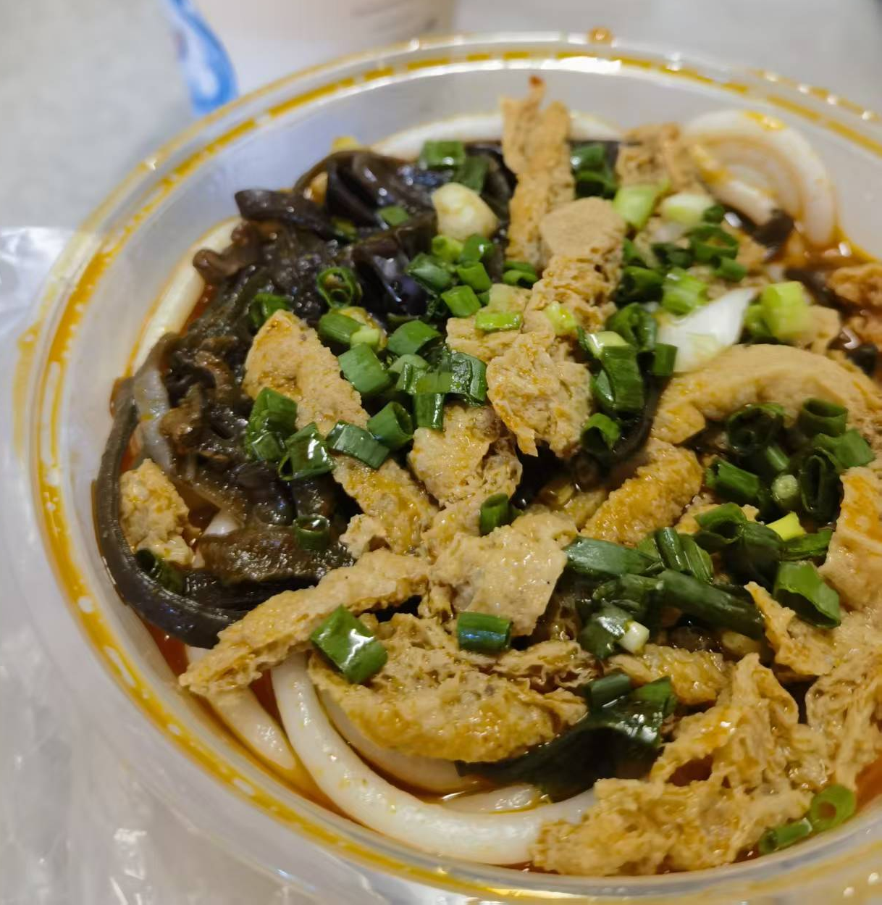
oiled tofu and shredded fungus
木耳豆腐

Slide 9
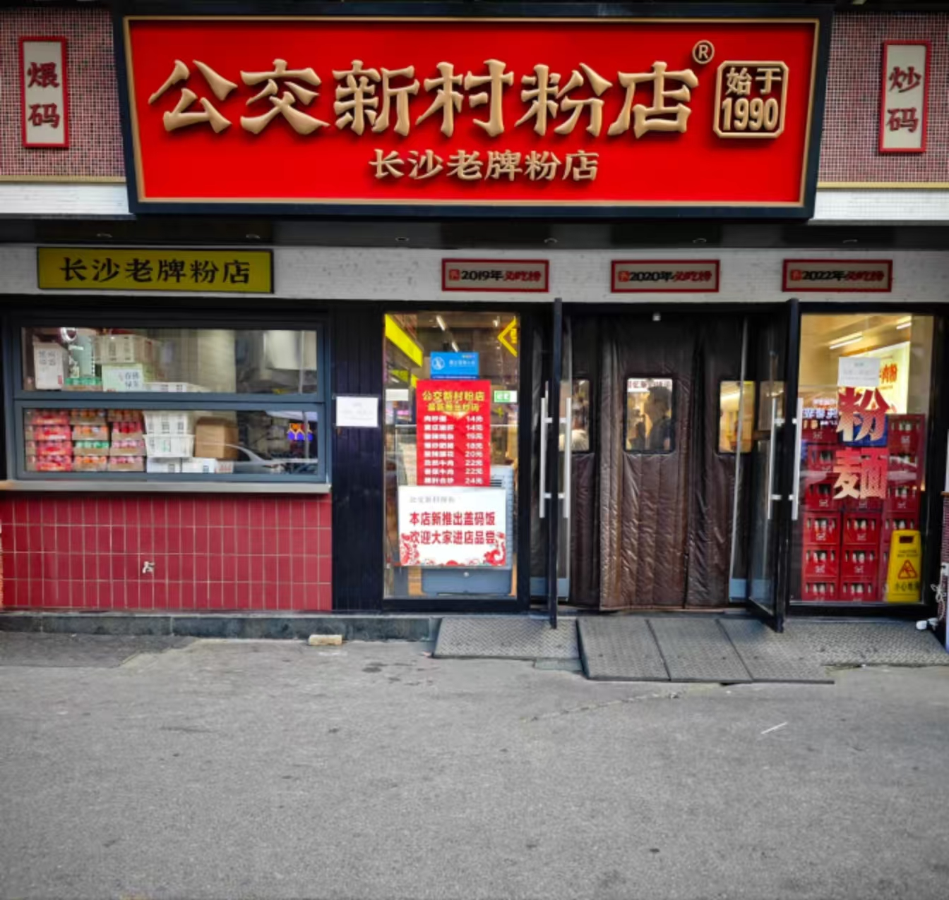
Situation:
Supposing you are in a rice noodle restaurant in Changsha.
圆滴 VS 扁滴
Slim or Flat

Slide 10
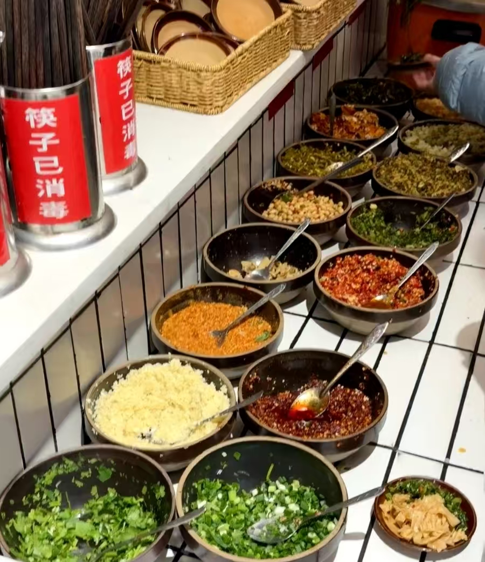

DIY Your Own Bowl of Rice Noodles
Chopped Green Onion葱花
Minced garlic 蒜末
Shredded Ginger 姜丝
Chopped chili 剁辣椒
…

Slide 11
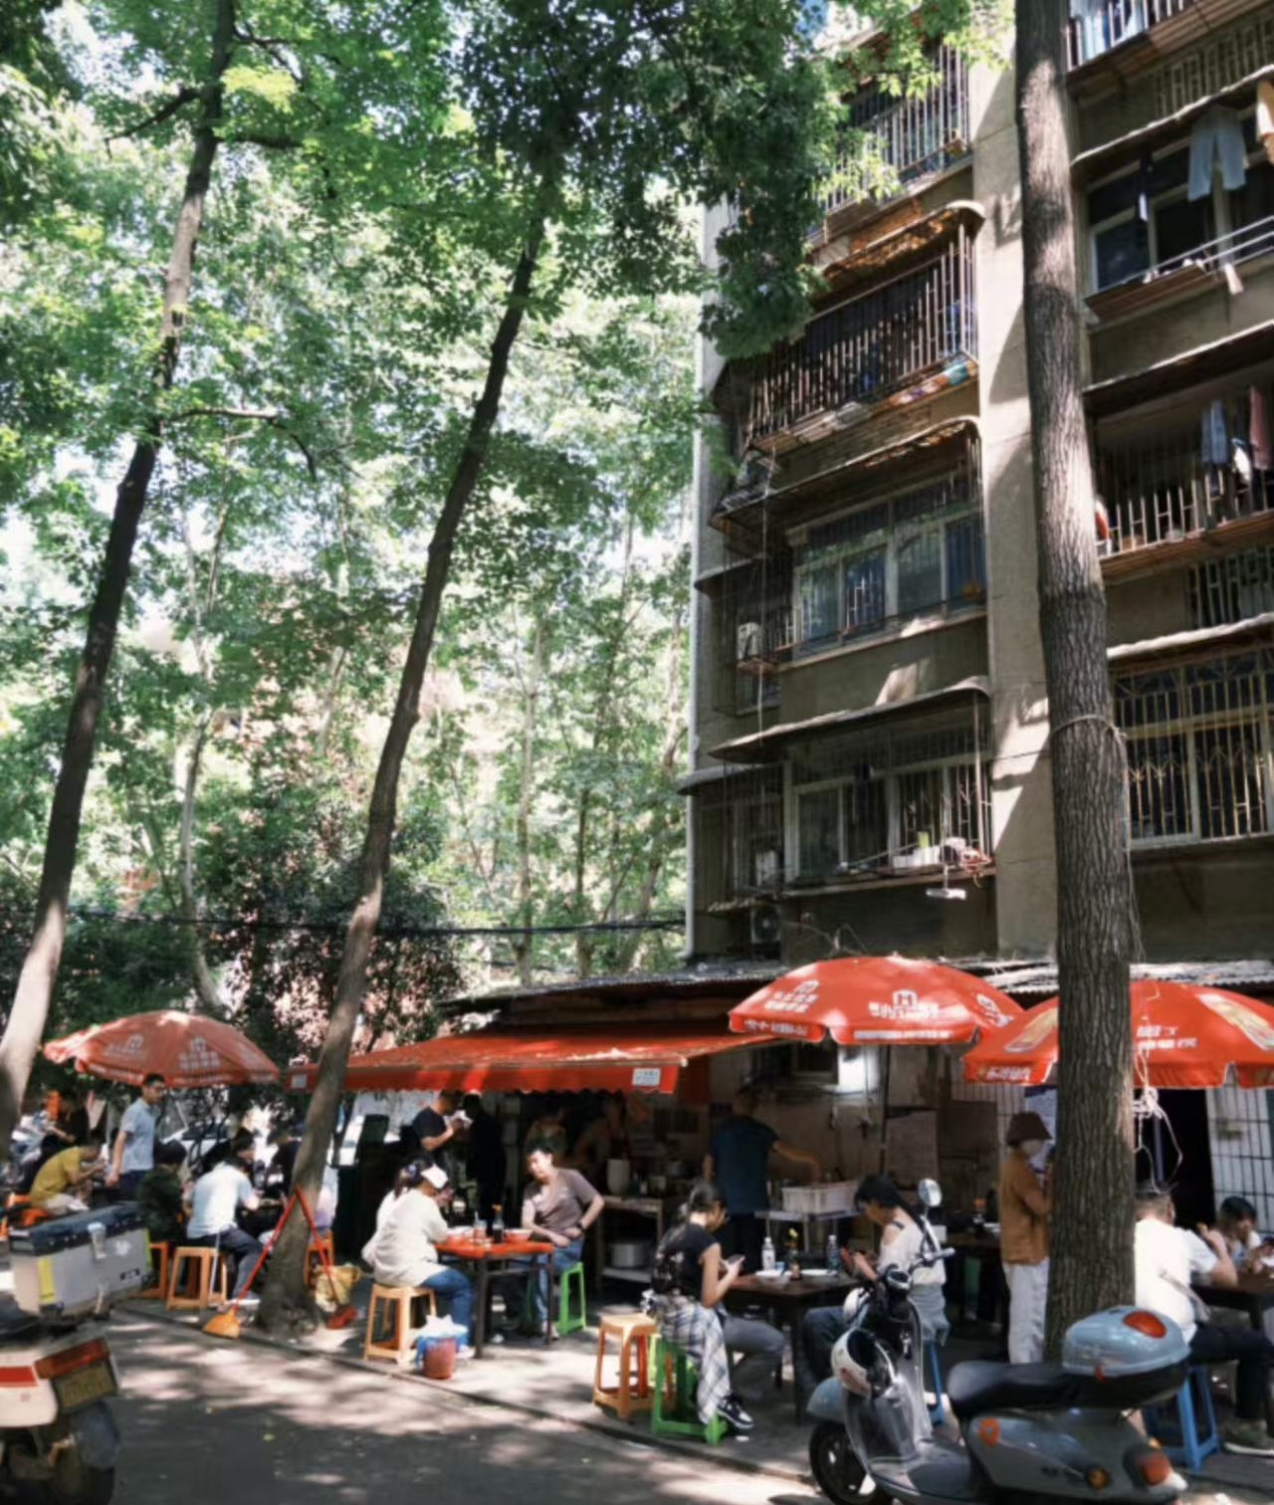
No matter where we are, eating a bowl of familiar rice noodles is like going back to home.

Slide 12
Thank you for listening
感谢聆听

