Slide 1
Jiangxi school of poetry!!!

Slide 2
Su Shi
Su Shi a small literary circle which included
Huang Tingjian
Qin Guan
Chao Buzhi
Zhang Lei
Chen Shidao
Of these people Huang Tingjian and Chen Shidao are two of the most important.

Slide 3
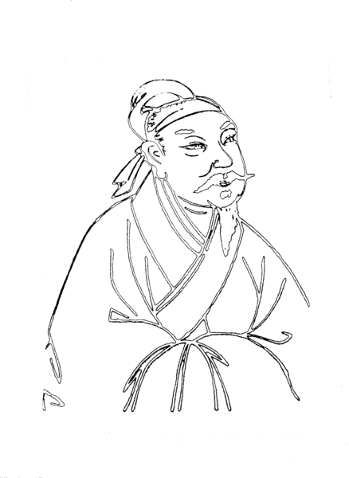
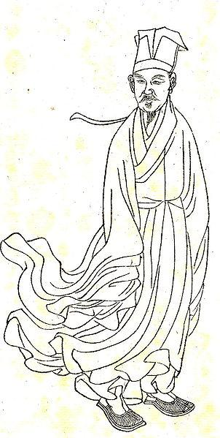
Huang Tingjian(1045-1105)

Slide 4
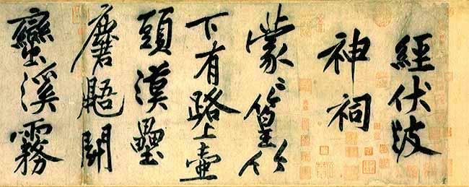

Slide 5
Huang vs. Su Shi
What is remarkable about Huang's style is that his poetry was very complex whether it seemed to be or not.
Poem #1
"The Viscount of Tube City does not have the appearance of eating meat
Brother Square Hole has written a letter breaking off relations" (420).
Poem #2
"I live on the northern sea, you on the southern,
Too far apart even to entrust letters to wild geese to carry.
Peach and pear in spring wind, a single cup of wine,
Rivers and lakes in night rains, ten years by lamplight" (421).

Slide 6
Poem
#1
The Viscount of Tube City does not have the appearance of eating meat
Brother Square Hole has written a letter breaking off relations
"'The viscount of Tube City' alludes to a fanciful biography Han Yu had written about the writing brush, in which the brush is personified and has an official career. At the end of its 'life,' the writing brush is enfeoffed as a viscount of Tube City, an actual place whose name, appropriately enough, doubles as a synonym for 'brush'" (420).
"'Brother Square Hole' is a droll euphemism for money, because Chinese coins had square holes in their middle and were 'as treasured as older brothers.' Also, it happens that the words for 'hole' doubles as a surname, so that the CHinese for 'square hole' sounds like a plausible personal name. Letters written to terminate relations were an established type of letter, with ancient precedents. Line two means that Older Brother Money will have nothing to do with our poet. In other words, not only is Huang fated to remain undistinguished and unknown, he is also destined to remain poor" (420).

Slide 7
Poem
#2
I live on the northern sea, you on the southern,
Too far apart even to entrust letters to wild geese to carry.
Peach and pear in spring wind, a single cup of wine,
Rivers and lakes in night rains, ten years by lamplight
"There are no specific allusions here...They are stock poetic phrases, really, bordering on cliche. And yet the meaning actually is not obvious and, as it turns out, not quite simplistic either" (421).
"The lines are the second couplet ina poem Huang sent to a friend with whom he had grown up. The two men had traveled to the capital to take the examinations ten years before these lines were written. Subsequently, as each began his official career, the two were separated and had not met again... (Peach and pear...) recalls the last springtime the two friends were together, when they took the examinations. The line evokes an enjoyable setting, in which the friends sat outside beneath flowering fruit trees and a single cup of wine. Why a 'single cup'? Probably to show the intimacy of the two friends, or perhaps also their impoverishment, which did not detract from their enjoyment of each others company" (421).

Slide 8
Politics in poetry
Huang and other also changed poetry by distancing themselves from politics and current events.

Slide 9
Writing about poetry
Huang also wrote a lot about poetry.
Wrote to young aspiring poets
Wrote a lof in metaphors
"Change the bones and steal away the embryo" (422).
"This refers to repeating meaning found in earlier poems but either in new diction (bones) or in a new form and shape (embryo)" (422).
"Huang dwells on the idea that each 'line must have an eye", that is, some element that animates it, making it memorable.

Slide 10
Onset of printed books
Huang also was affected by the widespread printing of books.
Changed the ways that he thought about literature and the ways that his predecessors thought about literature.

Slide 11
Chen Shidao
"After he first met Huang Tingjian, [he] went home and burned all his poems, having resolved to study Huang's methods. By the time of his death in 11055, Huang had many younger followers who imitated his dense and erudite style" (425).

