Slide 1

中华典籍外译
Chinese Classics Translation for Master Students of Translation Studies
湖南师范大学 2022年2月25日-2021年6月10日
中国文化基础 周五第九和第十节课14:30-16:10，
上课地点：外国语学院大楼613室
助教：Li Xin 李欣
吴漠汀特聘教授 Distinguished Professor Dr. Martin Woesler
培高德 教授 Professor Dr. Cord Eberspächer
湖南师范大学外国学院 Foreign Studies College, Hunan Normal University

Slide 2
Session 1 第一周
Session Overview 本节概览 (Organizational things)
Preparation:
1. WeChat group, rename yourself as
„Wang Jianguo王建国 21级笔译“
2. Register on course wiki https://bit.ly/WIKIREG input your username and real name (PINYIN!!!), first time password “wikicaptcha”更多资源：打开维基网站，请点击登录、申请，然后输入用户名字和真实姓名（以拼音的方式，第一次登录密码是“wikicaptcha”）
3. Start VooV 775-353-554. (All students need to turn on camera or will be blocked by student assistant. If Tencent does not work, here is an emergency Zoom session: https://bit.ly/ZOOMCOURSE.)
4. Access our course website http://bit.ly/CLASSICS2022
5. Take part in EU survey http://bit.ly/EU-SURVEY, prepare texts/ppt

Slide 3
Session 1 第一周
Session Overview 本节概览 (Organizational things)
Self-introduction, student introductions (too many, so before presentation) 自我介绍，学生介绍 （学过口译麦恩慈大学、外交部、给总理、使馆、慕尼黑、翻译红楼梦、王蒙、韩寒等等。助教： Lan Qi）
Disclaimer: Course is recorded, all data and contributions incl. produced with students belong to teacher or (if indicated) to university, only published data will be stored longer than 2 years.
Contents, required textbooks, WeChat group 课程内容，课本，微信群
Review existing concepts (what are classics?), preview this semester‘s contents: 复习已有的概念，预习本学期的内容
What you will be able to do at the end of this semester 这学期结束时你能做到什么？
Jointly agree on commitment, use of classroom time, weight of grades 共同达成教室使用时间和成绩比重的协议

Slide 4

Self-Introduction 自我介绍
Cord Eberspächer 培高德
Hunan Normal University, Full Professor 湖南師範大學，教授
Friedrich-Wilhelms-University Bonn, Adjunct Professor 波恩大學兼职教授
World Conference of Sinology, Board Member 世界漢學大會理事會成员
German China Association, Board Member 德中協會理事會成员
Oldenburg, Hamburg, Leiden, Peking, Berlin, Bristol,
Düsseldorf, Peking, Bonn 奧爾登堡 漢堡 來頓 北京
柏林 布里斯托 杜塞爾多夫 北京 波恩
Modern Chinese History 中國近代歷史
History of Sino-German Relations 中德關係
Global History 全球歷史
Military/Naval History 軍史/海軍史
Historical Stereotypes 陈规定型在歷史
Chinese Culture 中國文化

Slide 5
Self-Introduction 自我介绍
Martin Woesler 吴漠汀
Xiaoxiang Scholar Dist. Prof., PhD supervisor 潇湘学者特聘教授、博士导师
Academian, Europ. Acad. of Sciences & Arts, Salzburg 欧洲科学院院士
Jean Monnet Chair Professor 让膜内主席教授
Int‘l Chinese Studies Centre, Director 外语学院国际汉学中心主任
German China Association, President 德中協會主席
World Association of Chinese Studies, President 世界喊學研究會會長
Bochum, Peking, Harvard, Mainz/Germersheim, Witten, Harvard, Orem/USA, Rome, Peking Normal & Witten波鸿，北京，哈佛，美因茨/盖默斯海姆，威腾，哈佛，奥勒姆/美国，罗马，北师大&威腾
Essays (Western influence, social impact, cf.: blogs) 散文（西方的影响，社会影响）
Early literary translations 早期文学翻译
Literature Development (Canonization etc.) 文学的发展（经典，分类）
Early Western reception of Hongloumeng 《红楼梦》在西方的早期反响
Translation workshop (volunteers?) 翻译工作坊（有志愿者可以找我报名）

Slide 6
Your Introduction 学生介绍
Since we are too many students, please write your bio on your Wiki page:
https://wiki.rub.de/uvu/index.php/User:Lei_Feng

Slide 7
Schedule 学期题目
1 2.25 Organizational things, intro to the concept of a „classic“
2 3.4 Canonization
3 3.11 Early Translation of Chinese Literature
4 3.18 Reception of the Red Chamber Dreams in the West
5 3.25 How to make people read classics again?
6 4.1 Western Classics in Chinese clothes: The example of Utopian Literature
7 4.8 Attractiveness of Chinese Classics as part of softpower
8 4.15 Chinese Classics in the West: The Example of Germany
9 4.22 Sinicization – Politics for Cultural Export: The Example of the Chinese classics
10 4.29 Chinese Classics in World Lit. Anthologies and World Literary History Books
11 5.6 Translation of Modern Classics: Mo Yan, Yu Hua, Liu Cixin etc.
12 5.13 Chinese Classics on Overseas Bookfairs
13 5.20 Cinema Movie Adaptions of Chinese Classics
14 5.27 Lessons to learn from the Classics: Integration or Sharpening the Cultural Profile?
15 6.3 Final Discussion
16 6.10 Final Exam

Slide 8
Use of time
Agreement on how to use time:
Homework before class
Reading before class
In Class: At least one oral contribution each session
Presentations once a semester

Slide 9
About grades 关于成绩
Expectation for grades 对成绩的期许
=
Requirements from the curriculum课程要求

Slide 10
About grades
学期论文（结合学期所学，撰写一篇
以上汉字或单词的论文）成绩占70%。

Slide 11
How to find resources
怎麽能找到參考資料
百科百度（起點，要看文章用的參考資料）
https://gg.xueshu5.com/ (MLA標準)
CNKI
圖書館
tupian.baidu.com、ppt on baidu
Ishare? Douban? books.google.de?

Slide 12
Unique Selling Points 独特的卖点
EU Expert Course – counts for Diploma Supplement
(EU multilingualism)
quality: based on experience in Germany (Bochum, Mainz/Germers-heim, UAL Munich, Witten), Italy (Rome III), the USA (Harvard, UVU) 质量：基于在德国、意大利、美国的经历
understand major literary trends with selection of extracts from main texts 理解重要课本中提取选择的主流文学趋向
jointly agree on: weight of grades 共同协议：成绩的比重
jointly agree on: your oral presentation will be documented in a wiki article and will be published 共同协议：你的口头展示会被收录到维基文章中并被公开
fellowship: get help of others and help others 同学/友谊：互帮互助
simple quizzes as reading response 对阅读反馈的简单测验

Slide 13
Session 1 第一次上课
1 Introduction: Organizational Things.
Prepare for next time: Choose your presentation topic (existing topic)
Unit 1, translate 1 sentence per text (ONLY FELLOW STUDENT CORRECTION)
2 Unit 1.
Homework: Reflect on last time: Write 1 tip for translation
Prepare for next time: Unit 2, translate 1 sentence/text
3 Unit 2.
Homework: Reflect on last time: Write 1 tip for translation
Prepare for next time: Unit 3, translate 1 sentence/text
…
16 Unit 15 – write new text book topic for final exam paper on wiki
(THE EARLIER, THE BETTER FELLOW STUDENT CORRECTION)

Slide 14
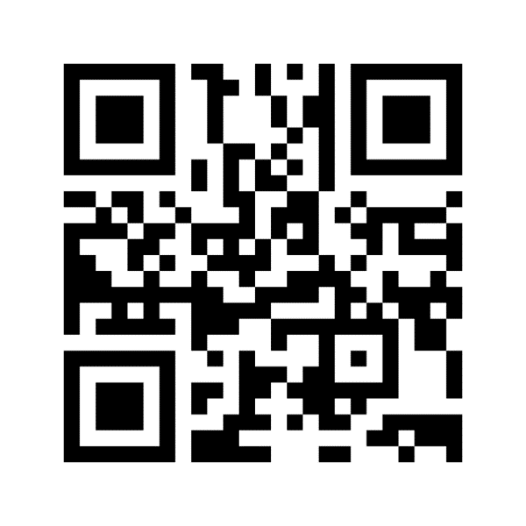
Expectations?
wordcloud
http://menti.com 2007 2653
https://www.menti.com/pfkzcyt7a4

Slide 15
Anonymous questions to the teachers
http://menti.com 1933 1105
https://www.menti.com/5htnmrawxa

Slide 16
Review existing concepts
What are classics?
Why classics?
Why culture?
For next time: Read text about „CANONIZATION“

Slide 17
Always here for you!
随时为你们服务
Professor Dr. Martin Woesler
吴漠汀
湖南师范大学特聘教授，博士导师
Office / 办公室: 外国语学院415
国际汉学中心309
Phone / 电话: (150) 1138 8818
(德国+49 178 2073538)
Email / 电子邮件: wmt@hunnu.edu.cn

Slide 18
Thank You

