Slide 1
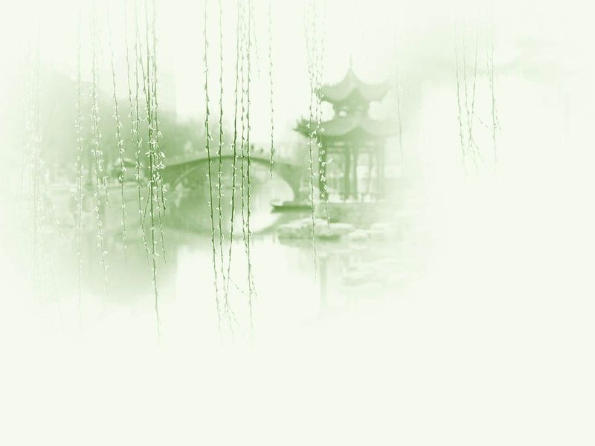
Unit 8 Literature

Slide 2
Questions Concerning Section A Classical Literature
1. What does classical Chinese literature refer to?
2. What does pre-Qin literature refer to? What are its masterworks?
3. What is Sima Qian’s greatest achievement?
4. Who are the representatives of Jian’an Literature?
5. What does the golden age of classical poetry refer to? Can you name some of the great poets then?
6. What’s the greatest literary achievement in the Song Dynasty? What are its two styles? Can you name some of its masters?

Slide 3
Questions Concerning Section A Classical Literature
7. Who are the Eight Great Writers of Tang and Song?
8. What is the greatest literary achievement in the Yuan Dynasty?
9. Can you name some of the representative Yuan writers and their masterworks ?
10. What are the greatest literary achievements in the Ming and Qing dynasties? Can you name some of the great Ming dramatists and their masterworks?
11. Can you name some of the great Qing novelists and their masterworks?

Slide 4
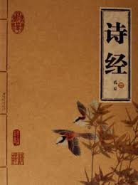
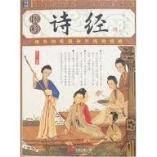
The Book of Songs or The Classic of Poetry

Slide 5
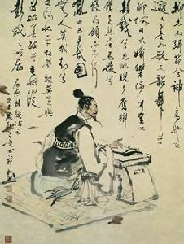
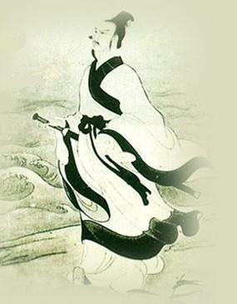
Qu Yuan and his A Lament

Slide 6
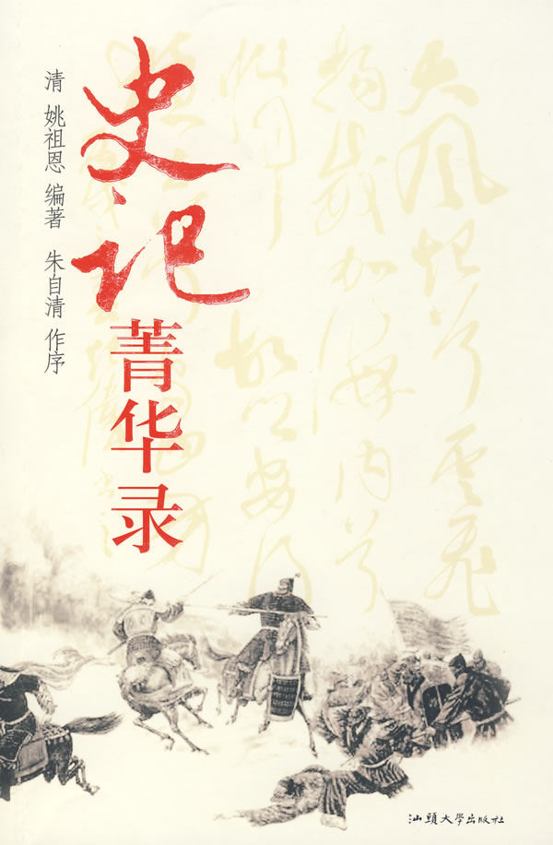
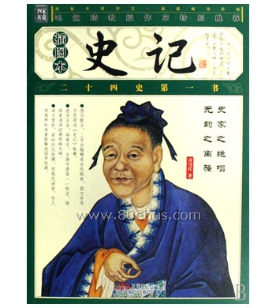
Sima Qian & his masterwork

Slide 7
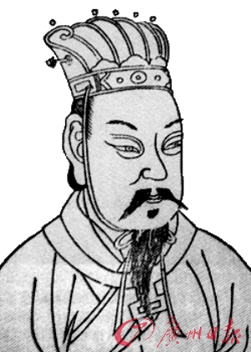
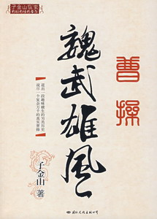
Cao Cao and his biography

Slide 8
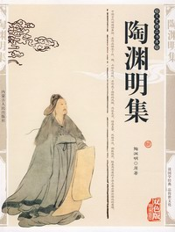
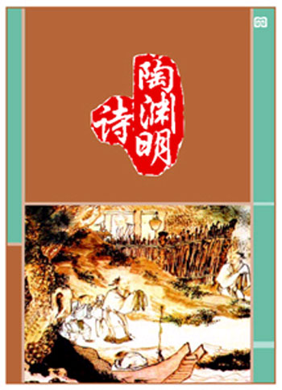
Collections of Tao Yuanming’s works

Slide 9
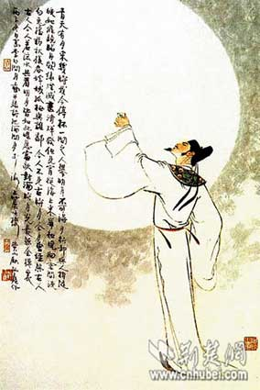
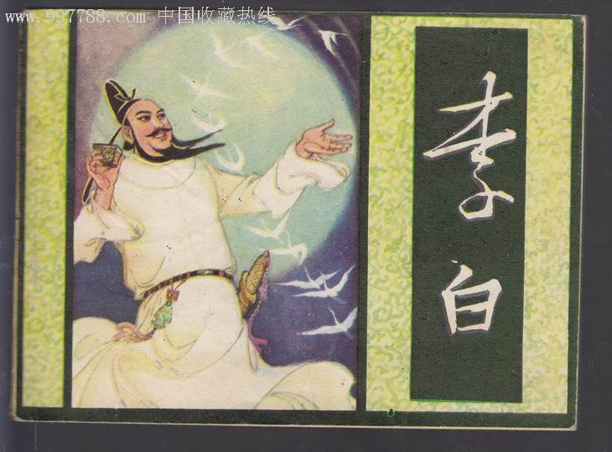
Li Bai, a romantic poet

Slide 10
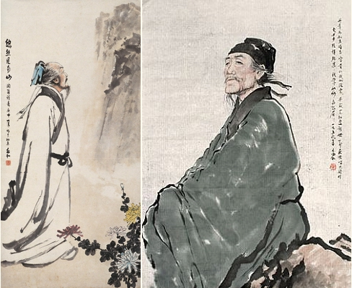
Du Fu, a realist poet

Slide 11
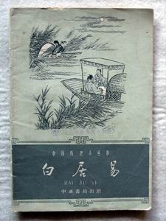
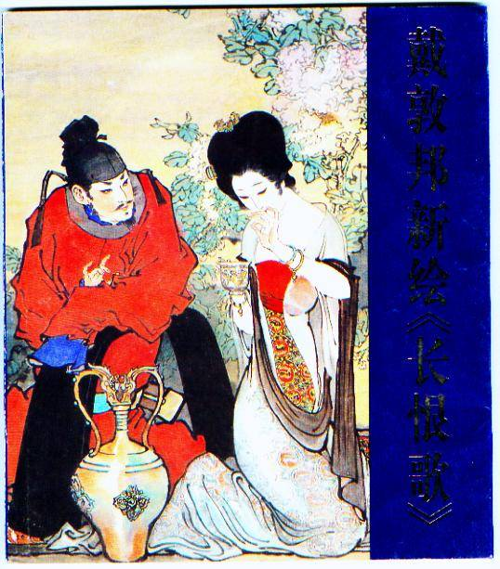
Bai Juyi and illustrations of his works

Slide 12
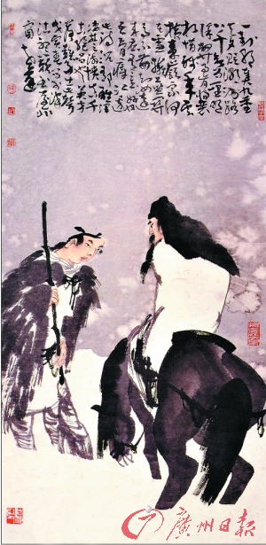
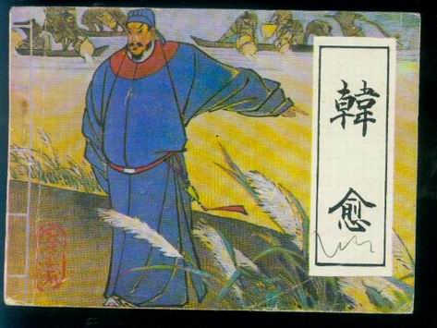
Paintings of Han Yu

Slide 13
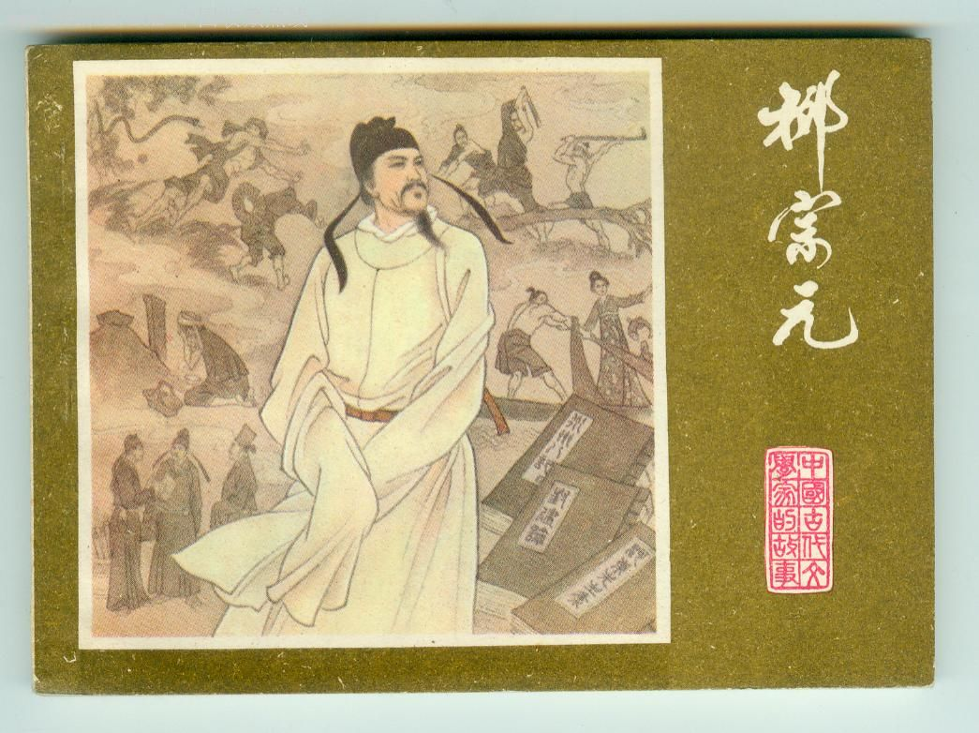
Liu Zongyuan

Slide 14
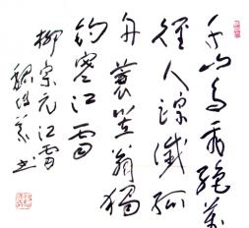
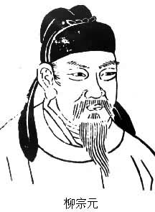
Liu Zongyuan and his poem “Fishing in Snow”

Slide 15

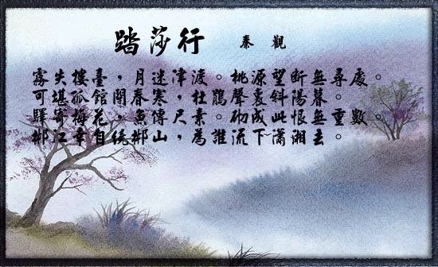
Qin Guan and his best-known poem

Slide 16
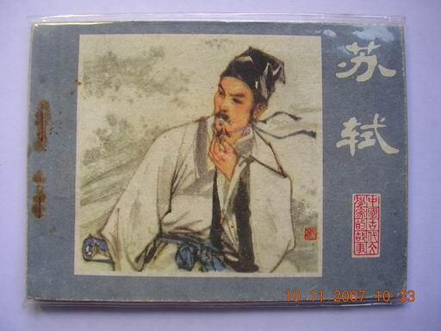
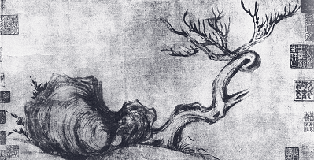
Su Shi & his painting

Slide 17
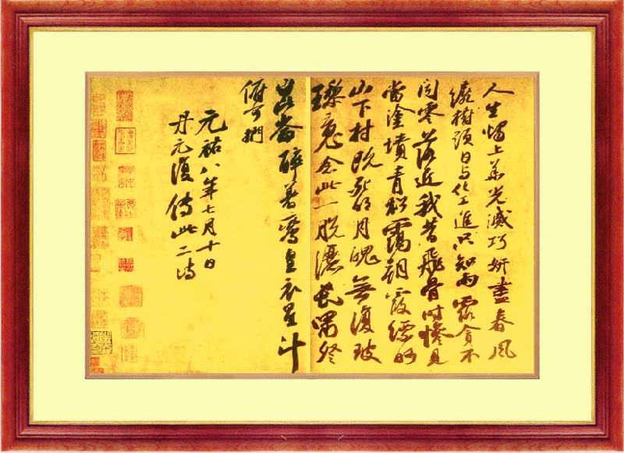
Su Shi’s calligraphy

Slide 18
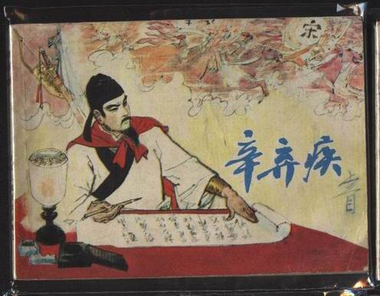
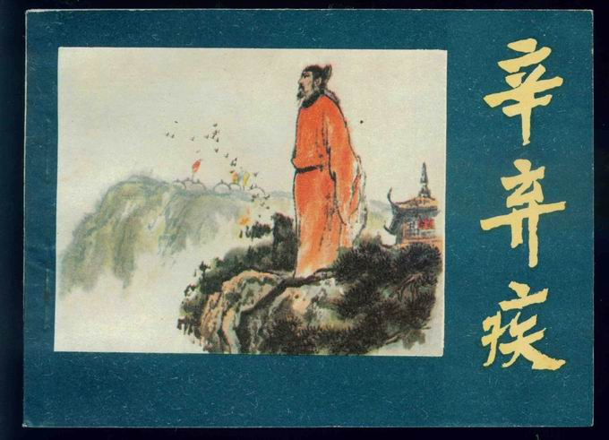
Xin Qiji

Slide 19
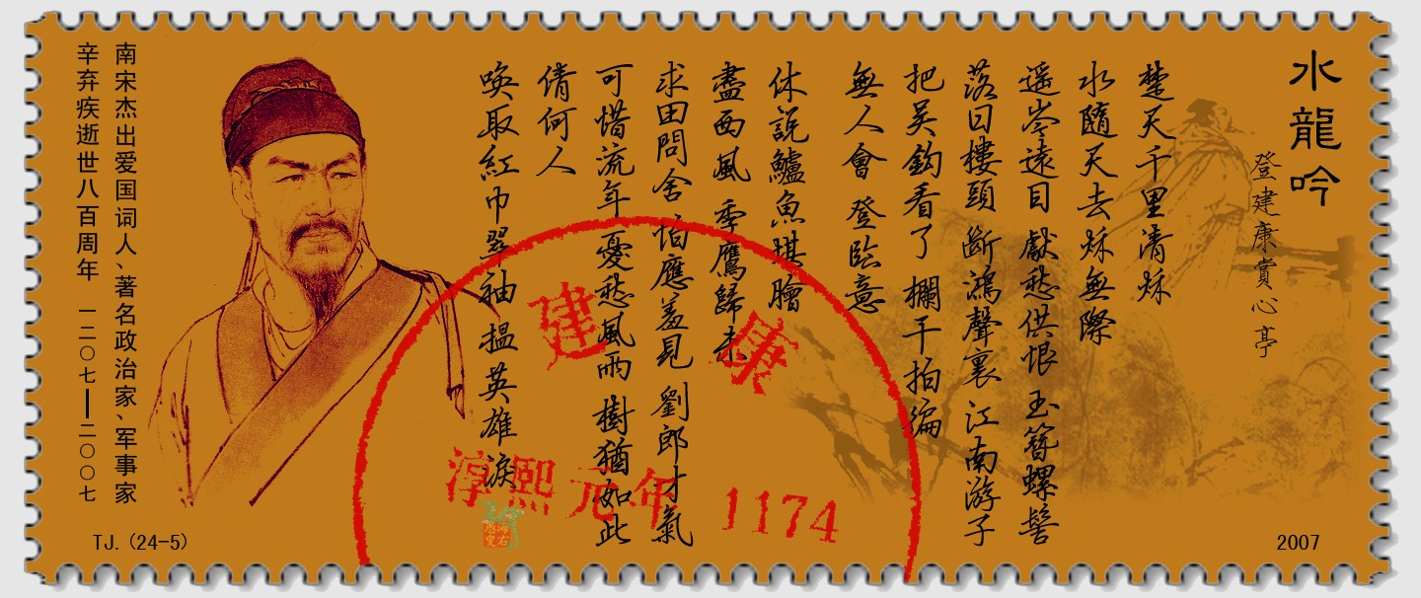
Xin Qiji and his poem

Slide 20
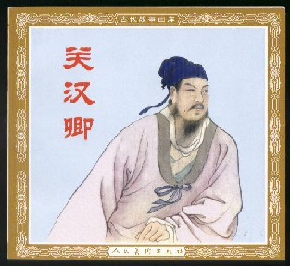
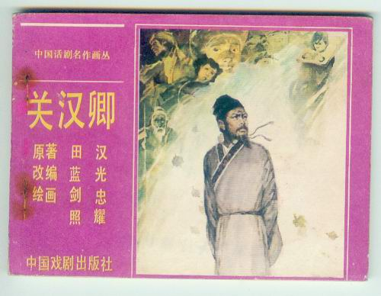
Guan Hanqin and Guan Hanqin by Tian Han

Slide 21
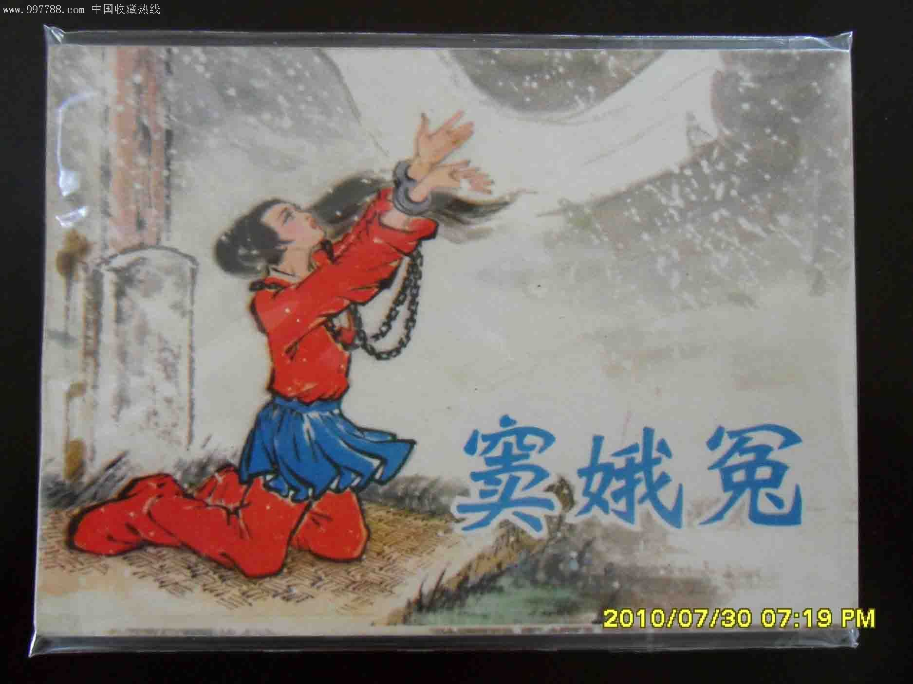
The Wrongs Suffered by Dou E

Slide 22
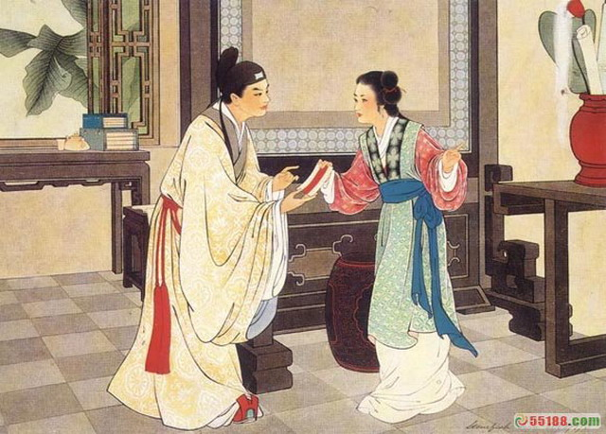
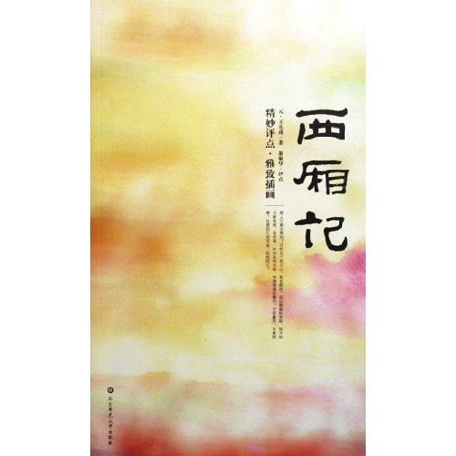
Wang Shifu’s masterwork and an illustration

Slide 23
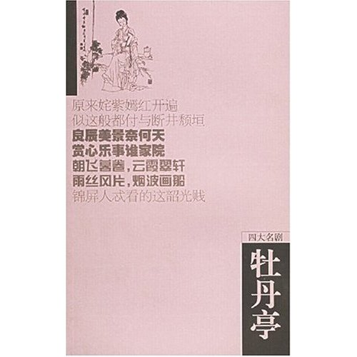
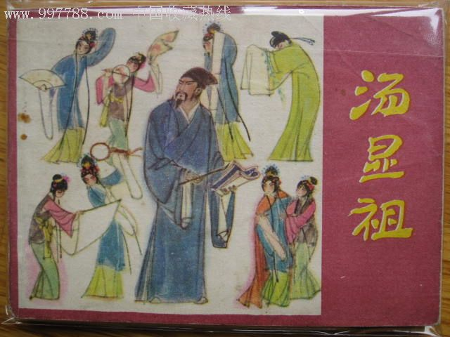
Tang Xianzu and his masterwork

Slide 24
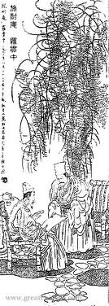
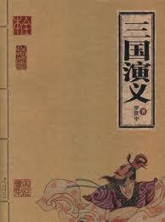
Luo Guanzhong and his masterwork

Slide 25
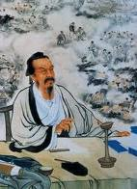
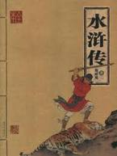
Shi Nai-an and his masterwork

Slide 26
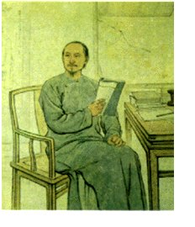
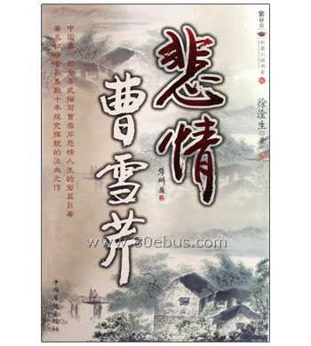
Cao Xueqin and his biography

Slide 27
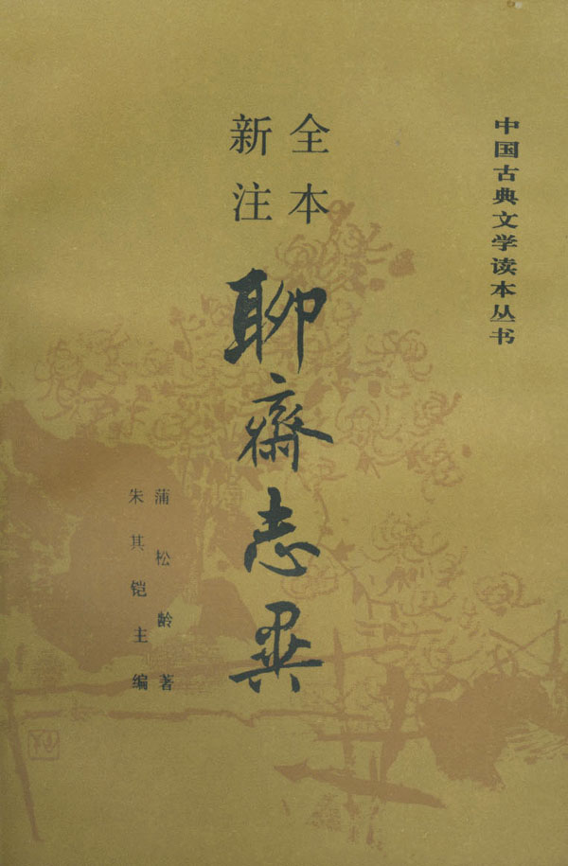
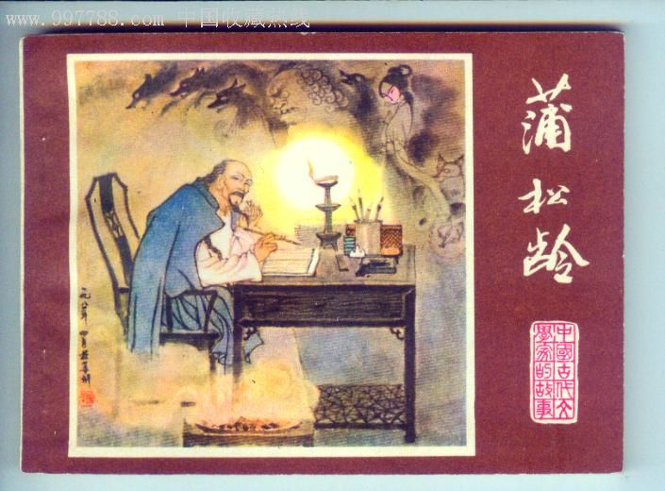
Pu Songlin and his masterwork

Slide 28
Questions Concerning Section B Modern Literature
1. What does modern Chinese literature mean?
2. Under what circumstances was progressive literature born? Who were the representative writers of progressive poetry?
3. What are “the 4 great novels of exposure”?
4. Who were the leading translators in the late 19th century? What works did they translate?
5. How did Beijing Opera become a “national opera”?

Slide 29
Questions Concerning Section B Modern Literature
6. What movement marked the division of modern literature into 2 stages? What are the 2 stages?
7. Who are the representative writers of revolutionary literature? What are their masterworks?
8. What does the League of Left-wing Writers mean? What important works did they produce?
9. What role did Mao’s “Talks at the Yan’an FLA” play in revolutionary literature during the 1937-1945 War? Who were some of the well-known communist writers?

Slide 30
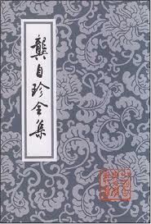
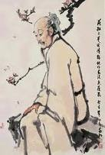
Gong Zizhen and his complete collection

Slide 31
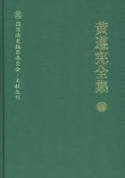
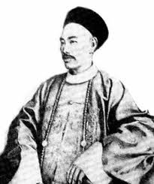
Huang Zunxian and his complete collection

Slide 32
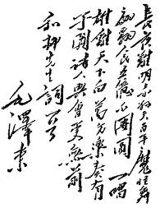
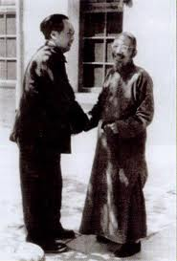
Liu Yazi and Mao’s poem in reply

Slide 33
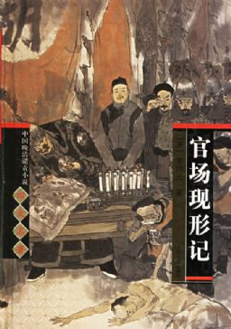
Li Boyuan’s masterwork

Slide 34

Wu Jianren’s masterwork

Slide 35


Liu E’s calligraphy and Zeng Pu’s masterwork

Slide 36


Yan Fu’s translations and his biography

Slide 37


Lin Shu’s portrait and his collection

Slide 38


Lu Xun & a commentary

Slide 39



Lu Xun and his birthplace

Slide 40


Guo Moruo & his calligraphy

Slide 41


Guo and his drama

Slide 42


Mao Dun and his works

Slide 43


Lao She and his works

Slide 44


Zhao Shuli and his works

Slide 45

D. Selected Tang Poems

Slide 46
A brief introduction
這是一首以年輕商婦的愛情與相思為題材的敘事抒情詩，以女子自述的口吻、回憶的形式，娓娓叙述了她自童年、成婚到別離相思的過程以及对未來的想望。全詩充滿了女子溫柔、深厚而又熾熱、奔放的感情，透過李白敏銳的藝術眼光、高度的文學技巧和豐富的想像力成功地呈現出來。该詩分為童年生活、婚姻生活、別後相思與未來期盼四個部分。

Slide 47
Translation Exercises
建安是东汉末年汉献帝的年号，即公元196—220年。这时期的政治大权完全操纵在曹操手里。所以那时的文学领袖都是曹家人物。著名的七位诗人建安七子也大都死于建安年间，故称这时期为建安文学。
曹操平定冀州后，文学的发展获得了一个相当宽松的社会文化环境，文学士人在建功立业的同时创作出许多表现时代精神、反映时代生活、展现时代风貌的作品，使得建安时期成为我国历史上第一个真正意义上的文学繁荣时期。

Slide 48
Translation Exercises
庞德几乎不懂汉语,他从事汉诗的翻译也纯属偶然。1912年, 他正在潜心研究意象诗，遇到了美国学者菲诺洛萨(Fenollosa)的遗孀玛丽。菲诺洛萨曾多年从事东方文学研究，留下很多未完成的手稿。她正在寻找帮助整理和出版菲诺洛萨有关日本戏剧和中国诗词手稿的人选。庞德想借此吸取一些东方文化的精髓，便同意帮助整理和出版菲诺洛萨的手稿。1913年底，玛丽将菲诺洛萨的十七本笔记和一些手稿交给庞德，随后庞德相继出版了英译中国古诗集《华夏》(1915)等。庞德只收录了李白《长干行》的前一首，也许根本不知道原诗是由两首组成。

Slide 49
Further Readings
乌衣巷：朱雀桥畔长满了野草，到处盛开着一簇簇的野花。黄昏时刻，夕阳西下，乌衣巷内一片幽暗。那些曾经在王导和谢安的高楼华屋中筑巢的燕子，如今都飞到普通百姓家中去了。
乌衣巷在秦淮河南岸，三国时是吴国镇守石头城部队的营房所在地。当时军士都穿黑色制服，故称“乌衣巷” 。后为东晋时名门望族的聚居区，开国元勋王导和指挥淝水之战的谢安都住在这里。
如今时过境迁，昔日繁华已如落花流水不复存在了。全诗抒发的是一种物是人非、沧海桑田的感慨，诗人选用了意蕴深刻的意象：野草、斜阳、飞燕。燕子彼时飞入侯门，如今那侯门深宅已成了百姓家，飞燕成为历史的见证人。全诗含蓄隽永，耐人寻味。

Slide 50
Further Readings
金缕衣：我劝诸君不要太珍惜那华贵的金缕衣，我要劝诸君应当爱惜青少年时代的青春年华。如同鲜花盛开之时应该及时摘取一样，切莫要枝上无花之时再去摘取，那可就要落空了。
上联用赋，下联用喻，反复咏叹“珍惜时光”的主题。“千金散去还复来”，而青春却一去不返。
这是中唐时的一首流行歌词。据说镇海节度使李锜酷爱此词，常命侍妾杜秋娘在酒宴上演唱。歌词的作者已不可考，有的选本径题为杜秋娘作或李锜作，是不确的。

Slide 51
Further Readings
默默无语，独自登上西楼，天边月形如勾，在这清寒的秋夜，院子里深锁着梧桐，也锁住了寂寞。心中的思绪，想要减断，却怎样也减不断，想好好梳理，却更加的杂乱，这样的去国之愁，而今在心头上又是另一般不同的滋味。此阙“相见欢应”是后主被掳之后所写，以一个丧国的君主而言，内心的苦楚与怅惘，时时刻刻如影随形，尤其是在萧瑟的秋夜。
首句开门见山，将愁绪直接表达於无言独上楼的情绪中，第二句以月如勾的意象，传述一种孤清与不圆满的遗憾意境，紧紧扣住西楼独处的人，月如勾，人憔悴，一副好不凄凉的景色。第三句用寂寞统领整个情绪，梧桐也寂寞、深院也寂寞，是寂寞锁住了秋，亦或是清秋锁住了寂寞，只因作者的情绪，眼中所见皆是寂寞。梧桐孤立深院的景象，将寂寞与清秋紧扣一起，更增添了秋的萧瑟与作者的孤独。
“剪不断，理还乱”，这样的情绪想要抛开，却怎样也无法割舍，想要好好梳理，却又更加的杂乱。手法上作者利用了对峙的情绪，表达心中的冲突起伏。“是离愁？别是一般滋味在心头”，这样恼人的情绪作弄着人，如今却更有不同的感受在心头酝酿。这背后却隐藏著作者极深的哀痛，在无可奈何的环境中，在离愁的煎熬下，痛极而无泪。

Slide 52
Topics for discussion
1. What do you think of the poems composed by officials banished to Hunan?
2. Who is your favorite Chinese author? How has his\her work impressed you?
3. Why has no Chinese author been granted the Nobel Prize for Literature?

Slide 53
See you next time!

Slide 54

What does classical Chinese literature refer to?

Slide 55


What does pre-Qin literature refer to? What are its masterworks?

Slide 56

What is Sima Qian’s greatest achievement?

Slide 57


Who are the representatives of Jian’an Literature?

Slide 58


What does the golden age of classical poetry refer to? Can you name some of the great poets then?

Slide 59

What’s the greatest literary achievement in the Song Dynasty? What are its two styles? Can you name some of its masters?

Slide 60

Who are the Eight Great Writers of Tang and Song?

Slide 61


What are the greatest literary achievements in the Ming and Qing dynasties? Can you name some of the great Ming dramatists and their masterworks?

Slide 62

What does modern Chinese literature mean?

Slide 63

Under what circumstances was progressive literature born? Who were the representative writers of progressive poetry?

Slide 64

What are “the 4 great novels of exposure”?

Slide 65


Who were the leading translators in the late 19th century? What works did they translate?

Slide 66

How did Beijing Opera become a “national opera”?

Slide 67

What movement marked the division of modern literature into 2 stages? What are the 2 stages?

Slide 68

What role did Mao’s “Talks at the Yan’an FLA” play in revolutionary literature during the 1937-1945 War? Who were some of the well-known communist writers?

