Slide 1
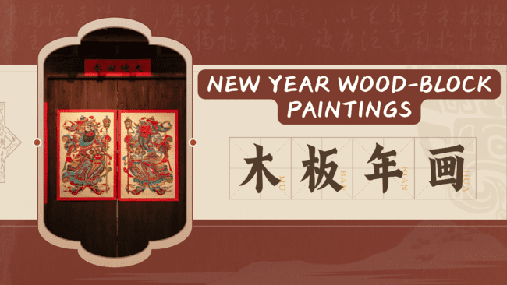

Slide 2
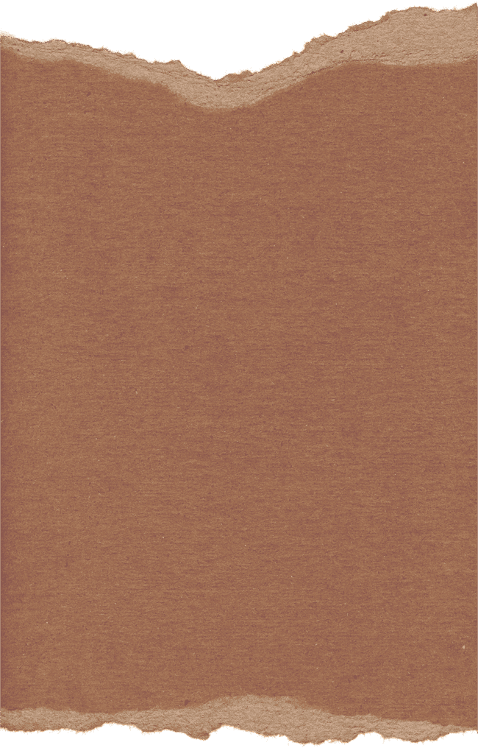
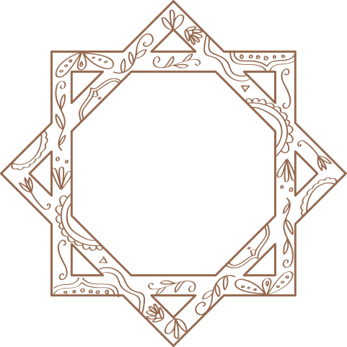
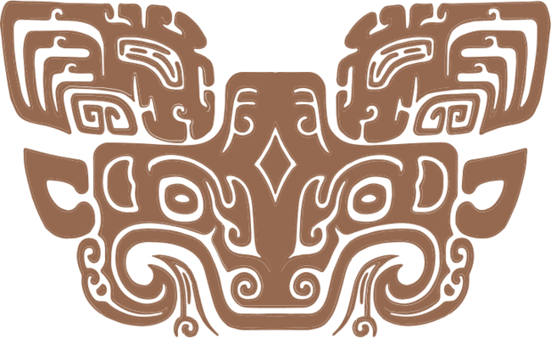

目录
CONTENT
Part1
Part2
贰
Part3
Part4
叁
肆
简介
历史背景
风格分类
当代创新
BRIEF INTRODUCTION
HISTORY
CATEGORIES OF STYLES
Modern Revitalization

Slide 3
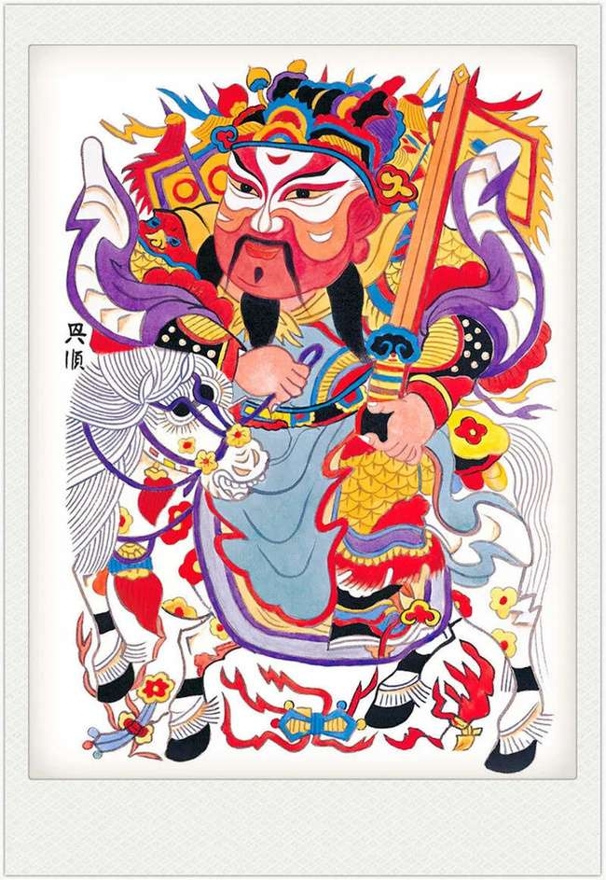



中药源远流长，历经千年沉淀，以天然草本植物为主要成分，具有独特疗效，被广泛运用于中医
Brief introduct
简介

Slide 4

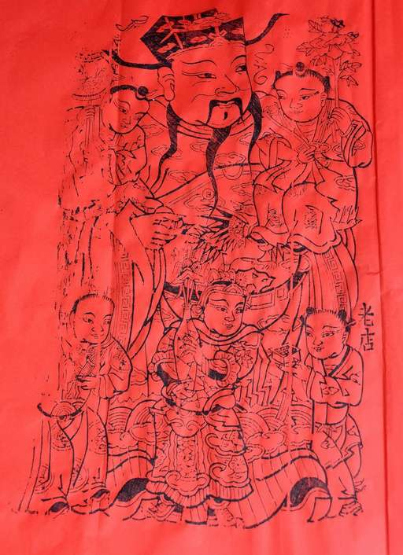
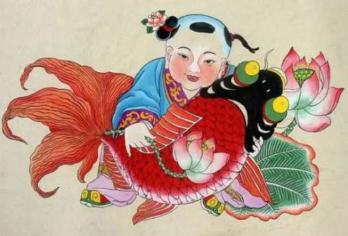
What is New Year Wood-block Painting？
文化本质 | Cultural Essence
主题 | Main theme
Originated from Han Dynasty Door God rituals
Auspicious & Protective
Harvest celebration & Wealth prayers
“Encyclopedia of folk life”

Slide 5
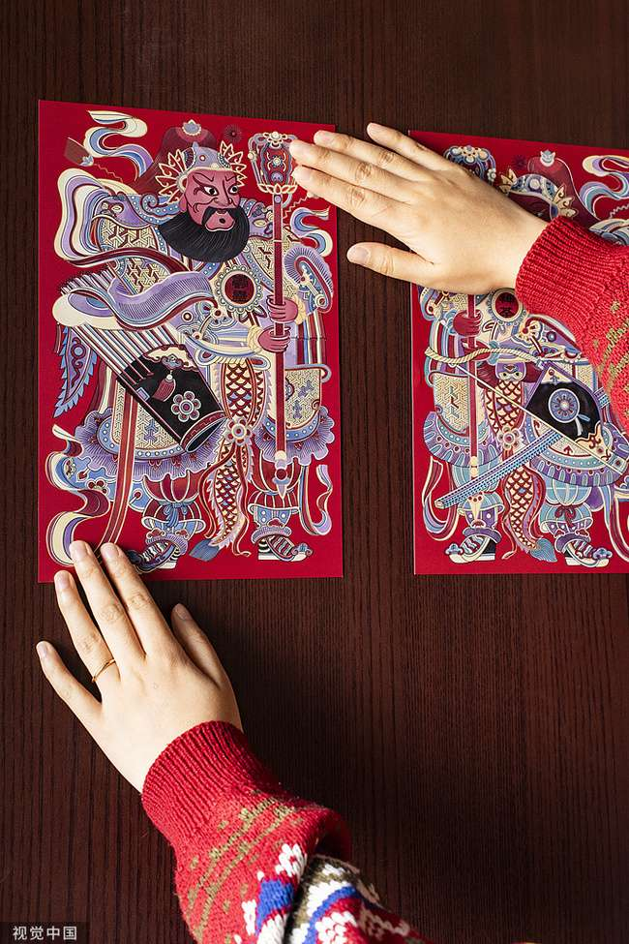
中药源远流长，历经千年沉淀，以天然草本植物为主要成分，具有独特疗效，被广泛运用于中医
History
历史背景

Slide 6

History
Commercialization: Bianliang "Painting Market" emerges
Earliest Existing Work: Four Beauties
Technological Disruption:
Plummeting Demand
Theme Misalignment
Succession Crisis
Prototype of Door Gods: Warding off evil & inviting blessings
Origin
Consolidation Period
Challenges Across Eras
__________
Han
Dynasty
Tang Dynasty
Song Dynasty
Ming-Qing Dynasties
Morden times
Contemporary
Growth Period
Golden Age
Revive
transformation: ”Ancient Craft, Modern Stories“
Foundation of Woodblock Printing (Buddhist scripture printing)
Theme Expansion
Technical Mastery
Different Regional Styles

Slide 7
中药源远流长，历经千年沉淀，以天然草本植物为主要成分，具有独特疗效，被广泛运用于中医
Categories of styles
风格分类

Slide 8
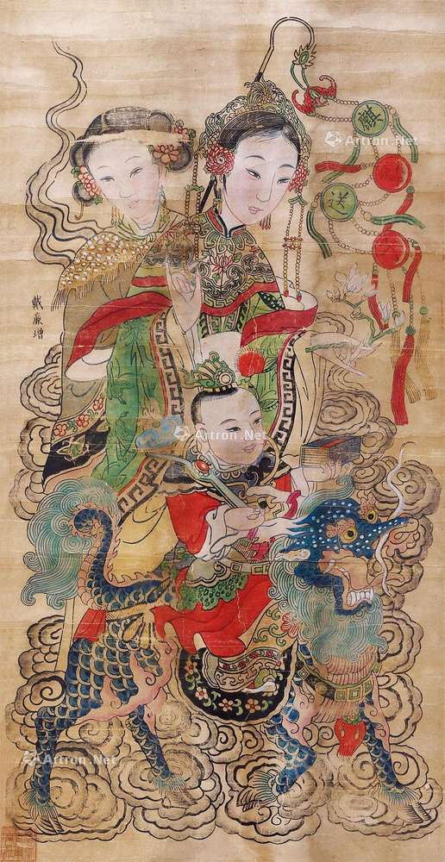
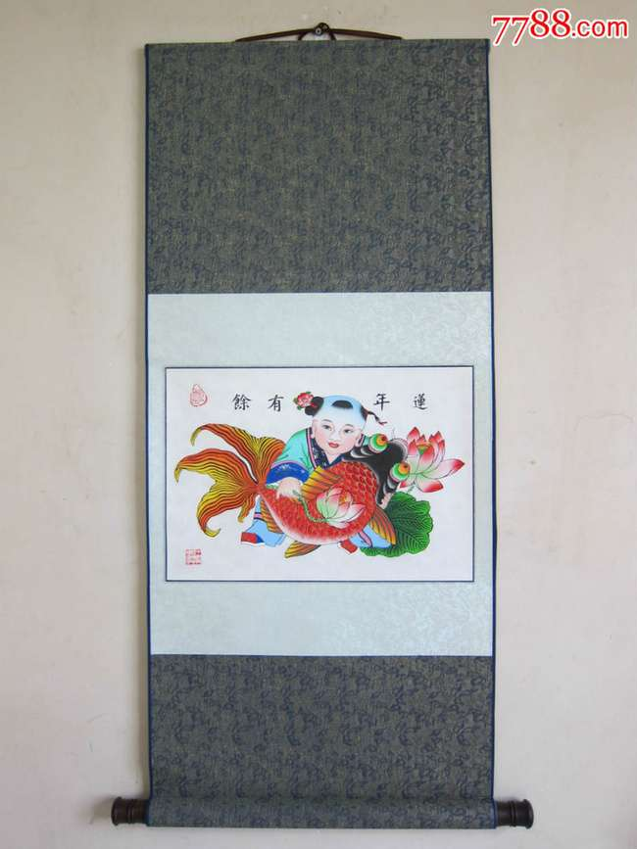
Yangliuqing New Year Wood-block paintings
Feature
Special Crafts
Yangliuqing New Year Wood-block paintings, combine courtly elegance with civilian charm.
They adopt the unique "semi-printed and semi-painted"
Main theme
The themes mainly include children, ladies, and mythical legends. With soft and gorgeous colors, beautiful character modeling, and lifelike expressions, they vividly depict the warm scenes of daily life and people's yearning for a better life, full of rich civilian flavor.

Slide 9
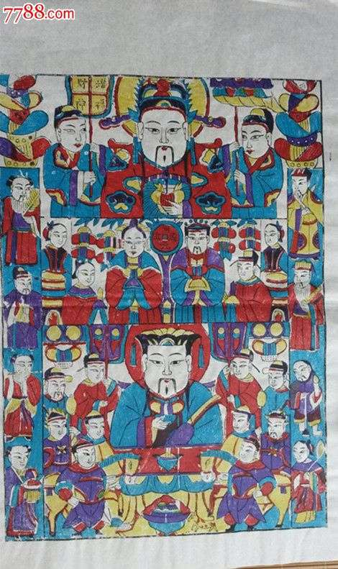
Yangjiabu New Year Wood-block Paintings
Feature
Main theme
They draw their themes from folk legends, mythical stories, and agricultural life, such as The Kitchen God. With exaggerated modeling, simple and bold lines, and strong and vivid colors, they often use highly contrasting colors like red, green, yellow, and purple, full of rich life flavor and simple peasant aesthetics.
Yangjiabu New YearWood-block paintings is known for their rugged simplicity and rich rural flavor.

Slide 10
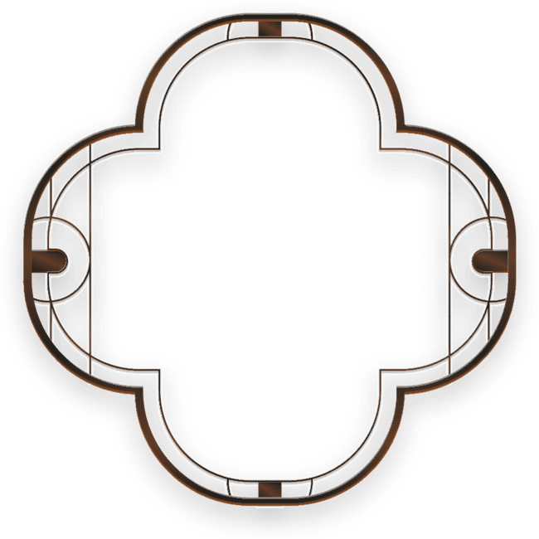
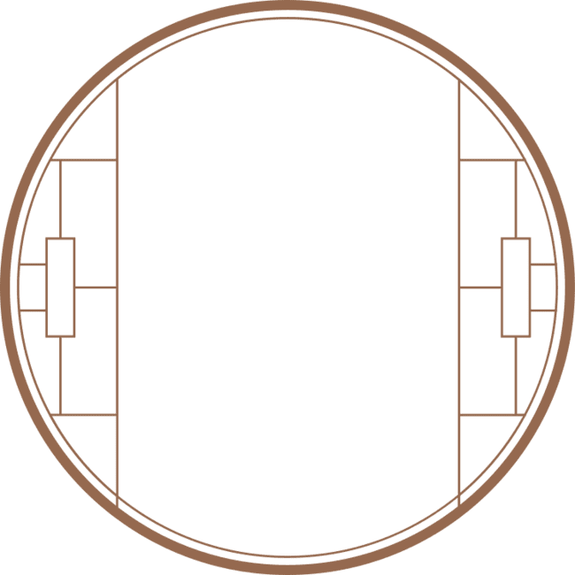
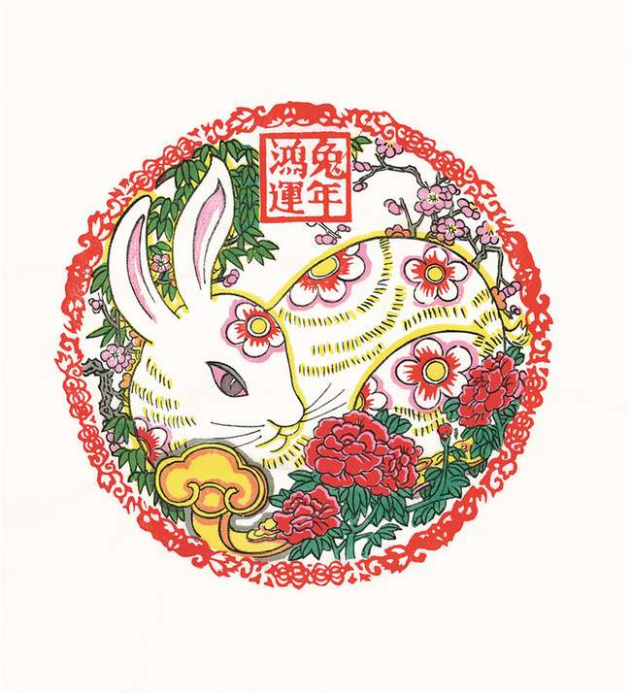

Taohuawu Wood-block New Year Paintings
Feature
1
It is renowned for their delicate and meticulous artistic style. They incorporate the artistic features of literati paintings and prints in the Jiangnan region, with exquisite compositions, smooth and delicate lines, and soft colors. Tones such as light green and light purple are often used, presenting the elegant and gentle characteristics of the Jiangnan water town.
Main themes
2
The themes are extensive, including folk life, historical stories, scenic spots, etc.

Slide 11
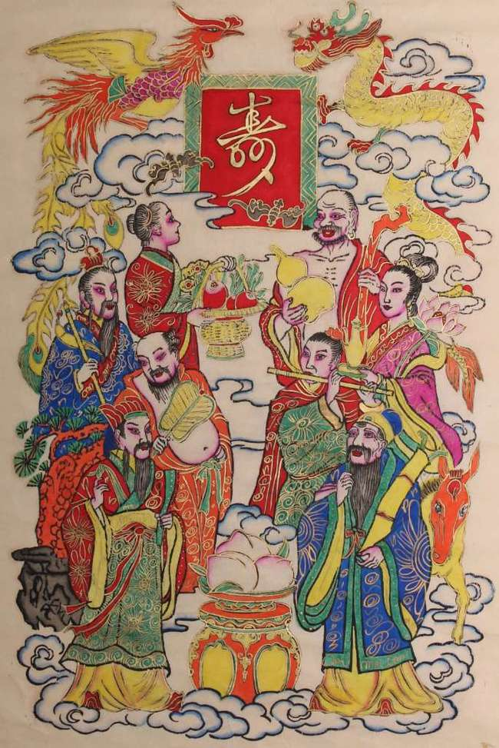
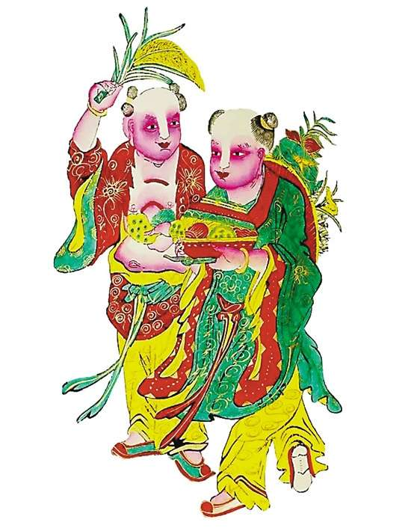
Foshan New Year wood-block paintings
FEATURE
Foshan New Year wood-block paintings in Guangdong have strong regional characteristics. They often use red and black as the base colors
STYLE
Figures: Bold exaggeration & Powerful lines & Sharp contours
Layouts: Compact density & Rich details & Clear focal points

Slide 12
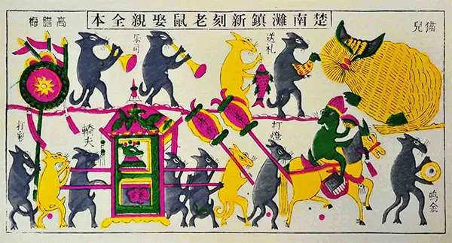
Tantou New Year Wood-block paintings
Style
Embodies Central Hunan's cultural DNA - earthy colors, folk mysticism. They have vibrant and lustrous colors, archaic yet exaggerated forms.
Main Theme
Special Craft
It narrates Hunan's cultural DNA – from ancient shamanistic rituals to ethnic minority legends, capturing the vibrant folk life steeped in local flavor.
The creation of Tantou New Year paintings relies on the use of ancient Tantou paper, a material renowned for its exquisitely complex crafting process.

Slide 13


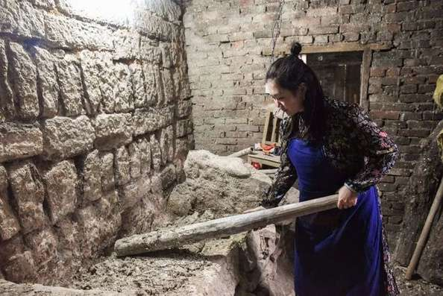
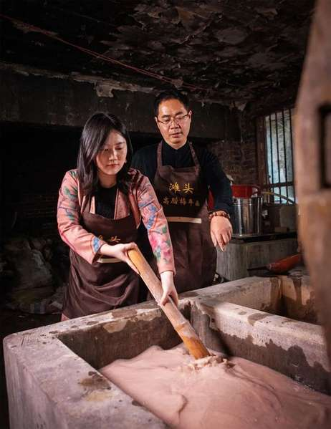
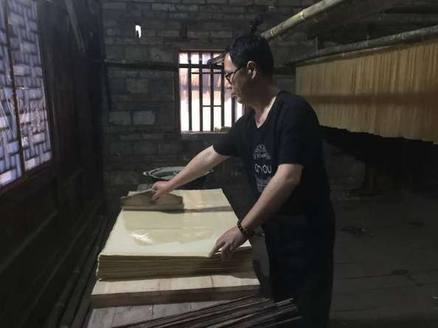
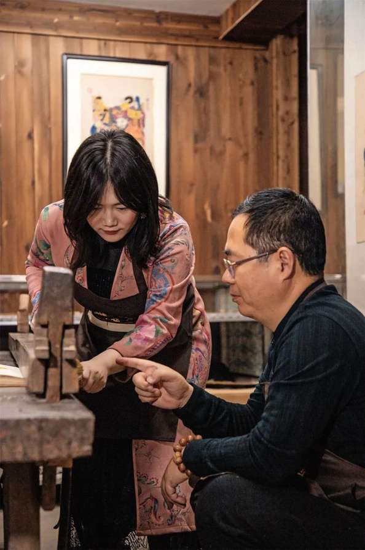
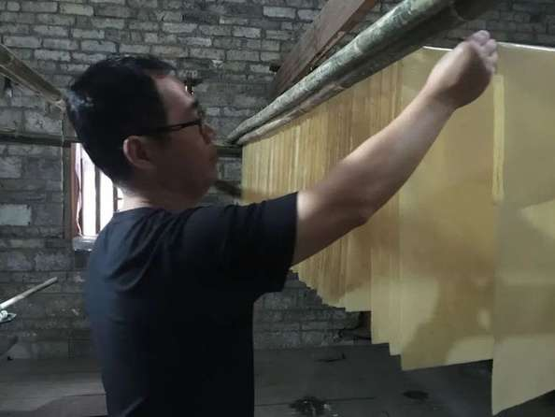
Production Process
Step 1 Papermaking preparation

Slide 14
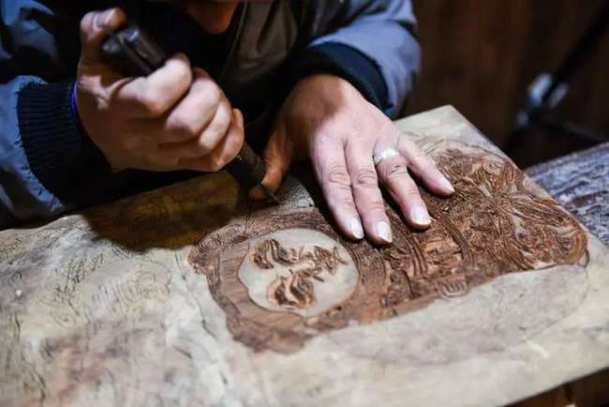
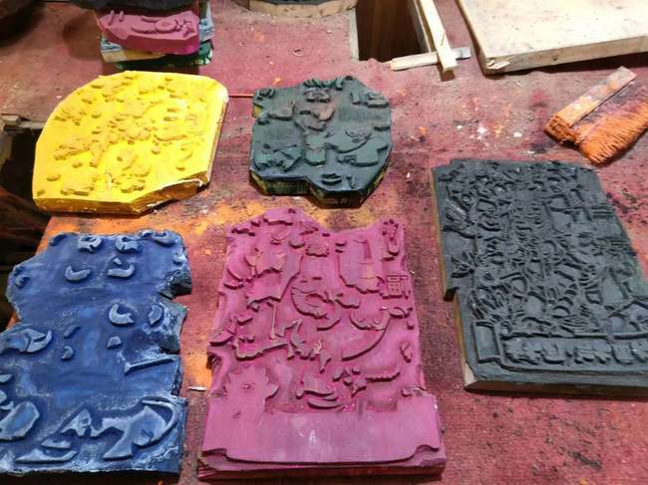
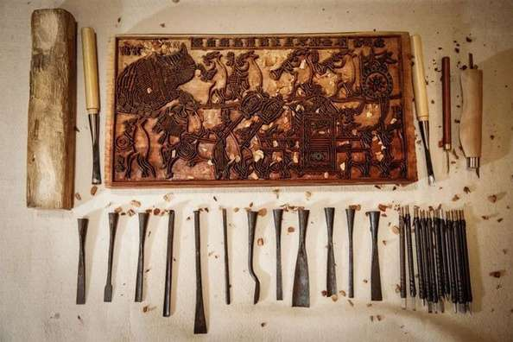
Production Process
Step 2 Woodblock carving

Slide 15
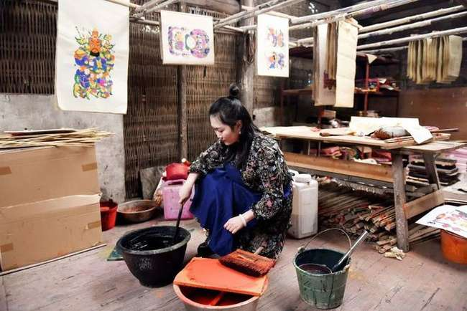
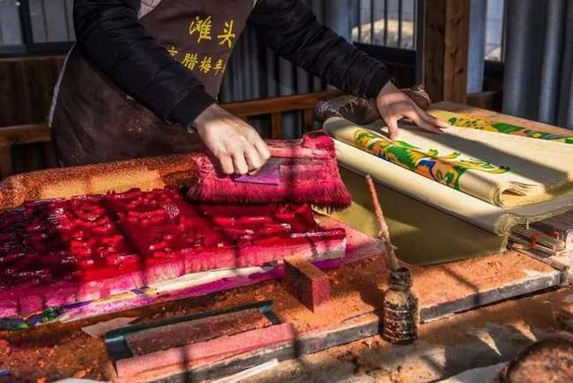
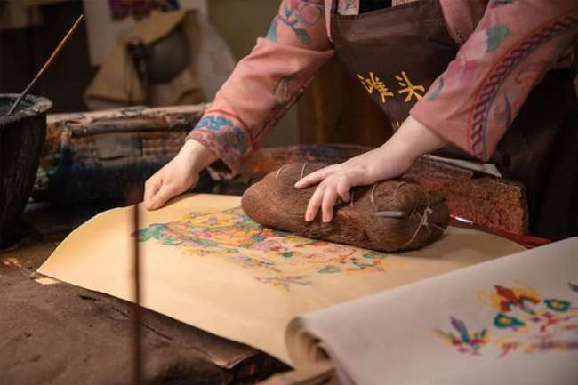
Production Process
Step 3 Color mixing and woodblock overprinting

Slide 16
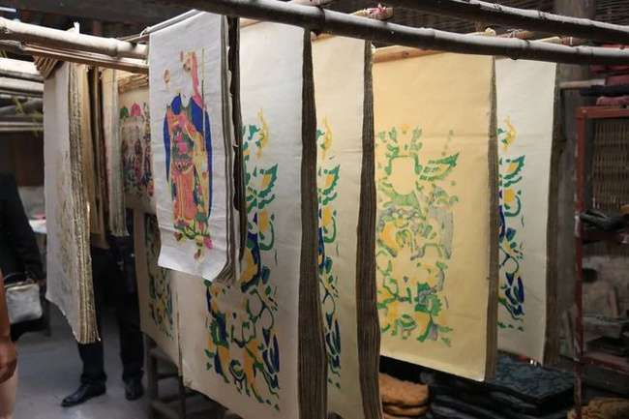
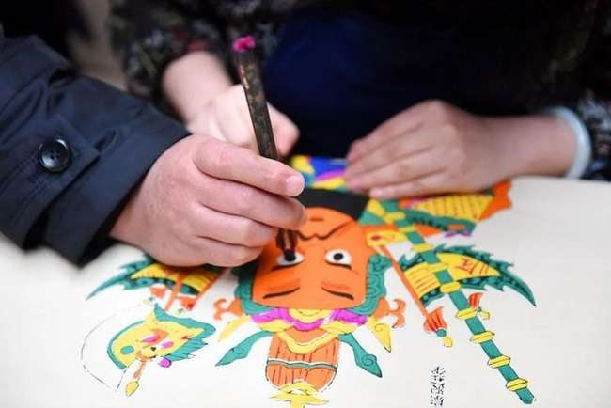
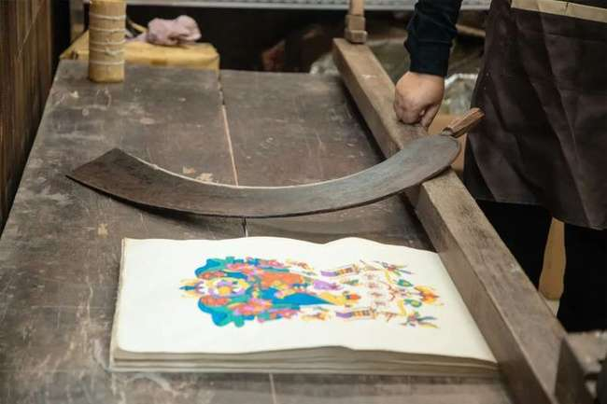
Production Process
Step 4 Facial detailing (painting the eyes) and final product inspection

Slide 17
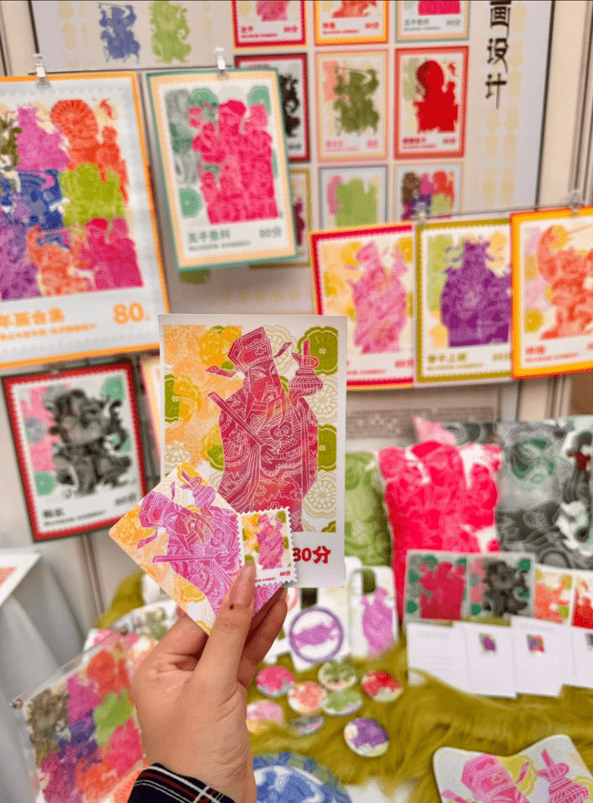
中药源远流长，历经千年沉淀，以天然草本植物为主要成分，具有独特疗效，被广泛运用于中医
Modern Revitalization
当代创新

Slide 18


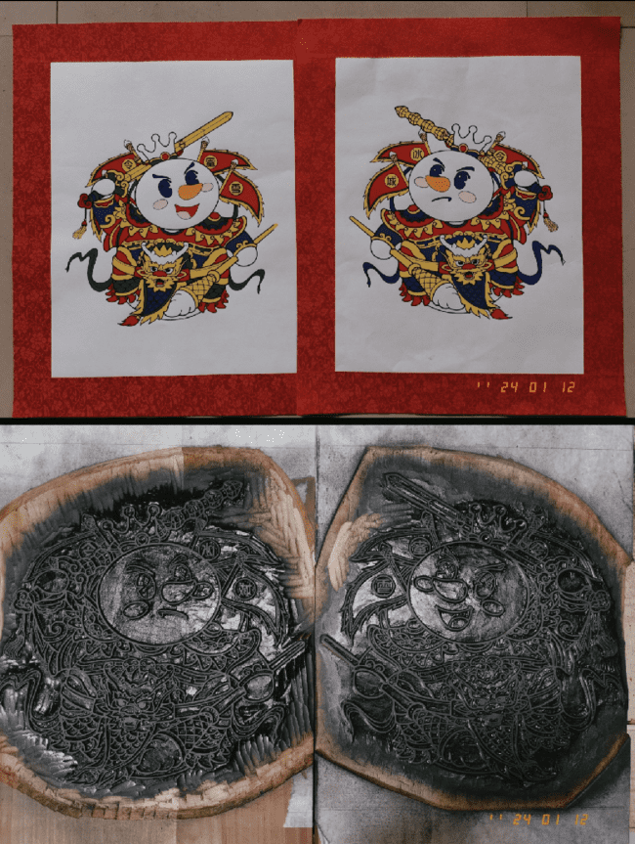

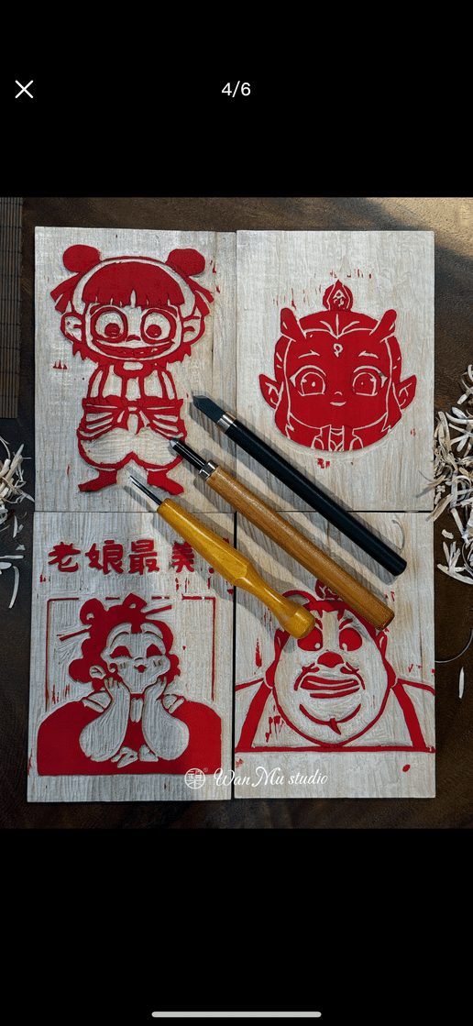
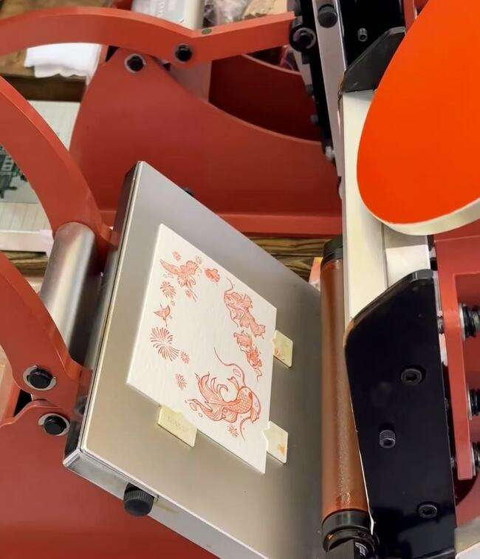
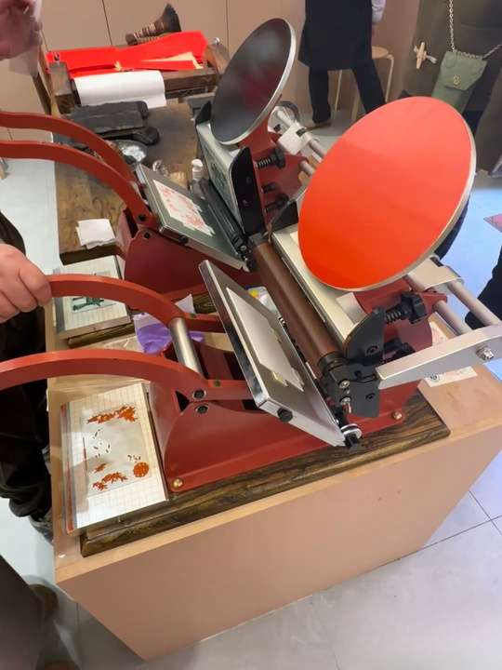



Summary Reflection
Cultural Tourism
IP Crossover
Landmark Stamp Culture:
Huangshan "Welcoming Pine"
Stamp Collection
Brand Collabs:
Mixue Year Print Co-branded Cup Sleeves
DIY Print Kits:
Custom auspicious phrases ( "Success", "Fortune") + heritage toolkit
Trending Co-creation:
Carve pop culture themes (Ne Zha）

Slide 19
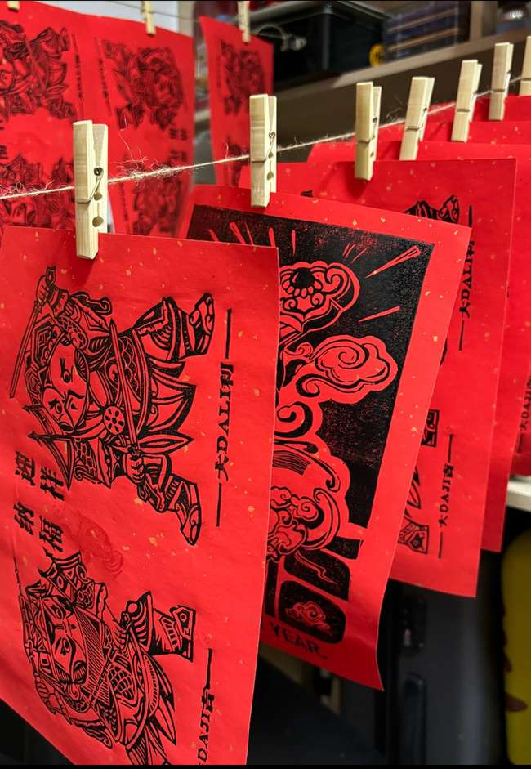
中药源远流长，历经千年沉淀，以天然草本植物为主要成分，具有独特疗效，被广泛运用于中医
Intangible heritage thrives not in museums, but in everyday joy.
THANK YOU FOR WATCHING！

