Slide 1
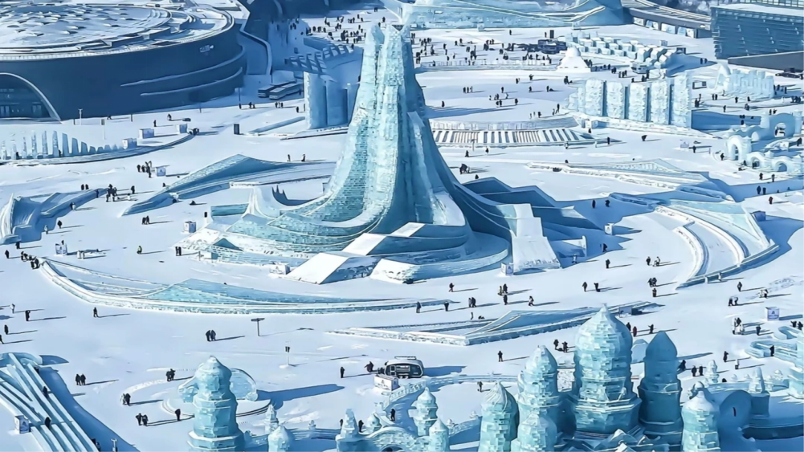
Landscapes and Tourism: Harbin Ice and Snow World
汇报人：韩佳燕

Slide 2
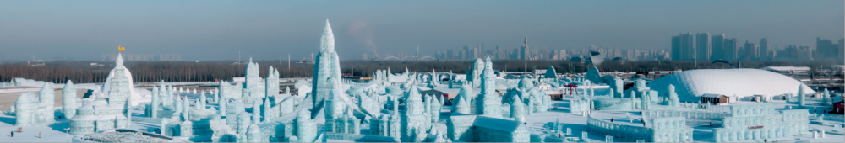
CONTENTS
01
02
03
Introduction
Origins
Blessing Snow Buddha

Slide 3
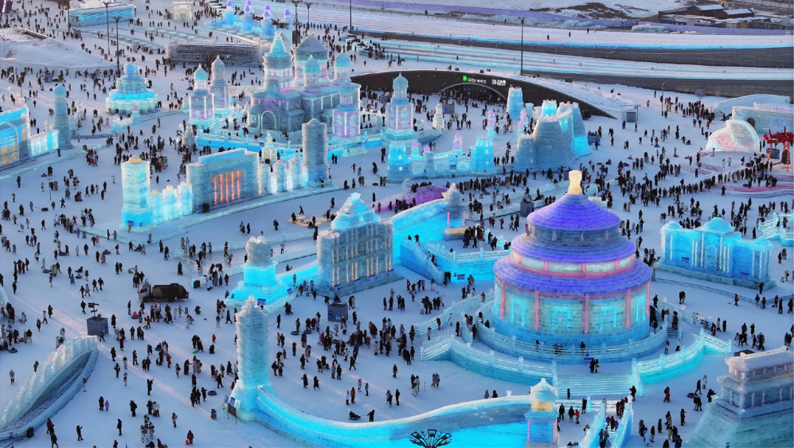
01
Introduction

Slide 4
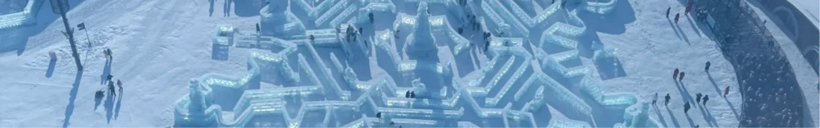
Harbin Ice and Snow World is a large - scale ice - snow art project launched by the Harbin Municipal Government in 1999 to welcome the millennium celebration. It has been successfully held 26 times as of May 2025. Located on the west side of Sun Island in Songbei District, Harbin, it is a world - famous ice - snow theme park.
The park covers a large area and uses a huge amount of ice and snow to build various spectacular ice - snow landscapes, such as the main tower "Ice and Snow Crown", as well as ice - built landscapes like "Ice Piano" and "Fairy - Tale Kingdom". There are also many exciting entertainment projects, such as the super ice slide up to 423 meters long and the snow - circle drifting. At night, the park is illuminated by colorful lights, presenting a dream - like scene. In 2024, it was recognized as the world's largest ice - snow theme park and won the Guinness World Record.

Slide 5
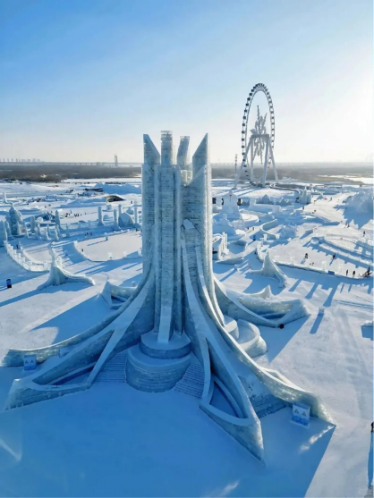
The Crown of Ice and Snow
The main tower of Harbin Ice-Snow World consumes nearly 40,000 cubic meters of ice for its single structure. Adopting sophisticated curved-surface craftsmanship, it stands 42.5 meters tall. The main tower and eight auxiliary towers are arranged in a non-linear and staggered layout, forming a crown shape when viewed from above.

Slide 6
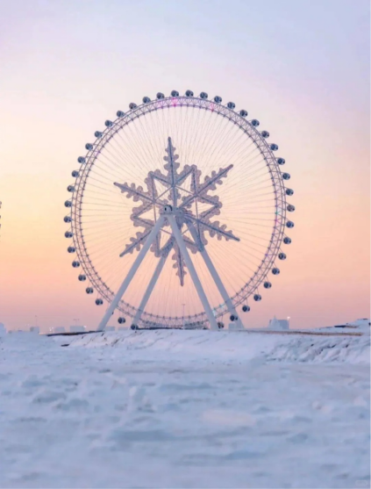
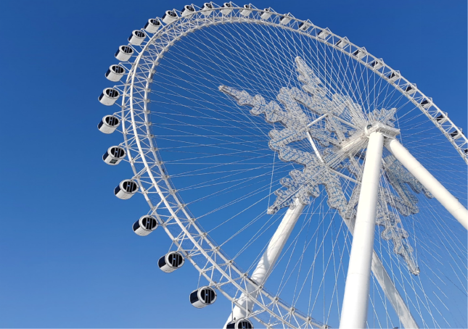
Snowflake Ferris Wheel

Slide 7
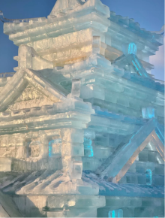
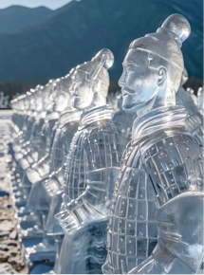
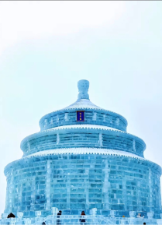
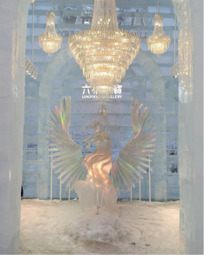
Ice Carving
Traditional Chinese Architecture
Temple of Heaven
Lukfook Jewellery
Terracotta Warriors

Slide 8
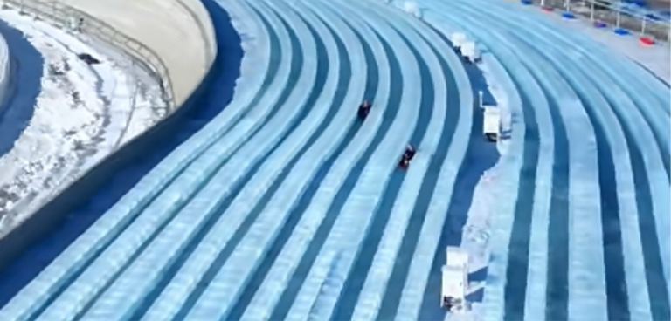
Super Ice Slide

Slide 9
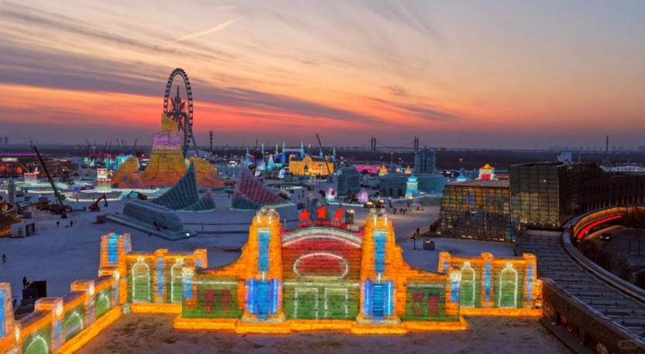
evening view

Slide 10

02
Origins

Slide 11

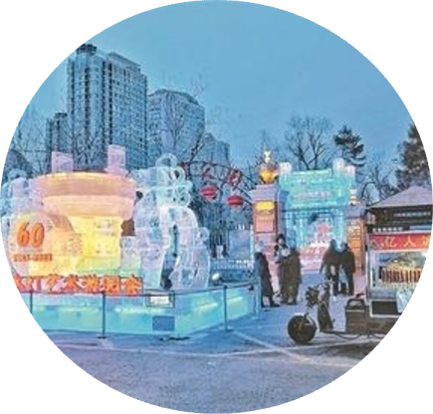
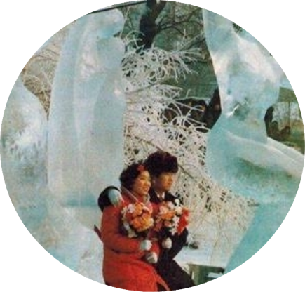
演示文稿是一种实用的工具，可以是演示演讲报告等。大部分时间，它们都是在为观众服务。演示文稿是一种实用的工具，可以是演示，演讲，报告等。大部分时间，它们都是在为观众服务。演示文稿是一种实用的工具，可以是演示，演讲，报告等。大部分时间，它们都是在为观众服务。
Ice Wedding of the 1980s
Ice Lantern Garden Party of the 1960s

Slide 12
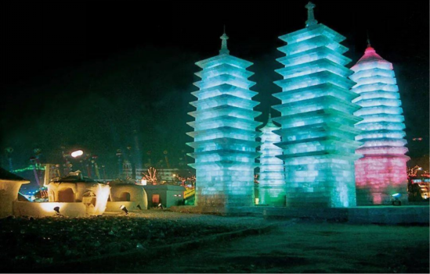
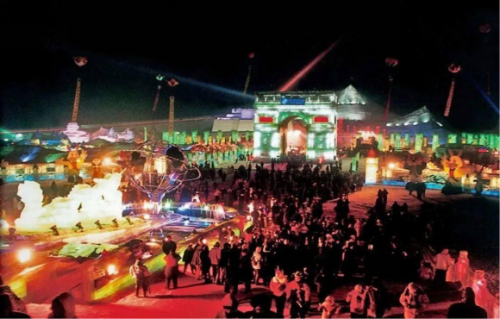
the first Harbin Ice-Snow World of the 1999

Slide 13
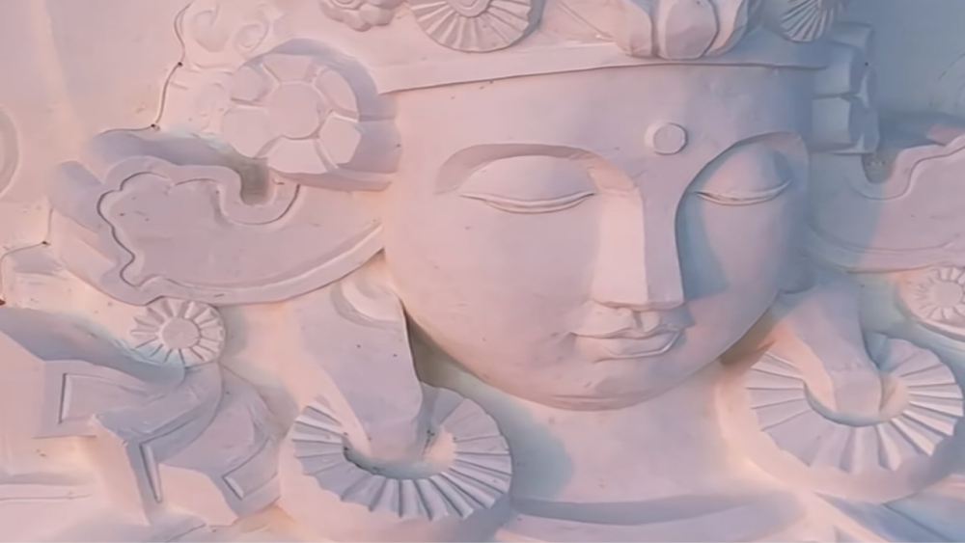
03
Blessing Snow Buddha

Slide 14
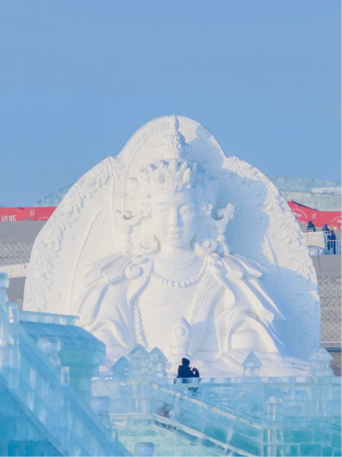
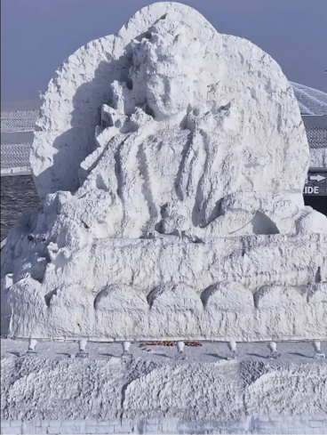
About The Blessing Snow Buddha

Slide 15
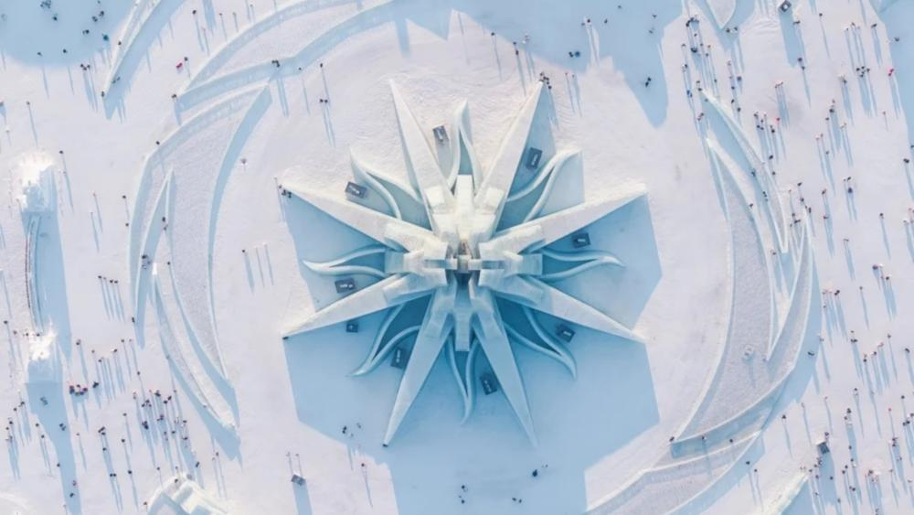
THANK YOU

