Slide 1


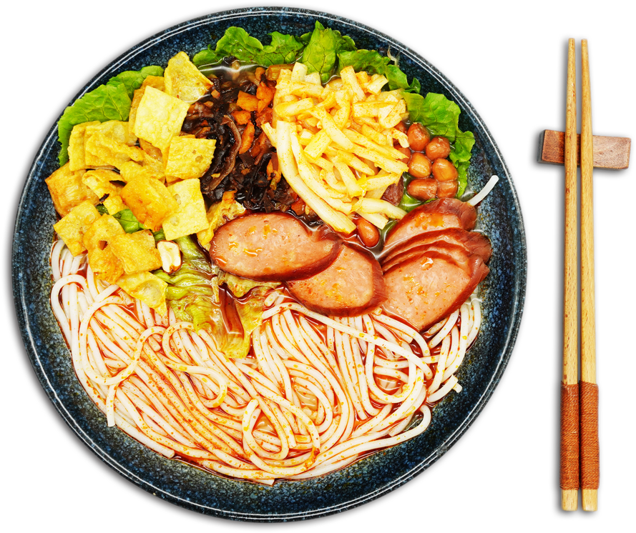
Luo
正宗柳州
si
CHINESE
FOOD
fen
reporter: 熊若瑶

Slide 2

Catalogue
Historical origin
壹
贰
Cooking method
叁
Development

Slide 3
第一部分
Historical origin

Slide 4
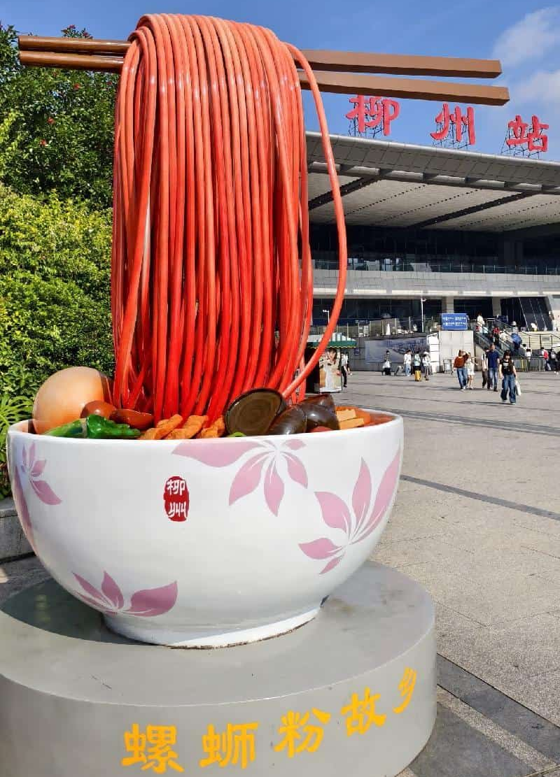


Historical origin
spicy
Liuzhou Luosifen originated in the night markets of Liuzhou, Guangxi, during the late 1970s to early 1980s. Luosifen has gained widespread recognition and entered the public spotlight due to its strong aroma and delicious flavor. While it is increasingly beloved by many, its distinctive smell also leads some to keep their distance. As an online review aptly puts it, “There are only two kinds of people when it comes to Luosifen: those who have never tried it, and those who are addicted.”
flavorful
sour

Slide 5

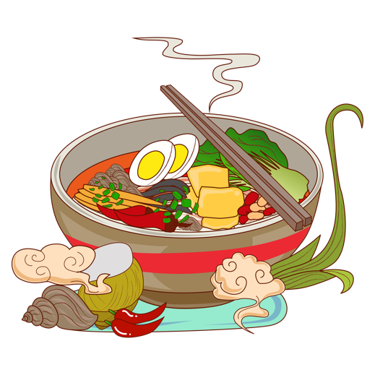
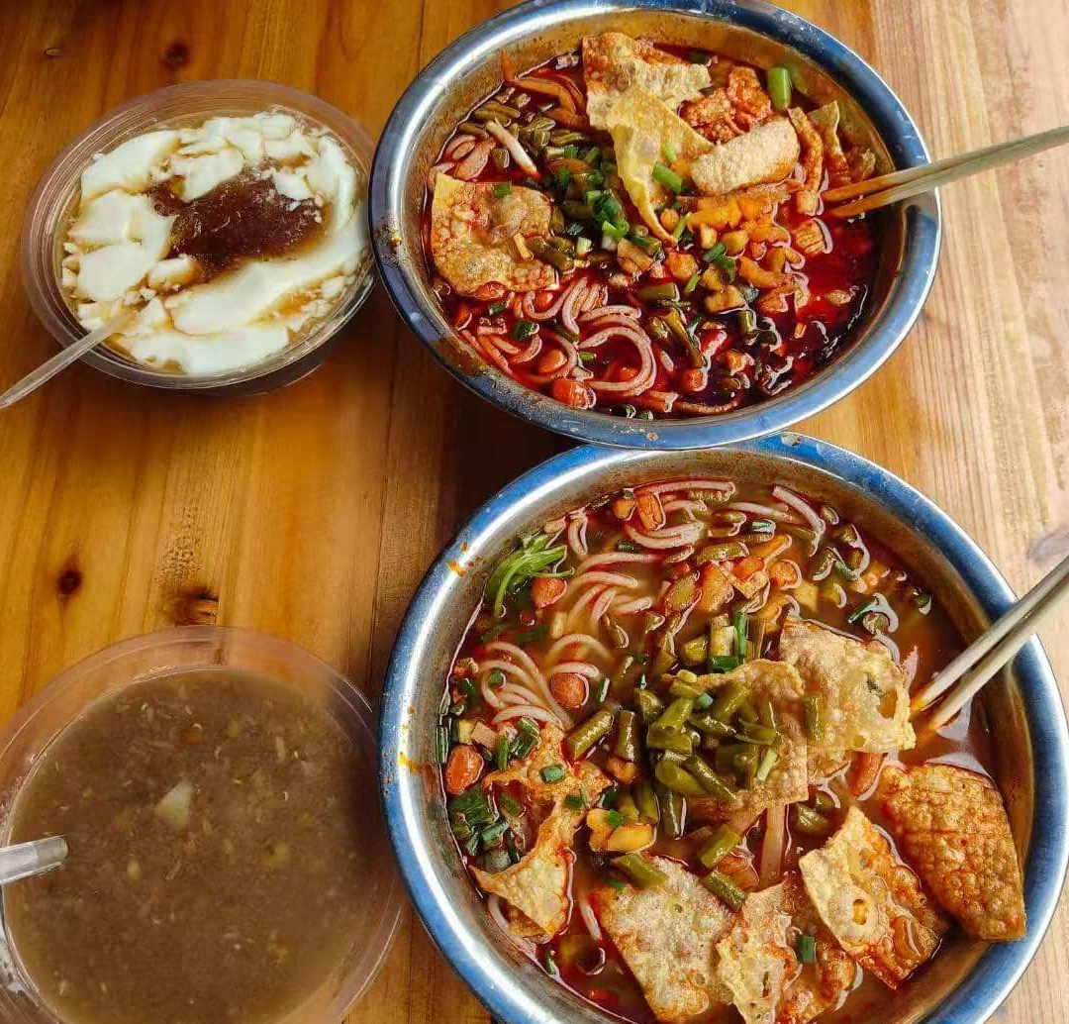
Historical origin
A third account describes a late-night incident in the early 1980s when a noodle stall owner, having run out of bone broth, served rice noodles in leftover snail soup to foreign customers. The recipe was later refined into what is now known as Luosifen.
One story claims that in the mid-1980s, an employee from a grocery store on Jiefang South Road often cooked dry noodles in a neighboring granny’s river snail soup. Inspired by the flavor, Grandma Wang, the snail vendor, began selling Luosifen.
Another theory suggests that during the 1970s-80s, the Gubu Street night market flourished near the Workers’ Theater, with vendors selling both river snails and rice noodles. Patrons spontaneously started adding rice noodles to the flavorful snail broth, creating an early version of the dish.

Slide 6
第二部分
Cooking method

Slide 7
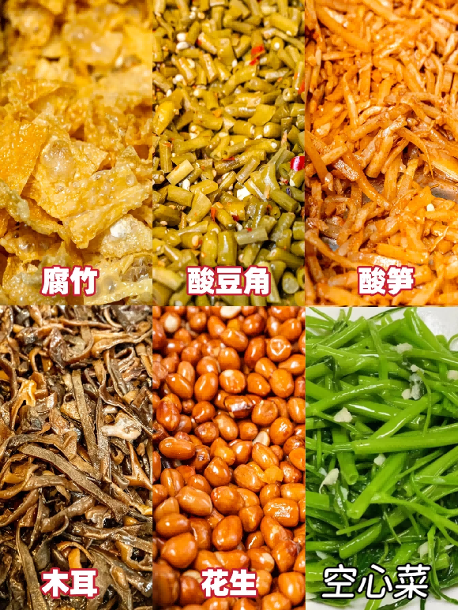
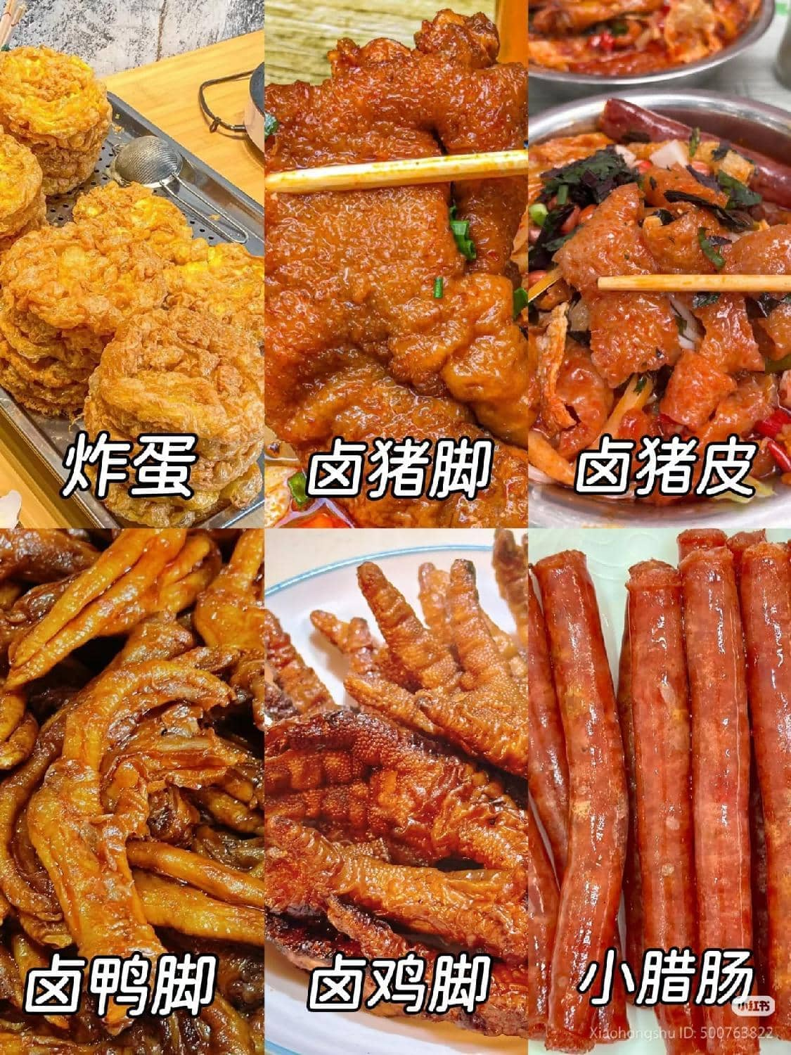
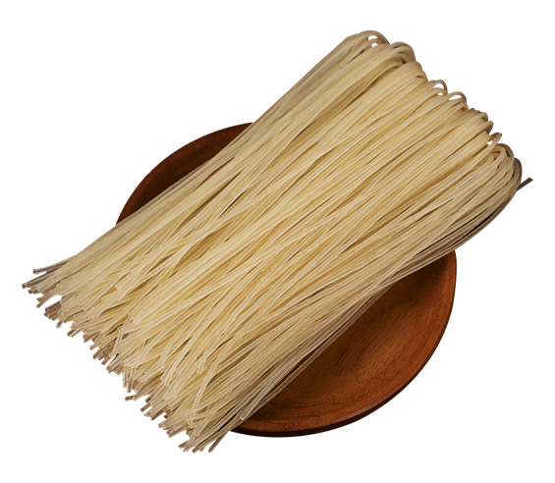
Cooking method
Food materials

Slide 8
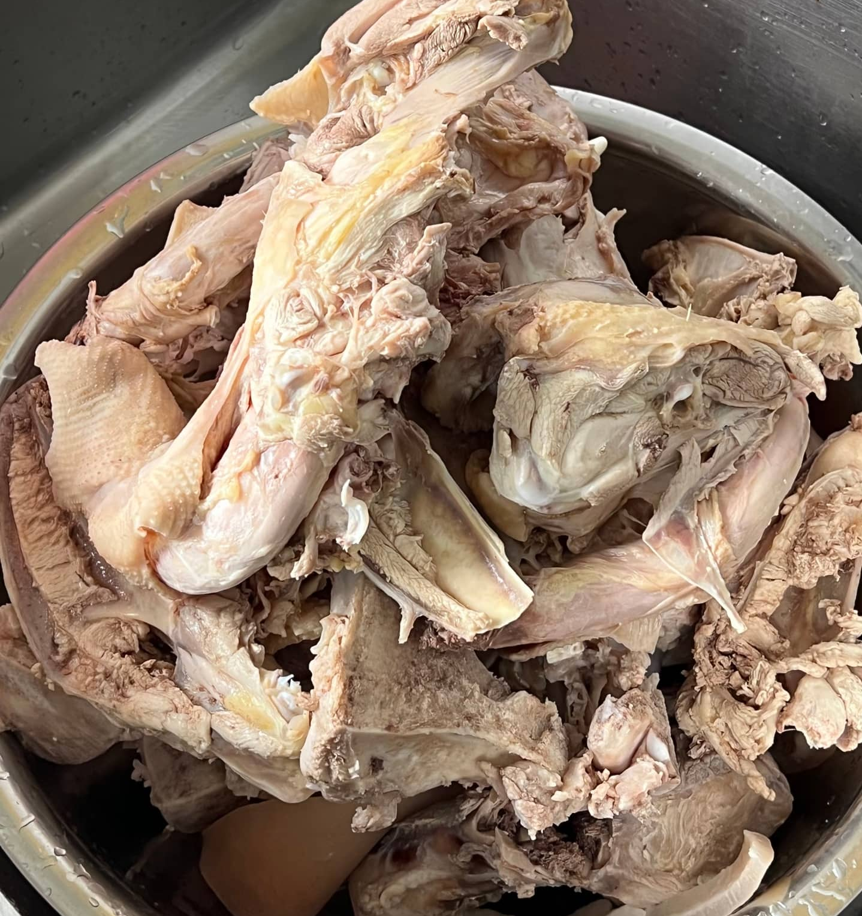
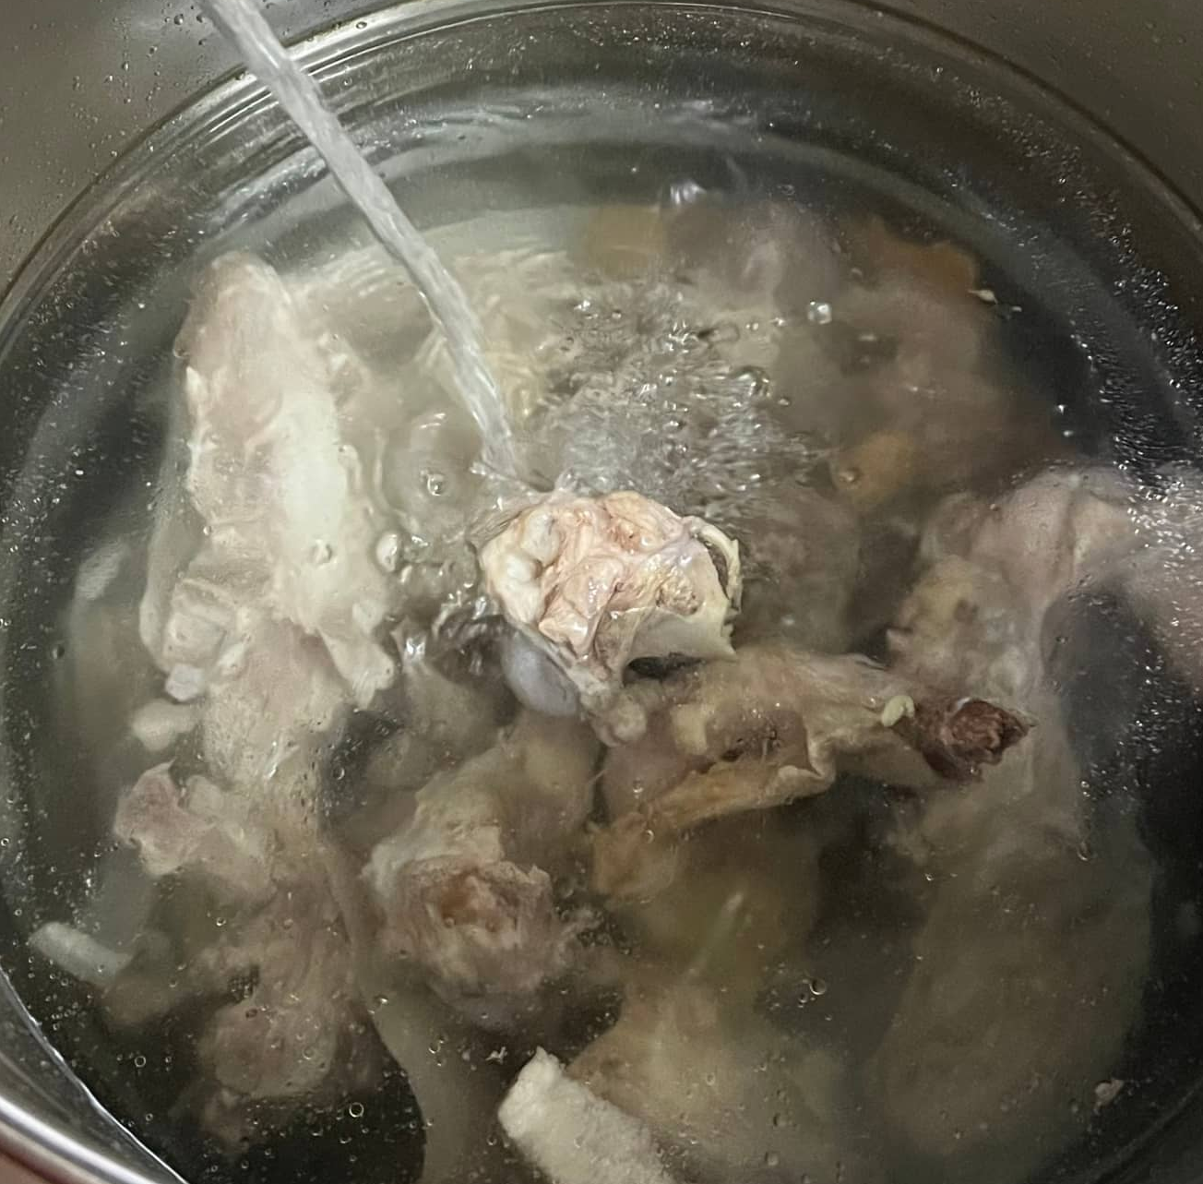
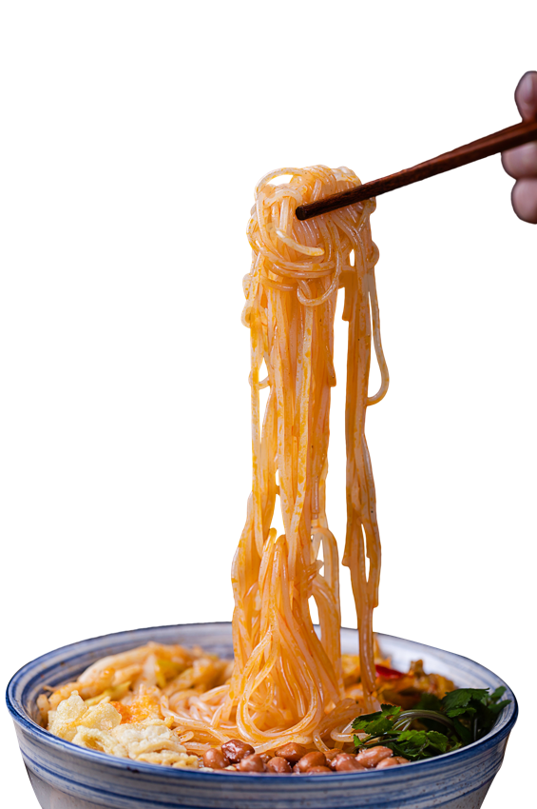
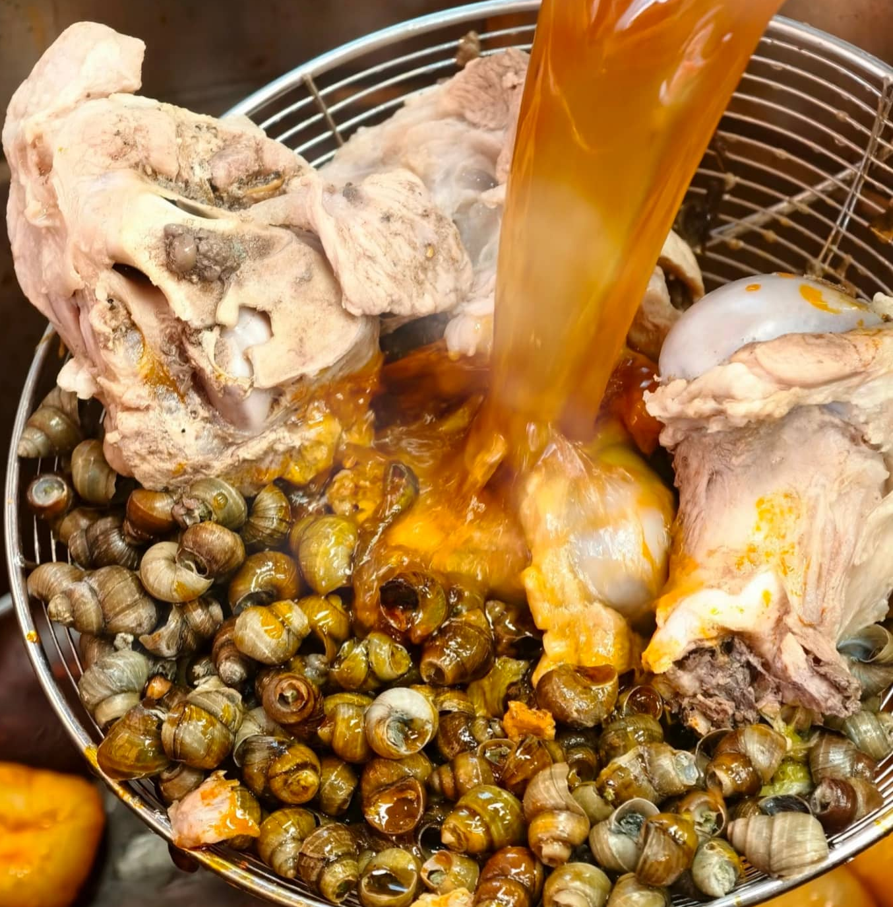
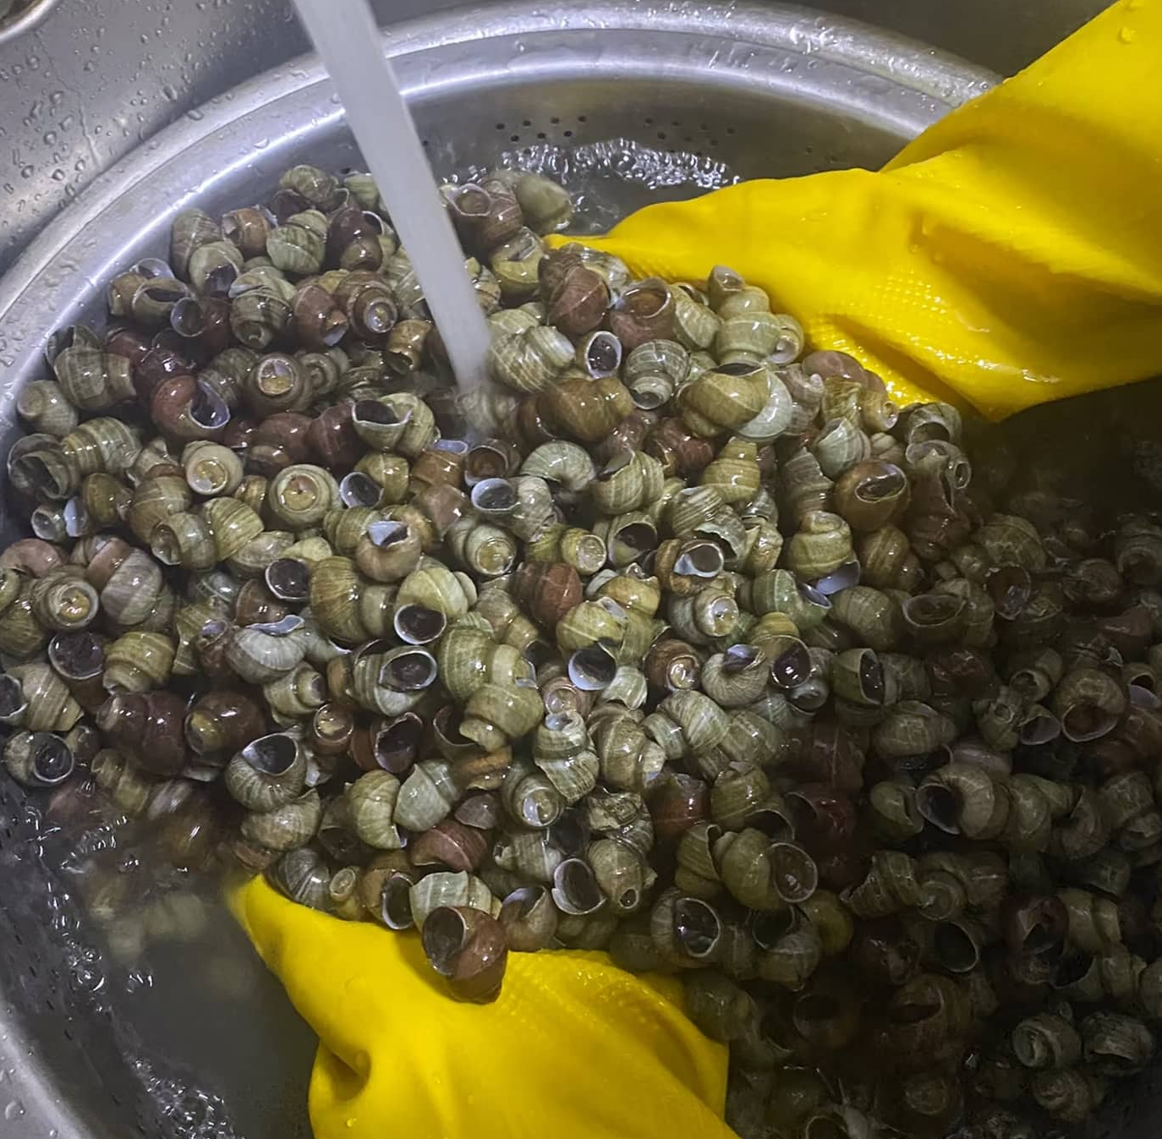
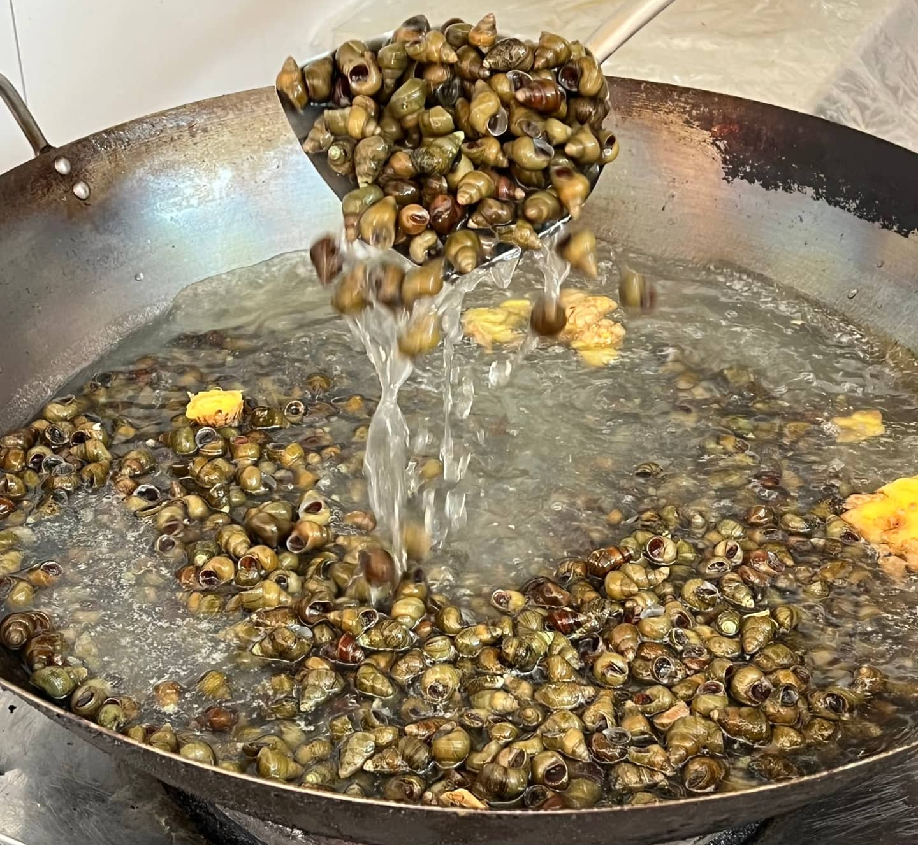
Making steps
Add the pork bones to a pot of boiling water, along with a spoonful of rice wine. Then add shredded pickled vegetables and diced tofu, stir-frying them with a little oil but no salt.
Soak the river snails in water for 1 hour to remove sediment and earthy flavor, then rinse them again.
Cut the lean meat off the pork bones and remove the spine directly.
Simmer the river snails in the broth for a full hour, then pour in the previously prepared chili oil (omit if you prefer a non-spicy version).
螺蛳粉起源
Soup-stock

Slide 9
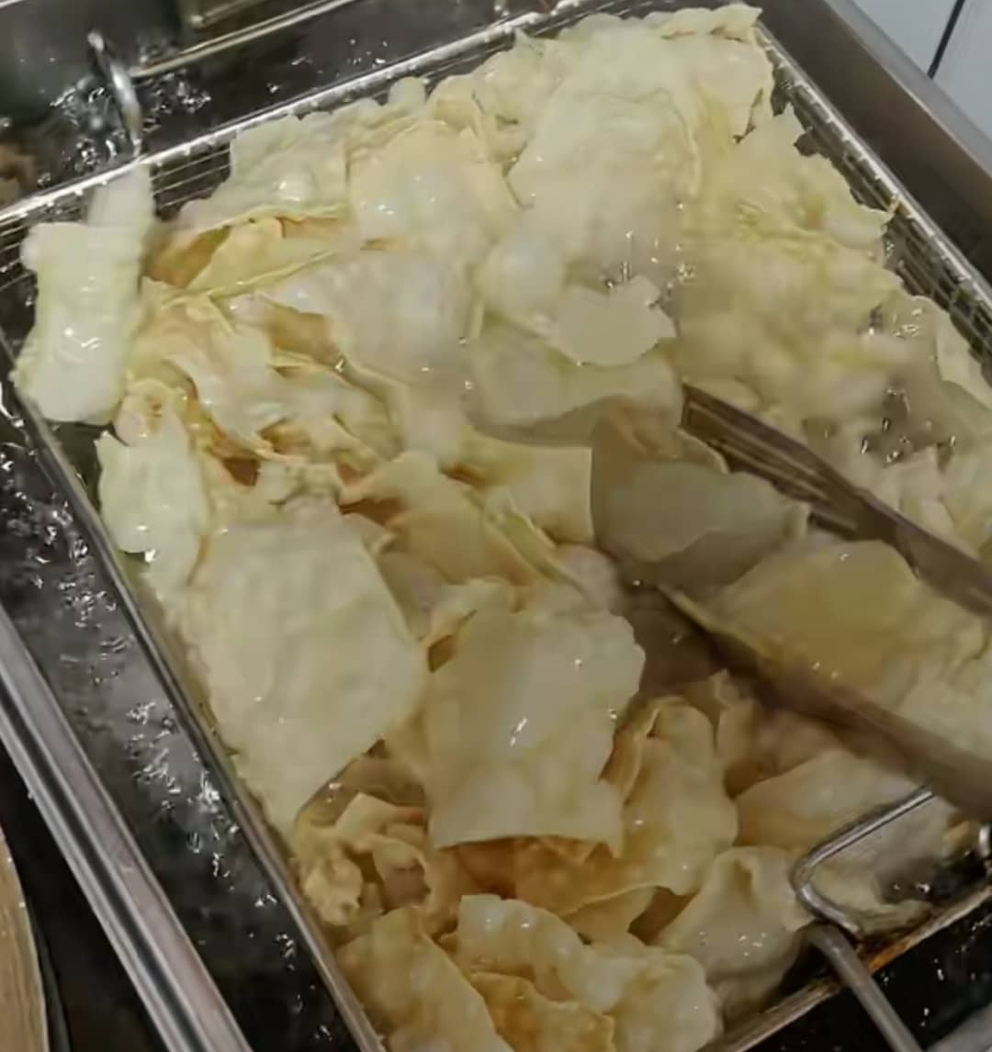
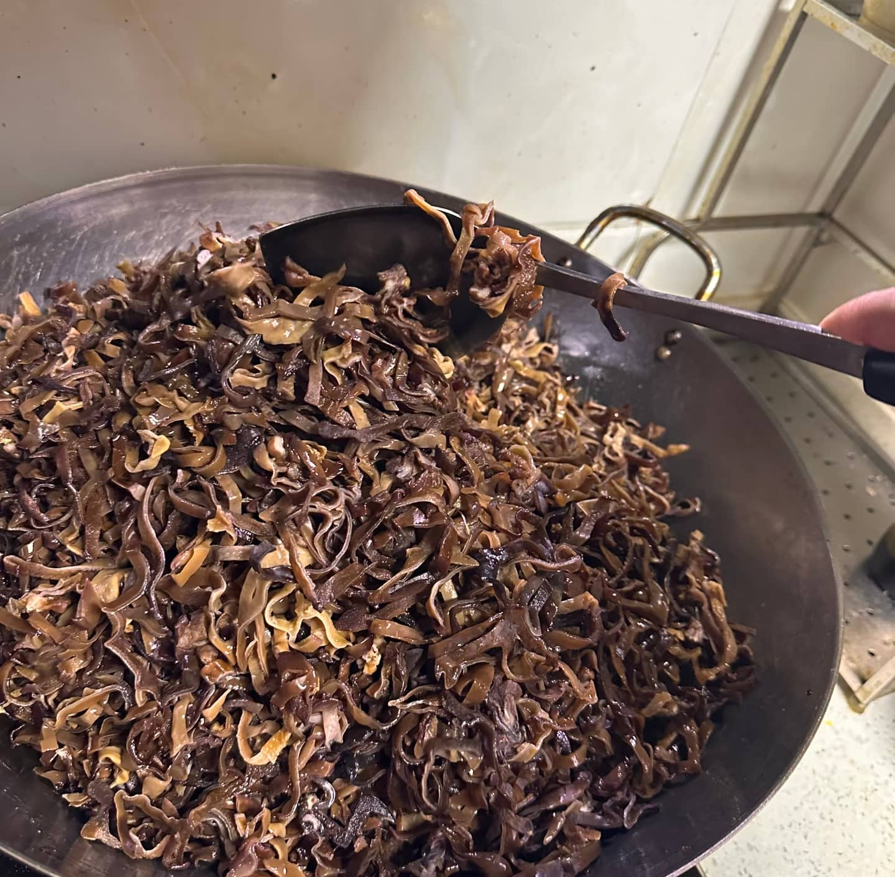
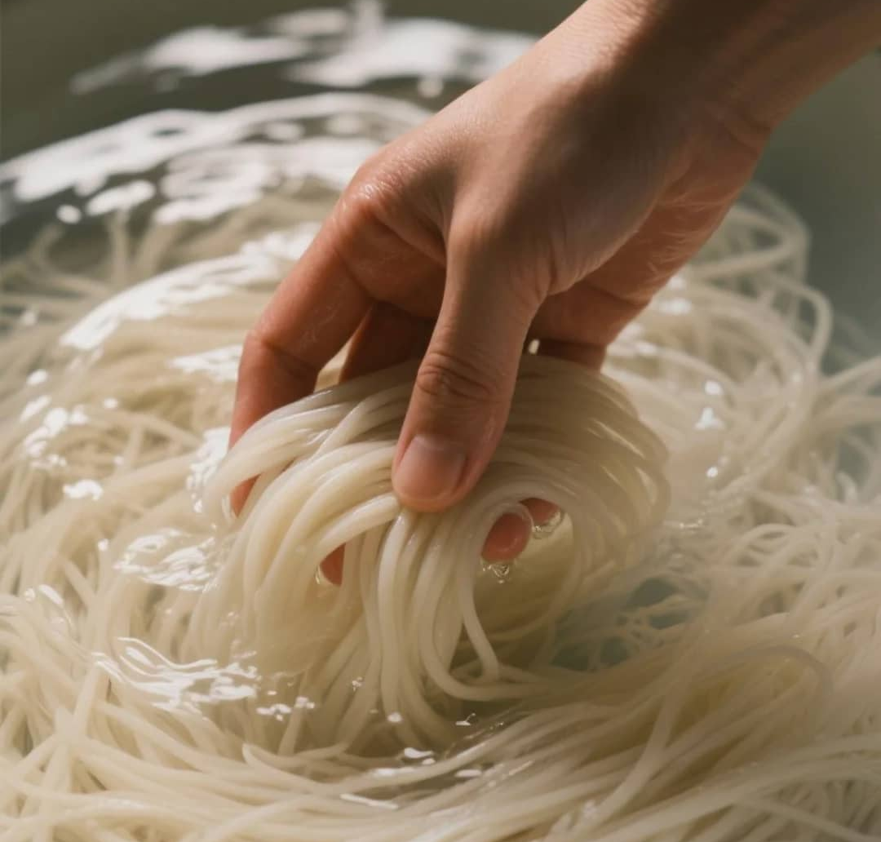
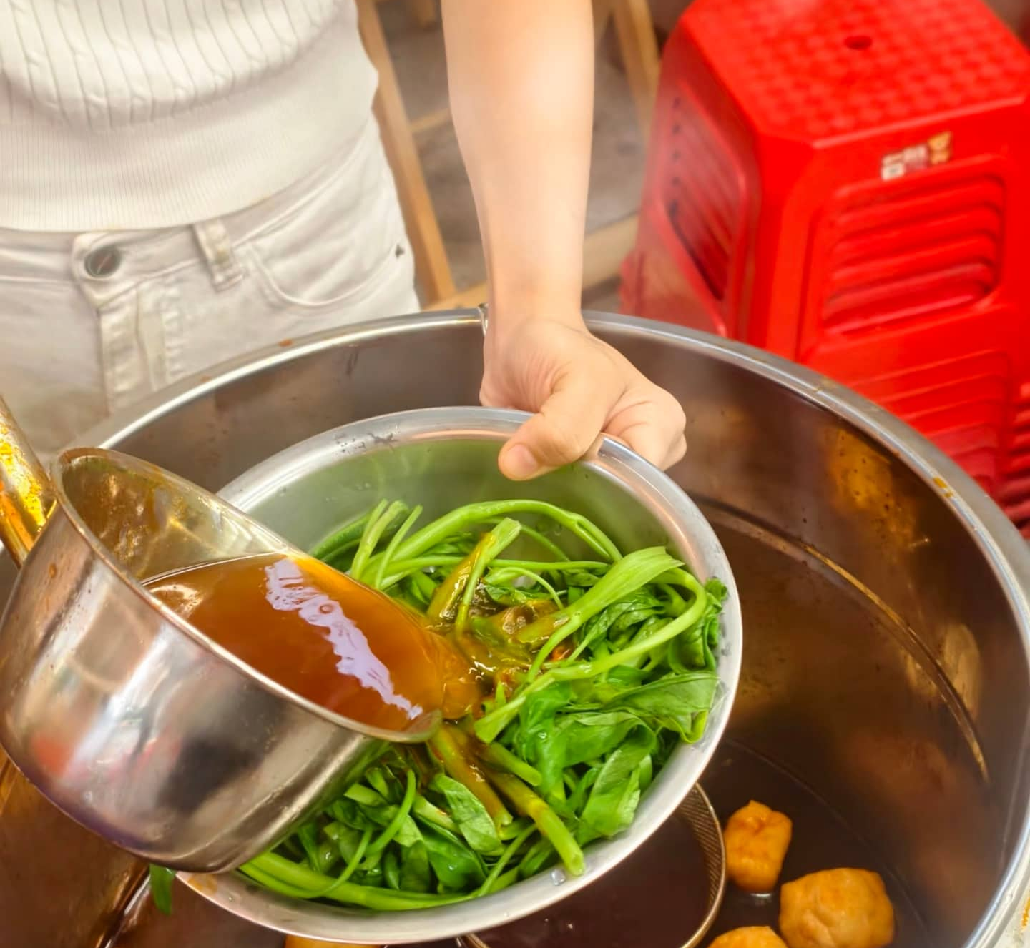
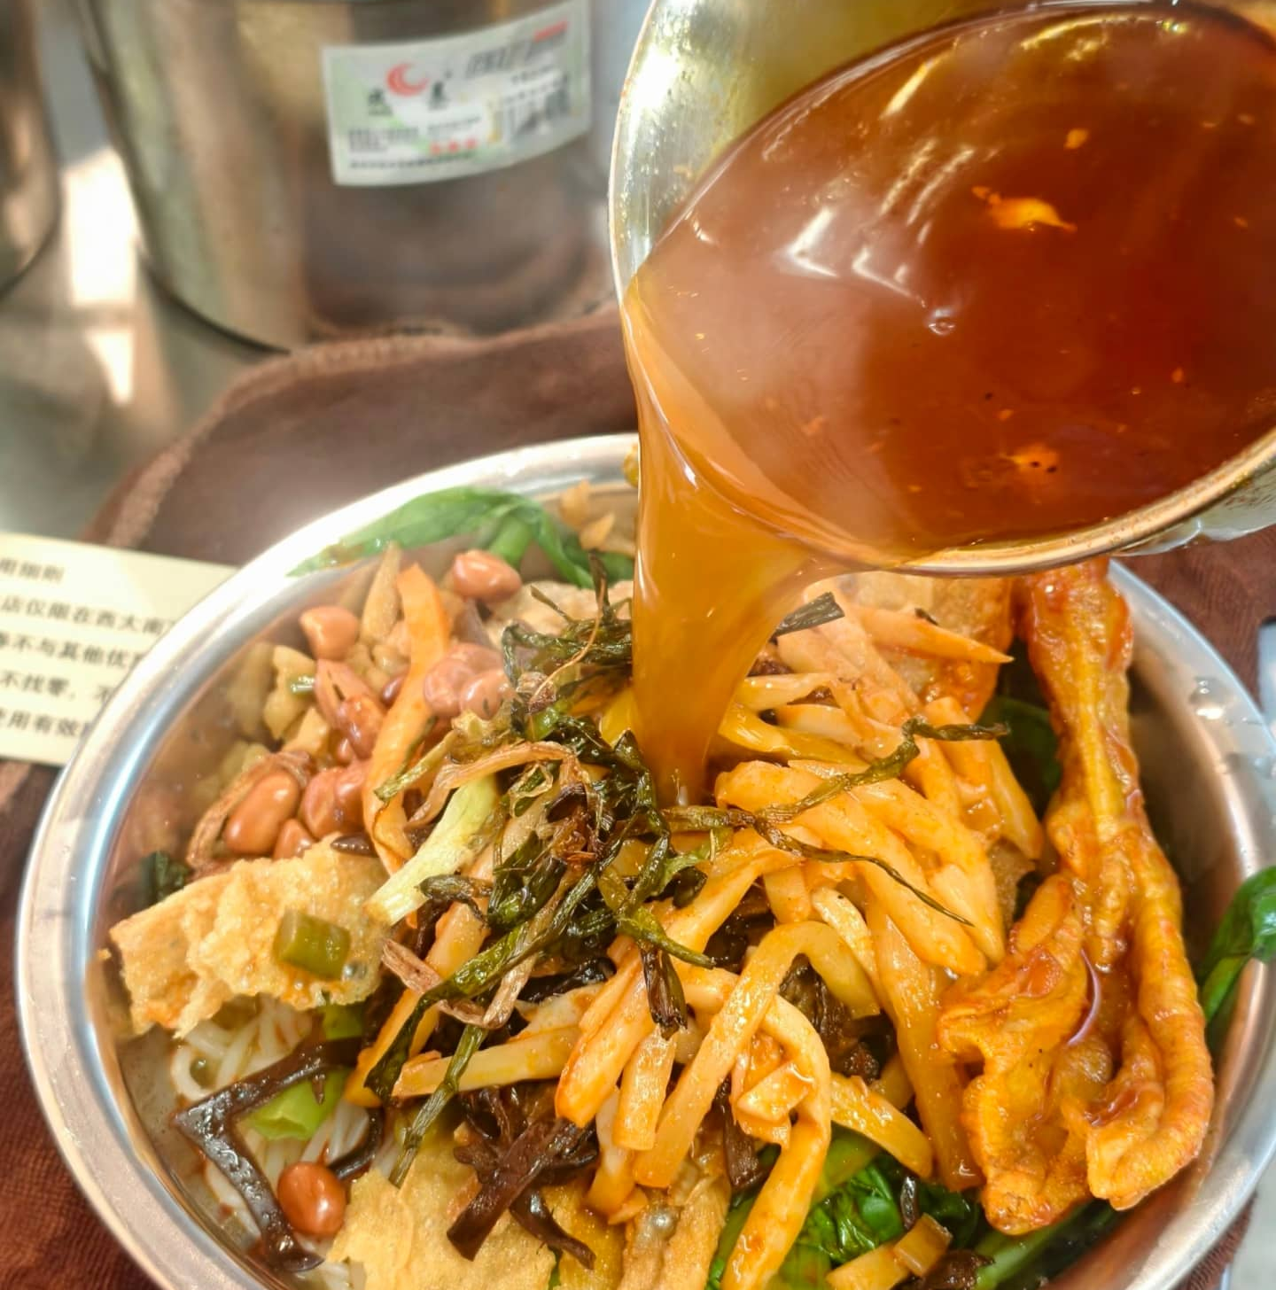
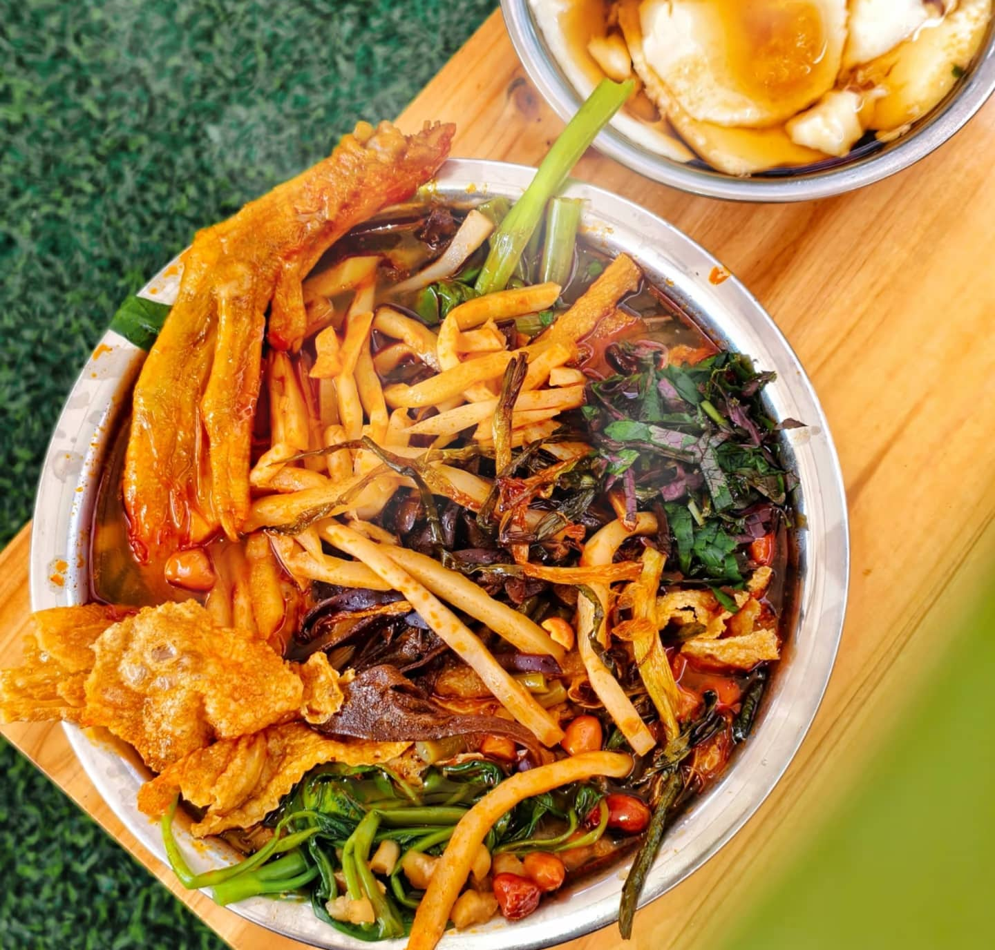
Making steps
prepare side dishes
Cut the side dishes into small strips and chunks. Pour oil into a pan and fry the tofu slices (make sure the oil is hot, but do not turn on the heat while frying to prevent burning). Use the leftover oil to make chili oil by adding chili powder
Add black fungus and the previously cut lean pork to the pan, stir-frying with a little salt.
Add one tablespoon of salt and half a tablespoon of spice, stir-fry for 2 minutes, then pour in half a bowl of water. Bring to a boil and transfer everything to the bone broth.
Boil half a pot of water, add salt (stir well until the water tastes salty). Once boiling, blanch the rice noodles separately in the water. Serve the noodles with the prepared ingredients and finally ladle the river snail broth over them. Your Luosifen are now ready.
螺蛳粉起源

Slide 10
第三部分
Development

Slide 11
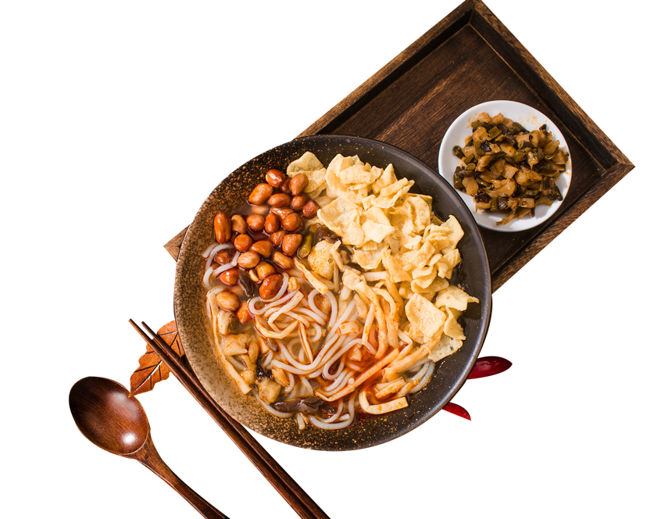

Development
Once upon a time, you could only find Luosifen at night markets. But now, they’re everywhere—from simple local eateries to fancy hotel restaurants. Since so many people fell in love with this unique flavor, the local government decided to take it to the next level by turning it into a full-scale industry. That’s when pre-packaged instant versions hit the shelves. And that’s not all—it even inspired a whole wave of spin-offs like hotpot, malatang, and all sorts of snacks with that signature tangy and spicy taste, attracting foodies from all over to come and give them a try.
传承与保护
传承与保护

Slide 12
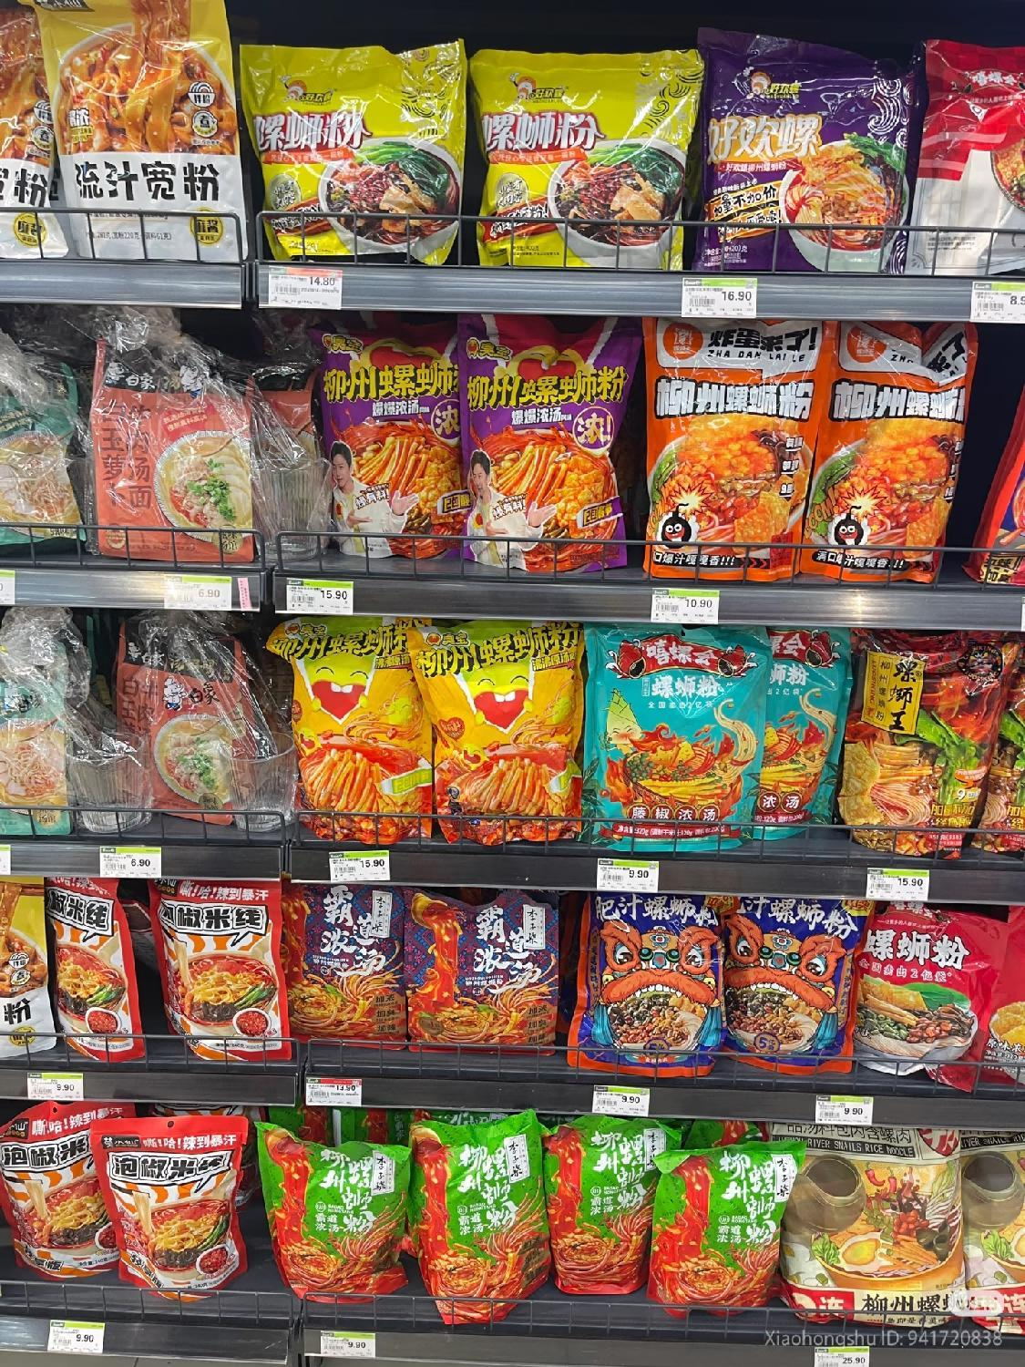

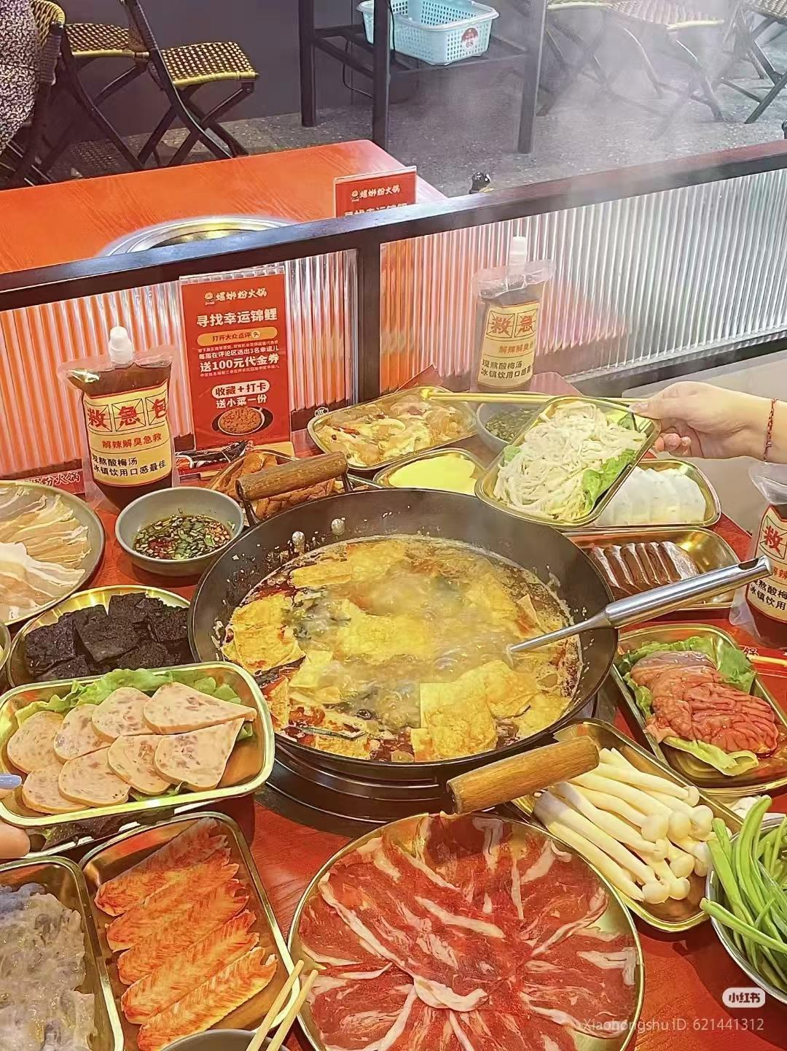
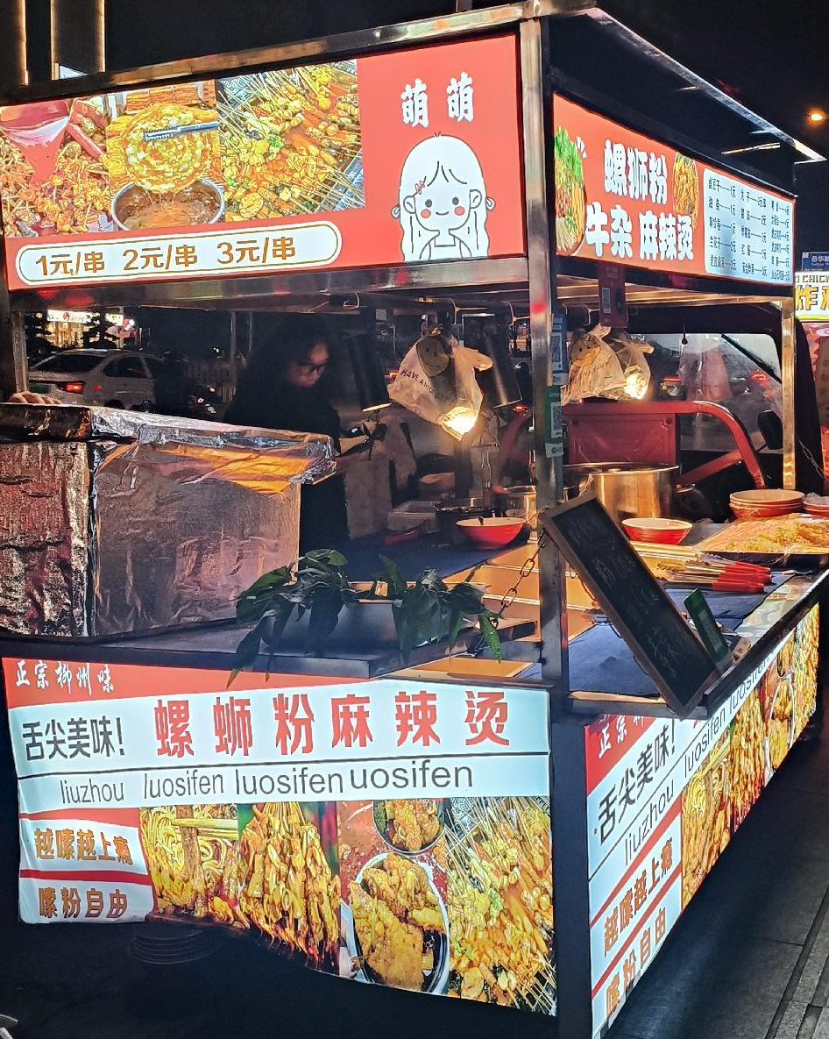
Different business models

Slide 13

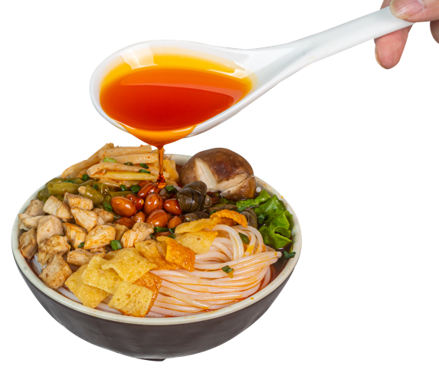

Development
In 2021, the art of making Liuzhou Luosifen was officially added to China’s national intangible cultural heritage list. This was a big deal—it wasn’t just some internet-famous snack anymore, it became a nationally treasured heritage, carrying deep traditional skills and local culture.
Today, this bowl of noodles has grown into a huge industry, worth over 75 billion yuan a year. It’s a perfect example of how traditional skills can team up with modern business, turning something trendy into a long-lasting success, and keeping this tasty piece of heritage alive and kicking.

Slide 14
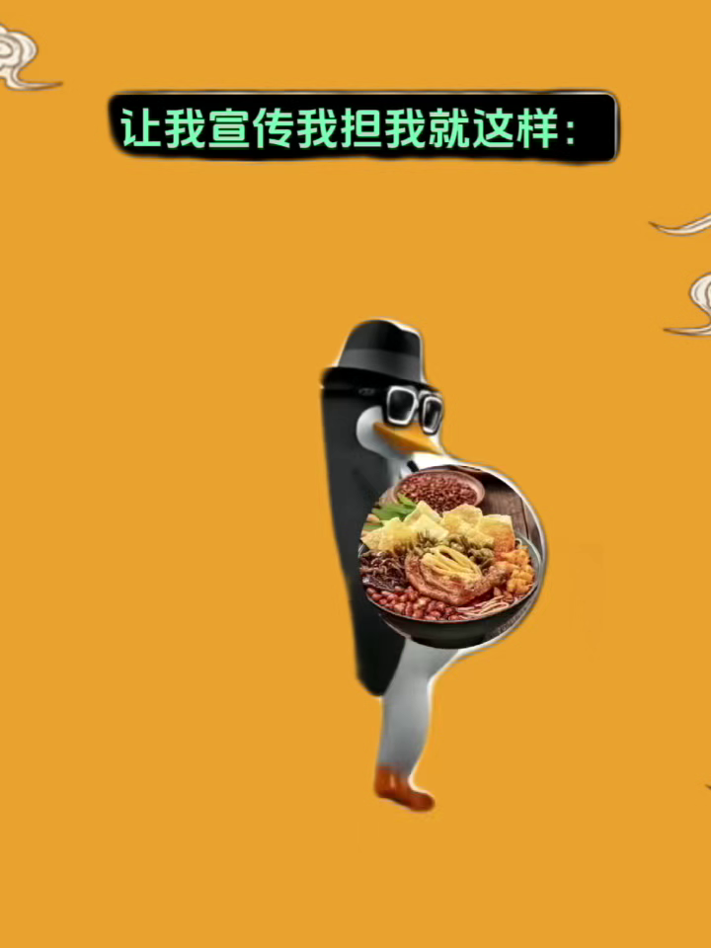
Thank
正宗柳州
you
资料来源：
小红书
百度
抖音
《中国语言文化》

