Slide 1


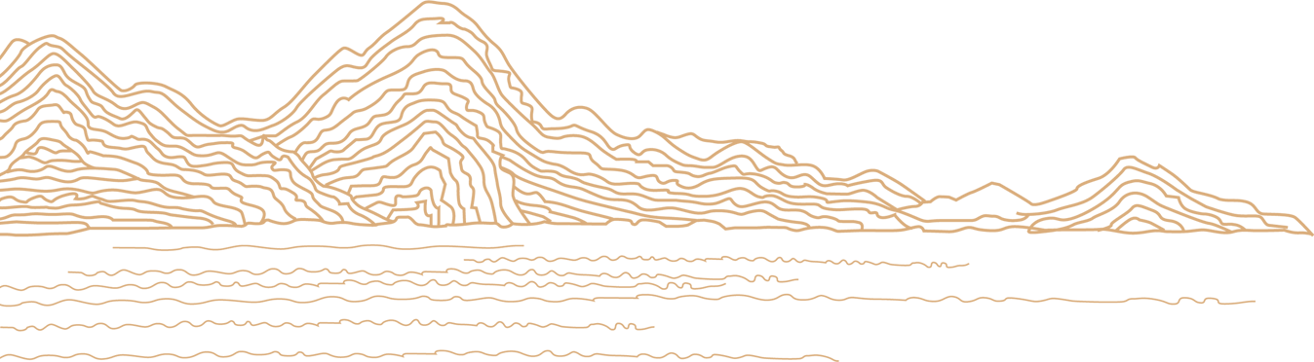

The Eastward Spread of Western Learning
Speaker: Mo Yuting （莫雨婷）
Student number: 202170081622

Slide 2
Content
Different stages
Background
1
2
Famous figures
Influence
3
4

Slide 3

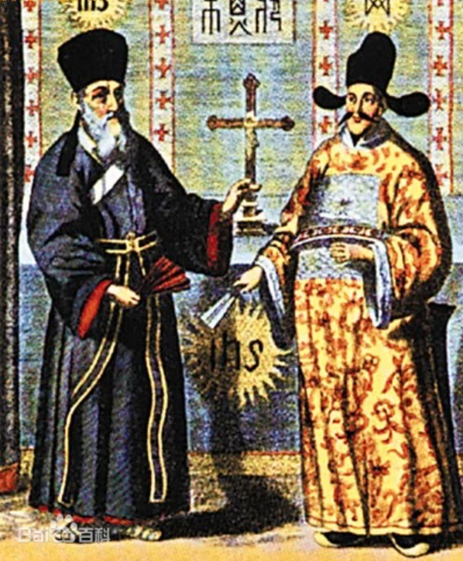
Part 1
Background

Slide 4
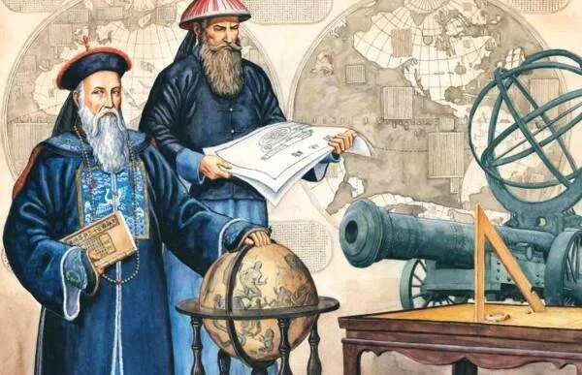
Part 1 Background
It took place in the late Ming Dynasty and early Qing Dynasty and lasted until the middle of the Qing Dynasty.
At that time, foreign missionaries from the Society of Jesus（耶稣会传教士） came to China. They spread religious doctrines and introduced works on astronomy, mathematics, physics, geography, paintings, and music to China.

Slide 5
Part 2
Different stages

Slide 6
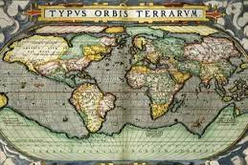
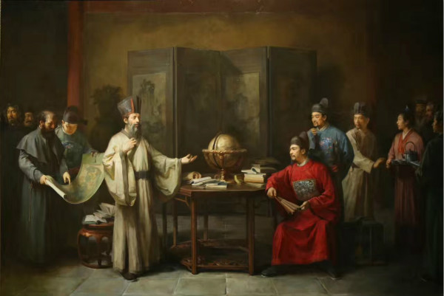
Part 2 Different Stages
1
The late Ming Dynasty during the reign of Emperor Wanli (1573-1620)
Foreign missionaries from the Society of Jesus came to China, spread Catholic doctrine, western scientific technologies, and western works. However, its influence was limited. These western technologies and works were only popular among scholar-officials.

Slide 7
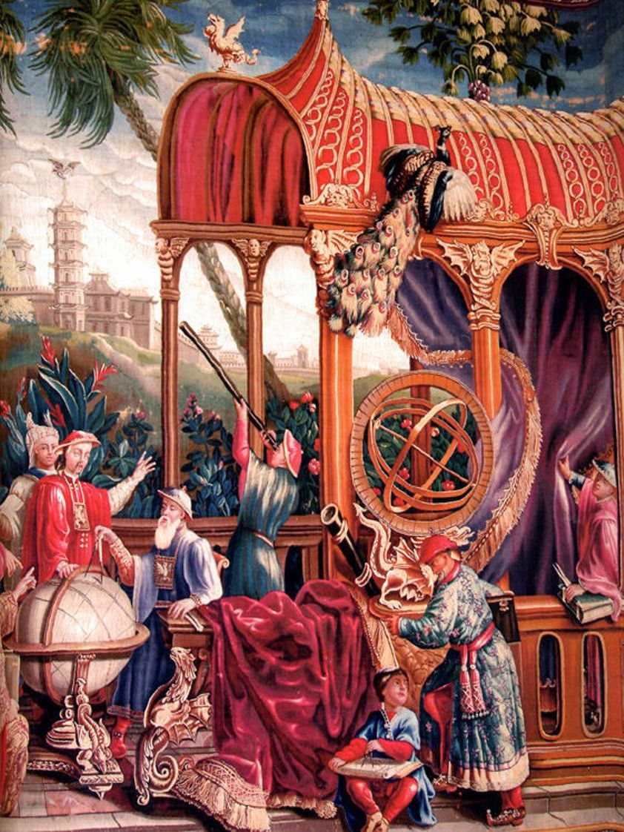
Part 2 Different Stages
2
The second half of the 19th century
More western foreigners came to China, this time, they brought something more. Works on culture, trade, history, academic thoughts, etc. were introduced to China. More Chinese people started engaging in learning from the West.

Slide 8
Part 3
Famous figures

Slide 9
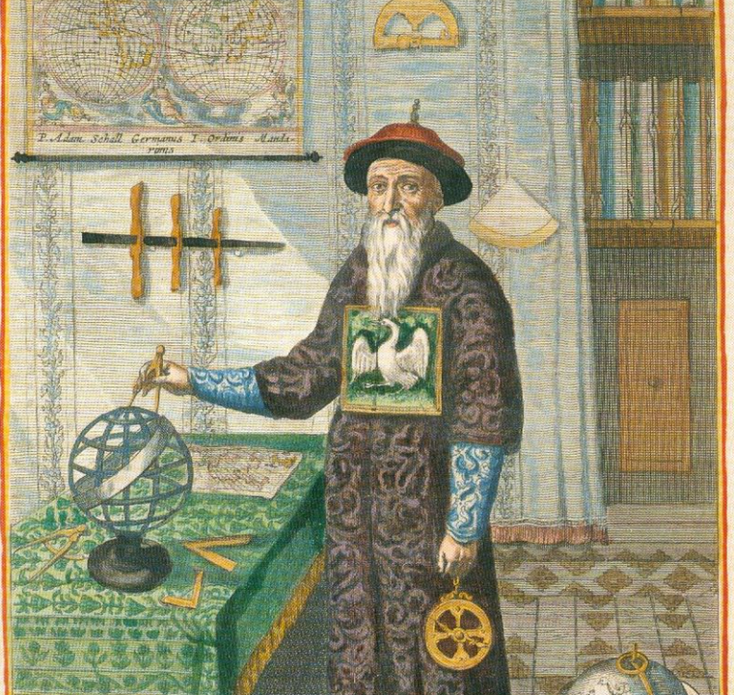
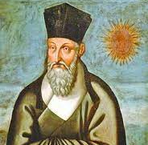
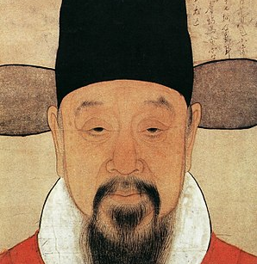
Part 3 Famous figures
Tang Ruowang
Xu Guangqi
Matteo Ricci

Slide 10
Part 3 Famous figures
① Matteo Ricci
He was an Italian Jesuit priest, one of the founding figures of the Jesuit China missions, an expert in theology, and knew a great deal about astronomy, mathematics, geography and philosophy.
He arrived at Macau in 1582, and came to Guangzhou in 1583. Ricci became the first European to enter the Forbidden City of Beijing in 1601 when invited by Emperor Wanli.
He was Famous works: Great Universal Geographic Map(坤舆万国图), The Elements (Chinese version)

Slide 11
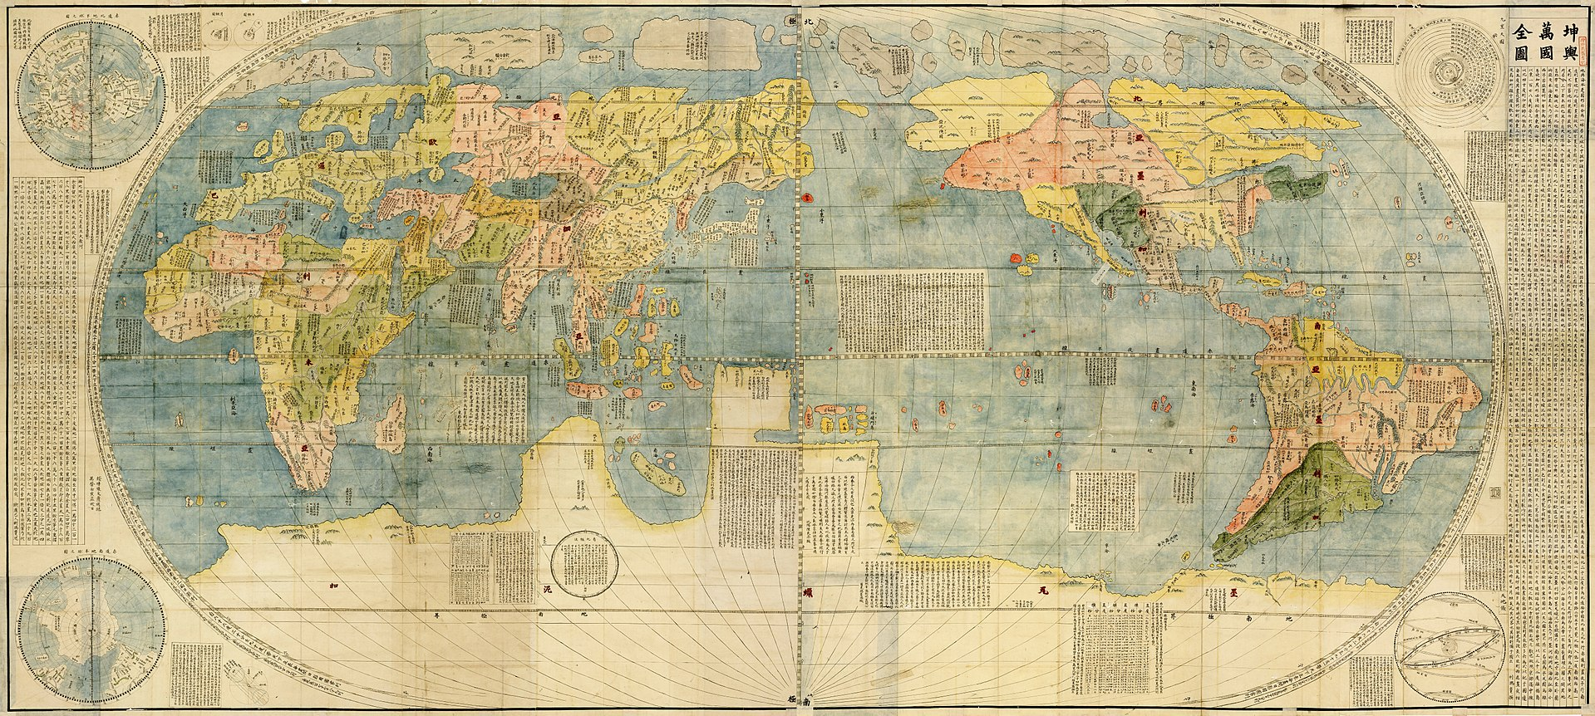
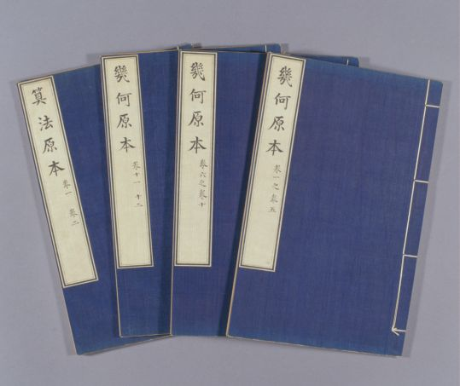
Part 3 Famous figures
Great Universal Geographic Map(坤舆万国图)
The Elements (Chinese version)

Slide 12
Part 3 Famous figures
② Xu Guangqi
He was a Chinese agronomist, astronomer, mathematician, politician, and writer during the Ming dynasty.
Xu had frequent discourses with Matteo Ricci and studied hard in western learning. He translated 6 volumes of The Elements together with Matteo Ricci and introduced the fundamental theories of Euclid’s Geometry.
Famous works: The Elements (Chinese version), Complete Treatise on Agriculture (《农政全书》), Mr Xu’s Amateur Observations (《徐氏庖言》）

Slide 13
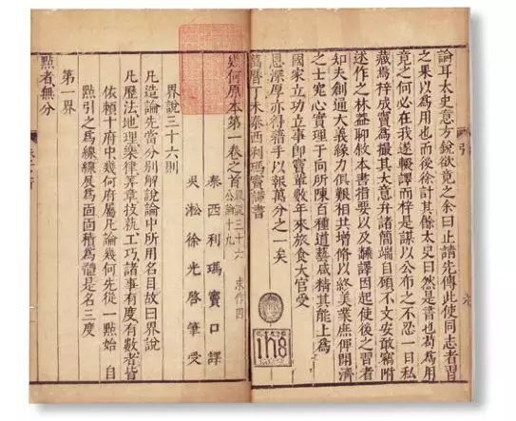
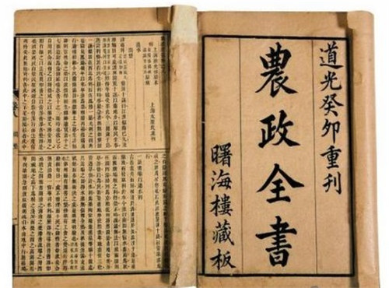
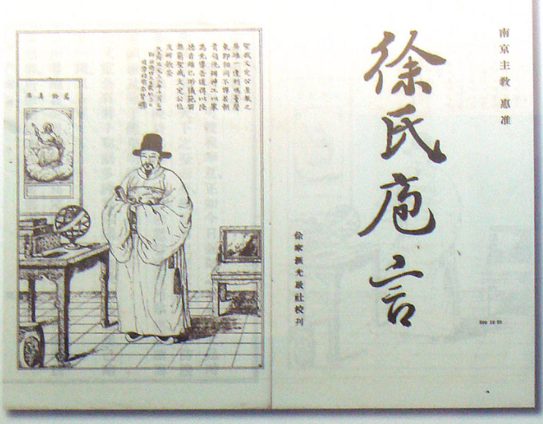
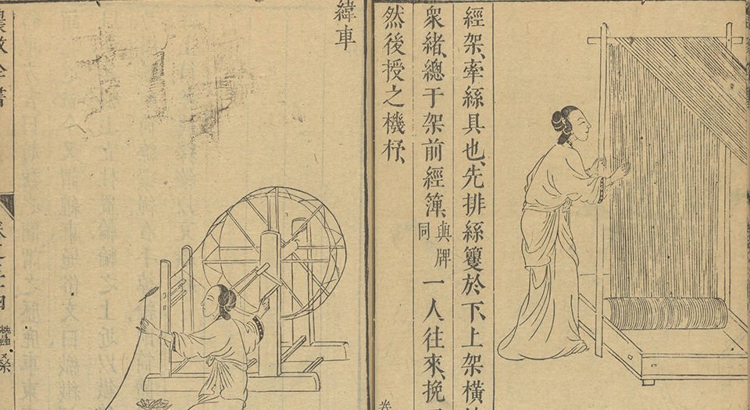
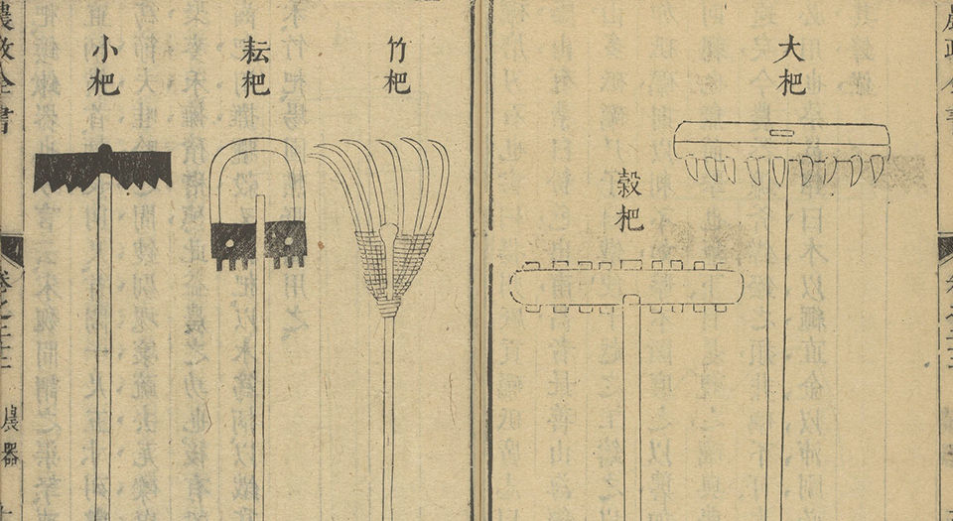
Part 3 Famous figures
The Elements (Chinese version)
Complete Treatise on Agriculture
Mr Xu’s Amateur Observations

Slide 14
Part 3 Famous figures
③ Tang Ruowang
Also named Johann Adam Schall von Bell. He was a German Jesuit, astronomer, and one of the most important Jesuit missionaries in China.
Tang arrived at Macau in 1620, and came to Beijing in 1630. He lived in China for 47 years and experienced the Ming-Qing transition.
Tang became Shunzhi Emperor’s trusted counsellor and took up a post as the Director of the Imperial Observatory (钦天监).
Famous works: Chongzhen Calendar (《崇祯历书》), All Essential Matters on Firearms (《火攻挈要》/《则克录》)

Slide 15
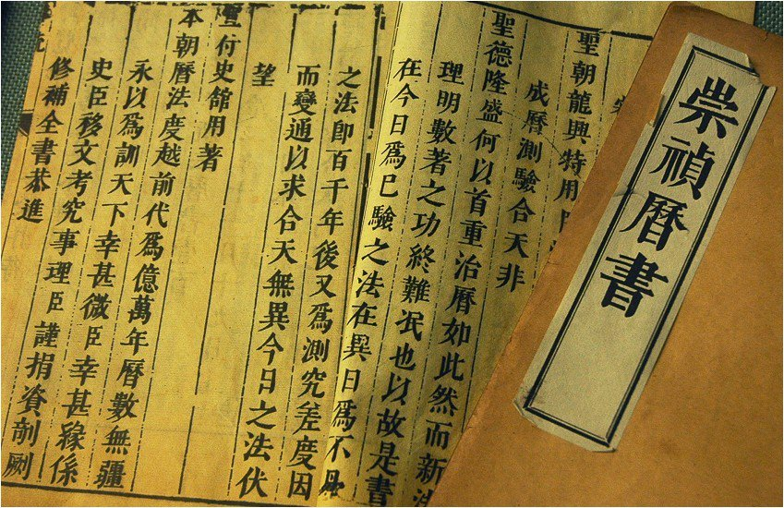
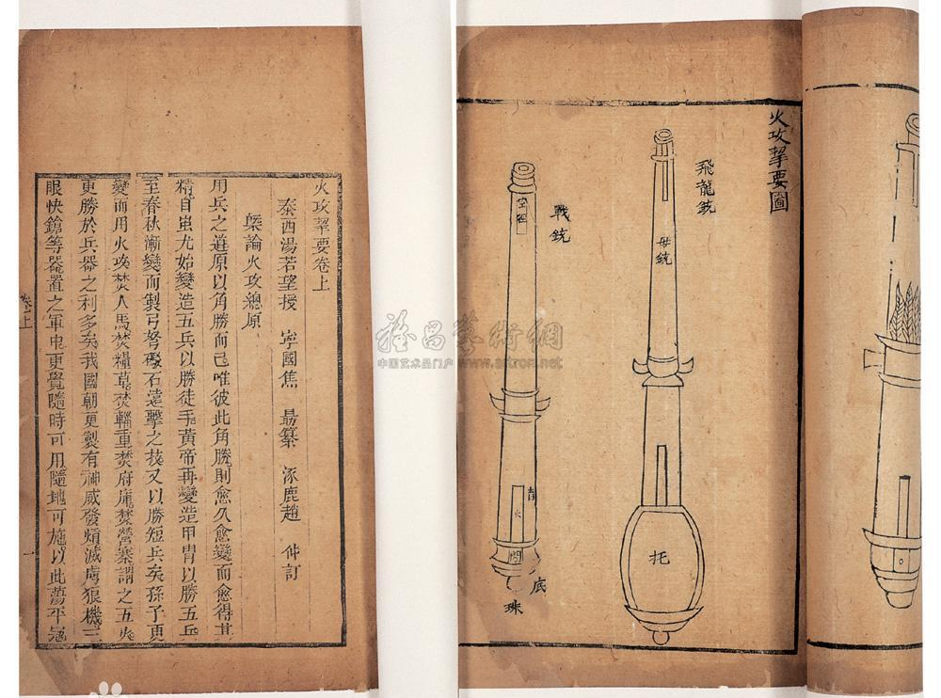

Part 3 Famous figures
Chongzhen Calendar
All Essential Matters on Firearms
A video clip

Slide 16
Part 4
Influence

Slide 17
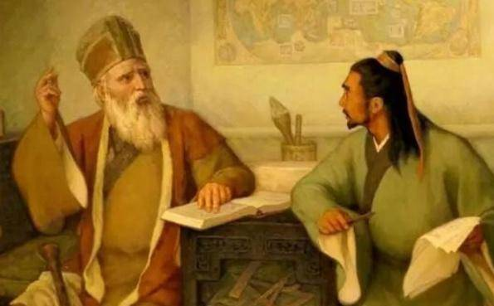
Part 4 Influence
The West to the East
It was the first wave of the introduction of Western learning to the East.
At this time, western foreigners, overseas Chinese, books and new education became the spreaders of western mathematics, philosophy, astronomy, physics, geography, scientific technologies, history, literature, arts, etc.
It had a great influence on Chinese academic ideas, thoughts, politics and social economy.

Slide 18
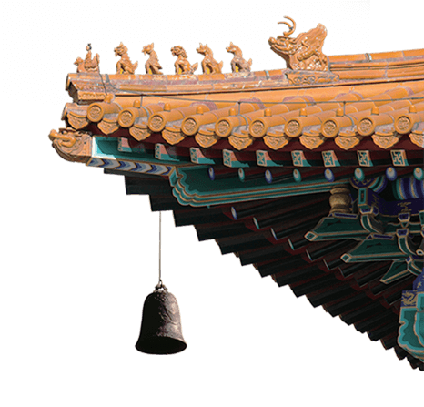
Part 4 Influence
The East to the West
These foreign missionaries made contributions to cultural exchanges between China and the West, they brought Chinese Confucian and Daoist doctrines back to the West.
Take Matteo Ricci for example, he translated Four Books (namely The Great Learning, The Doctrine of the Mean, The Analects of Confucius and The Mencius) into Italian, wrote the book: De Christiana expeditione apud Sinas, which described his experiences in China and introduced Chinese politics, economy, science, culture, and customs to the West.

Slide 19
Thanks for you listening

