Slide 1


红
红
包
包
来
来
啦
啦

Slide 2






壹
壹
Introduction to Red Envelope.
贰
贰
Wechat red envelope.
叁
叁
Red envelope culture outside of China
肆
肆
Award-winning questions.
录
目
录
目

Slide 3
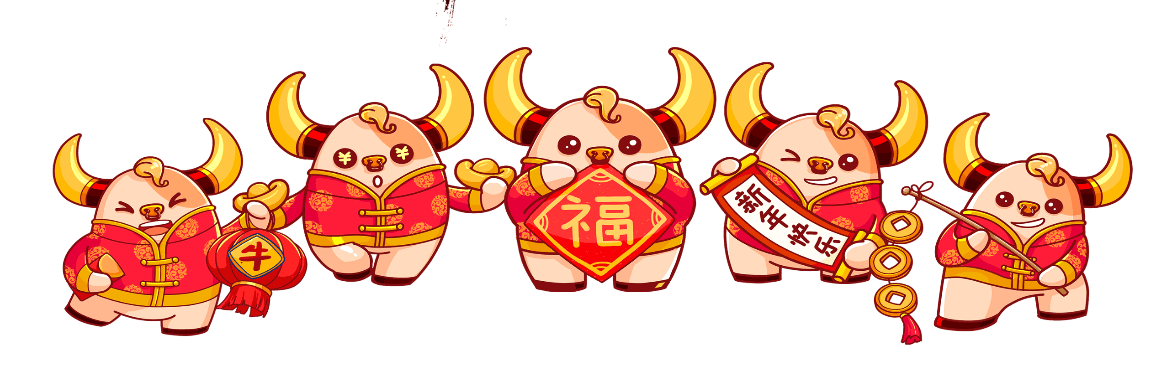





Introduction
Introduction
壹
壹

Slide 4
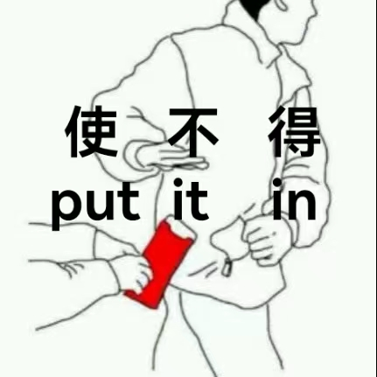

A red envelope is simply a long, narrow, red envelope. Traditional red envelopes are often decorated with gold Chinese characters, such as happiness and wealth.
红包是一个又长又窄的红色信封。传统红包通常饰有金色的汉字，比如“福”字和“财”字。

Slide 5

During Chinese New Year, lucky money is put inside red envelopes which are then handed out to younger generations by their parents, grandparents, relatives, and even close neighbors and friends.
春节期间，父母、祖父母、亲戚，甚至近邻和好友把钱装进红包发给小辈们。

Slide 6
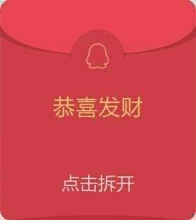
Red symbolizes luck and good fortune in Chinese culture. That is why red envelopes are used during Chinese New Year and other celebratory events.
红色在中国文化中象征着幸运和财富，这就是为什么在中国新年和其他庆祝活动中都会用到红包。

Slide 7


Slide 8
Wechat red envelope
Wechat red envelope
贰
贰

Slide 9
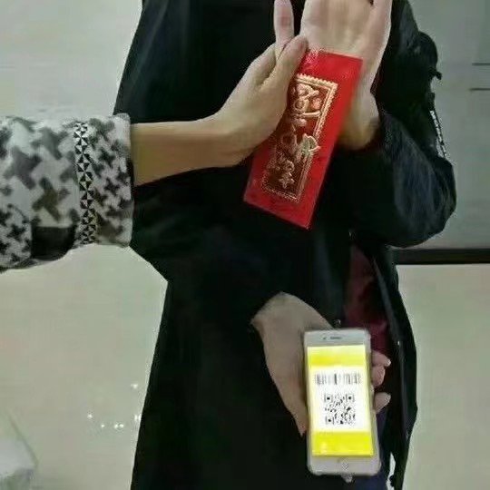
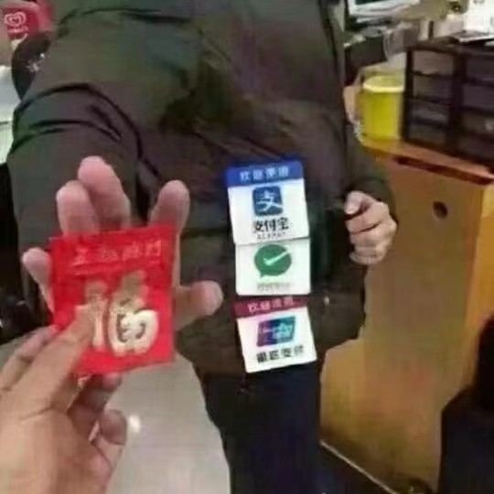
Moving on from the traditional Red Envelope, in the 21st century, many people exchange digital Red Envelopes instead of the traditional paper ones. Smartphone users can send digital Hóngbāo to each other using apps such as Alipay, WeChat and the Weibo Red Envelope.
In recent years, it has become popular among young people to send "Red Envelopes" by WeChat as a greeting. It has become a new way to greet friends or relatives during the Chinese New Year period.

Slide 10

Red envelope culture outside of China

Slide 11
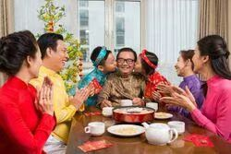


The similar customs have been adopted throughout Southeast Asia and many other countries with sizable populations of Chinese descent.
In Vietnam, Lucky Money is called Lì xì/Tiền mừng tuổi.
In Japan, Lucky Money is called Otoshidama(お年玉).
In Korea, Lucky Money is called Sabae.

Slide 12
Award-winning questions.
肆
肆

Slide 13
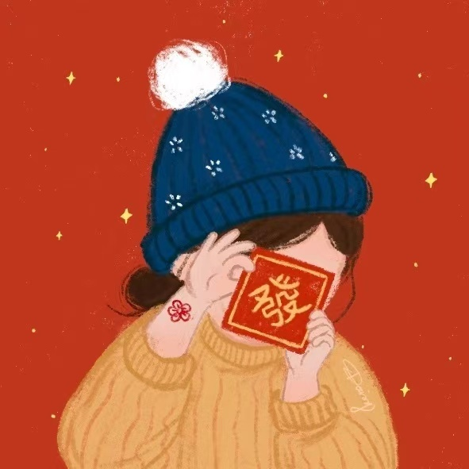
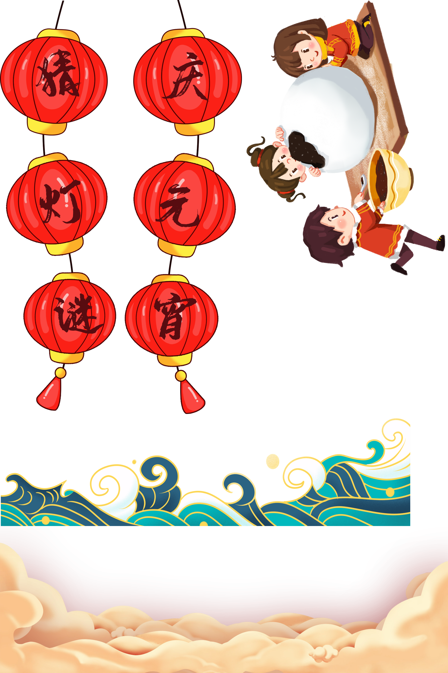

What is the demon in the red envelope legend?
锟锟的红包
七七的红包
七七的红包
七七的红包
七七的红包
锟锟的红包
锟锟的红包
锟锟的红包
岁
好好学习，天天向上
好好学习，天天向上
好好学习，天天向上
好好学习，天天向上
祟
陈锟
年
開
開
開
開
回答错误
红包两个
真有你的
乱讲

Slide 14
Which APP is the most commonly used for sending red envelopes？
锟锟的红包
锟锟的红包
锟锟的红包
七七的红包
七七的红包
七七的红包
七七的红包
锟锟的红包
QQ
U校园
Wechat
好好学习，天天向上
好好学习，天天向上
好好学习，天天向上
好好学习，天天向上
王者荣耀
開
開
開
開
很接近了
一派胡言
一个红包
？？？？

Slide 15
What do the Japanese call red envelopes?
锟锟的红包
锟锟的红包
锟锟的红包
七七的红包
七七的红包
七七的红包
七七的红包
锟锟的红包
envelope
Otoshidama
Oshidama
好好学习，天天向上
好好学习，天天向上
好好学习，天天向上
好好学习，天天向上
Li Ci
開
開
開
開
很接近了
红包两个
老眼昏花
？？？？

Slide 16
When do people often send red envelopes?
Marriage
Funeral
Birthday
New year
一个红包
啥也没有
一个红包
一个红包

Slide 17
How do Germans celebrate the new year?
锟锟的红包
七七的红包
大红包
好好学习，天天向上
開
大红包

Slide 18
感谢聆听

