Slide 1



Zheng He
and
the Maritime Silk Road
Reporter: He Changqi
Handout: Hu Baihui

Slide 2

Part One
The History of Maritime Silk Road
Part Two
Zheng He's voyage to the West
Part Three
The 21st Century Maritime Silk Road
Part Four
Translation Tips
目录

Slide 3

Part One
The History of Maritime Silk Road

Slide 4



History
1
2
3
4
Forming stage
Development stage
Climax
Declining phase
Western Han Dynasty （206 B.C.-24 A.D.）
Tang Dynasty(618-907) to Yuan Dynasty(1279-1368)
Ming Dynasty (1368-1644)
Qing dynasty (1644-1911)

Slide 5
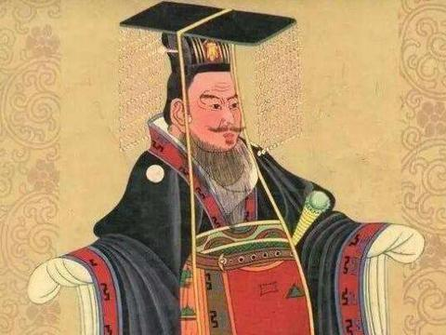
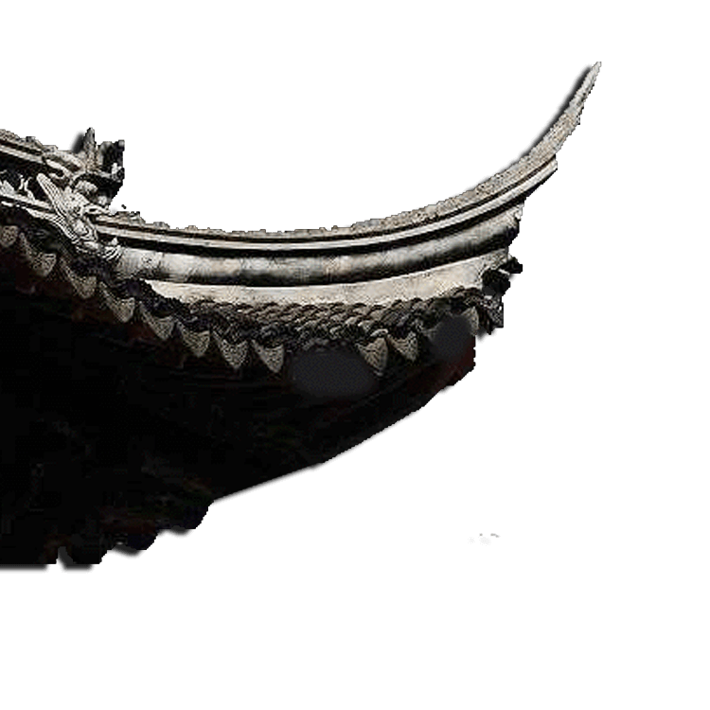
Forming Stage
The maritime silk road was formed in the time of Emperor Wu of Han Dynasty. The South China Sea route, which starts from China and sails westward, is the mainstream of the maritime silk road.

Slide 6
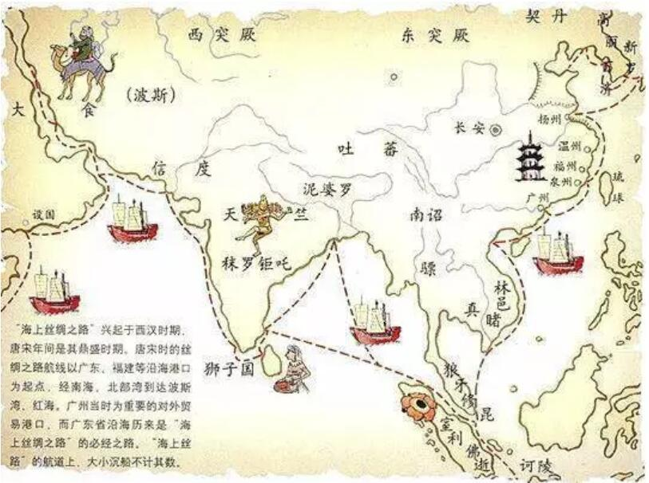
Development Stage
Tang Dynasty
Song Dynasty
Yuan Dynasty
Development of shipbuilding and navigation technology
The widely use of compass in navigation
Government's strong support of the overseas trade

Slide 7
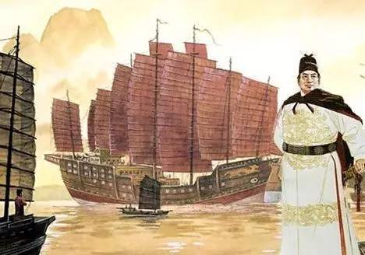

Climax
It was during the Ming Dynasty (1368-1644) that the Maritime Silk Road reached its climax, and the one who made a great contribution is Zheng He.

Slide 8

Declining Phase
During the Qing Dynasty, due to the government policy of banning maritime trade, Guangzhou became the only trading port. After the Opium War, China lost its marine power. From then on, the maritime silk road was in decline.

Slide 9
Part two
Zheng He's Voyage to the West

Slide 10
About Zheng He
Zheng He (1371–1433), born Ma He in Kunyang of Yunnan, was often called Sanbao.
Intelligent and knowledgeable about the navigation, he was entrusted by the emperor to direct all seven adventurous missions.
In 1433, at the age of 62, Zheng He died on his way back home because of overwork.

Slide 11
The First Naval Expedition
On July 11, 1405, a huge fleet of 208 ships appeared on the blue sea of the earth, they set sail from Liujiagang, Jiangsu Province.
Carrying cargoes of porcelain, silk, tea, and other treasures ,the fleet navigated the South China Sea, passing through the Strait of Malacca, and traversing the Indian Ocean to arrive at countries on the coasts of Asia and Africa.

Slide 12
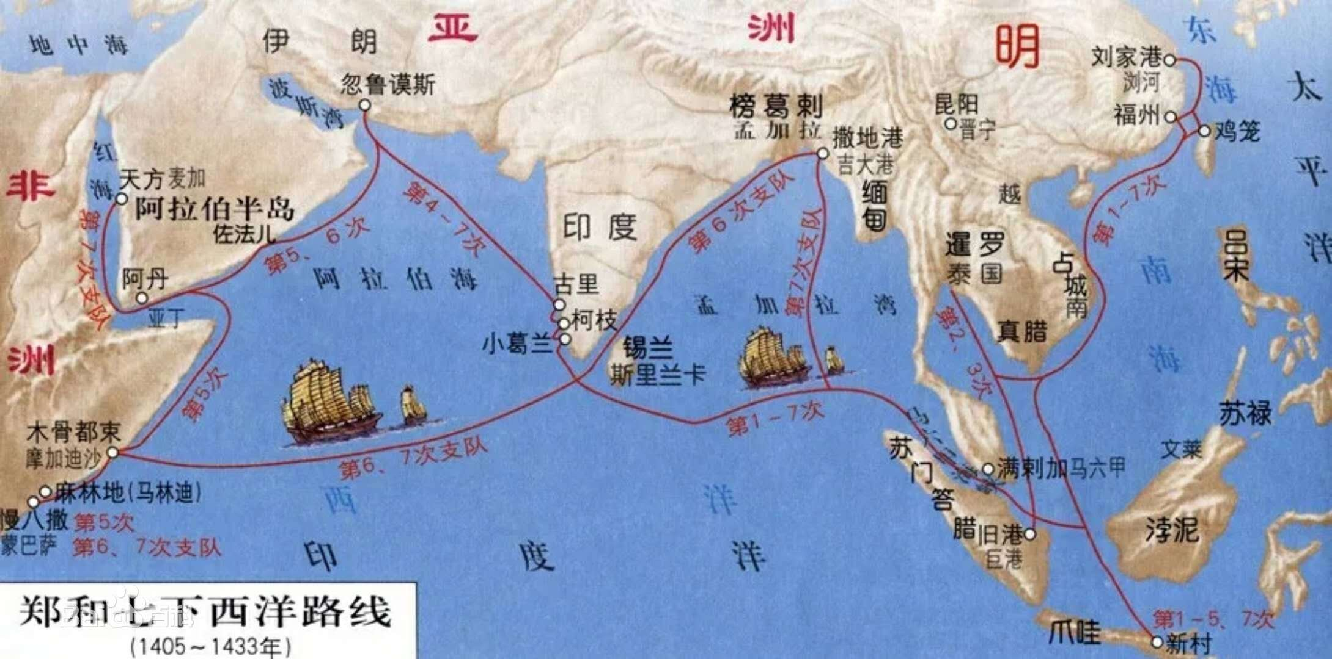
The Other Six Naval Expeditions
Over the next 28 years, six more fleets of a similar scale, with crews totalling 100,000 people, left China for further voyages to the Western Seas, visiting more than 30 countries and regions in Asia and Africa at that time.

Slide 13
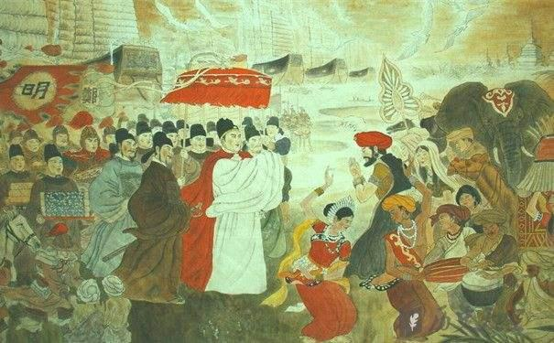
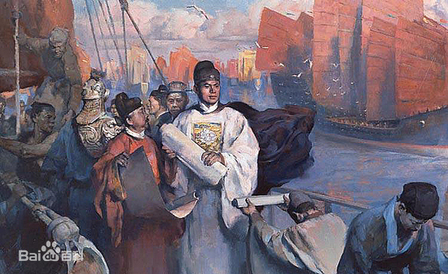
Zheng He began his journey of cultural exchange by showing the textile and other representative achievements of Chinese civilization, to the other countries.
According to statistics, 185 kinds of goods were imported into China. It provided new areas and space for the development of Chinese zoology, botany, medicine and enriched the material life of the Chinese people.

Slide 14
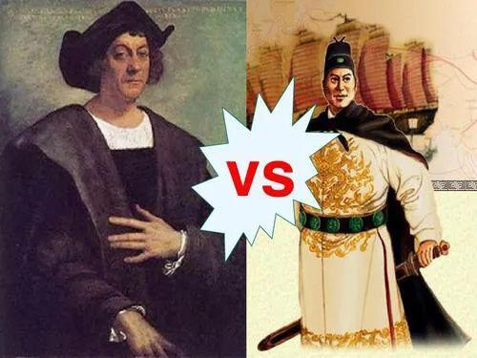
Christopher Columbus (1451-1506) came upon the the continent of the Americas in 1492 by traveling across the Pacific with his Spanish Fleet. Columbus’s fleets had only 3 ships and 88 members at that time.
Compared with these explorers, Zheng He’s voyages took place much earlier and on a much larger scale. For the first voyage, Zheng He's fleets had 62 ships and 27,800 crewmen.
Zheng He’s fleets were unparalleled during his time in terms of size, navigation technology, organization and amenitie, in order to be capable of making those successful long tirps.

Slide 15


Influence
1
2
3
It has spread the blessing of peace.
It opened up mutual trade.
It strengthened the exchanges between Chinese and foreign civilizations.

Slide 16
Part Three
The 21st Century Maritime Silk Road

Slide 17


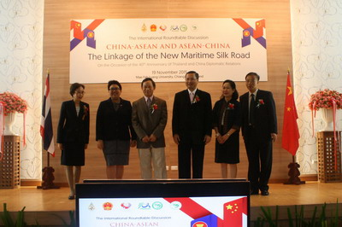
Introduction
Introduction
In October 2013, Present Xi delivered a speech at the Indonesian Parliament, in which he proposed for the first time the initiative of building the 21st Century Maritime Silk Road with ASEAN, with the purpose of deepening cooperation between China and ASEAN and building a closer community with a shared future.
As we all know, the Southeast Asian region has been an important hub of the Maritime Silk Road since ancient times.

Slide 18
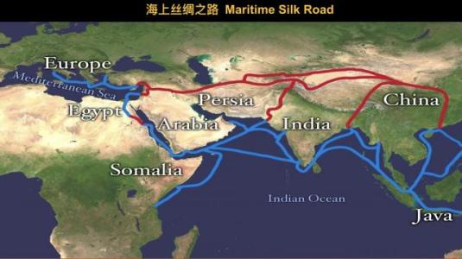
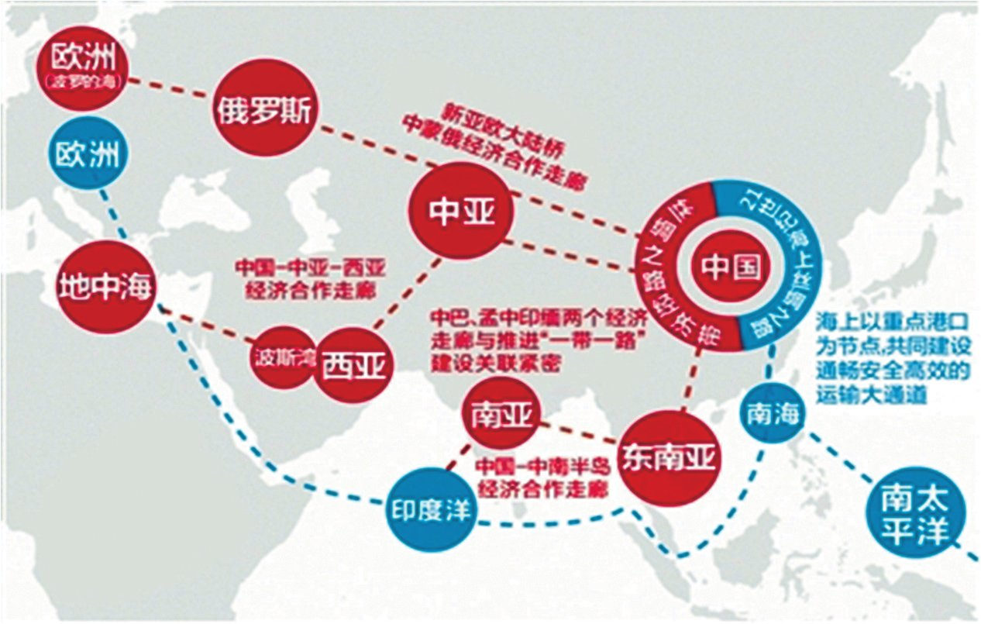
Introduction
The 21st Century Maritime Silk Road

Slide 19
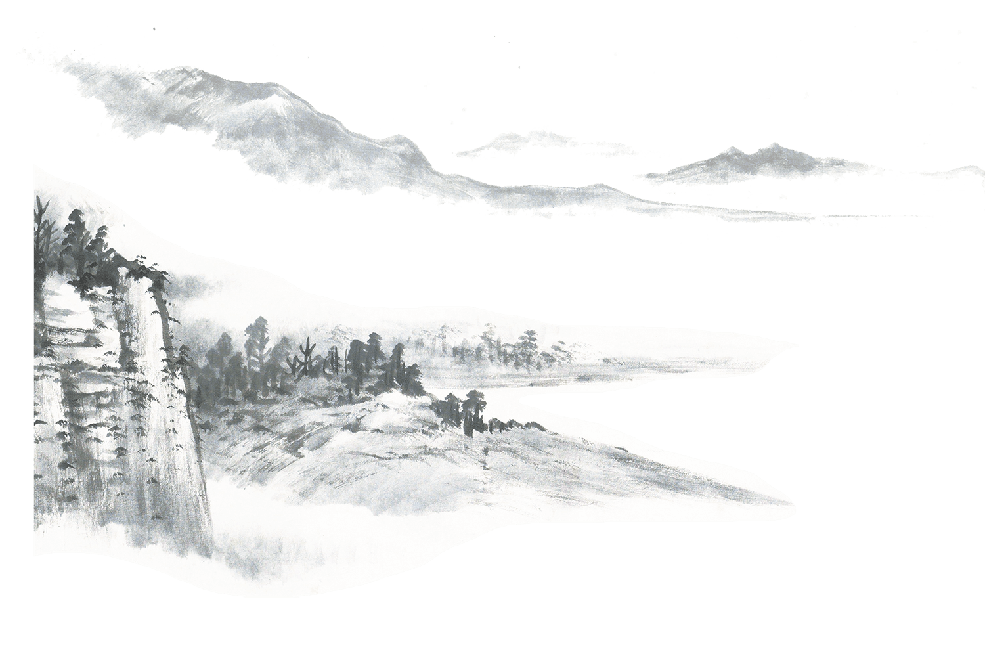
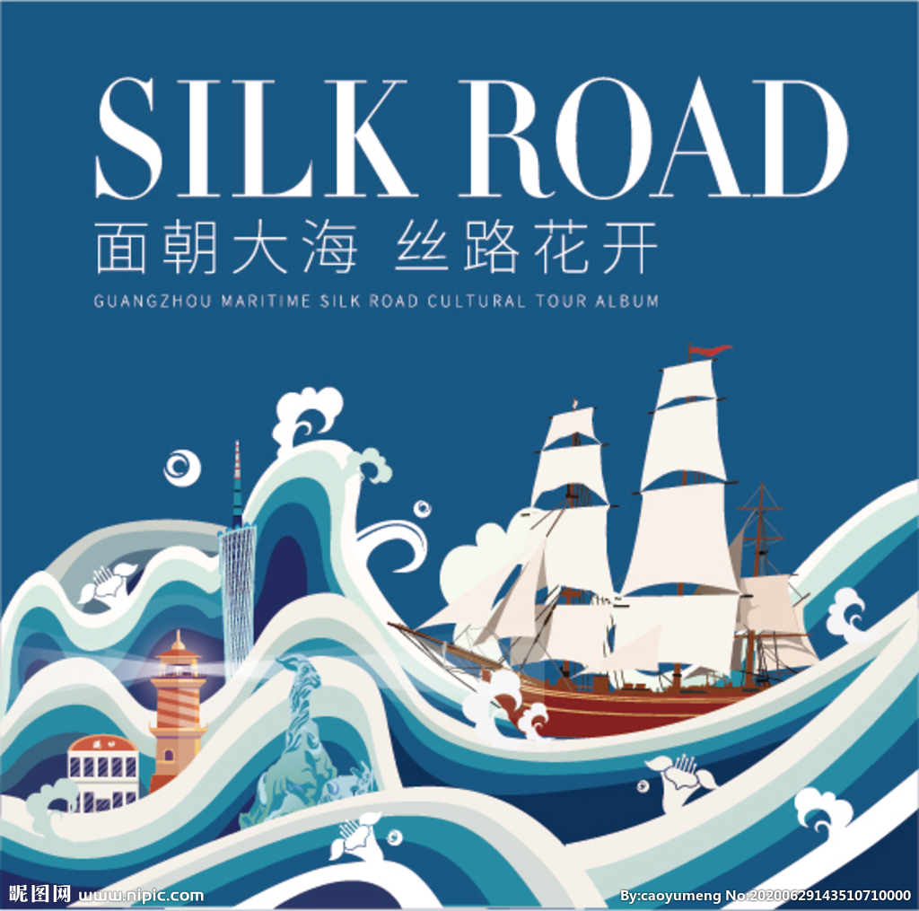
Enlightenment
1.Boosting Cultural Exchange
Cultural exchange is one of the themes of the Silk Road. In the context of globalization, the 21st Century Maritime Silk Road will adhere to the principles of mutual consultation, sharing and building to enhance mutual learning and appreciation between cultures.

Slide 20
Enlightenment
2.Promotig Trade Exchanges
The 21st Century Maritime Silk Road is guided by the correct concept of righteousness and profit in terms of values. The correct concept of righteousness and profit is, in short, the correct treatment and handling of the relationship between 'righteousness' and 'profit', i.e. working together for mutual benefit under the premise of morality and responsibility.

Slide 21
“一带一路” 倡议以实现“政策沟通、设施联通、贸易畅通、资金融通、民心相通”为主要内容，以“共商、共建、共享”为原则，实实在在地造福沿线国家和人民。
The initiative focuses on promoting policy coordination, connectivty of infrastructure and facilities, unimpeded trade, finacial integration, and closer people-to-people ties through a consultative process and joint efforts, with the goal of bringing benefits to all.

Slide 22
Part Four
Translation Tips

Slide 23
Translation Tips
Tips about translating the proper Name(including Names of people, places, dynasties, races, organizations, etc.)
Places(eg:the South China Sea)
①Use the dictionary for reference.
②When ancient place names first appear, it is better to mark modern place names.
Dynasties[eg:Western Han Dynasty (206 B.C.-24 A.D.)]
When translating the names of dynasties, the time should be added.

Slide 24
Translation Tips
Places
以出产瓜片著称的安徽六安（Lu’an）
别称“福城”的湖南郴州（Chenzhou）
古称“谯城”的安徽亳州（Bozhou）
以榨菜闻名全国的重庆涪陵（Fuling）
位于粤港澳大湾区（Guangdong-Hong Kong-Macao Greater Bay Area）中心位置的广州番禺（Panyu）

Slide 25
Thank you!

