Slide 1
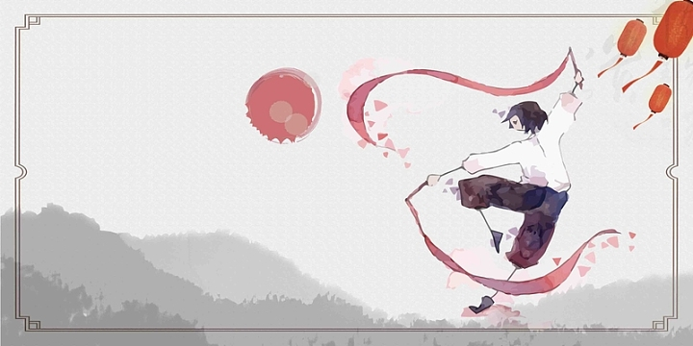
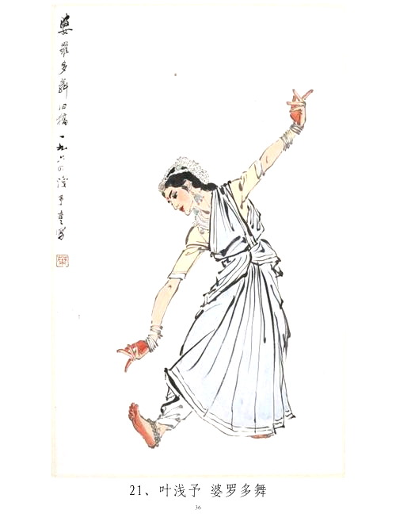
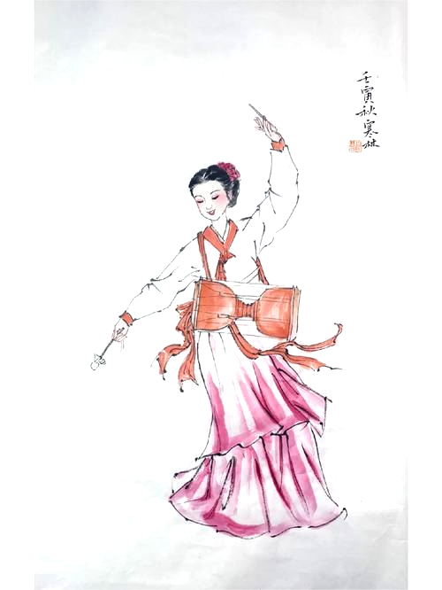
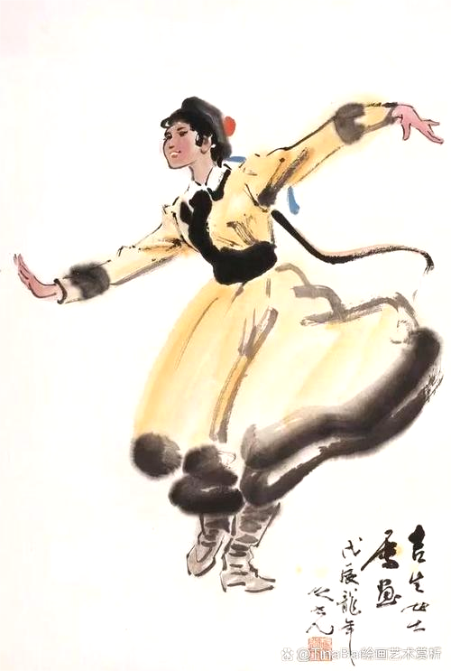
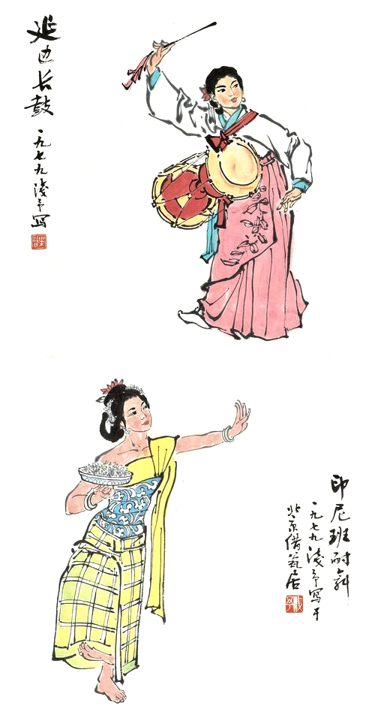
Body movement performance:
Traditional Chinese Dance
Speaker: Guo Xiaopei
2025. 10. 16

Slide 2
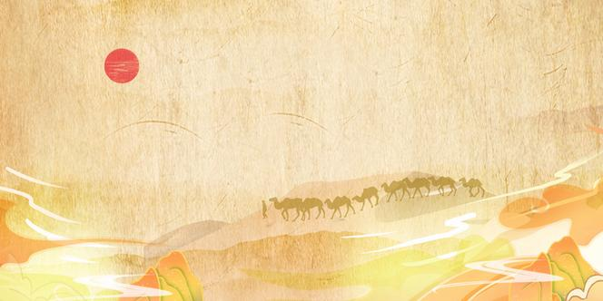
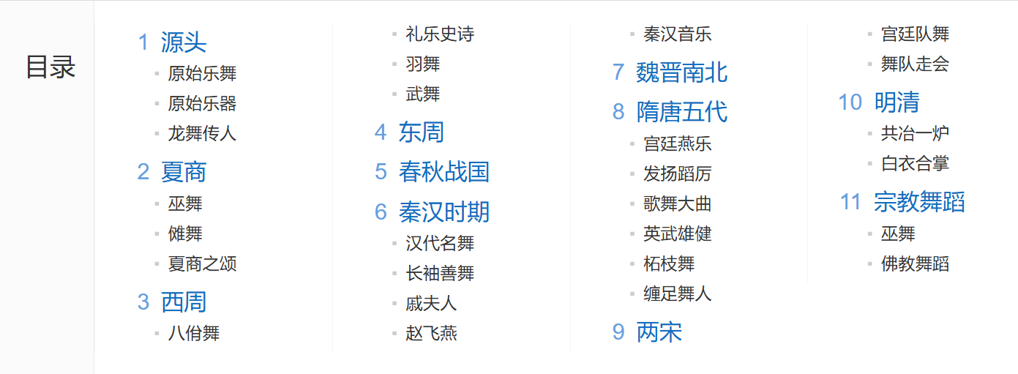
An Introduction of Tranditional Chinese Dance
History: As old as Chinese civilization
zenith

Slide 3
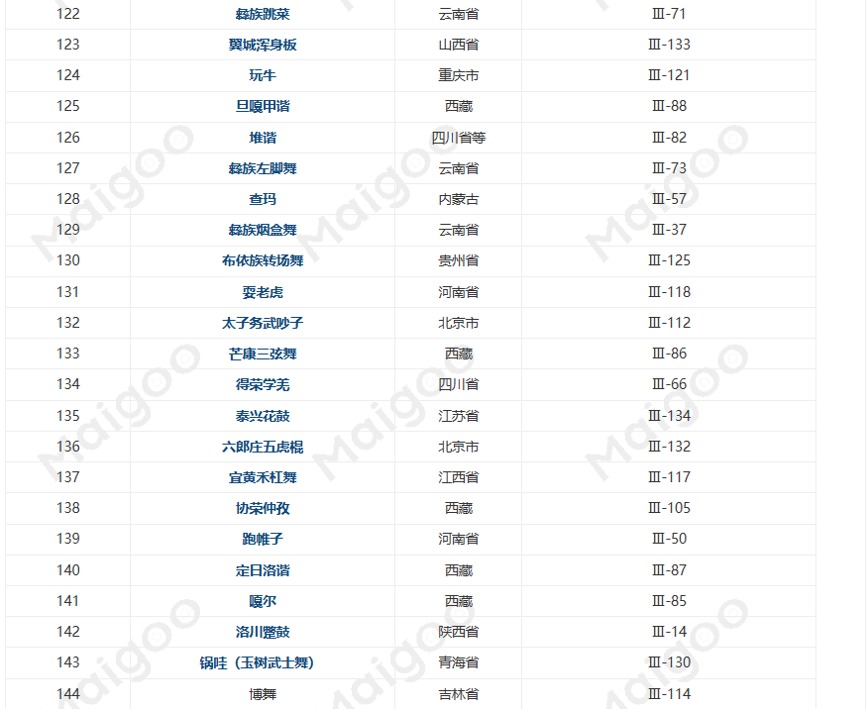
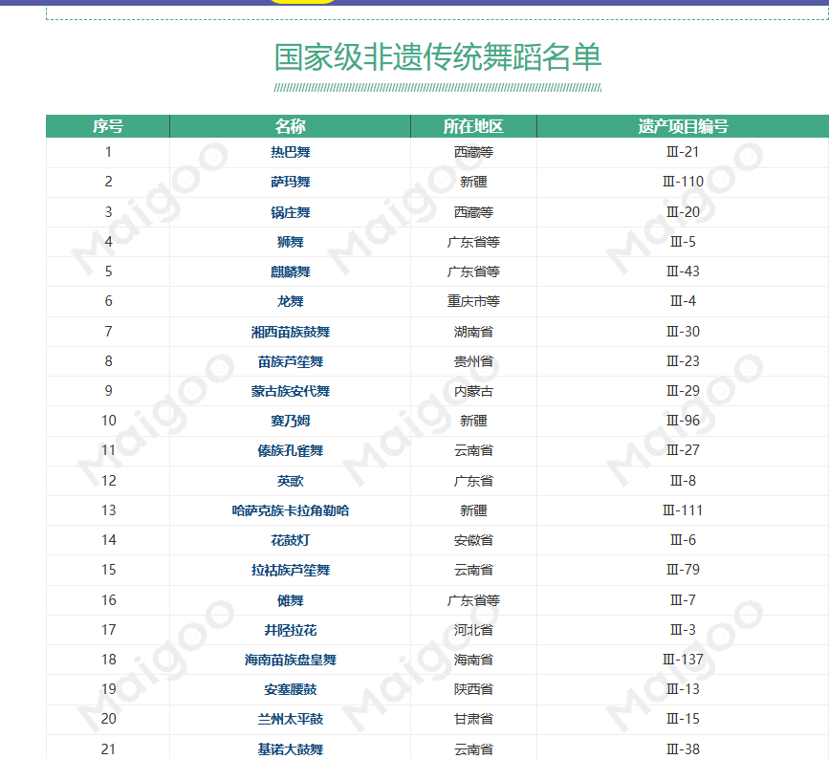
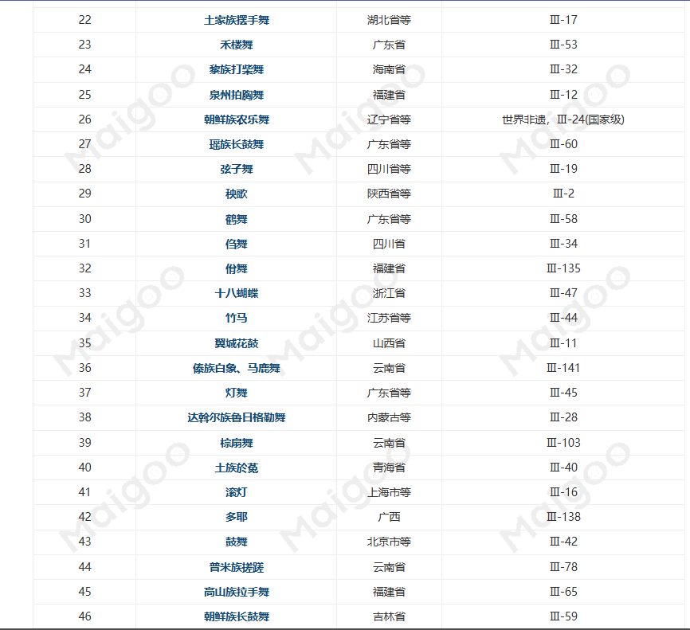
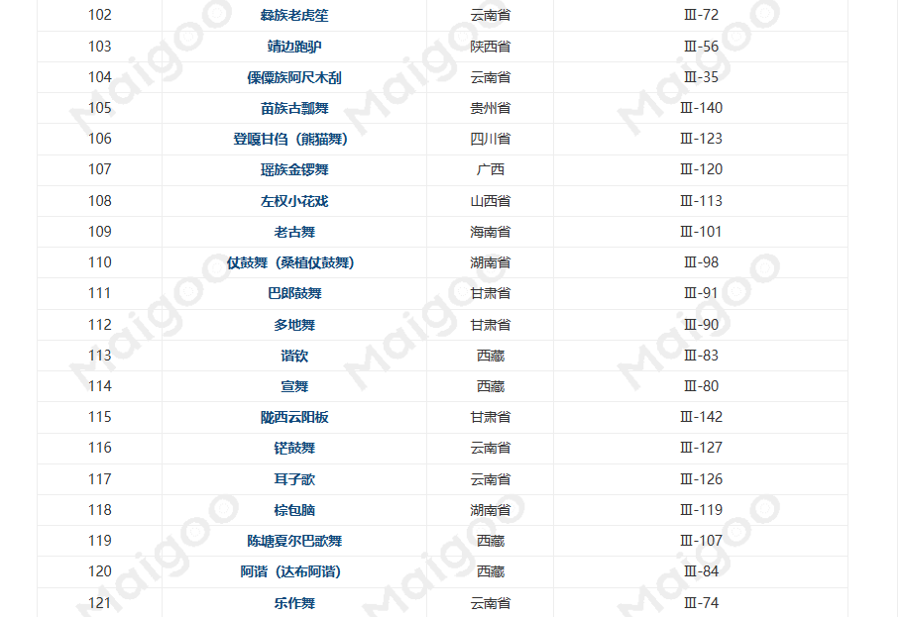
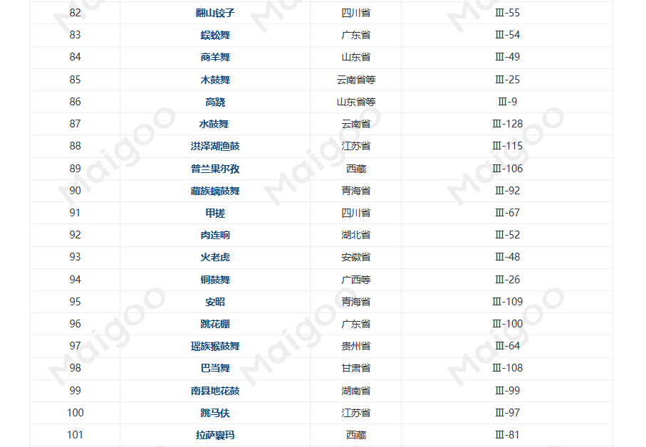
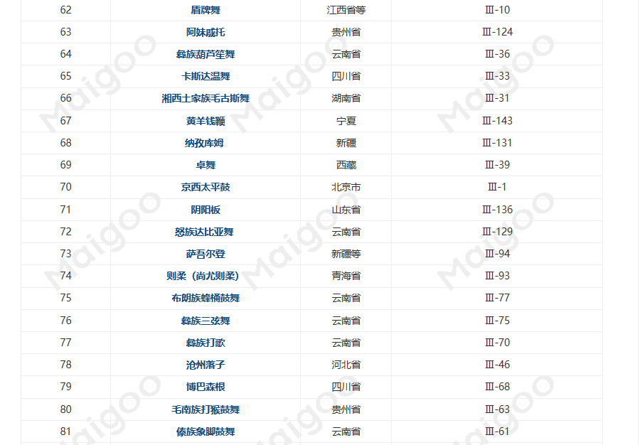
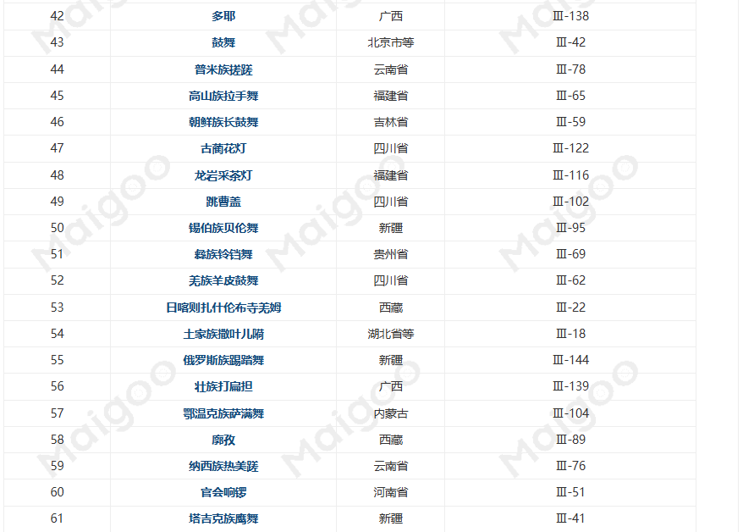
List of Intangible Cultural Heritage Traditional Dances (144)

Slide 4
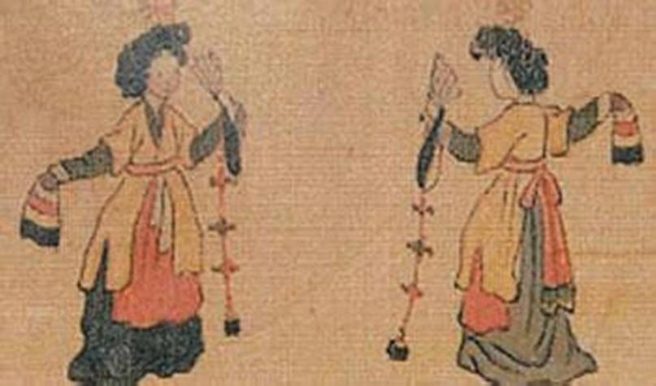
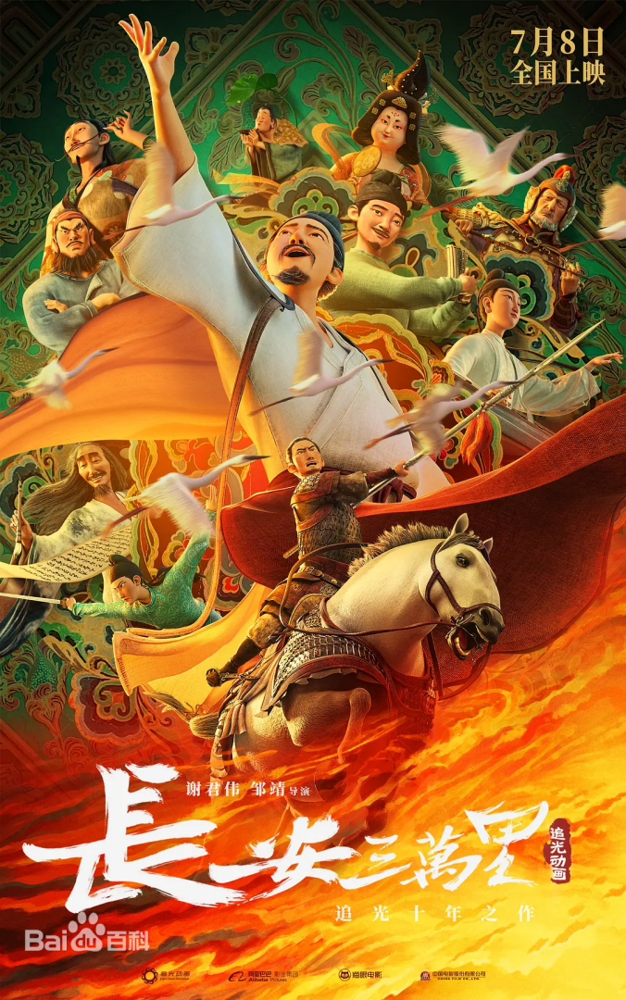
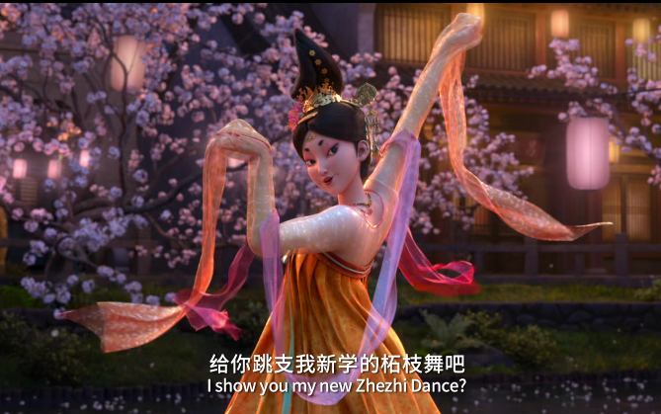

Slide 5
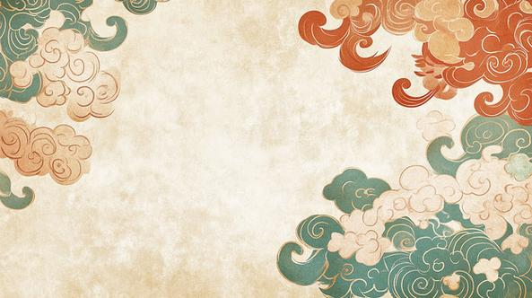
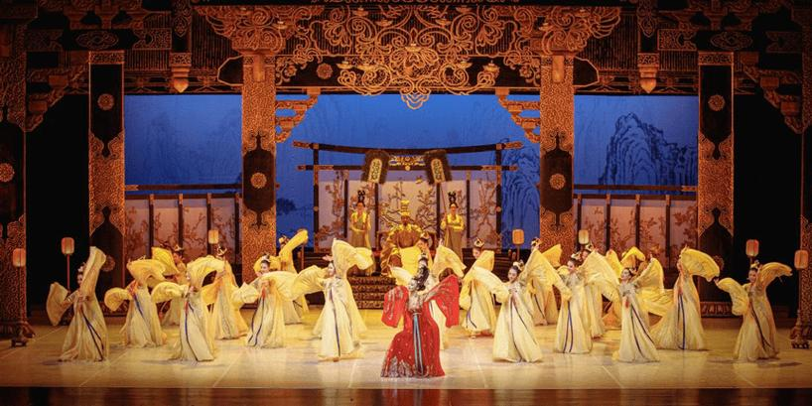
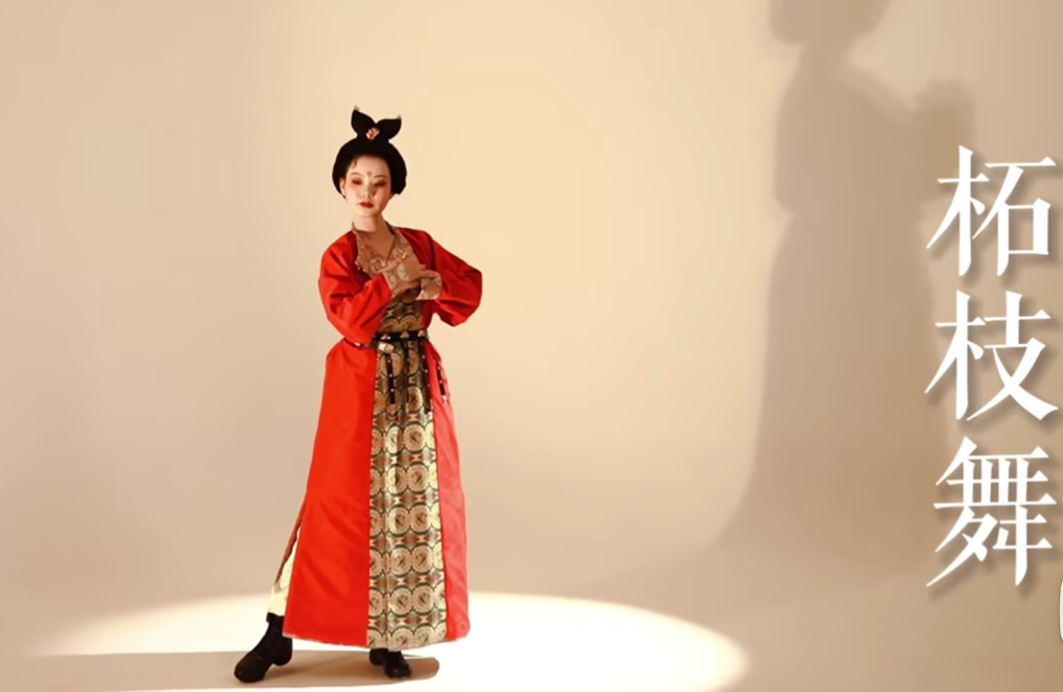
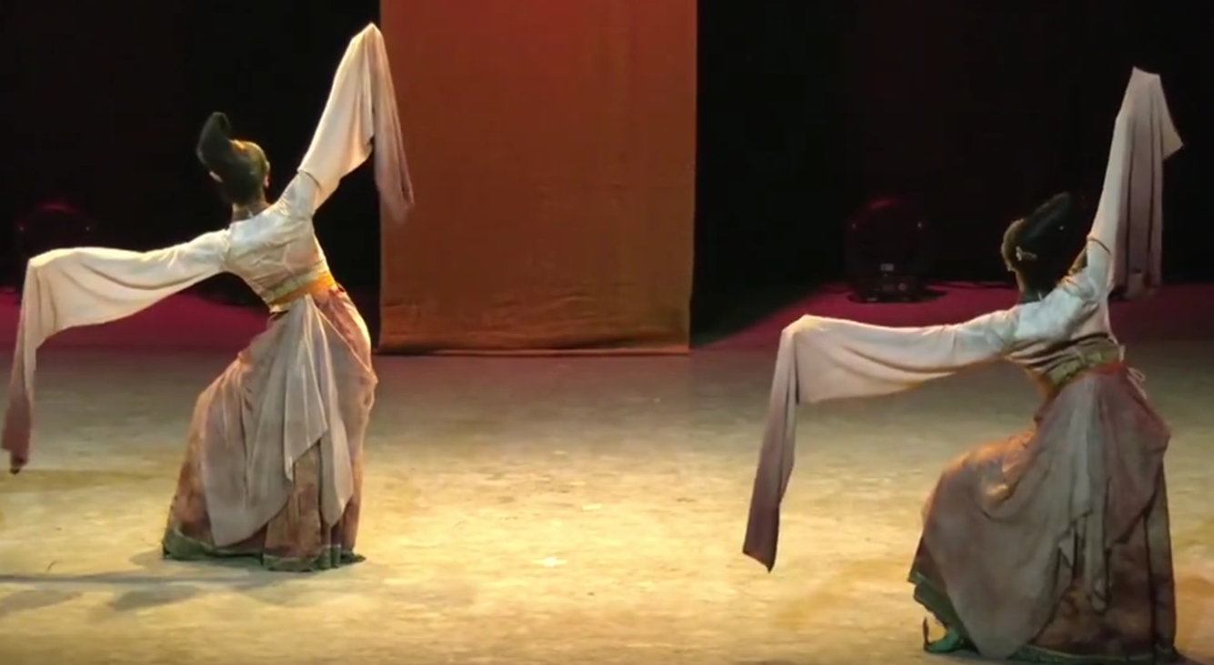
Zhezhi
Dance
柘枝舞

Slide 6
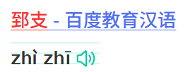
Zhezhi Dance
-- One of the Traditional Chinese Dance
Time: In Tang Dynasty
Zhizhi (present-day Jambyl (A province in Kazakhstan) in Central Asia)
The origin of Zhezhi Dance
Chang'an, Tanzhou (present-day Changsha), Hangzhou, Jiangsu, Sichuan, and other regions
The places where Zhezhi Dance became immensely popular
It is first a kind of “Ying Wu”(Energetic dance), with only one performer.
With its wide dissemination, specialized performers known as “Zhezhi Ji” appear.
Then it has two perfomers and its performing style changed a lot, turning to be more graceful.
Its development

Slide 7
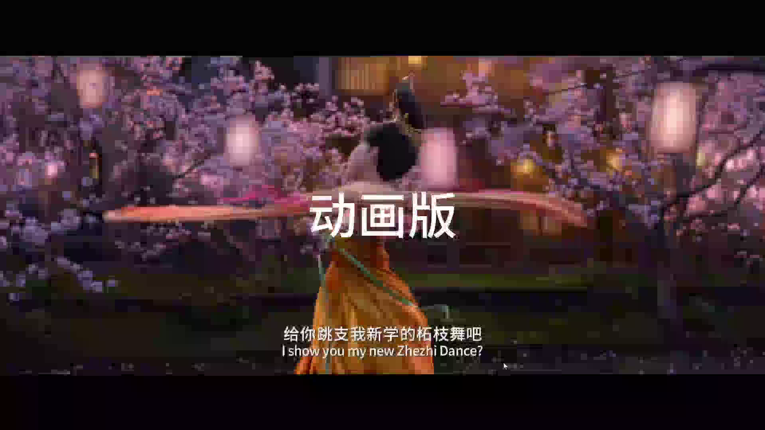

Slide 8
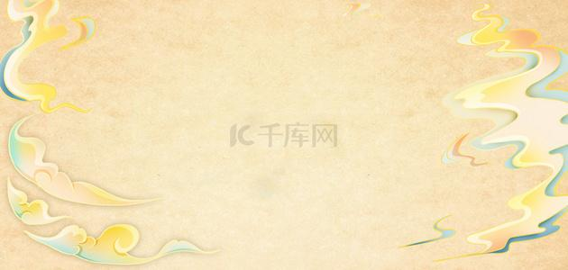
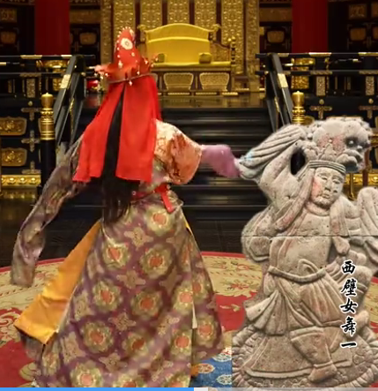
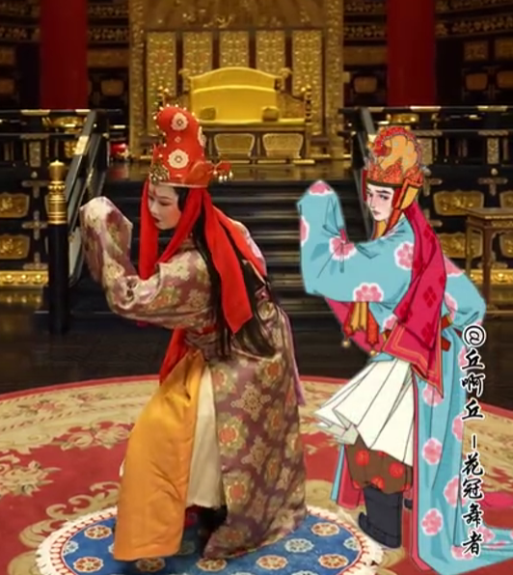
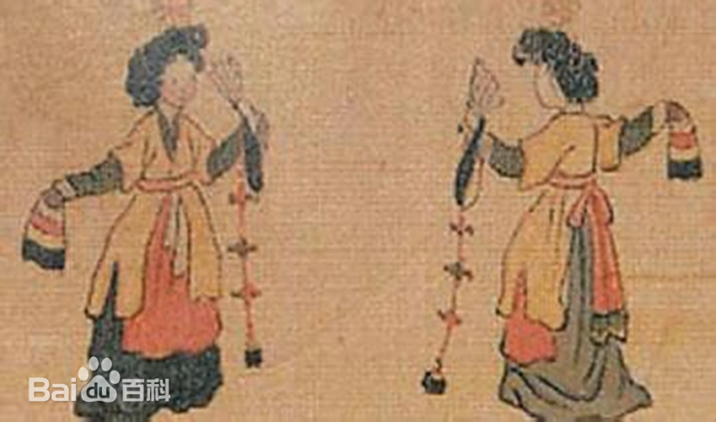
Costume Characteristics of the Zhezhi Dance Performers
Their waists are cinched with floral sashes adorned with jewels and ornaments
They wear beaded floral hats adorned with
bells and brocade boots,
creating a costume rich in ethnic flair.
Soft, form-fitting embroidered silk robes
featuring wide collars and narrow sleeves

Slide 9
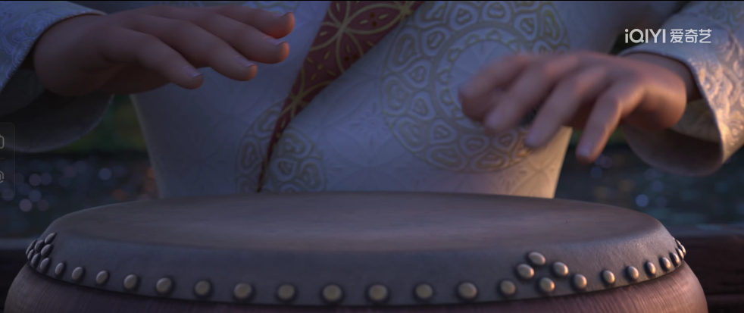
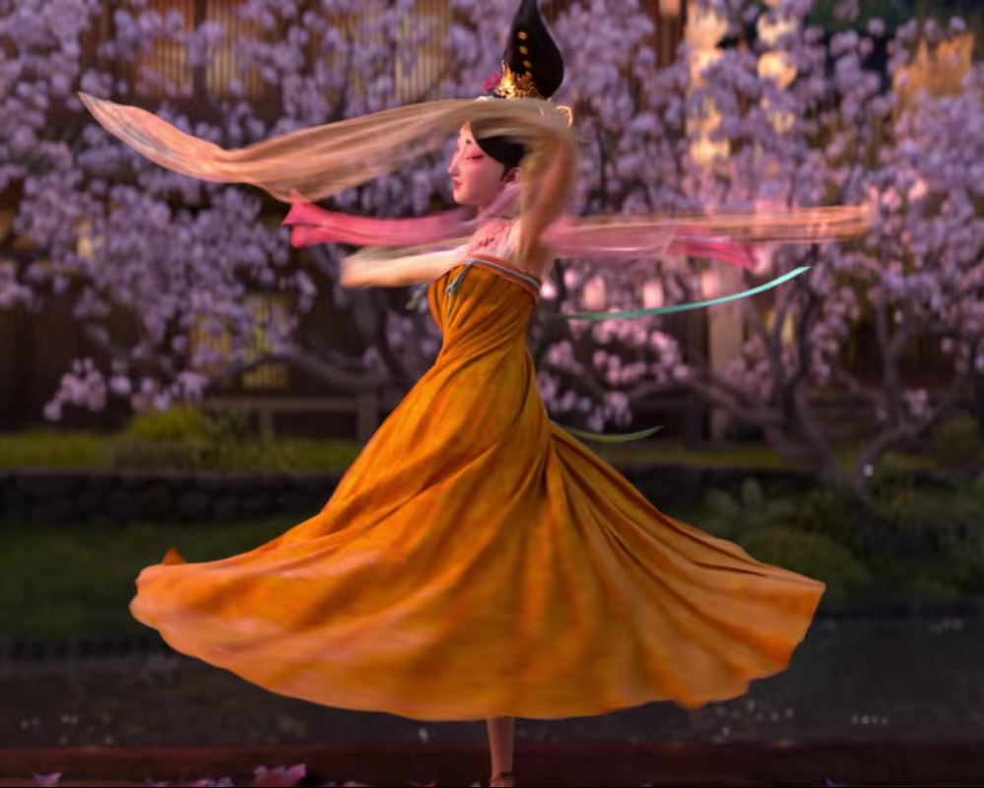
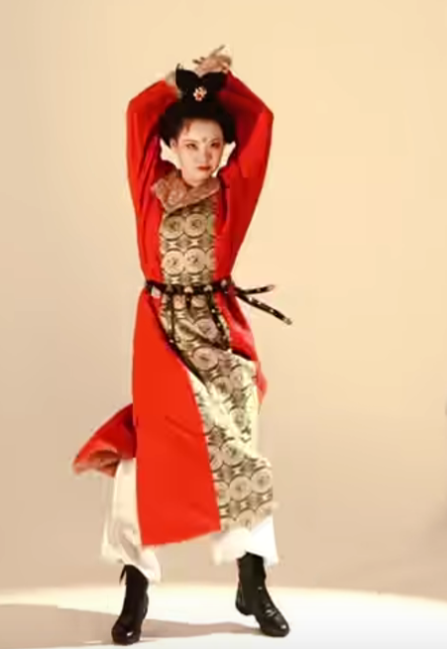
Accompaniment is primarily drum-based.
章孝标《柘枝》诗有：“柘枝初出鼓声招”
白居易《柘枝妓》有“连击三声画鼓催”
Characteristics of the moves of Zhezhi Dance
The dance movements are remarkably diverse, shifting between graceful, elegant, soft, and beautiful and agile, spirited, bright, and lively.

Slide 10
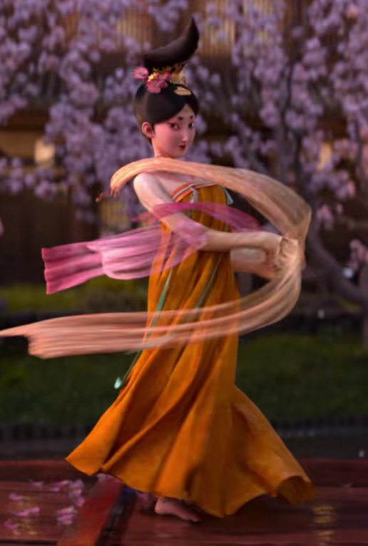
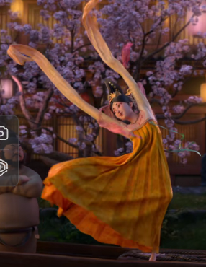
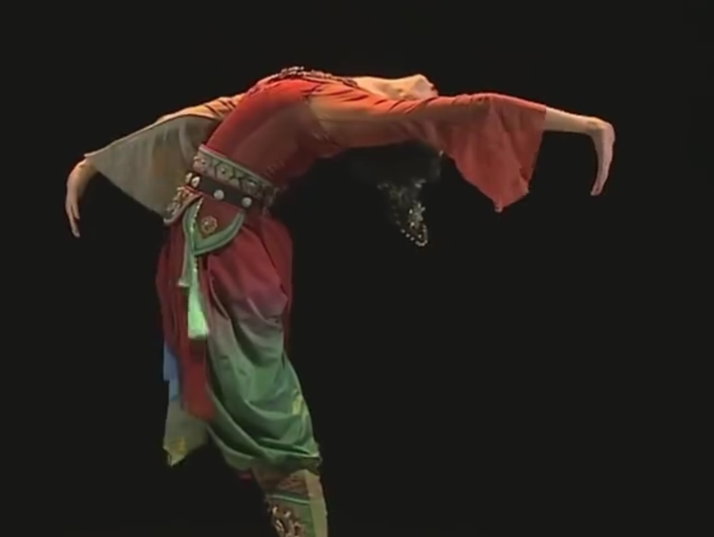
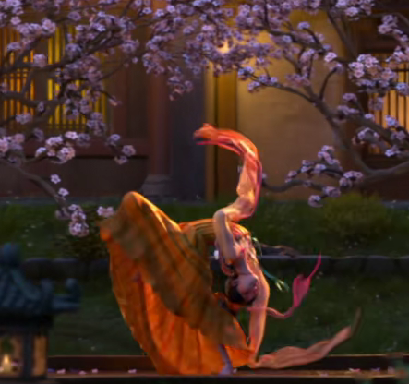
The sleeves sometimes hang low and flutter gently,
other times are swept upward with raised arms.
The dancers' supple backbends, seemingly bone-less, are truly astonishing.
many rotational movements

Slide 11
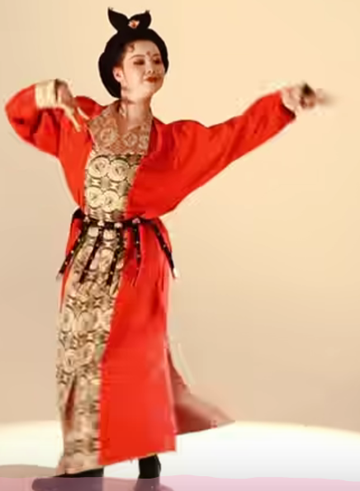
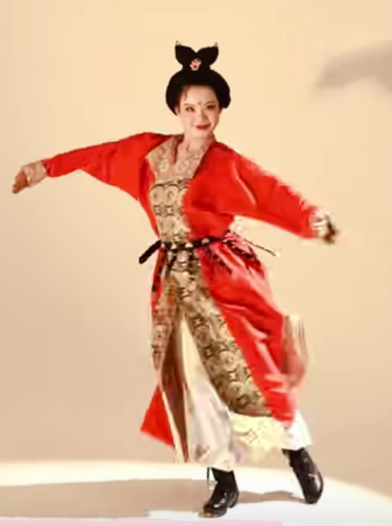
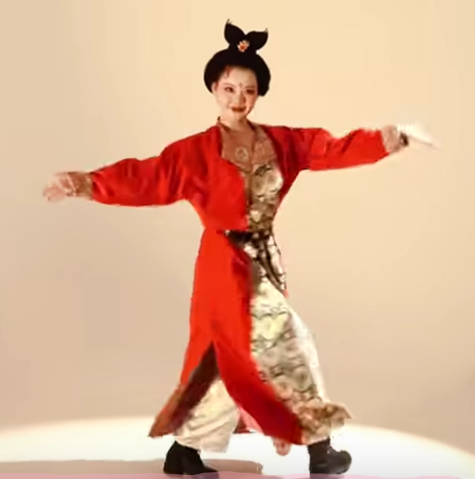
It also emphasizes the subtle shifts in facial expressions, particularly using the eyes as a vital form of dance language. Through gentle glances, alluring gazes, and charming expressions, the dancers convey emotion with grace and charm.

Slide 12
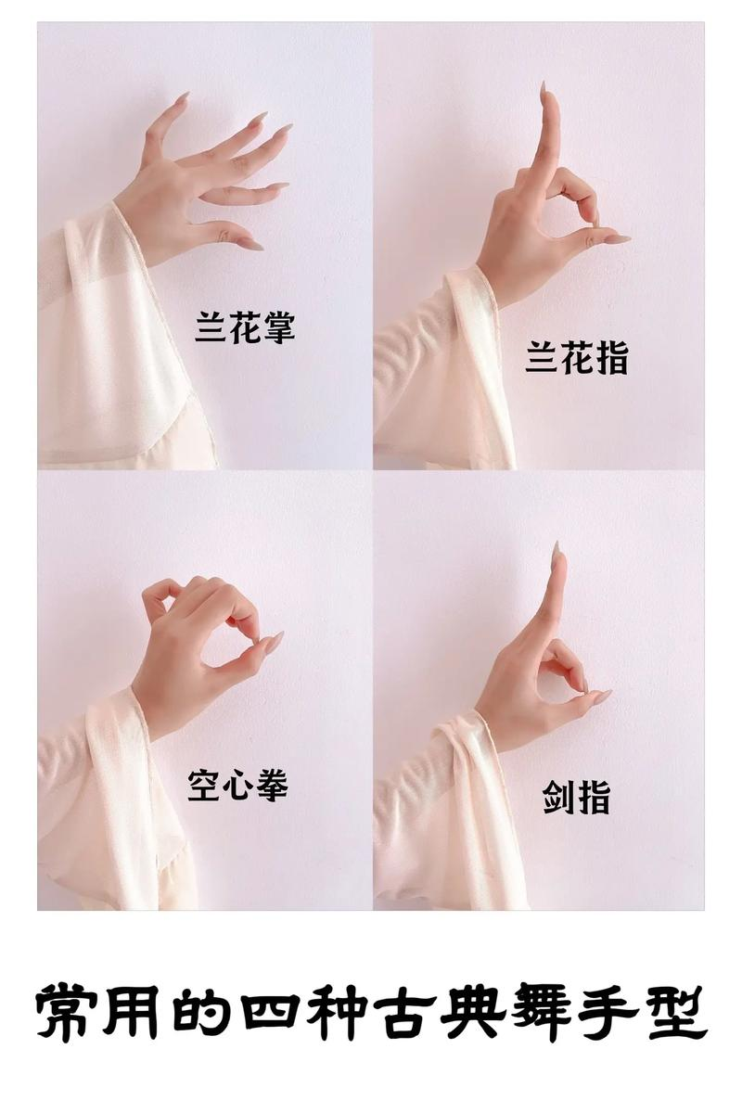
Hand Poses/Forms
Lotus Bud Gesture
Xiang Yun Shou (Auspicious Cloud Hands)
Chi Juan Dai Shou (Holding the Flowing Silk Ribbon)
Orchid Finger Gesture

Slide 13
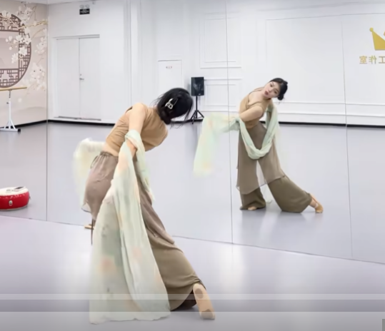
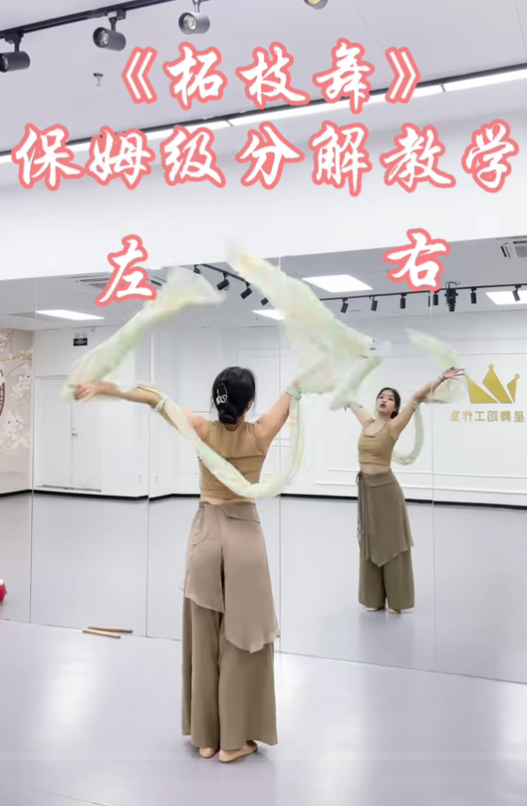
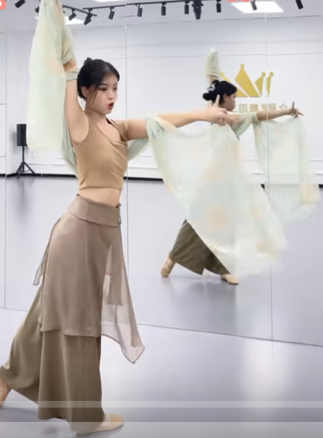
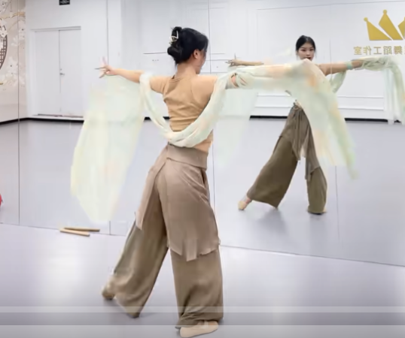
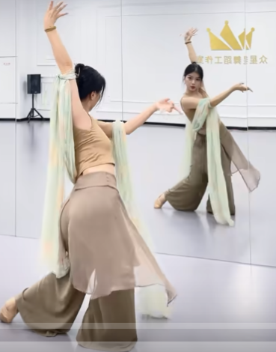
Let’s learn together!

Slide 14
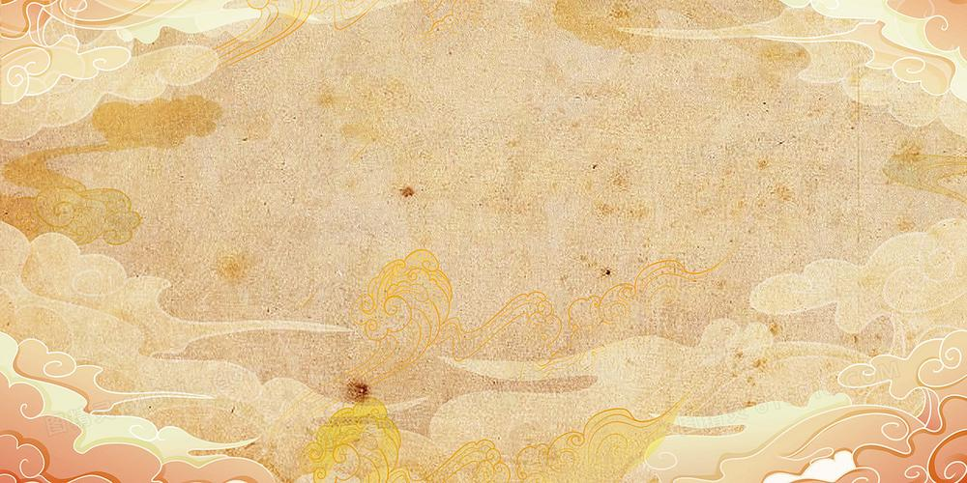
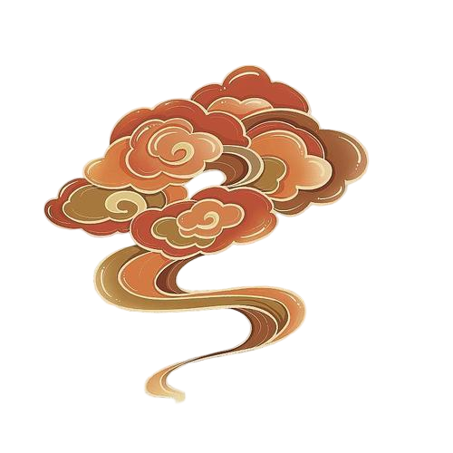
Thanks
for your
attention!
Speaker:Guo Xiaopei

