Slide 1

Oil-paper Umbrella

Slide 2
CONTENTS
01、Introduction
02、History
03、Current condition
04、Summary

Slide 3
01
Introduction

Slide 4
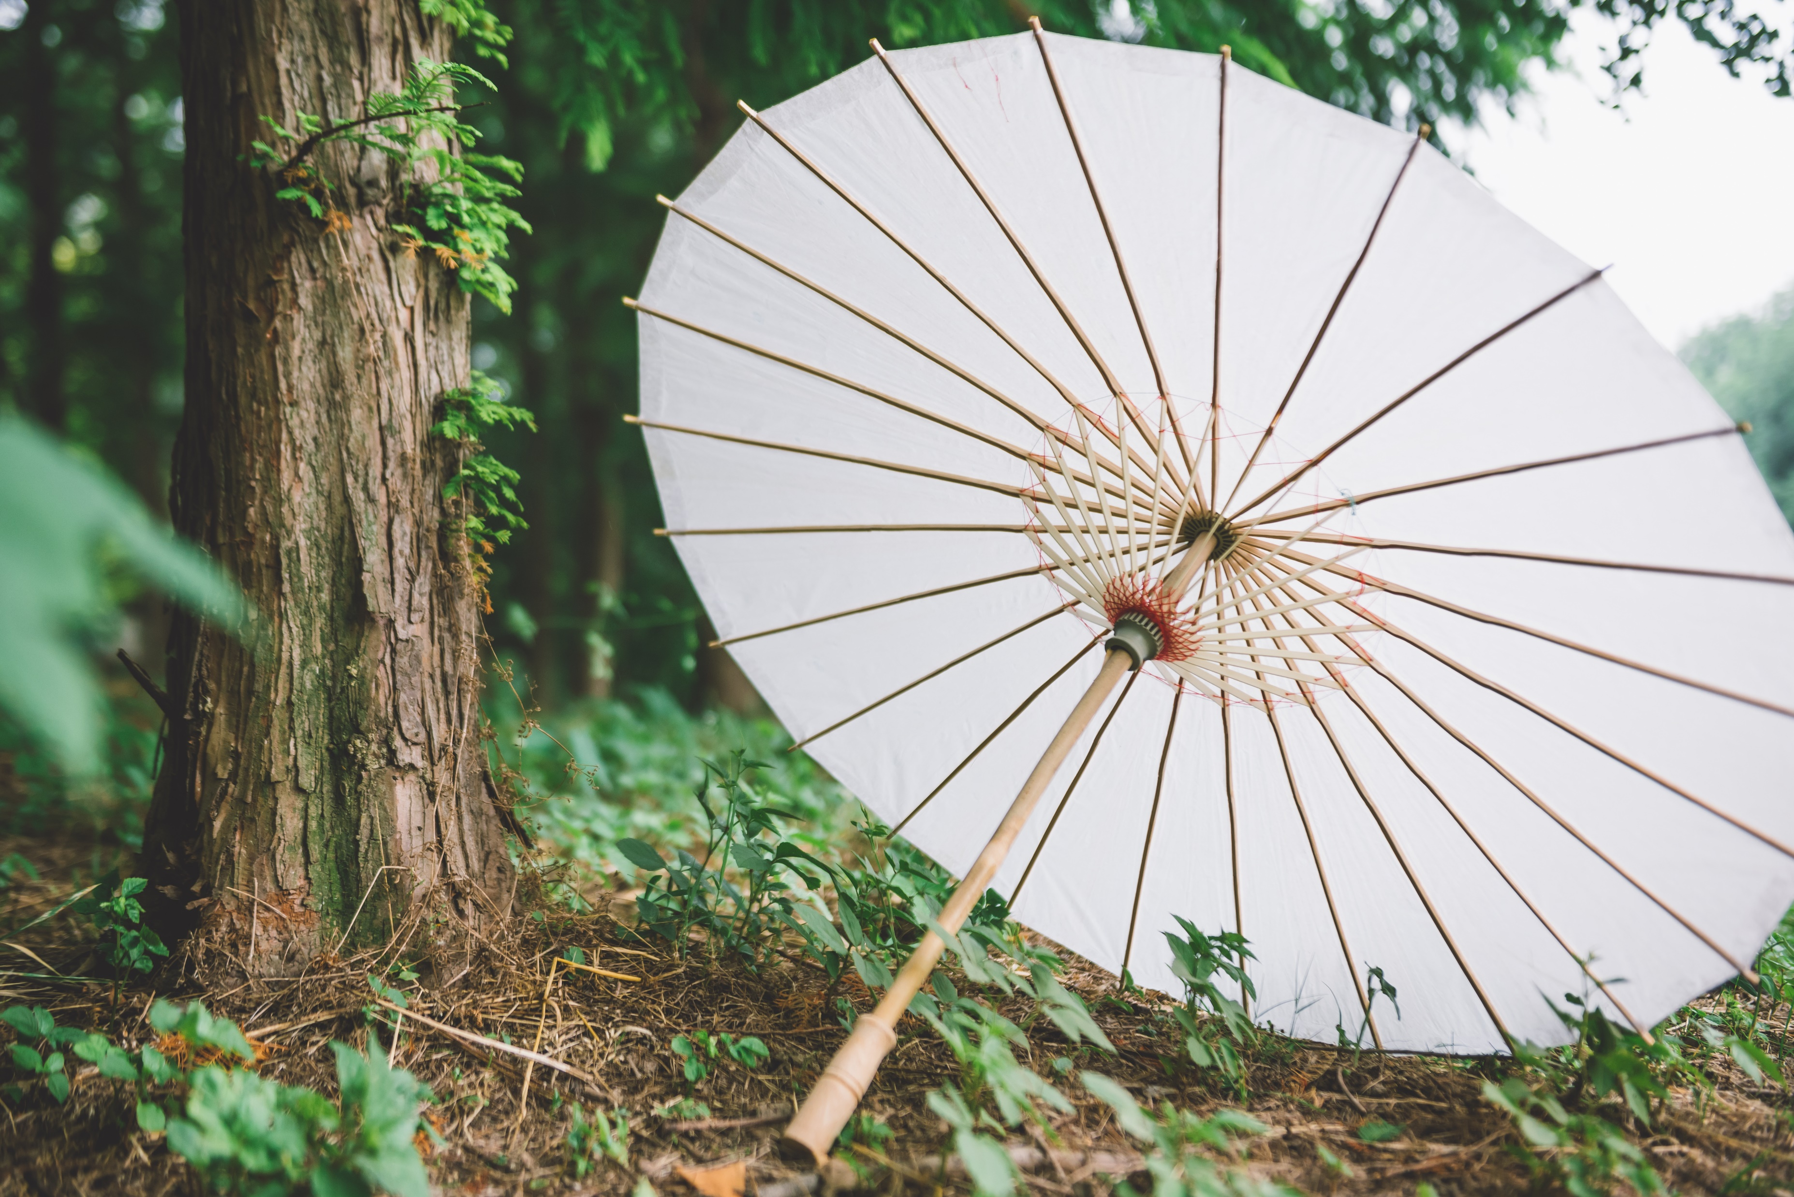
Brief Introduction
The oil-paper umbrella is one of China's famous traditional handicrafts, which not only serves its practical purpose but also holds high aesthetic value. It plays an important role in many ceremonys. According to legend, the earliest umbrella was invented by Yun, wife of Lu Ban, and it has been gradually improved and passed down to this day. With a long history and rich connotations, the oil-paper umbrella symbolizes many good wishes such as prosperity, happiness, and family reunion.

Slide 5
symbolic meaning
Many children
Steady promotion
“油纸”→“有子”
“傘”→five“人”
The umbrella rib is made of bamboo which has a section by section structure.
Family reunion
Safeness and
good fortune
The shape of the umbrella is circular, which means reunion in Chinese culture.
In Chinese folklore, it is believed that tung oil(桐油) can ward off disasters and evil spirits.

Slide 6

Basic production process
1
Bamboo is selected.
The bamboo is crafted and soaked in water. It is then dried in the sun, drilled, threaded and assembled into a skeleton.
2
Washi paper is cut and glued onto the skeleton. It is trimmed, oiled, and exposed to sunlight.
3
oil-paper umbrella
4
Patterns are painted onto the umbrella

Slide 7
02
History

Slide 8
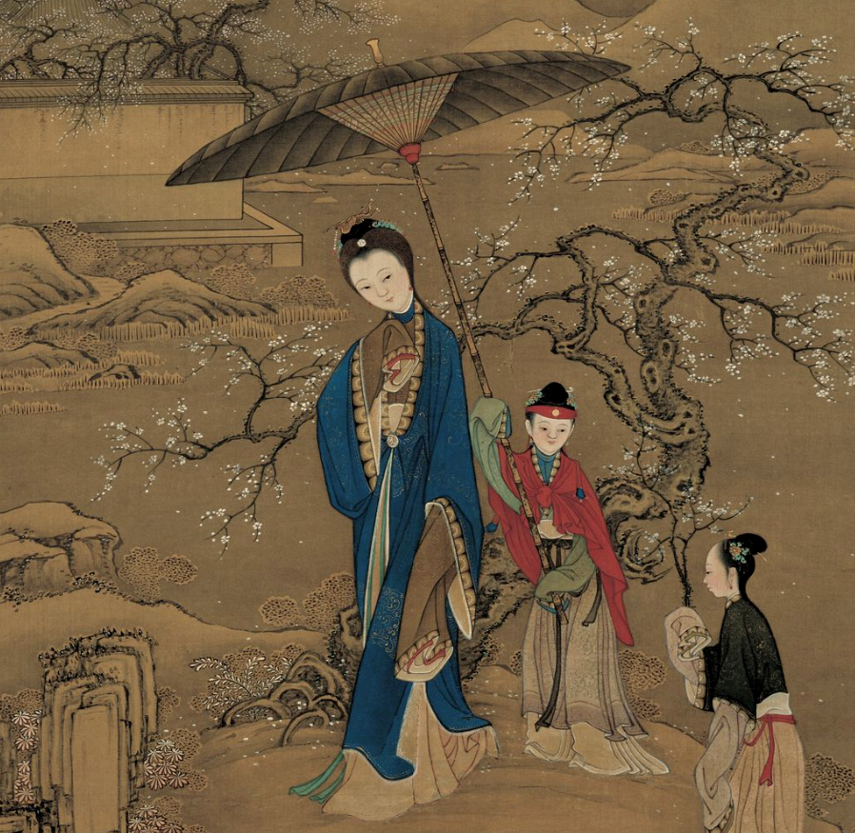
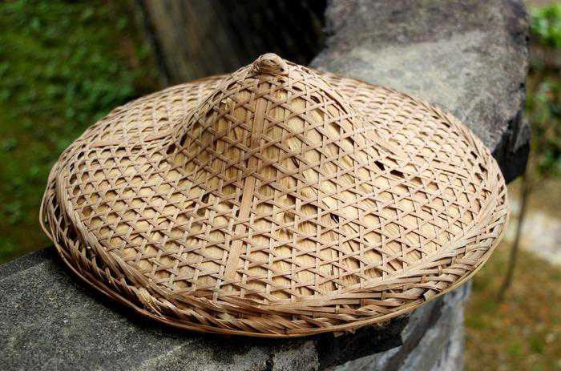
Primitive society
It is worn on the head,
with no handle to hold.
“笠”
It is larger than “笠”, with a handle to hold, but cannot be opened or closed.
“簦”

Slide 9
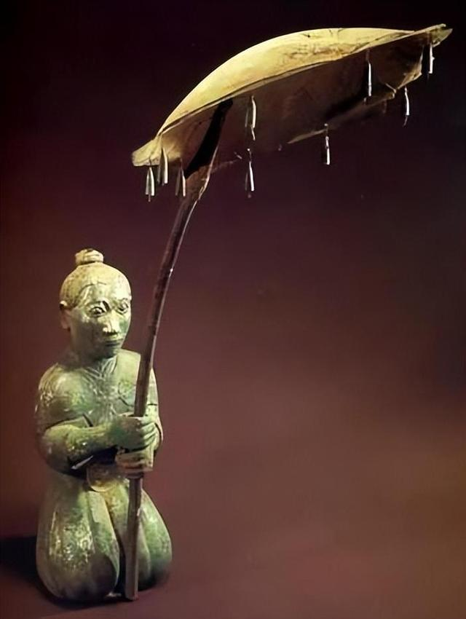
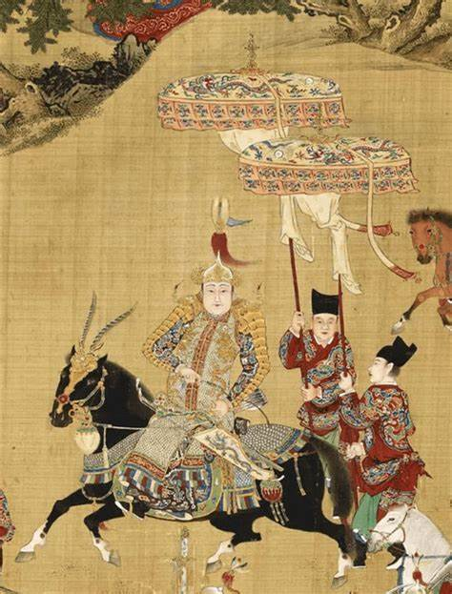
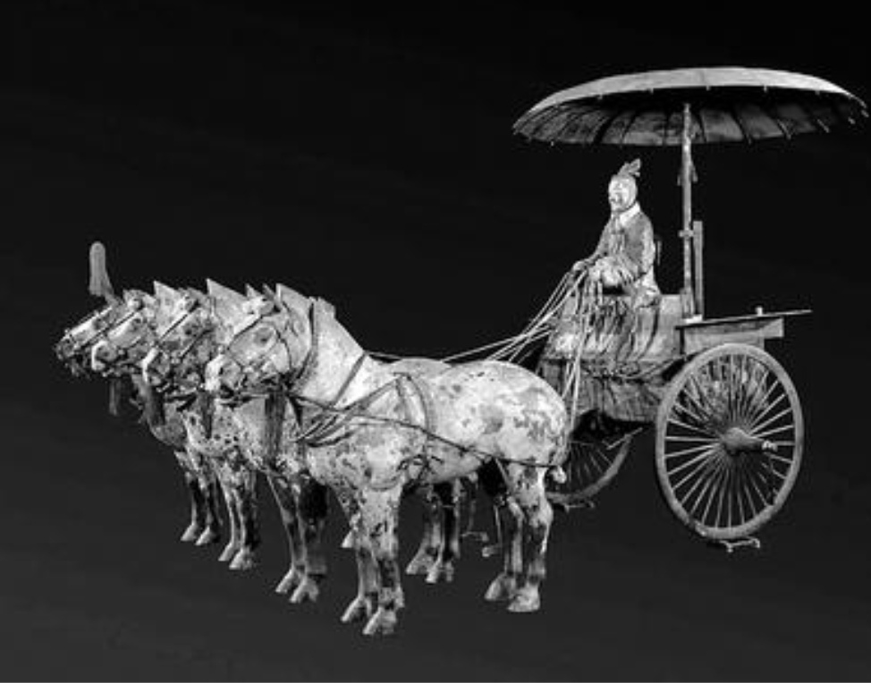
The Spring and Autumn Period and the Warring States Period
“盖”
It is mainly made of wood, feathers, and textiles, and still cannot be opened or closed. It is mainly used by aristocrats and has not been popularized among the common people.

Slide 10
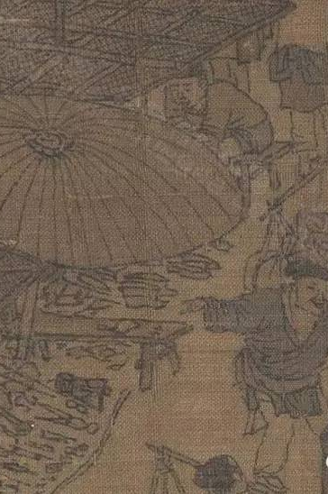
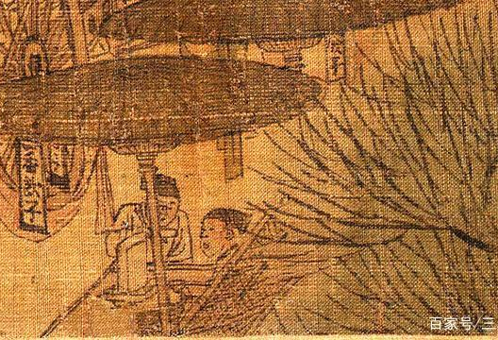
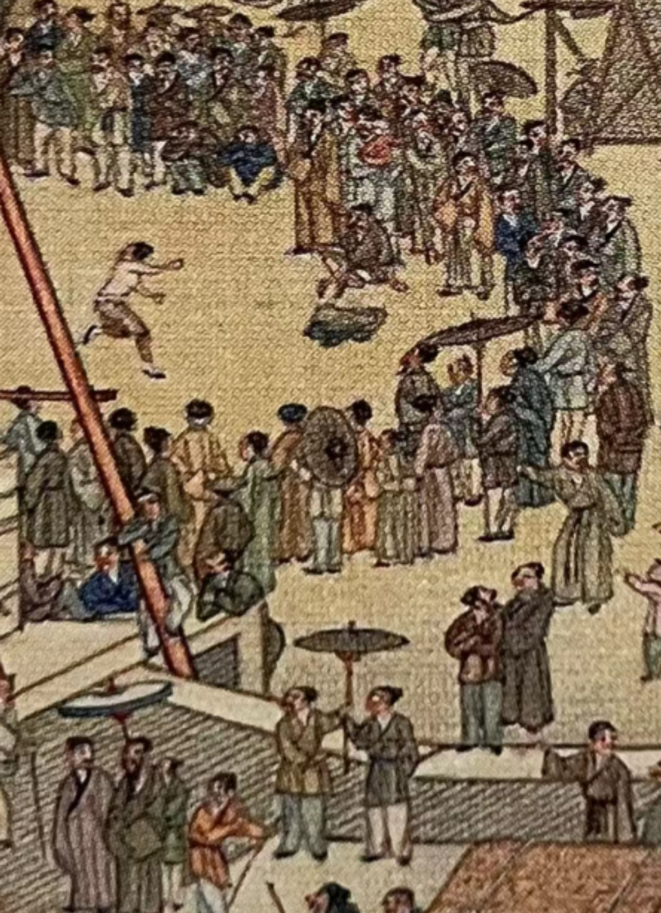
Wei and Jin Dynasties
Tang Dynasty and Song Dynasty
After the invention of papermaking technology, oil-paper umbrellas appeared. “盖“ entered the folk, gradually evolving into“伞”.
The production and use of oil-paper umbrellas became widespread, and umbrellas became foldable, spreading to neighboring countries like Japan and Korea. The umbrella-making industry had the characteristics of specialization and refinement.
In Zhang Zeduan's Along the River During the Qingming Festival, there are both large umbrellas used by shops and vendors, as well as small umbrellas for everyday use by common people.

Slide 11
Ming Dynasty and Qing Dynasty
About 1960s to 1970s
The craftsmanship of oil-paper umbrellas has been refined, and there is a wide variety of them.
Under the pressure of modern steel-framed umbrellas, the survival space for oil-paper umbrellas has become narrow, leading to their gradual decline.
Yuhang oil-paper umbrella

Slide 12
03
Current condition

Slide 13
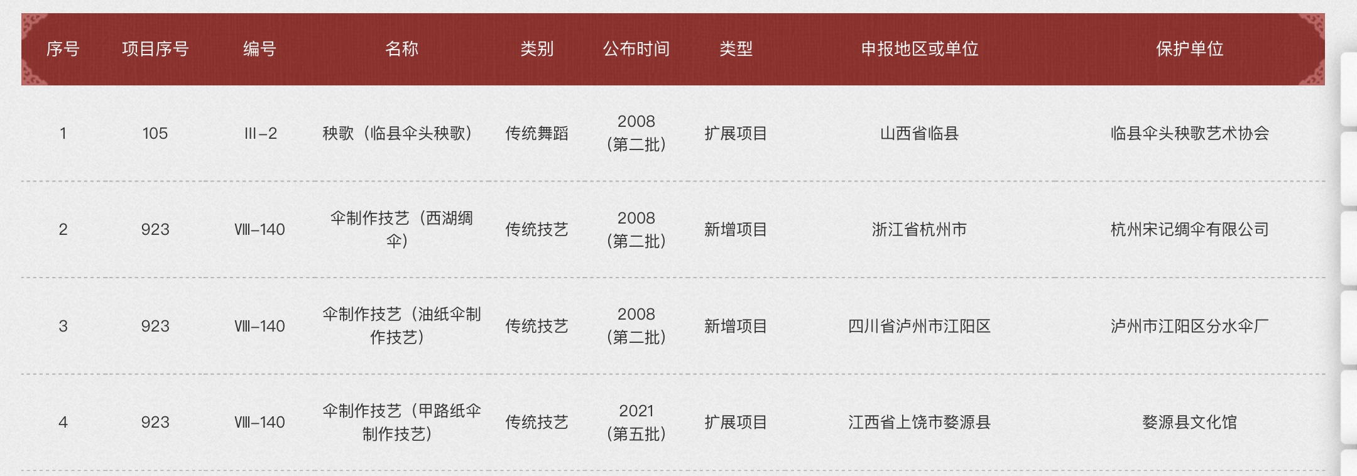
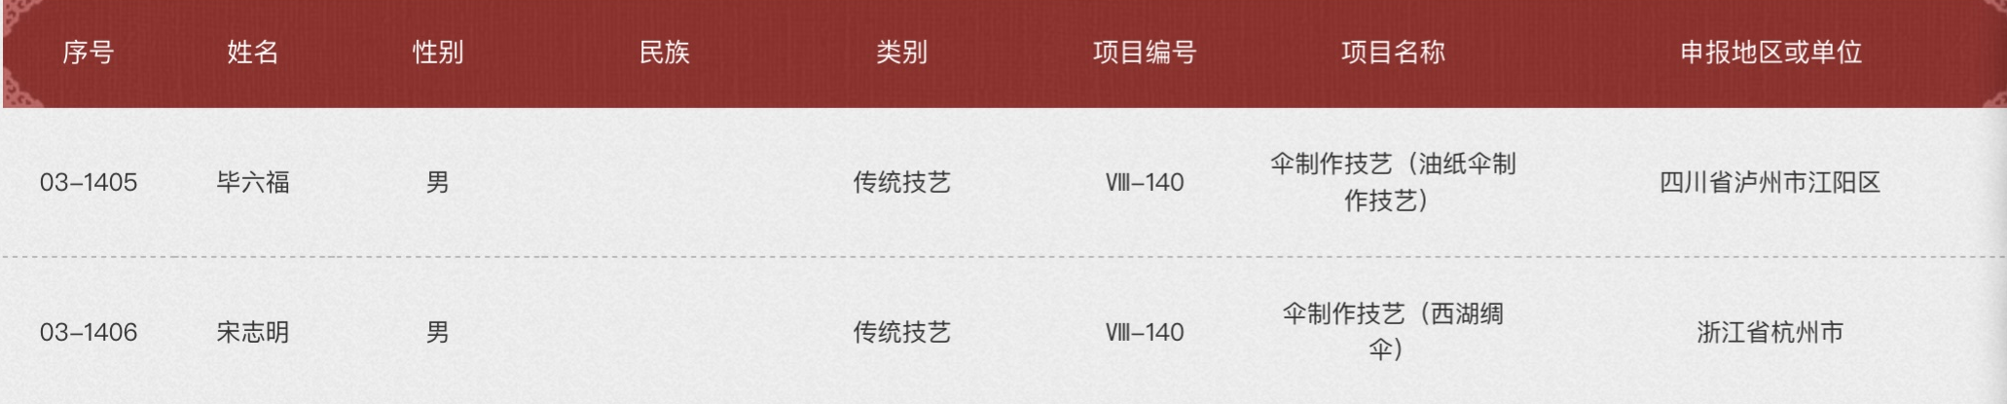
It is protected and on the way to renascence
Intangible Cultural Heritage

Slide 14
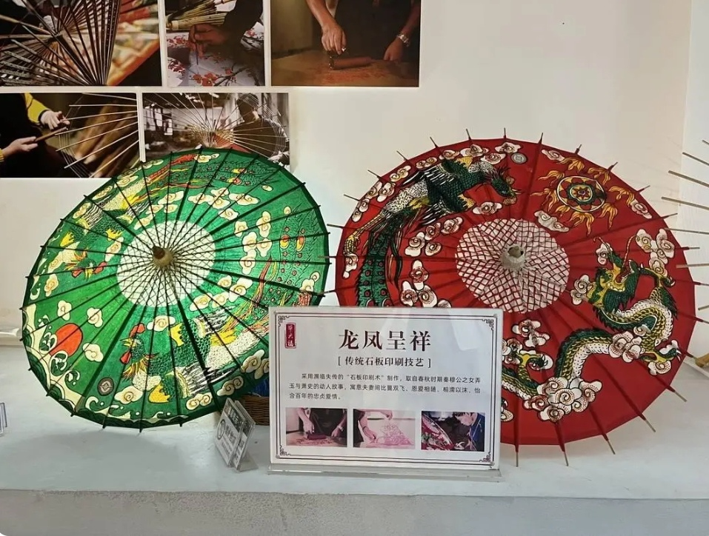
It is protected and on the way to renascence
Works of oil-paper umbrella
The oil-paper umbrella artwork Dragon and Phoenix Auspicious produced by Bi Liufu, an inheritor of intangible cultural heritage.

Slide 15
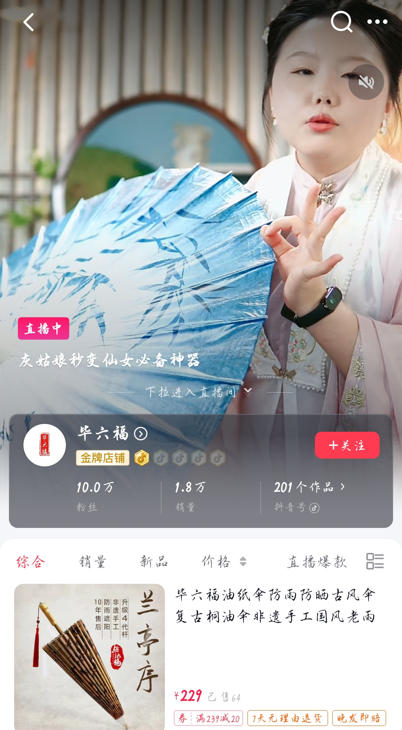
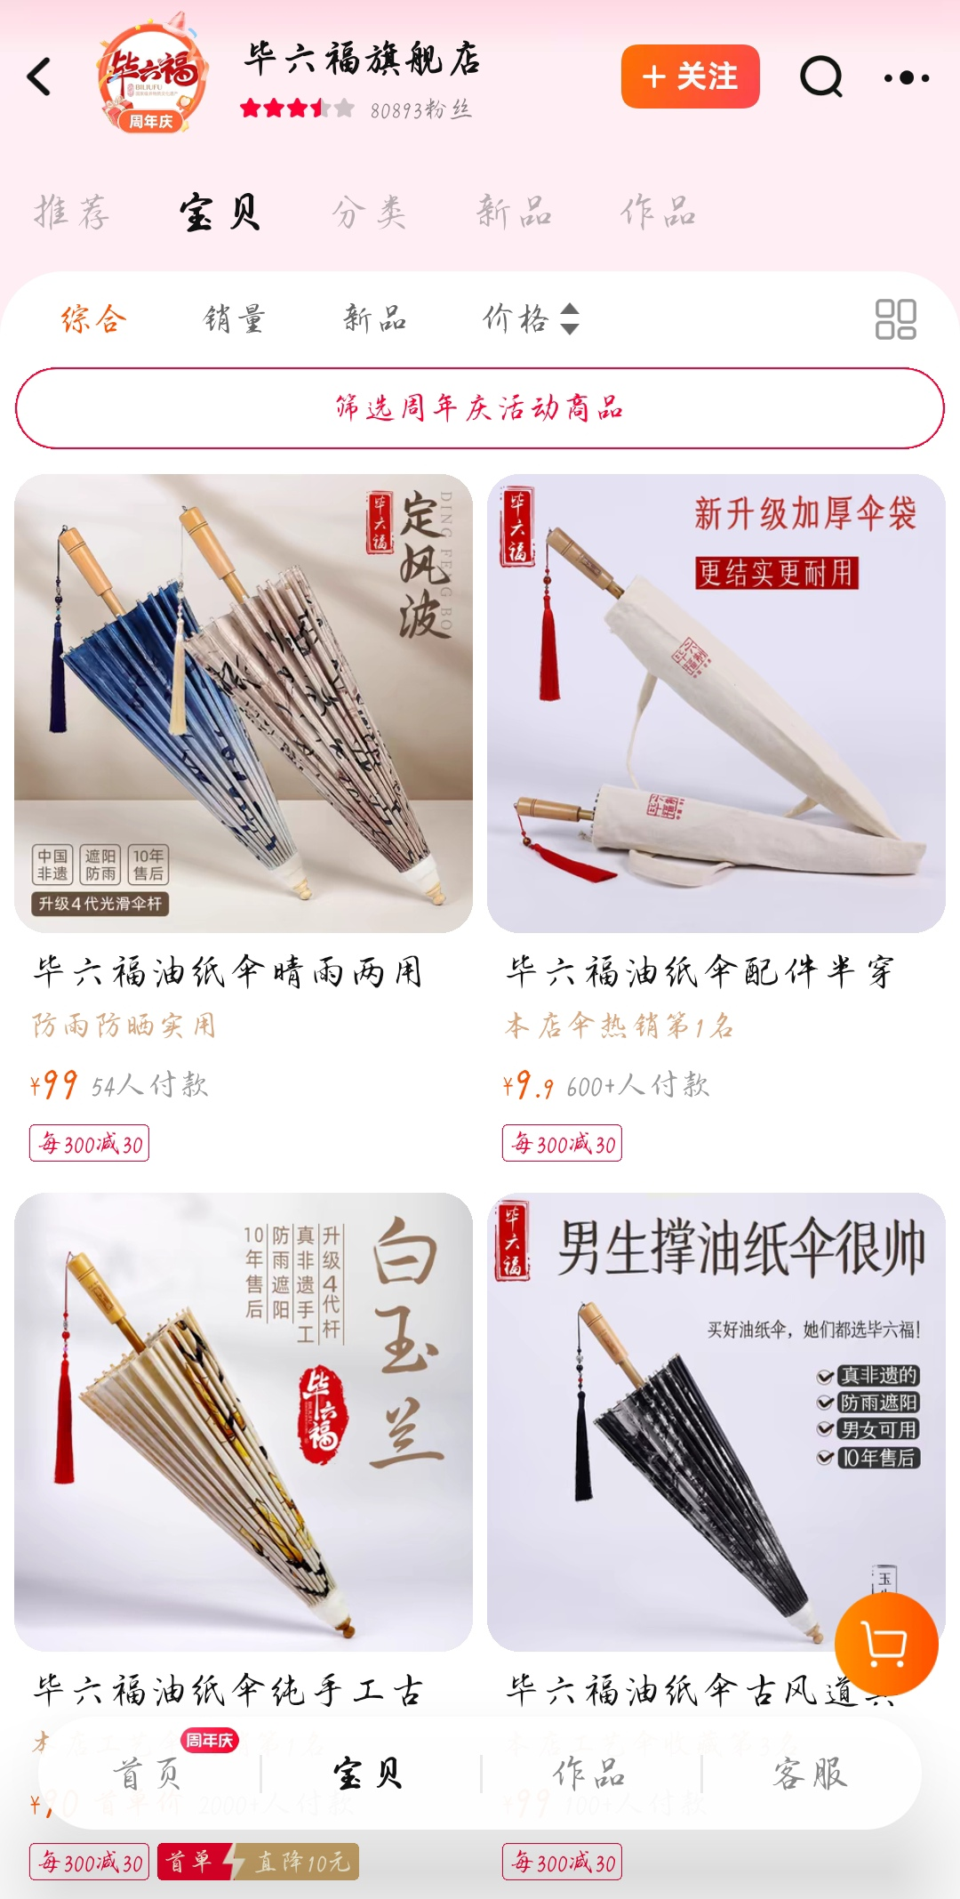


It is protected and on the way to renascence
Oil-paper umbrella on the internet
Bi Liufu has shops on both Taobao and Douyin (Chinese TikTok), and uses live streaming to sell products.

Slide 16
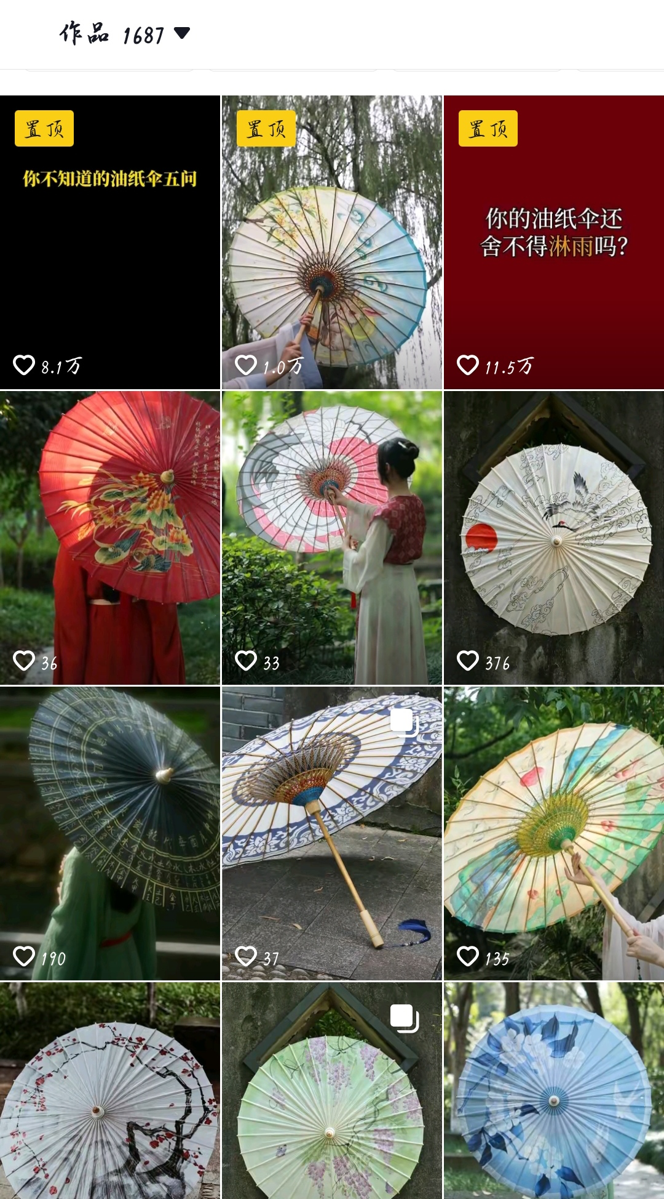
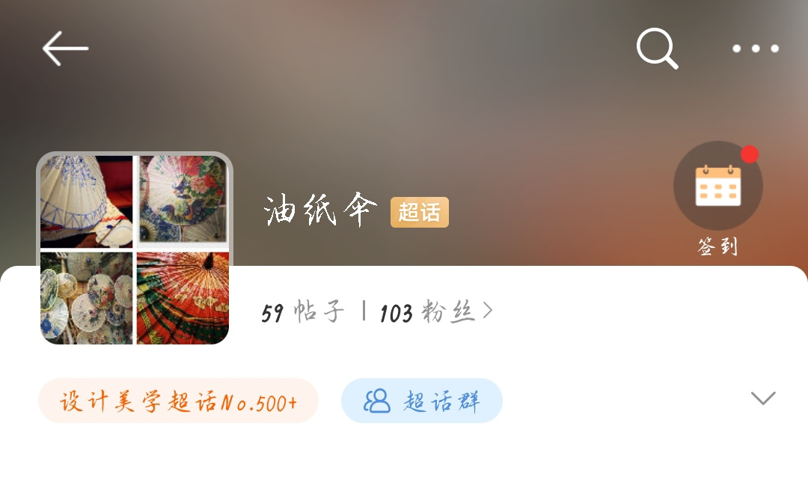
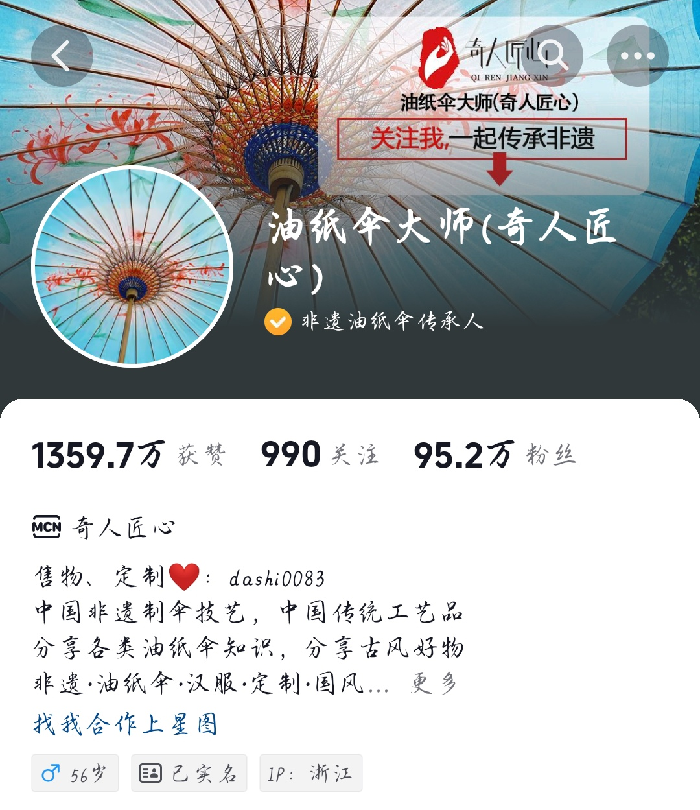
It is protected and on the way to renascence
Oil-paper umbrella on the internet
There are bloggers promoting oiled paper umbrellas online, but the number of likes is not very high. Additionally, the development of oil-paper umbrella topics on Weibo is not good, with relatively few fans and posts.

Slide 17
04
Summary

Slide 18
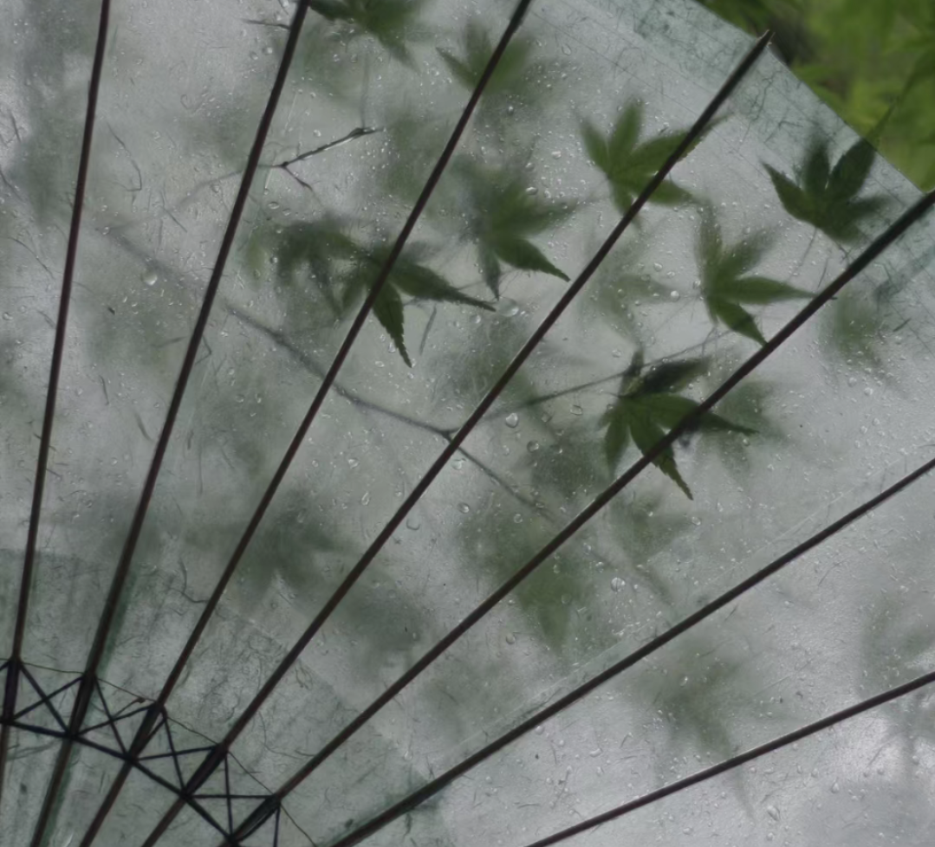
Although the practical value of oil-paper umbrellas is relatively low nowadays, their cultural and aesthetic value is undeniable. Many Chinese traditional aesthetic elements can be found in the painting on the oil-paper umbrella. They are frequently used to decorate home and public spaces and sometimes serve as props in photography. As carriers of historical culture, oil-paper umbrellas resonate with people's nostalgia and aesthetic pursuit. However, the promotion and dissemination of oil-paper umbrellas are still far from sufficient. While people are aware of their existence, their understanding of them remains limited. One way to enhance public understanding of oiled paper umbrellas is to establish an official website dedicated to craft information for browsing and learning.
Oil-paper umbrella

Slide 19
Thanks

Slide 20
参考文献
[1]杨雅璇.信息可视化在油纸伞工艺传承中的应用研究[D].天津科技大学,2021.DOI:10.27359/d.cnki.gtqgu.2021.000853.
[2]朱蕾.油纸伞制作技艺的保护与传承[D].中国艺术研究院,2016.
[3]油纸伞.百度百科
春季最后一个节气
谷雨节气
谷雨是二十四节气的第六个节气，也是春季后一个节气，每年4月19日～21日时太阳到达黄经30°时为谷雨，源自古人“雨生百谷”之说。同时也是播种移苗、埯瓜点豆的最佳时节。

