Slide 1

4.12
News Reading
陈柯汝，黄梓龙

Slide 2

1
The Title
2
The genre
CONTENTS
3
The structure
4
来年工作计划
NEXT YEAR WORK PLAN

Slide 3

01
The Title
PART ONE

Slide 4

ARATS,SEF Officials Meet 1st Time in 10 Years
1.Ellipsis
ARATS,and SEF Officials Meet for the 1st Time in 10 Years
(function words such as articles, conjunctions and copula are often omitted in newsreports)
2.Present Tense
(present tense is used here for freshness, reality and immediacy).
3.Punctuation “,”
ARATS,and SEF Officials Meet for the 1st Time in 10 Years
( “and” is often replaced by a “comma”in English Newsreports).

Slide 5
ARATS,SEF Officials Meet 1st Time in 10 Years
4.Capitalization
ARATS,and SEF Officials Meet for the 1st Time in 10 Years
(if the first ltter of each notional word实词 is capitalized, then, it is an American
newsreport;if only the first letter of the first word is capitalized, then, it is an
English newsreport.)
5.Initials/Acronyms
ARATS=the Association for Relations Across the Taiwan Straits
SEF=the Straits Exchange Foundation
6. “in ten years”
(the title mentions the time to suggest it has been so long since their last meeting.)

Slide 6
02
The Genre
PART TWO

Slide 7
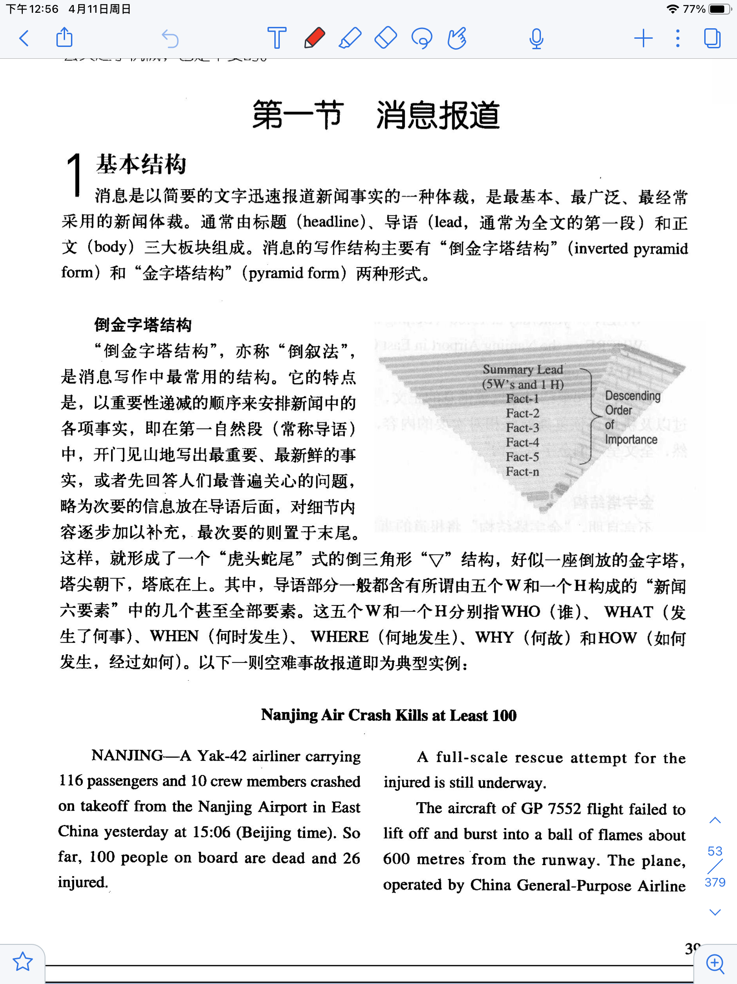
political news
economic news
technological news
cultural news
sports news
...
News Report
(消息报道）
pyramid form
inverted pyramid form
News
Feature Article（特写文章）
Review or Commentary
(新闻述评）

Slide 8
03
The Structure
PART THREE

Slide 9
para1
who:China's mainland and Taiwan
what:took a big step towards closer cross-Straits ties
when:yesaterday
how:through the first official meeting
para2-5
......

