Slide 1
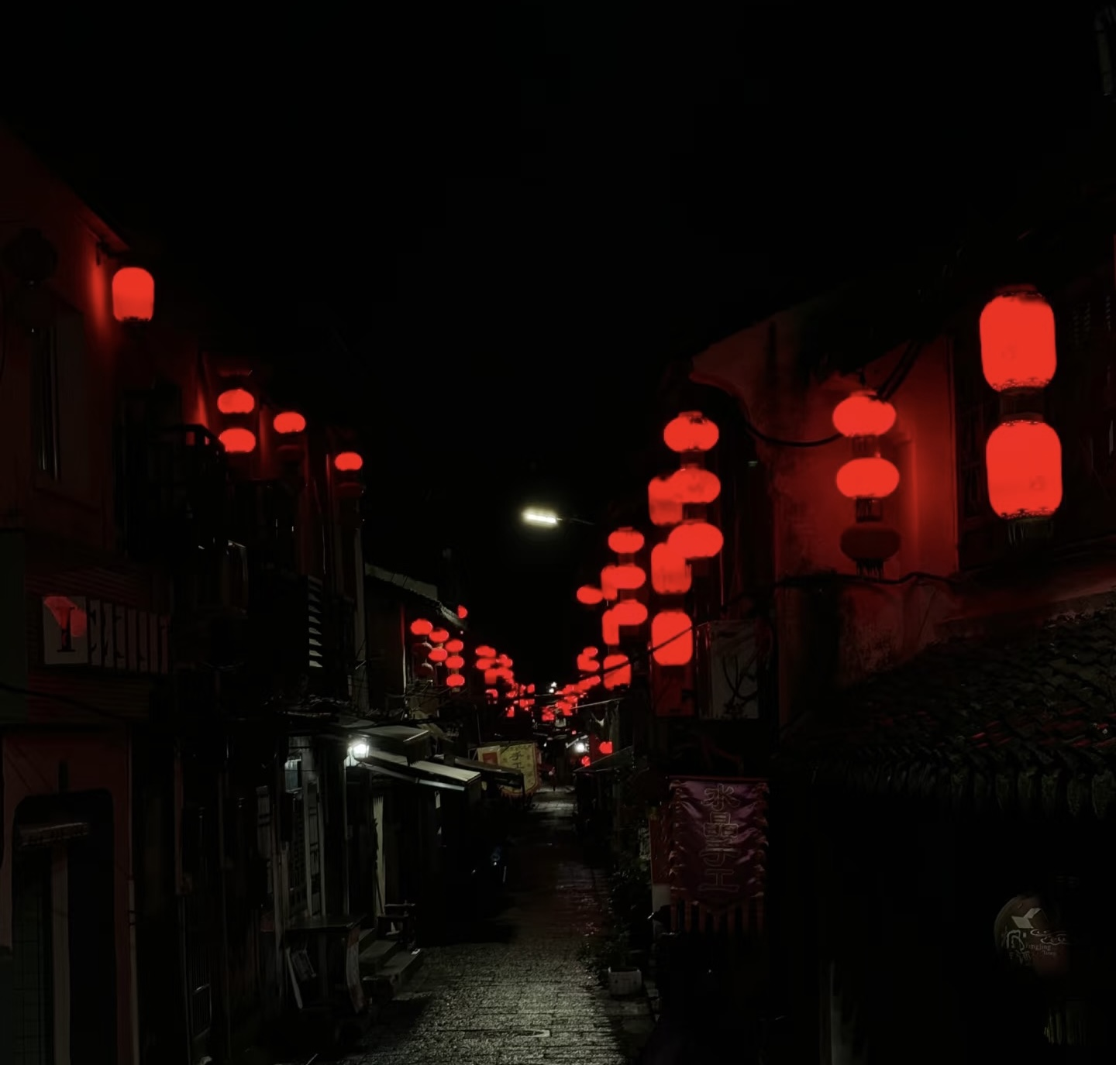
Chinese Horror Movies
by Chen Qianyun

Slide 2
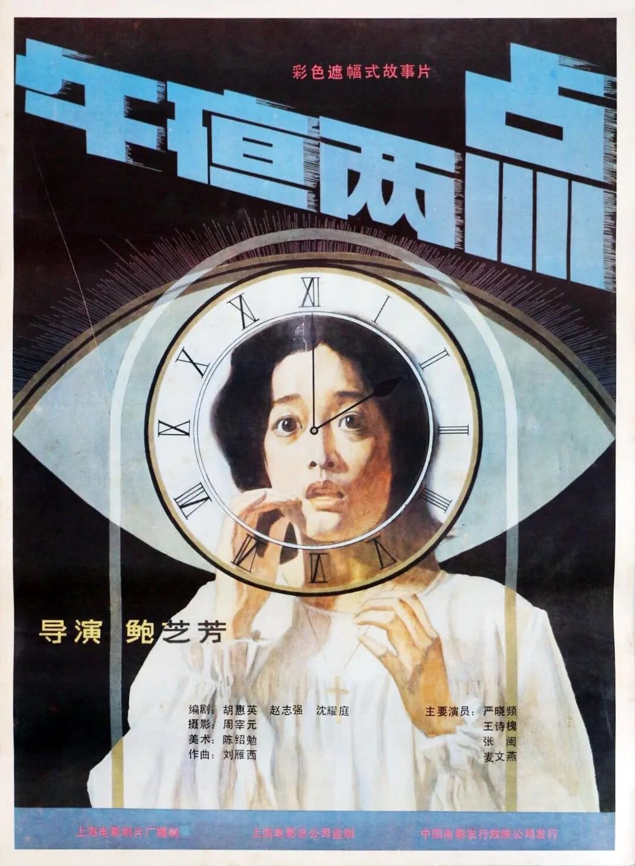
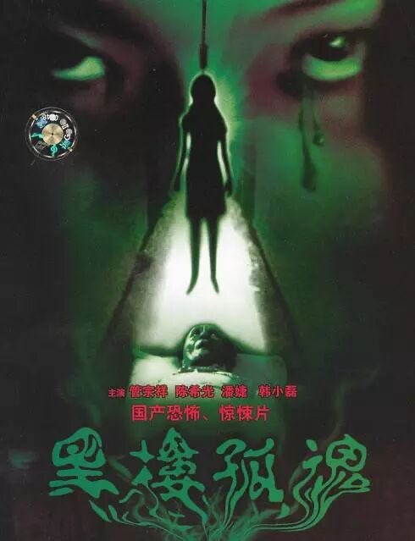
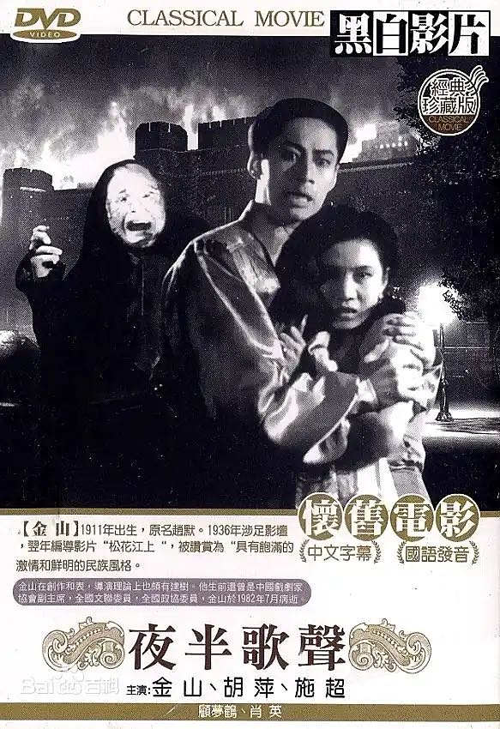
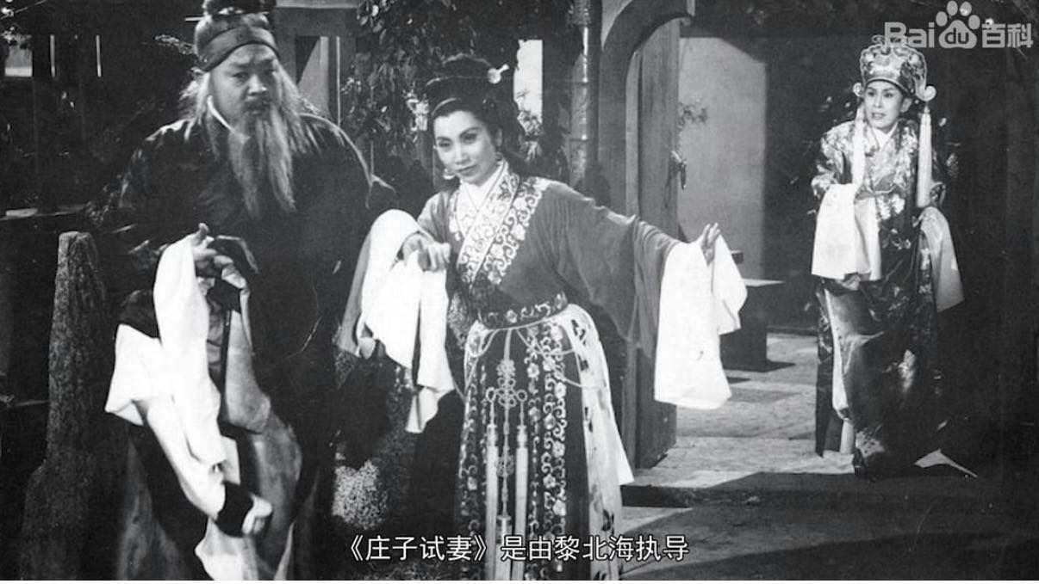
What are horror flims?
Story films specially designed to attract the audience’s curiosity with bizarre and grotesque plots, eerie and terrifying scenes, or sound effects.
----The Dictionary of Film Art
Two in the morning, The Lonely Spirit In An Old Building...----the initial transformation of horror films from traditional to modern
The Phantom lover----the formal arrival of horror films as a genre in Chinese cinema
Chuang Tzu Tests His Wife
----the dawn of Chinese horror cinema
1978----
1937
1913
The development of Chinese Horror Films

Slide 3
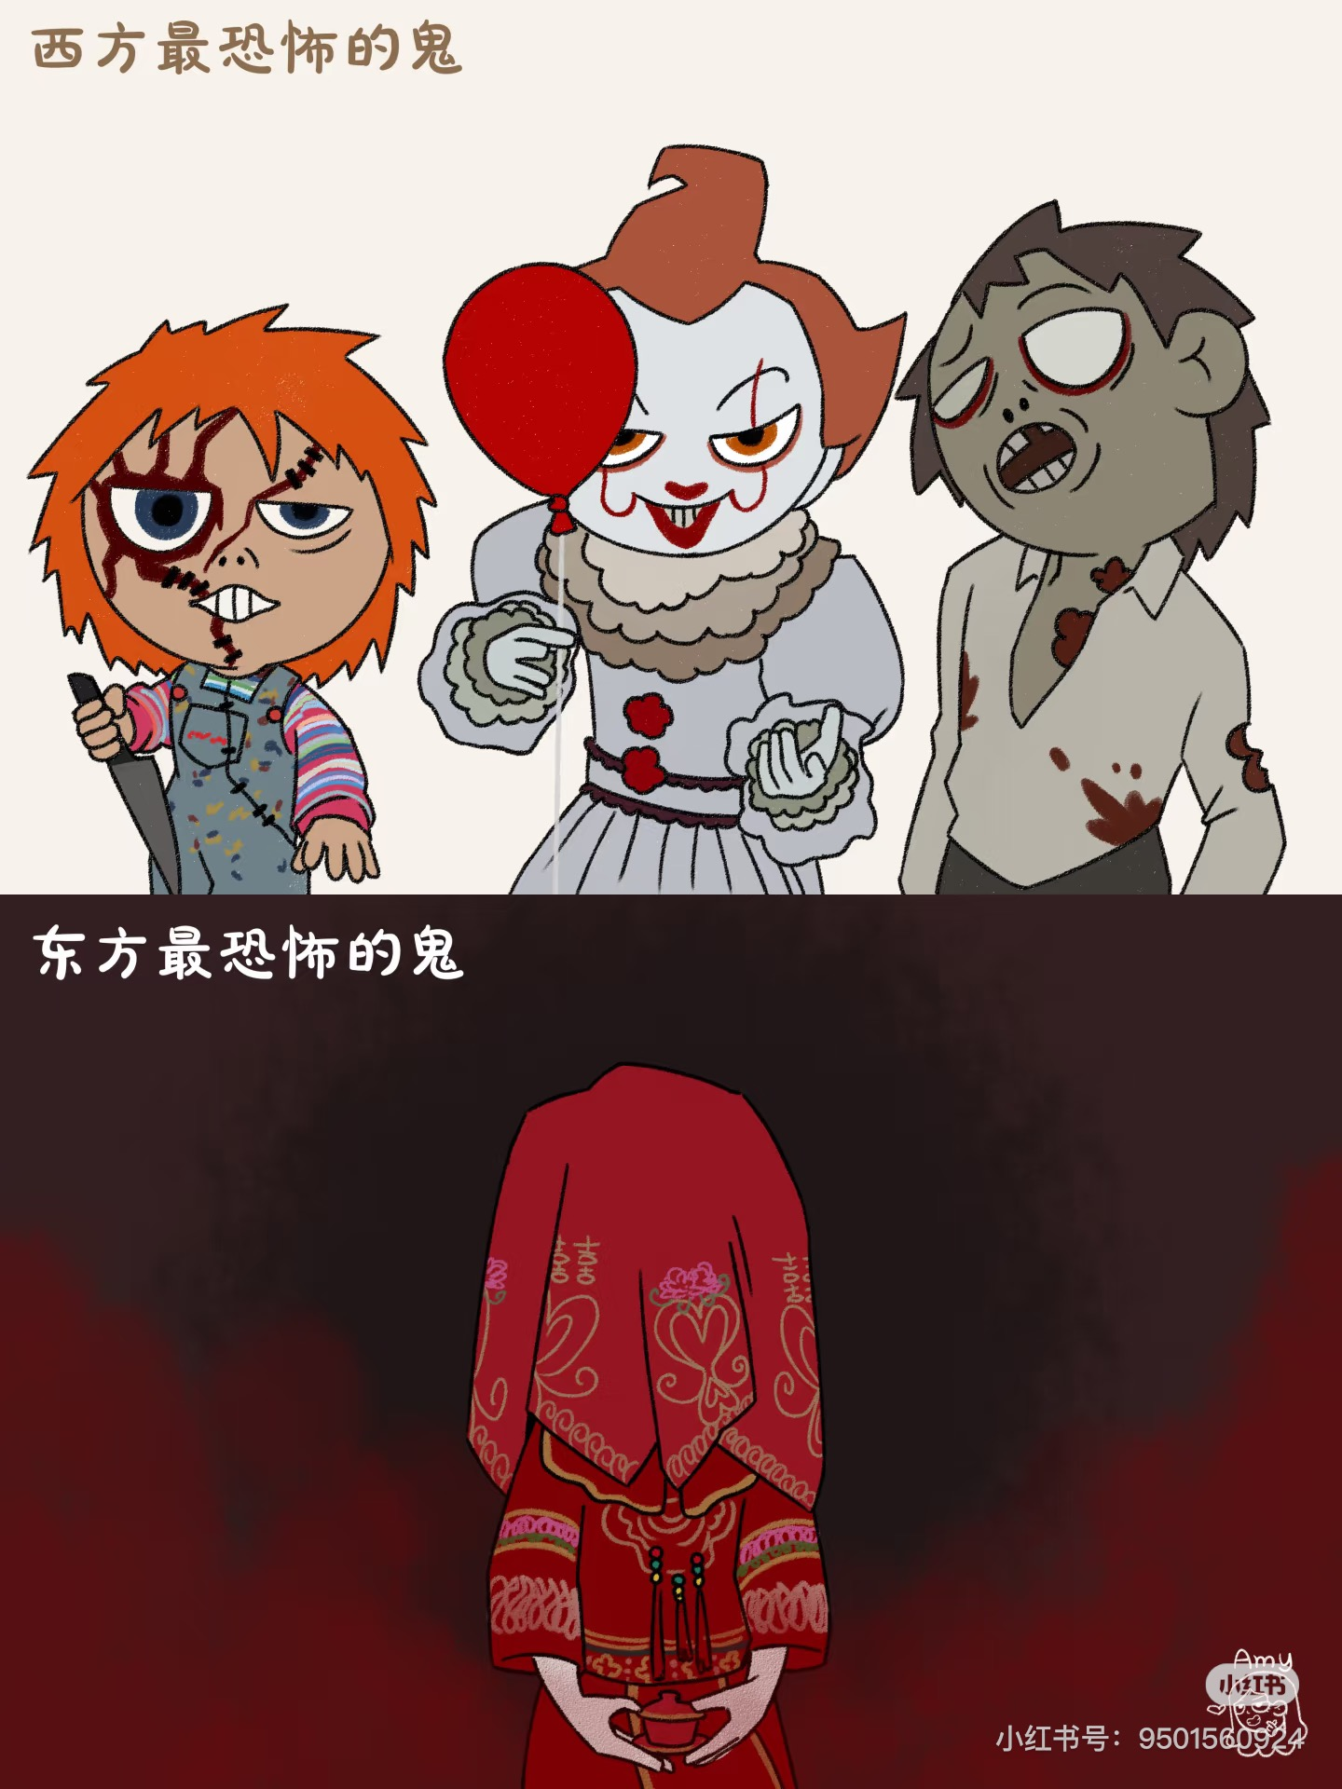
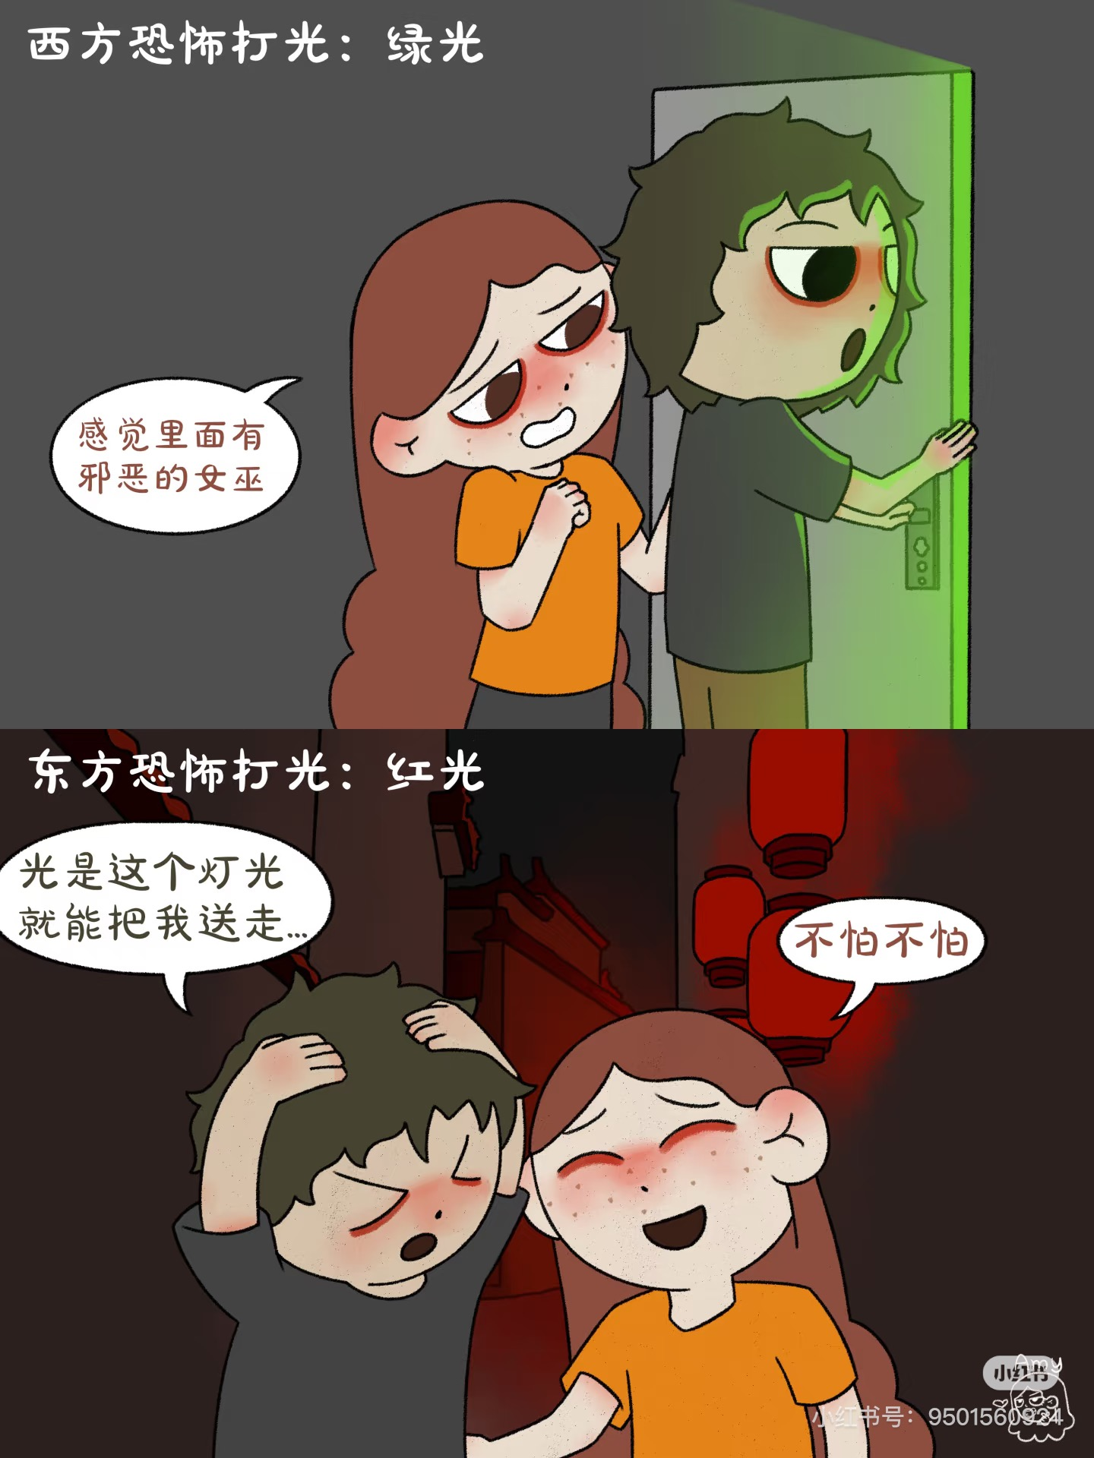
Western
VS
Chinese

Slide 4
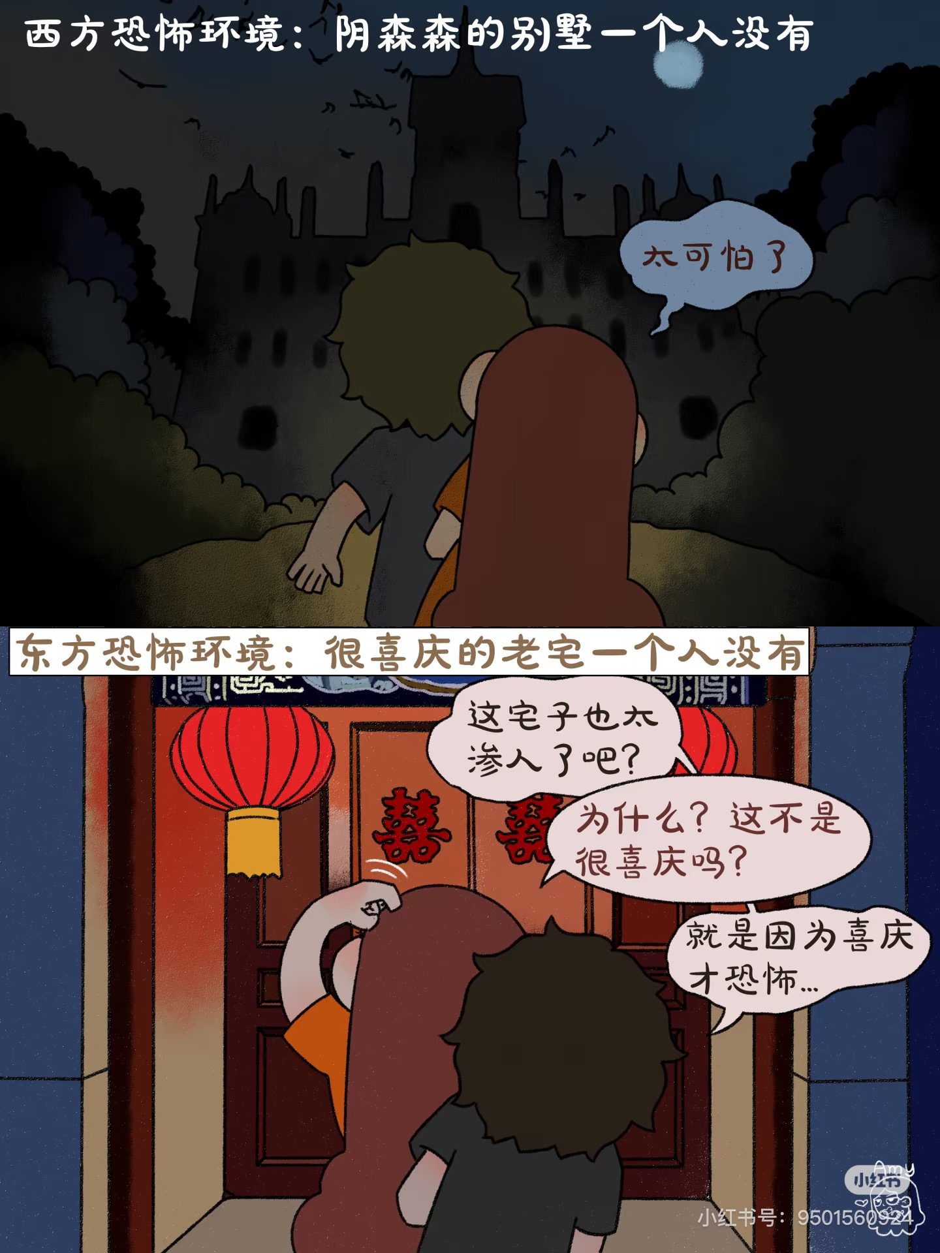
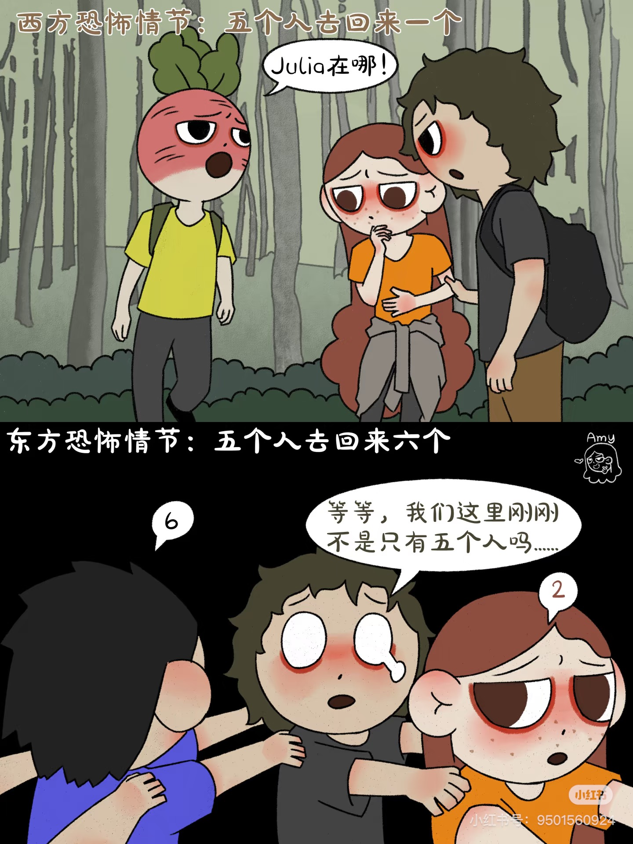
Western
VS
Chinese

Slide 5

Chinese Horror Films
The horror elements primarily include divination 占卜 (like Bunshinsaba series 《笔仙》系列, Ouija series 《碟仙》系列), witchcraft 巫蛊 (like The Possessed 《中邪》), taboos and incantations 禁咒 (like the Forbidden Taboos series 《恐怖禁忌》系列),and rituals 祭祀 (likeThe House That Never Dies《京城81号》).

Slide 6
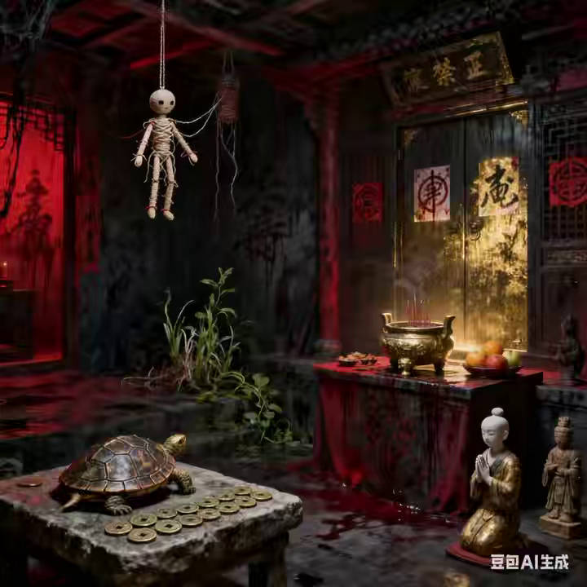

Slide 7
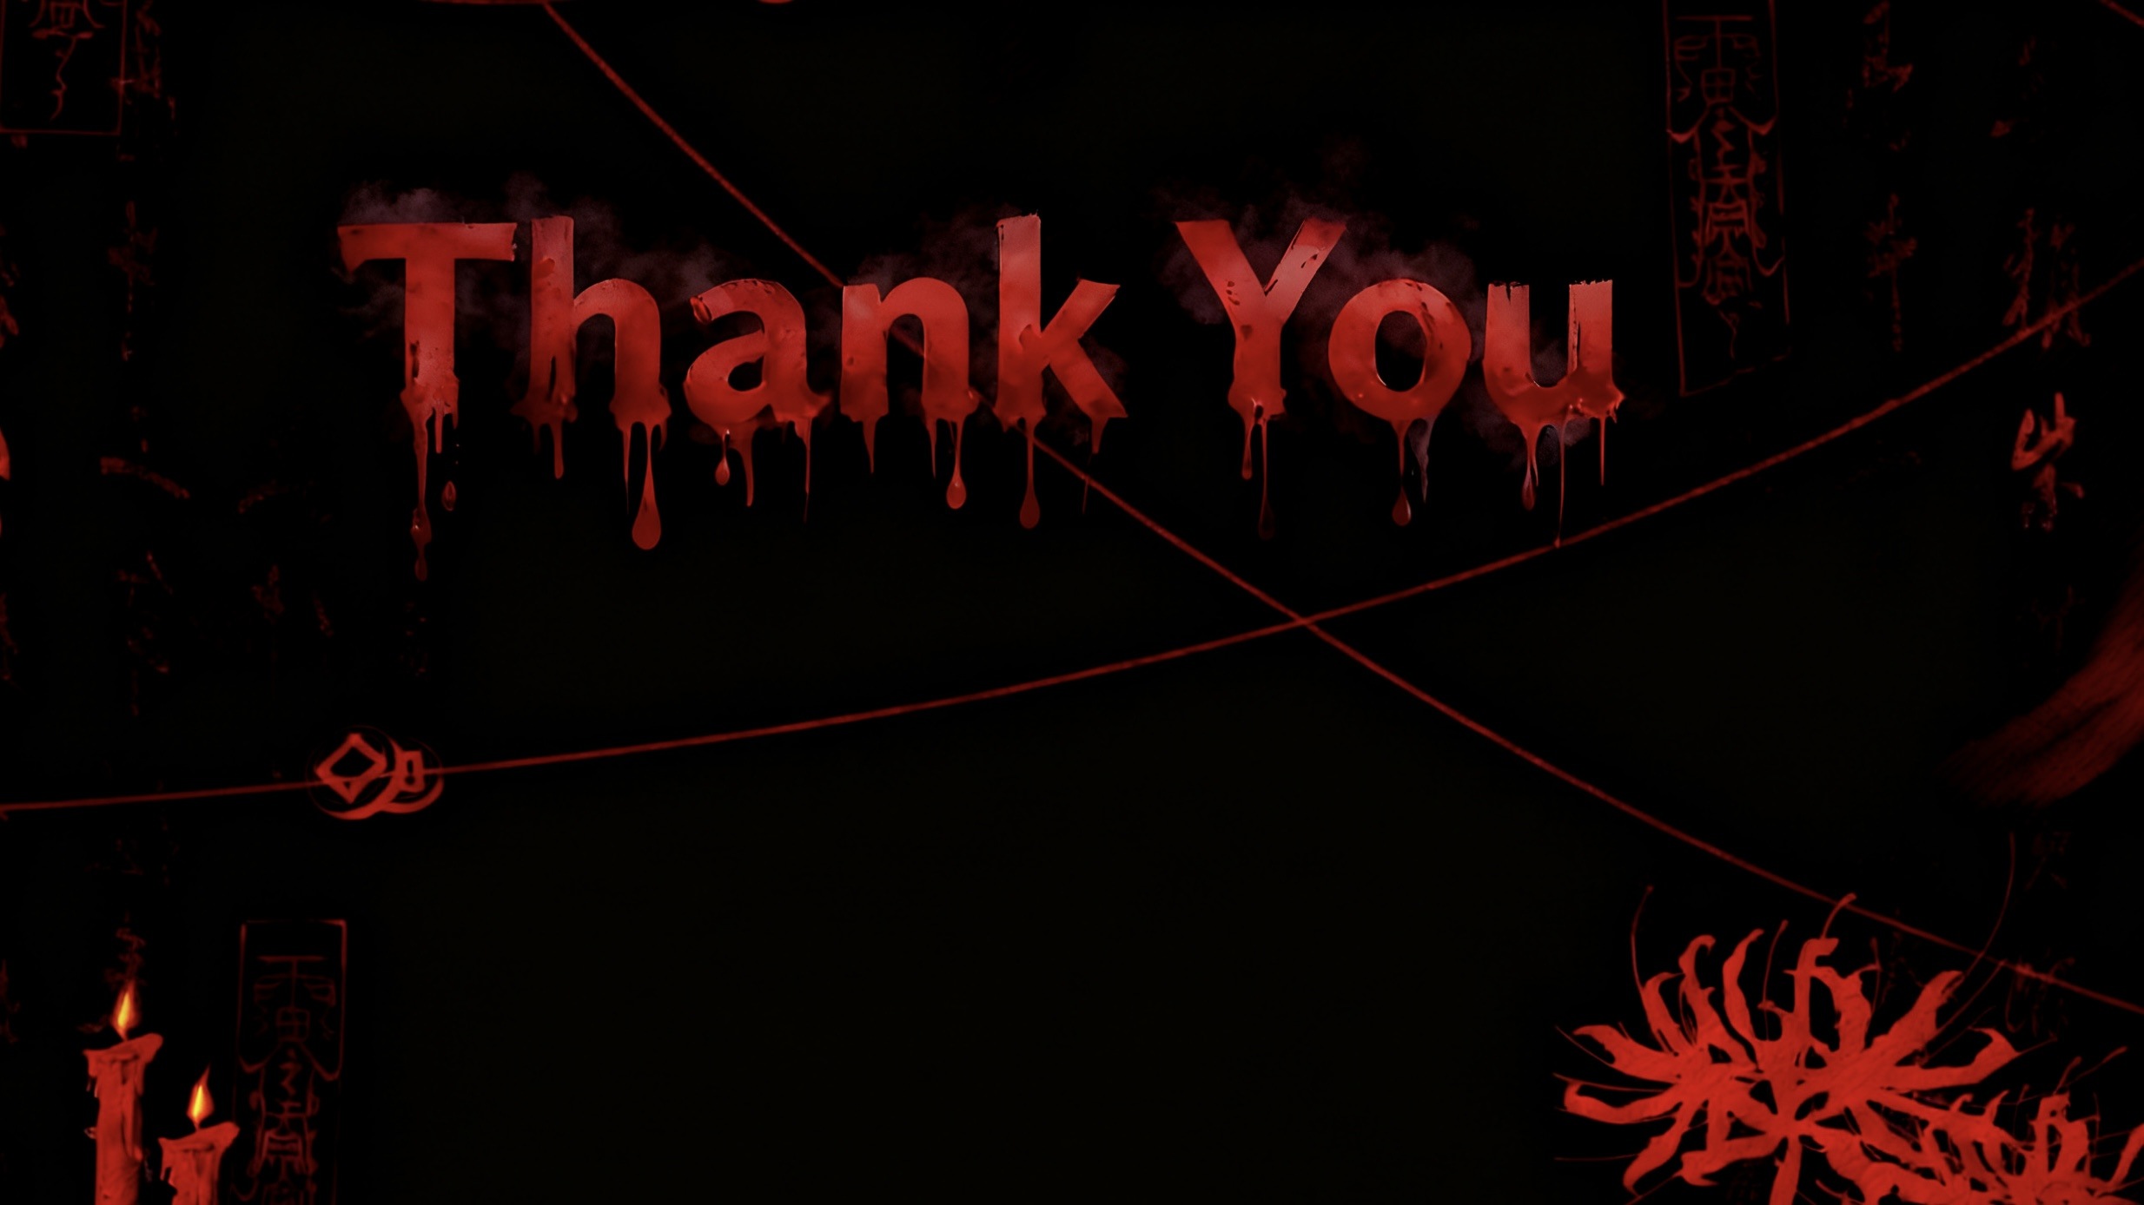
Tha
Chinese horror films emphasize cause-and-effect retribution, so as long as we treat others friendly, no evil things can hurt us.
不做亏心事，不怕鬼敲门

