Slide 1
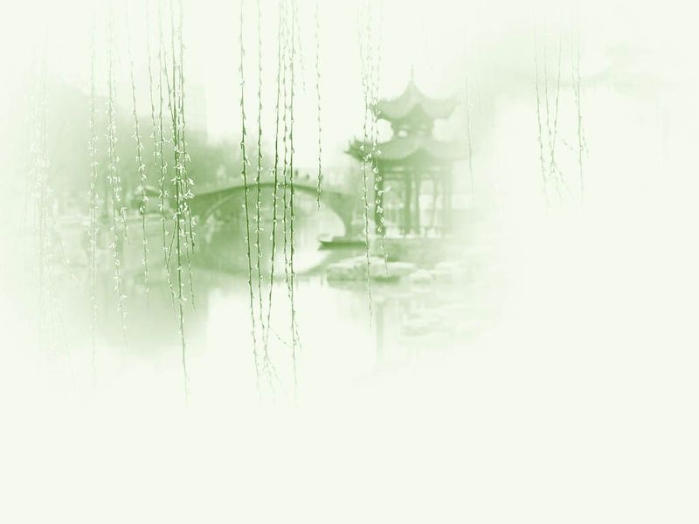
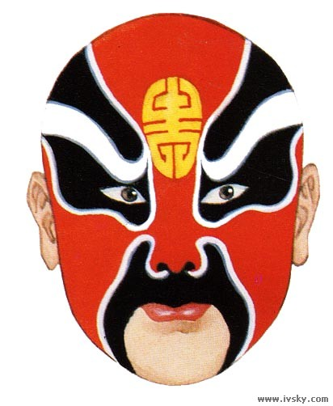
Unit 8 Beijing Opera and Acrobatics

Slide 2
Questions Concerning Section A Beijing Opera
1. How important is Beijing Opera in Chinese theater?
2. Why do we say that classical Chinese drama is a comprehensive performing art?
3. What do you know about the differences between Chinese drama and Western drama?
4. What is expected of a B. O. performer in appearance?
5. How should a B. O. performer pose on the stage?
6. Why are theatrical forms of other provinces difficult for us to understand?
7. How did Beijing Opera come into being?

Slide 3
Questions Concerning Section A Beijing Opera
8. Why isn’t acting in Beijing Opera restricted in time and space?
9. Give examples to show the symbolic meanings of activities in Beijing Opera?
10. What are the most important elements of B. O.?
11. What is the main stringed instrument used in B. O.?
12. Where are the main tunes of B. O. from?
13. What do you know about xipi tune and erhuang tune?
14. What do you know about yunbai and jingbai?

Slide 4
Questions Concerning Section A Beijing Opera
15. How are the main character roles in B. O. classified? What do they refer to respectively?
16. Is facial painting applied to all character roles? What are red, gold and silver symbolic of in B. O.?
17. Can painted facial patterns be used repeatedly? What can we do about them?
18. Are the colors of B. O. costumes symbolic? Examples.
19. Do different roles wear different costumes? Examples.
20. What else do you know about Beijing Opera?

Slide 5
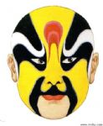
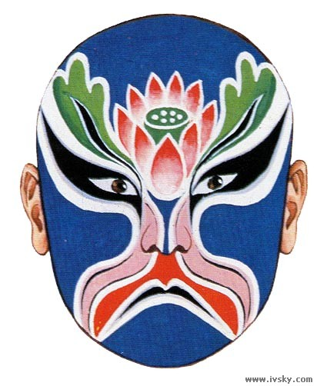
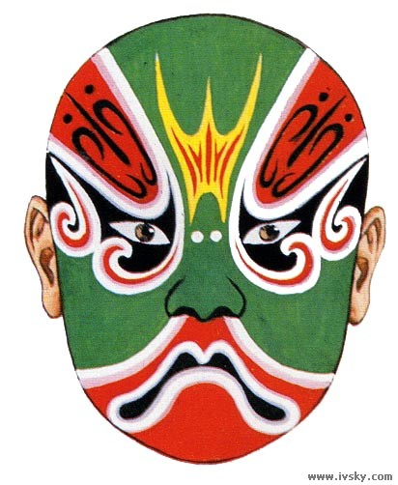
Painted faces of Beijing Opera performers

Slide 6
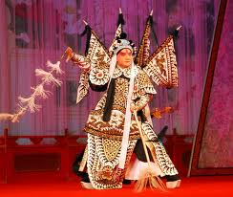
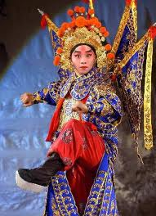
Character roles: sheng (male)

Slide 7
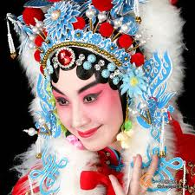
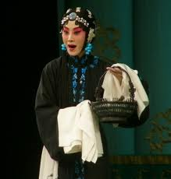
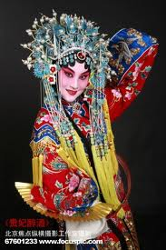
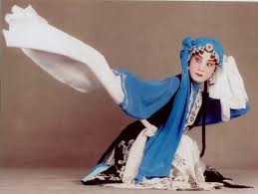
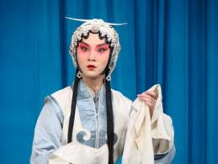
Character roles: dan (woman)

Slide 8
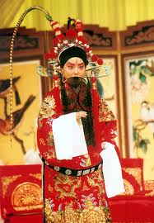
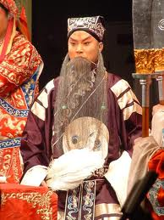
Character roles: jing

Slide 9
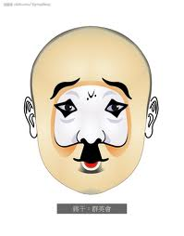
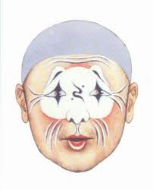
Character roles: chou (clown)

Slide 10
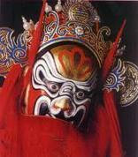
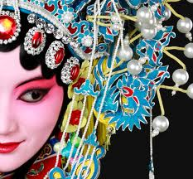
Hats and hair ornaments

Slide 11
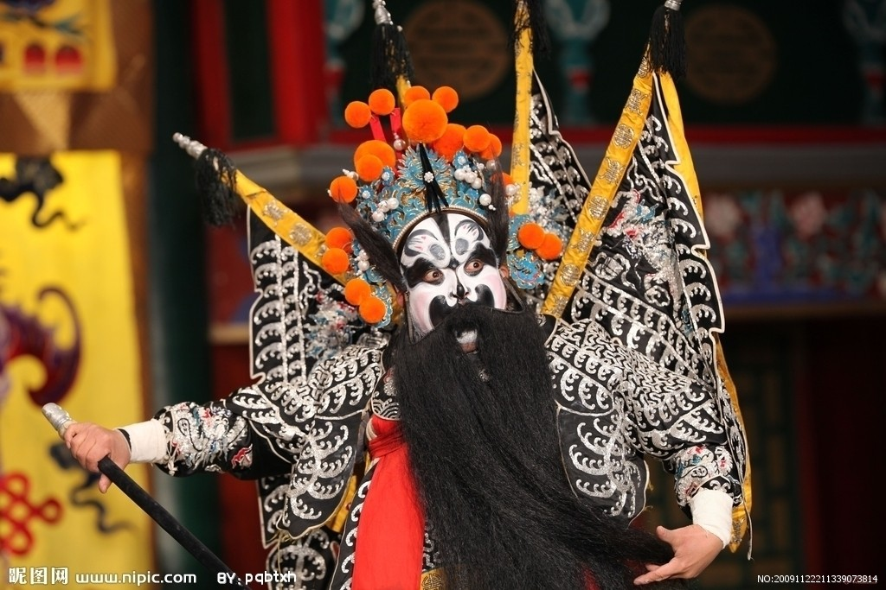
Cao Cao in Beijing Opera

Slide 12
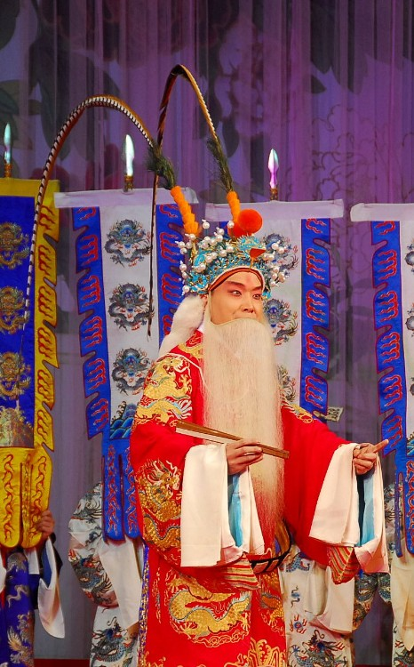

Laosheng and Wusheng

Slide 13
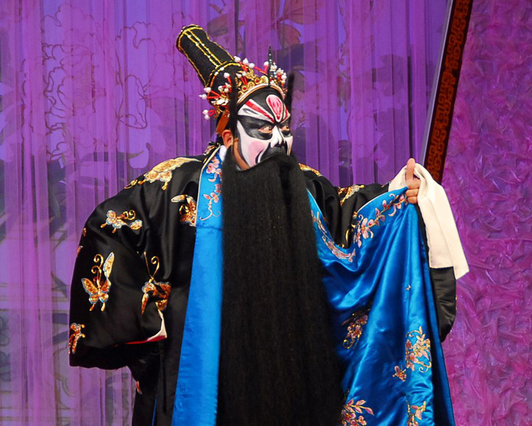
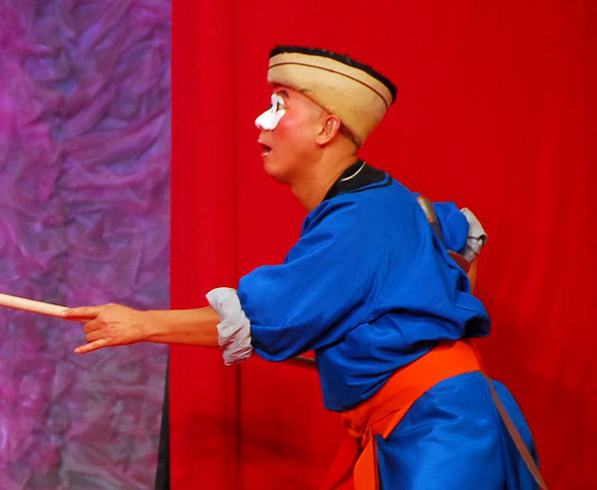
Jing and chou roles

Slide 14
Questions Concerning Section B Mei Lanfang
1. What do you know about Mei’s early life?
2. How many roles did Mei play in his career? What roles did he prefer to play?
3. What dances did Mei design to help express the character of the role he played? What other dances did he design?
4. What plays are included in the repertory of the Mei School?
5. What did Mei contribute to the musical accompaniment?
6. Was Mei the first artist to introduce B. O. abroad? What do you know about his tours of Japan, America and the Soviet Union?

Slide 15
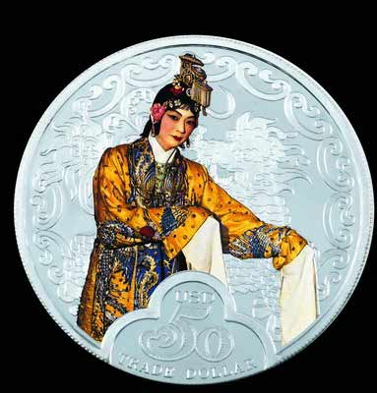
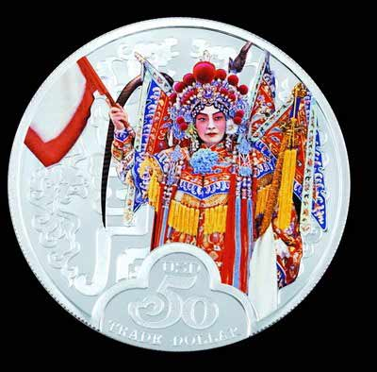
The conqueror’s concubine & Mu Guiying as marshal 《霸王别姬》、《穆桂英挂帅》

Slide 16
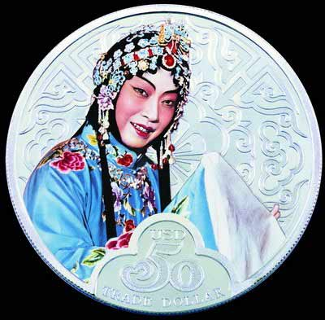
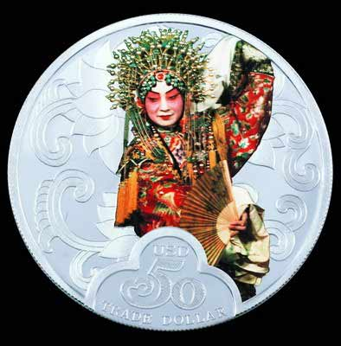
Women roles Mei played 《游园惊梦》、《贵妃醉酒》

Slide 17
Questions Concerning Section C Acrobatics
1. How long is the history of Chinese acrobatics as an independent form of art? What do you know about acrobatics programs of the Han Dynasty?
2. What does the Tang mural in the Dunhuang Grottoes show about acrobatics?
3. How did acrobatics develop as a folk art?
4. How prosperous have acrobatics been since 1949? What innovations have there been?
5. Can you describe some traditional acrobatics items?
6. What new items have been born? How successful are they?

Slide 18
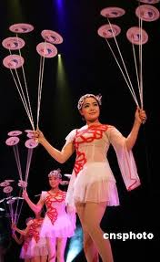
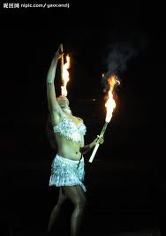
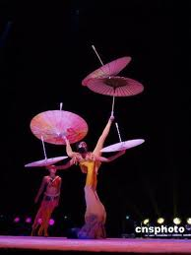
Plate-spinning, umbrella-balancing & fire-eating

Slide 19
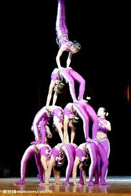
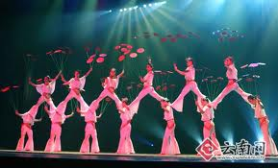
Pyramids plus plate-spinning

Slide 20
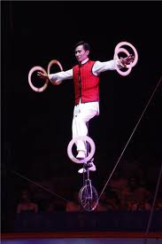
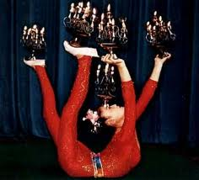
Candle-balancing & unicycle balancing

Slide 21
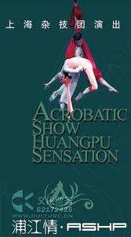
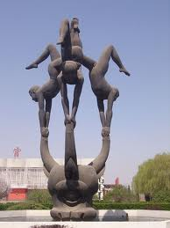
Poster & sculpture of Wuqiao

Slide 22
Translation exercises
京剧是我国主要剧种之一，由清代中叶的徽调、汉调相继传入北京合流演变而成。腔调以西皮、二黄为主，用胡琴和锣鼓等伴奏，后流行于全国。
京剧是在北京形成的戏曲剧种之一，至今已有将近二百年的历史。它是在徽调和汉戏的基础上，吸收了昆曲、秦腔等一些戏曲剧种的优点和特长逐渐演变而形成的。京剧的传统剧目约在一千个，常演的约有三四百个，其中除来自徽戏、汉戏、昆曲与秦腔者外，也有相当数量是京剧艺人和民间作家陆续编写出来的。京剧较擅长于表现历史题材的政治和军事斗争，故事大多取自历史演义和小说话本。

Slide 23
Translation exercises
1790年秋，为庆祝乾隆八旬寿辰，扬州盐商江鹤亭（安徽人）组织了一个名为“三庆班”的徽戏戏班，由艺人高朗亭率领进京参加祝寿演出。这次祝寿演出规模盛大，从西华门到西直门，每隔数十步设一戏台，南腔北调，四方之乐，荟萃争妍。在这场竞赛当中，第一次进京的三庆徽班即崭露头角，引人瞩目。高朗亭是安徽安庆人，入京时才十六岁，演旦角，技艺精湛。
1919年，梅兰芳率剧团赴日本演出，京剧艺术首次向海外传播；1924年，他再度率剧团到日本演出，1930年，梅又率由二十人组成的剧组到美国访问演出，取得很大成功。1934年，他应邀去欧洲访问，在苏联演出，受到欧洲戏剧界的重视。此后，世界各地把京剧看成中国的演剧学派。

Slide 24
Translation exercises
1919年4月26日，日本的一篇报道这样写到，被梁启超称为如果是女人、将是东洋第一美女的梅兰芳到达东京，他年纪还很轻，穿着时髦的新西装，头发是很整齐的中分，脸形比照片上的略小，被誉为一笑千古春的眼睛更是价值千金。那一年，梅兰芳25岁。
5月1日，梅兰芳在日本帝国剧场正式演出。这是他第一次站在外国的舞台上演出中国京剧，也是中国京剧演员第一次出国演出。《朝日新闻》这样描述梅兰芳的登台亮相：梅兰芳正是我们所听到的那样，是一个真正的美男子，他在一曲独特的中国乐曲声中缓慢登场，他的天女的造型栩栩如生，完全可以看作一个十八九岁的姑娘，极富立体感的脸庞以及婀娜的身段。秋水为神，玉为骨，移过来形容他也不为过。

Slide 25
Translation exercises
中国吴桥国际杂技艺术节创办于1987年，每两年一届，举办时间为10月底至11月初，节期一般为9天，举办地点在河北省石家庄市，由中华人民共和国文化部和河北省人民政府共同主办。
吴桥杂技节是河北省最具国际影响力的文化品牌，是中国四大国家级国际性文化节庆之一，是国际公认的世界三大杂技赛场之一。赛场最高奖项——金狮奖已成为国际杂技艺术家向往和追逐的目标，历届杂技节参赛节目都成为各国演出商热衷的目标。2005年，被国际节庆协会评为“中国最具国际影响力十大节庆活动”。

Slide 26
Topics for discussion
1. What other schools of Chinese opera do you know?
2. Why isn’t Beijing Opera popular with young people?
3. What acrobatic item has impressed you most deeply?
4. What do you know about China’s non-material cultural heritage at different levels?

Slide 27
See you next time!

Slide 28
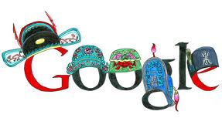
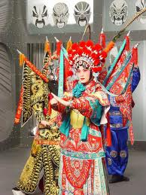
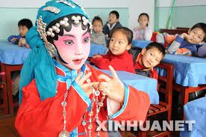
How important is Beijing Opera in Chinese theater?

Slide 29
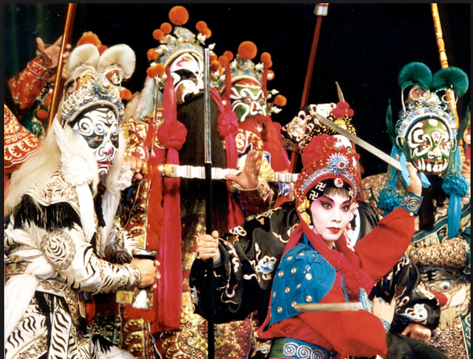
Why do we say that classical Chinese drama is a comprehensive performing art?

Slide 30
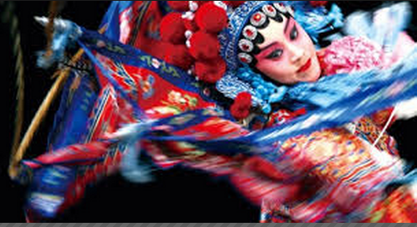
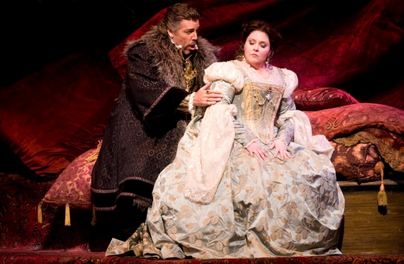
What do you know about the differences between Chinese drama and Western drama?

Slide 31
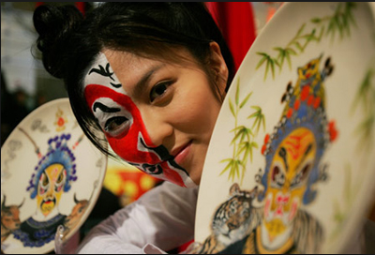
What is expected of a Beijing Opera performer in appearance?

Slide 32
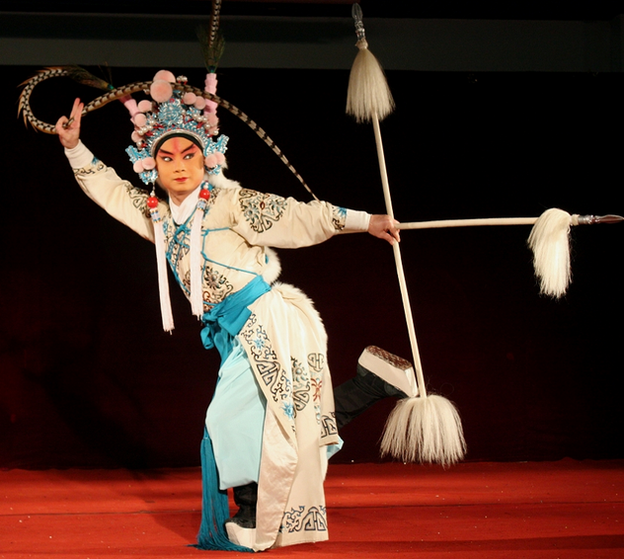
How should a Beijing Opera performer pose on the stage?

Slide 33
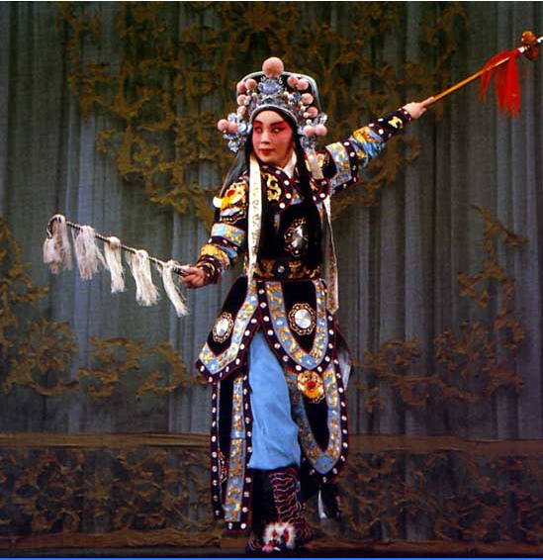
Why isn’t acting in Beijing Opera restricted in time and space?
Horse-riding
Notes:
京剧里，常常用假设的东西代表实物，用的词汇叫做“虚拟”。比如：骑马，京剧演出中是没有真马上台的。演员手拿一根马鞭，用腿往上一迈，就上马了。一挥动马鞭，虽然还是人走，可意味着马跑起来了，说跑五华里，就是五华里；说跑一千公里，就是一千公里。台上明明没有马，可是演员就像在骑马的感觉，观众也都相信。骑马上还有很多“功夫”，像马不驯服，马惊了，又蹦又跳，人怎么样降服它，演员都能从动作中体现出来。这是京剧的奥妙之处。

Slide 34
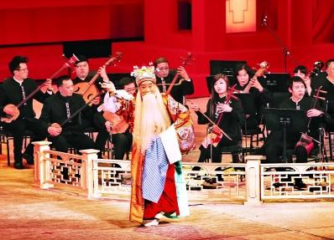
What are the most important elements of Beijing Opera?

Slide 35
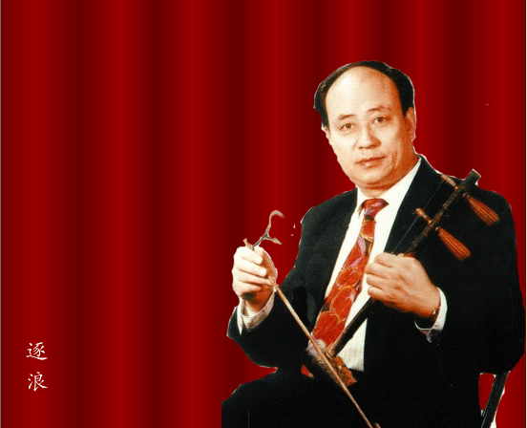
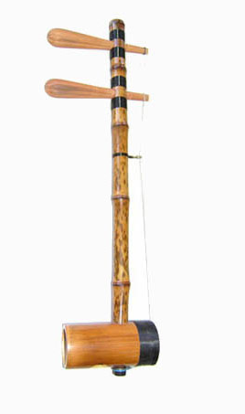
What is the main stringed instrument used in Beijing Opera?
Notes:
京胡，拉弦乐器。京胡于清乾隆年间在胡琴基础上改制而成，因主要用于京剧伴奏而得其名。

Slide 36
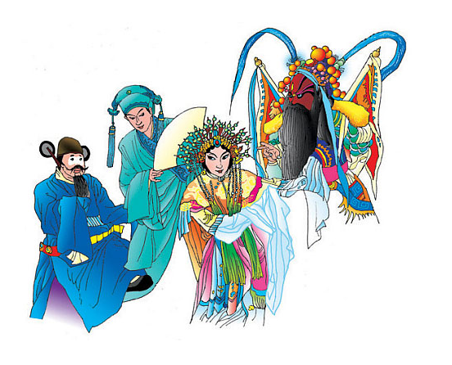

How are the main character roles in Beijing Opera classified? What do they refer to respectively?
净
生
旦
丑
Notes:
末行扮演中年以上男子，多数挂须。又细分为老生、末、老外。一般扮演比同一剧中老生作用较小的中年男子。
从京剧的发展历程看，以“生”为主是京剧的发展趋势，而末行阻碍了这种发展，使生行在许多地方无用武之地，而且京剧需要艺术全面的演员，但末行只重表演不重唱亦能不适应时代潮流，最后消亡由生行代演也是必然的。

Slide 37
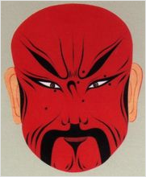
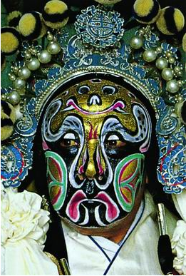
Is facial painting applied to all character roles? What are red, gold and silver symbolic of in Beijing Opera?
红色一般表示忠勇、正直，如关羽、关胜、吴汉等；
黄色一般表示枭勇、凶暴、沉着，如典韦、姬僚等；
蓝色一般表示刚强、骁勇、有心计，如窦尔墩、王陵、吕蒙、盖苏文等；
白色一般表示阴险、狡诈，如曹操、赵高、司马懿、董卓、伊利等；
黑色一般表示刚正、粗鲁、凶猛，如张飞、项羽等；
紫色一般表示刚正、稳练、沉着，如徐延昭、专诸、黄盖等；
金色和银色则通常用来表示神怪，如孙悟空、土行孙等。
Notes:
京剧中的红派角色。在传统戏曲中勾画红色脸谱指在解决矛盾冲突的过程中充当友善或令人喜爱的角色(跟“唱白脸”相对)，代表正面或正义性的人物，是褒义词。表示忠勇耿直，有血性的勇烈人物。如关羽、赵匡胤、姜维等但也有例外，如《法门寺》中反面人物刘瑾就勾红脸，这里有讽刺之意，使人一看便知是个擅权的太监。
红色一般表示忠勇、正直，如关羽、关胜、吴汉等；
黄色一般表示枭勇、凶暴、沉着，如典韦、姬僚等；
蓝色一般表示刚强、骁勇、有心计，如窦尔墩、王陵、吕蒙、盖苏文等；
白色一般表示阴险、狡诈，如曹操、赵高、司马懿、董卓、伊利等；
黑色一般表示刚正、粗鲁、凶猛，如张飞、项羽等；
紫色一般表示刚正、稳练、沉着，如徐延昭、专诸、黄盖等；
金色和银色则通常用来表示神怪，如孙悟空、土行孙等。

Slide 38

Are the colors of Beijing Opera costumes symbolic? Give some examples.

Slide 39


What do you know about Mei’s early life?

Slide 40



.What dances did Mei design to help express the character of the role he played? What other dances did he design?

Slide 41

Was Mei the first artist to introduce B. O. abroad? What do you know about his tours of Japan, America and the Soviet Union?

Slide 42


How long is the history of Chinese acrobatics as an independent form of art? What do you know about acrobatics programs of the Han Dynasty?
西漢彩繪陶樂舞雜技俑

Slide 43


What does the Tang mural in the Dunhuang Grottoes show about acrobatics?
《宋夫人出行图》
Notes:
《宋国夫人出行图》
张议潮夫人宋氏春游画卷，位置与“河西节度使张议潮统军出行图”相对。
画面可分三个部分：杂技舞乐部分，有“戴竿技”、舞伎、乐工献艺。出行图主体部分，有车三辆，一辆榜题曰：“司空夫人行李车马”，肩舆之后绘全画的中心人物宋国夫人，榜题为“宋国河内郡夫人宋氏出行图”。宋国夫人及所骑白马均较其他随从高大，以突出主要人物。饮食供给部分。绘卫士及引射猎骑和驱驼运酒食仆从多人，黄羊奋蹄奔逃，猎骑疾驰追逐，十分生动。
全画人物百余，骏马三十余，杂技舞乐，车舆驼羊，熙熙攘攘。从中可见唐代贵族春游踏青的煊赫豪富气派，其气势与规模可与唐代卷画“虢国夫人游春图”相媲美。

Slide 44

How prosperous have acrobatics been since 1949? What innovations have there been?

