Slide 1


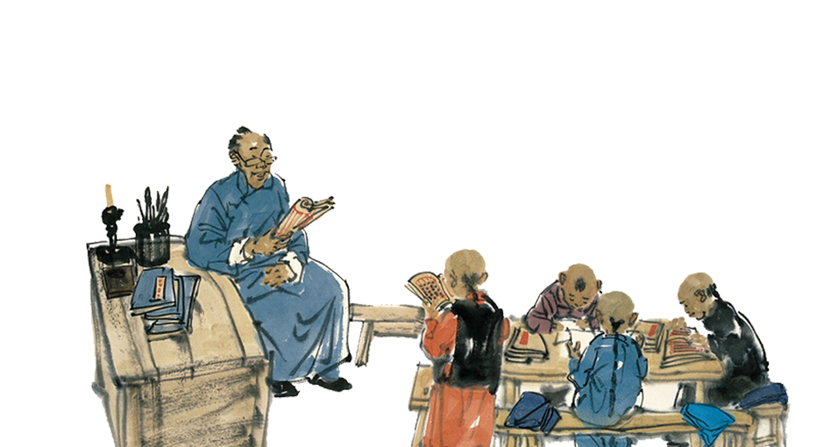
TCM
Health Preservation Action
Presenter: 黄雅倩

Slide 2

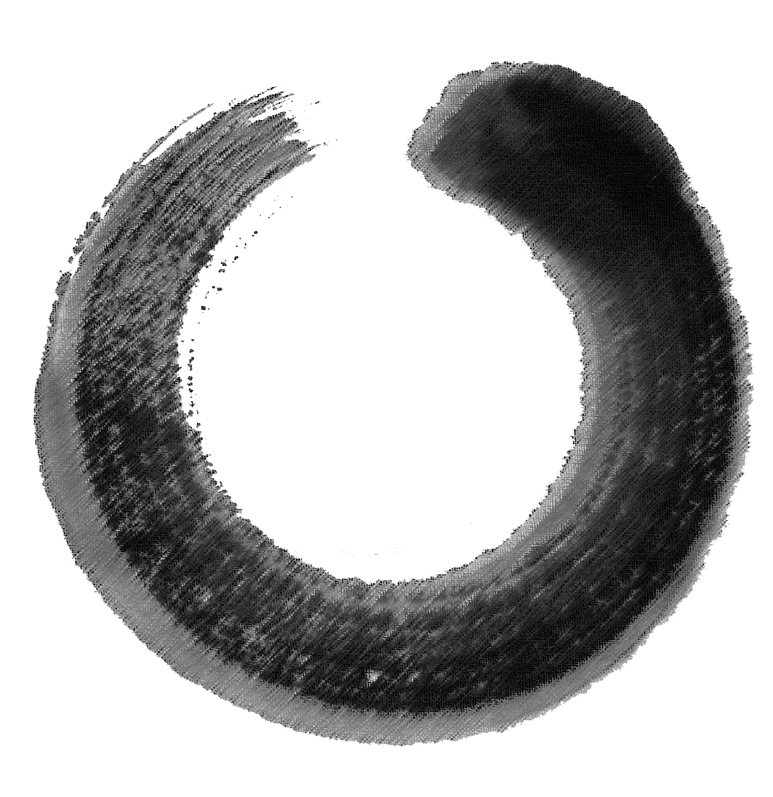
1
Pat Eight Soft Joints

Slide 3
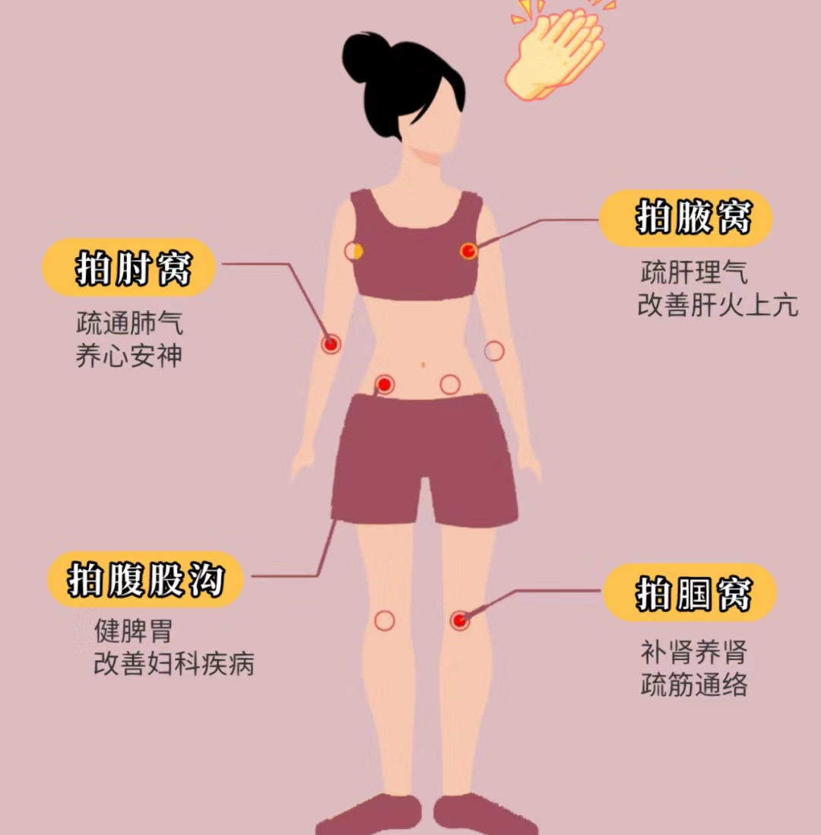
Eight soft joints
Eight soft joints include two axillas(腋窝), two cubital fossae(肘窝), two groins(腹股沟), and two popliteal spaces(腘窝).
These eight places are the key parts of the integration of Qi and blood, the most vulnerable to pathogenic factors, inducing diseases.

Slide 4

Pat cubital fossae
Efficacy: Patting cubital fossae can clear lung qi, nourish the heart and calm the mind, prevent heart and lung diseases.
Principle: In the cubital fossae, there are heart meridian, pericardium meridian(心包经), and lung meridian. Patting these places can expel internal heat, pathogenic factors and toxins from the heart and lungs

Slide 5
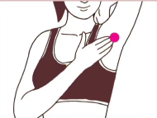
Pat axillas
Efficacy: To relieve depression, unstable emotions in women during menopause, or problems such as breast hyperplasia(乳腺增生)and nodules(结节)
Principle: The axilla has the heart meridian, pericardium meridian, and gallbladder meridian. So the person who often feels angry, and depressed can pat.

Slide 6
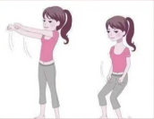
Pat groins
Efficacy: Patting the groins can strengthen the spleen and stomach, and improve abdominal distension(腹胀) and cold limbs.
Principle: The groin has Chongmen point(冲门穴)and Qichong point(气冲穴), which can regulate reproductive system diseases, including irregular menstruation and dysmenorrhea(痛经)

Slide 7
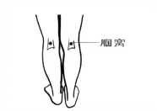
Pat popliteal fossa
Efficacy: Patting popliteal fossa has the function of tonifying the kidney, relaxing tendon and dredging collaterals(舒筋通络), and strengthening lumbar bone(腰椎骨)
Principle: The popliteal fossa is at the back of the knee, with the bladder meridian, the kidney meridian, Weizhong point(委中穴) and Yinggu point(阴谷穴). Weizhong is a key point for treating pain in the waist and legs. Yin Gu is often used for diseases of the urinary and reproductive systems

Slide 8
Thanks for listening
VS
来源：WHO术语标准、小红书

