Slide 1
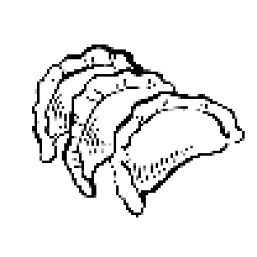



Traditional Cuisine: Jiaozi
speaker: Yu Chen
202570081726

Slide 2


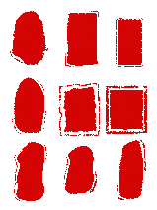

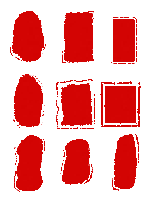

Contents
I
Introduction of Chinese dumplings
II
The Variety of Chinese Dumplings
III
The Process of making Jiaozi
The Variations of Jiaozi
IV

Slide 3




Part I
Introduction of Chinese Dumplings

Slide 4


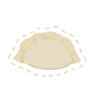

Traditionally, Jiaozi are believed to have originated in ancient China over 2,600 years ago.
Zhang Zhongjing, a Chinese physician from the Eastern Han Dynasty(AD 25–220), created jiaozi as a form of medicine to treat frostbitten ears.
"tender ears" “娇耳”

Slide 5
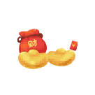


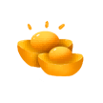


Their shape resembles ancient Chinese gold or silver ingots, making them symbols of wealth and prosperity. Some cooks will even hide a clean coin inside a jiaozi for the lucky to find.
Thus, jiaozi have become much more than just food, they are a cherished symbol of prosperity and family unity.
福
阖家团圆

Slide 6


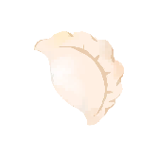

Part II
The Variety of Chinese Dumplings

Slide 7





Boiled Dumplings are the classic type, often served during Chinese New Year.
水饺
Steamed Dumplings are common in dim sum cuisine, known for their delicate taste.
蒸饺

Slide 8



煎饺
Pan-Fried Dumplings are crispy on the bottom and soft on top, offering a satisfying texture.
汤饺
Soup Dumplings contain rich broth inside, requiring careful eating to savor the hot soup.

Slide 9

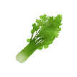






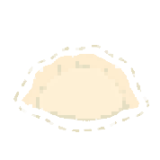
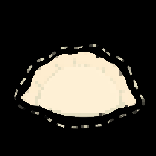


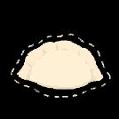



Varieties of Fillings
“Celery" in Chinese sounds like "hard work and wealth“.
芹菜的谐音：勤劳致富
“Leek" sounds like "long-term wealth" .
韭菜的谐音：长久的财富
“Cabbage" sounds like "hundred fortunes".
白菜的谐音：百财到家
勤
久
百
财
财
财
“Fish“ sounds like “abundance".
鱼的谐音：年年有余
有
余

Slide 10
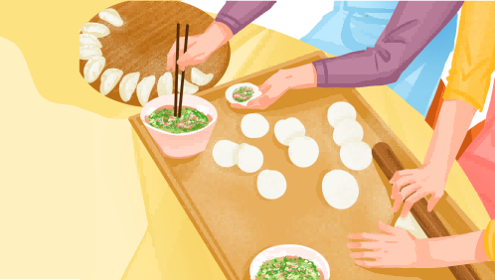
Part III
The Process of making Jiaozi

Slide 11

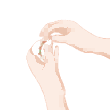


1. Preparing dough and rolling it into small, round wrappers.
3. The edges are folded and sealed carefully to create the dumpling shape.
2. Prepare a variety of fillings.
4. Cook the dumplings for a period of time after they float to ensure that they are well cooked.

Slide 12



Part IV
The Variations of Jiaozi

Slide 13
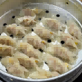

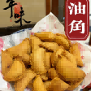

"Cantonese-style dumplings are smaller and wrapped in a thinner translucent skin, and usually steamed.
广东饺子
Another Cantonese dumpling is yau gok , which are made with glutinous rice dough and deep fried.
油角

Slide 14



Guotie (potstickers) are a northern Chinese style dumpling popular as a street food, appetizer, or side order in Chinese cuisine.
锅 贴
Momo: The Tibetan and Nepaulese version of dumpling is known as momo.
尼泊尔momo

Slide 15



Conclusion
From its humble beginnings as a medicinal food to its status as a global symbol of family and celebration, Chinese dumplings embody the values of reunion, heritage, and shared joy. So, the next time you see a Jiaozi, remember, you're looking at a tiny, delicious piece of Chinese history and heart.

Slide 16

来源：
百度
小红书
人民网
中国文化课本

Slide 17



Thank you
speaker: Yu Chen

