Slide 1
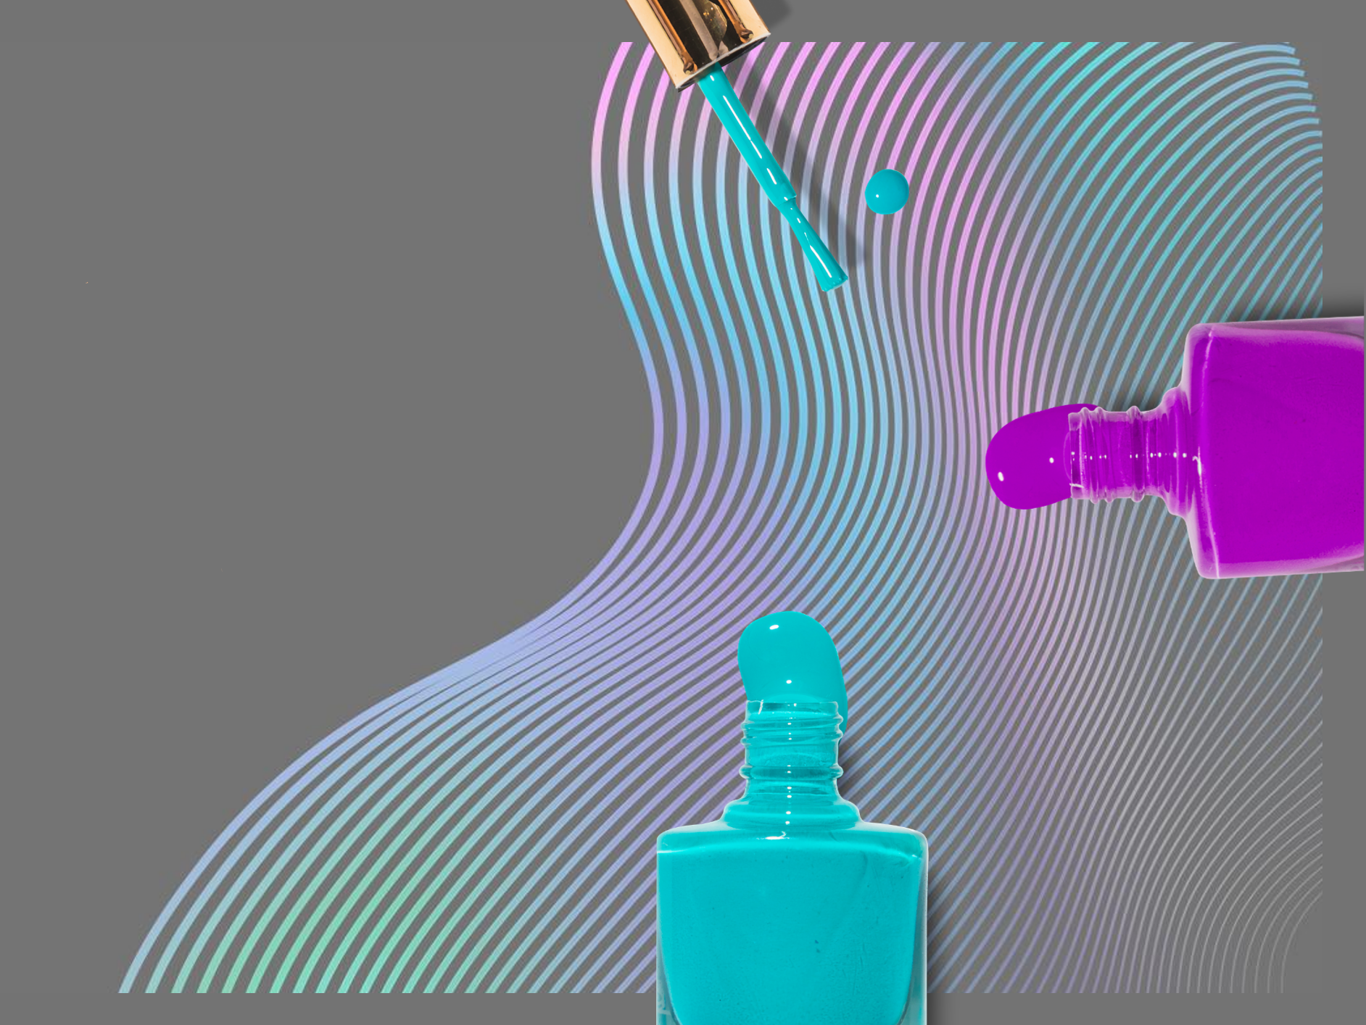
Nail Art More Than Just Beauty
英语口译 何颖 202570081744

Slide 2
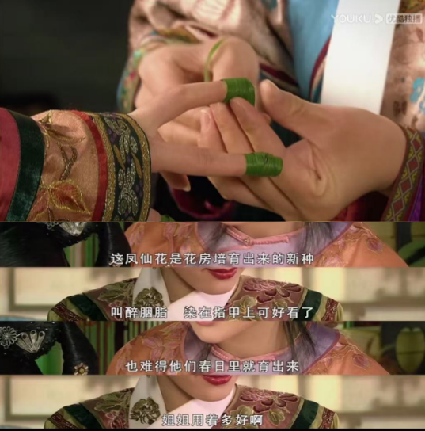
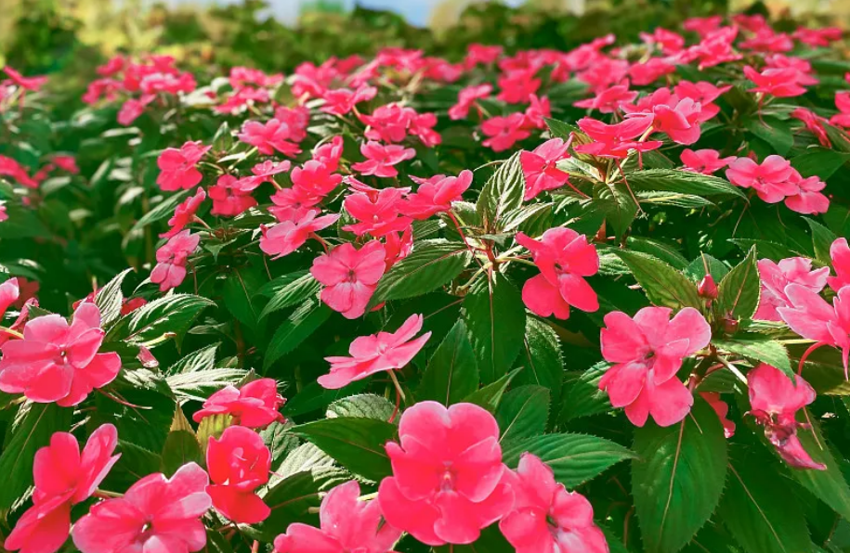
The Development of Chinese Nail Art:
Origin
Flourishing
Luxurious
Diversification
Balsam flower dye
凤仙花汁
creating long-lasting red nails, reflecting rising aesthetic tastes.
“Noblewomen applied mixtures of beeswax and egg whites to their nails to maintain a glossy and translucent appearance.”
--Textbook
♀: a symbol of freedom from manual labor
(noble status)
♂: a sign of authority and elite power
Personalization & diversification
style, shape, pattern, color, material...
Women use nail guards for protection and display.
Shang & Zhou
Dynasties
Tang & Song
Dynasties
Ming & Qing
Dynasties
Modern Era

Slide 3
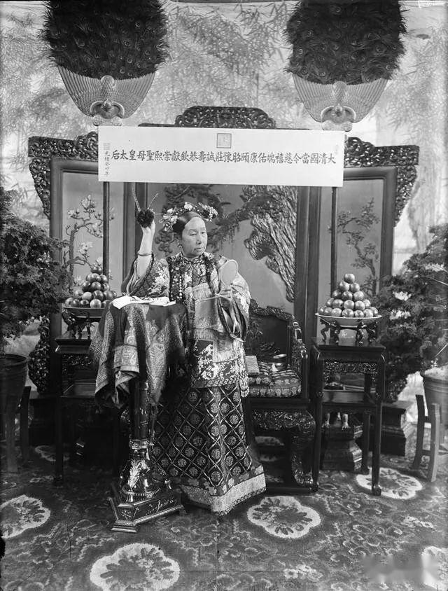
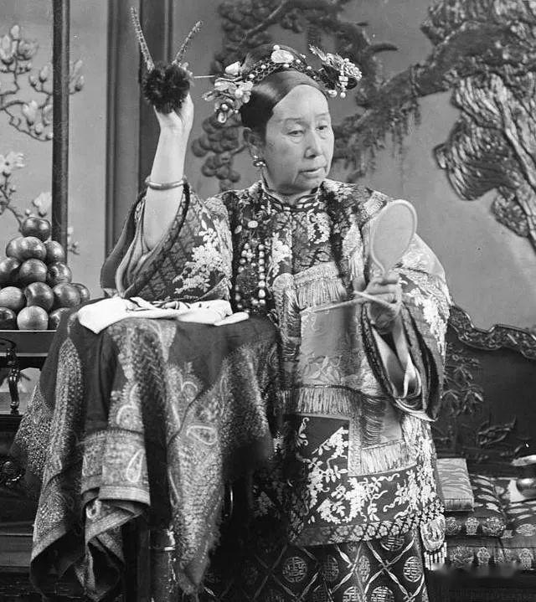
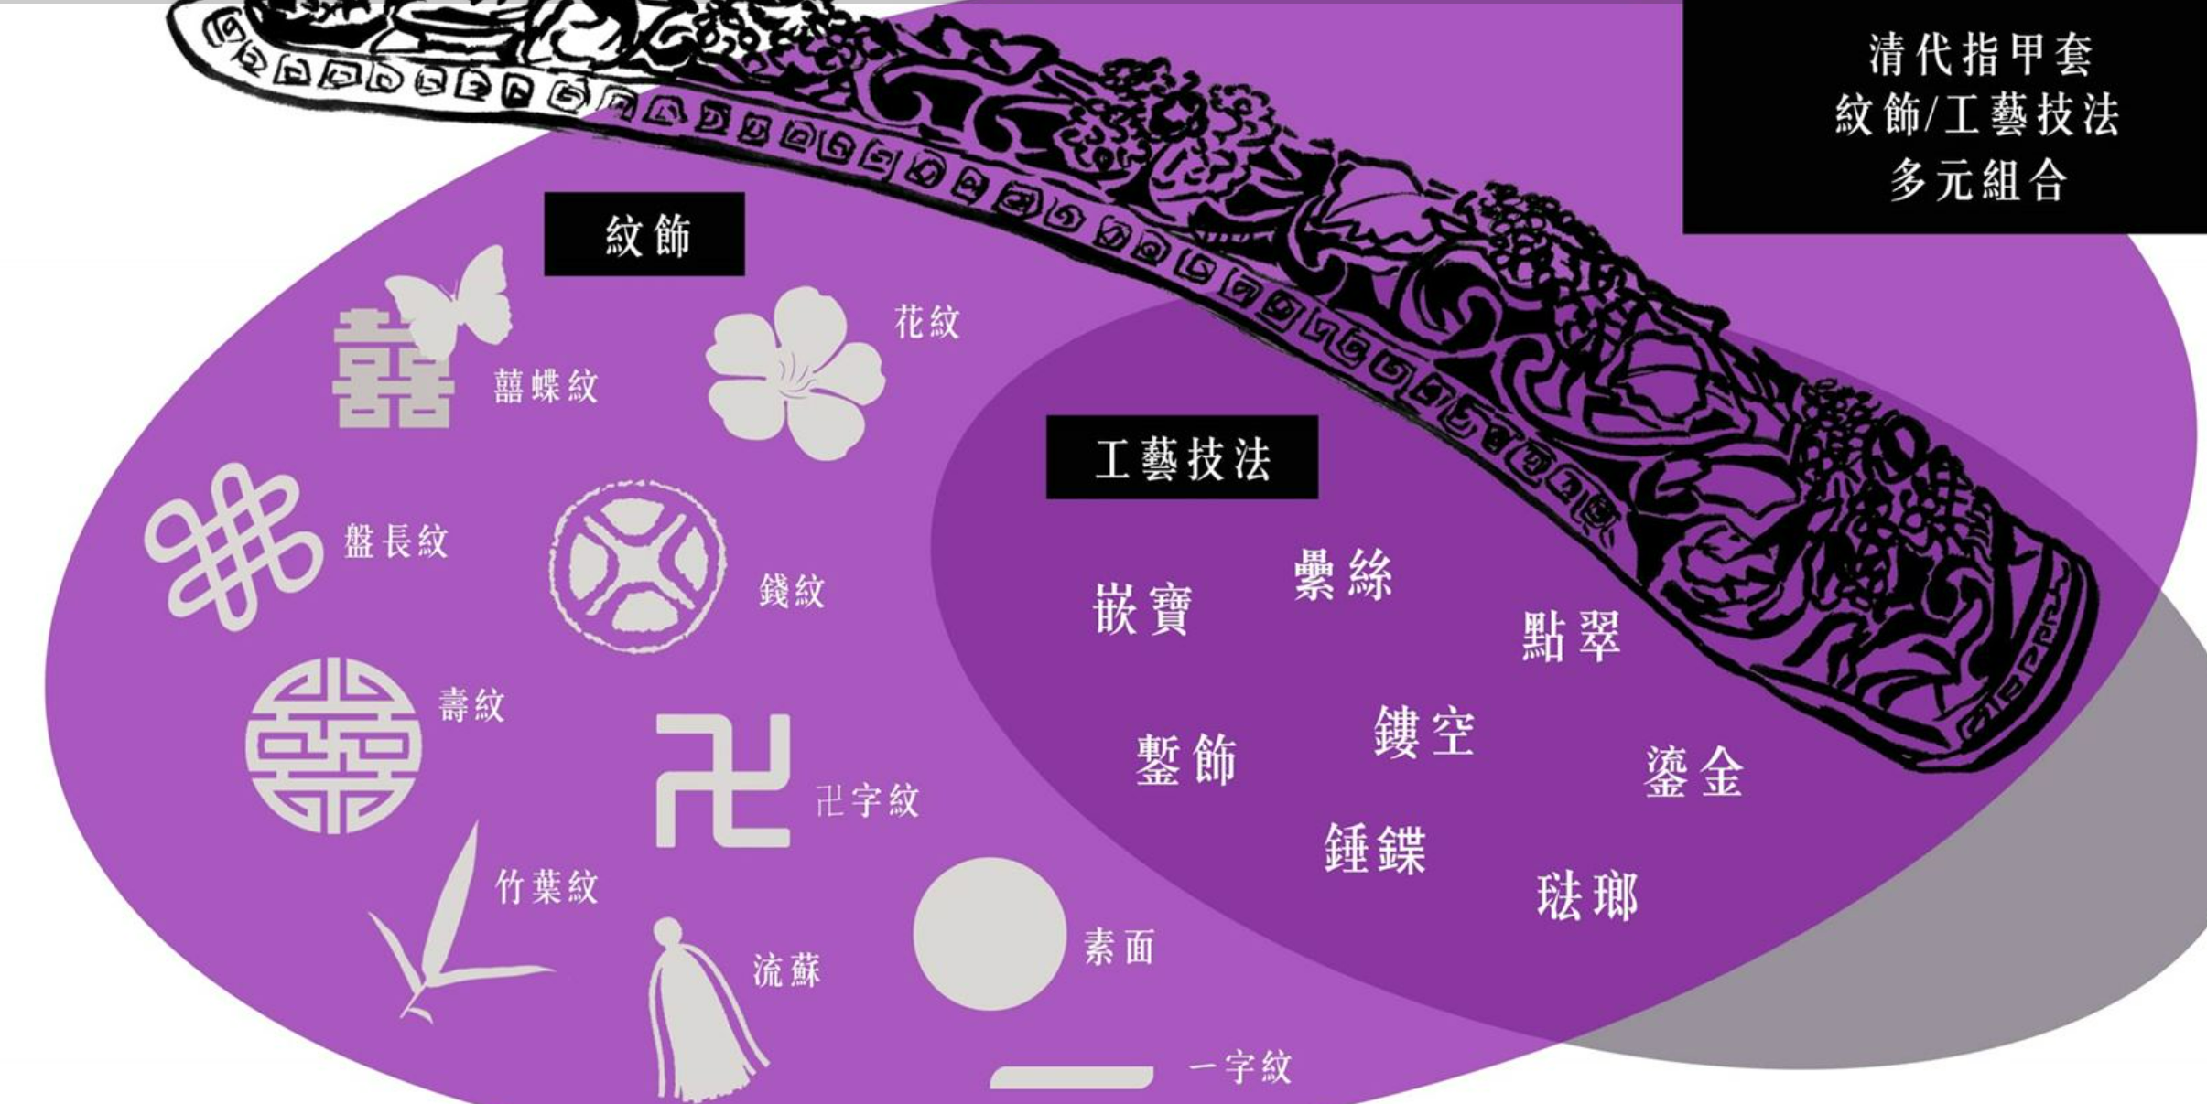
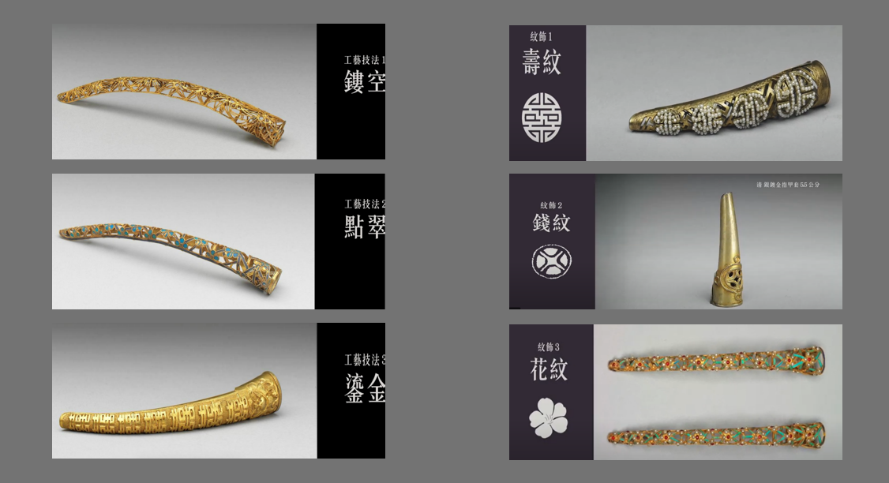
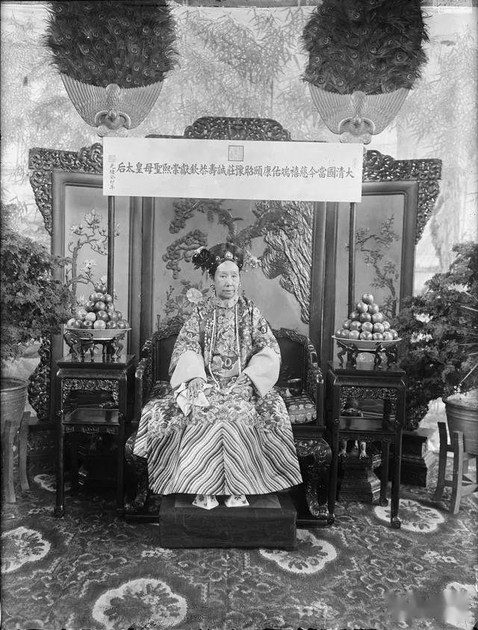
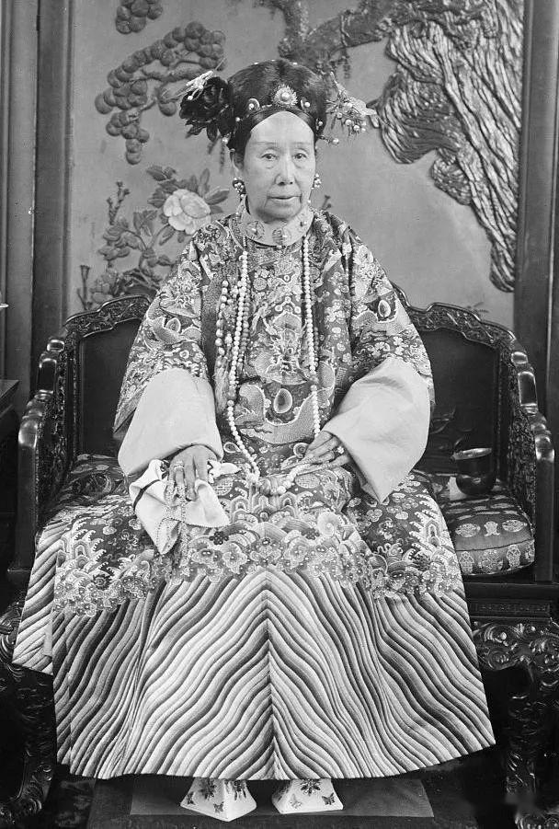
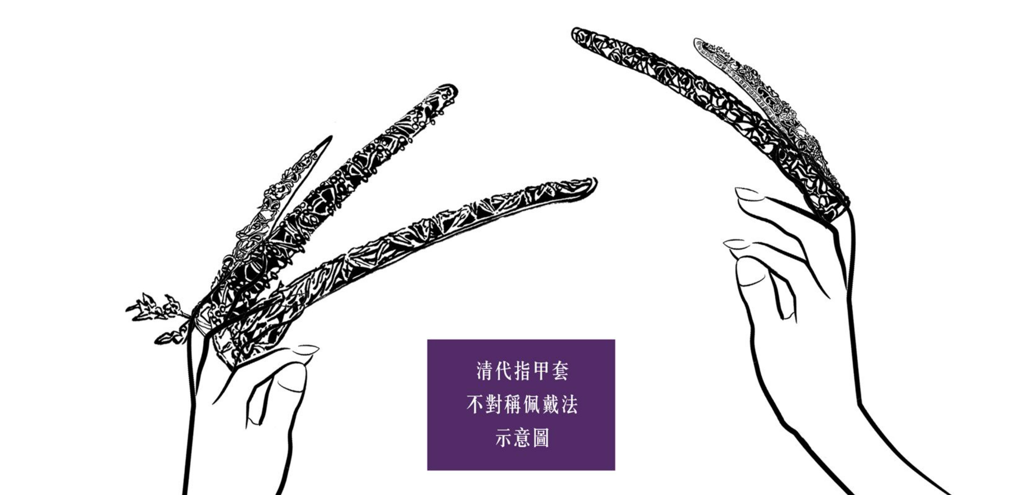
Empress Dowager Cixi
From：
清宫美甲术：指甲套的阶级美感
（故宫线上展）

Slide 4
The Developmentof Chinese Nail Art:
Origin
Flourishing
Luxurious
Diversification
Balsam flower dye created long-lasting red nails, reflecting rising aesthetic tastes.
♀: a symbol of freedom from manual labor
(noble status)
♂: a sign of authority and elite power
“Noblewomen applied mixtures of beeswax and egg whites to their nails to maintain a glossy and translucent appearance.”
--Textbook
Personalization & diverse
style, shape, pattern, color, material...
Women use nail guards for protection and display.
Shang & Zhou
Dynasties
Tang & Song
Dynasties
Ming & Qing
Dynasties
Modern Era

Slide 5
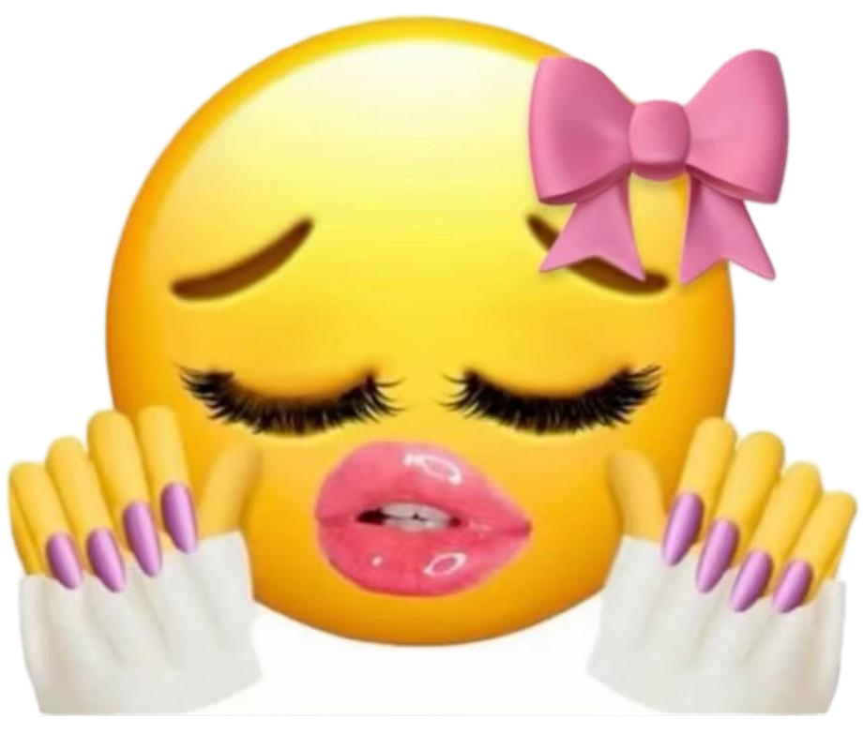

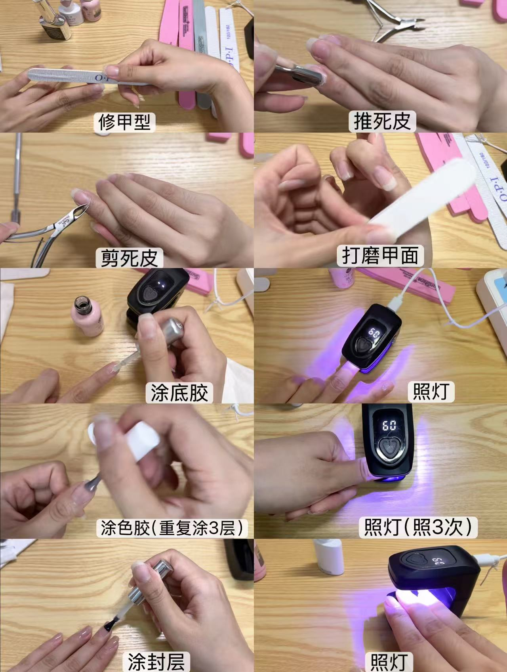
1. Emotional & Psychological Value
Self-care & Self-reward
Several hours in the nail salon can provide a rest space to relieve stress.
After completion, the new nail art enables people to gain psychological satisfaction.
Rituality
selection→appointment→production→completion
Self-presentation
choosing different styles for different occasions

Slide 6
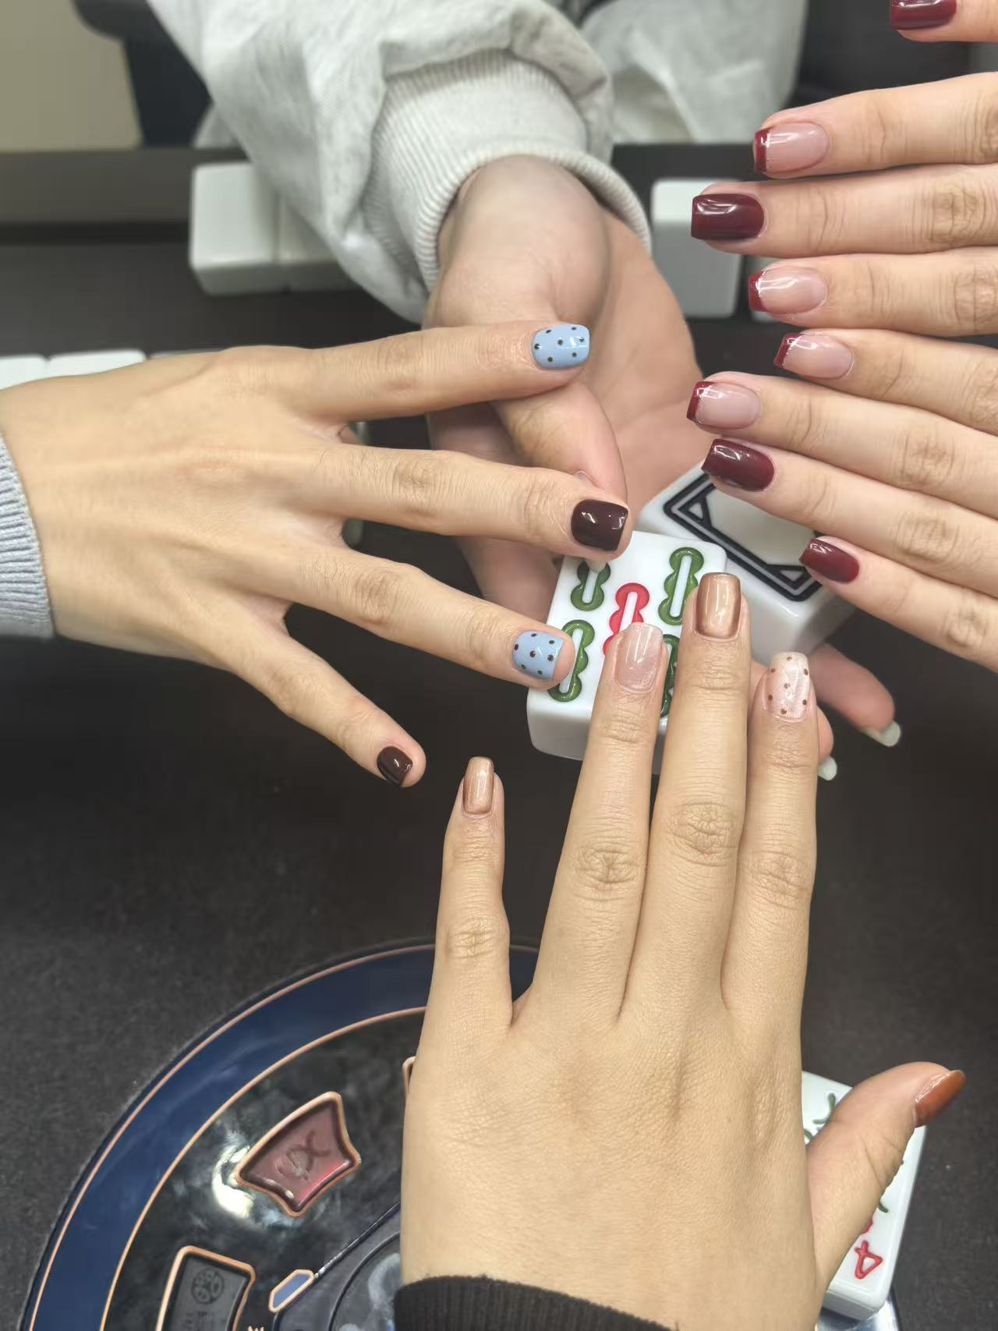
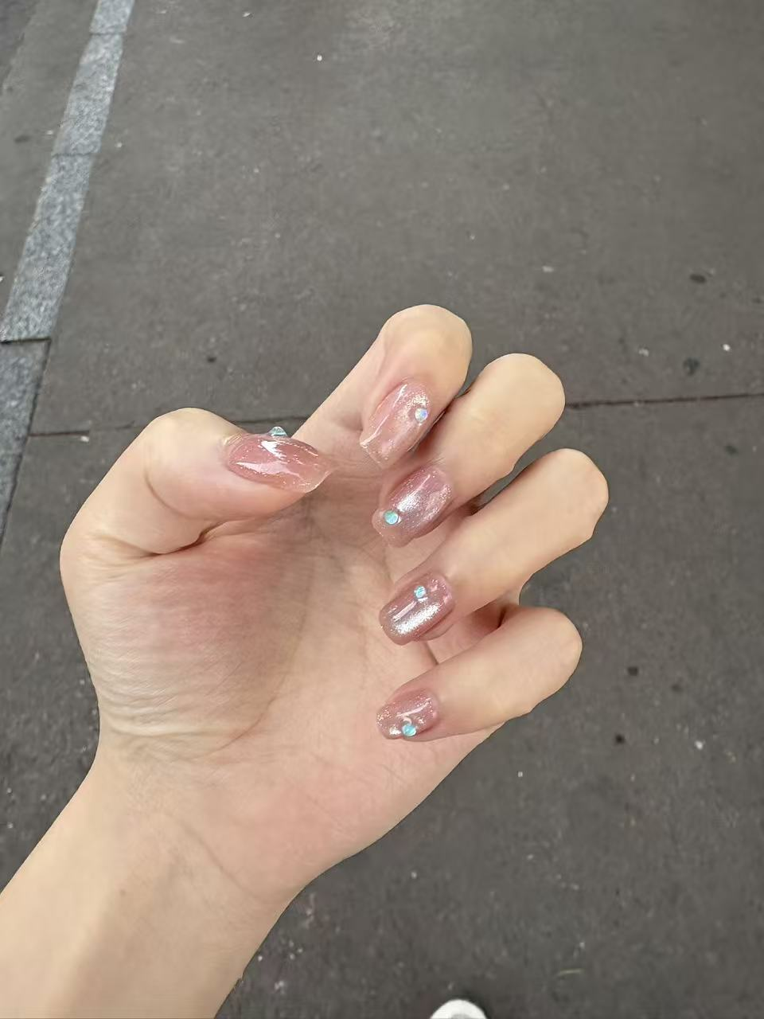
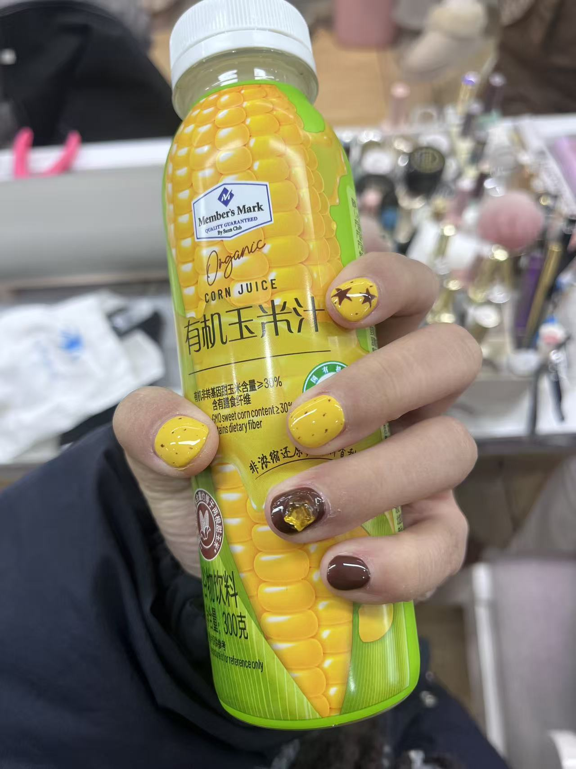
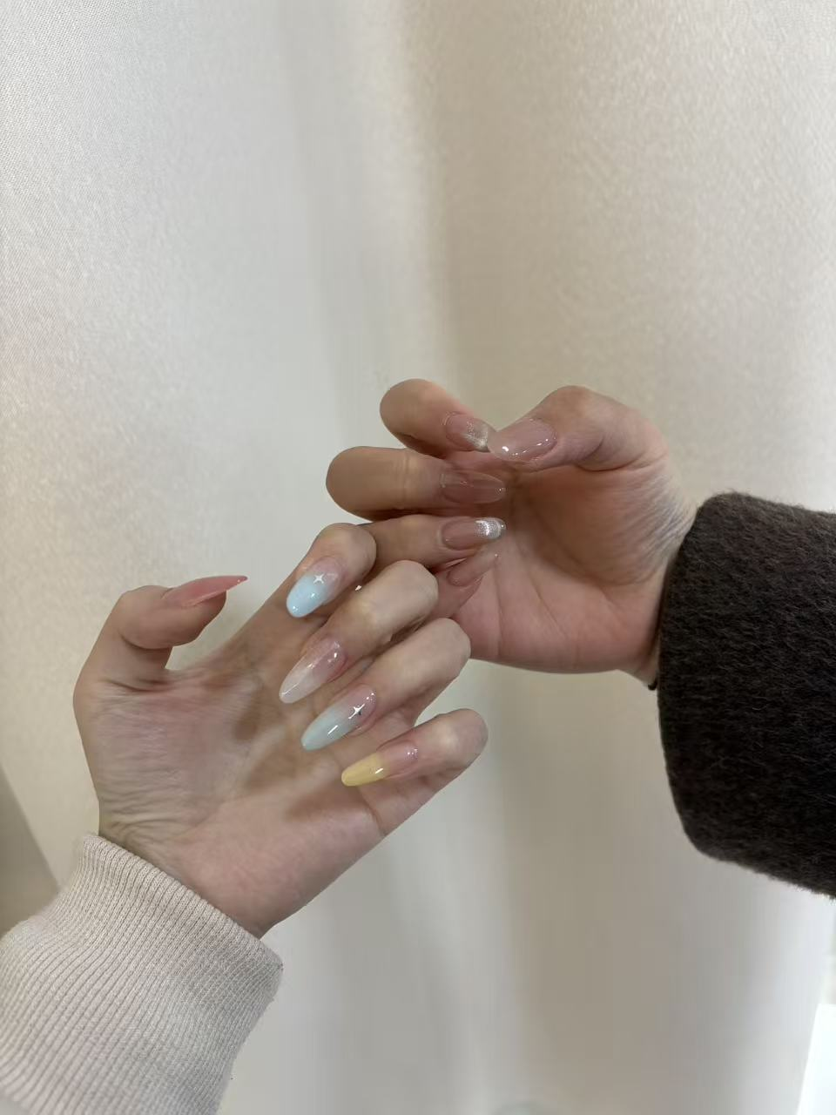
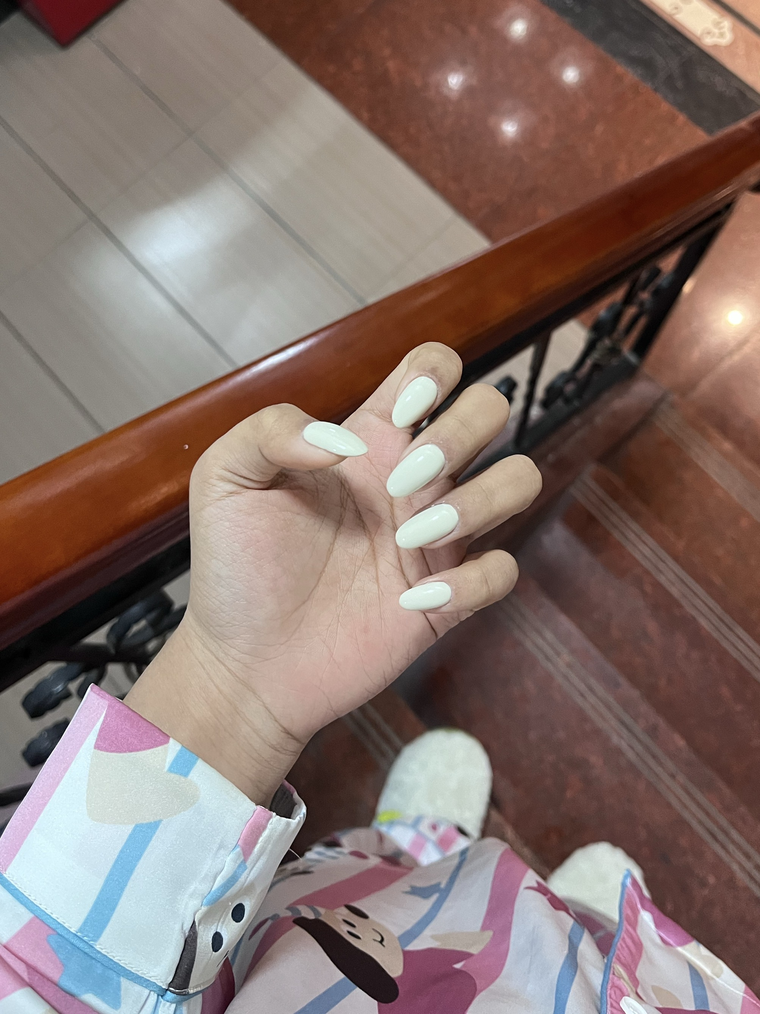
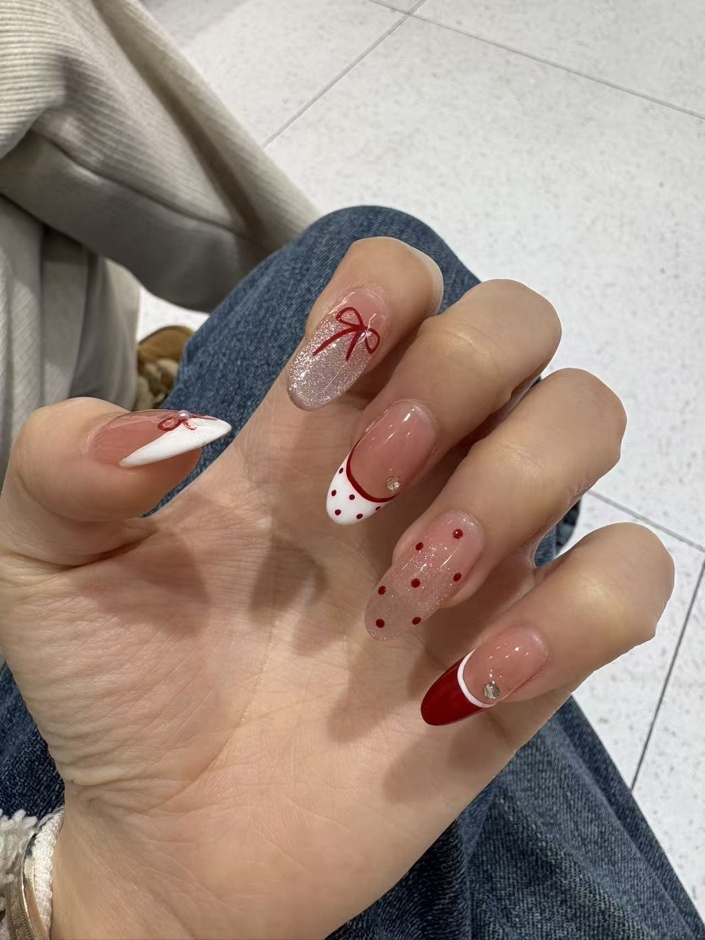
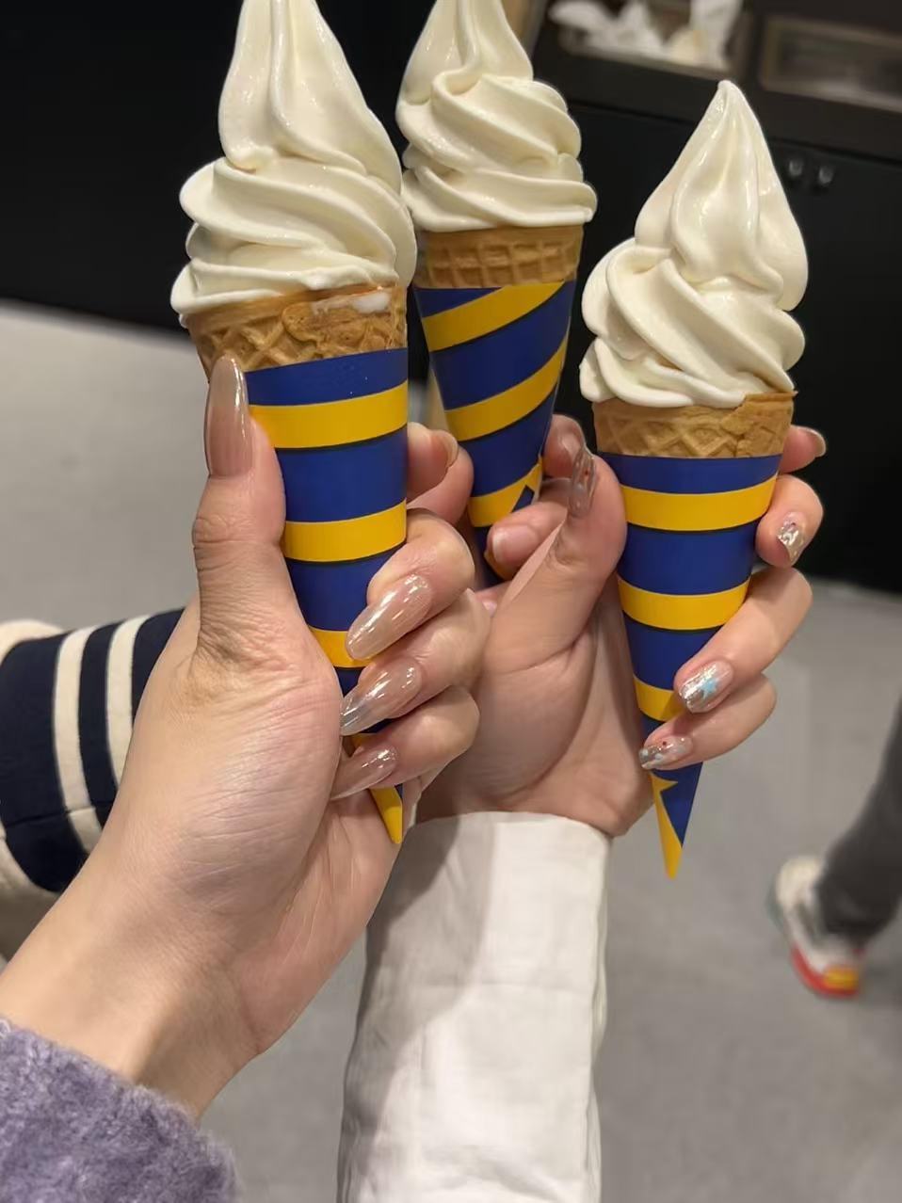
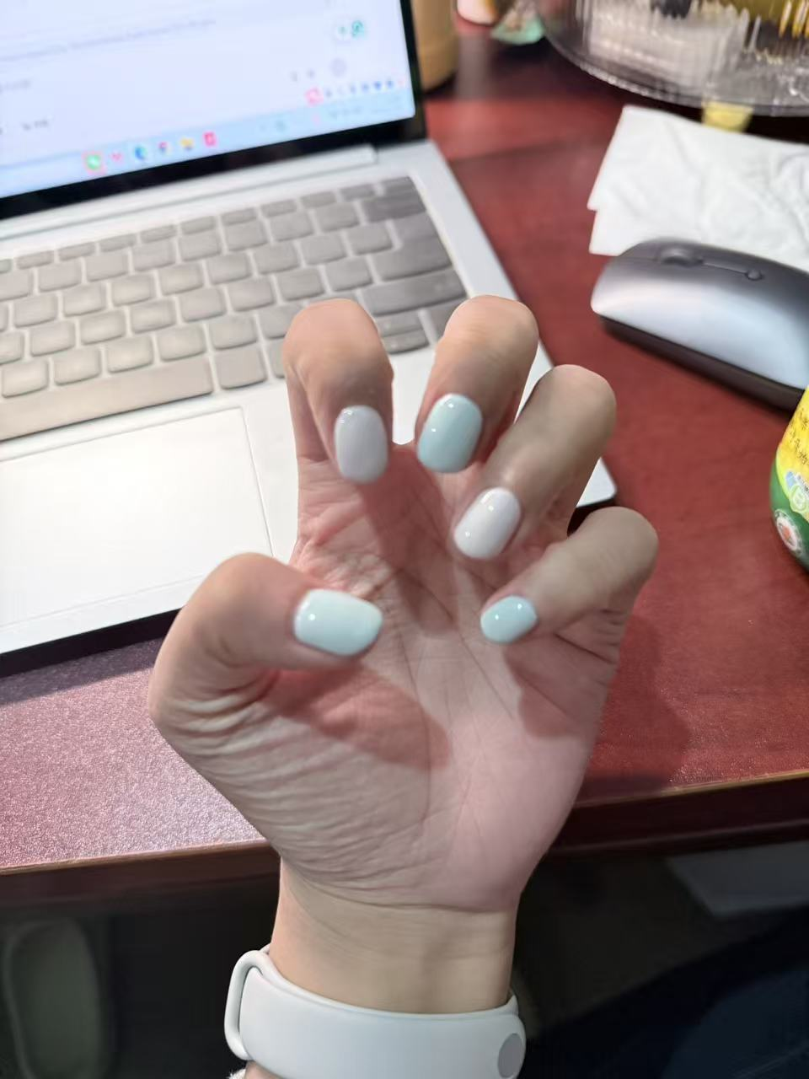
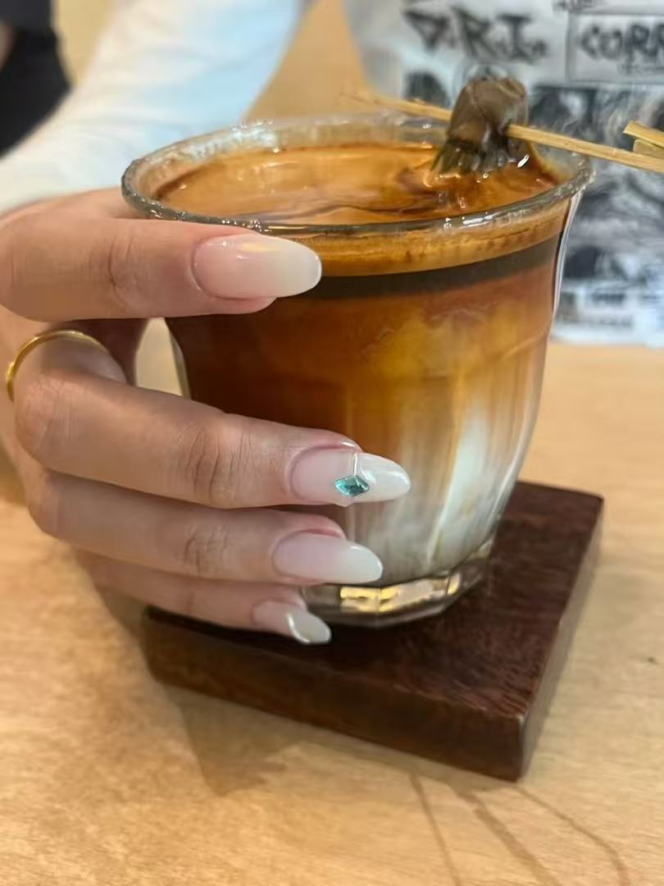
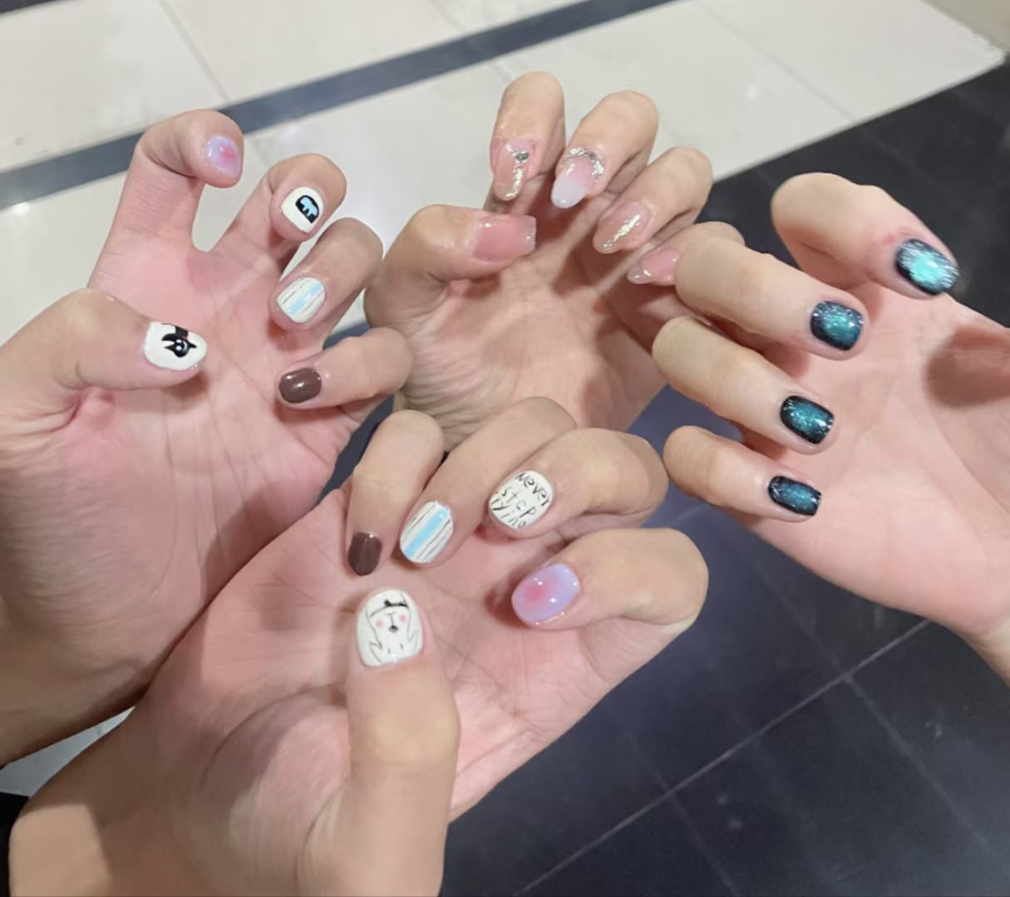
Nail arts of my friends

Slide 7
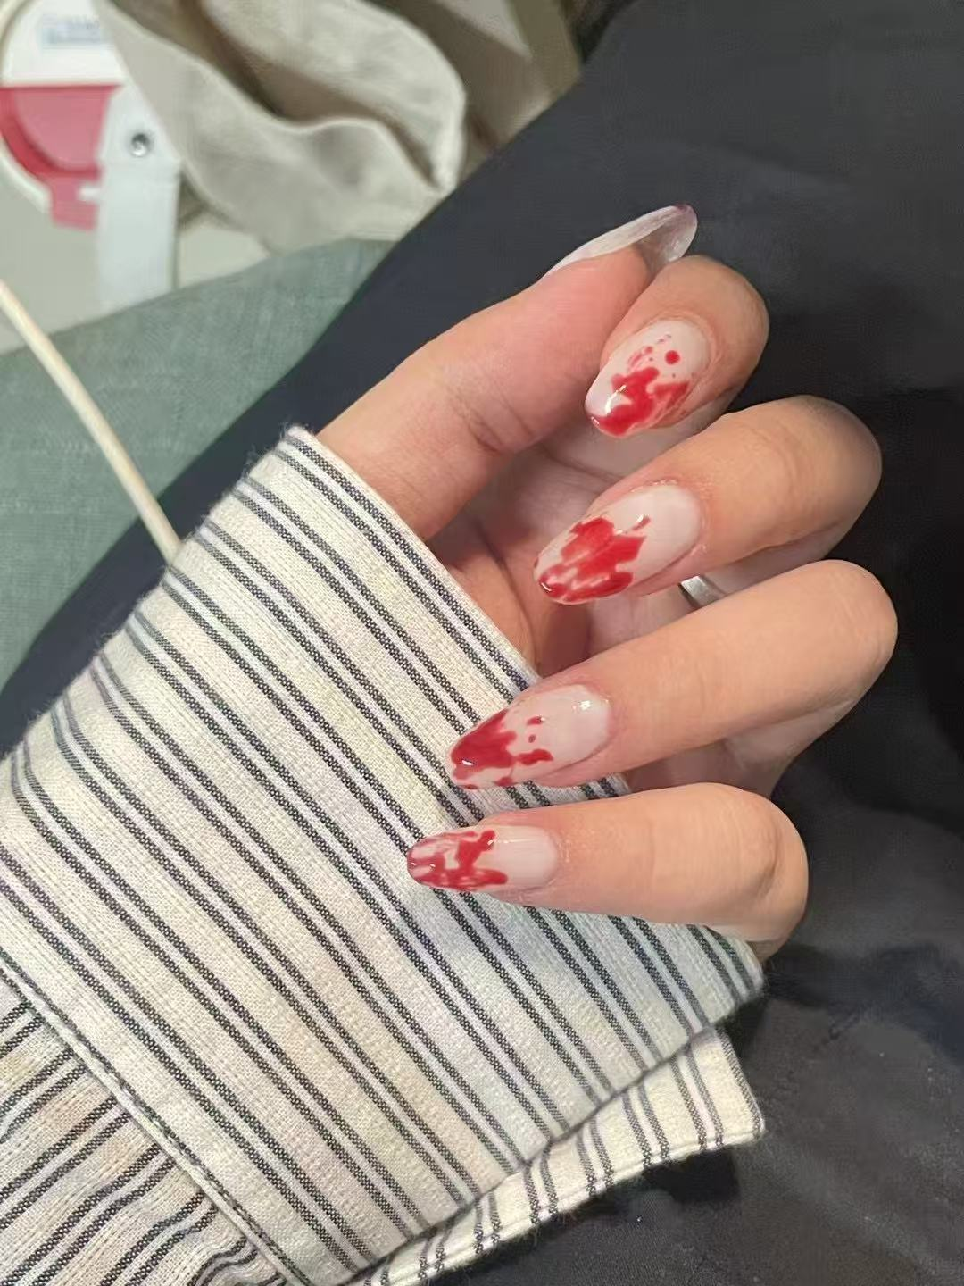
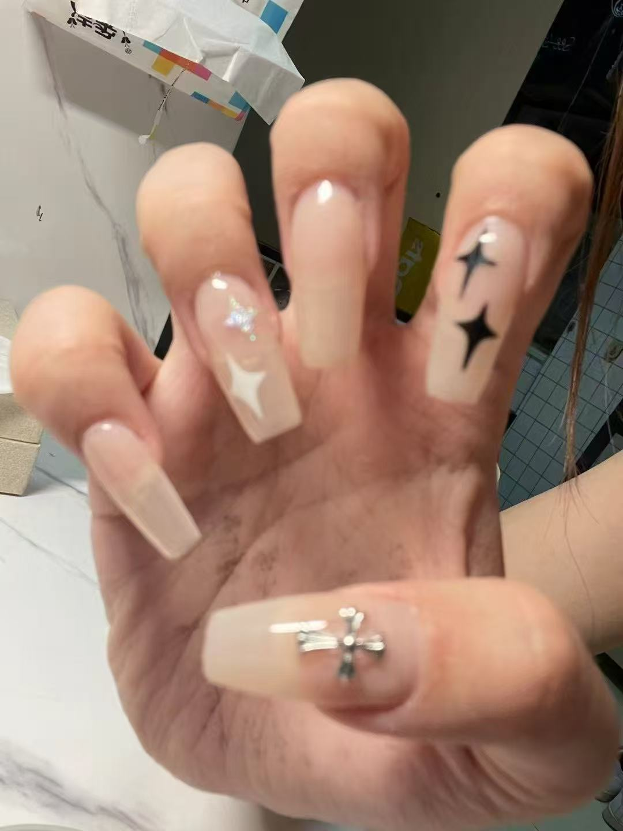
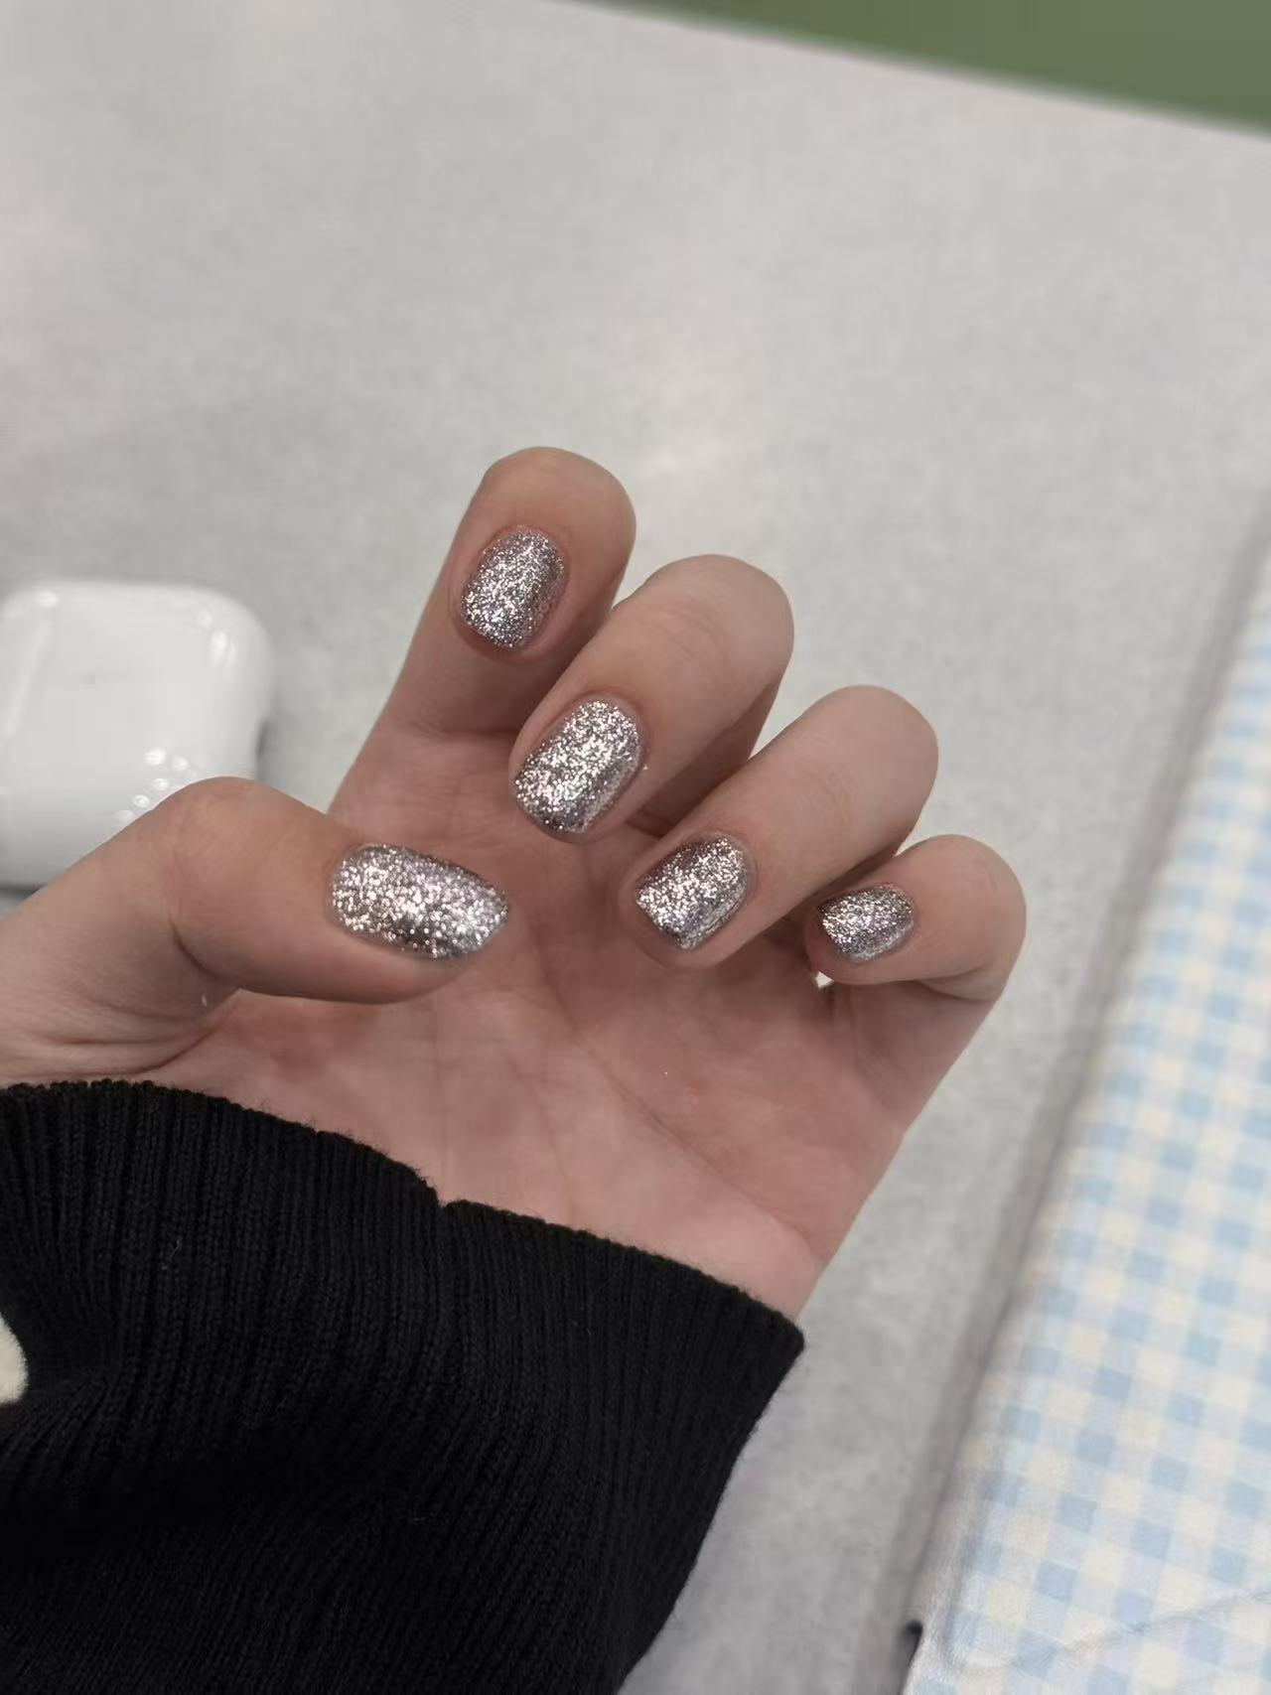
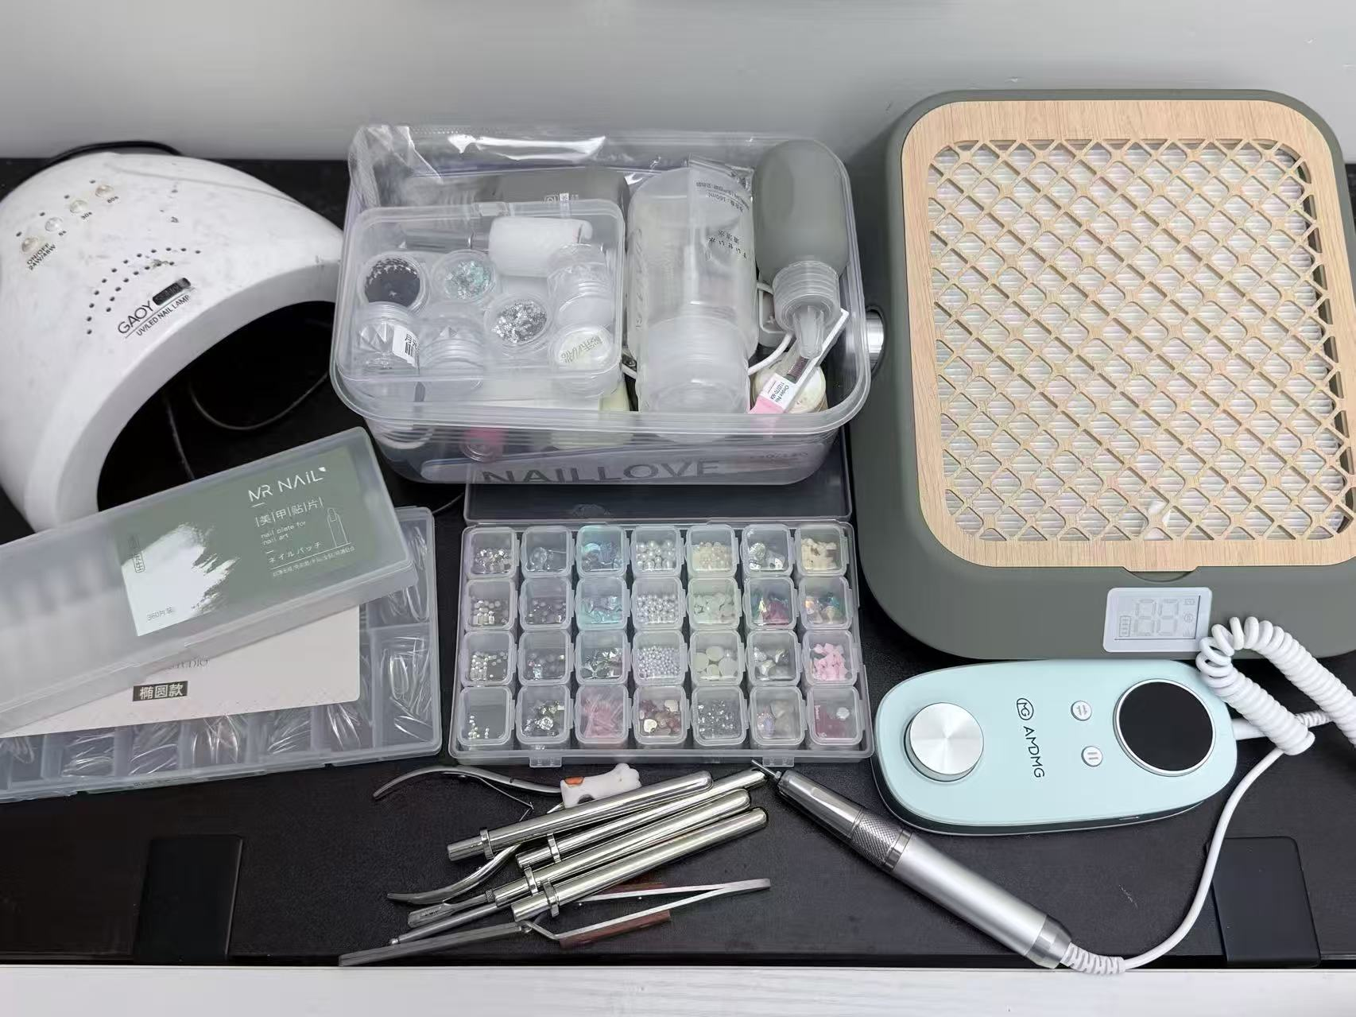
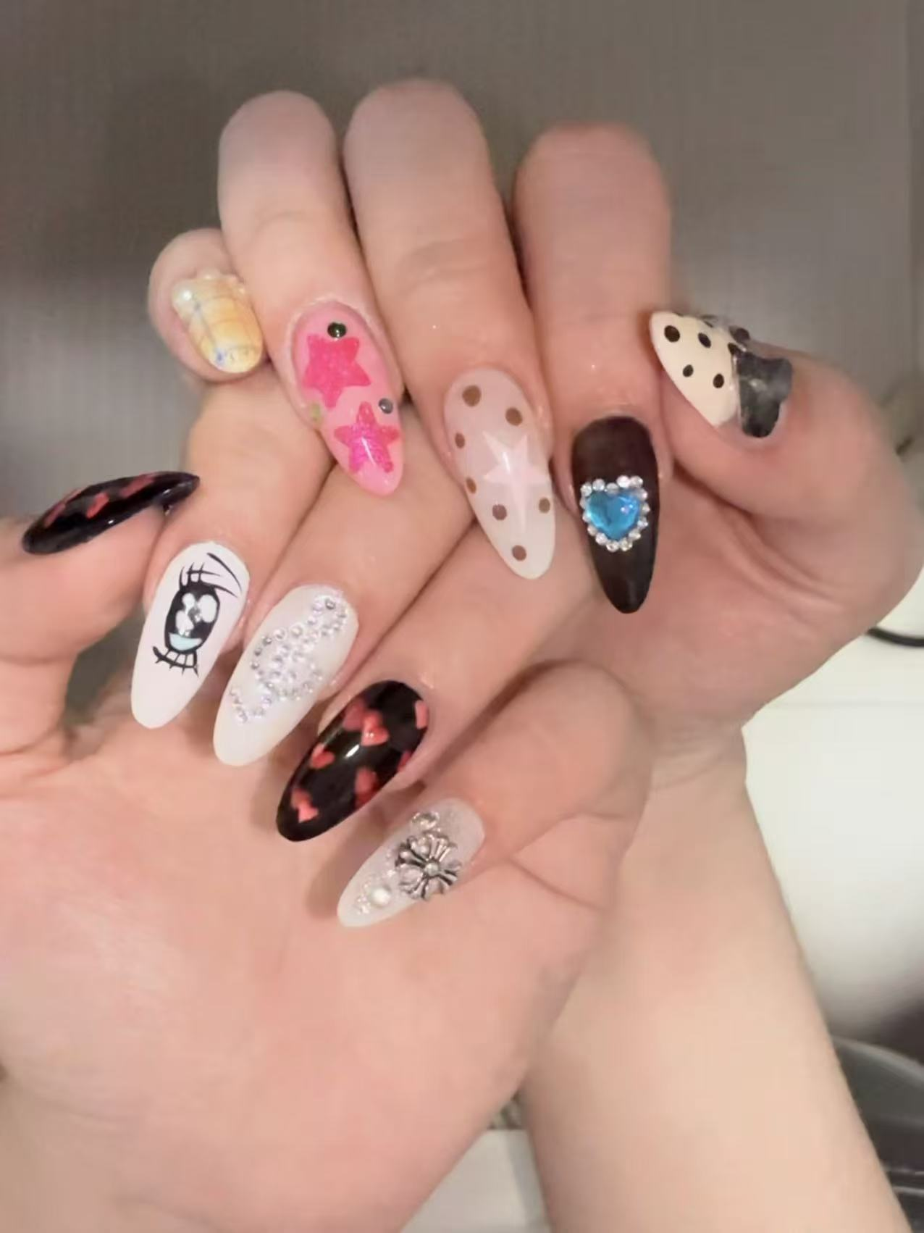
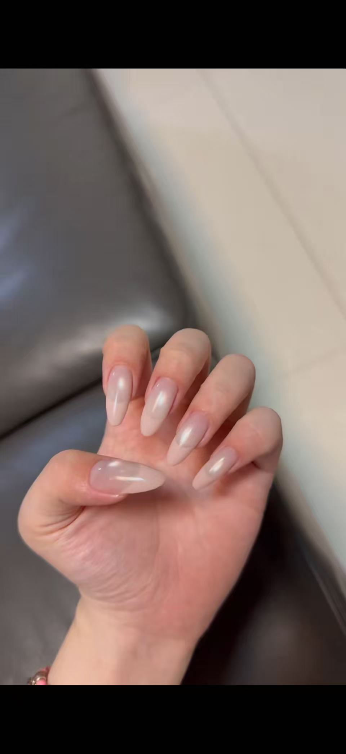
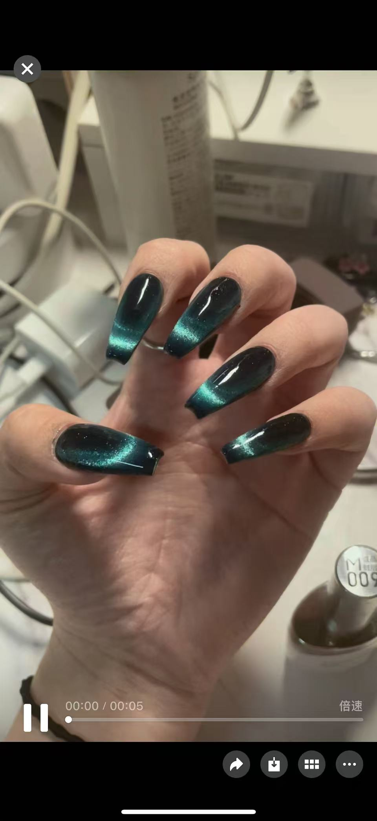
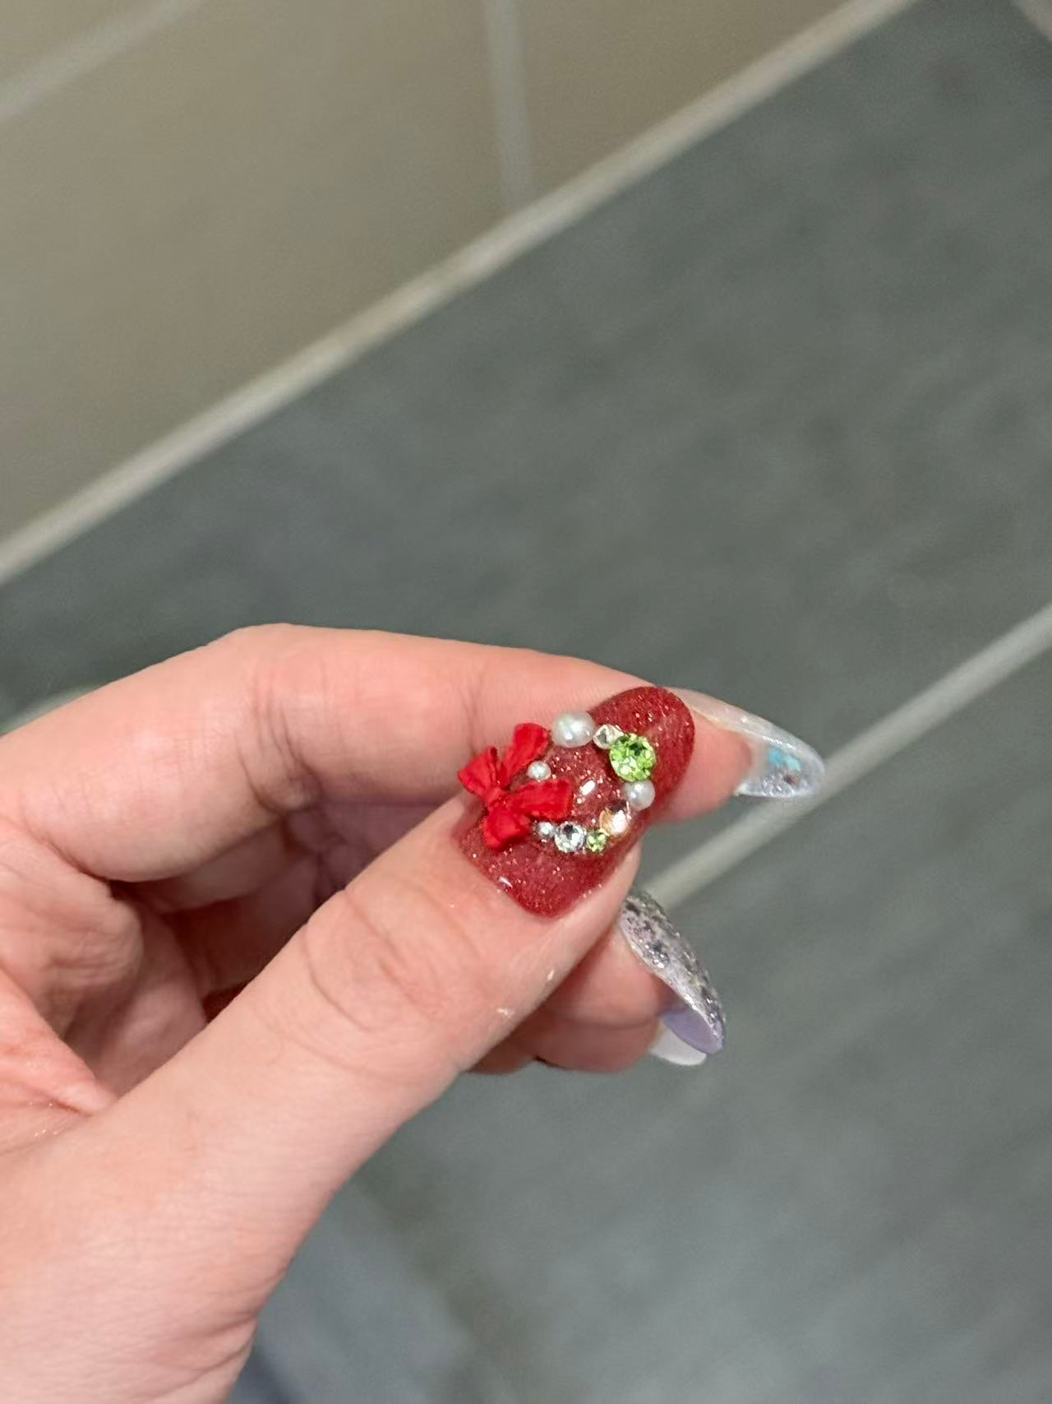
DIY nails by my friend

Slide 8
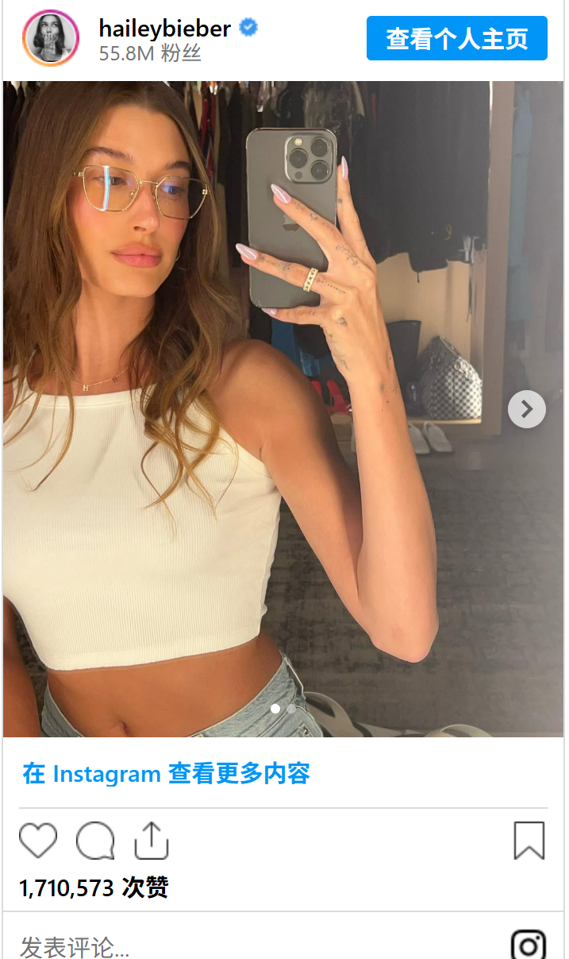
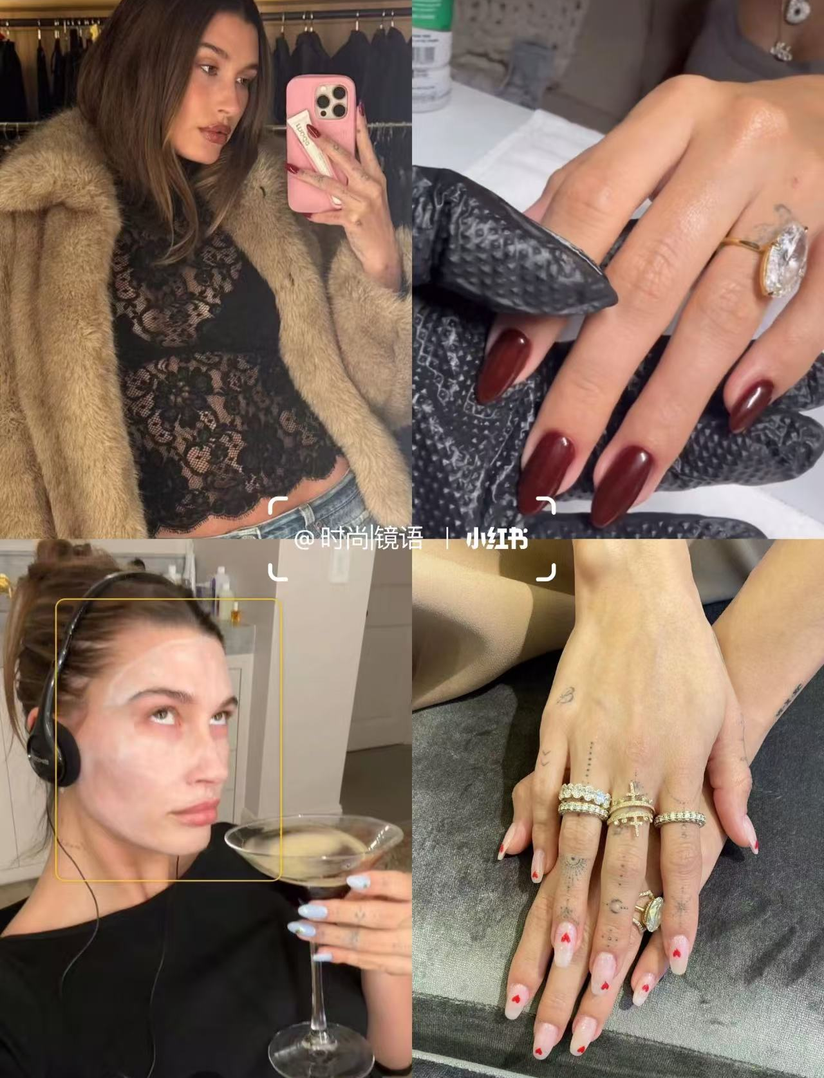
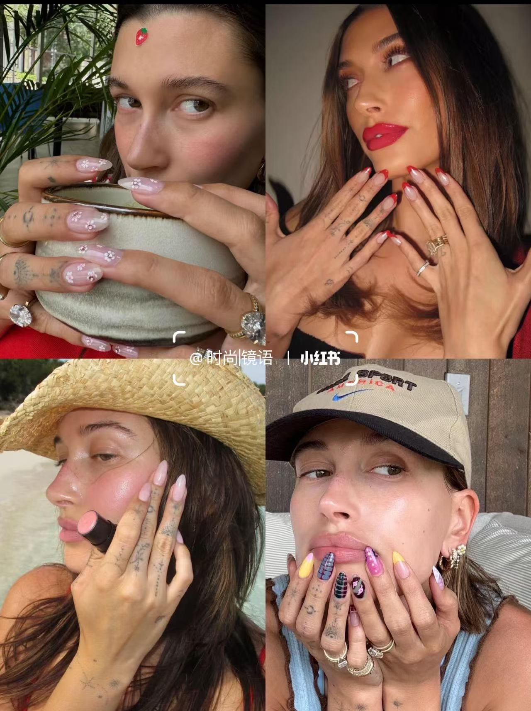
2. Economic Driver in the Beauty Industry
Industrial chain expansion
Celebrity influence
“She Economy”
upstream
(nail polish, chemical materials)
midstream
(nail salon, nail technician training)
downstream
(short video marketing)
...

Slide 9
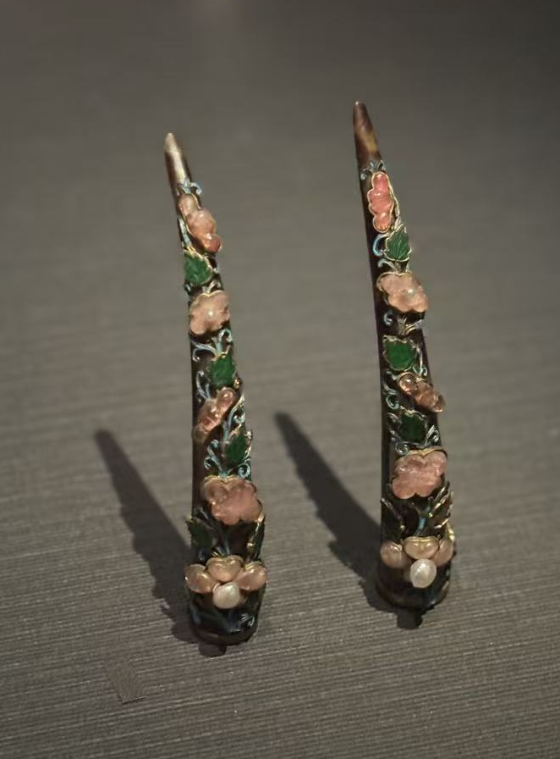
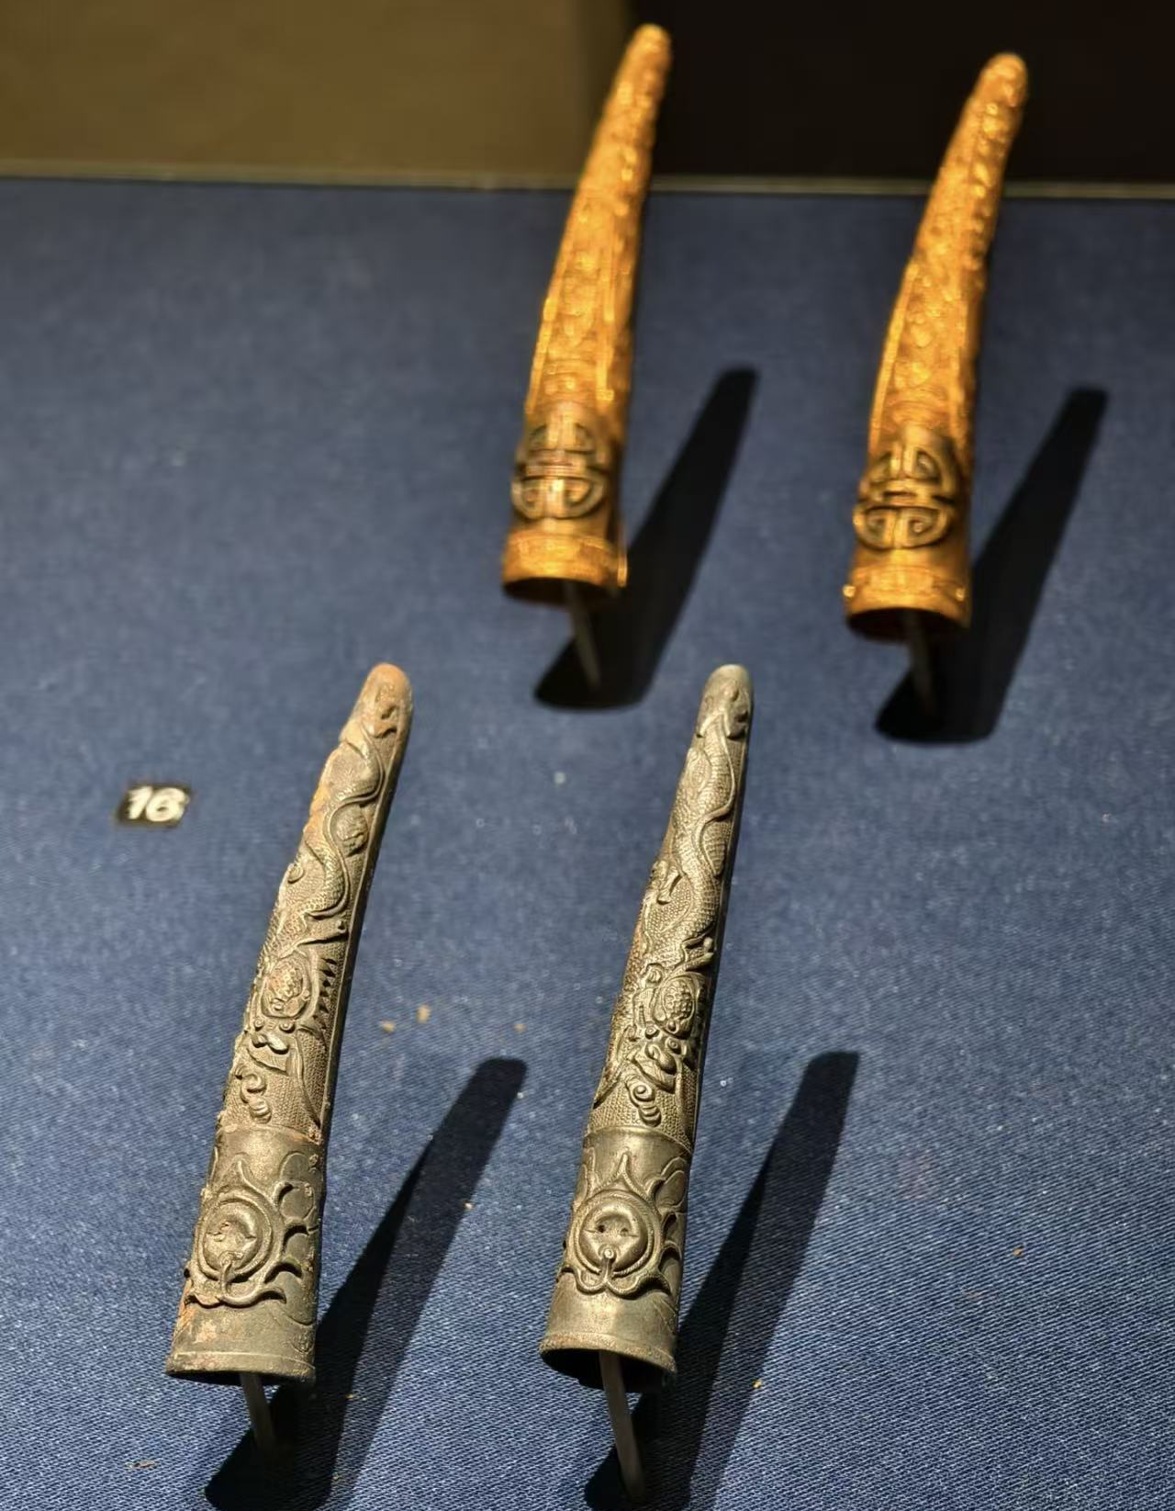
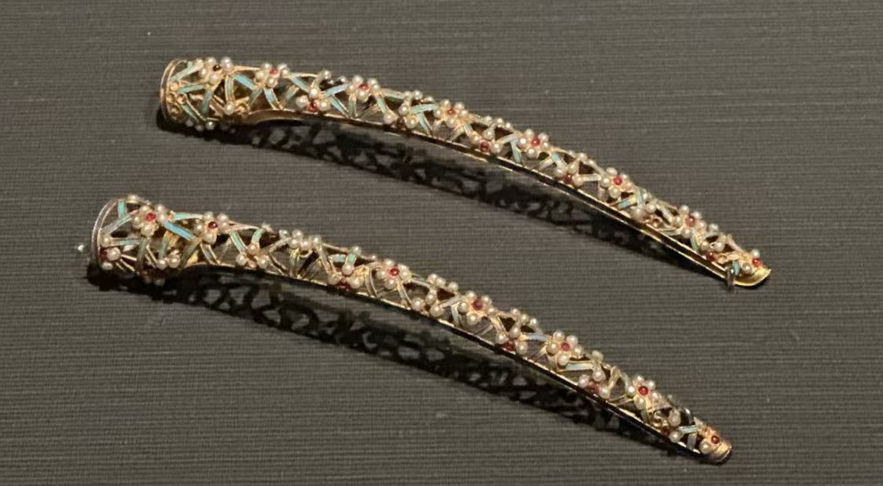
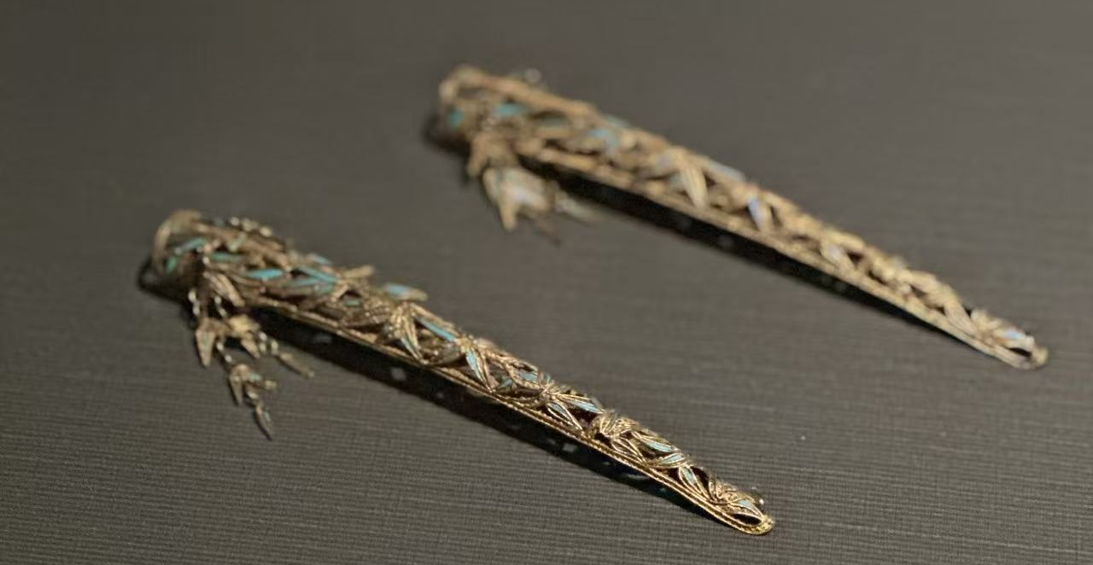
3. Embodiment of Traditional Cultures
“身体发肤，受之父母，不敢毁伤，孝之始也。” ——《孝经》
Our bodies - to every hair and bit of skin - are received by us from our parents, and we must not presume to injure or wound them. This is the beginning of filial piety.
Protect nails→filial piety
Nail Guards
Strict Feudal Hierarchy in Ancient Times

Slide 10


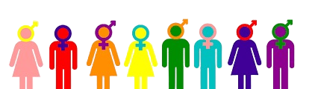
4. Mirror of Social Transformations
"social label"
"aesthetic freedom"
Technological and Aesthetic Evolution
Ancient Times:
natural dyes, beeswax, and traditional nail guards...
20th Century:
industrial nail polish and chemical pigments
21st Century:
gel manicure(光疗美甲);
3D nails(3D浮雕美甲);
artificial nails(贴片美甲)
Ancient Time: symbol of social status
Modern Time: expression of individuality, freedom and creativity
“De-gendered”
In the past, nail art was often regarded as part of “female beauty,” but with increasing male participation, it is becoming more gender-neutral.

Slide 11
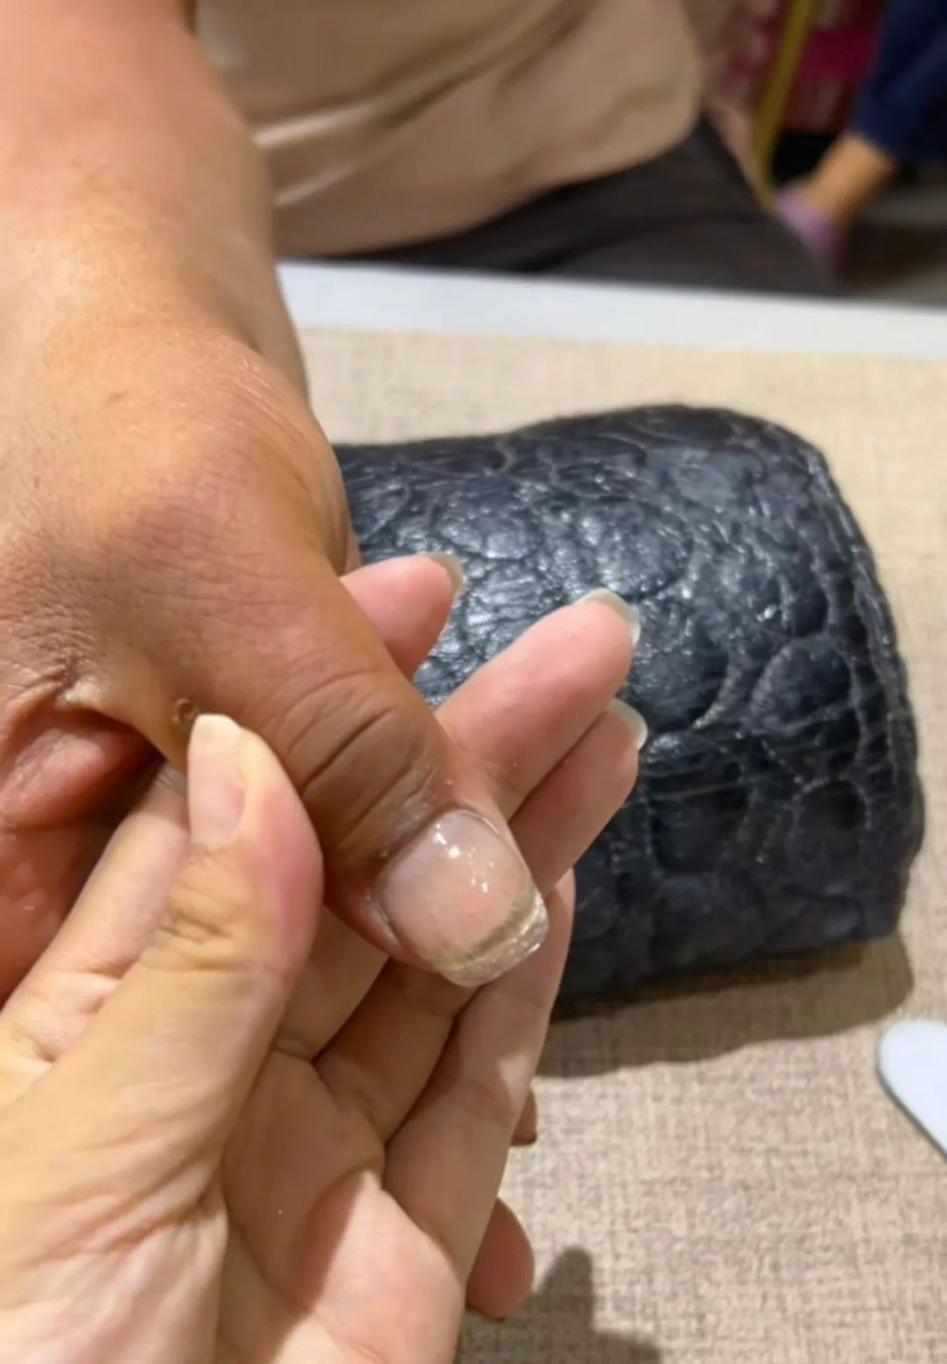
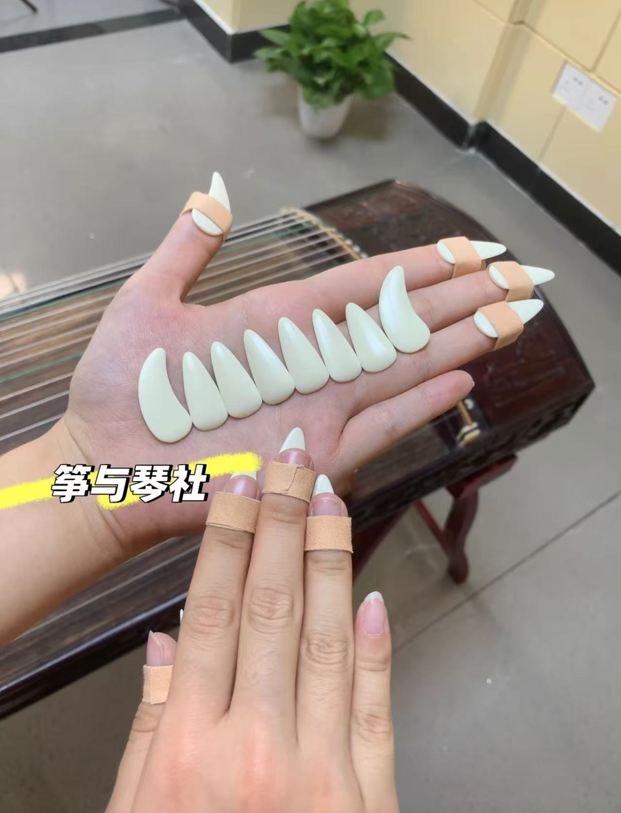
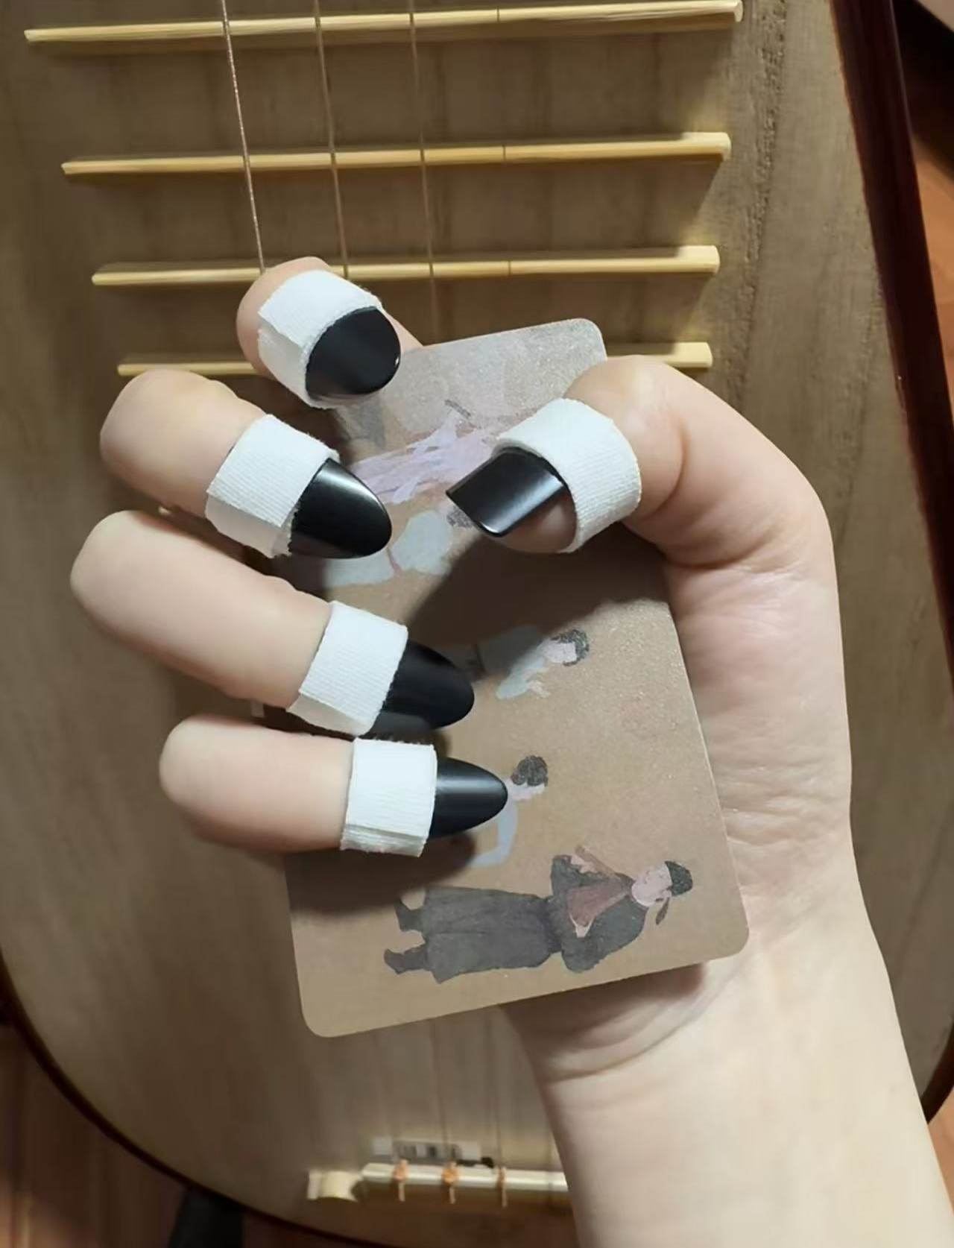
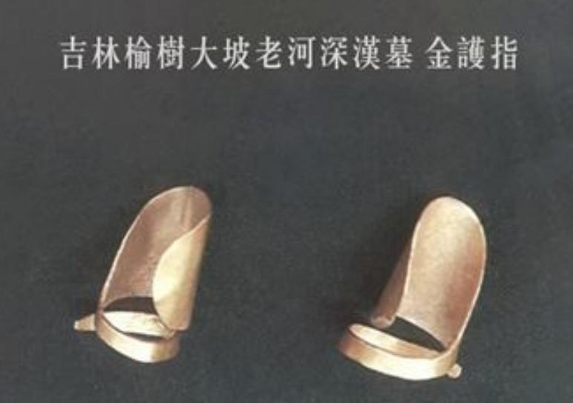

5. Practical Functions
Combined with Labor
The trend of “green bean–picking nails” began in real rural labor. During harvest season, farmers pick hundreds of kilos of beans a day, wearing their thumbnails down to the flesh through constant snapping.
To protect the thumb, a nail technician created a special “bean-picking nail”—a reinforced, reshaped extension that makes the work easier and less painful.
Combined with Music
Guzheng
Pipa

Slide 12
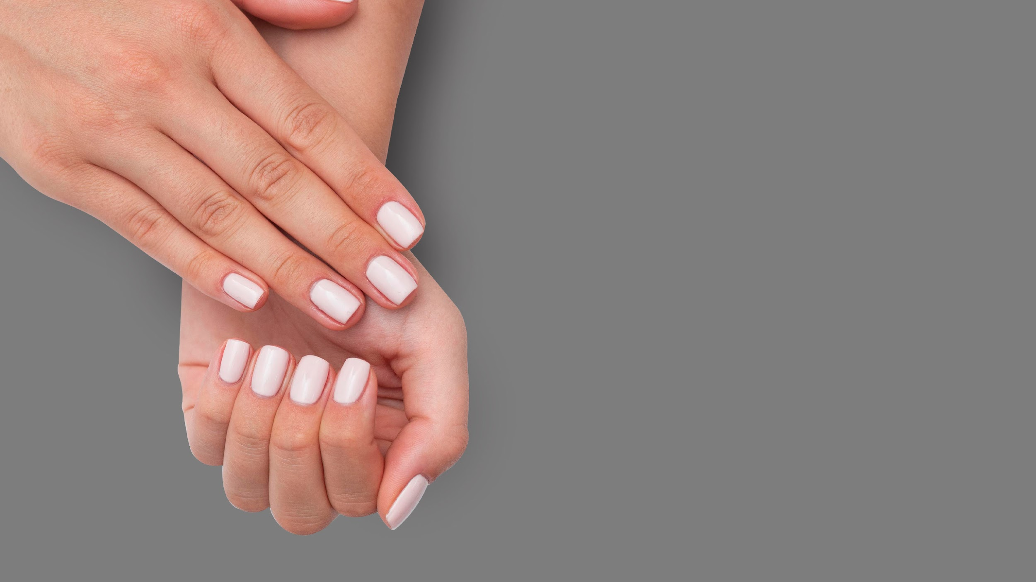
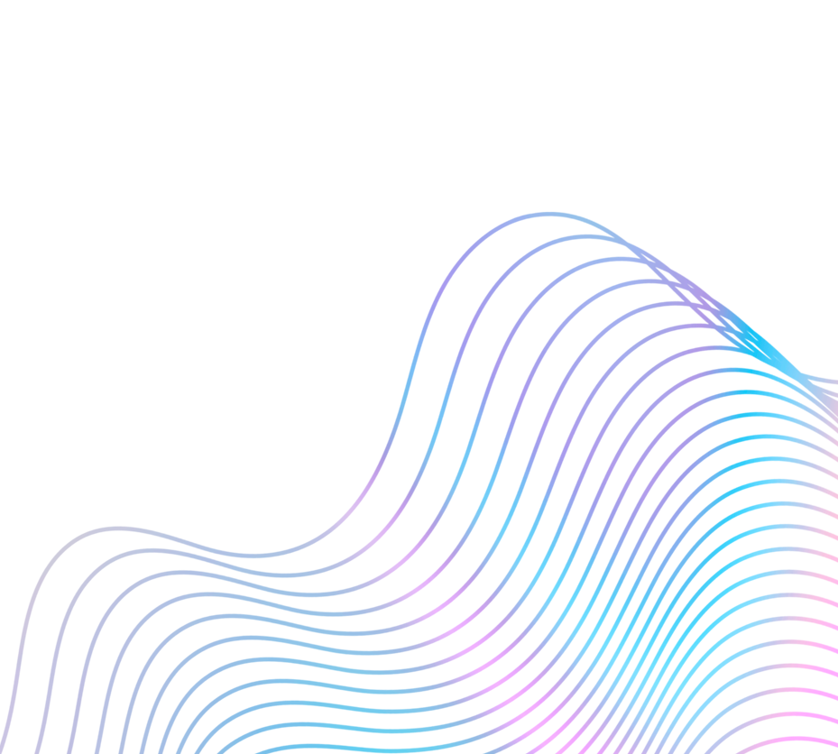
THANKS!
图片来源：小红书、百度、google、故宫官网

