Slide 1
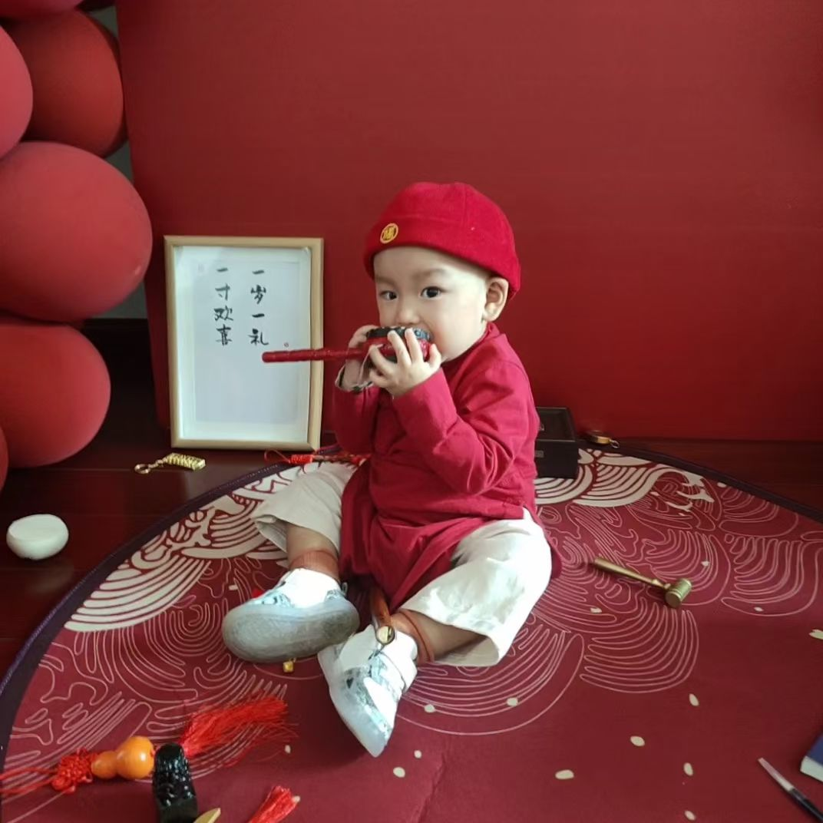


Slide 2
Zhuazhou 抓周
--One-Year-Old Catch
Speaker：罗语嫣 Luo Yuyan
2025/10/16

Slide 3
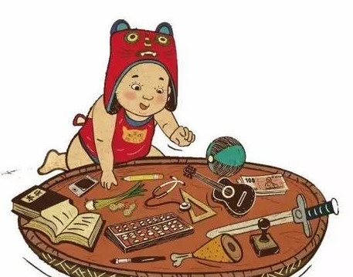


What is Zhuazhou?
A Chinese childrearing ceremony also called “晬盘”、“试儿”等
Held on a child’s first birthday, also called “testing on the firstbirthday.”
Preparing some items which symbolize different occupations and talent, such as books, pens, money, seal and musical instrument.

Slide 4
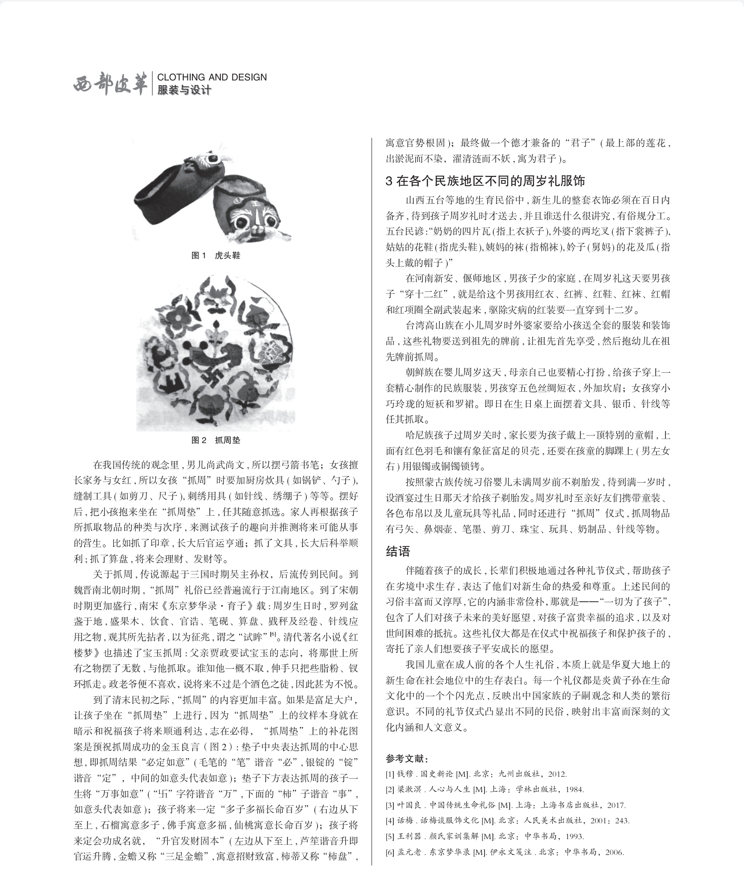
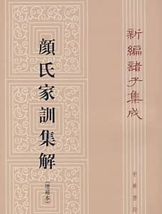
The Origins of Zhuazhou
The legendary origin
During the Three Kingdoms period, Sun Quan determined the crown prince (Sun He) among his sons by Zhuazhou.
Written record
Southern and Northern Dynasties: The Yan’s Family Rule (Yan Zhitui)

Slide 5
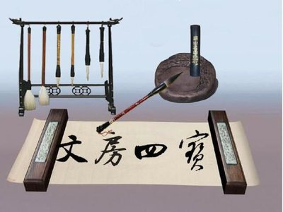
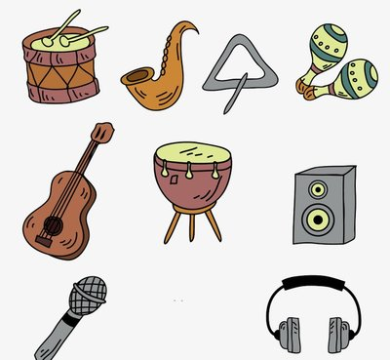
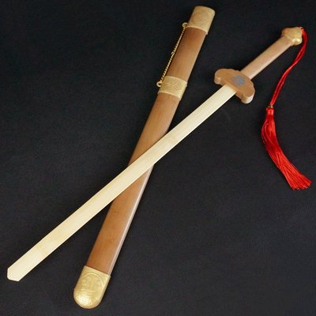
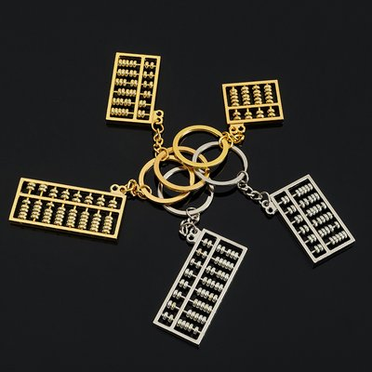
Meanings Behind the Objects
——love and good wishes
Wisdom and Intellectual
Artist
Brave and Bold
Wealthy

Slide 6
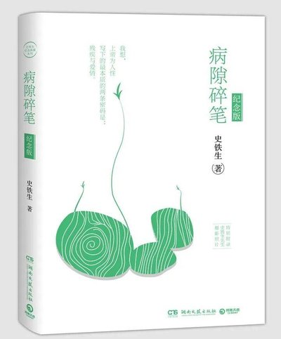
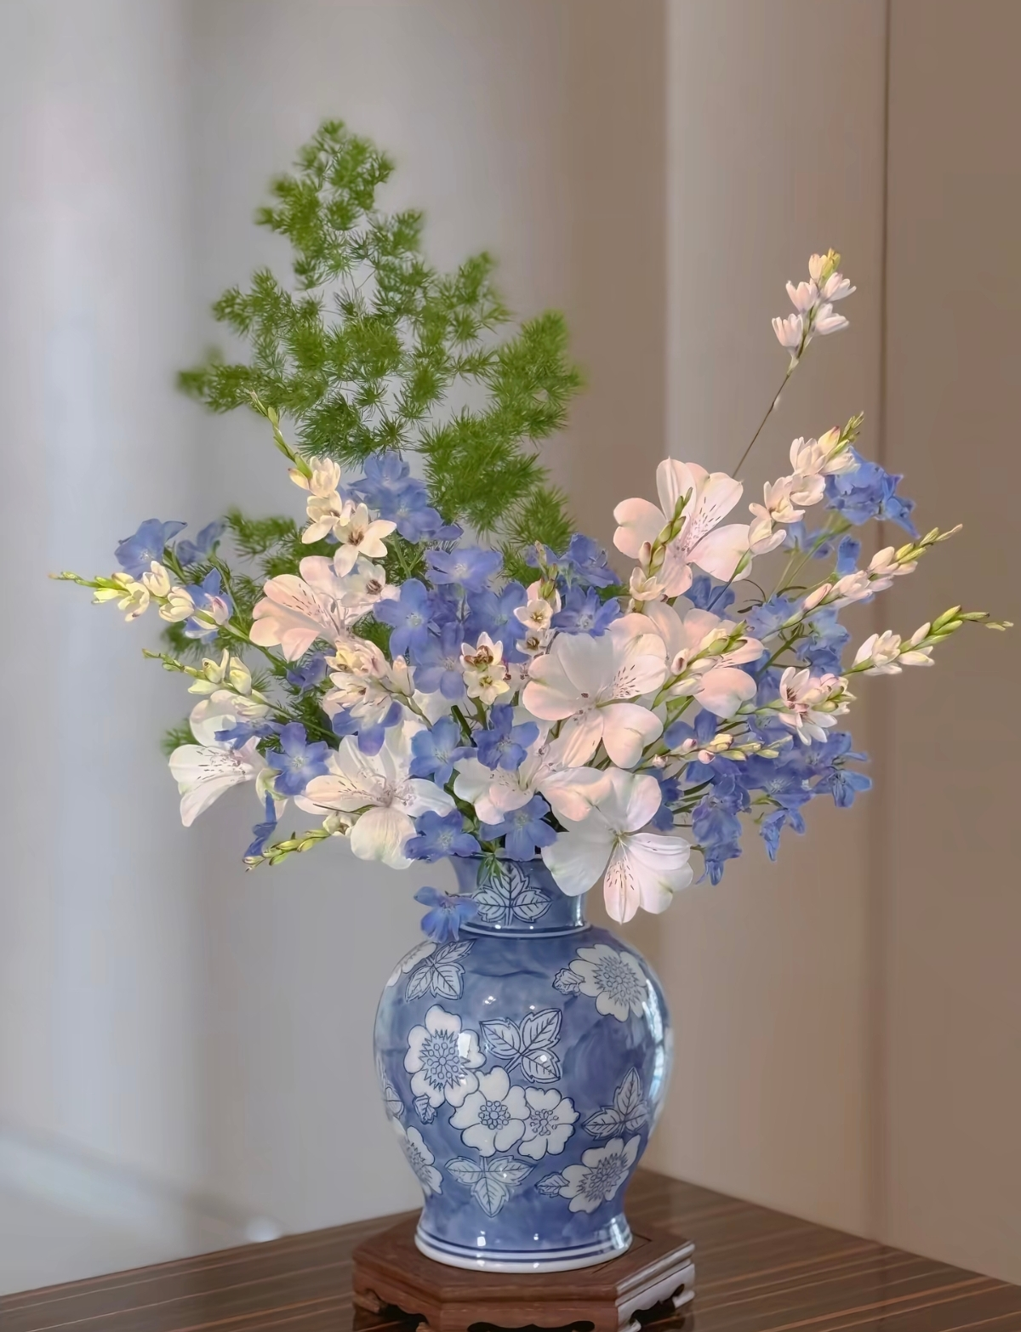
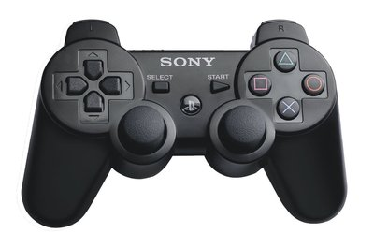

If you are a little baby now...
knowledge and introspection passion and fun romantic life exploration and adventure

Slide 7
Thanks

