Slide 1

Chinese Astrology
Reporter:Deng Yingjie

Slide 2
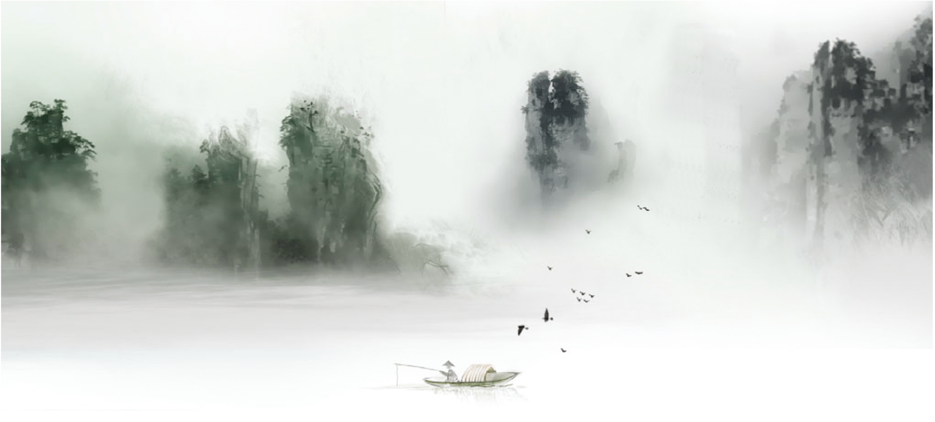
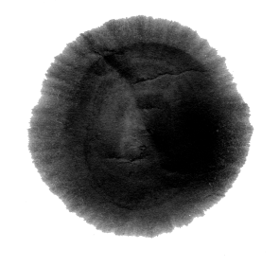

CONTENTS
The History
The Zodiac
The Five Elements
YIN / YANG

Slide 3

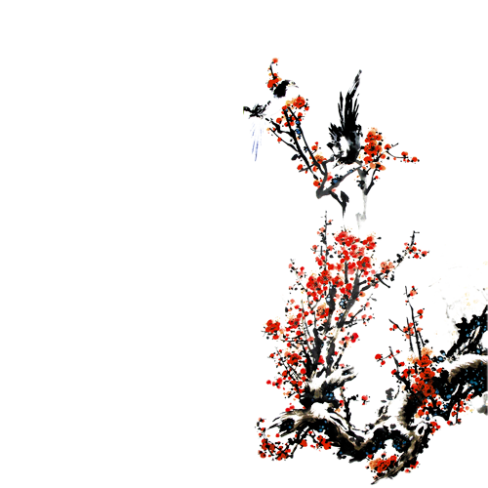

Chinese Astrology has been practiced in China for thousands of years and has played a significant role in Chinese culture. The origins of Chinese Astrology can be traced back to ancient China, where early astronomers observed the movements of the stars and created a system of astrological beliefs and practices.
The practice of Chinese astrology has gone through several changes throughout history. During the Han Dynasty (206 BCE - 220 CE), astrology was used to predict the fate of the emperor and his kingdom. Later, during the Tang Dynasty (618 CE - 907 CE), astrology was used to select auspicious dates for important events such as weddings and ceremonies.
During the Qing Dynasty (1644 - 1911), astrology became more accessible to the general public, and astrological predictions were published in newspapers and almanacs. In modern times, Chinese astrology has become popular worldwide, with people using it to gain insight into their personalities, relationships, and future prospects.
The History

Slide 4


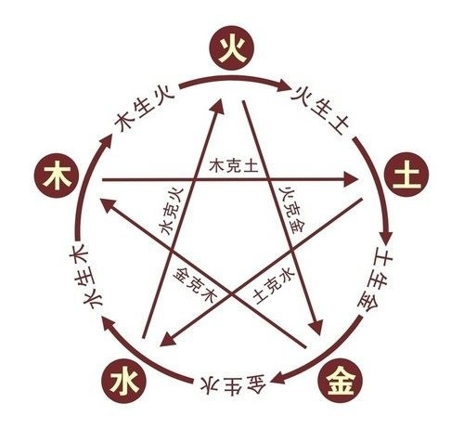
The Five Elements
Chinese believe that the five basic elements, Wood, Fire, Earth, Metal, and Water form everything in the Universe. As a fundamental part of the Oriental philosophy, the five elements are divided into Conducive and Controlling interrelationships. A Conducive interrelationship means that these five elements will produce one another and help nourish each other.

Slide 5
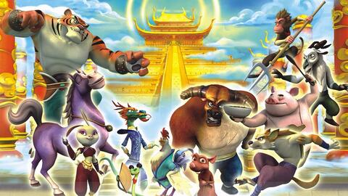
The Zodiac(十二生肖)
The Chinese zodiac is the most well-known aspect of Chinese astrology. The zodiac is based on a twelve-year cycle, with each year corresponding to one of twelve animals: rat, ox, tiger, rabbit, dragon, snake, horse, goat, monkey, rooster, dog, and pig. The animal that corresponds to the year in which a person is born is believed to influence their personality and fortunes.

Slide 6
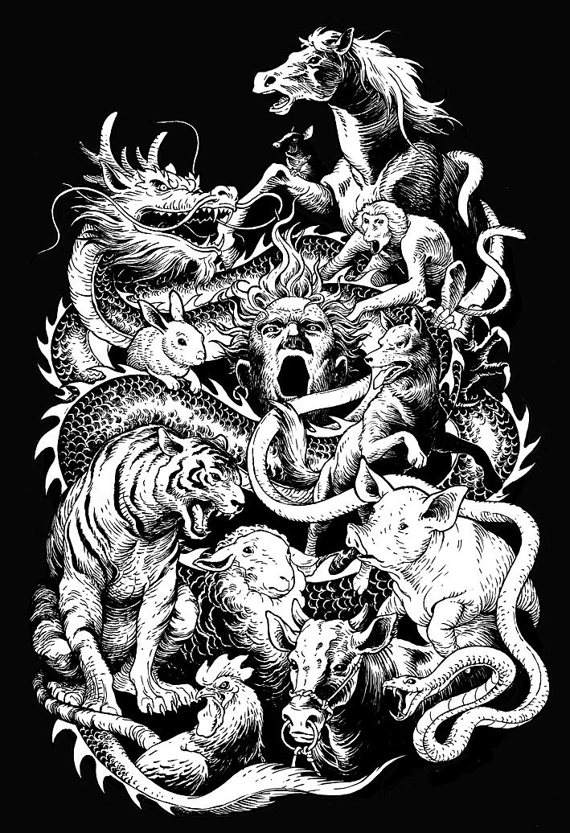

Slide 7
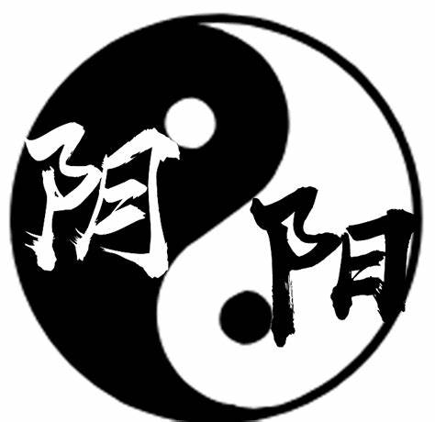
‘’Tai Chi’’
The Content of YIN / YANG
Since ancient times, the Chinese have believed that two major forces, the Yin and the Yang, control the universe. These two forces are the foundation of Chinese philosophy, people, and even Chinese medicine.
A well-known symbol called “Tai Chi” (the ultimate matter) embodies the Yin and the Yang. In the circle, the two forces equilibrate the energy and keep everything balanced. No force is stronger or weaker than the other, when one is at its highest, the other is at its lowest.Together the Yin and the Yang become a whole and thus keep the universe in harmony.

Slide 8

The Application of YIN / YANG
1. ) To predict the future
When it comes to predicting the future, Chinese people may use YIN / YANG to understand the potential outcomes of various situations. For example, they may consult a traditional Chinese fortune-teller who uses various divination methods, such as astrology, I Ching（易经）, or feng shui, to determine the balance of yin and yang in a person's life.

Slide 9
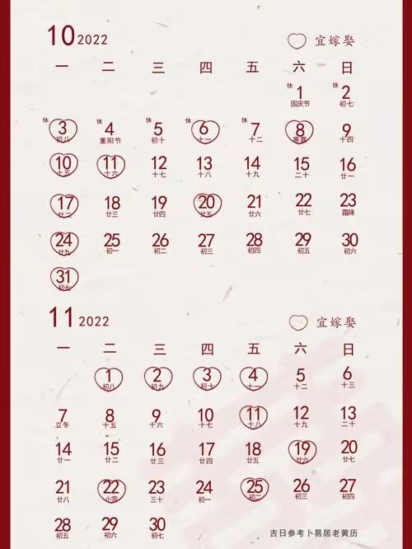
The Application of YIN / YANG
2. ) To determine days which are seen as the perfect days in which to initiate a particular project, especially a wedding ceremony or a new business enterprise.

Slide 10

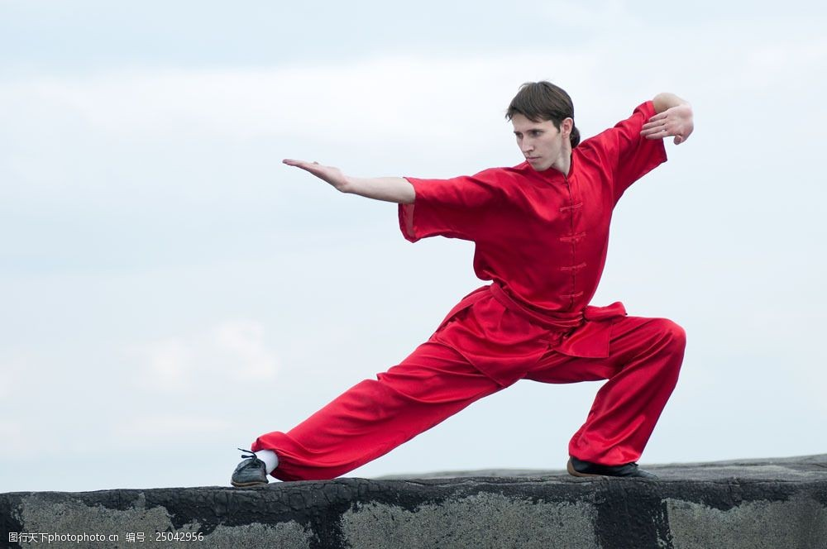
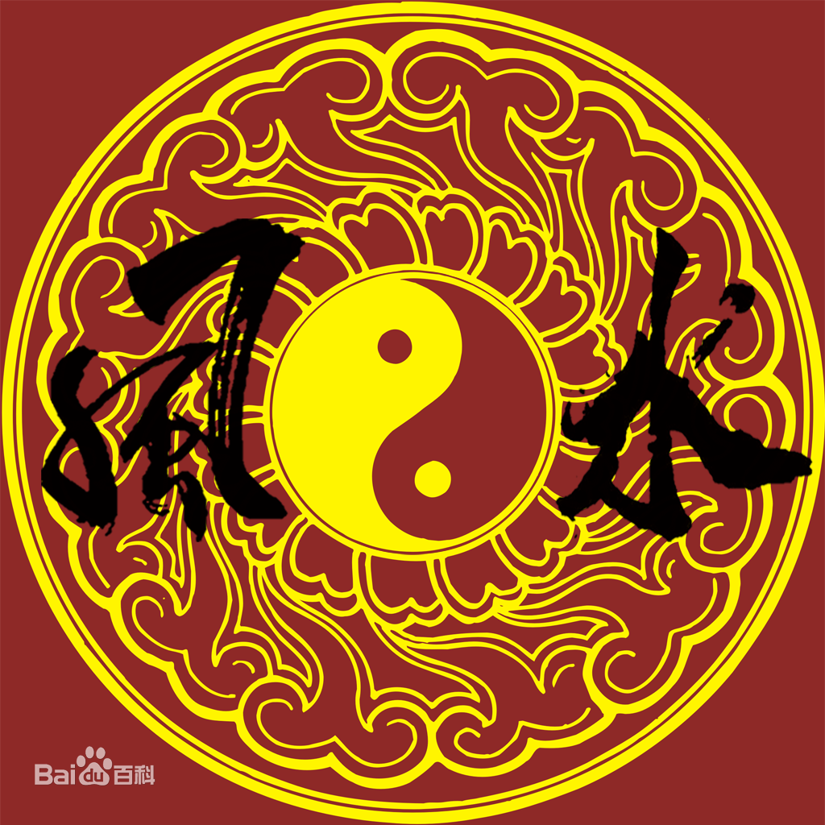
Traditional Chinese Medicine
Martial Arts
Feng Shui (风水)

Slide 11
Thank you

