Slide 1


中国书法
Chinese Calligraphy
徐佳 肖婷

Slide 2


Contents
Conception of Calligraphy
Five categories of calligraphy
Outstanding Calligraphers

Slide 3

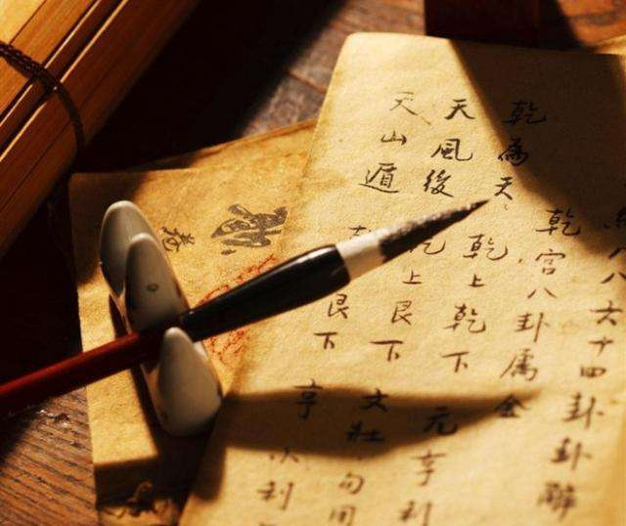
書 法
Chinese calligraphy is a traditional art of writing Chinese characters.
Chinese calligraphy was designated as an intangible cultural heritage by UNESCO in Sep.30,2009.

Slide 4


Chinese Calligraphy
Seal script ( Zhuan Shu )
Clerical script ( Li Shu )
Regular script ( Kai Shu )
Cursive hand ( Cao Shu )
Running hand ( Xing Shu )

Slide 5
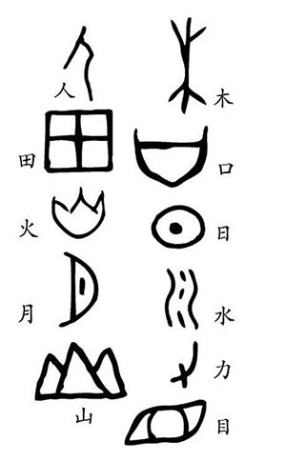
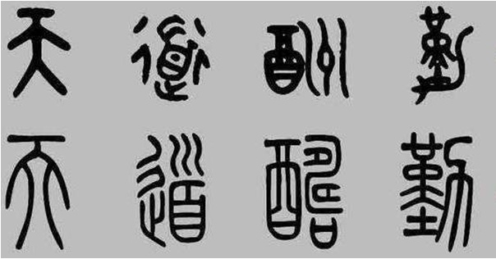
象形字
The seal script ( Zhuan Shu ) could be divided into Da Zhuan and Xiao Zhuan.
Compared to pictographic characters, Da Zhuan have more clear lines and and the character pettern tends to be in better order, which laid the foundation for the emergence of square characters.
Xiao Zhuan, the official script in Qin Dynasty, is well-proportioned and its strokes is uniform in thickness.
大篆
小篆
Seal Script

Slide 6

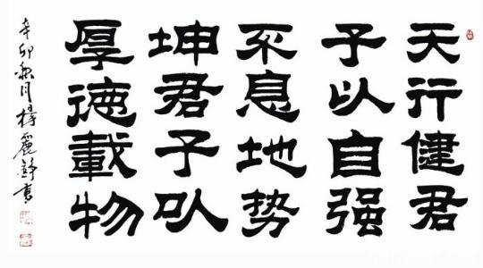
Clerical Script
Li Shu, the clerical script, is wide and flat in structure, with long horizontal strokes and short vertical ones, and it stresses a unique writing technique of “silkworm head and swallow tail” .

Slide 7

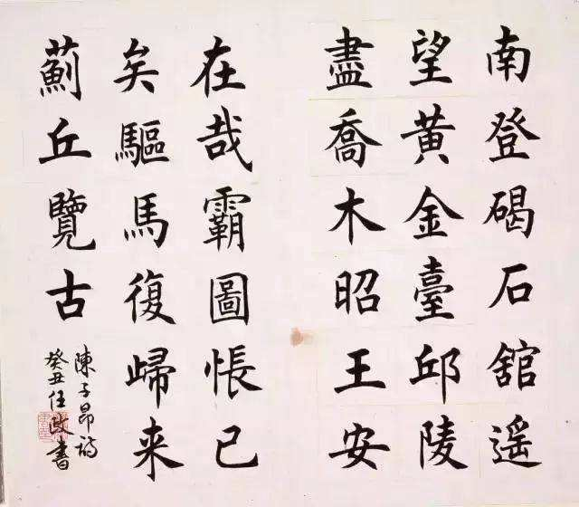
Kai Shu, the regular script, is more simplified and has been widely used in modern society. It has smooth horizontal and vertical strokes, and the shape of characters is square.
“形体方正，笔画平直，可做楷模。”
——《辞海》
Regular Script

Slide 8
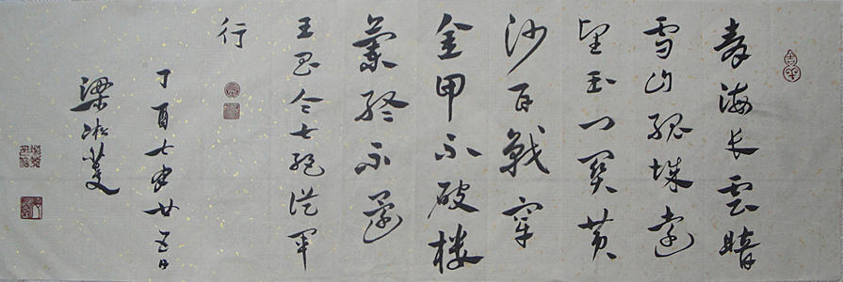
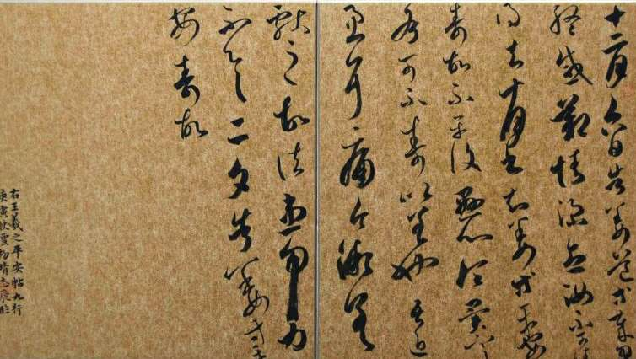
章 草
Cursive Hand
Cao Shu, the cursive hand, could be divided into Zhang Cao and Jin Cao.
Zhang Cao is the early style of the cursive hand. Combining the two styles of Li Shu and Cao Shu, it has some strokes connected in a single character but keeps every two characters apart. In general, the stroke of Zhang Cao have a heavy and raised end.
Jin Cao is more fluent and flexible, featuring both hardness and softness.
今 草

Slide 9
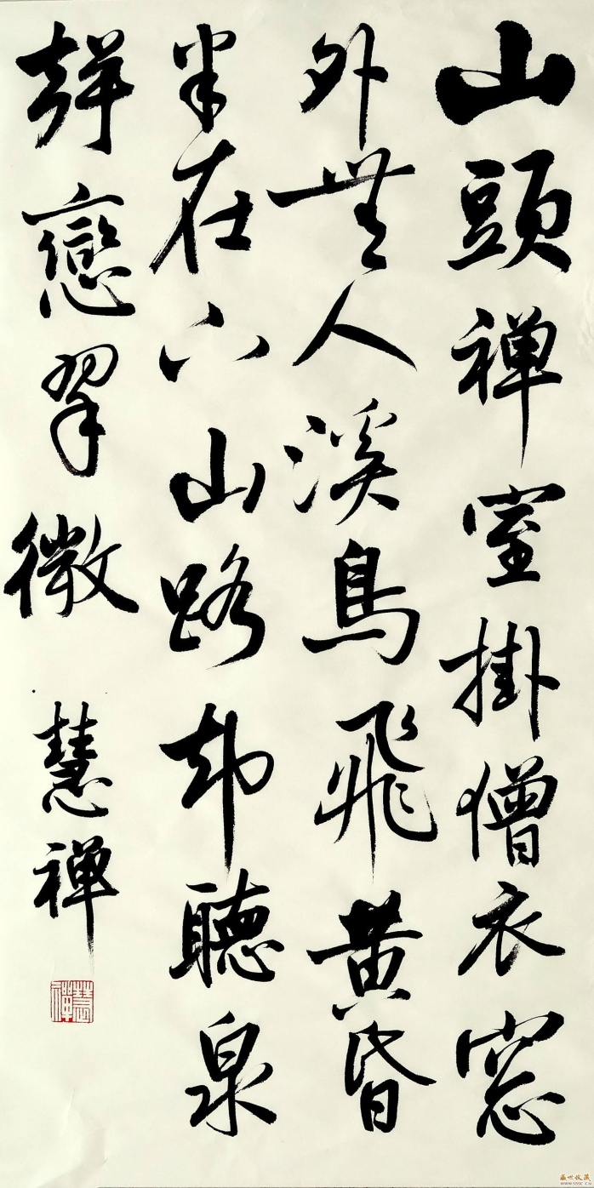
Running Hand
Xing Shu, the running hand, is a kind of script between Kai Shu and Cao Shu. It is not so square and regular as the former, nor rough and illegible as the latter. It enables people to write faster and the writing is easy for people to recognize.

Slide 10

Outstanding calligraphers
● Yan Zhenqing (颜真卿)
● Liu Gongquan(柳公权)
● Wang Xizhi(王羲之)

Slide 11
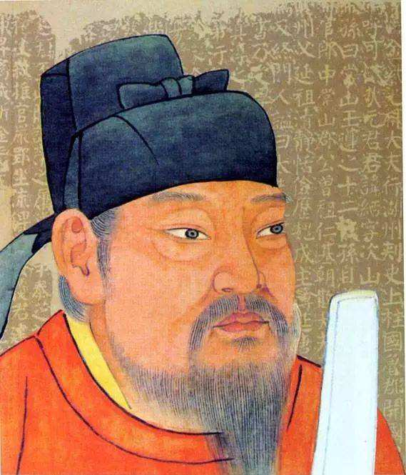
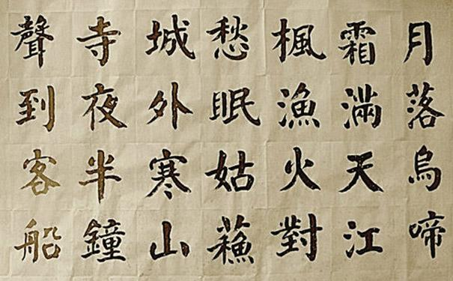
颜真卿
Yan Zhenqing, one of the four greatest masters of Kai Shu in Tang Dynasty. It is said that when he was a little boy, he used to practice calligraphy while sweeping the yard. His handwriting is elegant and graceful, with an air of magnificance.

Slide 12
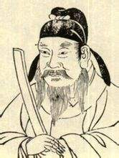
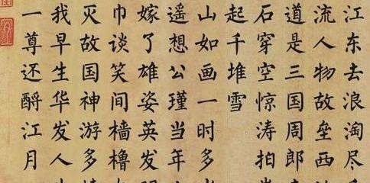
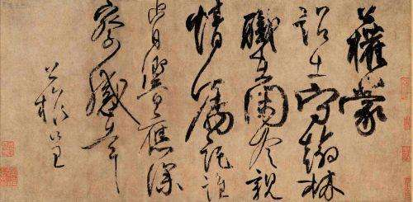
柳公权
Liu Gongquan, a master of the regular script and the cursive hand, who is often mentioned with Yan Zhenqing.
His regular script features firm strokes and rigorous structure, while his running-cursive is fluent and vigorous.

Slide 13
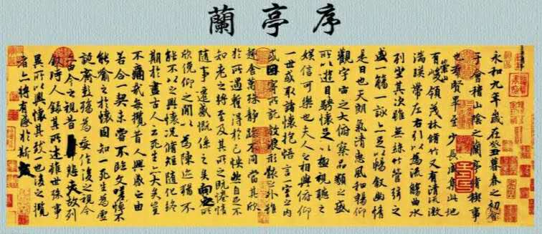
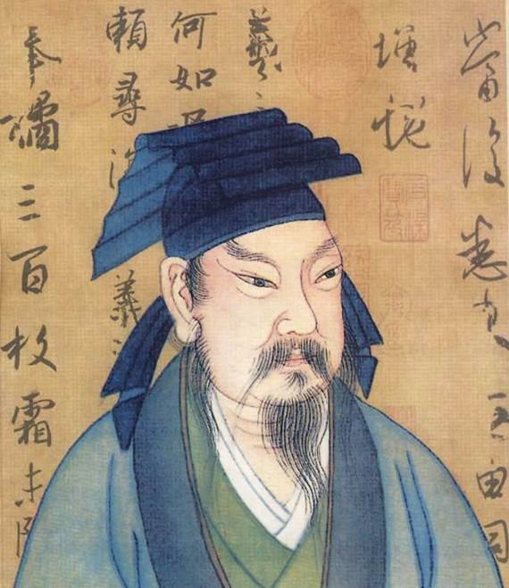
王羲之
Wang Xizhi is acclaimed as “the Saint of calligraphy” and is famous for his cursive hand, which is flowing, flexible and powerful as well. His most famous work is Preface of Lanting, which has been regarded as the best running hand in the world.

Slide 14
Difficulties in Translation
● Some four-character words describing the features of the scripts are difficult to find their counterparts in English.
● Some proper nouns in Chinese can only use Pinyin during translation.

Slide 15
Thank you

