Slide 1
China's modern education system
翻译二班 谢香琳
Notes:
51PPT模板网，幻灯片演示模板及素材免费下载！
51PPT模板网 唯一访问网址：www.51pptmoban.com

Slide 2

CONTENTS
Education system
Examinations
Double reduction policy
Characteristics of Chinese education

Slide 3
Education system
01

Slide 4
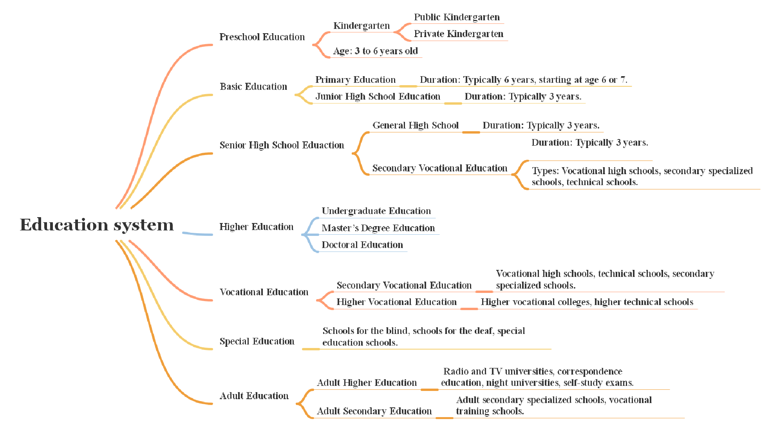

Slide 5
Education system
Curriculum Design
Enrollment
Qualification
receive a specialized secondary school diploma
can take further education entrance exams
specialized secondary schools (中专)
Strong systematic professional knowledge, balancing cultural and specialized courses
junior high school
high school graduates
receive a technical school diploma
have the opportunity to obtain relevant vocational qualifications
can directly enter the workforce or continue their studies
Mainly professional skills training, with few cultural courses and a significant emphasis on practical teaching
junior high school graduates
high school graduates
technical schools (技校)
receive a vocational high school diploma
can take specialized exams to enter higher vocational colleges or other higher education institutions
vocational high schools (职高)
Balance cultural, professional, and skill courses, focusing on vocational skills training
junior high school graduates

Slide 6
Examinations
02

Slide 7

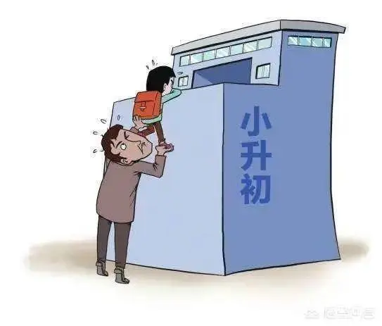
junior high school entrance examination
Later, in order to alleviate the pressure, the relevant laws were enacted and the unified examination was abolished.
”
Previously, it was divided into
the unified examination, i.e. by the local education bureau,
the school examination, i.e. the enrollment of the school's own organization.

Slide 8
junior high school entrance examination
”
enrollment in the nearest school
Some key secondary schools and private secondary schools can still organize selective examinations.
In order to send their children to a better middle school, parents will try to buy a nearby school district house .
The pursuit of prestigious schools is highly competitive, creating a huge market for education and training. The involution of education is expanding to the lower grades.

Slide 9
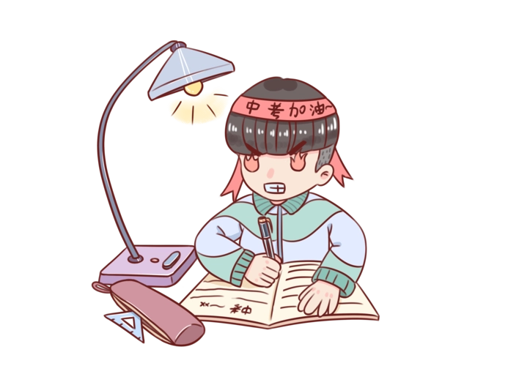
The Senior High School Entrance Examination (Zhongkao)
The examination is a prerequisite for admission to almost all educational institutions at the upper secondary level, such as general, vocational and technical high schools.
Exams are organized differently in different places. Enrollment policies vary from high school to high school.
Unified Examination in Biology and Geography(生地会考):
After the reform, geography and biology are no longer tested in the Zhongkao, but are organized in the form of the Geography and Unified Examination in Biology and Geography when students are in the eighth grade, which is in the form of a written examination, mostly closed-book, and is usually arranged after the Zhongkao (mid-June) every year.

Slide 10
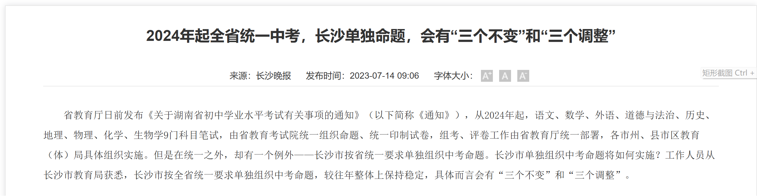
The Reform in Hunan
省教育厅相关负责人表示，长沙市是我省唯一的基础教育综合改革国家级实验区。从近几年国家基础教育质量监测情况来看，长沙市义务教育质量处在全省前列。为支持实验区建设，鼓励长沙市开展基础教育改革创新，允许长沙市按省里统一要求单独组织中考命题。
“实施中考省级统一命题，有利于提高命题质量，进一步发挥考试评价导向作用，引导深化义务教育教学改革，推动义务教育优质均衡发展。”
From 2024 onwards, Hunan will implement a unified secondary school examination, while Changsha will organize a separate secondary school examination proposition.
In Changsha:
English:
120 points→100 points 120min→100min
Chinese：150min→120min
Morality and the Law, history and geography written tests in Changsha are open-book, while closed-book is used elsewhere.
Physics, chemistry and biology will be based on a combination of written and laboratory tests.

Slide 11


The National University Entrance Examination (NCEE)/Gaokao
The national university entrance examination is a screening test for Chinese higher education institutions to enroll qualified senior high school students.
Currently, most provinces in China adopt the “3+X” system. The “3” refers to three subjects, Chinese, Mathematics, Foreign Language while the “X” refers to a subject selected by the student from the humanities group or the science group of subjects.
Starting on June 7, the exams will take 2 days in some provinces and 3-4 days in those provinces where the reform is implemented.

Slide 12
Counterpart test(对口升学)
Background:
With the adjustment of national economic policy to meet the needs of society for technical talents, and in order to support the development of secondary vocational schools and to meet the aspirations of vocational college students for further study, the Ministry of Education has introduced a policy of “counterpart test”.
Explanation:
Secondary school students in the completion of the professional courses, can participate in the national unified examination for further study, into colleges and universities to continue to study their specialty.
For example, if they study computer science in junior schools, they can still study computer science after entering colleges and universities, which is called “counterpart”.
Applicants:
Secondary vocational schools (including vocational secondary schools, vocational high schools, general secondary schools, adult secondary schools) graduates and former graduates
“3 + 2 comprehensive” examination form:
100 points:Chinese+Math+English + 200 points: professional theory+professional practice=700 points

Slide 13
Double reduction policy
Logo Here
design
share
Summarize
03

Slide 14
Opinions on Further Reducing the Burden of Homework for Students in Compulsory Education and the Burden of Out-of-School Training
2021,《关于进一步减轻义务教育阶段学生作业负担和校外培训负担的意见》
Core:Improving the quality of in-school education and reducing after-school burdens
Details:
Fully reducing the total amount and duration of homework and alleviating the excessive burden of homework on students
Improve the level of after-school services to meet the diversified needs of students.
Adhere to strict governance and thoroughly regulate off-campus training behaviors
Vigorously improve the quality of education and teaching, and ensure that students learn enough and learn well in school.
Strengthen supporting governance and enhance support and guarantee capacity

Slide 15
Challenges:
1. Inadequate implementation by localities and schools: The Double Reduction Policy was intended to improve class quality and reduce after-school burdens. Instead, the actual situation is that the content of the class is reduced, the difficulty of the examination remains unchanged, and the burden after school increases.
2. Where there are policies,there are corresponding solutions.For example, vacation tuition is conducted under the name of summer camp.

Slide 16
Characteristics of Chinese education
04

Slide 17
My Education Experience
In the sixth grade, some students from well-off families and with good grades would go to a famous private junior high school in the city with very good conditions and a high promotion rate.
a poorly equipped elementary school near my home
primary school
enrollment in the nearest school
Senior high school
Gaokao
junior high school
Liling No. 1 middle school
University
But it's still an hour's bike ride to school.
Hunan Normal University

Slide 18
By the second semester of our third year in junior middle school, high-achieving students are grouped together and instead of studying textbook content, we prepare for independent entrance exams for high schools,mainly the best high school in the city, Liling No. 1 middle school.
Halfway through the second semester of the junior year, the key high schools hold selective examinations for independent enrollment. The top students in each junior high school take the exams in Chinese, Math, English and Siences. The exams are more difficult than the Zhongkao and the questions are innovative.
Only two of us passed the exam that year, but it was the best result in our junior high school for several years, and the best result for a junior high school in town.
However, with a total enrollment of about 100 students,in the town's junior high schools, usually only one or two students passed the exam, even none, while in that city's private junior high school ,more than 70 to 80 students.
independent recruitment

Slide 19
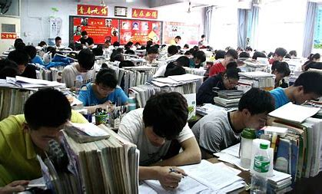
Study
By senior year, we had a half-day vacation every week, from 12:00 to 6:00 pm and one full day off each month for students to go home and rest.
Evening classes ended until 11:00 p.m. Lights go out in the dormitories at 11:20 p.m. and students go to bed.
However, there is an unwritten rule for seniors. We can still study during nap time as well as after lights out, and the dormitory teachers do not punish us. So it's not surprising that the dormitory building is still lit up late at night.

Slide 20
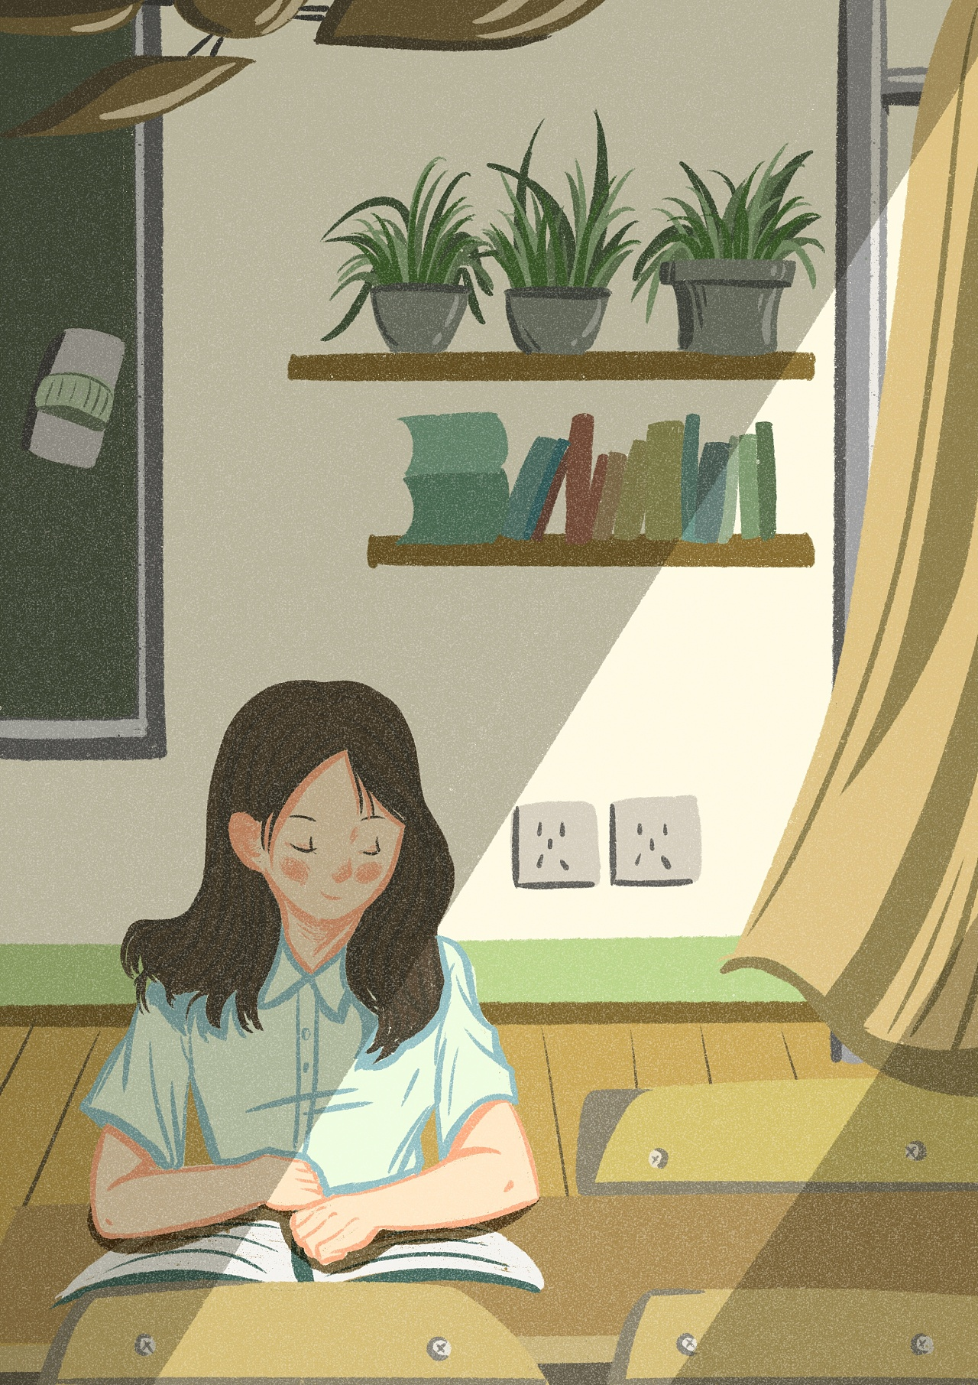
feelings
There are no cell phones to contact family and few ways to connect with the outside world. My senior year of high school, it was all about studying .
Going back once a month or even once every two months gave me a strong sense of alienation from my hometown and even my family. A lot can happen in a month, and a lot can change in the outside world, but for me the most change in a month was my grades.

Slide 21
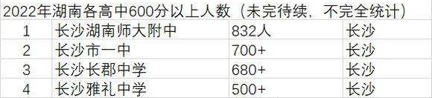
There are a total of five local high schools,
Liling No. 1 middle school(98%)
Liling No. 2 middle school & Liling No. 4 middle school
Liling No. 3 middle school
Liling No. 5 middle school(20%)
In 2022, there were only 66 people who scored 600 points or more in Gaokao in my high school.
However, in the same year, the four most prestigious schools in Changsha were as follows.

Slide 22

Inovative classes
Students who passed the Independent Entrance Examination
Higher grades
class A
class B
Students entering through the Zhongkao
Other classes
Higher grades
class A
class B
Of those 66 individuals, 42 were from Innovative Class A, which had a class average grades of 615.

Slide 23

Characteristics
From my experience and presentation, you may get a glimpse of why parents are so obsessed with pushing their children to learn. Nowadays, in this context, it is no longer enough to be good at learning, it is necessary to be very good. At all stages of education, there are graded levels. Each division can be a watershed in life.

Slide 24
Characteristics
Inequalities in educational resources and the quality of teaching:
China is a vast country, and there are inevitably large differences between regions and between rural and urban areas. Despite the Government's efforts to balance this imbalance, the education gap remains unbridgeable, and is most prominently reflected in the rates of advancement to higher education in different regions.
Diverse Educational System and Pathways:
China's education system includes various levels and types of education, such as compulsory education, general higher education, vocational education, and adult education. This provides diverse learning pathways and development opportunities for students with different needs and aspirations.
Educational Reform and Innovation:
China continually pursues educational reform and innovation, exploring models and methods that align with modern societal needs and development.

Slide 25
Characteristics
Emphasis on Basic and Disciplinary Education:
The Chinese education system places a strong emphasis on basic education, particularly in subjects like Chinese, mathematics, and English. The curriculum is systematic and comprehensive, focusing on the development of students' foundational knowledge and essential skills.
Care of Examination Systems and Selection Mechanisms:
China employs a unified college entrance examination system (Gaokao), which is the primary selection mechanism for higher education. Exam results directly influence students' opportunities for further education and future development. Therefore, there is a prevalent tendency towards exam-oriented education, resulting in significant pressure on students.
Educational Equity and Universal Education:
The Chinese government prioritizes educational equity and universal education, implementing a nine-year compulsory education system. Efforts are made to narrow the educational gap between urban and rural areas and among different regions, promoting balanced development to ensure every student has equal access to education.

Slide 26
References:
https://baike.baidu.com/item/%E5%88%9D%E4%B8%AD%E5%AD%A6%E4%B8%9A%E6%B0%B4%E5%B9%B3%E8%80%83%E8%AF%95/20833164
http://www.changsha.gov.cn/szf/ywdt/zwdt/202307/t20230714_11164442.html
https://baijiahao.baidu.com/s?id=1771173926082894598&wfr=spider&for=pc
[1]余蓉(2023-07-12).全省统一中考，长沙为何单独命题.湖南日报,004.
中共中央办公厅 国务院办公厅印发《关于进一步减轻义务教育阶段学生作业负担和校外培训负担的意见》

Slide 27
Thank you for
watching
谢香琳
Notes:
51PPT模板网，幻灯片演示模板及素材免费下载！
51PPT模板网 唯一访问网址：www.51pptmoban.com

