Slide 1
Filter Bubbles in China
Zhou Zihao & Qiu Xu

Slide 2
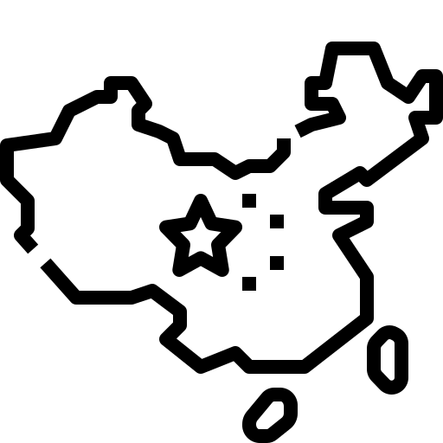
Menti Code
1234 5678

Slide 3
Merrian-webster Dictionary:
An environment and especially an online environment in which people are exposed only to opinions and information that conform to their existing beliefs

Slide 4
















Slide 5


opinion
Dog is cute.
Cat is cute.

Slide 6


Slide 8
Fact
DOG IS THE ONLY CUTE ANIMAL!

Slide 9



Filter Bubble
Information Cocoon
Echo Chamber
Information Enclave
Truth Decay
Extremism
Misconception
Falsehood

Slide 10
Nationalism
Xenophobia

Slide 11





Slide 12
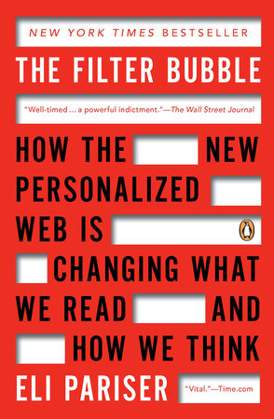
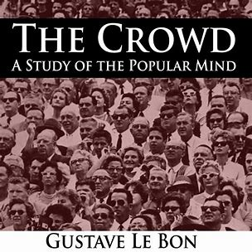

Slide 13
Thanks!
25 November 2022

Slide 14
