Slide 1
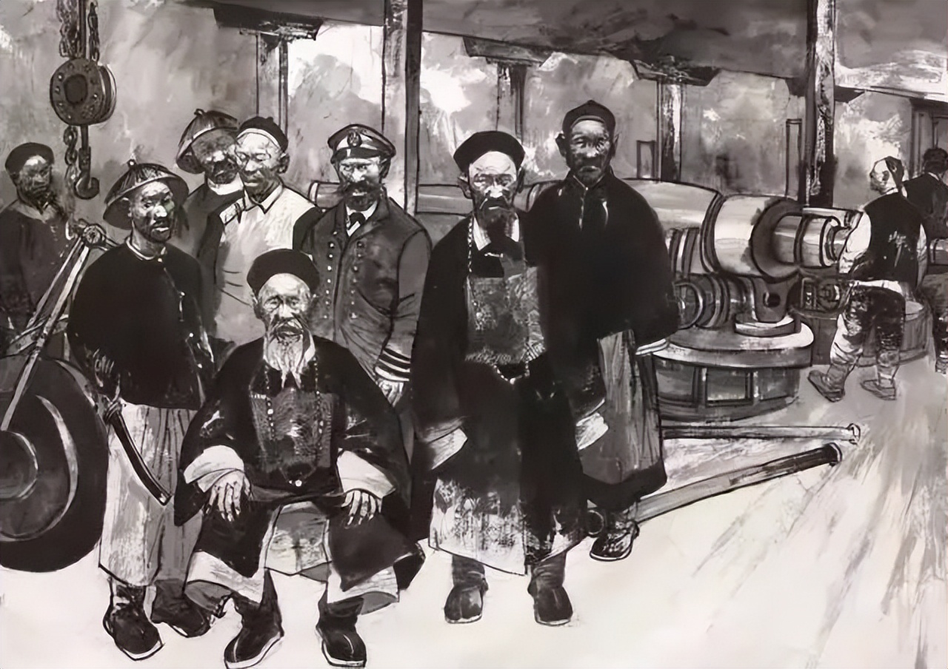

The Westernization Movement
洋务运动 [yáng wù yùn dòng]
By Yan Qi & Ma Mingyu

Slide 2

Westernization Movement (Self-strengthening Movement)
Time: 1860s-1890s
Advocates: the Westernization Faction
Property: Self-rescue movement
Western military equipment, machine production, science and technology

Slide 3
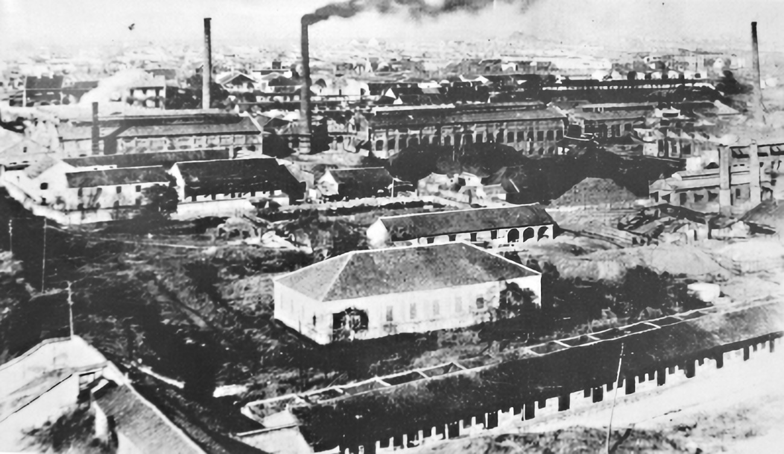
1.Background
2.Representives
3. Influence
Content

Slide 4
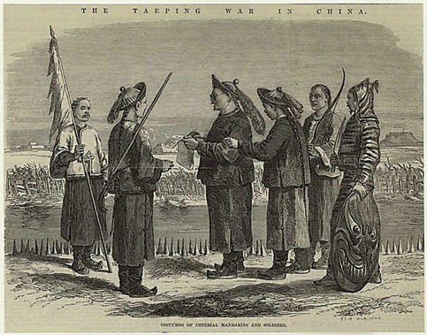
Background
1
1. The Second Opium War
2. Supression of the Taiping Rebellion

Slide 5
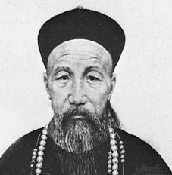
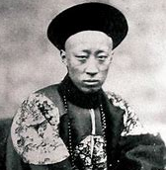
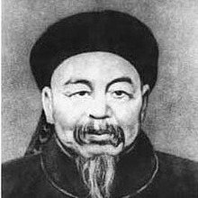
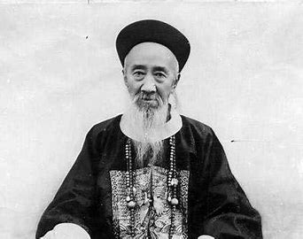
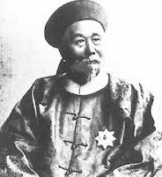
Representitives
2
Zeng Guofan 曾国藩
Anqing Ordnance Institute
Translation Bureau
Prince Gong/Yi Xin 恭亲王奕䜣
Li Hongzhang 李鸿章
Zuo Zongtang 左宗棠
Jiangnan Manufacturing Bureau
Merchants Steamship Bureau
Fuzhou Shipping Bureau
Zhang Zhidong 张之洞
Hanyang Iron Works

Slide 6

Influence
3
Military modernization
a
b
Economic impact
Limits
c
Feudal political sysyem
Contributions
d
Dependence on western powers
e
Red-tape and corruption

Slide 7
Why did the Westernization Movement finally fail?
Question：

Slide 8
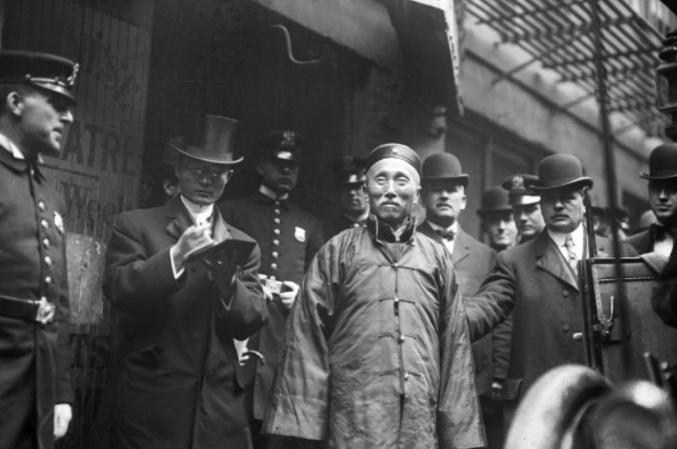
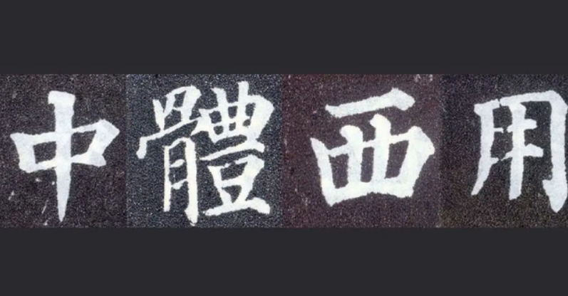
Chinese essence and Western utility

Slide 9
References
[1]廖慧贞.论洋务运动对中国近代化的深刻影响[J].经济与社会发展,2011,9(09):136-142.DOI:10.16523/j.45-1319.2011.09.008.
[2]戴逸. 中国近代史稿[M].中国人民大学出版社:戴逸文集, 201801.624.
[3]王立新.中国文化知识读本:洋务运动[M].吉林出版集团有限责任公司, 201105.59.
[4]Britannica, The Editors of Encyclopaedia. "Self-Strengthening Movement". Encyclopedia Britannica, 7 Feb. 2022.
[5]Jianbo Zhou, 2022."The Far-Reaching Impact of Westernization Movement," Palgrave Studies in Economic History, in: Westernization Movement and Early Thought of Modernization in China, chapter 0, pages 349-357, Palgrave Macmillan.

Slide 10
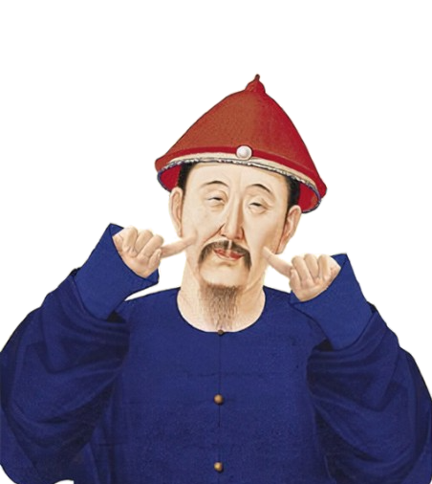
Thank You!

