Slide 1

Literature of the Late Ming
1573-1644
Pages 63-82

Slide 2
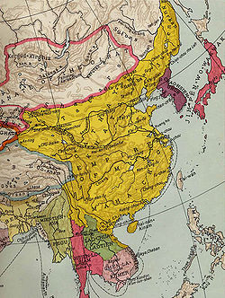
Literature of the Late Ming
A selection of what is literature
Wanli 1573-1620
Jiajing and Longqing (1521-1572)

Slide 3
Book And paper making
Book Production
Wood black Printing
Europe vs Ming book and printing
Classics, histories, philosophy, belles-letteres (assorted works)
Everyone had the opportunity to get hold of books
Precious scrolls (baojuan), and Morality books (shanshu)
Notes:
Nanjing and jian yang centers of publishing
1.185 comercial prints
Jujube wood
Philosophy (Zi)
Encyclopedia’s (Leishu)
Wanlin was 6 times more producctive
europe
Literate women/ women literatuer

Slide 4
Literature of the Late Ming
Hu Yinglin (1551-1602)
Books making become extremely cheap and more luxurious
min Qiji’s edition of Du Fu
Libraries of ten thousand chapters
Authors began publishing during life
Notes:
Hu yingglin fiction genre writer
Artisans singed and drew pictures in books
Color printingg became in use more blues and reds
Hu yinglin 42,384
Mao jing 84,000
Millionare

Slide 5
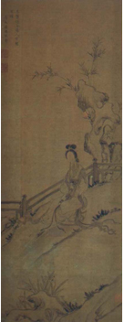
Jiangnan
Cultural center of the Ming
Fantasized china
Xue Susu eight famous courtesans of the Ming
World wide Trade center
Fashion trends
Notes:
Courtesans, artsts writers
Jiagsu and zhejiang
Yangzi river delta
Crazy book prodution becase it was 3v times cheaper

Slide 6
Elites and literary societies
Shi
Wanglin (1573-1620)
Examination system
Compilations of essays
Wenshe
Revival Soceity
Notes:
18%
3%

Slide 7
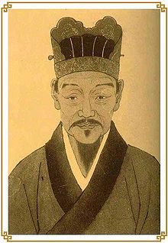
Li Zhi
Radical
Follower of Mencius
Anachronistic
Authenticity.
Notes:
Shaved his head like a monk
Imprisioned for heredoxy
He slit his throat
Instinctive morals,
Anti confucius not us.

