Slide 1
Gardens on the Yangtze Delta
Reporter: Zhang Yuxing
Team member: Xie Fan

Slide 2
Content
Gardens
Characteristics
Favorable Conditions
Famous Poems and Their Translation

Slide 3
Gardens
Zhan Garden
The Garden for Lingering in
Humble Administrator Garden
Jichang Garden

Slide 4
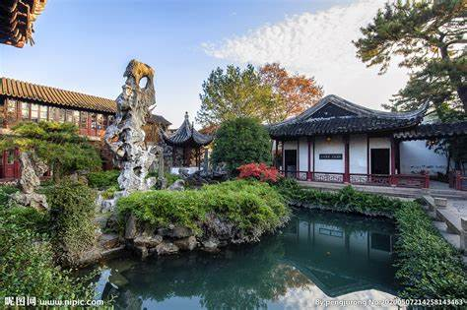
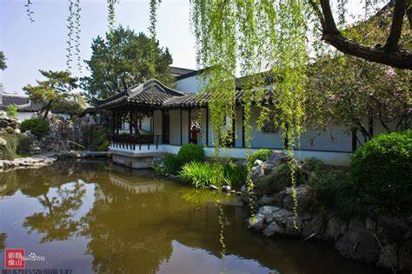
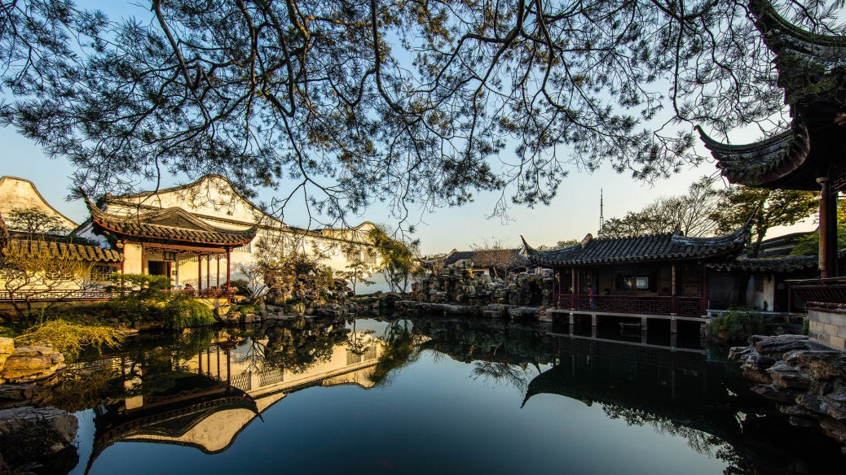
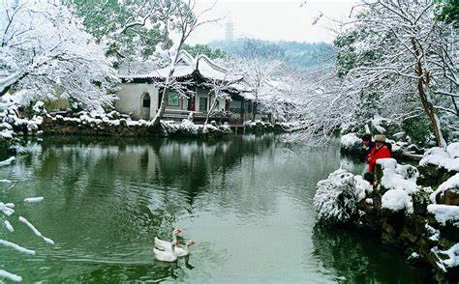

Slide 5
Characteristics
1. Stacking stones and water
2. Full of different flowers and trees
3. Elegant and simple style

Slide 6
Favorable Conditions
Natural Conditions
Historic Condition
Relocation of the Jin dynasty
Warm and humid climate
The climate of Jiangnan was not invariable in history
Bai Juyi
Southern Song Dynasty(Lin 'an and Wu Xing)
Ming and Qing Dynasties

Slide 7
Famous Poems and Their Translation
SL: 江南园林甲天下，苏州园林甲江南。
TL: Gardens on the Yangtze Delta are the best in China, and among them the gardens of Suzhou are the best.

Slide 8
Famous Poems and Their Translation
饮酒
结庐在人境，而无车马喧。
问君何能尔？心远地自偏。
采菊东篱下，悠然见南山。
山气日夕佳，飞鸟相与还。
此中有真意，欲辨已忘言。

Slide 9
Famous Poems and Their Translation
Drinking Wine
One builds a house on human territory, yet there is no sound of cart or horse.
One asks you how this can be so, But your mind is a distant place, self-absorbed.
Picking chrysanthemums under the eastern fence, one pensively views the southern mountains.
The mountain air and sunset are beautiful; flying birds return together.
There is true meaning in this; desiring argument, one stops and forgets to speak.

Slide 10
Thanks for your listening!

