Slide 1


Aesthetic Ideals and Social Customs:
Marriage-Accompanying Songs
in Hunan
Presenter:雷慧婷

Slide 2
Contents
01
Introduction
02
Legend and Theme
03
Singing Form
and Contents
04
Values

Slide 3
01
The Introduction of
Marriage-Accompanying Songs

Slide 4
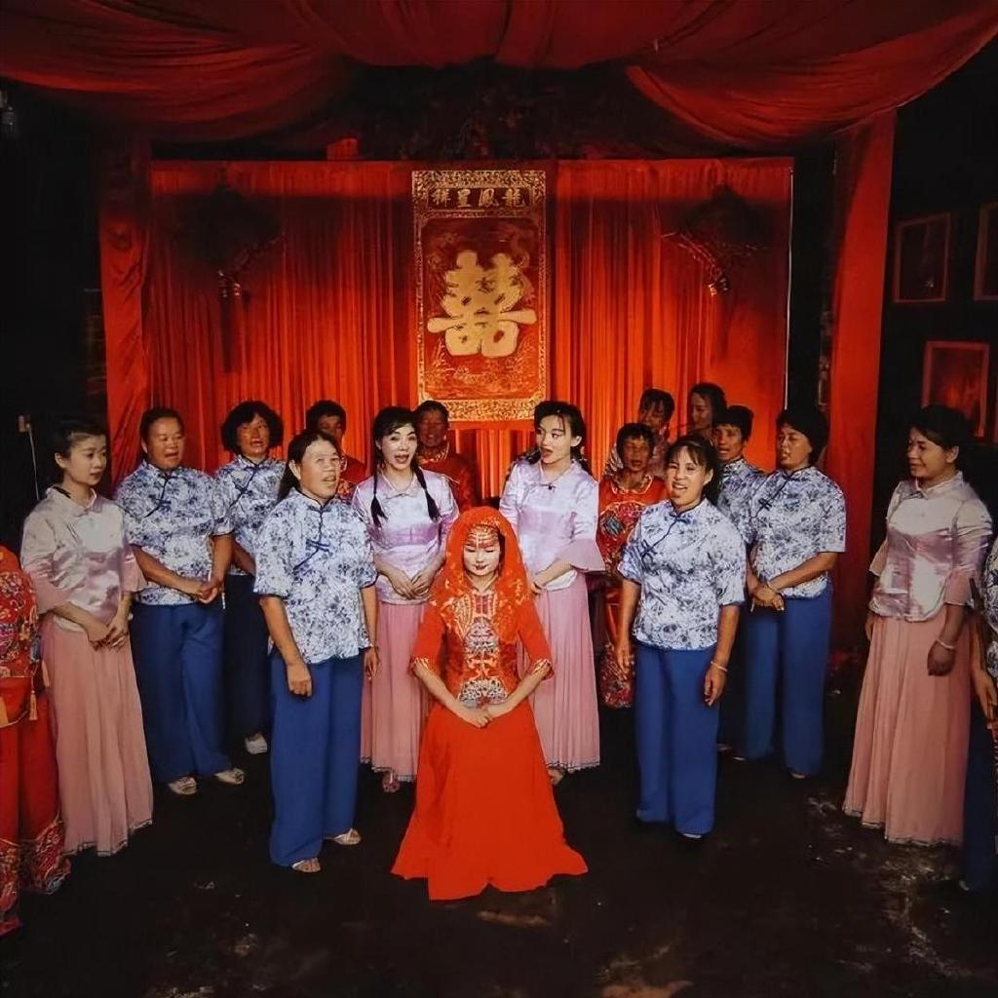
Marriage-Accompanying Songs
Description:
Marriage-accompanying song is a traditional folk song spread in Jiahe(嘉禾). It is a unique custom of crying for marriage in Hunan.
It is a kind of farewell activity held on the eve of the wedding. The bride’s female relatives and friends come to accompany the bride, and sing songs to express their emotions.
History:
Records of Jiahe folk songs can be traced back to the Eastern Han Dynasty.
By the Tang and Song dynasties, the forms of artistic expression became increasingly perfect.
同治版《嘉禾县志》载：“嫁女前夕，具酒馔，集妇女歌。歌阕，母女及村姑伯姨相向而哭，循叠相继，达曙乃止。”

Slide 5
Marriage-Accompanying Songs
民族之歌
Importance:
Marriage-accompanying song has a large number, rich singing, diverse performance forms, and complete system. Now more than 1300 marriage-accompanyingsongs have been collected. They are the most representative custom music of the traditional marriage etiquette activities of the Han nationality.
In 1993, Jiahe was named the "Hometown of Folk Songs" by the Provincial Department of Culture.
In 2006, it was listed as the first batch of provincial intangible cultural heritage protection list.
入选第一批省级非物质文化遗产保护名录
In 2021, it was officially announced by The State Council as the fifth batch of representative items of national intangible cultural heritage.入选第五批国家级非物质文化遗产代表性项目名录
“走过很多地方，接触了很多地方民歌，但像嘉禾伴嫁歌这样完整和系统的民歌，不仅全国很少，全世界也不多见。嘉禾民歌完全可以向全国、向全世界推介。”
——王佑贵

Slide 6
02
The Legend and Theme of
Marriage-Accompanying Songs

Slide 7
Legend
The princess of the Chu Kingdom was named Chu Yu. One day when Chu yu was traveling, she met Chen Xianyun, a fugitive(逃婚的) woman from Jiahe. After learning about her unfortunate coming marriage, she led a group of fairies to Chen Xianyun's home on the eve of her marriage. The two girls sang hundreds of narrative songs in succession. Each sentence was to thank Chen Xianyun’s parents for raising her and persuade them not to interfere with her freedom of marriage lyrics. The fairies also sang and danced to the beat. The princess and the fairies didn’t return until dawn was about to show up.
Woman’s reresentment, anger and struggle
against the feudal marriage system and the old ethics

Slide 8
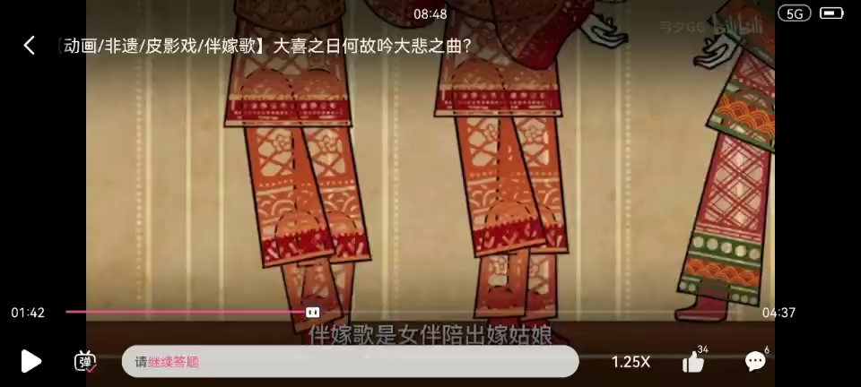

演示文稿是一种实用的工具，可以是演示，演讲，报告等。大部分时间，它们都是在为观众服务。
演示文稿是一种实用的工具可以是演示，演讲，报告等。大部分时间，它们都是在为观众服务。
演示文稿是一种实用的工具，可以是演示，演讲，报告等。大部分时间，它们都是在为观众服务。

Slide 9
03
The Singing Form and Contents of
Marriage-Accompanying Songs

Slide 10
The Singing Form
There are various kinds of singing forms, including solo, unison, antiphonal singing(对唱), round singing, crying, scolding, dancinging while singing.
The melody of the song is graceful and soft, singing in local dialect,
mixed with southern mandarin（湘南官话）

Slide 11
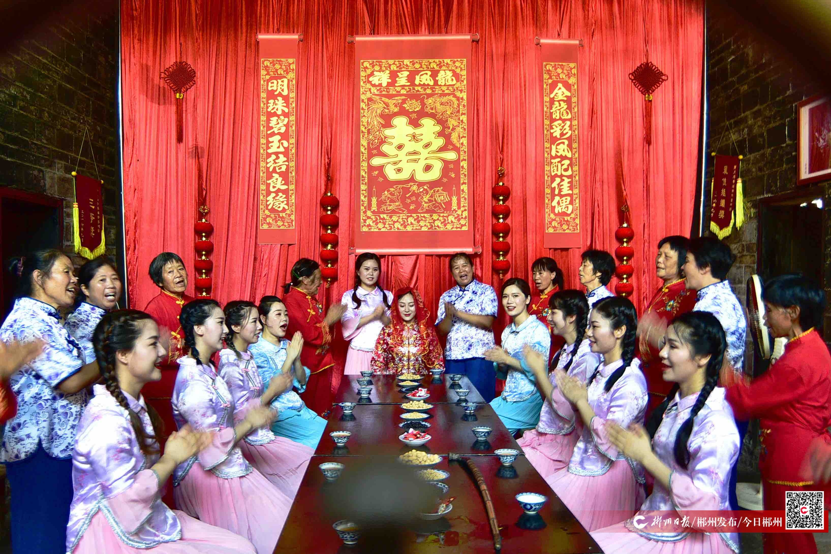
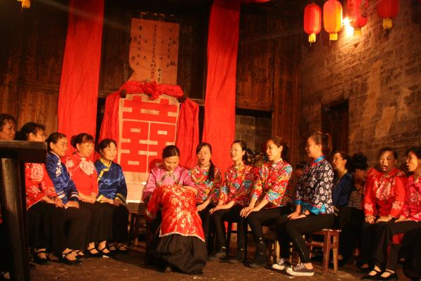
The Contents
The content of the wedding song is very extensive, which can be divided into five parts: marriage joking songs耍歌,long songs 长歌, accompaniment dances 伴嫁舞, crying songs 哭嫁歌 and teasing bridegroom songs 徒歌.

Slide 12
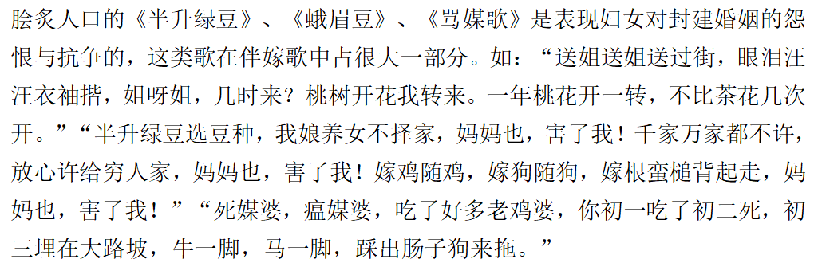
The Contents
1.marriage joking songs耍歌
Short tune, distinct rhythm, diverse styles and flexible structure.
Accounting for more than 70% of the songs. It is usually sung by young women. Its lyrics are short and concise, generally four sentences about one song, each sentence is generally seven words. The lyrics include the dissemination of history and production; the working life of women; the festive entertainment; the yearning and pursuit for a happy marriage; and against the ethics of feudal marriage...

Slide 13
The Contents
2. Long songs长歌
The long song is slow, sad, mainly about the tragedy of marriage, expressing reluctant and sad emotions. The lyrics are long and are mostly based on historical legends. There are 15 long songs already collected, most of which are tragic marriage stories. Because marriage is a festive event, the general song hall rarely sing, can sing less, only in the highest reputation of the singing hall old singer or singing head can sing.
《十八年终罗四姐》、《梁祝歌》、《孟姜女》、《卖花娘子》、《菜和饭》、《初一早晨去拜年》、《白碗白盏白花飞》

Slide 14
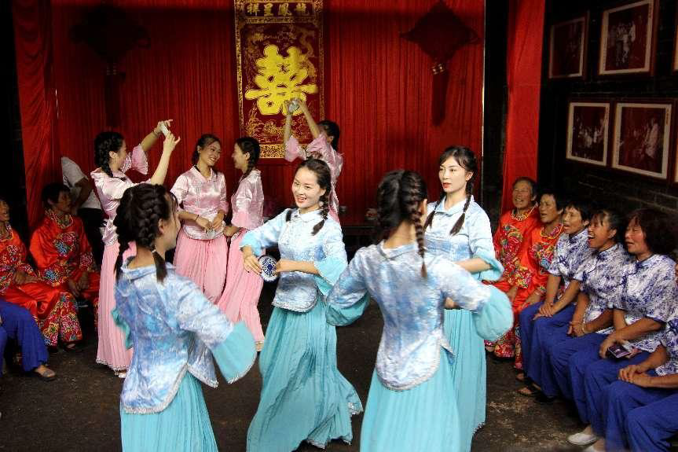
The Contents
3. Accompaniment dances伴嫁舞
The accompaniment dance is warm, cheerful and witty. When the wedding singing to the fast dawn, the lang family sedan chair is coming, the atmosphere of the song hall heating up, the singers conveniently picked up the tea set, wine set (generally dish, teapot, incense, umbrella, pot cover, rice tube, pipe) and other daily necessities as props, dancing, the song hall warm, farewell atmosphere to a climax.

Slide 15
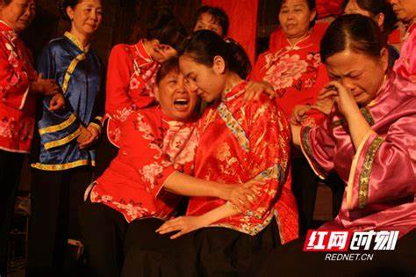
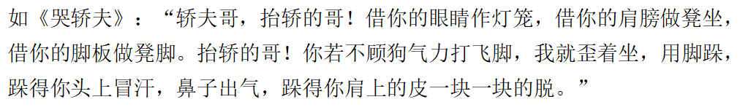
The Contents
4.Crying songs 哭嫁歌
Crying song to cry for sing, sing in cry, its lyrics with cry, that is to sing. The content is mostly love old farewell, there are also blame parents, scold matchmaker and sedan bearers, through the song, accused the feudal marriage ethics. The number of them is difficult to count.

Slide 16
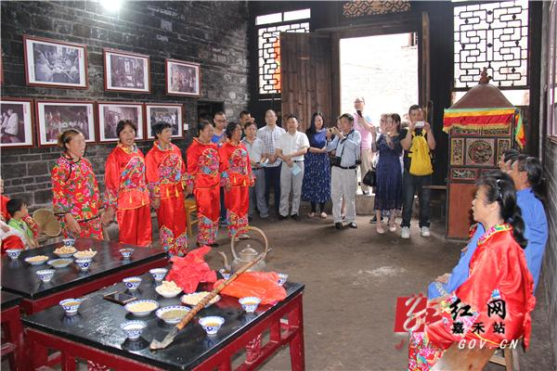
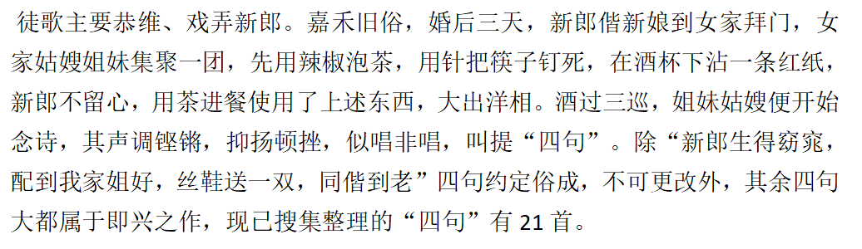
The Contents
5.Teasing bridegroom songs 徒歌
This type of song is an important manifestation of folklore and occupies a certain position in the wedding song. It mainly tells the plot of the groom being teased. The structure and sentence pattern are relatively simple.

Slide 17
04
The Values of
Marriage-Accompanying Songs

Slide 18
The Values in general:
Jiahe Marriage-Accompanying Songs is a female literature created by working women in Jiahe, which is a "mirror" reflecting women's production, life, thinking and marriage customs in southern Hunan. It plays a unique role in educating and cultivating people's thoughts, morality, sentiment and improving women's cultural and artistic quality. It is a model for the study of research, utilization, absorption and creation in music circle, film and television drama circle, and has unique historical and cultural value in anthropology, ethnology and folklore.

Slide 19
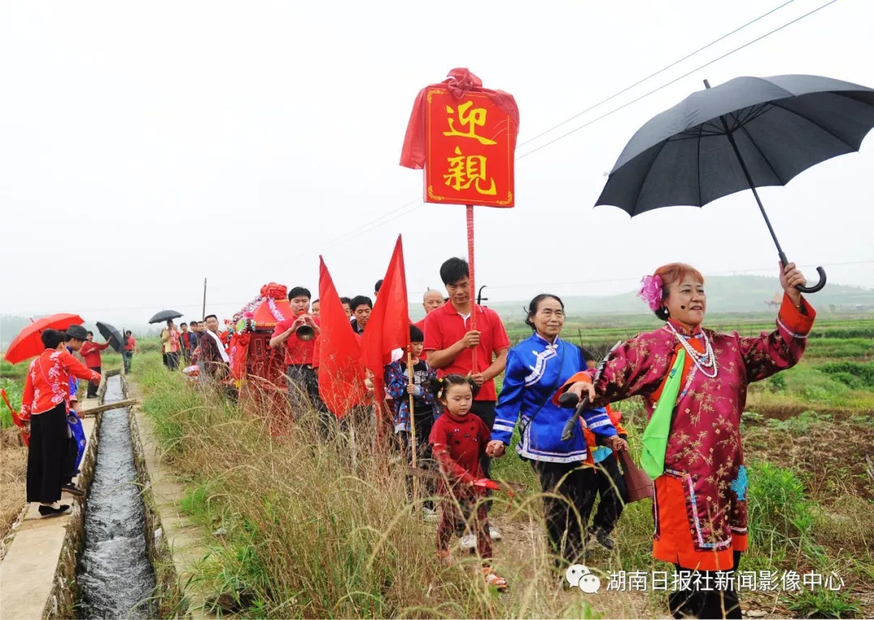
1. Social and cultural values:社会文化价值
Due to the closed traffic in the old Jiahe, ordinary people were almost isolated from the outside world, forming a closed culture. Therefore, marriage-accompanying songs is basically not influenced by foreign culture, at the same time, because the Jiahe dialect is difficult to understand, it is difficult to spread to other places, so that the Jiahe marriage song has formed its own unique style characteristics. The custom of marrying is popular in some areas of our country, but in terms of the procedure of Jiahe, the quantity, quality and integrity of the wedding song, it is incomparable to any region. The marriage-accompanying song is the most complete and the most social and cultural value of the Chinese Han nation.

Slide 20
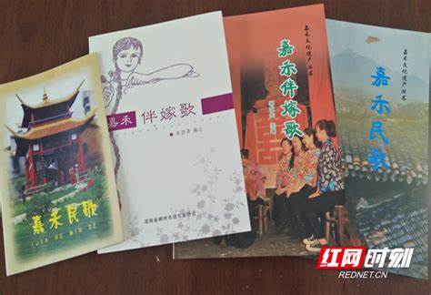
2. Artistic value:艺术价值
With song type structure is rigorous, especially the expansion of phrases, flexible body is worth studying, and the change of rhythm, the application of single beat, and rich and colorful lining words, lining cavity using technique, special type repetition, transfer technique, etc., by many experts, as a university music teaching material. The beautiful melody of the wedding song provides the composers with an inexhaustible source of creation, and achieves a lot of music works, film and television works.The lyrics of the marriage song are used for reference by the writers, which makes a large number of literary works created by the famous writers Gu Hua and Xiao Jianguo more vitality.

Slide 21
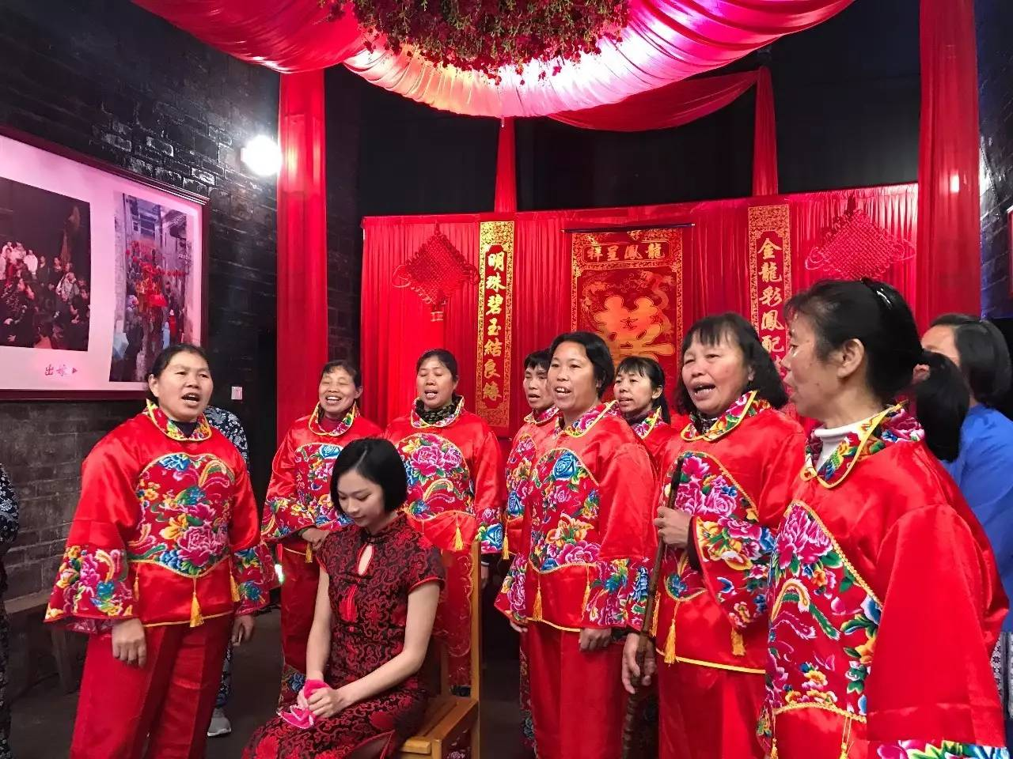
3. Anthropological value:人类学价值
Marriage song is a female culture, reflecting the thoughts and feelings of human women's inner world, and is a comprehensive art of female literature, music and dance activities. The marriage song reflects the human commonness, marriage and relatives before parting. In addition, through the artistic communication and emotional communication between the singers and the villages, the harmonious atmosphere in the world is created and the social harmony is promoted.
The custom of accompanying the marriage song hall has been spread for thousands of years, involving various rituals and customs of marriage, and is a living specimen of the study of folklore and sociology.

Slide 22
Referances
红网时刻：永不凋谢的艺术 https://cz.rednet.cn/content/2021/09/17/10153872.html
世界看湖南 https://www.sohu.com/a/581726430_120144390
王佑贵与嘉禾伴嫁歌https://www.bbkz.com/forum/showthread.php?t=6813
湖南非遗文化库http://hnfy1.txhn.net/fyml/ctyy/201609/t20160914_452461.htm
知乎https://zhuanlan.zhihu.com/p/634529388
百度https://baike.baidu.com/item/
可可诗词网, 湘南嘉禾伴嫁歌, https://www. kekeshici. com, 2019
李琴, 李跃忠. 嘉禾“伴嫁歌”研究综述[J]. 文教资料, 2019(31):87-89.

