Slide 1
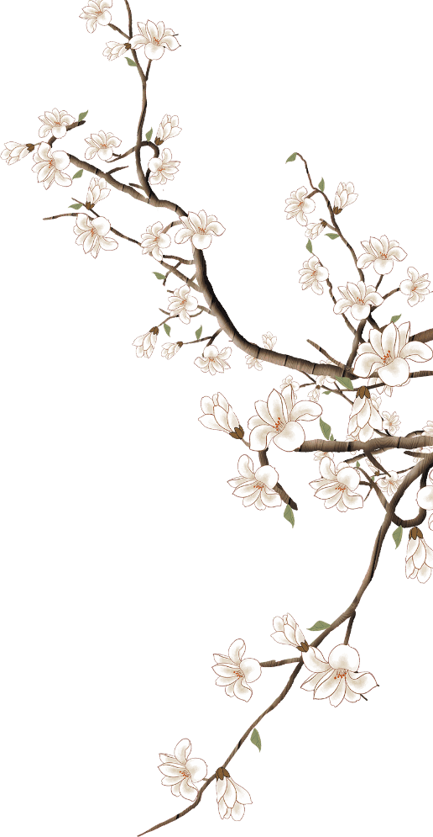

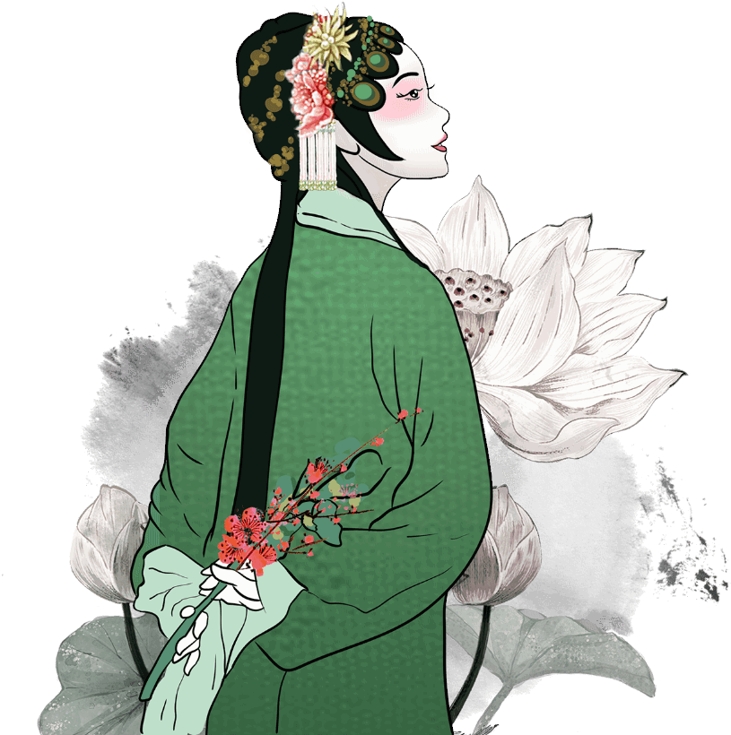
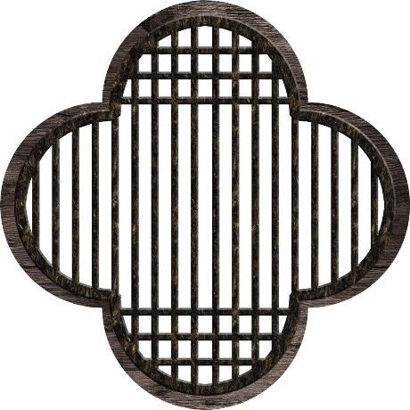

Hunan Huagu Opera
湖南花鼓戏
A Treasure of Folk Art
汇报人：刘康怡 Liu Kangyi

Slide 2
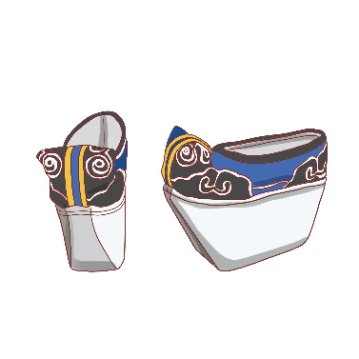
Content
壹
Overview of Huagu Opera
贰
Historical Development
叁
Performing Art Features
肆
Cultural Value and Preservation
伍
Liuhai Cuts Firewood

Slide 3
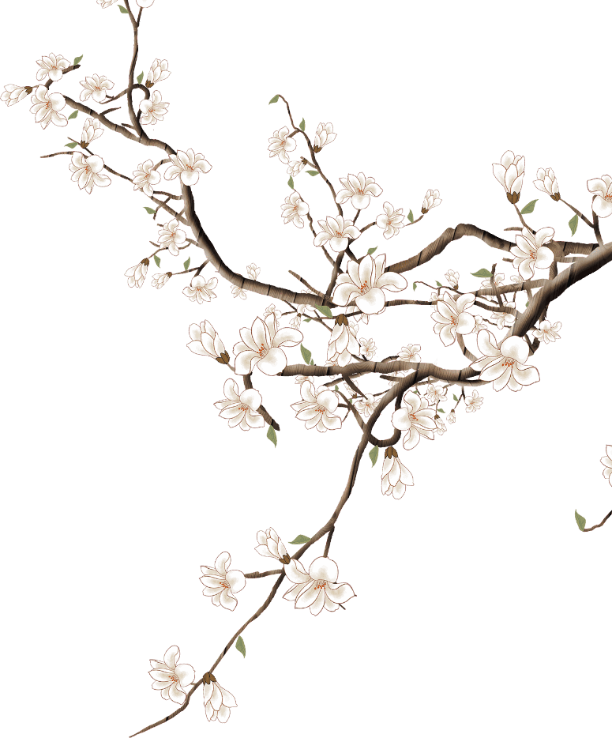
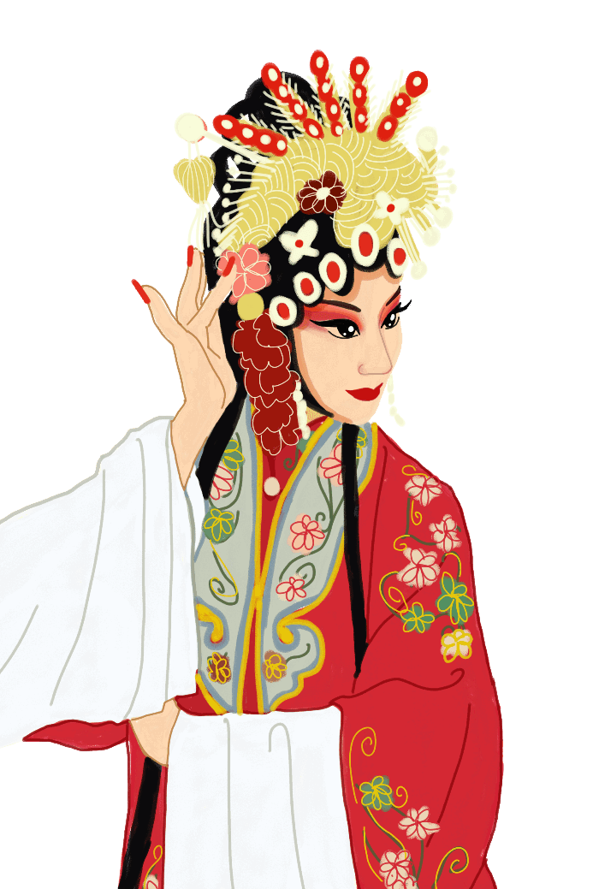

Overview of Huagu Opera
Notes:
模板来自于： 第一PPT https://www.1ppt.com/

Slide 4
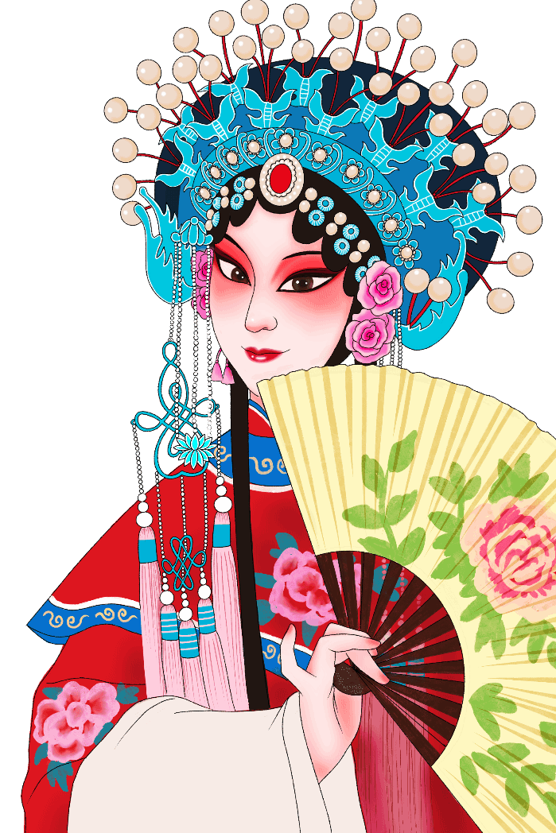
Definition
A regional folk opera genre rooted in Hunan Province, integrating singing, dancing, storytelling, and music into a vibrant performing art form.
Origin
Evolved from rural folk customs, harvest celebrations, and impromptu performances by farmers and craftsmen during the Ming and Qing Dynasties. It originated from folk tunes and ceremonial activities in the countryside.

Slide 5
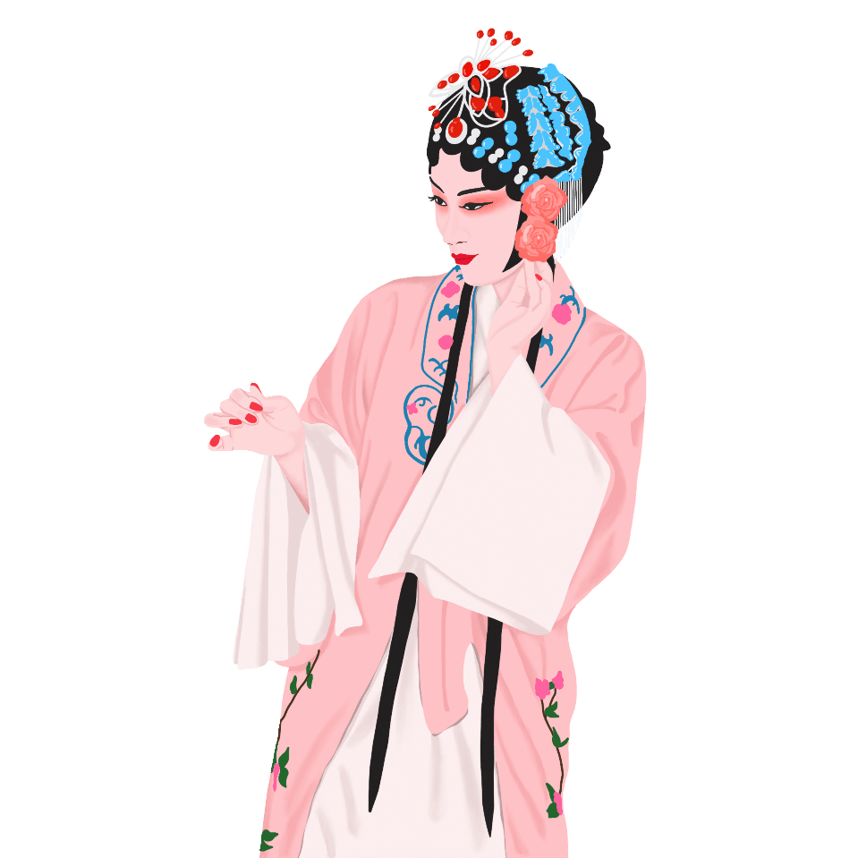
Main Popular Areas
Centered in Hunan Province, and also popular in neighboring regions like Hubei and Anhui Provinces, forming various local branches.
Hunan Huagu Opera is divided into six major schools: Changsha Huagu Opera, Yueyang Huagu Opera, Hengzhou Huagu Opera, Shaoyang Huagu Opera, Changde Huagu Opera, and Lingling Huagu Opera. Each school has developed distinct artistic styles.

Slide 6
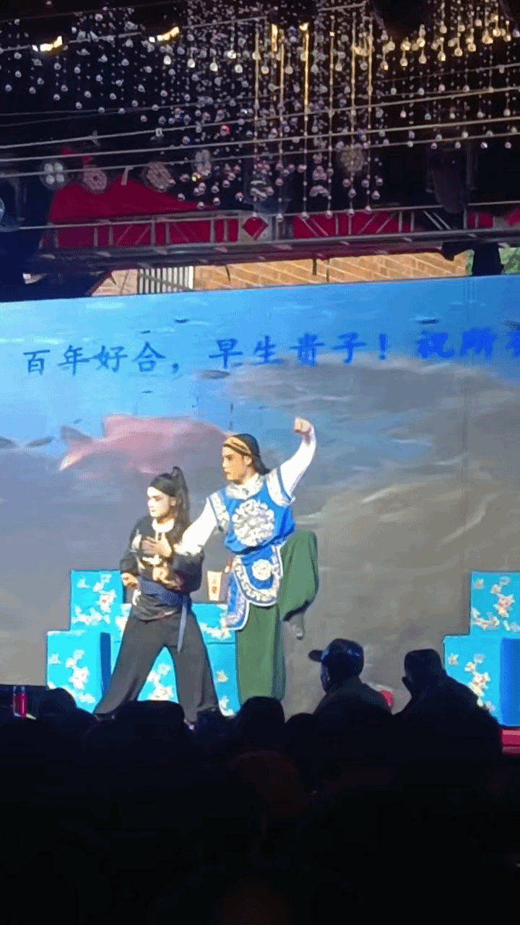
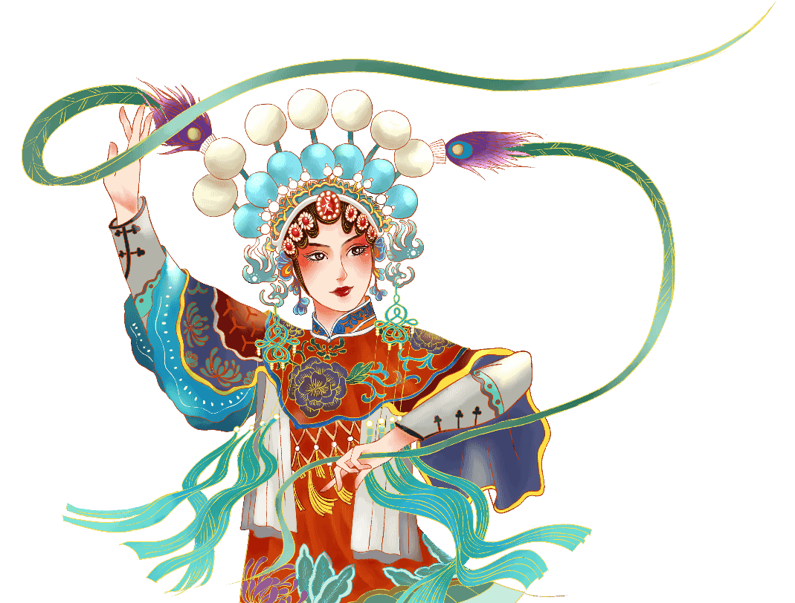

Slide 7
Historical Development

Slide 8
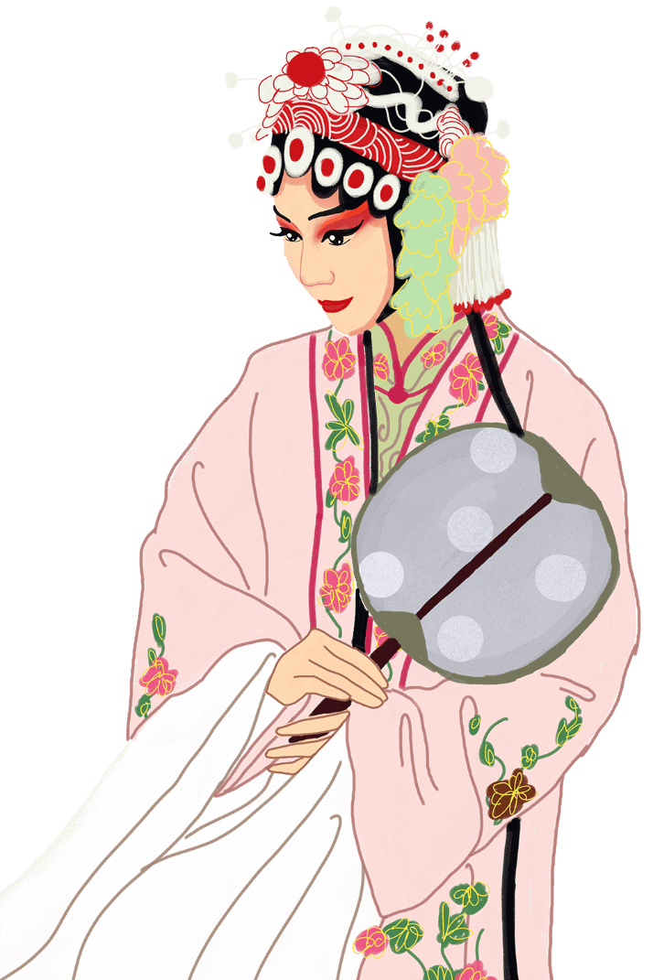
Early Formation Stage:
Combined local folk songs, dances, and storytelling arts, mainly performed as "Two-Role Plays" (male and female roles) or "Three-Role Plays" (adding a clown role).
Early repertoires focused on rural life and love stories, and sung in Hunan dialect with simple accompaniment of gongs, drums, and suona (a Chinese double-reed instrument).

Slide 9
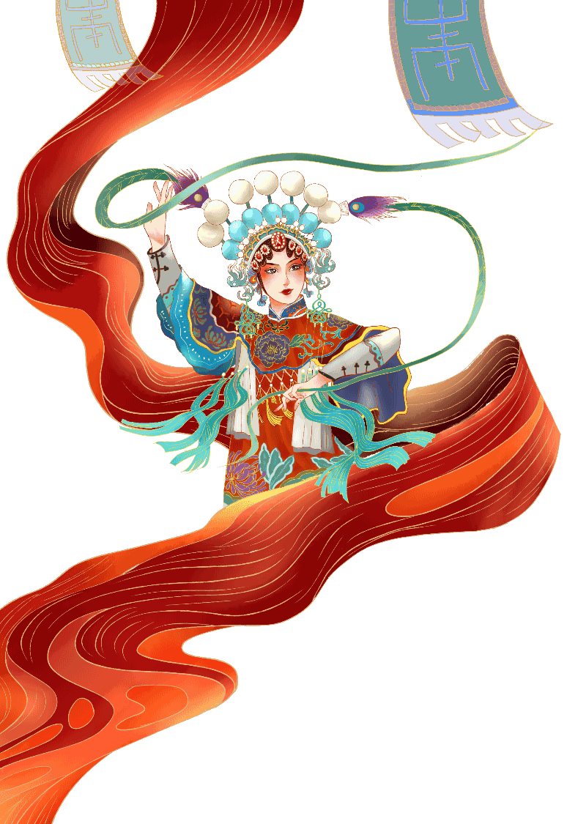
Modern Evolution:
After the founding of the People's Republic of China, professional opera troupes were established in various places, promoting the remarkable development of Huagu Opera.

Slide 10
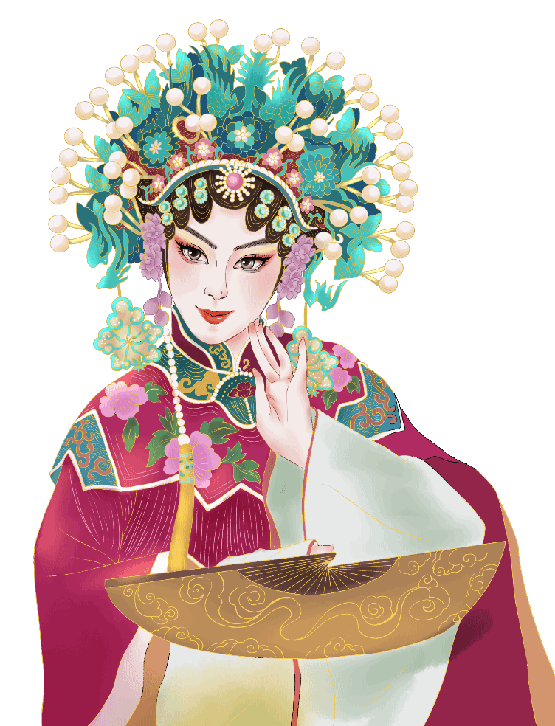
Contemporary Status
It was listed in China’s National Intangible Cultural Heritage in 2008. Various regions are promoting its inheritance and development by innovating performance forms and holding exhibition activities.

Slide 11
Performing Art Features

Slide 12
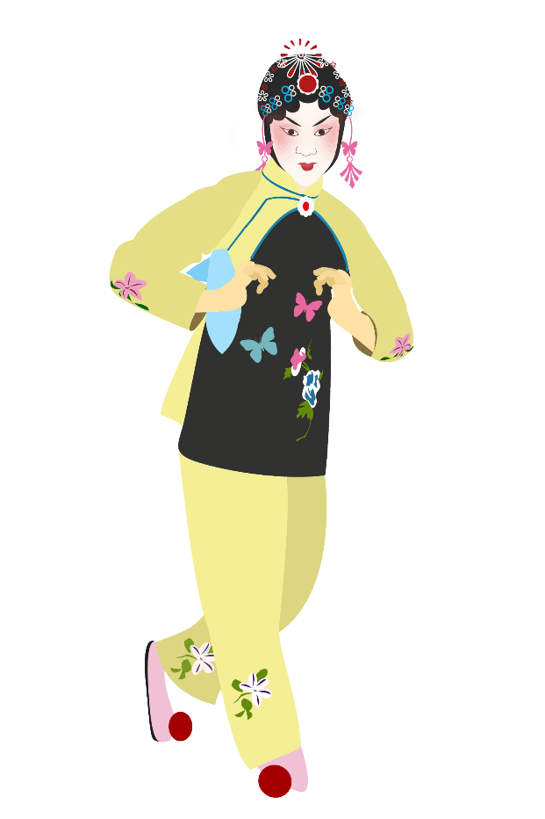
Singing is based on Hunan dialect, combining loud and clear folk song styles with soft and lyrical tunes. True-false voice switching and glissando techniques enhance emotional expression.​
Dance movements are derived from agricultural activities, such as "rice transplanting steps" and "carrying pole dance," blending realism with artistic beauty through exaggerated body language.​

Slide 13
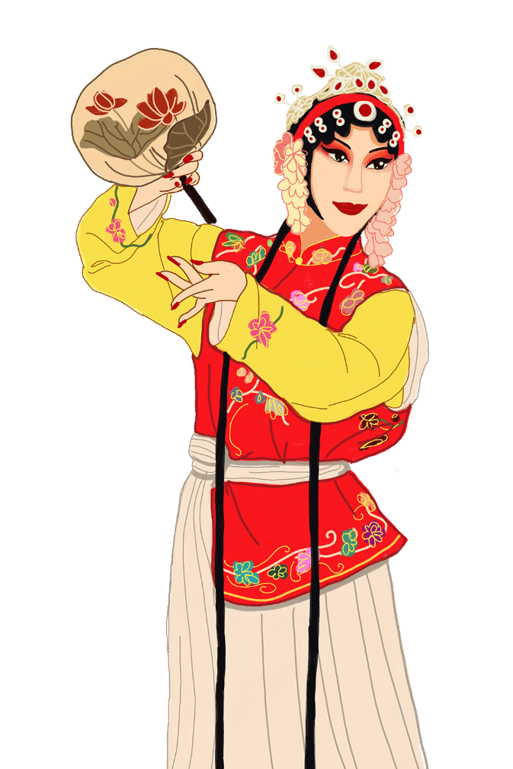
Prop Usage: Fans and handkerchiefs are common props. Techniques like throwing, spinning, and shaking the props reveal character traits – for example, bold characters often wave handkerchiefs vigorously, while gentle characters hold fans softly.
Instruments: Datong (a large two-stringed fiddle), suona, Banhu (a small drum), tanggu (a barrel drum), and small gongs

Slide 14
Cultural Value and Preservation
Notes:
模板来自于： 第一PPT https://www.1ppt.com/

Slide 15
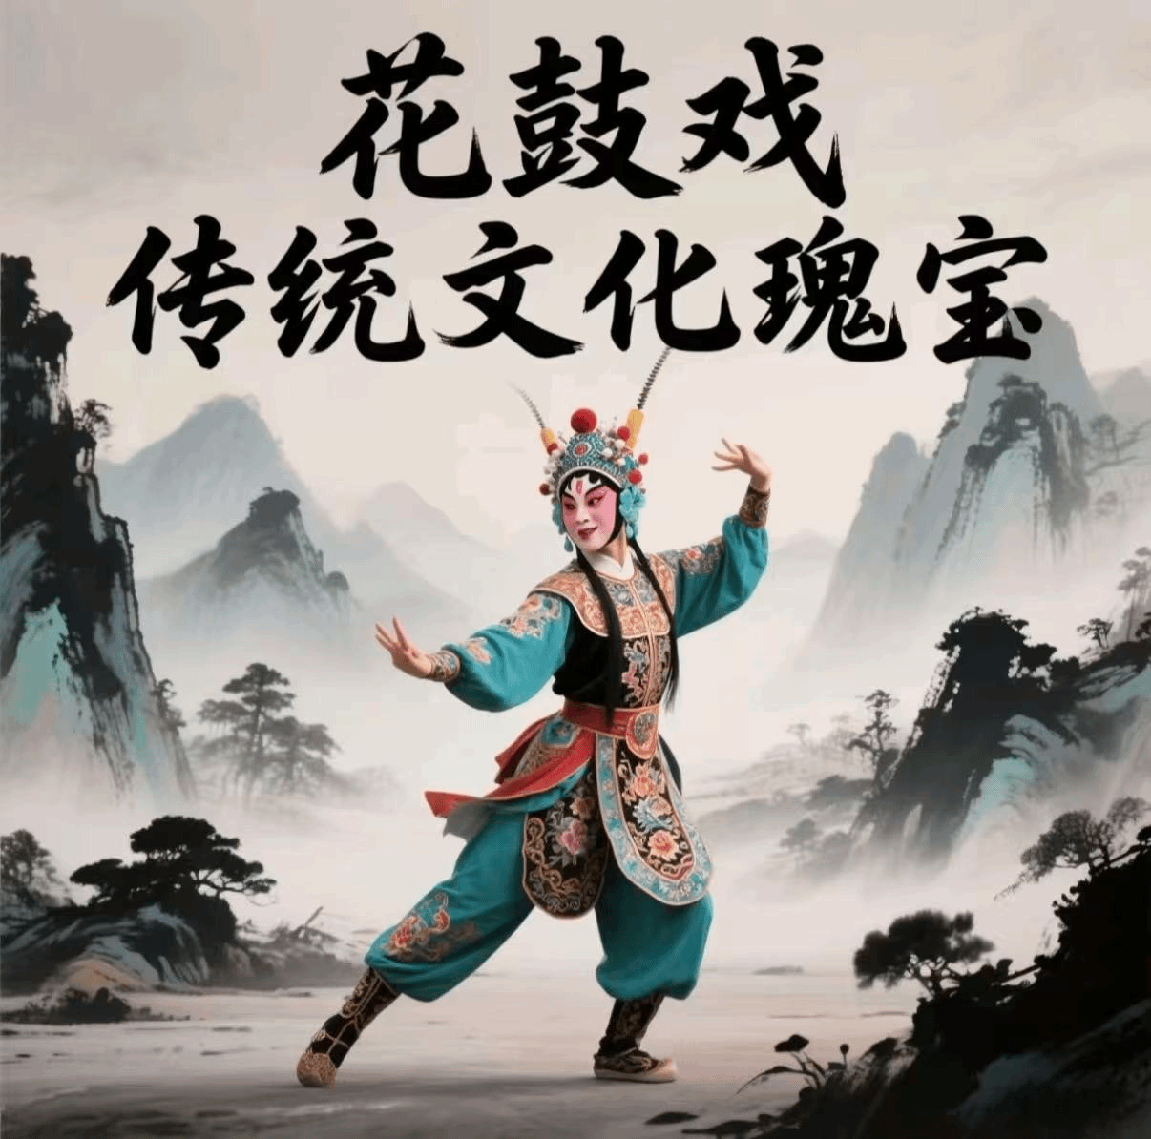
Culture value
Carrying profound cultural heritage and unique artistic value.
Enriching the cultural life of the masses and improve people's cultural literacy and aesthetic ability.​
Promoting Cultural Exchange.

Slide 16
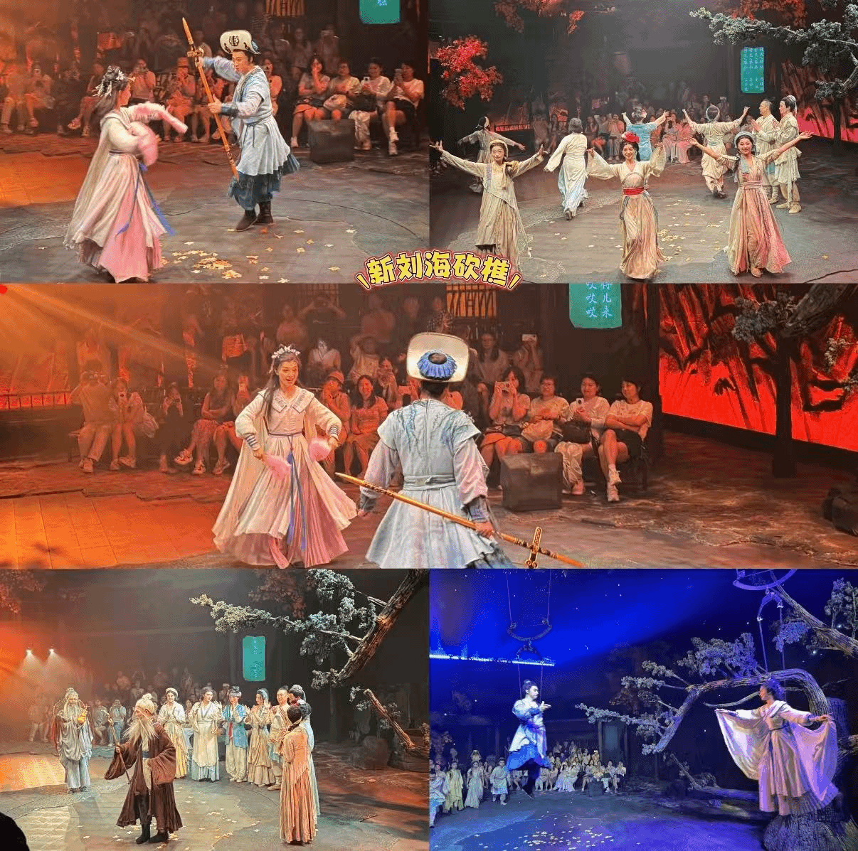
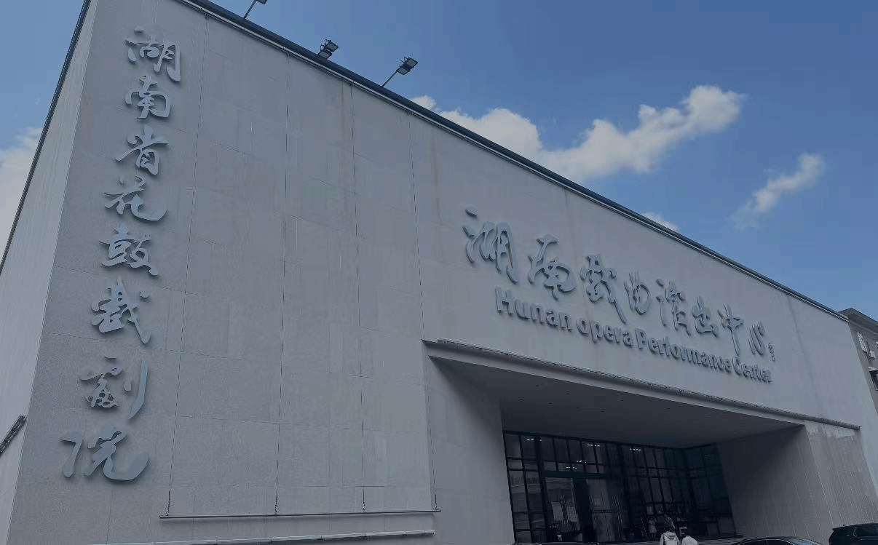
新刘海砍樵
the preservation and innovation

Slide 17
Classic Play -
Liu Hai Cuts Firewood​
Notes:
模板来自于： 第一PPT https://www.1ppt.com/

Slide 18
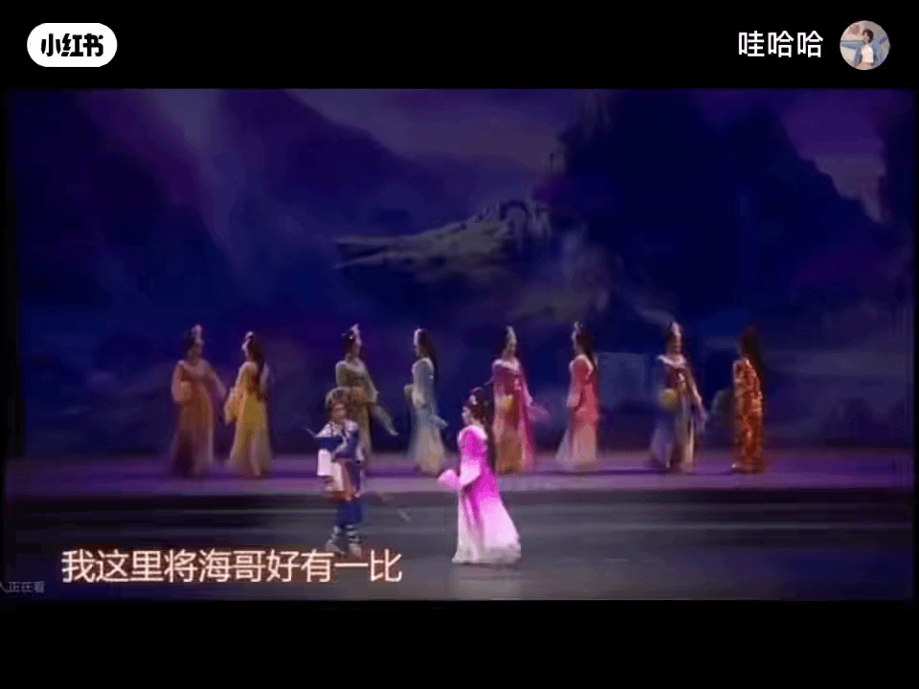

Slide 19
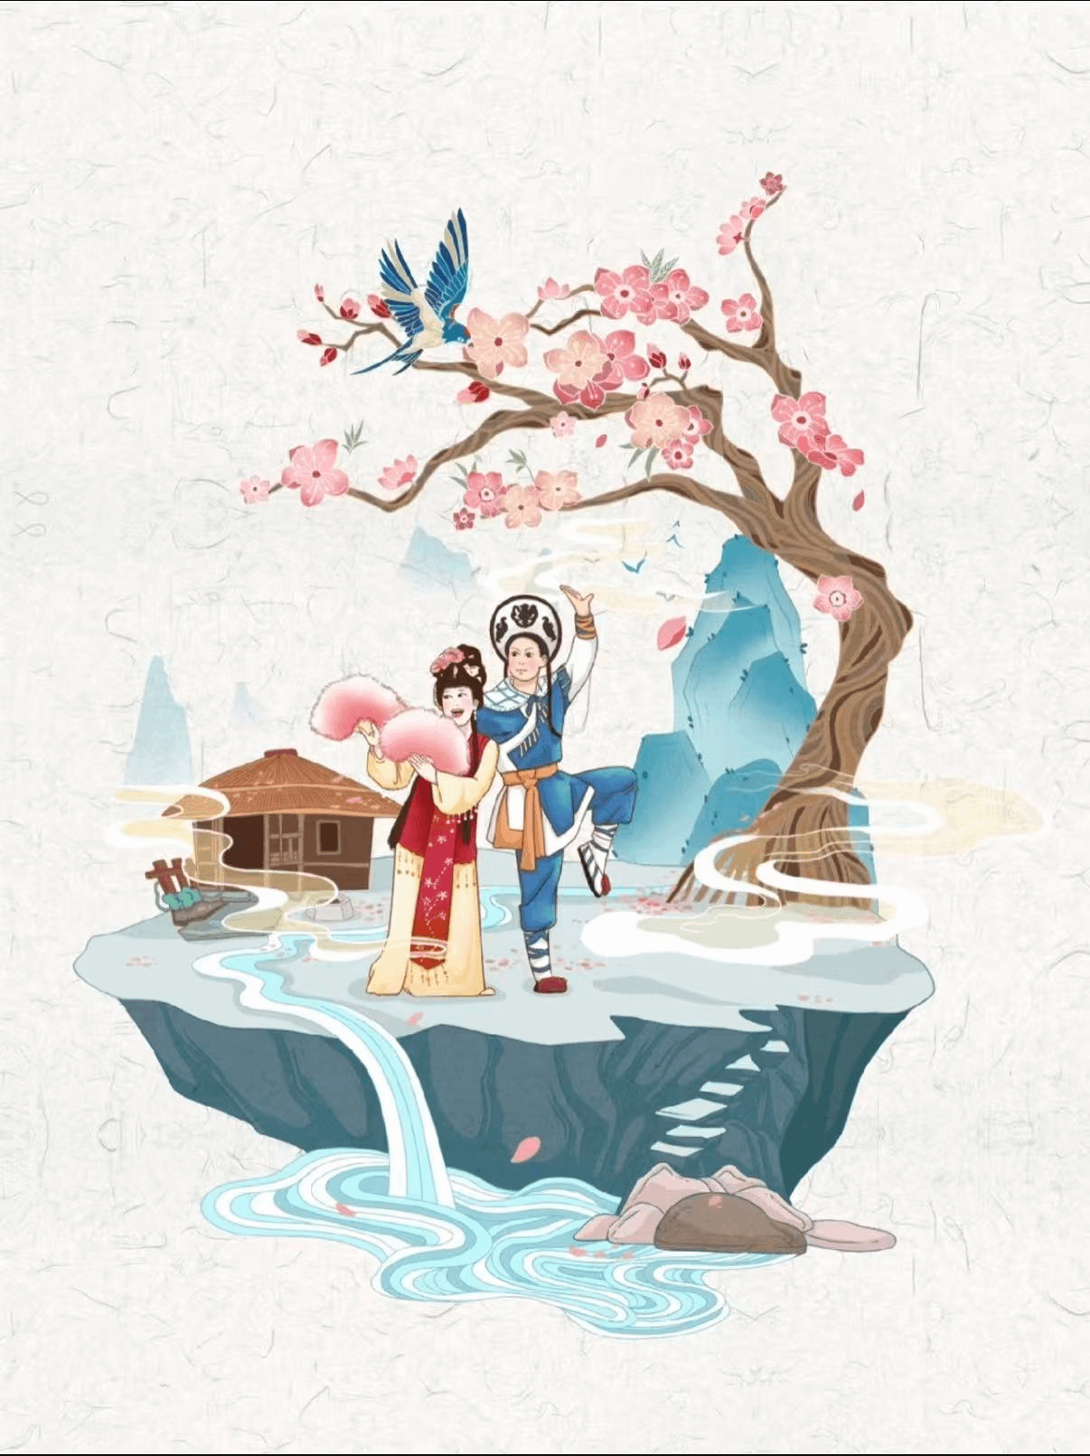
我这里将海哥好有一比呀。
（男）胡大姐，
（女）哎
（男）我的妻，
（女）啊
（男）你把我比作什么人罗。
（女）我把你比牛郎，不差毫分哪。
（男）那我就比不上罗。
（女）你比他还有多咯，
（男）胡大姐你是我的妻罗，
（女）刘海哥你是我的夫哇。
（男）胡大姐你随着我来走罗，
（女）海哥哥你带路往前行哪，
（男）走罗嗬,
（女）行罗嗬，
（男）走罗嗬，

Slide 20
文字来源：豆包 Doubao
课本 Textbook
图片视频来源：小红书 Rednote

Slide 21
Thank you
for your listening!

