Slide 1
Chinese Marriage Customs
杜心语

Slide 2
Introduction
China is an ancient country of rites. When it comes to the most important thing in one’s life---marriage, Chinese people have developed a set of unique and grand ceremonies. Generally speaking, weddings in ancient China needed to be approved by parents and arranged by parents.

Slide 3
Contents
1
Six Procedures
2
Customs
3
Development

Slide 4
1
Six Procedures
Na Cai
Wen Ming
Na Ji
Na Zheng
Qing Qi
Qin Ying

Slide 5
1
Na Cai

Slide 6
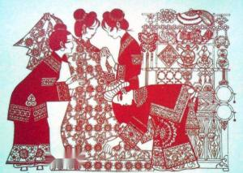

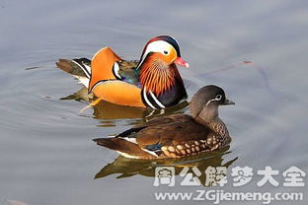
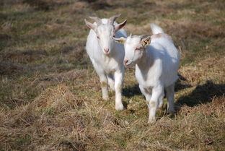
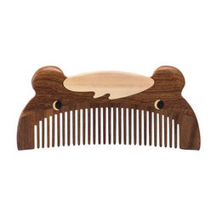
Na Cai is the begining of all the marriage processes. It refers to a practice that if a boy intends to marry a girl, firstly his family must invite a matchmaker to the girl's home to propose marriage
mandarin ducks
wooden comb
wild goose

Slide 7
2
Wen Ming

Slide 8
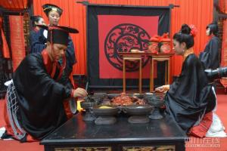
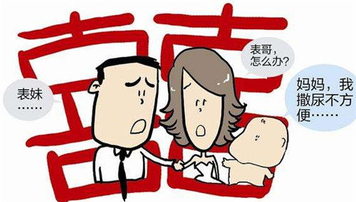
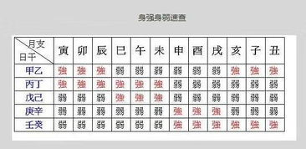
Wen Ming means that the boy's family asks the matchmaker to fetch the girl's name and date of birth.
assure the compatibility of the prospective bride and bridegroom through their “eight characters” of the birth moment.
prevent the marriage of close relatives with the same surname

Slide 9
3
Na Ji

Slide 10
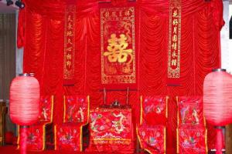
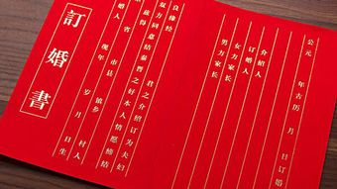
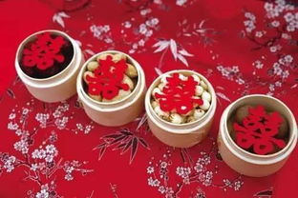
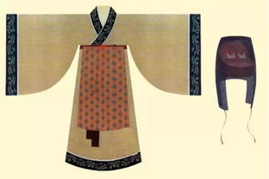
Naji happens after the matchmaker takes back the woman's name and eight characters. If divining an lucky portent, the boy's family will inform the girl’s parents and decide to engage the marriage.
What is more, Na Zheng is an important step when the boy sends engagement presents to the girl and for courtesy the girl will send back part of the presents such as food and some clothes.

Slide 11
4
Na Zheng

Slide 12
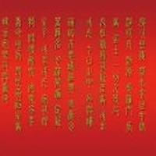
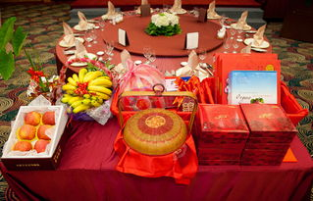
Nazheng is the ancient marriage custom of Han nationality“ The fourth of the six gifts, also known as "Nacheng", means that a man's Naji gives a bride price to a woman's.
The completion of acceptance marks the end of the engagement stage and is one of the main signs of the establishment of marriage.

Slide 13
5
Qing Qi

Slide 14
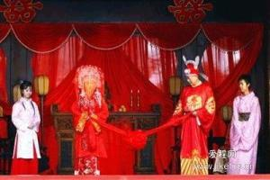
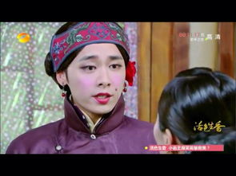
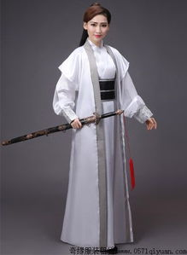
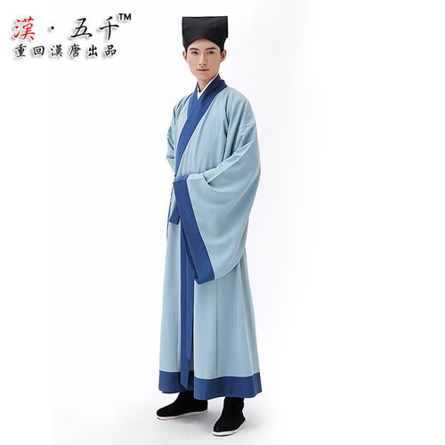
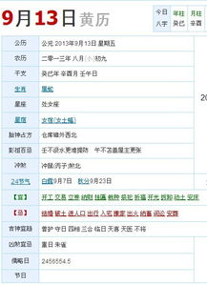
Qing Qi means that the boy's family choose a lucky day to hold the wedding ceremony and then dispatch the matchmaker to tell the girl’s family.
Qing Qi

Slide 15
6
Qin Ying

Slide 16

Qin Ying
Qin Ying is the last process of the six processes, that is, the groom goes to the bride's home to take the bride to his home.

Slide 17
2
Customs
In addition to the six steps mentioned above, there are many other customs in the traditional Chinese wedding ceremony. Generally speaking, ancient marriage was ordered by parents and matchmaker and many young people could not master their own marriage. Before wedding ceremony, men and women were not allowed to meet each other in that ancient people were very conservative and most girls were kept in boudoirs. If they met in private before marriage, it would be regarded as a kind of female infidelity and parents would also think it quite unlucky. Under this condition, newcouples could only see each other until the day of marriage.

Slide 18
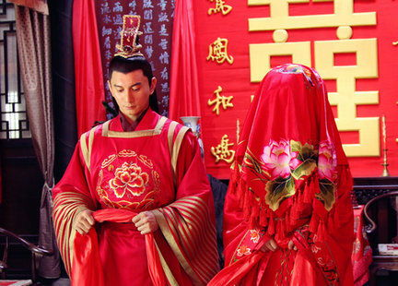
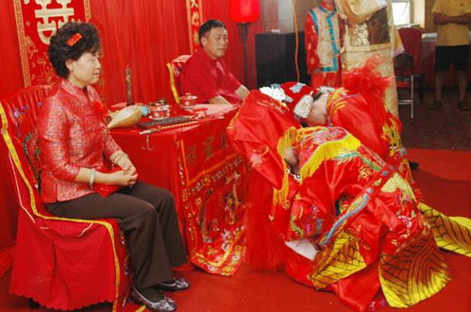
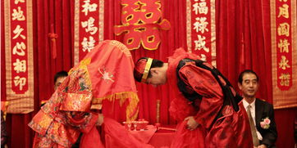
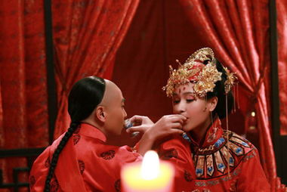
After that, the following step is the most grand one among the whole ceremony --- at the dusk moment, the groom and the bride, his parents as well as all the guests will gather together at the central room to witness the kneeling steps of the couple, which consists of 4 steps
Kneel down to heaven and earth
the new couple kowtow towards each other
drink “ cross-cupped wine ”
Kneel down to parents

Slide 19
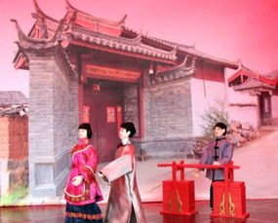
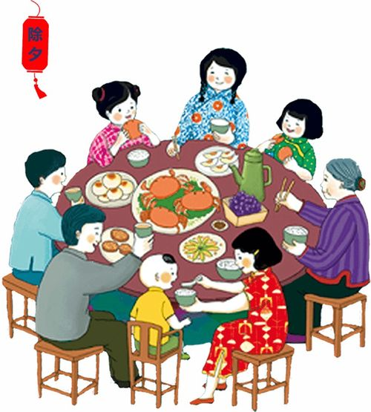
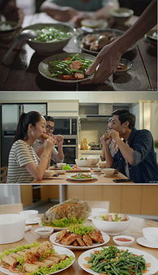
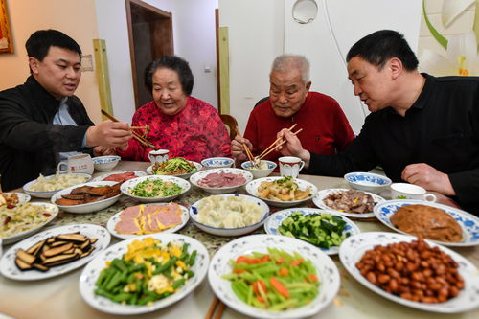
After wedding ceremony, the couple must return to the girl’s home together at the third day, which is called “Huimen” or “Guiling”. This step is indispensable. The groom should take some gifts for respect and change the way that he addresses the bride’s parents, and the latter will also prepare a good meal for the couple’s coming.
Hui Meng

Slide 20
4
Development

Slide 21
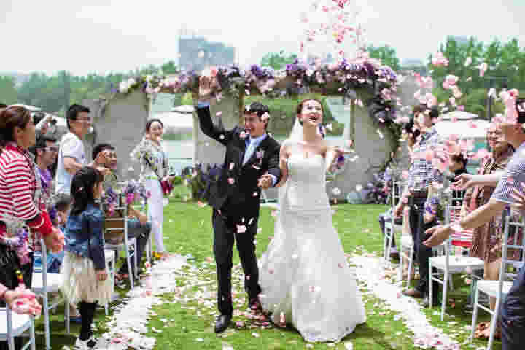

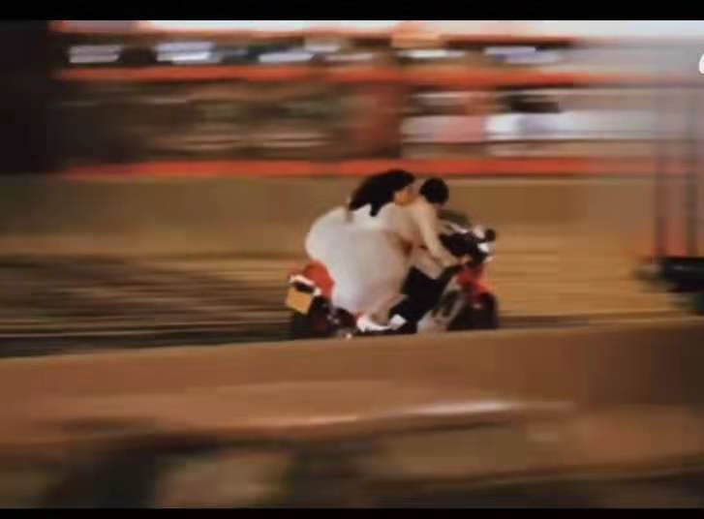
As time goes by, there are many reforms about marriage nowadays. Adults own the freedom to choose their form and they can meet each other every day if possible. Parents can’t master their “life event” any more. In addition, many couples skip the cumbersome rites in the wedding ceremony. Some of them choose to hold the ceremony in the church with some close relatives and friends and some even finish it through travel.

Slide 22
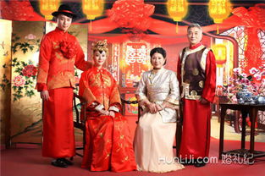
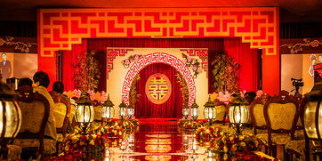
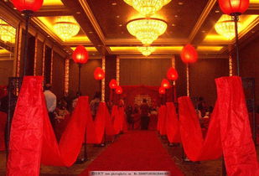
Nevertheless, most young people still adopt the main processes of the traditional Chinese customs, some of which are handed down until the present day. There still exist engagement gifts and dowries, and many couples choose to wear red costumes. The bridegroom should go to the bride’s home to escort her to the wedding and so on. Thus it can be seen that most traditional Chinese marriage customs are deeply rooted in the hearts of Chinese people and show a unique Chinese characteristics.

Slide 23
Thank you

