Slide 1
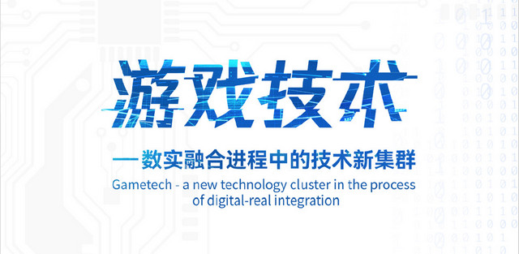
Is game merely a
science and technology?
Is game merely a
amusement?

Slide 2
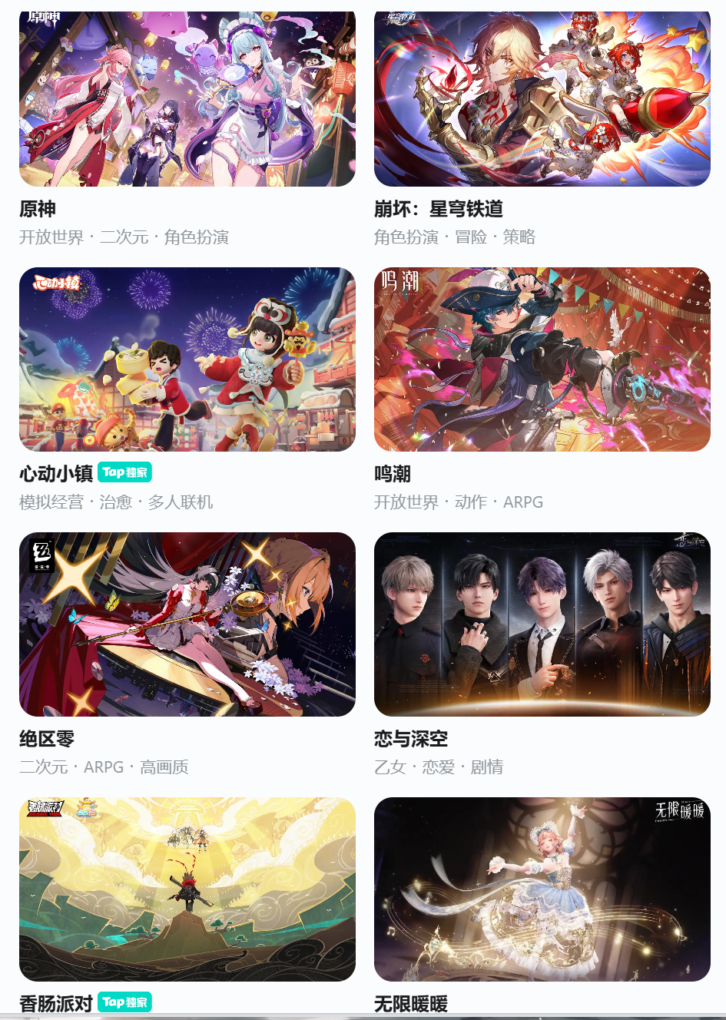

Do you play games?
Can you guess?
A Chinese mobile game
ranked first in the world
MOBA
(Multiplayer Online
Battle Arena)
Honor of Kings

Slide 3
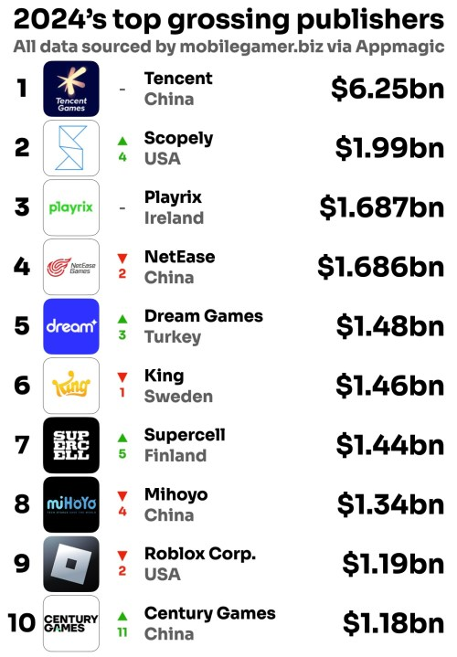
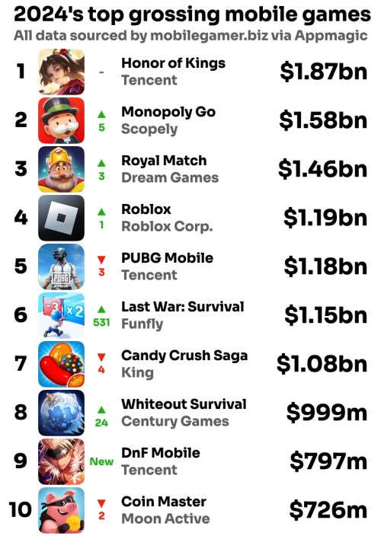

Slide 4
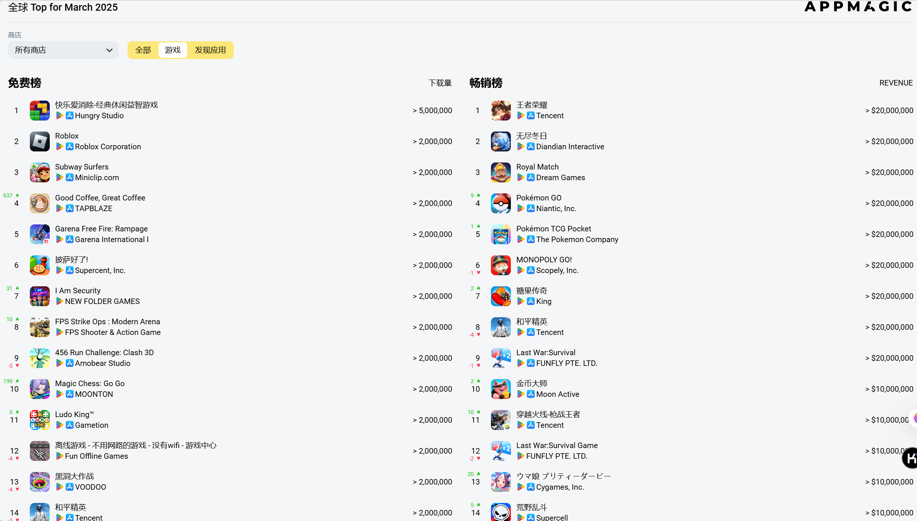

Slide 5
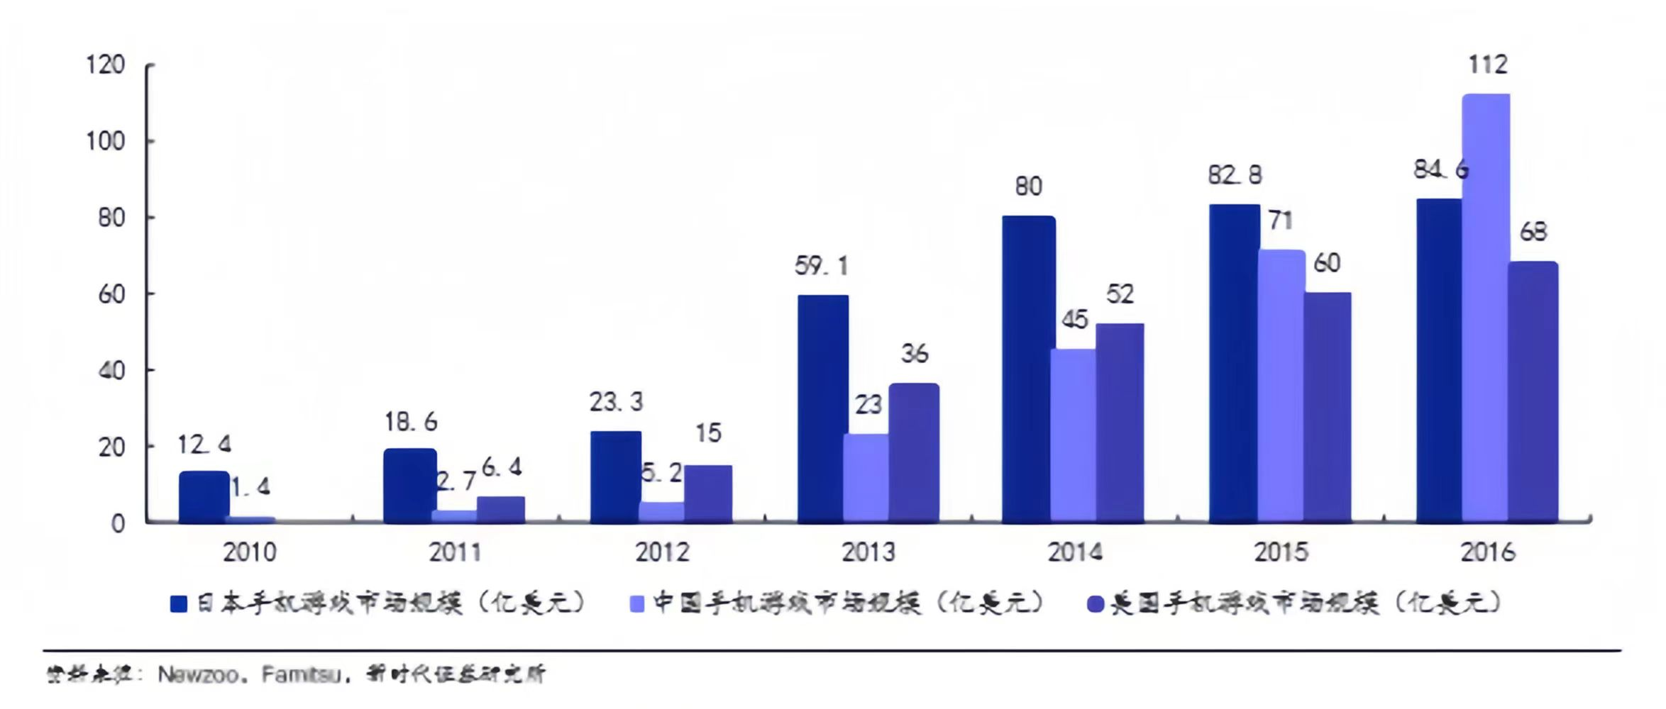
Different countries’ Game market size

Slide 6
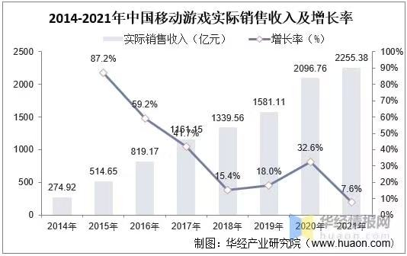
Economic
Phenomenon

Slide 7
The history of the
development of games
01
02
03
04
05
Early exploration stage
Transition period
Rapid development period
Explosive growth period
Maturity period
(before 2000)
(2007-2012)
(2013-2015)
(2015 - 2017)
(2018 to present)

Slide 8
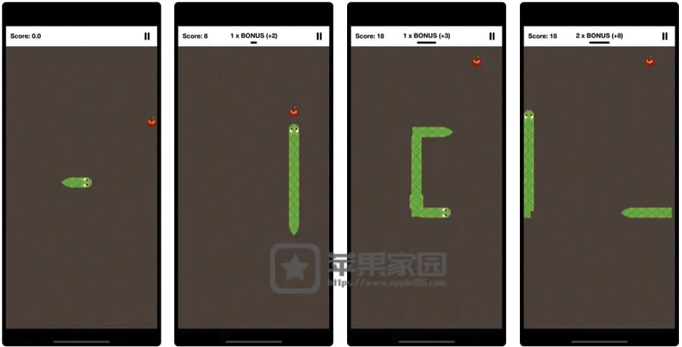
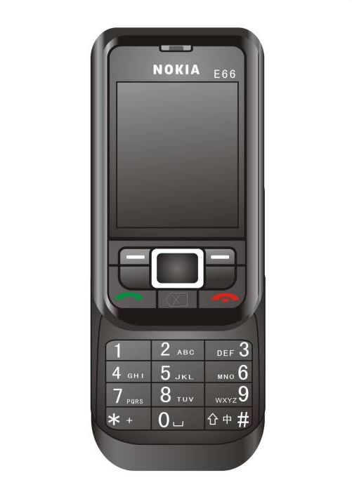

1. Early exploration stage (before 2000): During the feature phone era, games like "Snake" and "Tetris" were popular, which were simple single-player games. The game development and distribution channels were not yet mature, and the market size was limited.

Slide 9
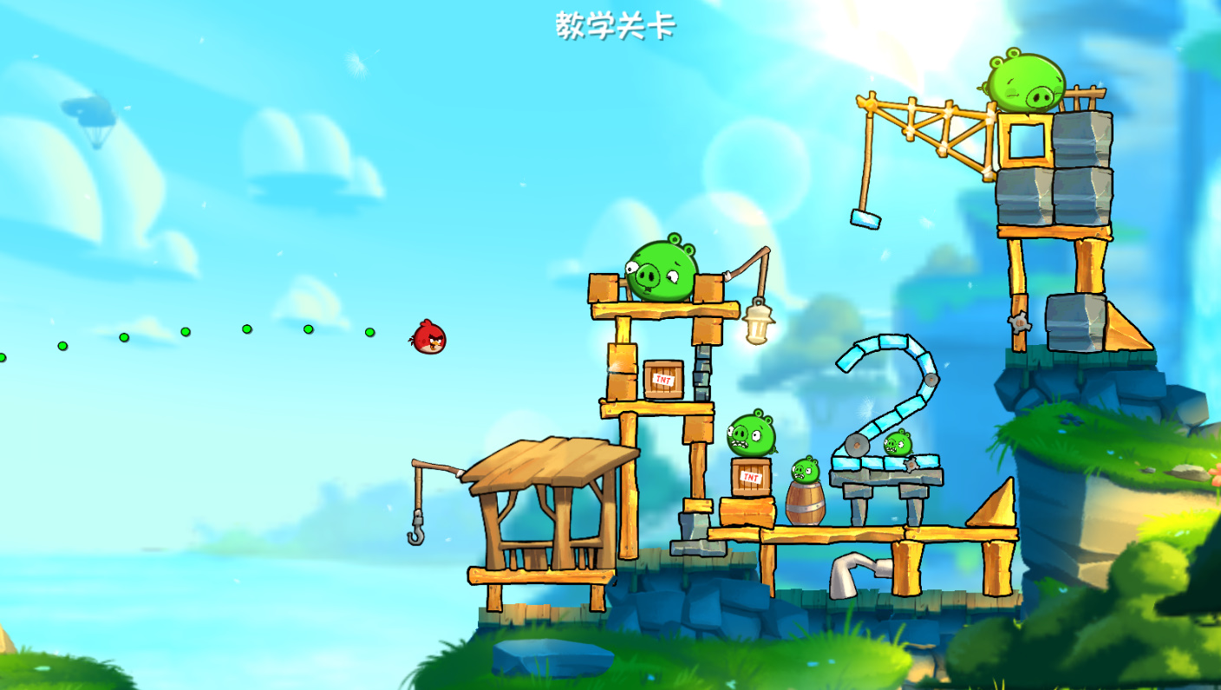
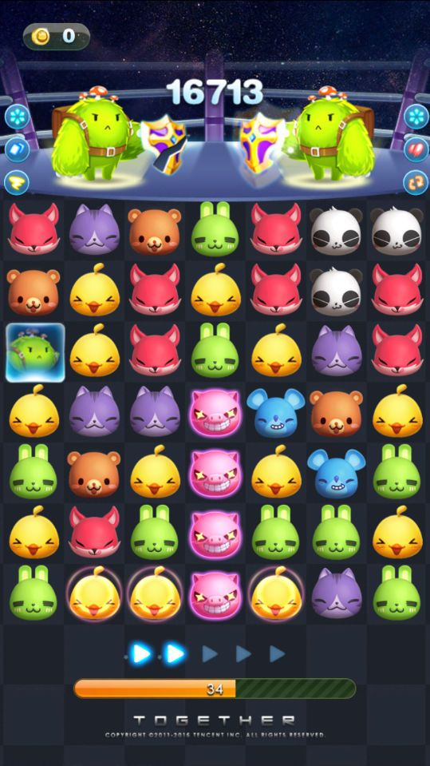
2. Transition period (2007-2012): The popularity of smartphones, especially the rise of iPhone and Android systems, has brought new opportunities to mobile games. In 2011, the hit of "Angry Birds" in China marked the beginning of mobile games entering the mainstream. The rise of social platforms such as WeChat has provided channels for the spread of social games, such as "Happy Elimination".

Slide 10
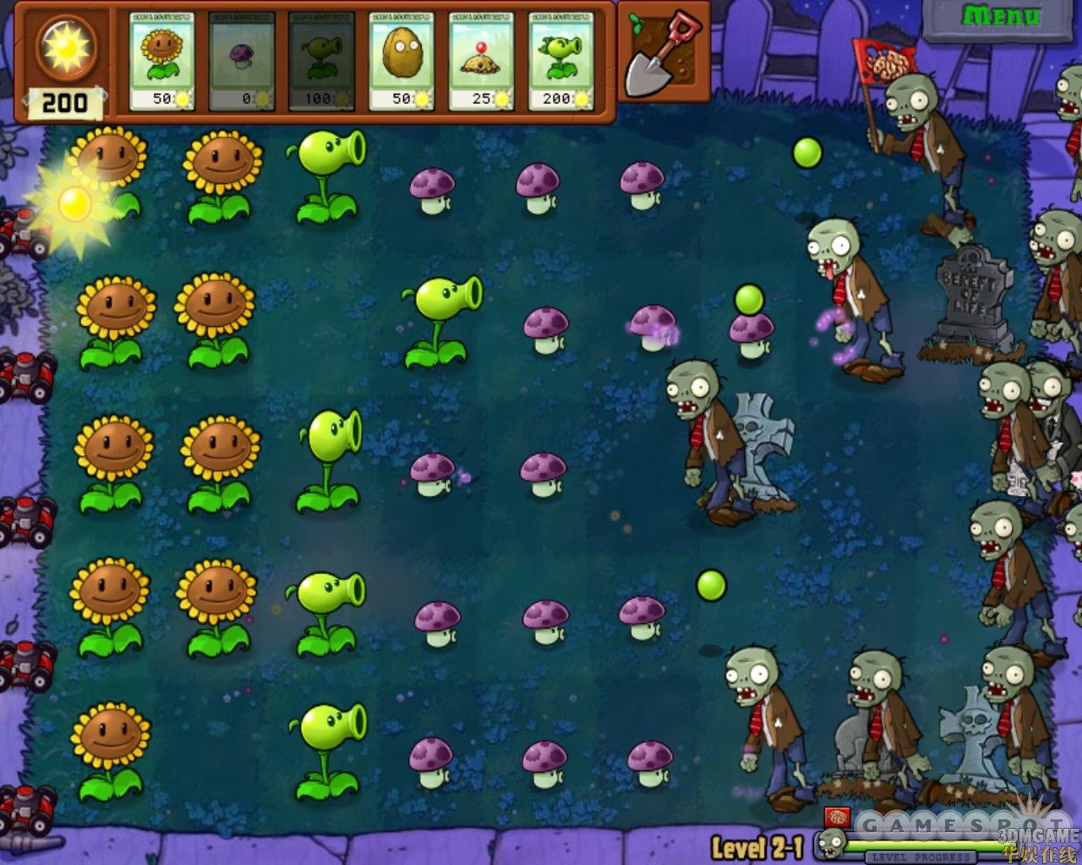
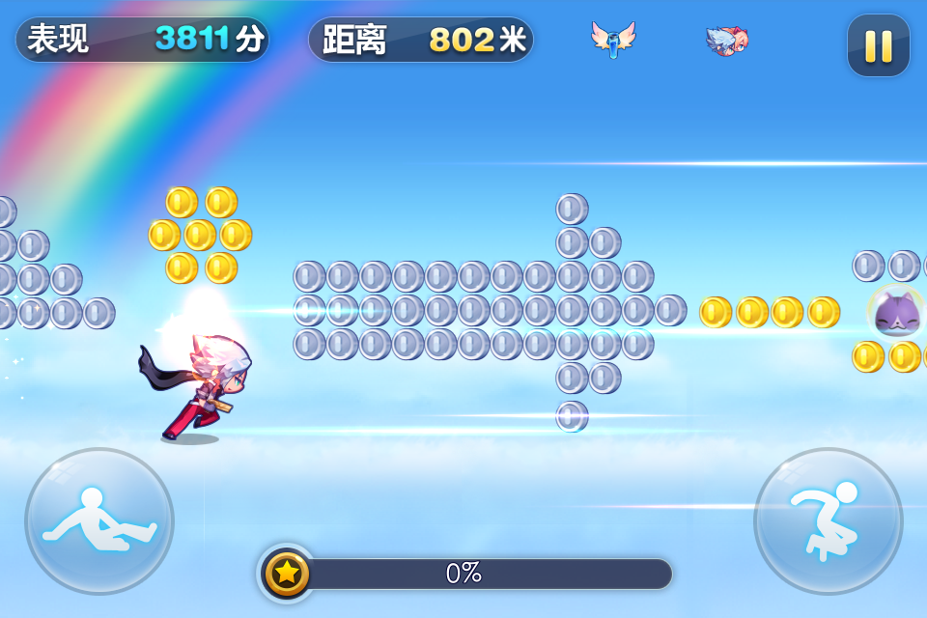
3. High-speed development period (2013-2015): Games like "Plants vs. Zombies" and "Cool running everyday" became popular, and the market size expanded rapidly.

Slide 11
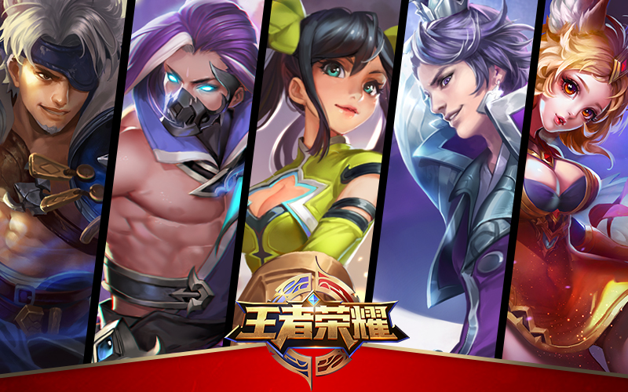
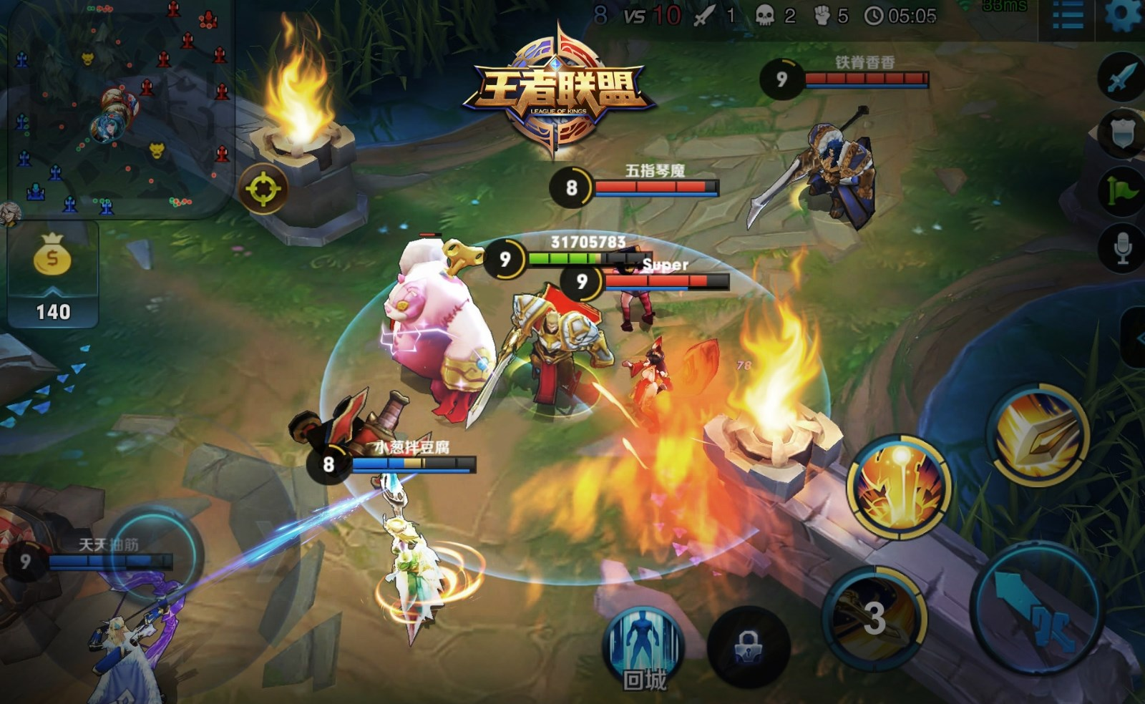
4. The explosive growth period (2015 - 2017): The release of "Honor of Kings" made it a phenomenon-level game and promoted the popularity of MOBA games. The free-to-play plus in-game purchase model became widespread, and the economy of advertisements and skins emerged. The government began to strengthen supervision, implementing real-name registration and anti-addiction systems.

Slide 12

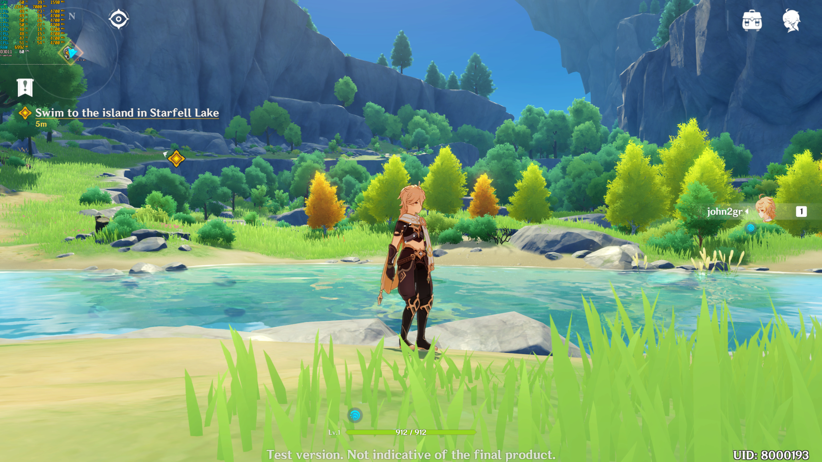
5. Maturity Period (2018 to present): Diversified development has led to the emergence of hardcore games like "Genshin Impact" and open-world games such as "Genshin Impact". The internationalization process has accelerated, and Chinese mobile games have achieved success in overseas markets. Policies have been further tightened, restricting the gaming time of minors, and the industry has entered a stage of standardization.

Slide 13
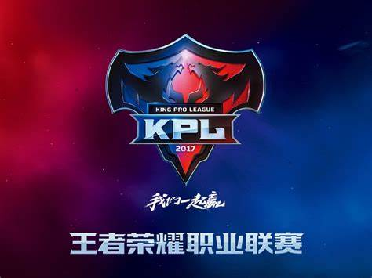
Features of Chinese mobile games:
1.Massive Market & Revenue :
China has the world's largest mobile gaming market, generating billions in annual revenue driven by a vast user base and high engagement.
2.Free-to-Play & in-game purchase model:
Most games adopt a free-to-play model, make profit through in-game purchases (e.g., skins, characters) and gacha mechanics ("loot boxes").
3.Social Integration & Community Focus:
Multiplayer features (teams, guilds), real-time chats, and social media sharing (e.g., WeChat) enhance player retention.
4.E-sports & Live Streaming Synergy:
Titles like “Honor of Kings” and “Game for Peace” dominate e-sports leagues and live-streaming platforms (e.g., Douyu, Bilibili).
5.From imitation to innovation:
It was initially introduced from abroad(e.g., "Angry Birds“, "Plants vs. Zombies" ) and gradually shifted towards independent innovation.
6.From domestic market to international market:
An increasing number of Chinese games have been successfully launched overseas, taking up a significant share of the overseas market.

Slide 14



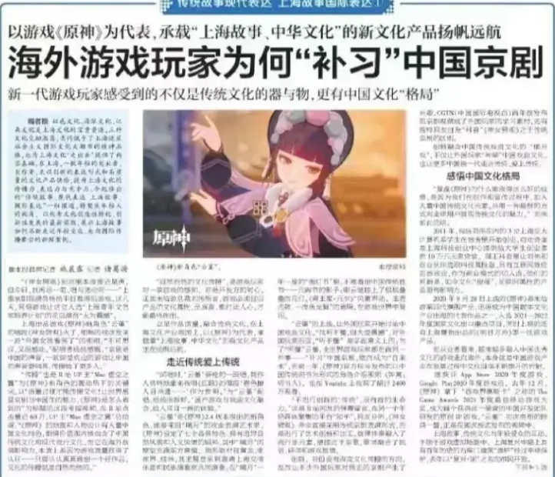
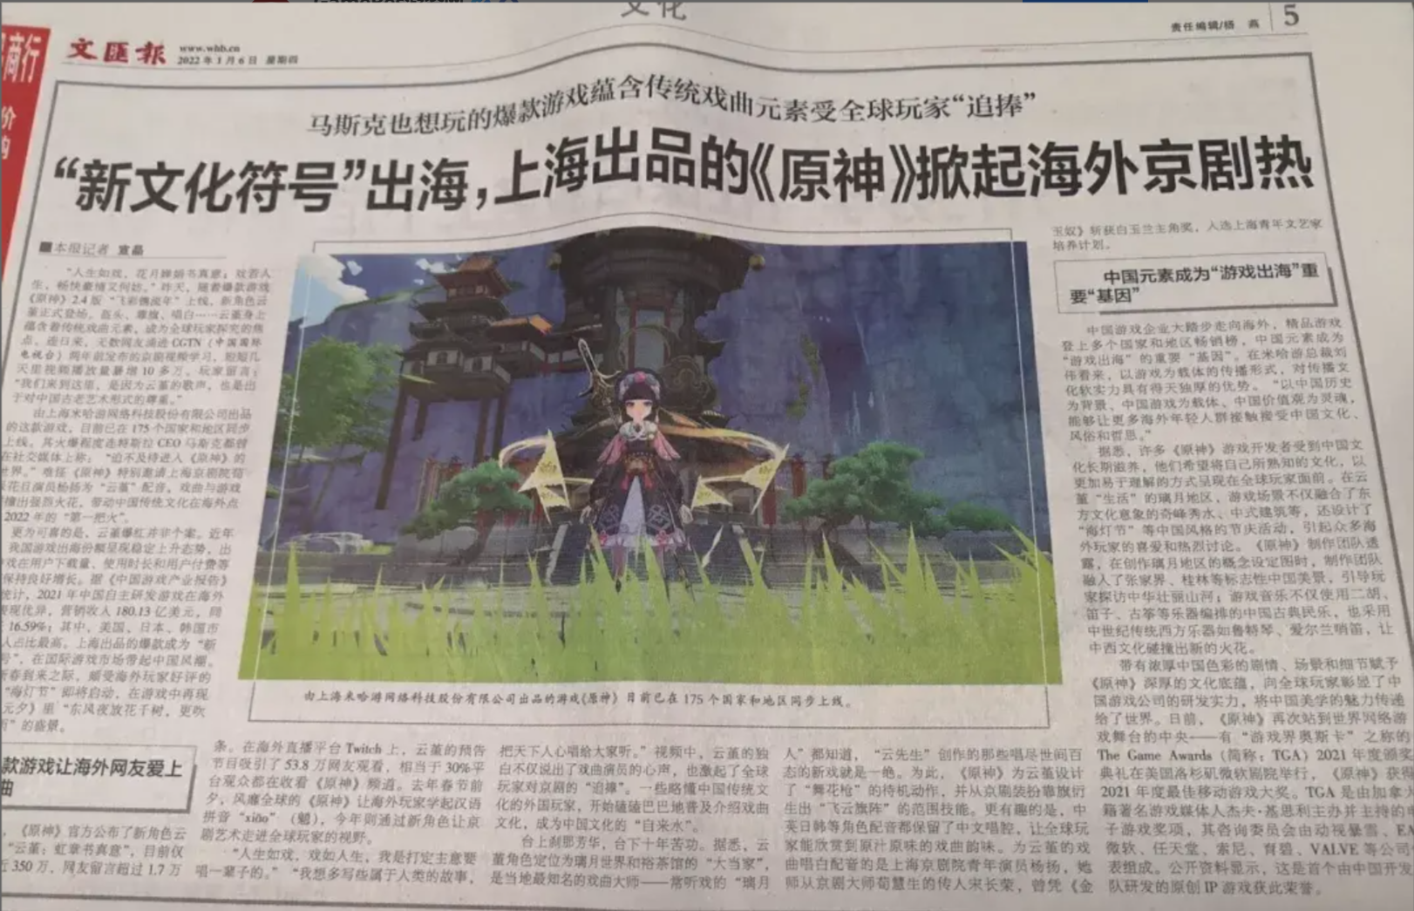
From game to art & culture:
This character from “Genshin impact”,named Yun Jin,has led the trend for foreign gamers to learn about traditional Chinese Peking Oprea culture. This incident was reported by many well-known official Chinese media outlets, including the Liberation Daily and the Culture Daily. The game is hailed as a new cultural symbol that has gone global.

Slide 15
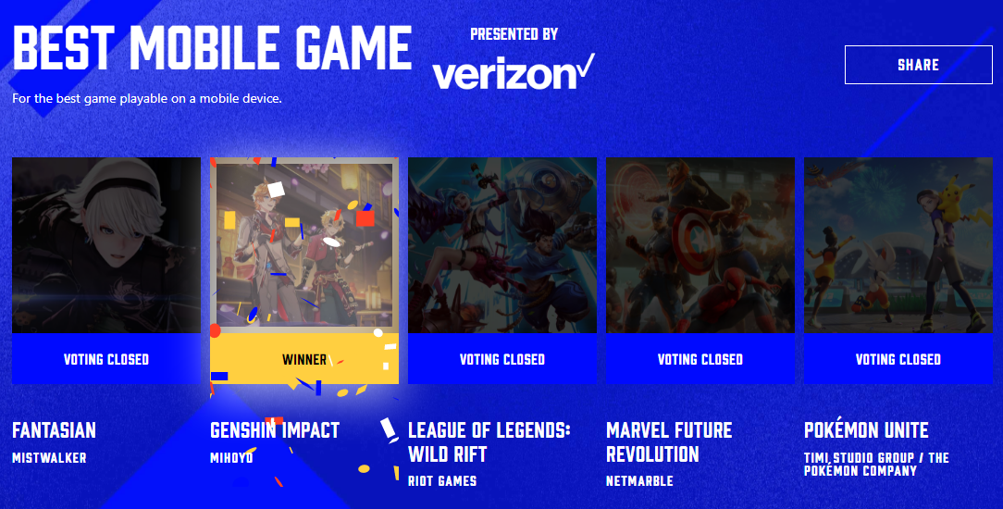
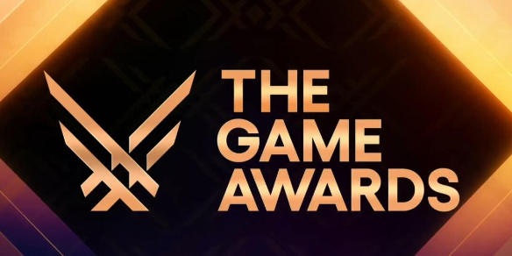
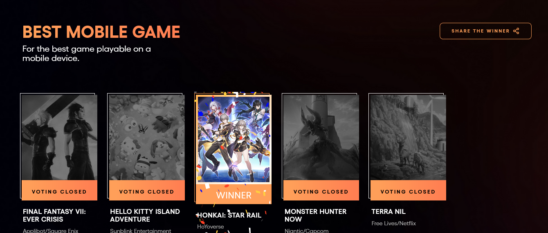
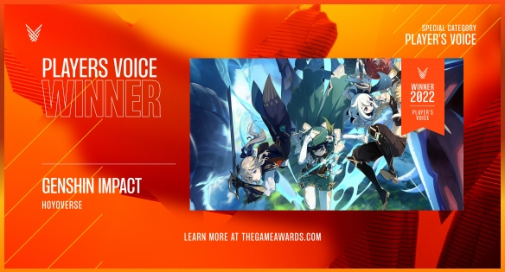
Achievement & International recognition:
The Game Awards (TGA) is one of the most influential annual events in the global gaming industry and is hailed as the "Oscar of the gaming world". Since its establishment in 2014, TGA has become an important benchmark for measuring the quality and innovation of game works through its authoritative selection mechanism, diverse award settings, and keen perception of industry trends.

Slide 16
Conclusion：
The game industry has become a significant engine driving technological progress, economic growth, and cultural dissemination.
From a technological perspective, games serve as a testing ground for cutting-edge technologies, accelerating the iteration and application of AI, cloud computing, VR/AR, and other technologies. For instance, AI-generated content (AIGC) technology enhances the interactive experience of games, while cloud gaming revolutionizes the content distribution model and feeds back into cross-industry fields such as industrial simulation and healthcare.
Economically, games have built a vast digital economy ecosystem. In 2024, the scale of China's game market exceeded 300 billion yuan, driving the coordinated development of the entire industrial chain, including hardware manufacturing, e-sports, and IP derivatives, creating millions of jobs, and facilitating the overseas expansion of domestic games to generate foreign exchange, such as "Genshin Impact" and "Black Myth: Wu Kong" achieving dual breakthroughs in global revenue and cultural export.
Culturally, games reconstruct traditional culture through youthful narratives, such as “Genshin impact" revitalizing Chinese traditional culture, while attracting global users with oriental aesthetic symbols like Peking Oprea and other traditional custom, becoming a "digital bridge" for cross-cultural communication.
The synergy of these three aspects is transforming games from mere entertainment tools into comprehensive social carriers that possess technological driving force, economic value, and cultural missions.

Slide 17
Thank you

