Slide 1

Education：Chicken Child
Fired-up Child
汇报人：陶瑜
日语笔译

Slide 2

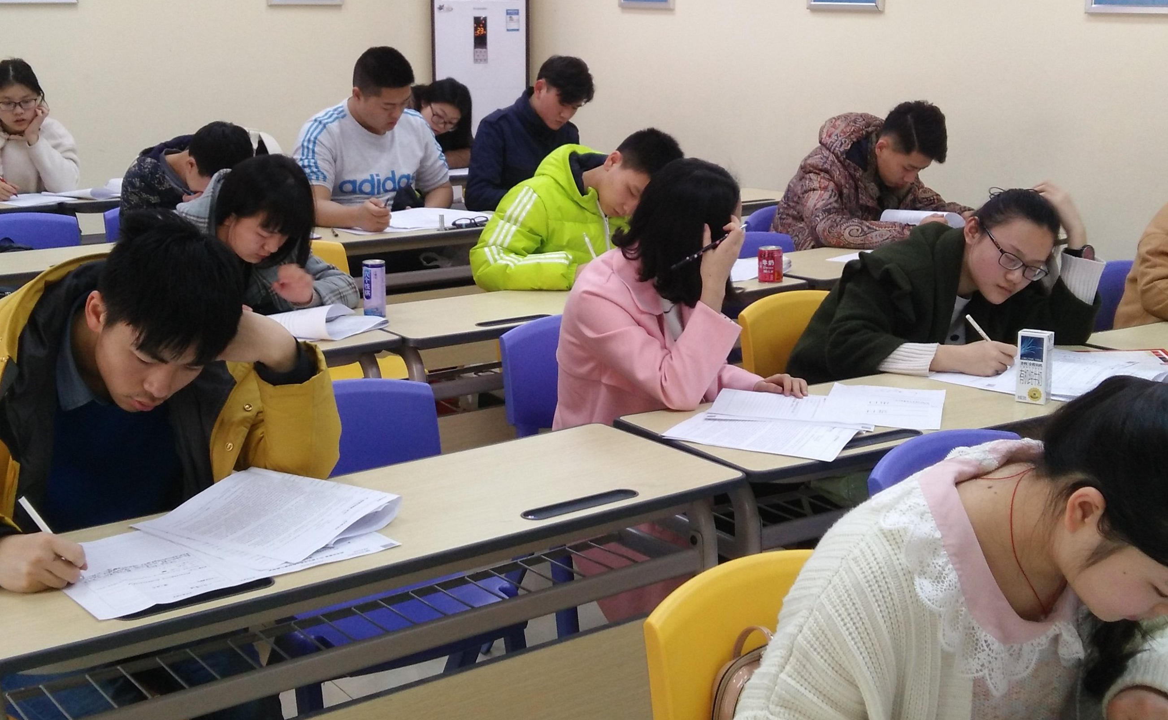
A quick survey
How many of you have taken extracurricular tutoring classes during elementary, middle, or high school?
If you have, please raise your hand.

Slide 3


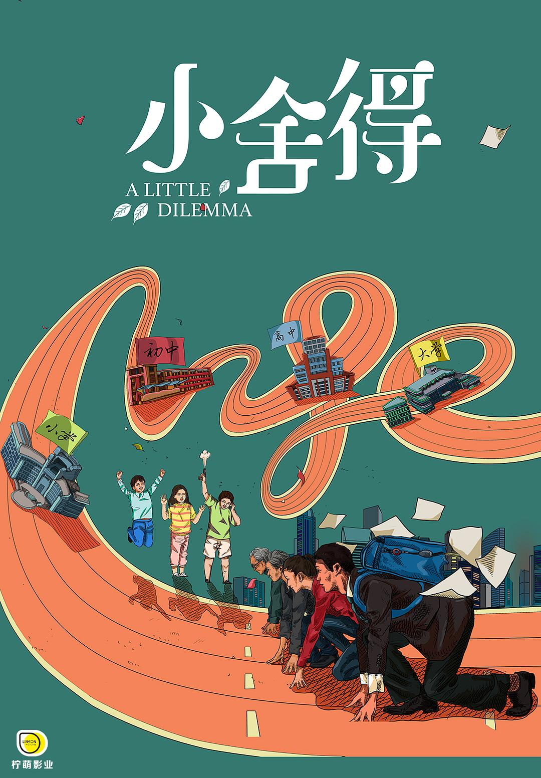
A Little Reunion
A Love For Separation
A Little Dilemma

Slide 4
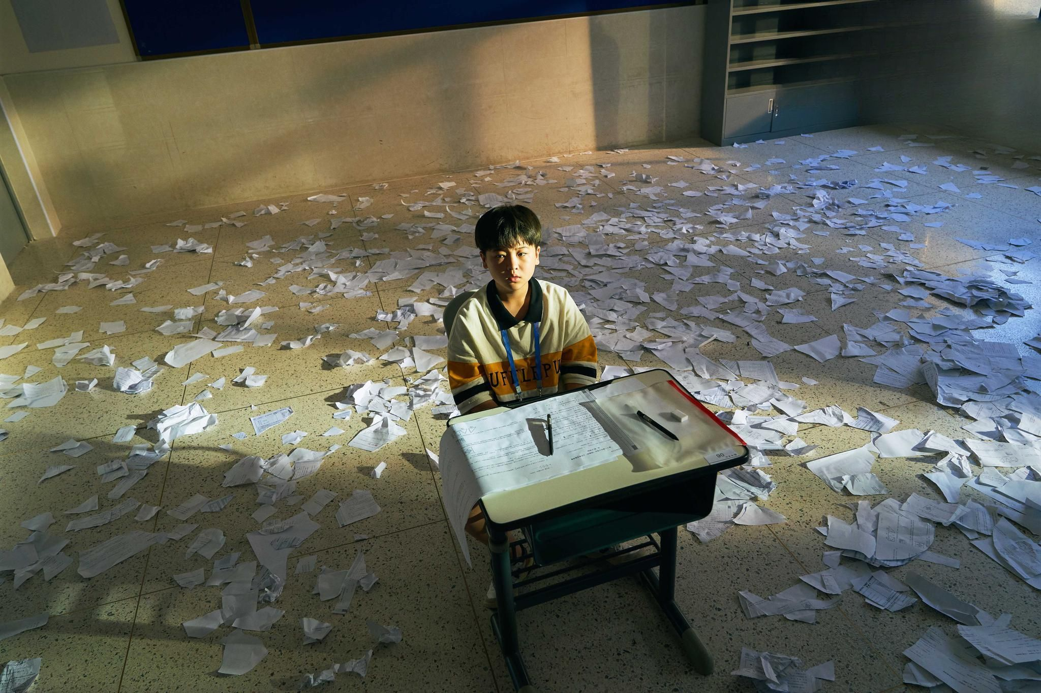
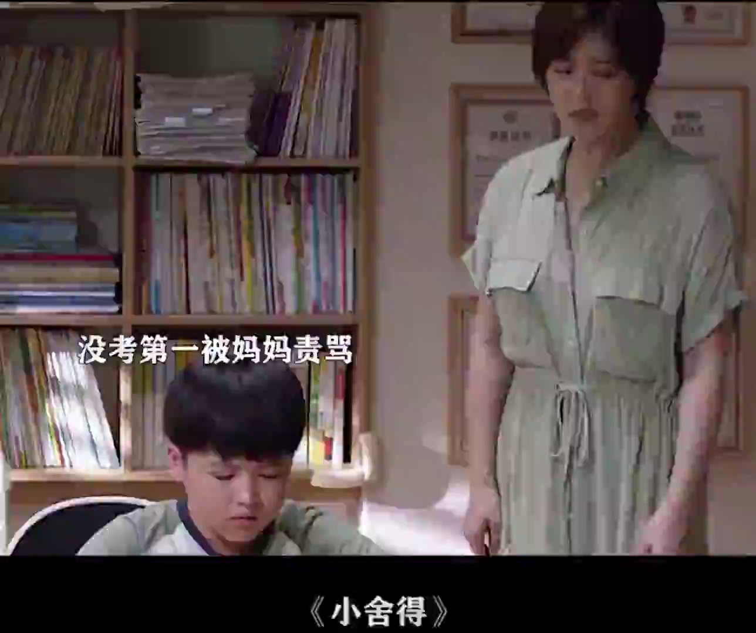

Slide 5

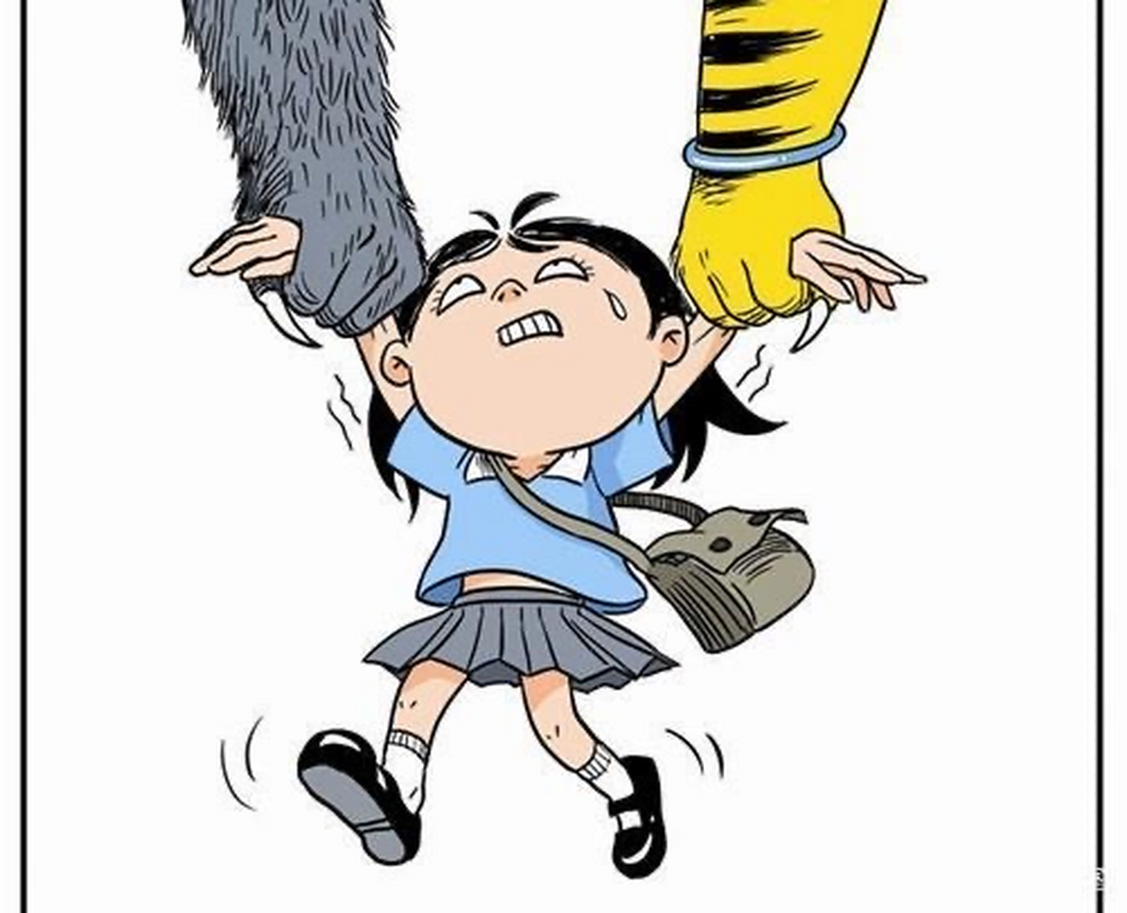
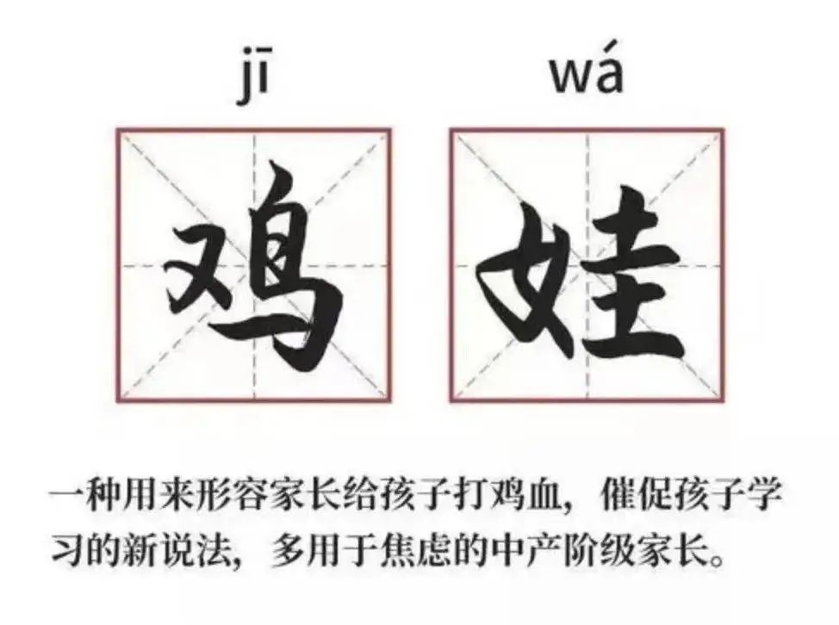
What is “Chicken Parenting”
The term “chicken parenting” means constantly pushing kids to their limits, like injecting them with “chicken blood” to keep them motivated.
Parents, often called “tiger moms” or “wolf dads,” relentlessly arrange extra lessons and activities for their children, hoping they’ll stand out in the fierce competition and succeed.

Slide 6
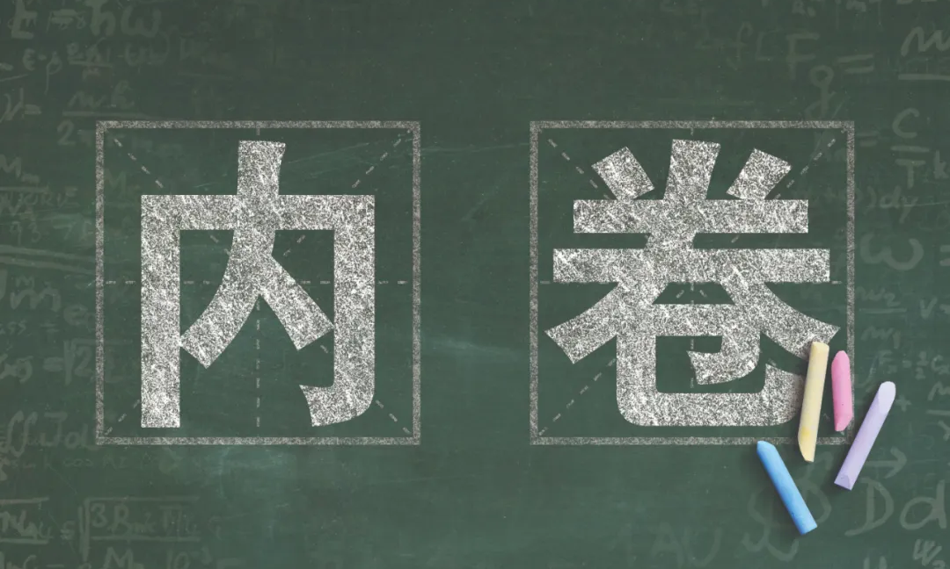
the essence behind the “Chicken Parenting”
This trend is a reflection of deep-seated educational competition, or what we call "involution".
And it reveals widespread educational anxiety, especially prevalent among the middle class and well-educated families.

Slide 7

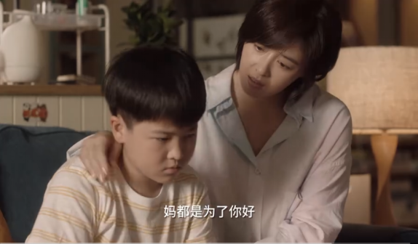
the essence behind the “Chicken Parenting”
These families don’t push their children merely for academic excellence. Beneath this drive lies a profound fear of downward social mobility. They hope that through intense education, their children can maintain a competitive edge in society and safeguard the family’s social status.

Slide 8
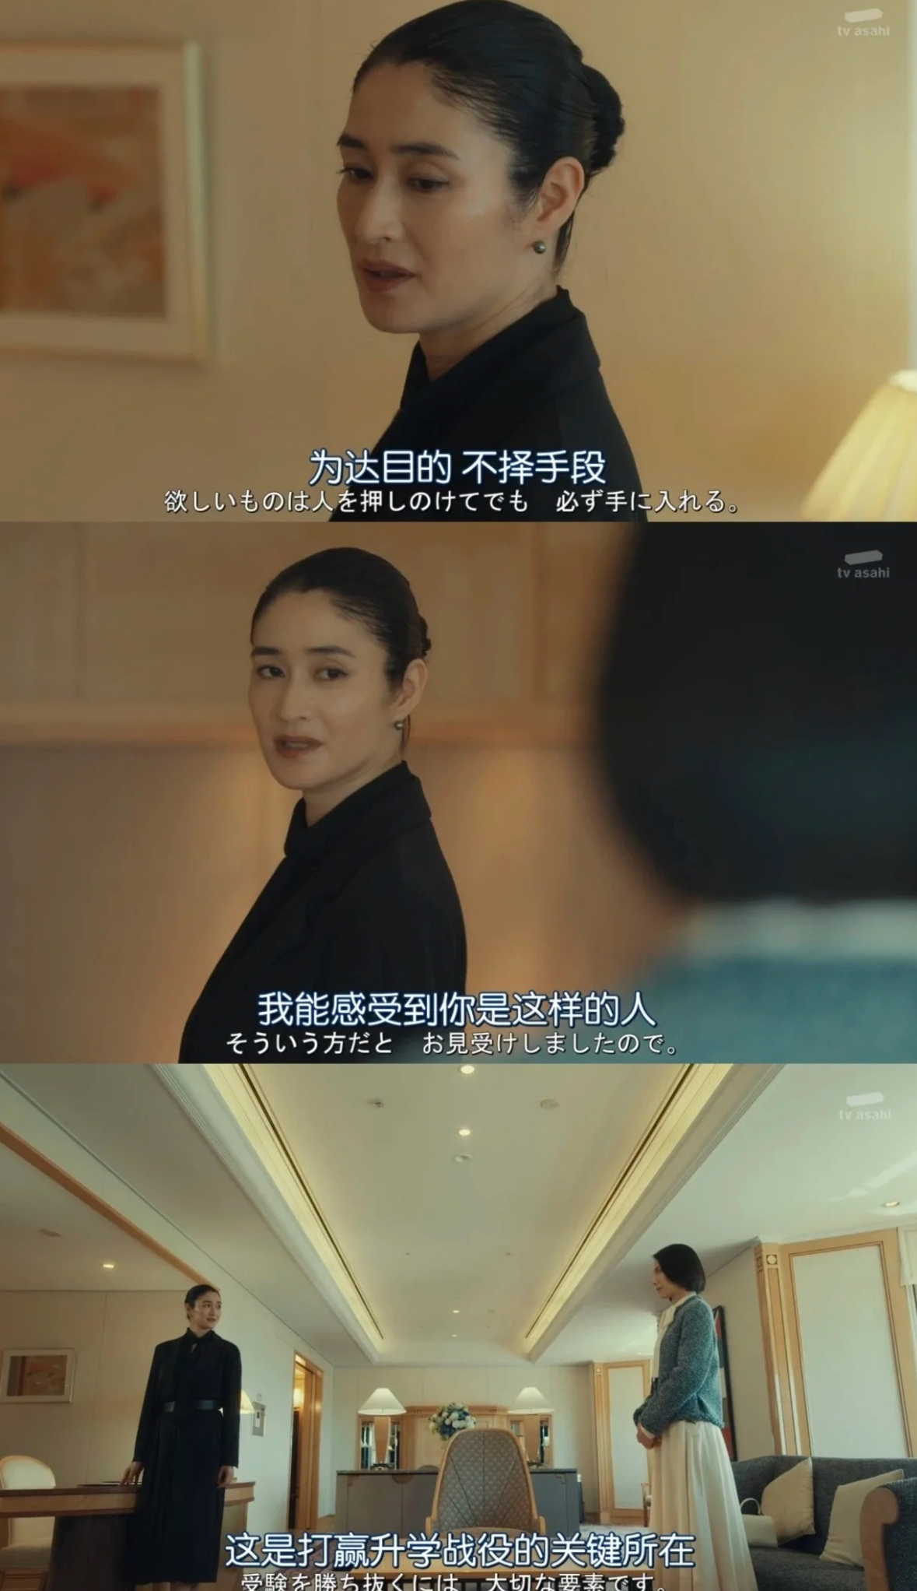
the essence behind the “Chicken Parenting”
China’s so-called “new middle class” is burdened by hefty mortgages, high debt levels, and limited cash reserves, leaving them vulnerable to economic risks.
Realizing that ordinary educational resources might not be enough, they invest considerable time, effort, and money in their children’s education, hoping this “chicken parenting” strategy will tip the scales in their favor.

Slide 9

My personal view
times have changed

Slide 10
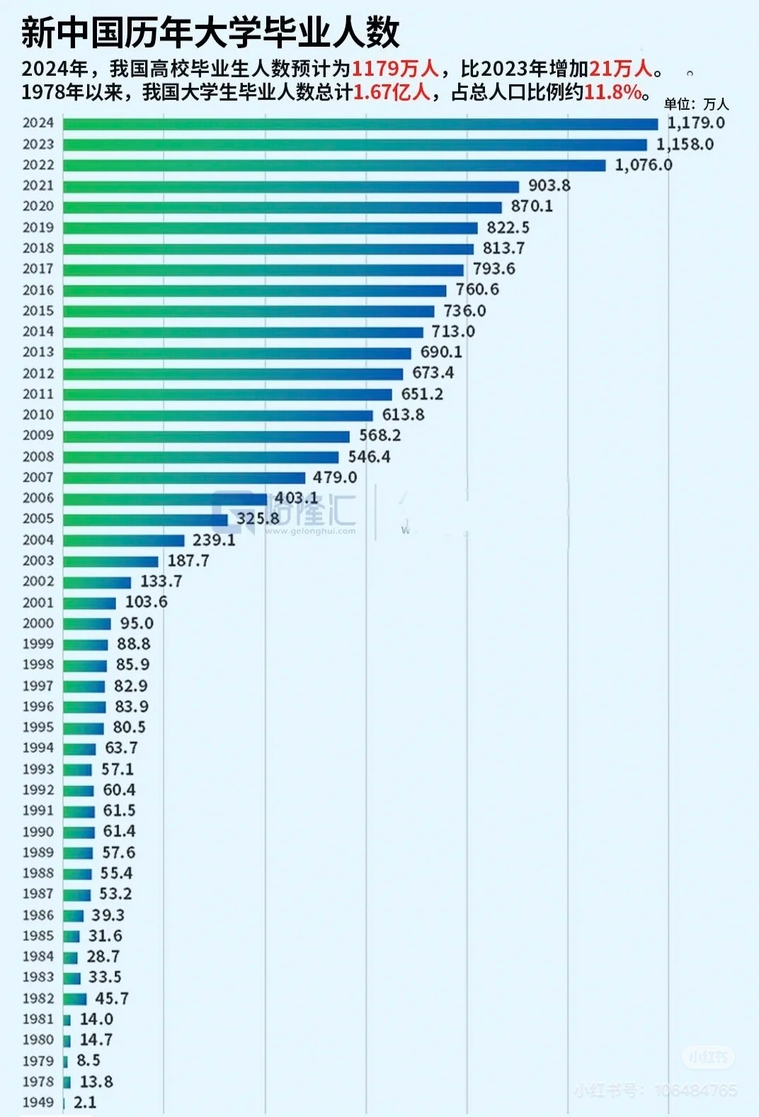
Diploma depreciation
Twenty years ago, China had just over a million university graduates annually. Many from the ’70s and ’80s generation benefited greatly from having a bachelor’s degree.
Today, however, more than ten million students graduate from universities each year, facing intense competition. academic degrees have significantly lost their value. Even a degree from a prestigious university is no longer a ticket to success.

Slide 11

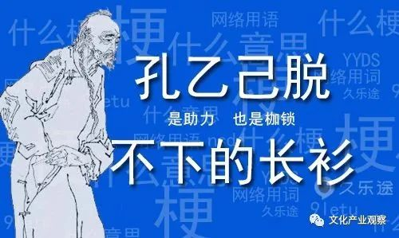
Recent social trends reflect this reality. The popular meme about “Kong Yiji’s long gown” sparked widespread discussion. It symbolizes how some graduates feel burdened by their degrees, which haven’t delivered the expected rewards.
Another example is the widespread criticism and controversy triggered by the TikTok influencer "Yang Maoyue" after he posted a sarcastic video about the difficulties faced by university students in finding employment.

Slide 12
Every child has their own pace and talents. Real success comes from nurturing who they truly are, not who we expect them to be.

Slide 13
Q＆A Can you name the English titles of the TV dramas 《小欢喜》, 《小别离》, and 《小舍得》?
《小欢喜》
《小别离》
《小舍得》

Slide 14

感谢您的聆听
THANKS

