Slide 1







Minority Languages
in China
Presenters: Liu Jiayu -- English Translation
Liao Lujia -- English Translation

Slide 2
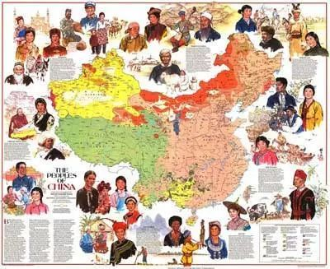

Questions:
1. Can you list some minority languages in China?
2. Does anyone know how to speak at least one minority language in China?

Slide 3

Ⅳ
Ⅲ
Ⅱ
Ⅰ
Catalogue
Definition
Measures
Significance
Use

Slide 4




Ⅰ
Definition
https://www.ypppt.com/
What is a minority language?

Slide 5
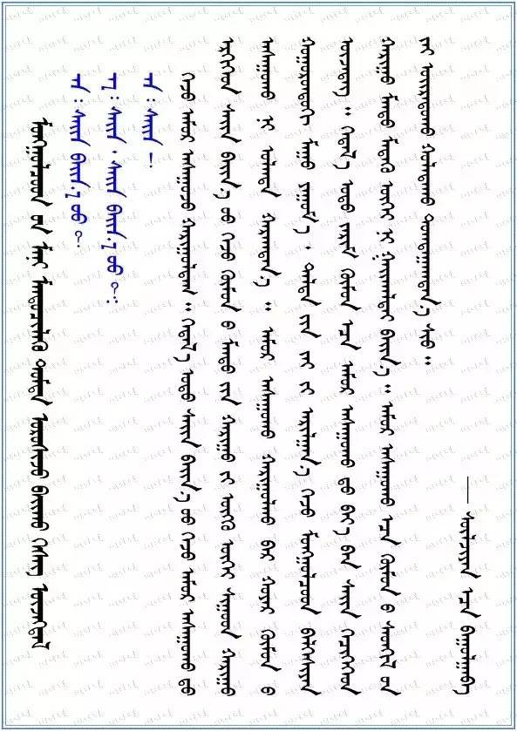

Definition
A minority language is an independent language system belonging to an independent nation.
2. minority languages = dialects?
Mongolian language（蒙古语）

Slide 6
Ⅱ
Use
The general situation
and use of minority languages

Slide 7
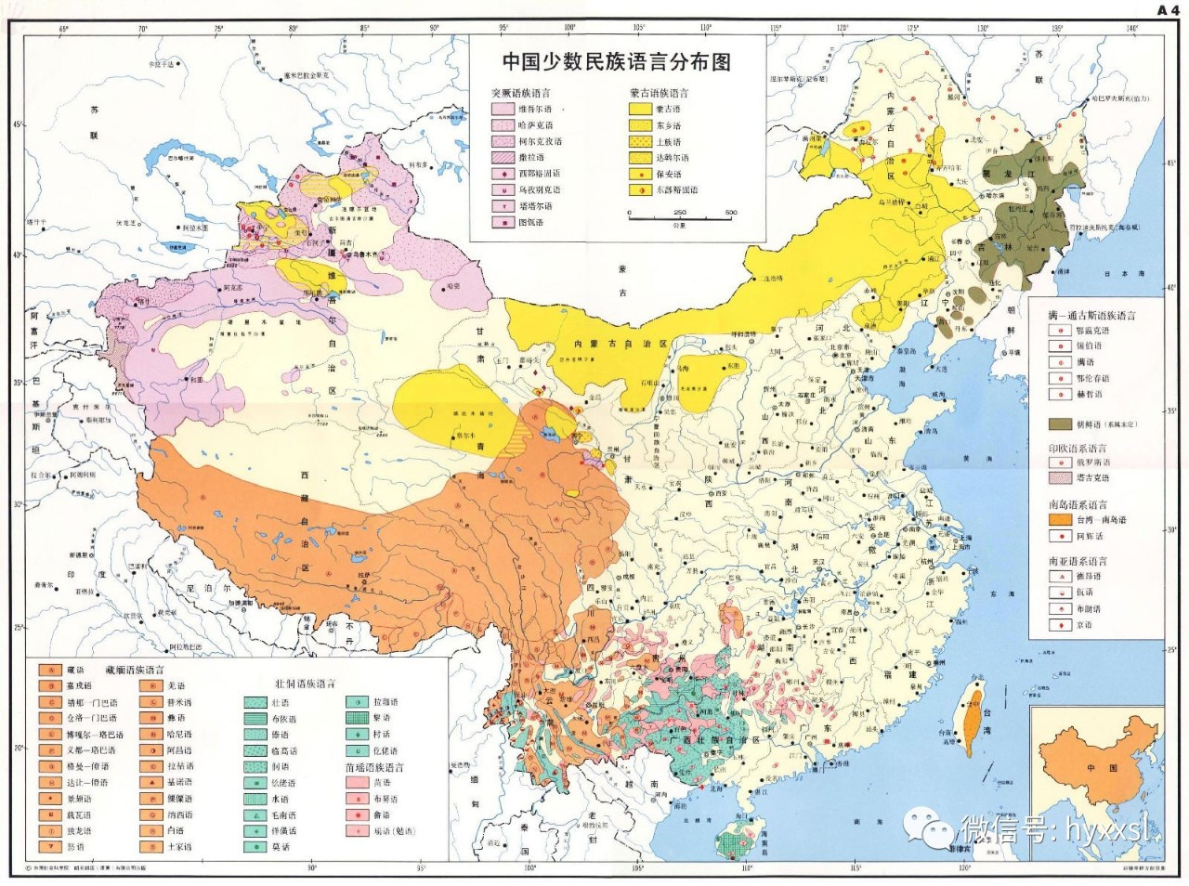
Distribution map
of minority languages
in China

Slide 8

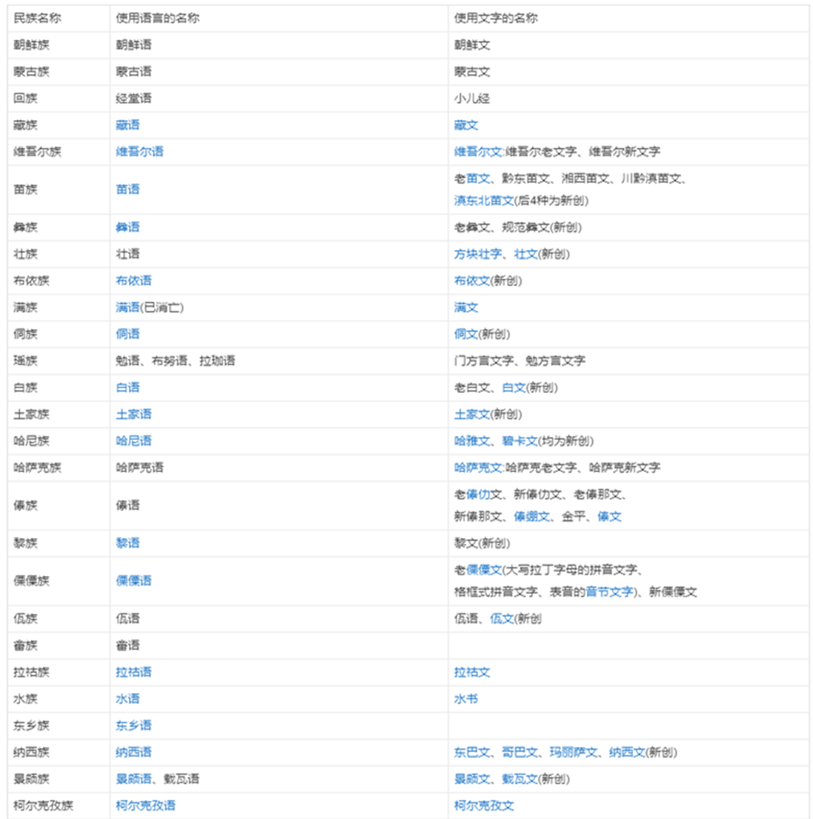
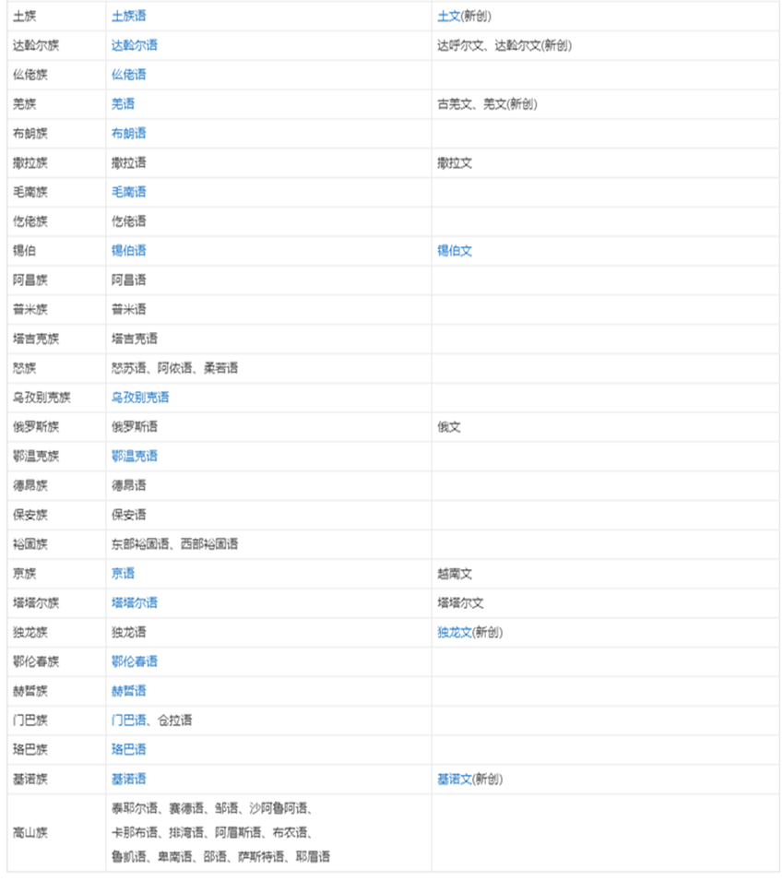

Slide 9
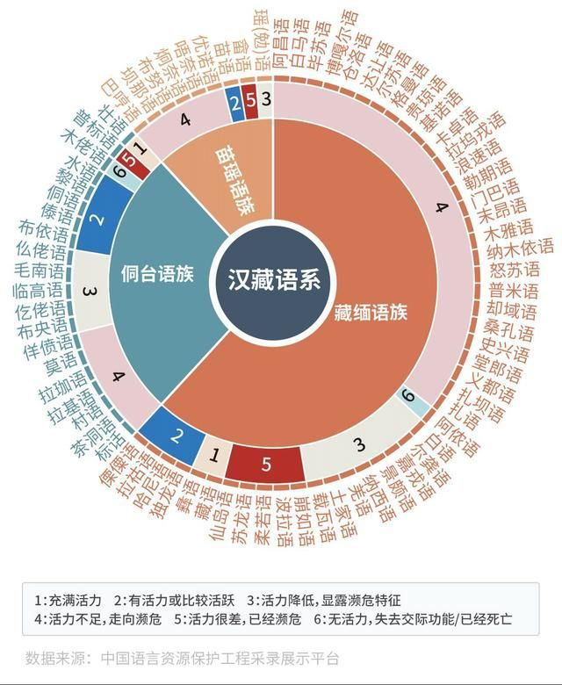

In China, more than 120 ethnic minority languages are in use, of which about half are spoken by less than 10,000 people, and more than 20 are spoken by less than 1,000 people. These languages are basically on the verge of extinction.
1: Be energetic
2: Energetic or relatively active
3: Decreased vitality, showing an endangered trend
4: Lack of vitality, towards the endangered
5: Vitality is poor and endangered
6: No energy, no communicative function/dead

Slide 10
Ⅲ
Significance
Why should we protect and inherit minority languages in China?

Slide 11
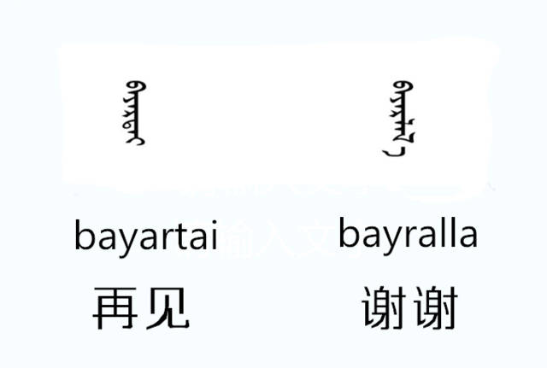
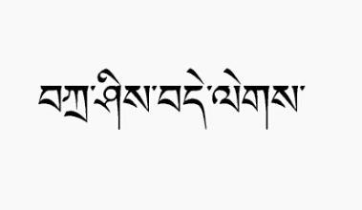
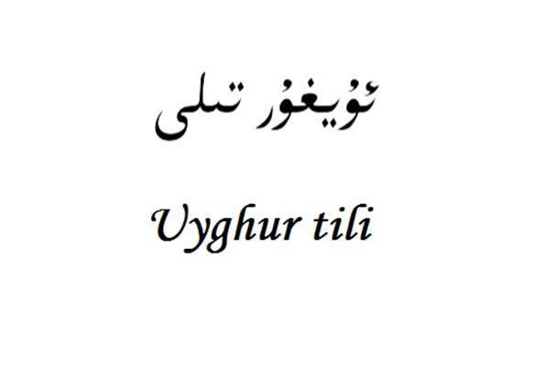


Why should we protect and inherit minority languages in China?
An important part of Chinese minority culture
The important basis of national identity
An important role in ethnic unity and social stability.

Slide 12
Ⅳ
Measures
How to protect and inherit minority languages?

Slide 13
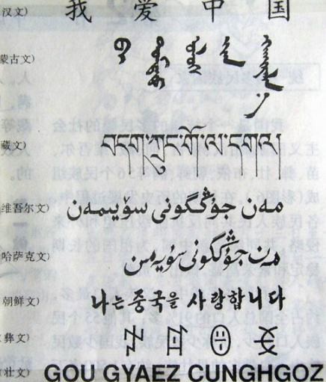

Measures to protect and inherit minority languages in China?
Sound legislation
Education
Public services
…

Slide 14
References
[1] Ren Xiaokun. The Semantic characteristics, formation mode and syntactic function of demonstrative Words: A Statistical Analysis of Chinese Minority Languages (9)[J]. Journal of Ethnic Languages,2021(05):27-38.
[2] Huang Xing. A Survey on the Use of Ethnic Minority Languages [J]. Ethnic Translation,2013(03):64-78.
[3] Li R. Language and Dialects of China [AI] Explanatory draft of Atlas of Chinese Language [J]. Journal of Chinese Dialects,1989(03):161-167.
[4] Lou Xiaoyue. On the language and culture of China's minority nationalities and their inheritance [J]. Northwest Second Institute for Nationalities (Philosophy and Social Sciences Edition),2006(03):39-42.
[5] Sun Hongkai. The record and protection of Minority Languages and cultures [J]. Ethnic China,2006(05):32-33.
[6] Dai Qingxia. Language protection and Ethnic minority languages in China [J]. Folk Classics and Characters Studies,2016(02):1-7+231.

Slide 15
Thanks for watching!

