Slide 1

中国文化基础
Foundation of Chinese Cultures for Bachelor Students of Translation Studies
湖南师范大学 2021年3月3日-2021年6月16日
中国文化基础 周三第七和第八节课14:30-16:10，
上课地点：在线
助教：刘廷阳 Liu Tingyang, wiki 助教：陈柯汝 Chen Keru
吴漠汀特聘教授 Distinguished Professor Dr. Martin Woesler
湖南师范大学外国学院 Foreign Studies College, Hunan Normal University

Slide 2
Session 5 第五周
Session Overview 本节概览 and Quizzes
Aesthetic ideals and social customs: Chinese Marriage Customs Presentation on Marriage Customs by Dù Xīnyǔ 杜心语 https://ks.wjx.top/vj/w3HDLsU.aspx
Music and instruments: Pipa Presentation on Music and instruments: Pipa by Liú Zhuōfán 刘卓凡 https://ks.wjx.top/vj/rutjD9h.aspx
Traditional Cuisine: The Art of Chinese Cooking Presentation on the Art of Chinese Cooking by Dài Mùyǔ 戴沐雨 https://ks.wjx.top/vj/Q0s0tfA.aspx

Slide 3
Session 5 第五周
Hitlist of Chinese cultural phenomena: This semesters‘ schedule
Order | Date | Topic | Chapter | Points | Popularity
1 | 10.03.2021 | Beverages: Milk Tea | 21 | 474 | 79%
2 | 10.03.2021 | Traditional Cuisine: Eight Major Cuisines in China | 28 | 468 | 78%
3 | 10.03.2021 | Beverages: Tea | 20 | 451 | 75%
4 | 17.03.2021 | Architecture: Architecture and Gardens, The Forbidden City | 36 | 433 | 72%
5 | 17.03.2021 | Traditional Festivals | 2 | 432 | 72%
6 | 17.03.2021 | Aesthetic ideals and social customs: The Four Most Handsome Men in Ancient China | 108 | 427 | 71%
7 | 24.03.2021 | Traditional Cuisine: Four Distinct Regional Cuisines | 24 | 423 | 71%
8 | 24.03.2021 | Education: Historical Figures, The Four Talented Women of Ancient China | 119 | 417 | 70%
9 | 24.03.2021 | Traditional Cuisine: Two Famous Dishes | 26 | 415 | 69%
10 | 31.03.2021 | Aesthetic ideals and social customs: Chinese Marriage Customs | 110 | 409 | 68%
11 | 31.03.2021 | Music and instruments: Pipa | 95 | 406 | 68%
12 | 31.03.2021 | Traditional Cuisine: The Art of Chinese Cooking | 25 | 404 | 67%
13 | 07.04.2021 | Silk and porcelain: Celadon and Celadon Song 《青花瓷》歌词 | 31 | 401 | 67%
14 | 07.04.2021 | Traditional Cuisine: Chinese Dining Etiquette | 23 | 396 | 66%
15 | 07.04.2021 | Facial Make-up: Cosmetics, Traditional Chinese Make-Up | 98 | 395 | 66%
16 | 14.04.2021 | Garden Culture: The Summer Palace | 41 | 385 | 64%
17 | 14.04.2021 | Money culture: The tradition of Red Envelope and Lucky Money | 106 | 384 | 64%
18 | 14.04.2021 | Stage entertainment: Crosstalk 相声 | 99 | 383 | 64%
19 | 21.04.2021 | Architecture | 35 | 377 | 63%
20 | 21.04.2021 | Music and instruments: Guzheng | 94 | 375 | 63%
21 | 21.04.2021 | Chinese Astrology: Twelve Animals of the Chinese Zodiac | 71 | 372 | 62%
22 | 28.04.2021 | Ancient literature: Four Folk Stories of Ancient China | 49 | 371 | 62%
23 | 28.04.2021 | Ancient literature: Chinese Classical Fairy Tales | 50 | 369 | 62%
24 | 28.04.2021 | Chinese language: Chinese Dialects | 45 | 368 | 61%
25 | 05.05.2021 | Animals: Panda | 128 | 366 | 61%
26 | 05.05.2021 | Facial Make-up: Face Changing in Sichuan Opera | 97 | 365 | 61%
27 | 05.05.2021 | Chinese Mythology: Huli-jing | 73 | 364 | 61%
28 | 12.05.2021 | Traditional Crafts: Folk Art - Chinese Paper-cutting | 19 | 364 | 61%
29 | 12.05.2021 | Science and Technology: Douyin (Tik Tok) | 8 | 362 | 60%
30 | 12.05.2021 | Chinese clothing / interieur: Chinese clothing | 112 | 361 | 60%
31 | 19.05.2021 | Facial Make-up | 96 | 360 | 60%
32 | 19.05.2021 | Beverages: The Liquor Culture of Ancient China | 22 | 357 | 60%
33 | 19.05.2021 | Premodern literature: Tang and Song (2 texts) | 51 | 357 | 60%
34 | 26.05.2021 | Chinese Medicine: The Development of Chinese Medicine | 68 | 356 | 59%
35 | 26.05.2021 | Modern and Contemporary Literature: Qian Zhongshu (Ch'ien Chung-shu) | 56 | 349 | 58%
36 | 26.05.2021 | Body movement performance: Traditional Chinese Dance | 103 | 346 | 58%
37 | 02.06.2021 | Chinese Astrology: Calendar, The 24 Solar Terms | 72 | 346 | 58%
38 | 02.06.2021 | Stage entertainment: Shadow Play | 100 | 344 | 57%
39 | 02.06.2021 | Chinese Astrology: Chinese Astrology | 70 | 338 | 56%
40 | 09.06.2021 | Chinese Writing: Chinese Characters | 9 | 336 | 56%
41 | 09.06.2021 | Landscapes and tourism: Landscape, Five Famous Mountains | 122 | 333 | 56%
42 | 09.06.2021 | Traditional Crafts: Carving | 17 | 326 | 54%
43 | 16.06.2021 | Landscapes and tourism: Tourism, Nanjing-An Ancient Capital of Six Dynasties | 126 | 319 | 53%
44 | 16.06.2021 | Garden Culture: Qingming Riverside Landscspe Garden | 42 | 317 | 53%
45 | 16.06.2021 | Traditional Crafts: Handcraft - Chinese Knots | 18 | 317 | 53%
46 |  | Fine Arts: Painting | 32 | 316 | 53%
47 |  | Chinese clothing / interieur: Cheongsam | 113 | 312 | 52%
48 |  | Silk Road - by land and by sea: Zhang Qian and the Silk Road | 89 | 309 | 52%
49 |  | Money culture: Currency, Jiaozi (A Paper Currency in Northern Song Dynasty) | 105 | 308 | 51%
50 |  | Beijing Opera: Actor Mei Lanfang | 61 | 306 | 51%
51 |  | Education: Ancient Chinese Education | 116 | 305 | 51%
52 |  | Chinese language | 44 | 304 | 51%
53 |  | Traditional Crafts: Embroidery | 14 | 304 | 51%
54 |  | Chinese Mythology: Gods and Immortals | 74 | 303 | 51%
55 |  | Chinese Writing: Calligraphy | 11 | 302 | 50%
56 |  | Landscapes and tourism: The Ancient Tea Horse Road | 123 | 300 | 50%
57 |  | Traditional Festivals: Spring Festival Couplets | 3 | 299 | 50%
58 |  | Premodern literature: Li Bai's 李白 《长干行》 and its translations | 52 | 297 | 50%
59 |  | Chinese Medicine: Acupuncture and Moxibustion | 67 | 296 | 49%
60 |  | Silk and porcelain: Silk | 29 | 296 | 49%
61 |  | Science and Technology: China's Four New Inventions | 7 | 294 | 49%
62 |  | Stage entertainment: Chinese cinema (dramas and movies) and its popularity and affection in Vietnam | 101 | 294 | 49%
63 |  | Games: Go 围棋 | 107 | 291 | 49%
64 |  | Premodern literature: Strange Stories from a Chinese Studio | 54 | 289 | 48%
65 |  | Religions: Daoism | 76 | 288 | 48%
66 |  | Science and Technology: Ancient Science and Technology | 5 | 286 | 48%
67 |  | Architecture: Bridges | 39 | 284 | 47%
68 |  | Education: Yuelu Academy (One of the Four Most Prestigious Academies) | 117 | 283 | 47%
69 |  | Landscapes and tourism: Mogao Grottoes | 124 | 283 | 47%
70 |  | Silk Road - by land and by sea: Zheng He and the Maritime Silk Road | 90 | 283 | 47%
71 |  | Ancient literature: Classical Literature | 46 | 281 | 47%
72 |  | Army and weapons: Chinese Ancient Weapons | 121 | 281 | 47%
73 |  | Aesthetic ideals and social customs: Habits, Ways of Contacting | 109 | 279 | 47%
74 |  | Architecture: Three Great Towers in China | 38 | 275 | 46%
75 |  | Fine Arts: Seal-cutting | 33 | 275 | 46%
76 |  | Silk Road - by land and by sea: Zheng He's Voyages | 91 | 275 | 46%
77 |  | Garden Culture: Gardens | 40 | 274 | 46%
78 |  | Chinese Medicine: Diagnosis and Pharmacology | 66 | 273 | 46%
79 |  | Beijing Opera | 60 | 272 | 45%
80 |  | Chinese Writing: Chinese Characters and Scripts | 10 | 272 | 45%
81 |  | Premodern literature: China's Four Great Classical Novels | 53 | 270 | 45%
82 |  | Chinese clothing / interieur: The Folding Screen | 115 | 267 | 45%
83 |  | Ancient literature: Chinese Mythology | 48 | 265 | 44%
84 |  | Chinese Medicine: Zhang Zhongjing | 69 | 264 | 44%
85 |  | Landscapes and tourism: Four State-Level Cultural Relics | 125 | 263 | 44%
86 |  | Martial Arts: Qigong | 64 | 262 | 44%
87 |  | Architecture: Four Great Pavilions | 37 | 261 | 44%
88 |  | Religions: Buddhism | 75 | 260 | 43%
89 |  | Traditional Cuisine: Chopsticks | 27 | 260 | 43%
90 |  | Westernization: The Eastward Spread of Western Learning | 92 | 260 | 43%
91 |  | Body movement performance: Chinese Lion Dancing | 104 | 259 | 43%
92 |  | Body movement performance: Stilts | 102 | 259 | 43%
93 |  | Science and Technology: Compass | 6 | 259 | 43%
94 |  | Chinese Writing: The Evolution of Calligraphy | 12 | 258 | 43%
95 |  | Chinese Writing: Ancient Writing and Painting Tool, Writing Brush | 13 | 255 | 43%
96 |  | Garden Culture: Bonsai (Penjing) | 43 | 253 | 42%
97 |  | Traditional Crafts: Lacquerware | 16 | 247 | 41%
98 |  | Chinese clothing / interieur: Batik | 114 | 242 | 40%
99 |  | Confucianism: Confucian Culture | 81 | 237 | 40%
100 |  | Westernization: The Westernization Movement | 93 | 236 | 39%
101 |  | Modern and Contemporary Literature: Novels | 57 | 234 | 39%
102 |  | Modern and Contemporary Literature: Literature, Science Fiction, and Fantasy | 59 | 233 | 39%
103 |  | Ancient literature: Yue Fu | 47 | 231 | 39%
104 |  | Modern and Contemporary Literature: Modern Literature | 55 | 231 | 39%
105 |  | Education: The Nine-Grade Official Selection System in Wei, Jin, Southern and Northern Dynasties | 118 | 229 | 38%
106 |  | Confucianism: Four Main Philosophic Schools | 79 | 226 | 38%
107 |  | Philosophical Schools (Daoism, Buddhism, Legalism): Classical Philosophy - Reading Tao Te Ching | 85 | 225 | 38%
108 |  | Minority cultures: Lisu People and Daogan Festival of Lisu Ethnic Minority | 111 | 219 | 37%
109 |  | Landscapes and tourism: Four Buddhist Shrines | 127 | 213 | 36%
110 |  | Beijing Opera: Beijing Opera Acrobatics | 62 | 211 | 35%
111 |  | Confucianism: Classical Philosophy - Confucius and Confucianism | 80 | 211 | 35%
112 |  | Martial Arts: Wushu | 63 | 211 | 35%
113 |  | Army and weapons: Terracotta Army | 120 | 210 | 35%
114 |  | Fine Arts: Bada Shanren and Qi Baishi | 34 | 210 | 35%
115 |  | Martial Arts: Huo Yuanjia | 65 | 210 | 35%
116 |  | Modern and Contemporary Literature: Contemporary Literature | 58 | 209 | 35%
117 |  | Philosophical Schools (Daoism, Buddhism, Legalism): Classical Philosophy - Daoism | 84 | 204 | 34%
118 |  | Traditional Festivals: Lattice on Ancient Chinese Windows | 4 | 203 | 34%
119 |  | Silk and porcelain: Porcelain | 30 | 197 | 33%
120 |  | Philosophical Schools (Daoism, Buddhism, Legalism): Legalism | 88 | 196 | 33%
121 |  | Confucianism: Chinese Traditional Culture-Five Constant Virtues | 83 | 195 | 33%
122 |  | Traditional Crafts: Cloisonne | 15 | 194 | 32%
123 |  | Religions: Christianity | 78 | 176 | 29%
124 |  | Religions: Islam | 77 | 171 | 29%
125 |  | Confucianism: Classical Philosophy - Reading The Analects | 82 | 170 | 28%
126 |  | Philosophical Schools (Daoism, Buddhism, Legalism): Classical Philosophy - Reading The Importance of Living | 87 | 168 | 28%
127 |  | Philosophical Schools (Daoism, Buddhism, Legalism): Classical Philosophy - Reading The Sutra of Hui-neng | 86 | 154 | 26%

Slide 4
Session 5 第五周
Order | Date | Topic | Chapter | Points | Popularity
25 | 05.05.2021 | Animals: Panda | 128 | 366 | 61%
26 | 05.05.2021 | Facial Make-up: Face Changing in Sichuan Opera | 97 | 365 | 61%
27 | 05.05.2021 | Chinese Mythology: Huli-jing | 73 | 364 | 61%
28 | 12.05.2021 | Traditional Crafts: Folk Art - Chinese Paper-cutting | 19 | 364 | 61%
29 | 12.05.2021 | Science and Technology: Douyin (Tik Tok) | 8 | 362 | 60%
30 | 12.05.2021 | Chinese clothing / interieur: Chinese clothing | 112 | 361 | 60%
31 | 19.05.2021 | Facial Make-up | 96 | 360 | 60%
32 | 19.05.2021 | Beverages: The Liquor Culture of Ancient China | 22 | 357 | 60%
33 | 19.05.2021 | Premodern literature: Tang and Song (2 texts) | 51 | 357 | 60%
34 | 26.05.2021 | Chinese Medicine: The Development of Chinese Medicine | 68 | 356 | 59%
35 | 26.05.2021 | Modern and Contemporary Literature: Qian Zhongshu (Ch'ien Chung-shu) | 56 | 349 | 58%
36 | 26.05.2021 | Body movement performance: Traditional Chinese Dance | 103 | 346 | 58%
37 | 02.06.2021 | Chinese Astrology: Calendar, The 24 Solar Terms | 72 | 346 | 58%
38 | 02.06.2021 | Stage entertainment: Shadow Play | 100 | 344 | 57%
39 | 02.06.2021 | Chinese Astrology: Chinese Astrology | 70 | 338 | 56%
40 | 09.06.2021 | Chinese Writing: Chinese Characters | 9 | 336 | 56%
41 | 09.06.2021 | Landscapes and tourism: Landscape, Five Famous Mountains | 122 | 333 | 56%
42 | 09.06.2021 | Traditional Crafts: Carving | 17 | 326 | 54%
43 | 16.06.2021 | Landscapes and tourism: Tourism, Nanjing-An Ancient Capital of Six Dynasties | 126 | 319 | 53%
44 | 16.06.2021 | Garden Culture: Qingming Riverside Landscspe Garden | 42 | 317 | 53%
45 | 16.06.2021 | Traditional Crafts: Handcraft - Chinese Knots | 18 | 317 | 53%
46 |  | Fine Arts: Painting | 32 | 316 | 53%
47 |  | Chinese clothing / interieur: Cheongsam | 113 | 312 | 52%
48 |  | Silk Road - by land and by sea: Zhang Qian and the Silk Road | 89 | 309 | 52%
49 |  | Money culture: Currency, Jiaozi (A Paper Currency in Northern Song Dynasty) | 105 | 308 | 51%
50 |  | Beijing Opera: Actor Mei Lanfang | 61 | 306 | 51%
51 |  | Education: Ancient Chinese Education | 116 | 305 | 51%
52 |  | Chinese language | 44 | 304 | 51%
53 |  | Traditional Crafts: Embroidery | 14 | 304 | 51%
54 |  | Chinese Mythology: Gods and Immortals | 74 | 303 | 51%
55 |  | Chinese Writing: Calligraphy | 11 | 302 | 50%
56 |  | Landscapes and tourism: The Ancient Tea Horse Road | 123 | 300 | 50%
57 |  | Traditional Festivals: Spring Festival Couplets | 3 | 299 | 50%
58 |  | Premodern literature: Li Bai's 李白 《长干行》 and its translations | 52 | 297 | 50%
59 |  | Chinese Medicine: Acupuncture and Moxibustion | 67 | 296 | 49%
60 |  | Silk and porcelain: Silk | 29 | 296 | 49%
61 |  | Science and Technology: China's Four New Inventions | 7 | 294 | 49%
62 |  | Stage entertainment: Chinese cinema (dramas and movies) and its popularity and affection in Vietnam | 101 | 294 | 49%
63 |  | Games: Go 围棋 | 107 | 291 | 49%
64 |  | Premodern literature: Strange Stories from a Chinese Studio | 54 | 289 | 48%
65 |  | Religions: Daoism | 76 | 288 | 48%
66 |  | Science and Technology: Ancient Science and Technology | 5 | 286 | 48%
67 |  | Architecture: Bridges | 39 | 284 | 47%
68 |  | Education: Yuelu Academy (One of the Four Most Prestigious Academies) | 117 | 283 | 47%
69 |  | Landscapes and tourism: Mogao Grottoes | 124 | 283 | 47%
70 |  | Silk Road - by land and by sea: Zheng He and the Maritime Silk Road | 90 | 283 | 47%
71 |  | Ancient literature: Classical Literature | 46 | 281 | 47%
72 |  | Army and weapons: Chinese Ancient Weapons | 121 | 281 | 47%
73 |  | Aesthetic ideals and social customs: Habits, Ways of Contacting | 109 | 279 | 47%
74 |  | Architecture: Three Great Towers in China | 38 | 275 | 46%
75 |  | Fine Arts: Seal-cutting | 33 | 275 | 46%
76 |  | Silk Road - by land and by sea: Zheng He's Voyages | 91 | 275 | 46%
77 |  | Garden Culture: Gardens | 40 | 274 | 46%
78 |  | Chinese Medicine: Diagnosis and Pharmacology | 66 | 273 | 46%
79 |  | Beijing Opera | 60 | 272 | 45%
80 |  | Chinese Writing: Chinese Characters and Scripts | 10 | 272 | 45%
81 |  | Premodern literature: China's Four Great Classical Novels | 53 | 270 | 45%
82 |  | Chinese clothing / interieur: The Folding Screen | 115 | 267 | 45%
83 |  | Ancient literature: Chinese Mythology | 48 | 265 | 44%
84 |  | Chinese Medicine: Zhang Zhongjing | 69 | 264 | 44%
85 |  | Landscapes and tourism: Four State-Level Cultural Relics | 125 | 263 | 44%
86 |  | Martial Arts: Qigong | 64 | 262 | 44%
87 |  | Architecture: Four Great Pavilions | 37 | 261 | 44%
88 |  | Religions: Buddhism | 75 | 260 | 43%
89 |  | Traditional Cuisine: Chopsticks | 27 | 260 | 43%
90 |  | Westernization: The Eastward Spread of Western Learning | 92 | 260 | 43%
91 |  | Body movement performance: Chinese Lion Dancing | 104 | 259 | 43%
92 |  | Body movement performance: Stilts | 102 | 259 | 43%
93 |  | Science and Technology: Compass | 6 | 259 | 43%
94 |  | Chinese Writing: The Evolution of Calligraphy | 12 | 258 | 43%
95 |  | Chinese Writing: Ancient Writing and Painting Tool, Writing Brush | 13 | 255 | 43%
96 |  | Garden Culture: Bonsai (Penjing) | 43 | 253 | 42%
97 |  | Traditional Crafts: Lacquerware | 16 | 247 | 41%
98 |  | Chinese clothing / interieur: Batik | 114 | 242 | 40%
99 |  | Confucianism: Confucian Culture | 81 | 237 | 40%
100 |  | Westernization: The Westernization Movement | 93 | 236 | 39%
101 |  | Modern and Contemporary Literature: Novels | 57 | 234 | 39%
102 |  | Modern and Contemporary Literature: Literature, Science Fiction, and Fantasy | 59 | 233 | 39%
103 |  | Ancient literature: Yue Fu | 47 | 231 | 39%
104 |  | Modern and Contemporary Literature: Modern Literature | 55 | 231 | 39%
105 |  | Education: The Nine-Grade Official Selection System in Wei, Jin, Southern and Northern Dynasties | 118 | 229 | 38%
106 |  | Confucianism: Four Main Philosophic Schools | 79 | 226 | 38%
107 |  | Philosophical Schools (Daoism, Buddhism, Legalism): Classical Philosophy - Reading Tao Te Ching | 85 | 225 | 38%
108 |  | Minority cultures: Lisu People and Daogan Festival of Lisu Ethnic Minority | 111 | 219 | 37%
109 |  | Landscapes and tourism: Four Buddhist Shrines | 127 | 213 | 36%
110 |  | Beijing Opera: Beijing Opera Acrobatics | 62 | 211 | 35%
111 |  | Confucianism: Classical Philosophy - Confucius and Confucianism | 80 | 211 | 35%
112 |  | Martial Arts: Wushu | 63 | 211 | 35%
113 |  | Army and weapons: Terracotta Army | 120 | 210 | 35%
114 |  | Fine Arts: Bada Shanren and Qi Baishi | 34 | 210 | 35%
115 |  | Martial Arts: Huo Yuanjia | 65 | 210 | 35%
116 |  | Modern and Contemporary Literature: Contemporary Literature | 58 | 209 | 35%
117 |  | Philosophical Schools (Daoism, Buddhism, Legalism): Classical Philosophy - Daoism | 84 | 204 | 34%
118 |  | Traditional Festivals: Lattice on Ancient Chinese Windows | 4 | 203 | 34%
119 |  | Silk and porcelain: Porcelain | 30 | 197 | 33%
120 |  | Philosophical Schools (Daoism, Buddhism, Legalism): Legalism | 88 | 196 | 33%
121 |  | Confucianism: Chinese Traditional Culture-Five Constant Virtues | 83 | 195 | 33%
122 |  | Traditional Crafts: Cloisonne | 15 | 194 | 32%
123 |  | Religions: Christianity | 78 | 176 | 29%
124 |  | Religions: Islam | 77 | 171 | 29%
125 |  | Confucianism: Classical Philosophy - Reading The Analects | 82 | 170 | 28%
126 |  | Philosophical Schools (Daoism, Buddhism, Legalism): Classical Philosophy - Reading The Importance of Living | 87 | 168 | 28%
127 |  | Philosophical Schools (Daoism, Buddhism, Legalism): Classical Philosophy - Reading The Sutra of Hui-neng | 86 | 154 | 26%

Slide 5
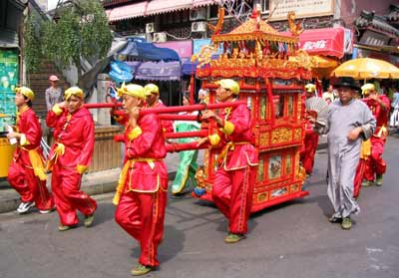
Marriage (Dù Xīnyǔ 杜心语)

Slide 6
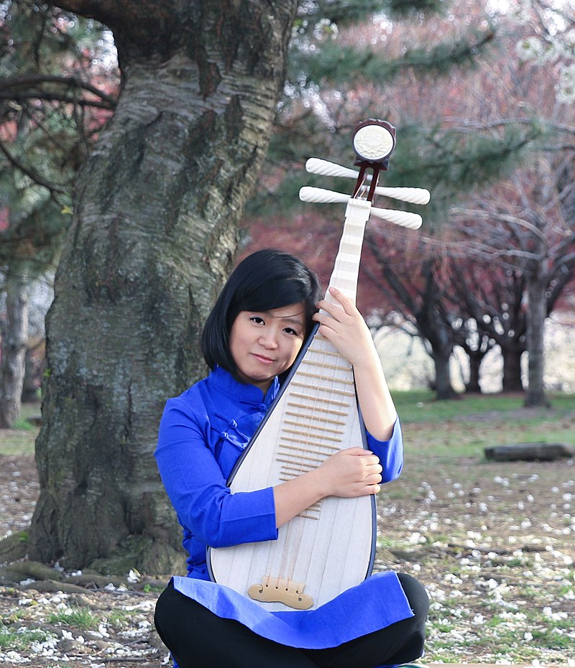
Pipa
(Liú Zhuōfán 刘卓凡)

Slide 7
Questions Concerning Section B.
The Art of Chinese Cooking
1. What differences are there between Chinese cuisine and Western cuisine?
2. What else is emphasized in Chinese cuisine besides the function of food satisfying the stomach?
3. What do you know about the choice of raw materials?
4. What do you know about the combination of main ingredients and auxiliary materials?
5. What do you know about the art of food cutting?
6. What do you know about the art of cooking Dongpo Braised Pork?

Slide 8
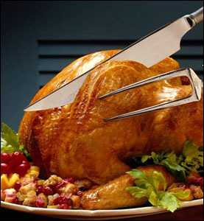
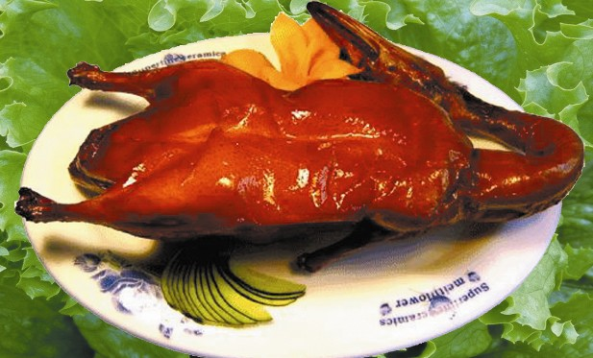
C. 2 Famous Dishes
Beijing Roast Duck

Slide 9
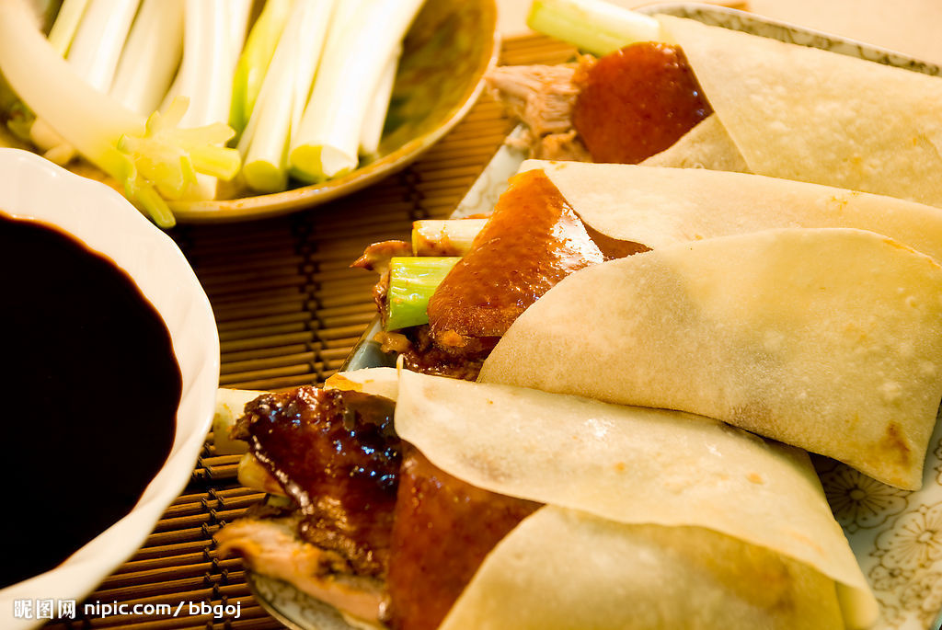
Beijing Roast Duck

Slide 10
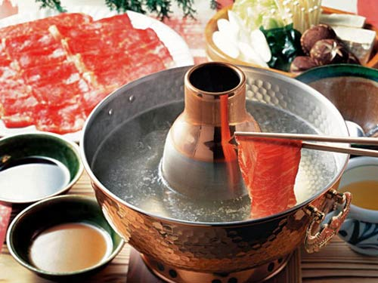
中国名菜之
羊肉火锅

Slide 11
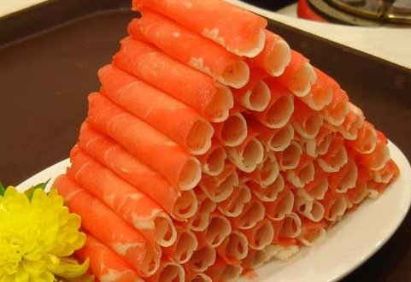
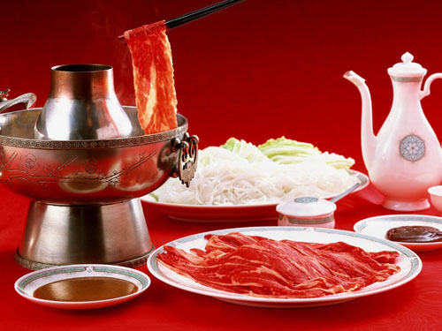
中国名菜之
涮羊肉

Slide 12
北京涮羊肉
据考证，我国南北朝时期已有火锅了，不过那时的火锅形状和质料并不像现在的铜质炭火锅，涮的肉也不像现在这样单一，有鸡、鱼、猪肉等。唐宋时的诗词中，不乏对火锅的吟诵。清代火锅已盛行，据载，嘉靖元年（1796），太上皇乾隆设的著名“千叟宴”，主菜就是涮羊肉。此宴用火锅多达1550多个，规模之大可以想见。第一家正式经营涮羊肉的店家，是开业于咸丰四年（1854）的前门外正阳楼。1914年，河北人丁德山开东来顺涮羊肉店。

Slide 13
乾隆做太上皇的第一年，为了庆祝国泰民安，在这个大殿里举行了一次别开生面的盛大宴会——“千叟宴”。这是清朝历史上规模最大、耗资最多、参加人数也最多的宴会。参加宴会的老叟有3000多人，故名。其实，清代一共举行过四次“千叟宴”，都是在康乾盛世时期，康熙和乾隆各有两次。这次宴会是在冬天举行的，天气很冷，而年岁最大的老人已经106岁了，乾隆怕把老人们冻坏了，不知吃什么好。这时，和绅提出吃火锅，又暖和又热闹。于是历史上最后一次“千叟宴”吃的就是火锅，这些老人们一边饮酒一边作诗，场面非常壮观。

Slide 14
Session 5 第五周
Quizzes
Aesthetic ideals and social customs: Chinese Marriage Customs Presentation on Marriage Customs by 杜心语
Music and instruments: Pipa Presentation on Music and instruments: Pipa by 刘卓凡
Traditional Cuisine: The Art of Chinese Cooking Presentation on the Art of Chinese Cooking by 戴沐雨

Slide 15
Always here for you!
随时为你们服务
Professor Dr. Martin Woesler
吴漠汀
湖南师范大学特聘教授，博士导师
Office / 办公室: 外国语学院406
国际汉学中心308
Phone / 电话: (150) 1138 8818
(德国+49 178 2073538)
Email / 电子邮件: wmt@hunnu.edu.cn

Slide 16
Thank You

