Slide 1
Chinese Cultures
Chinese Traditional Dance
Peng Jiayu
2021.5.26

Slide 2
Contents
A brief introduction
Characteristics of the dance
The best-known types

Slide 3
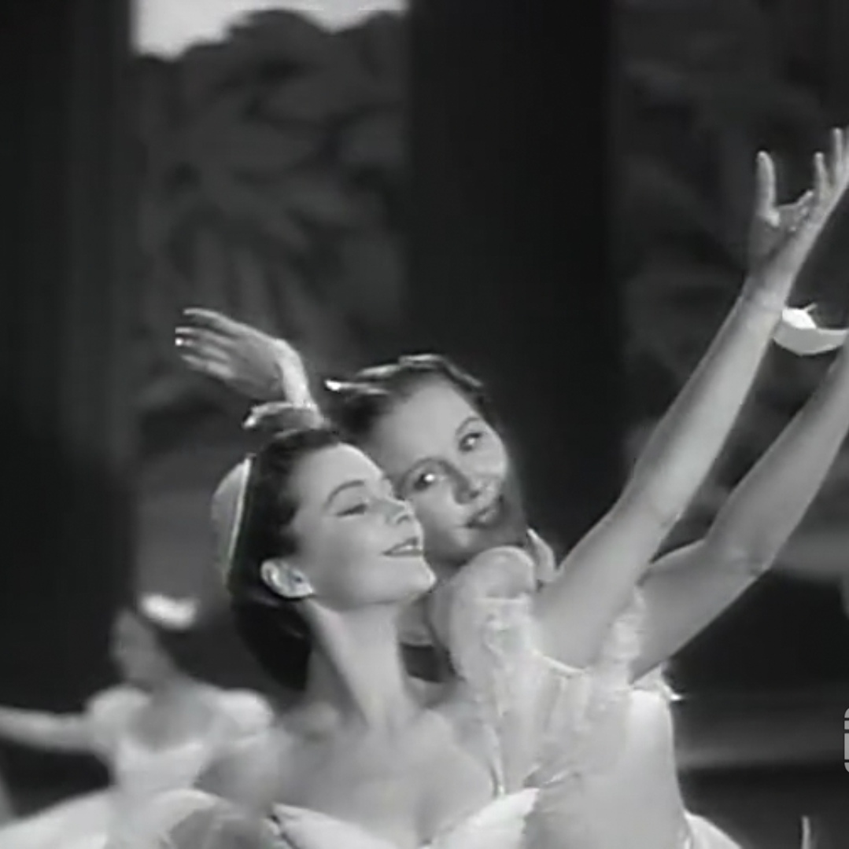
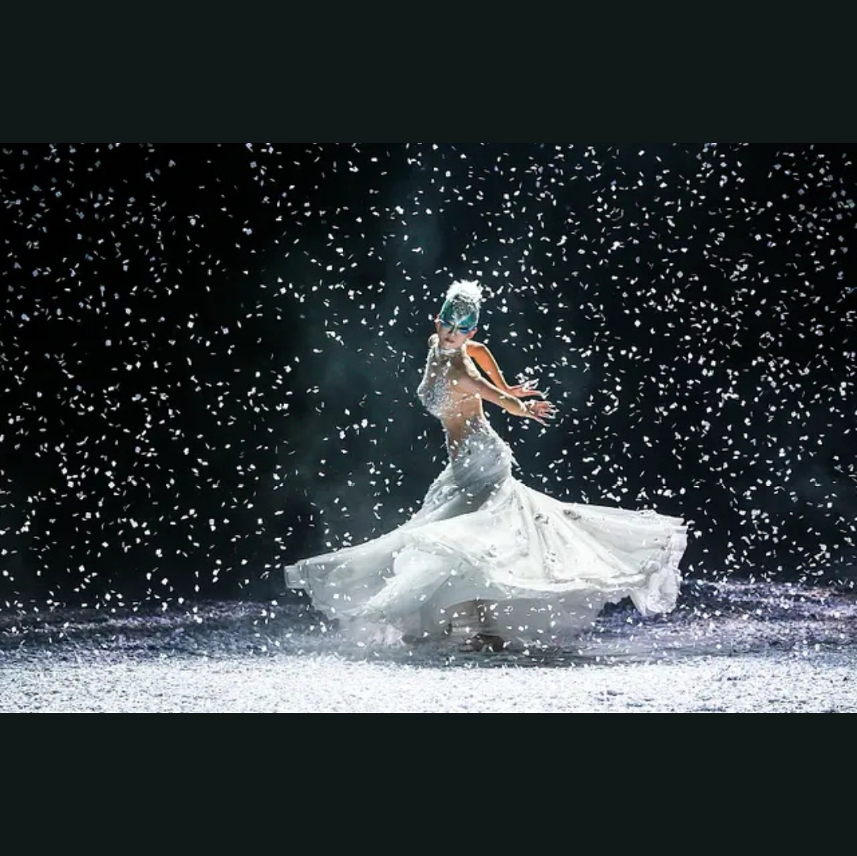
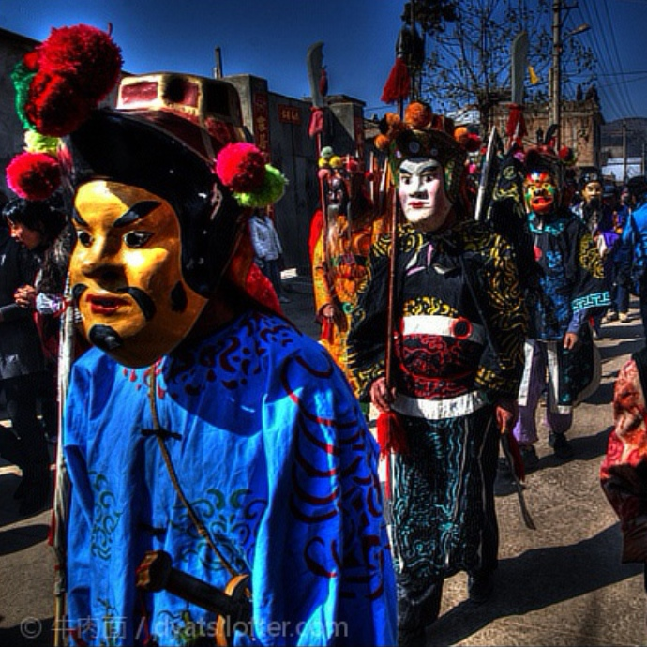
A brief introduction
There is a long recorded history in China for various kinds of dances. China is highly took position for art consisting for many modern and traditional dance genres. The dance covers a worldwide range, like folk dances, rituals and ballet.
We also know about that, there are also 56 officially recognized ethnic groups have their own folk dances and style of forms. The best known Chinese are the Dragon dance and Lion dances, and both dances were known in earlier dynasties in various forms.

Slide 4
Characteristics of the dance
There have 3 characteristic of the movements are: thrashing, quivering and lowering. The performer holds bamboo pole to play various dance movements by striking shoulders, chest, waist, abdomen, buttocks, feet and acupuncture points of the four limbs, and slightly swaying knees together with shoulder vibration.
The traditional movements are modified and developed which is called single-thrashing and double-thrashing. Single-thrashing movements including crouch thrashing, jump thrashing, rolling thrashing and mixed thrashing with one bamboo pole.

Slide 5
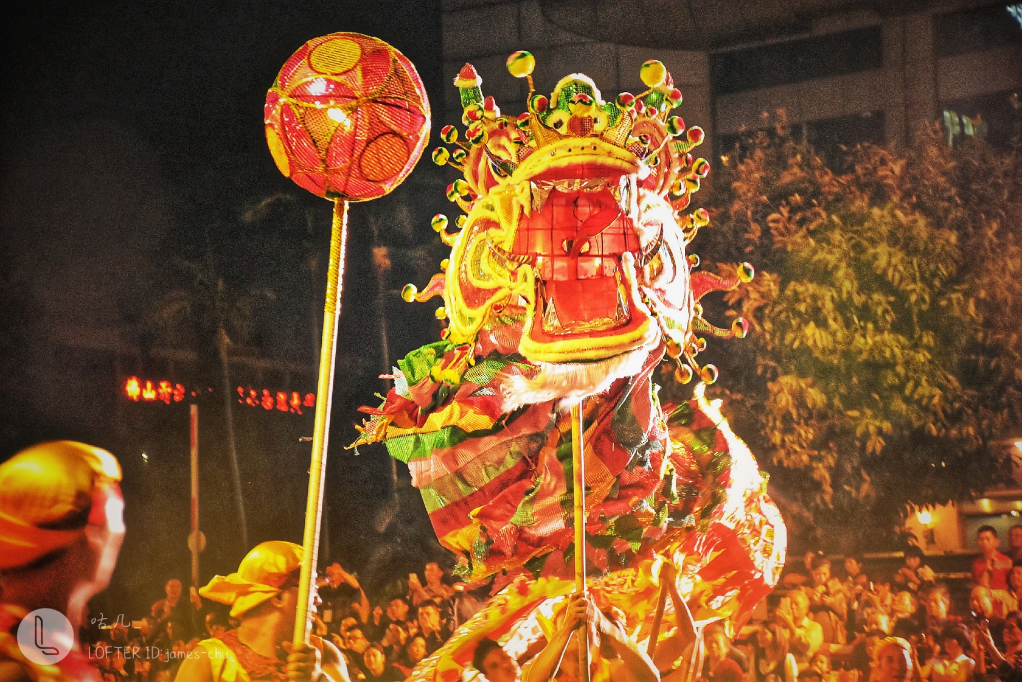
The best-known types
The Dragon Dance
The Dragon dance is a form of traditional dance and performance in Chinese culture.
Like the lion dance it is most often seen in festive celebrations. Many Chinese people often use the term "Descendants of the Dragon" as a sign of ethnic identity, as part of a trend started in the 1970s. Chinese people who taught them agriculture, law and medicine, the foundations of civilization.

Slide 6
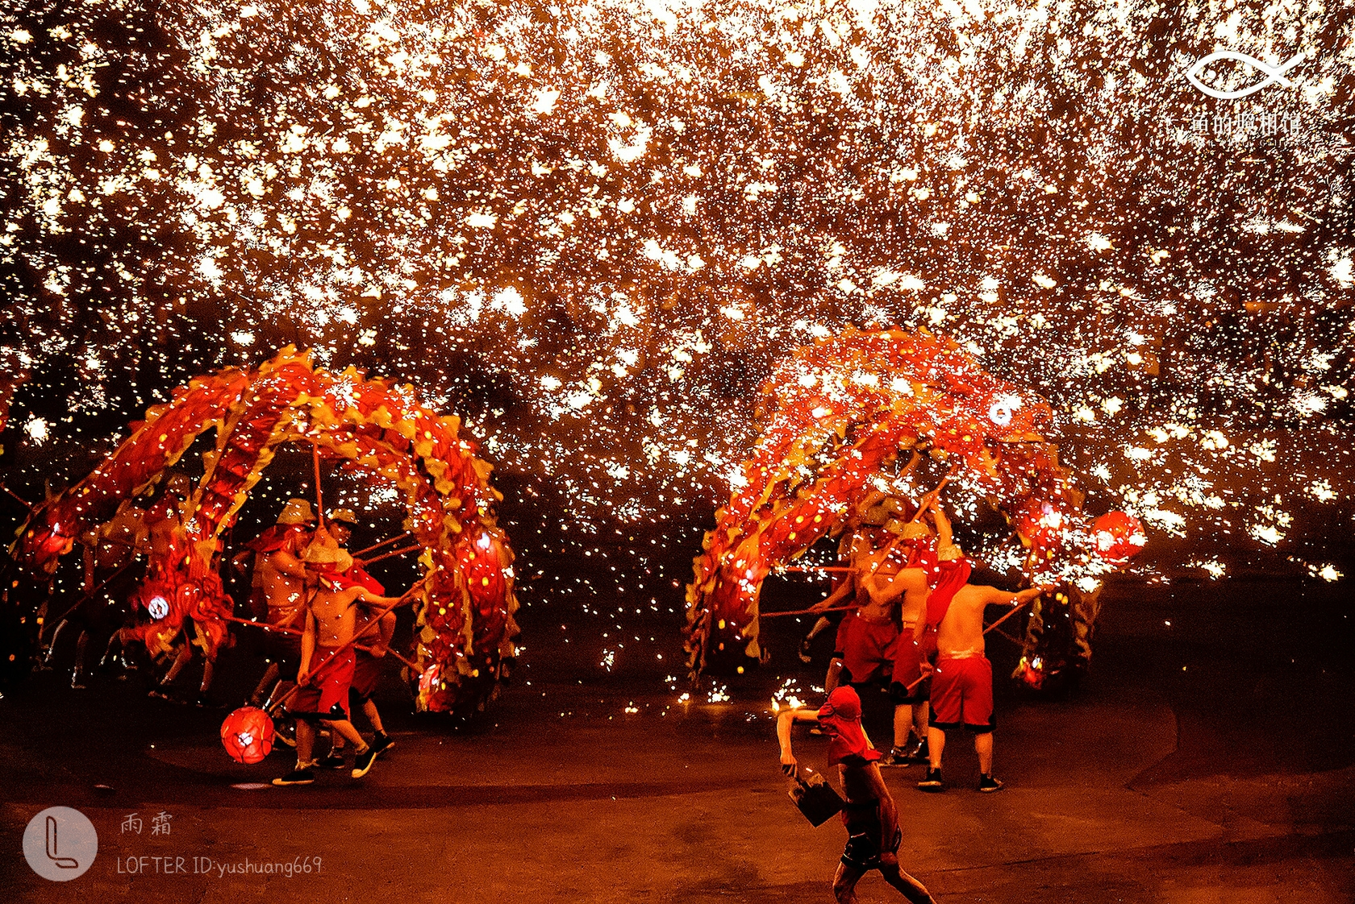
The best-known types
The Dragon Dance
The Dragon Dance originated during the Han Dynasty and was started by the Chinese who had shown great belief and respect towards the dragon. It is believed to have begun as part of the farming and harvest culture, also with origins as a method of healing and preventing sickness. It was also a popular event during the Song Dynasty and become a folk activity and like the lion dance, was most often seen in festive celebrations.

Slide 7
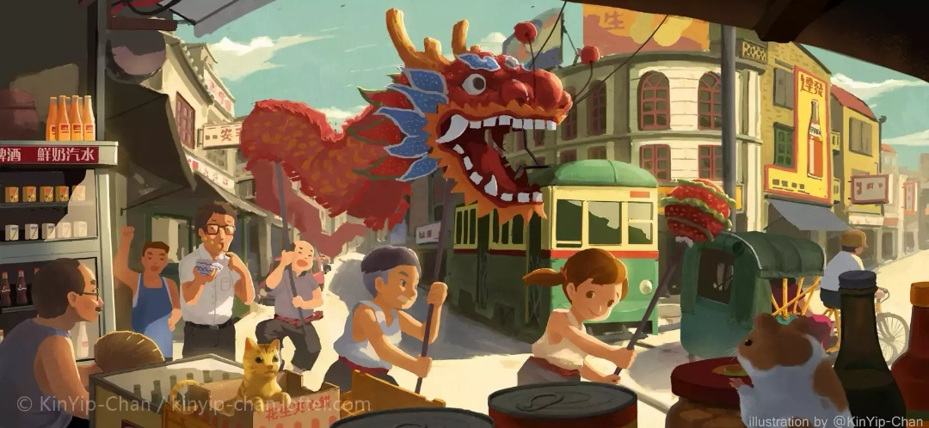
The best-known types
The Dragon Dance

Slide 8
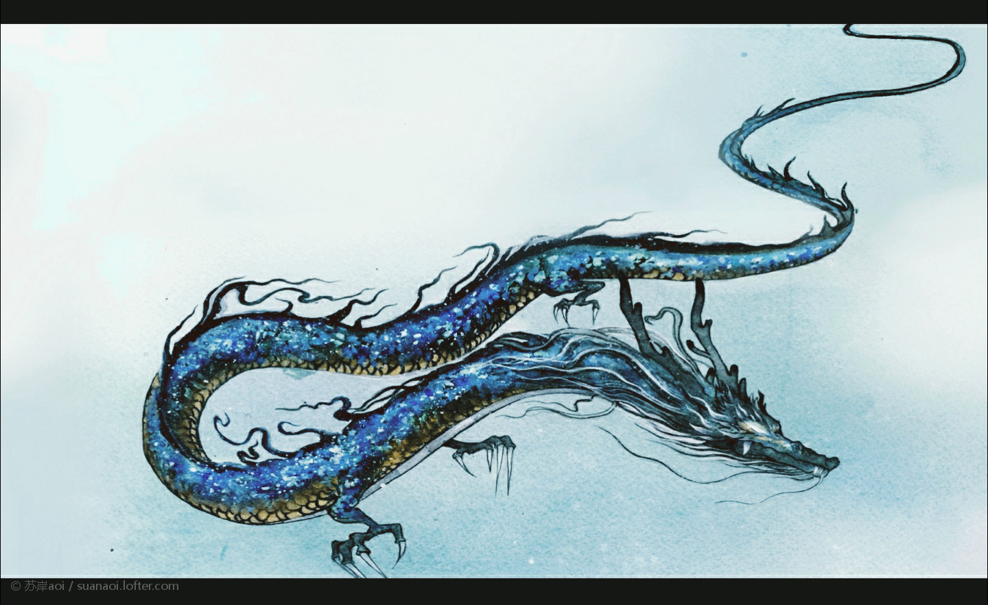
The best-known types
Loong? Dragon?
Dragons are believed to bring good luck to Chinese people, which are reflected in their qualities that include great power, dignity, fertility and wisdom. The appearance of a dragon is also bold.
As the dragon gives people a feeling of great respect, it is often called the Sacred Dragon. The emperors of ancient China considered themselves as the dragon. The Dragon is also the emblem of Imperial Authority. It symbolizes supernatural power, goodness, fertility, vigilance and dignity.

Slide 9
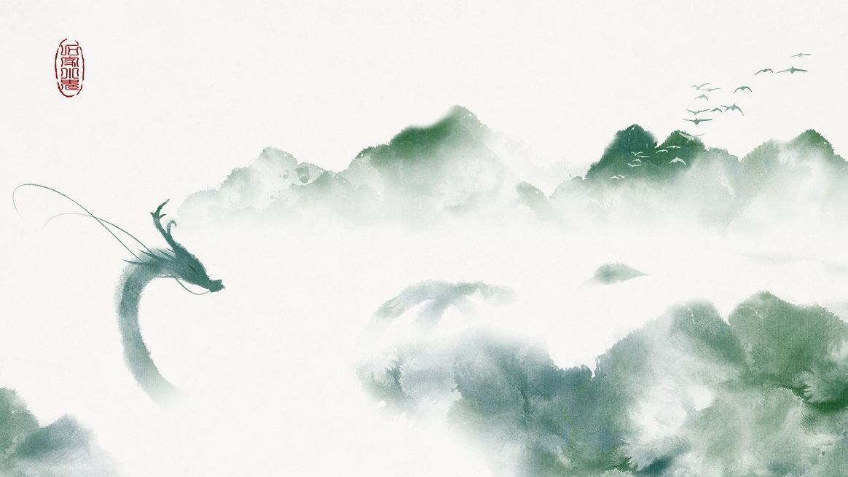
The best-known types
Loong? Dragon?
Loong
Worshipful
Glorious
Brave
Graceful
……

Slide 10
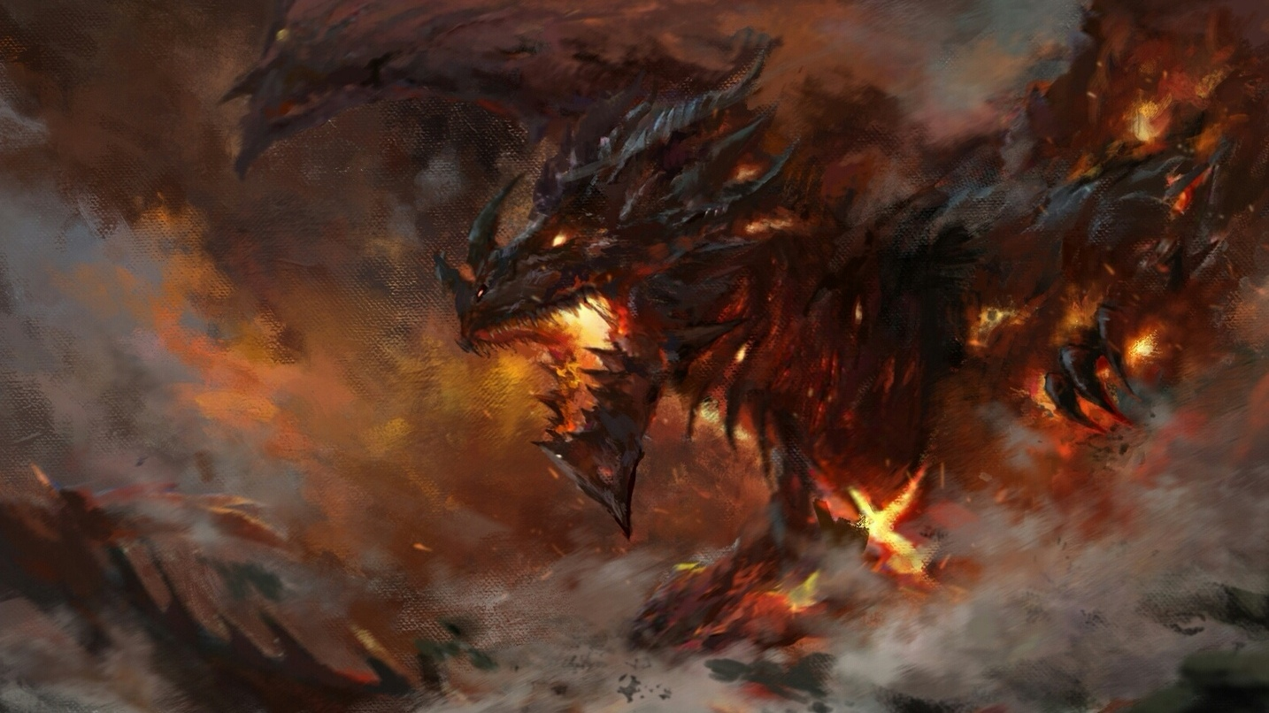
The best-known types
Loong? Dragon?
Dragon
Evil
Hateful
Awful
Frightening
……

Slide 11
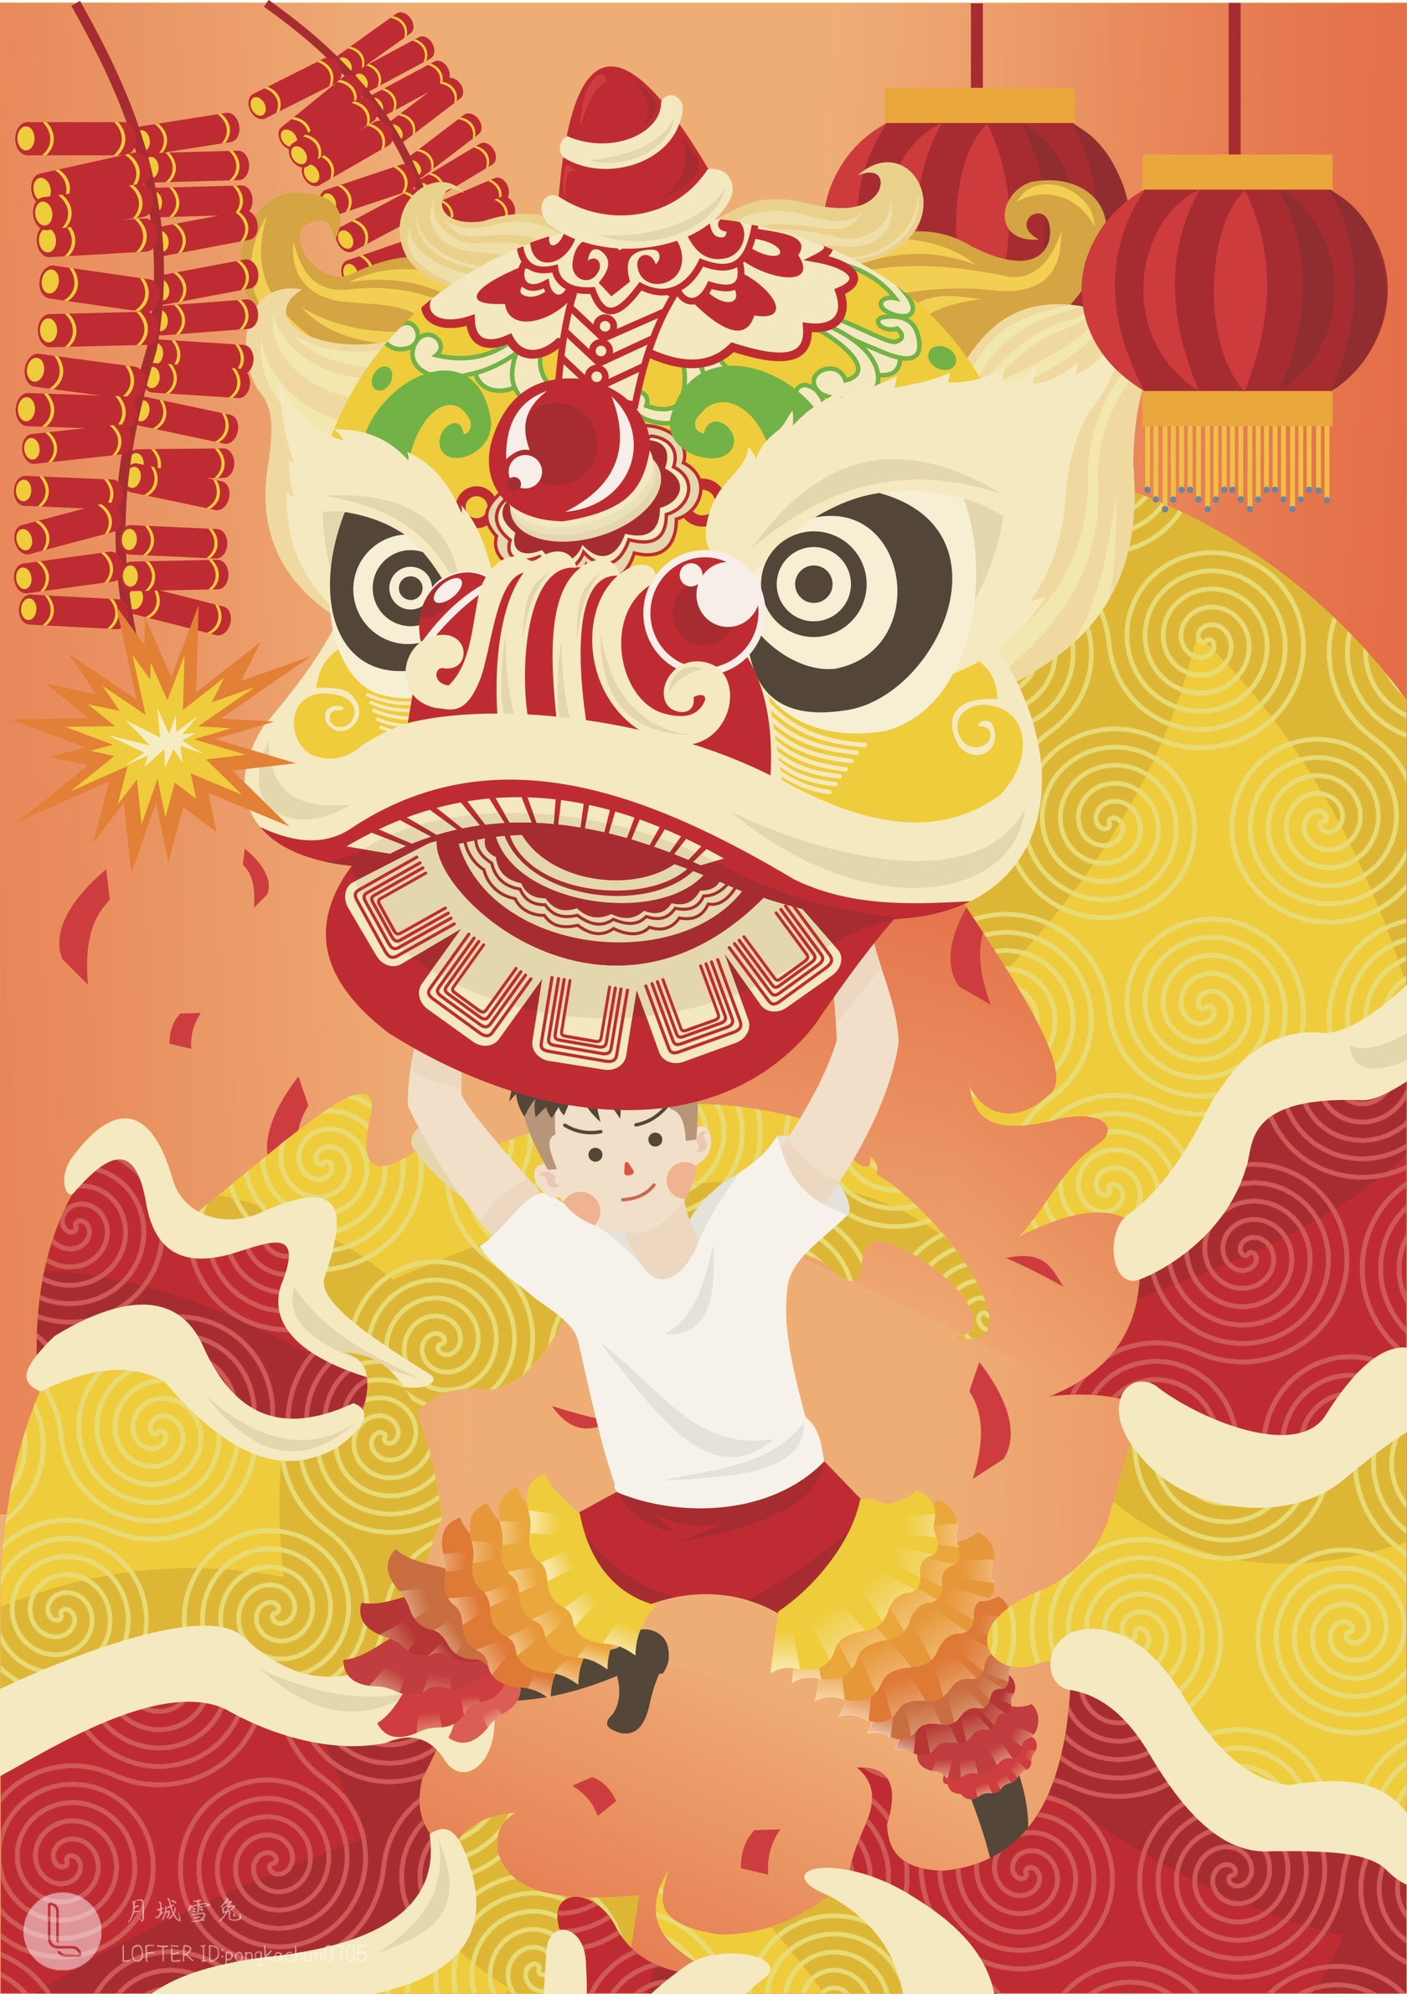
The best-known types
The Lion Dance
The lion dance is a traditional Chinese dance performed on big occasions, such as the Spring Festival (Chinese New Year) for good luck, as it is believed that the lion is an auspicious animal.
In Chinese culture, the lion symbolizes power, wisdom, and superiority. People perform lion dances at Chinese festivals or big occasions to bring good fortune and chase away evil spirits. The lion dance is one of the most important traditions during Chinese New Year. It is performed to bring prosperity and good luck for the upcoming year. The lion dance is also a way to create a festive atmosphere and bring happiness.

Slide 12
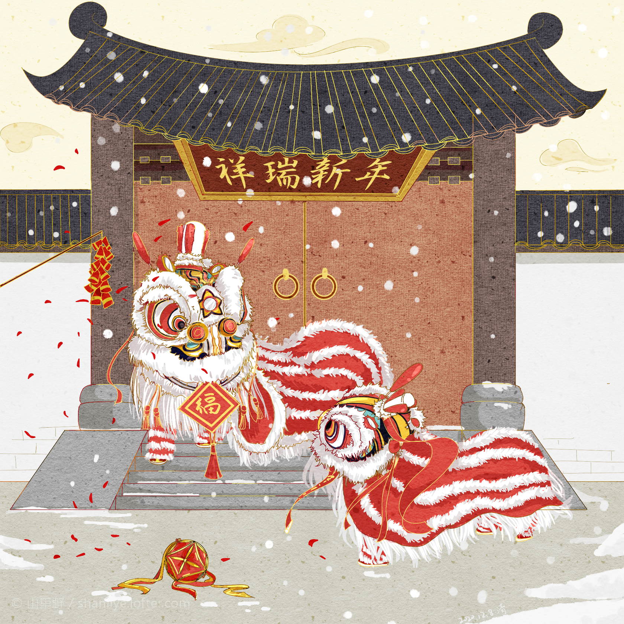
The best-known types
The Lion Dance
Performed in a lion costume, accompanied by the music of beating drums, clashing cymbals, and resounding gongs, lion dances imitate a lion's various movements or demonstrate martial arts, depending on the style. Though lion dances all use similar costumes, during its long development, the lion dance has divided into two styles: southern and northern.
The southern lion dance originated in Guangdong, and it is the style popular in Hong Kong, Macau, and the hometowns of overseas Chinese.
The northern lion dance has close relations to kung fu. A young lion is performed by a single person and an adult lion is performed by a duo.

Slide 13
THANKS.
2021.5.26

