Slide 1
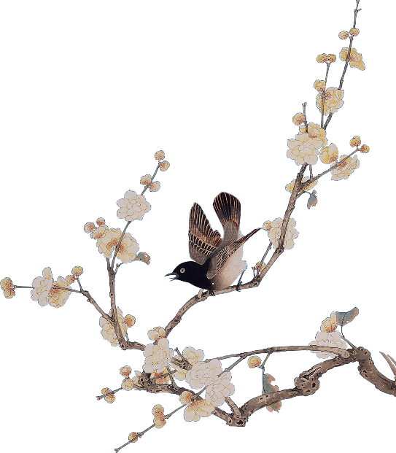
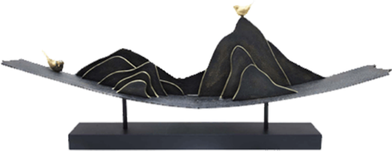
Games:
Kite Flying
Han Jingru

Slide 2
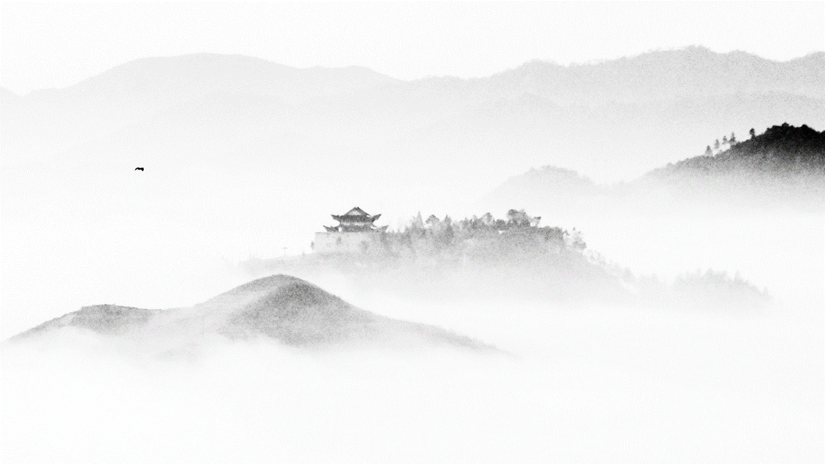
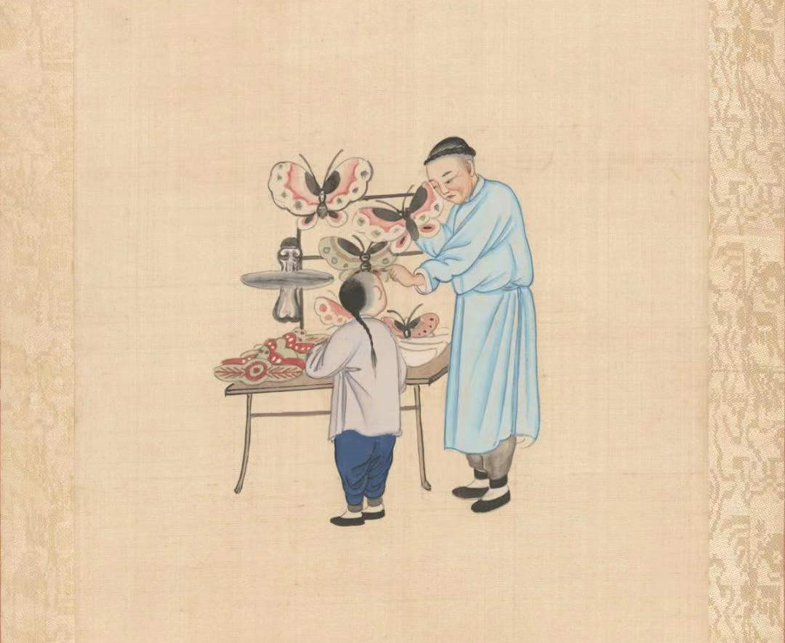
Kite flying has a long history in China, and it has been a long-standing sport to this day. As a traditional national sport, kite flying is deeply imprinted with Chinese culture, fully expressing people’s beautiful aspirations and fitness interests, and rich in national characteristics and local flavor. As a kind of folklore, kite flying is a kind of game and recreational activity for the purpose of leisure and physical and mental conditioning, so that people can rest after their work and benefit their physical fitness, mental and emotional, creativity and moral sense.
Kite Flying

Slide 3
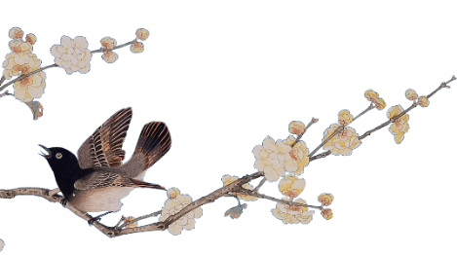
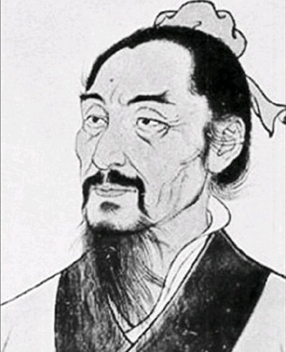
The Origin and Development of the Kite
According to some researches, the earliest kites in China were made of wood. During the Spring and Autumn and Warring States period, Mo Zhai (478-392 B.C.), the founder of the mohism, took three years to make a bird out of wood and flew it into the sky for one day before it landed. This “wooden kite” made by Mozi is said to be the earliest kite in China and the earliest kite in the world, with a history of more than 2000 years.
Invented by Mozi

Slide 4
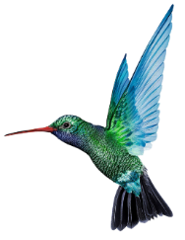
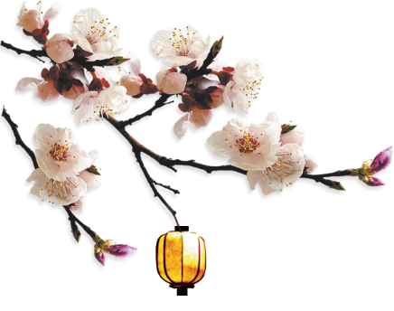
Originated from War
Kites originated in the late Han Dynasty. This view is based on the legend that Han Xin made kites in history. In the description of the kite in the eighth volume of Gao Cheng's The Chronicle of Things, Han Xin used kite to measure the length of a field in a war. In addition, according to Studio Miscellaneous Records, Han Xin made various kites out of cowhide and had musicians sit on them to fly over the Chu army and play Chu songs to try to make them miss their hometown and not be interested in fighting.

Slide 5
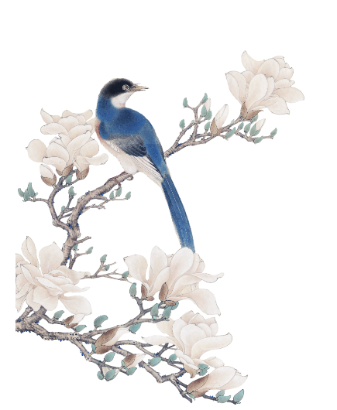
Originated from entertainment
In ancient times, people first flew kites to let go of bad luck and it was an outdoor activity with witchcraft meaning, and it was not for entertaining. Once the game was a cultural necessity to regulate social life, it was born with an entertainment meaning. Entertainment is one of the prerequisites for the emergence of kite flying. Kite flying not only adds interest to people’s life, but also makes people’s educational activities effective and enhanced in a pleasant situation. In the biography of Li Ye in the Records of the Five Dynasties, there is a record of the history of the Emperor and other people guessing riddles and flying kites in the palace. In addition, Li Ye made a paper kite game in the palace and made a flute out of bamboo and tied it to the head of the paper kite. When it flew in the air, with the wind springing up, it sounded like that someone is playing Chinese zither, thus the name “kite” was given.

Slide 6
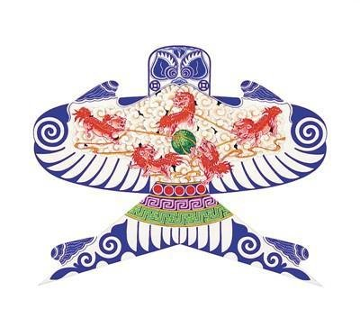
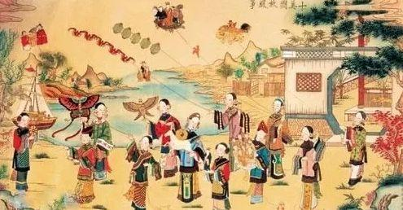
The Use and Production of Kites
tying
gluing
painting
flying
military tools to spread messages and measure the wind;
spy;
enterainment;
physical exercise…

Slide 7
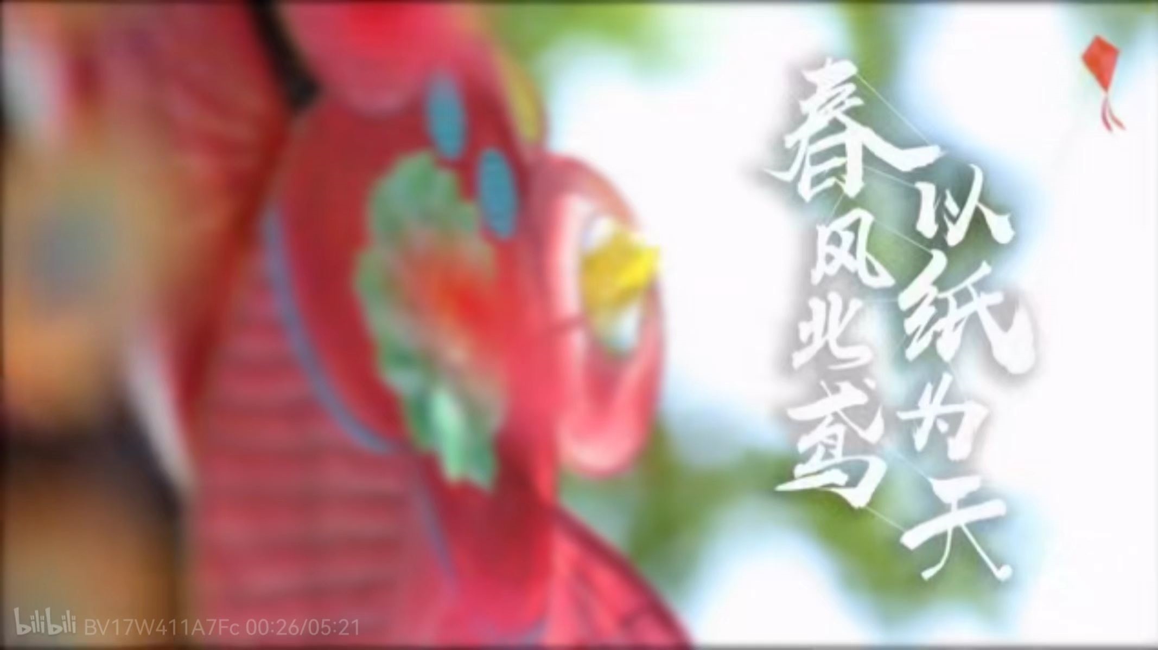
【你所不知道的风筝四艺，这位北京大爷给你细细解读-哔哩哔哩】 https://b23.tv/gXjXgSD

Slide 8
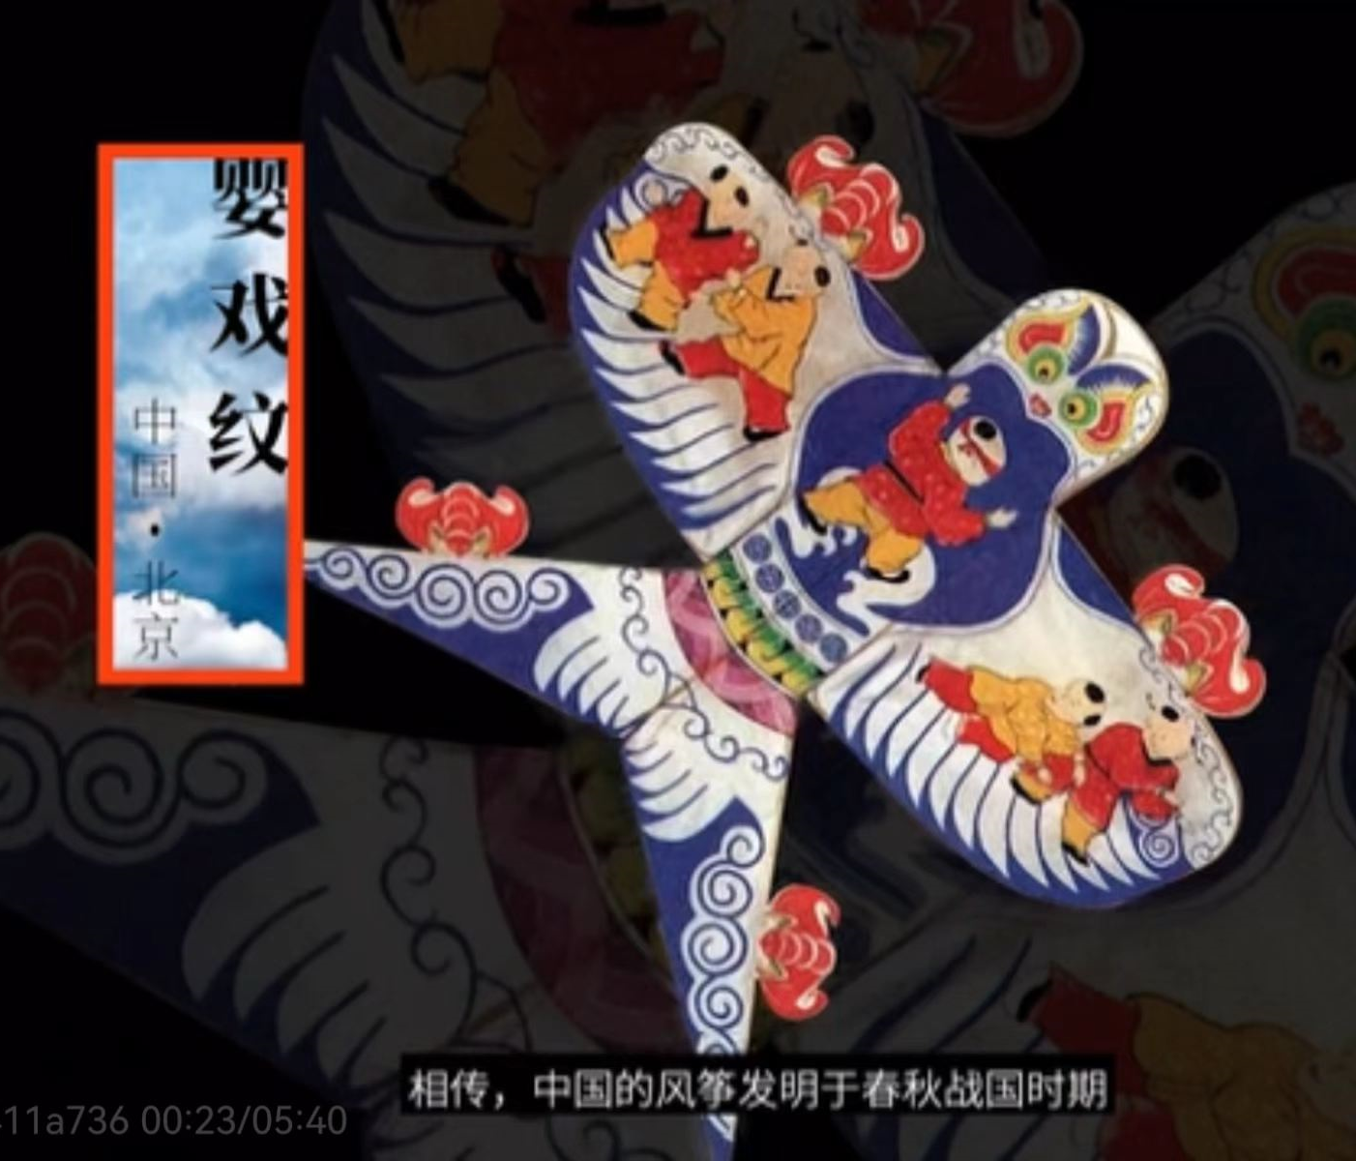
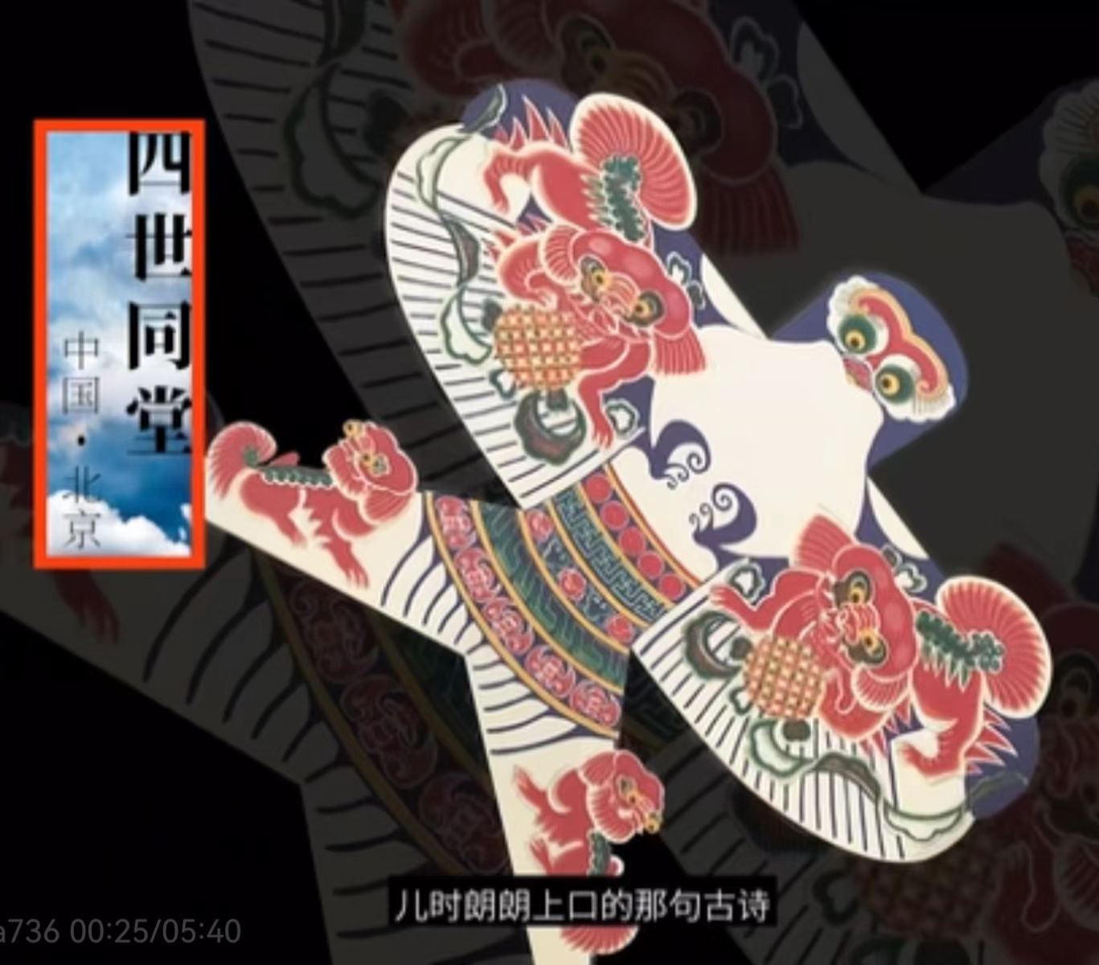
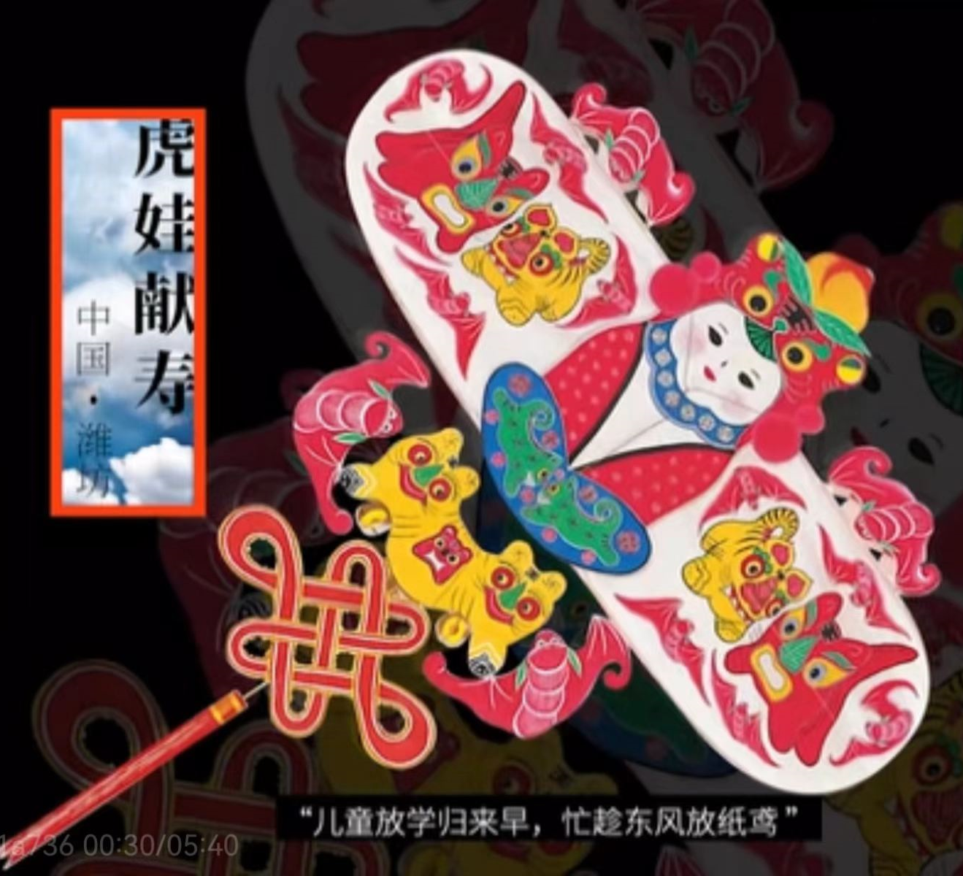
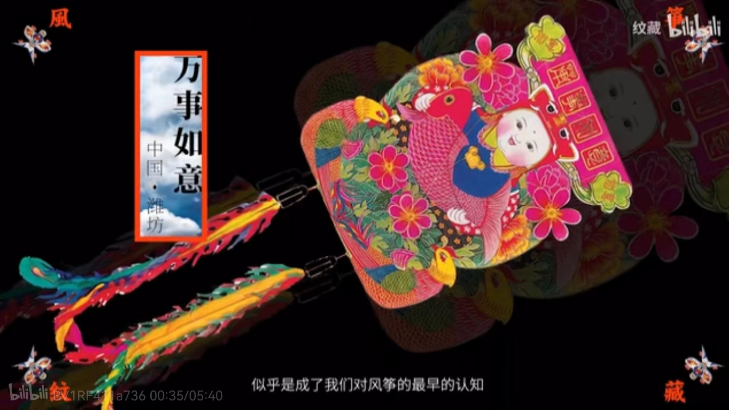
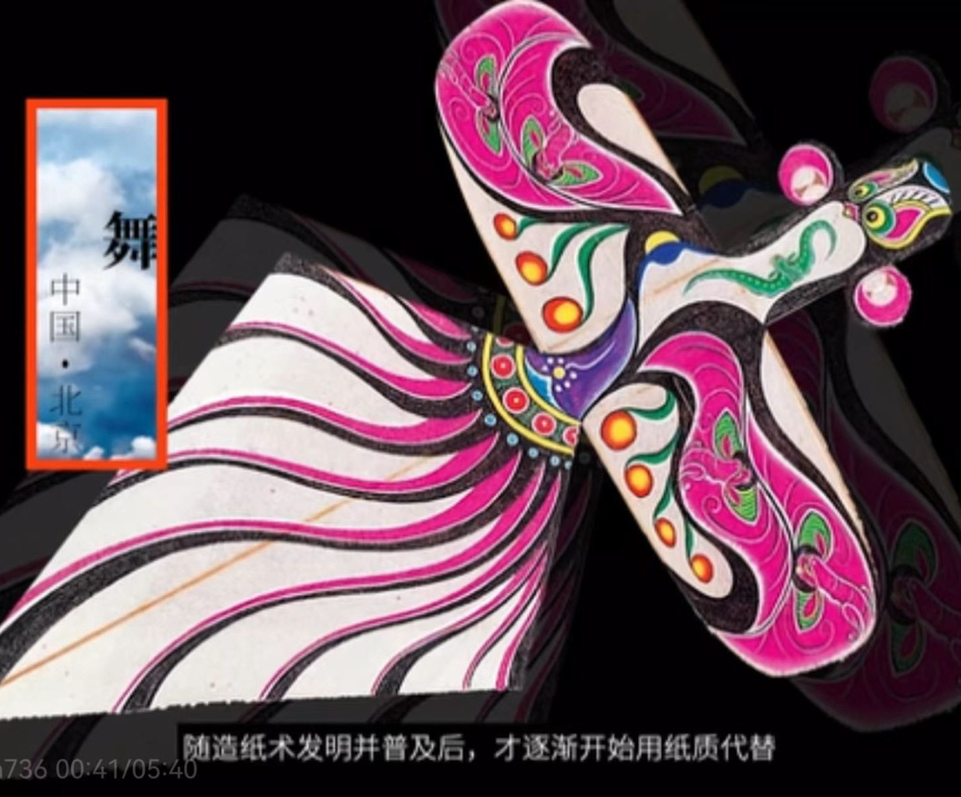
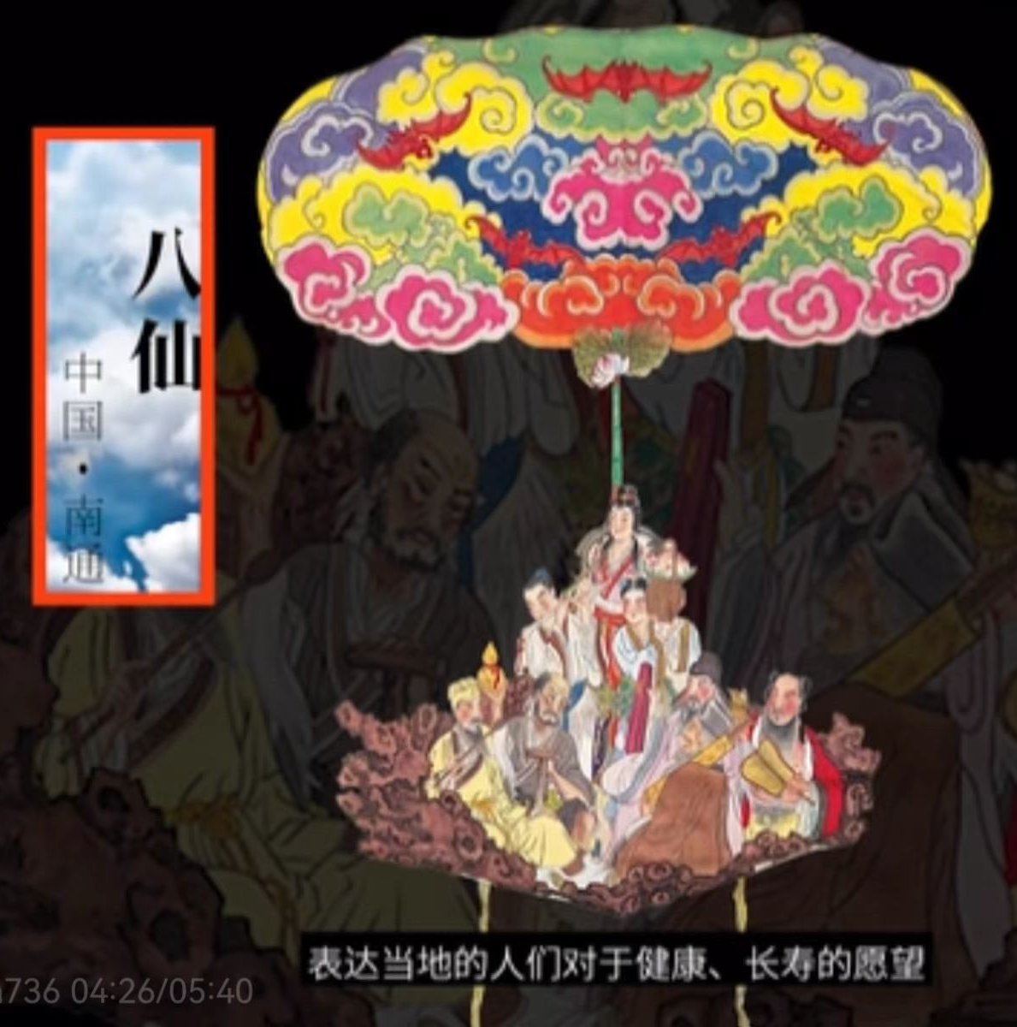
The Traditional Decoration of Kite

Slide 9
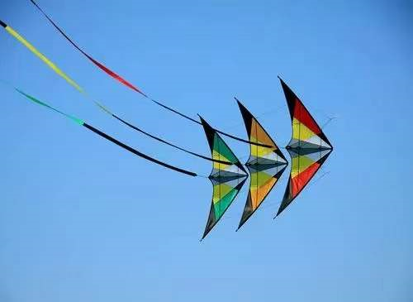
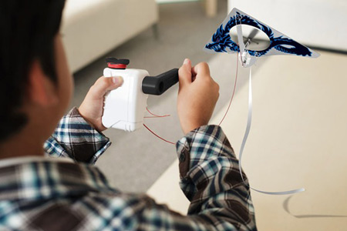
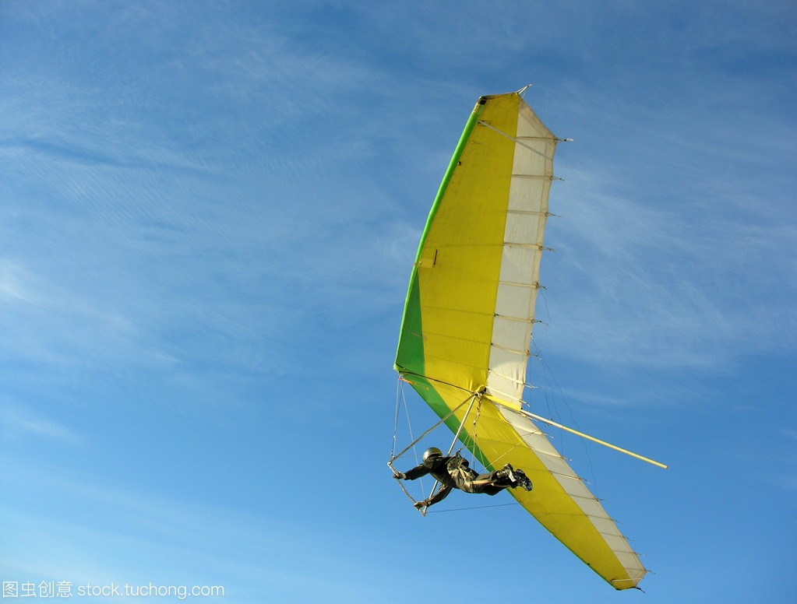
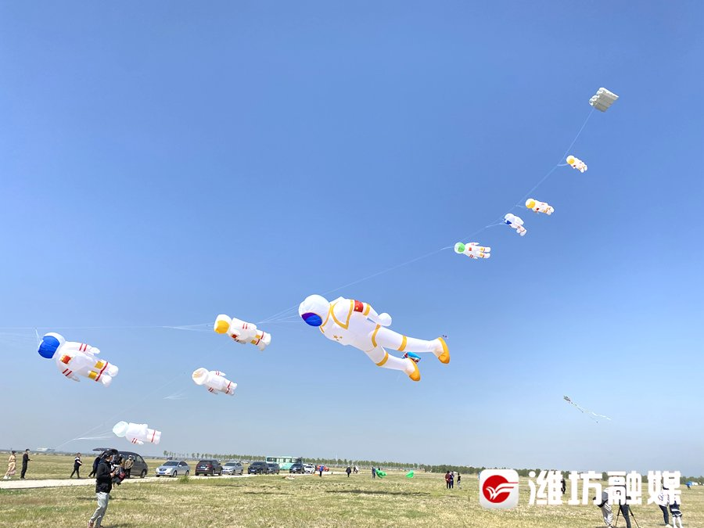
The Types of Kite
The
Fighter kite
The
Indoor Kite
The
Man-lifting Kite
The
Inflatable Single-line Kite

Slide 10
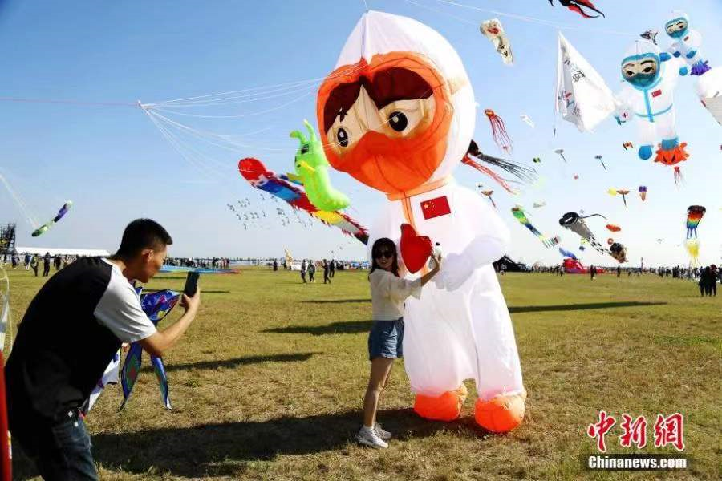
Weifang Internatinal Kite Festival
The Weifang International Kite Festival is an annual kite-flying festival held from April 20 to 25 in Weifang, Shandong, China.
Weifang is known as the kite capital of the world as people consider Weifang to be the birthplace of kites.
On April 1, 1984, with the help and support of the Chairman of the Seattle Kite Association, the first International Kite Festival was held in Weifang.
【潍坊，腾飞的风筝之都-哔哩哔哩】 https://b23.tv/0rq03wa

Slide 11
Games:
Kite Flying
Han Jingru

