Slide 1

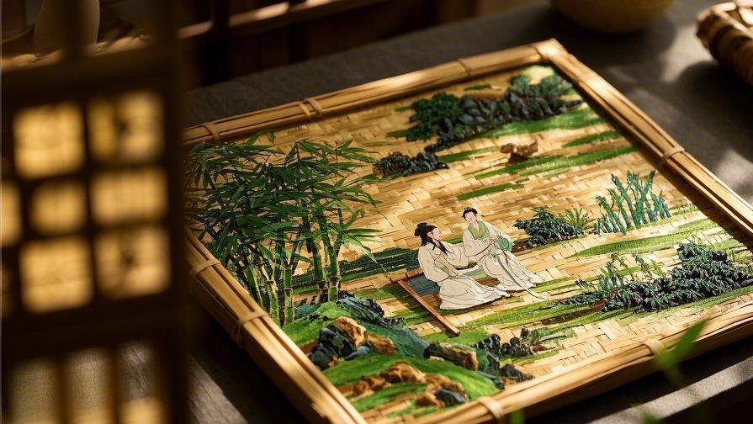


竹编
Bamboo Weaving
横竖交错的自然之美，
指尖上的优雅神技

Slide 2
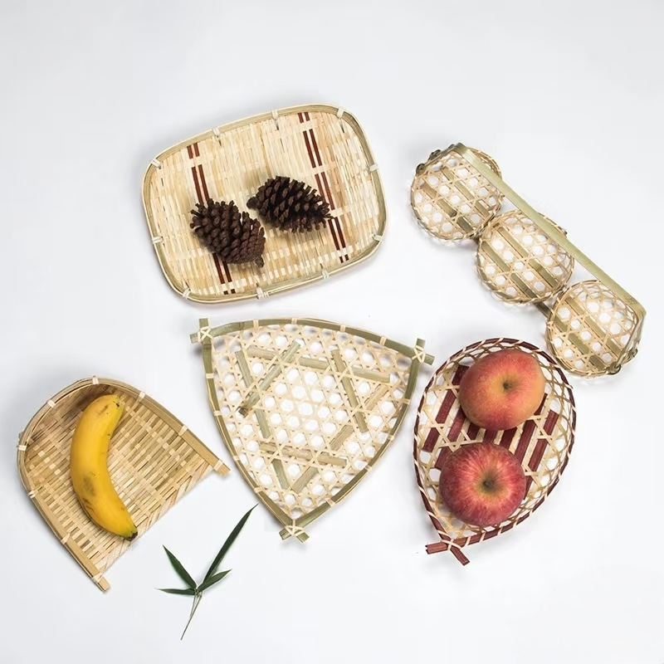
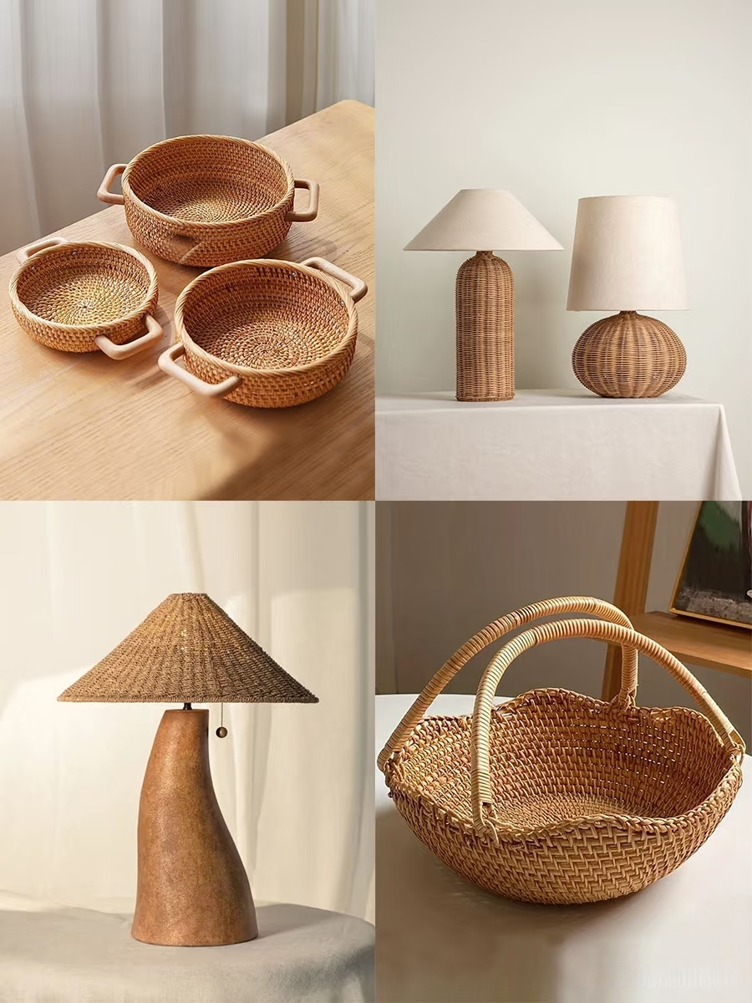
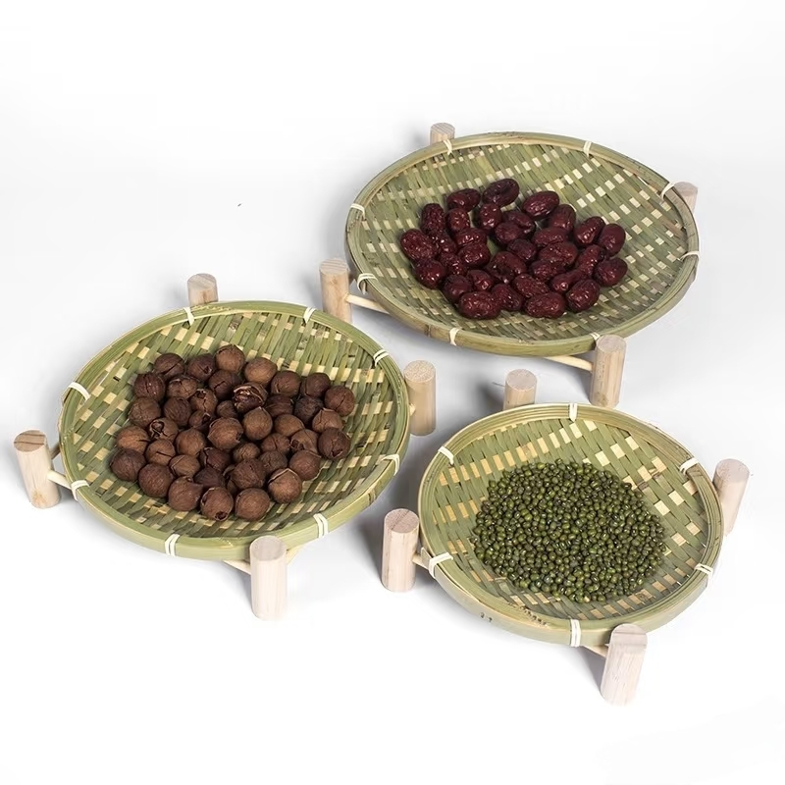

Slide 3
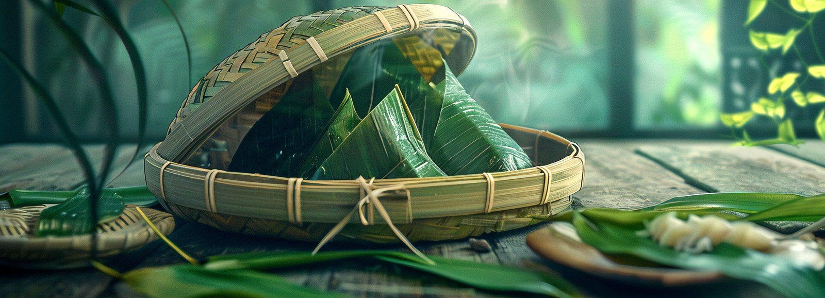
Brief Introduction
Bamboo weaving is a craft using bamboo as raw material and is created through techniques such as weaving and knotting. It was listed as a Chinese Intangible Cultural Heritage in 2008. The bamboo weaving process primarily involves steps like slicing, scraping, polishing, and splitting bamboo into strips of varying thicknesses. These strips are then woven into various household items, utensils, and tools.

Slide 4
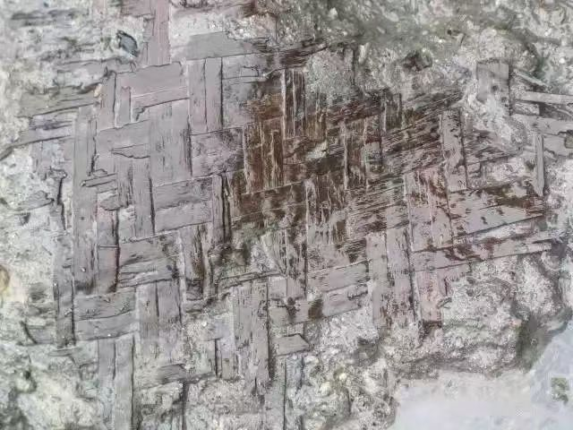
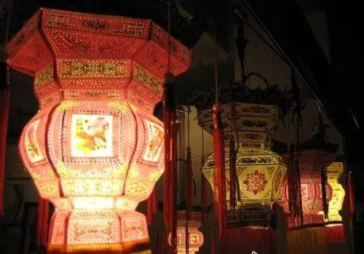
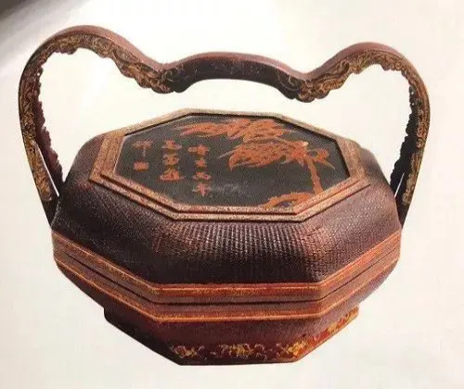
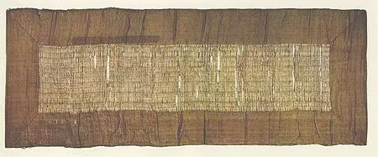
Origin and Development
Neolithic Age
Tang and Song dynasties
Ming and Qing dynasties
Qin and Han dynasties

Slide 5
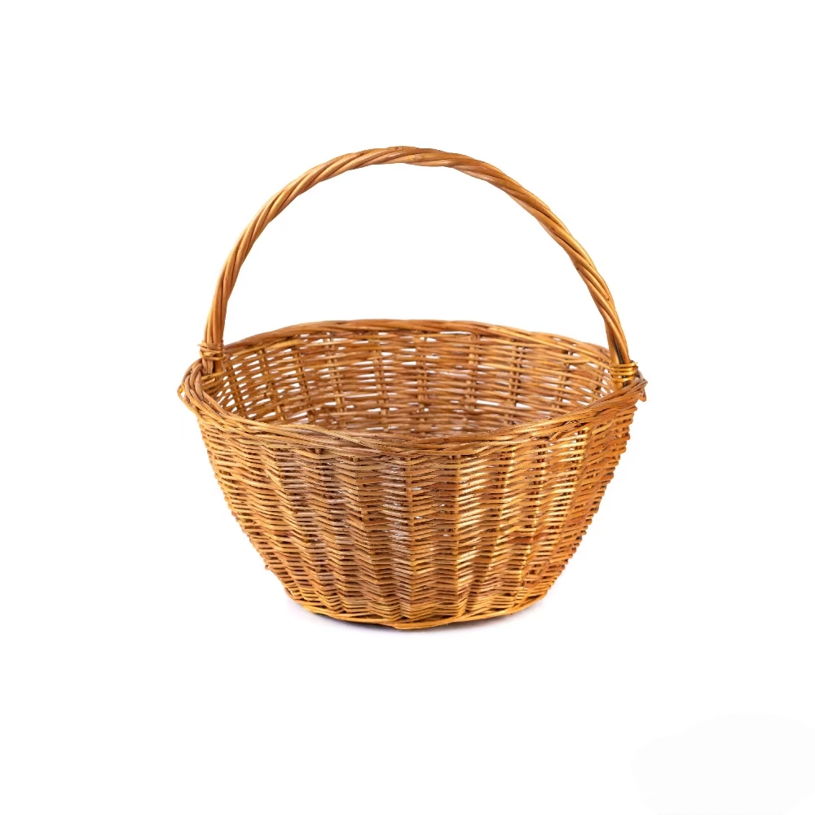
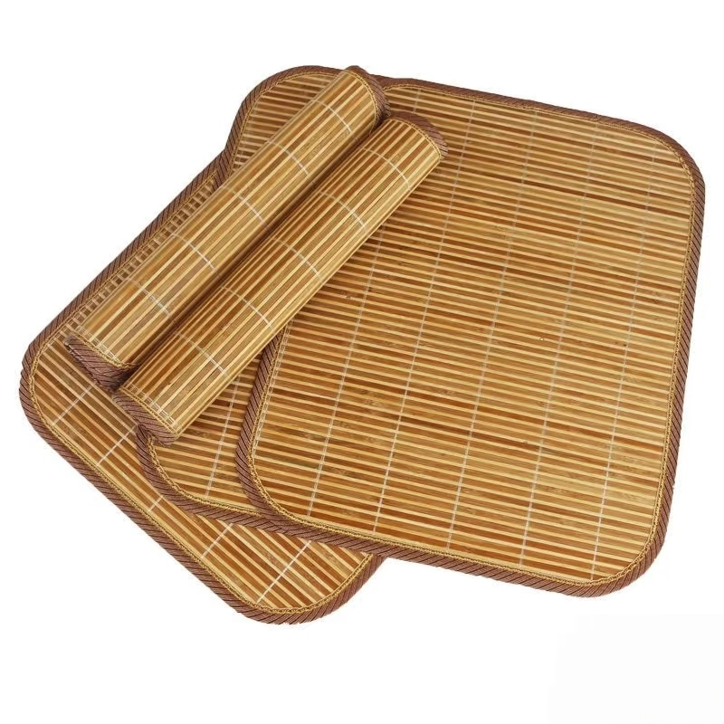
Classification: Coarse Weaving
Coarse bamboo weaving techniques are primarily found in southern China. Commonly crafted items include bamboo mats, cooling pillows, baskets, hampers, and cradles. These pieces are highly functional and typically serve as everyday household items.

Slide 6
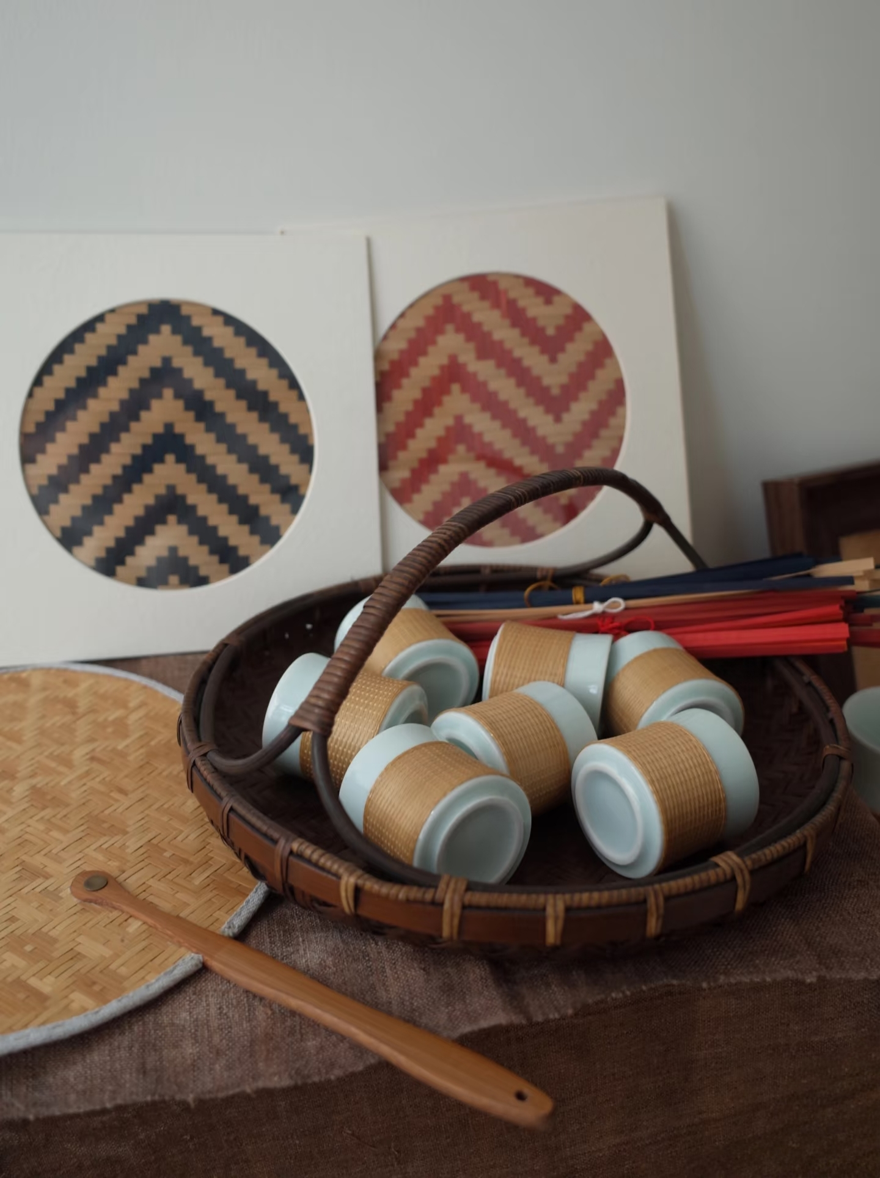
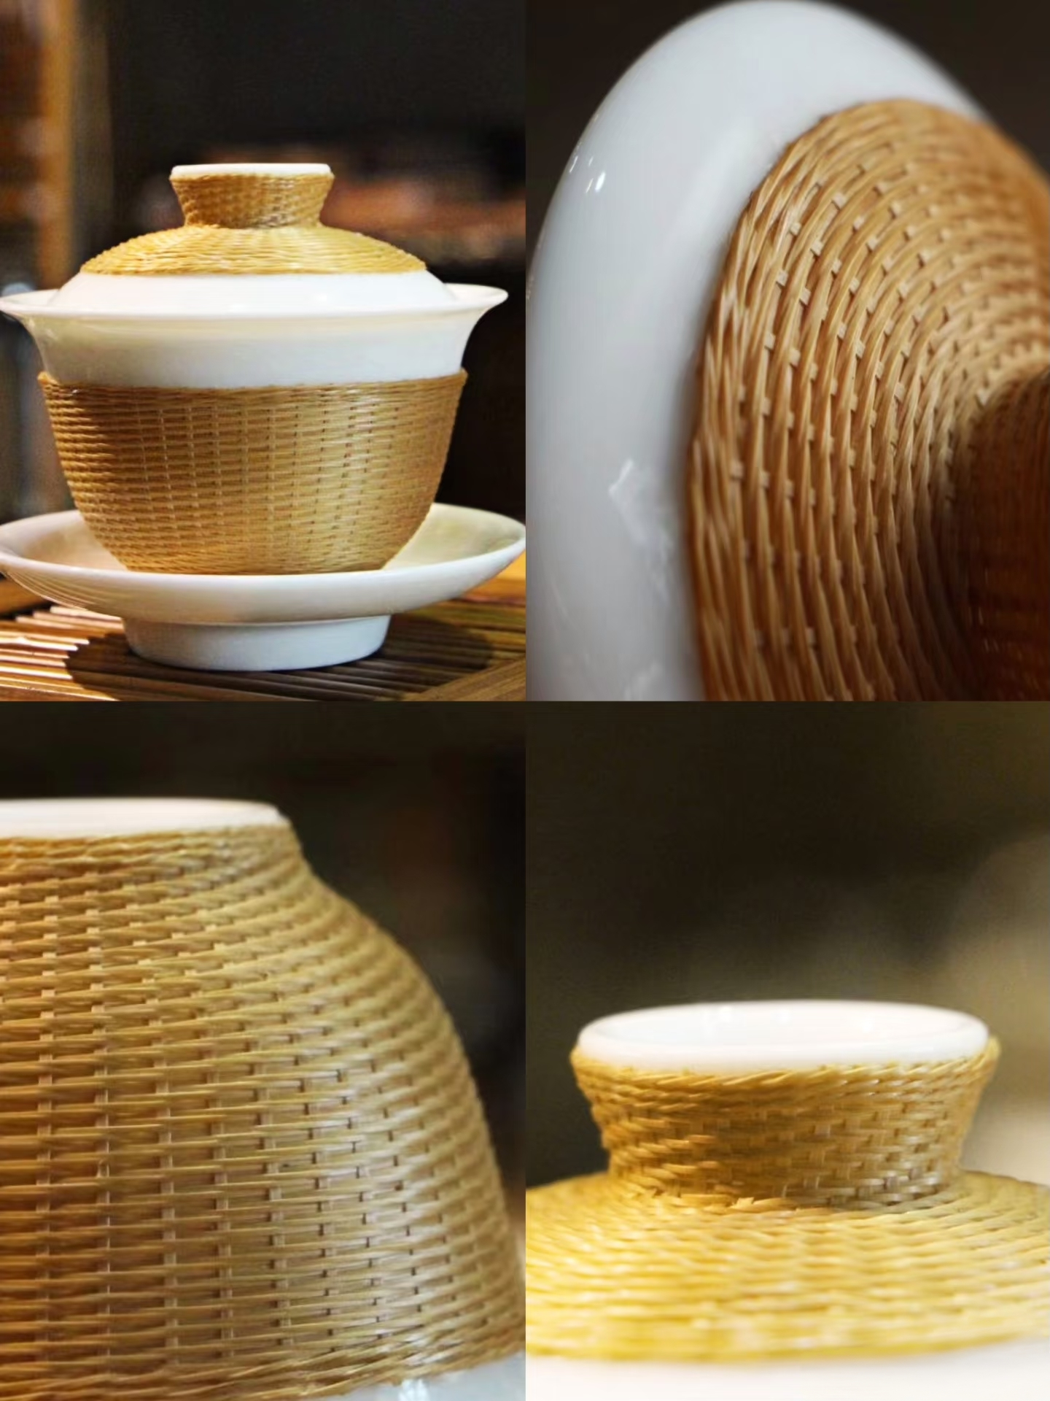
Classification: Filament Weaving
Bamboo filament weaving, also known as porcelain-core bamboo weaving, excels in its precision. Each bamboo filament must meet strict thickness requirements, ensuring uniform thickness throughout.

Slide 7
Production Process
1、Selecting Bamboo
2、Green Scraping
Strictly selecting 2 to 3-year-old mature bamboo, as fully grown bamboo is harder and more resilient, ensuring woven bamboo items resist mold, insect damage, and cracking.
Scraping off the outer green layer of the bamboo results in a more uniform color tone and enhanced durability in the final piece.
3、Splitting Bamboo
4、Air-dry
Using a bamboo splitter to divide the scraped bamboo into appropriate sections according to the bamboo's thickness.
Drying the sorted bamboo in the sun for 10 to 15 days to remove moisture and prevent mold growth and cracking.

Slide 8
竹编的制作过程
5、Charcoal Grilling
6、Remove Excess Section
Removing any excess bamboo sections and further sort the material. Discard any damaged raw bamboo that cannot be used, ensuring the final woven piece feels more natural and looks more aesthetically pleasing.
7、Slicing and Scraping
After sun-drying and charcoal-grilling the bamboo, remove the top layer and slice it into thin strips. Remove any remaining excess bamboo pith to enhance flexibility.
8、Extracting Fibers

Slide 9
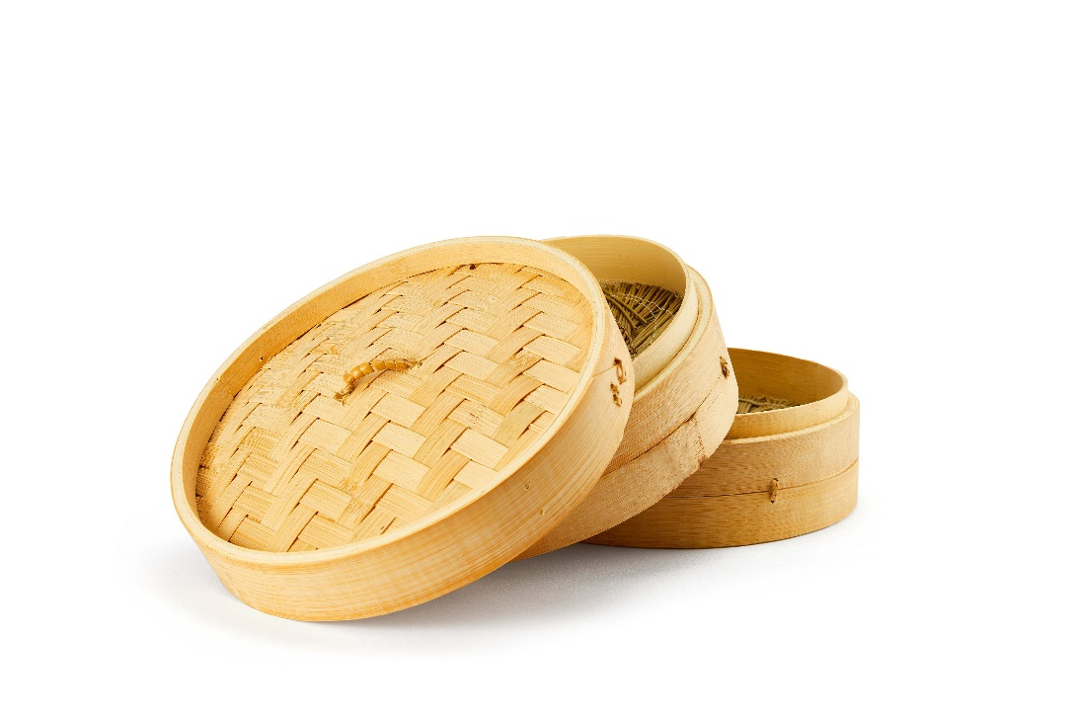
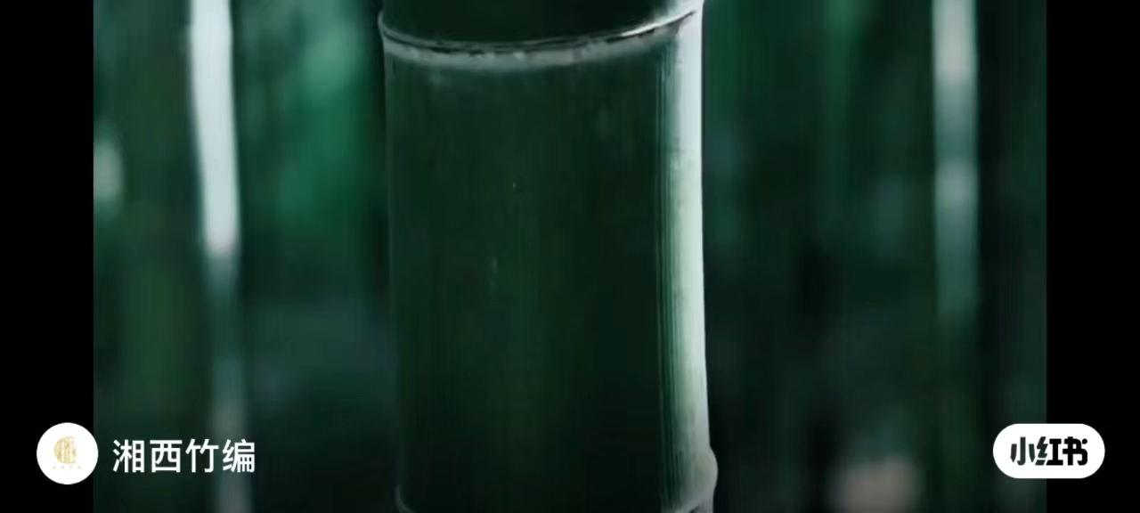
竹编的制作过程
9、Weaving
10、Oiling

Slide 10
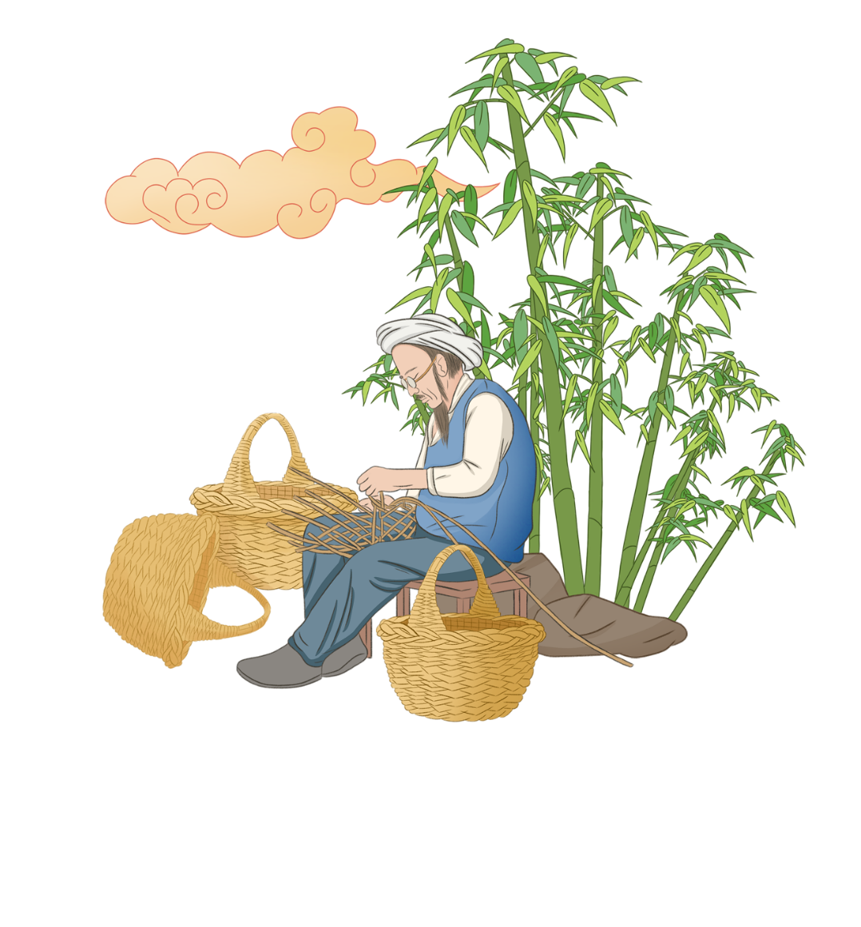
Reference Source
Red Book
Doubao
Thanks

