Slide 1
Chinese Electric Vehicles map the world’s horizons
Science and Technology
Deng Xin

Slide 2
Part 1 Key factors for the rise of Chinese EVs
Part 2 Gasoline Cars or Electric Cars
Contents
——Chinese EV- A new choice

Slide 3
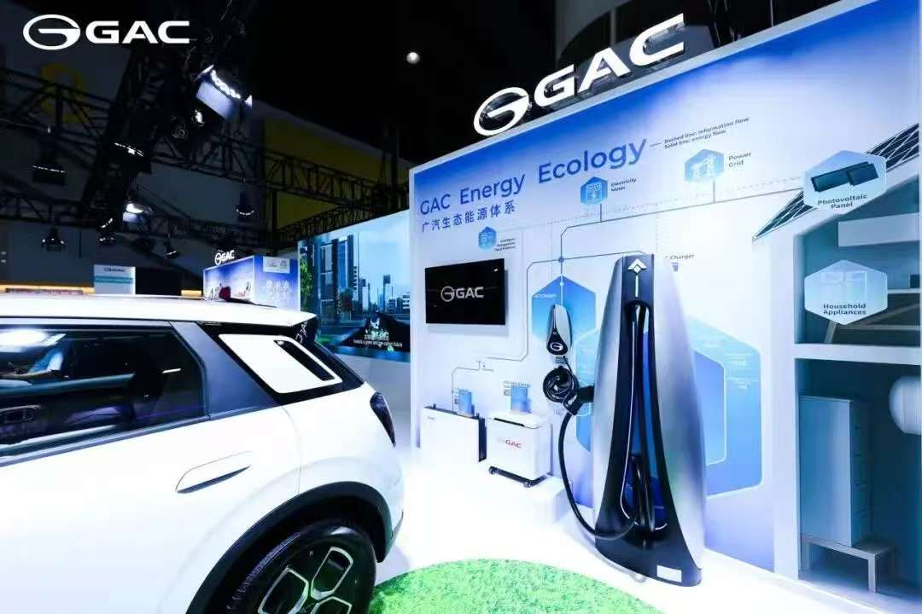
A dialogue from an interview in Canton Fair 2025
…European automobiles enjoy a global reputation. Why did you travel all the way to China to purchase vehicles?…
Correspondent
…comparatively low electricity prices in Europe….
…environmental protection requirements…
…technologically advanced
…affordable…
Crisan Flaviu from Romania

Slide 4
01
Key Factors for the rise of Chinese EVs

Slide 5
01
External factors
Carbon Peaking and Carbon Neutrality
being on the “same” starting line
A solid foundation for development
Industrial development policy
government subsidy
free exclusive license plate
exemption from vehicle purchase surtax
a well-developed industrial system
large market size
flourishing digital industry

Slide 6
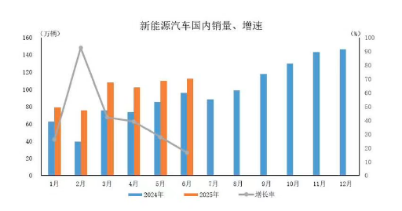
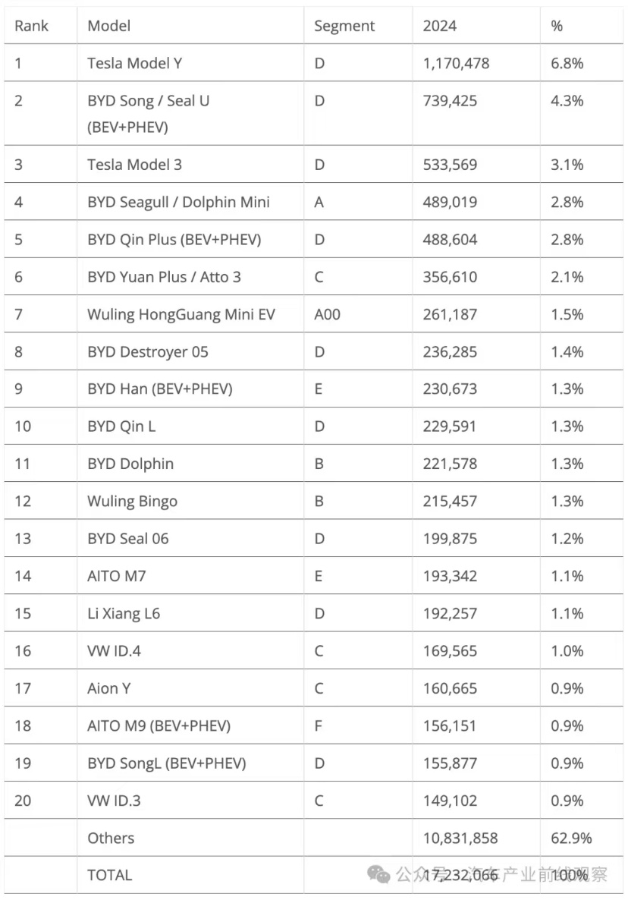
Statistics
World EV Sales December 2024
Source: China Association of Automobile Manufacturers
China Automative News:
In March 2025, global sales of electric vehicles (passenger cars) exceeded 1.6 million with 1.1 million units of pure electric vehicles.
In the first three months of this year, China's share of global new energy vehicles increased to 67.7%.

Slide 7
02
Gasoline Cars or Electric Cars?

Slide 8

Poll– Gasoline Cars or Electric Cars?

Slide 9
02
Gasoline Cars Camp
EVs Camp
Mature and stable technology
Safer
Widely distributed gas stations
Faster refueling
Charging problem of EVs
Long charging time of EVs
Susceptibility to environmental conditions of EVs
…
Substantial government subsidies and incentives
A superior smart driving experience
Optimism about future battery technologies
High cost of gasoline of gasoline cars
Expensive maintenance of gasoline cars
Difficulty of license plate lottery of gasoline cars
…

Slide 10

Future of EVs
An Irresistible Trend
Get refined internally and externally through technology and innovation

Slide 11
Source List
1.洪剑儒.中国新能源汽车丈量全球疆界[N].国际商报,2025-10-23(001).
2.李晓华.我国新能源汽车的发展现状与前景趋势[J].人民论坛,2024,(09):76-79.
3.袁晓东,杨博.油车or电车？消费者购车态度大调查[J].数据,2022,(11):15-17.

Slide 12

THANKS
Deng Xin

