Slide 1
The Forbidden City
Between Heaven and Earth

Slide 2
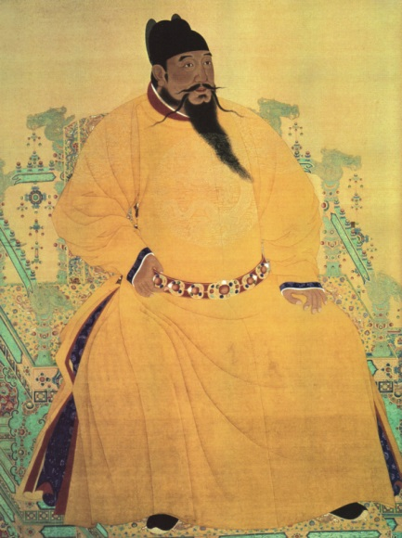
Origins
Yongle used treachery to usurp the imperial throne in early 1400s.
To meet his goals:
  Eradicated opponents.
  Move Capital to Beijing.
  Persuade the people of his authority and Mandate.
  Establish his status and reign by building large ornate palace.

Slide 3
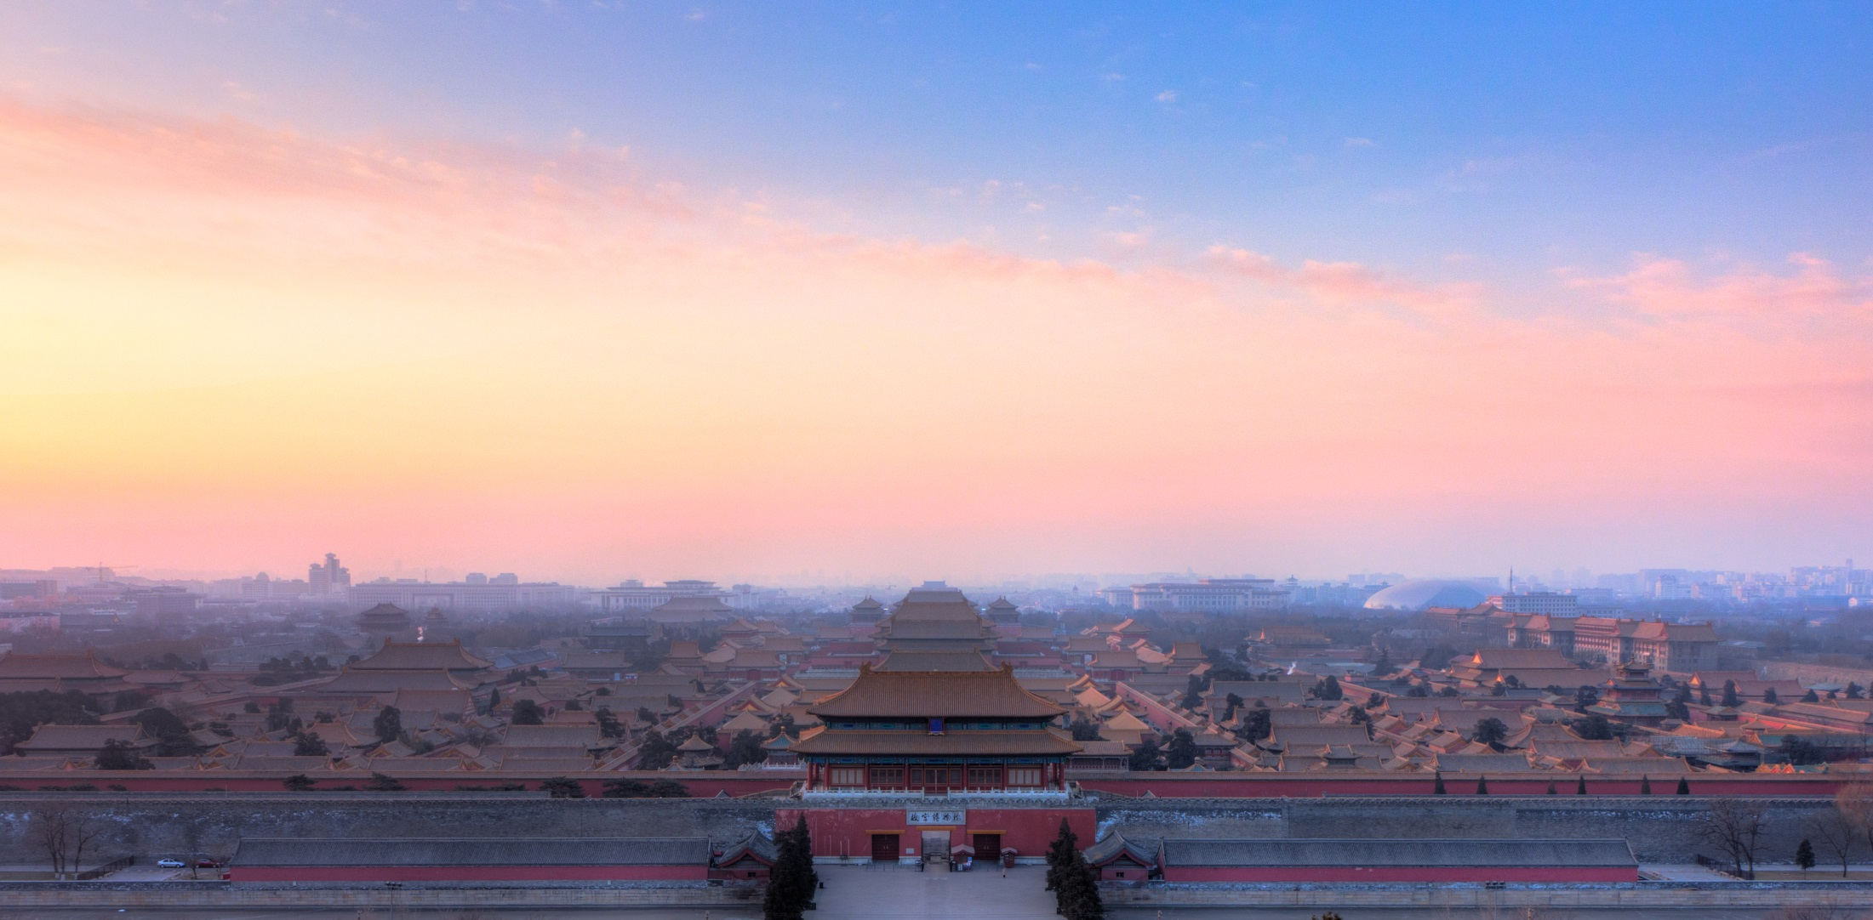
Size and Grandeur
Eunuchs measured every aspect of old palace to ensure the new one would be larger.
900 Structures.
  Watchtowers legend.
9,999 rooms? Not really.
Hundreds of thousands of bricks.

Slide 4
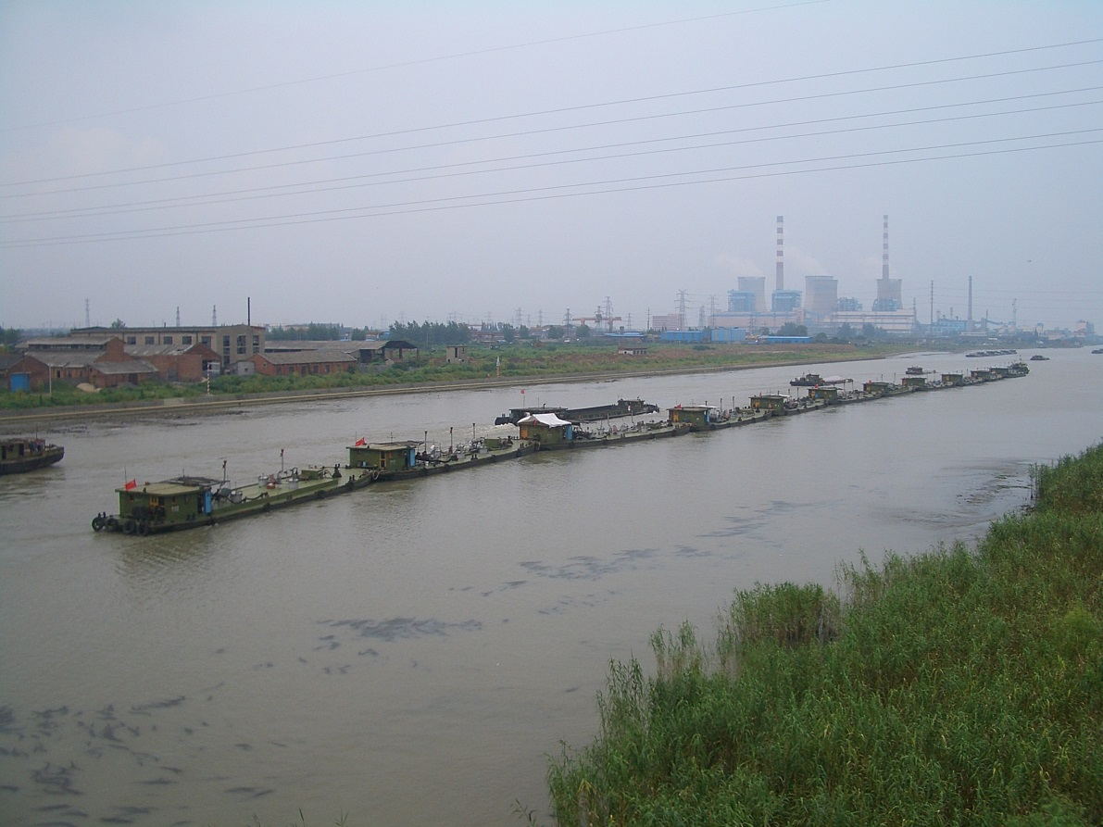
Construction
Grand Canal was re-dredged by 300,000 men to float timbers 1,100 miles to Beijing.
Took four years to send 380,000 timbers.
½ of loggers died in the process.

Slide 5
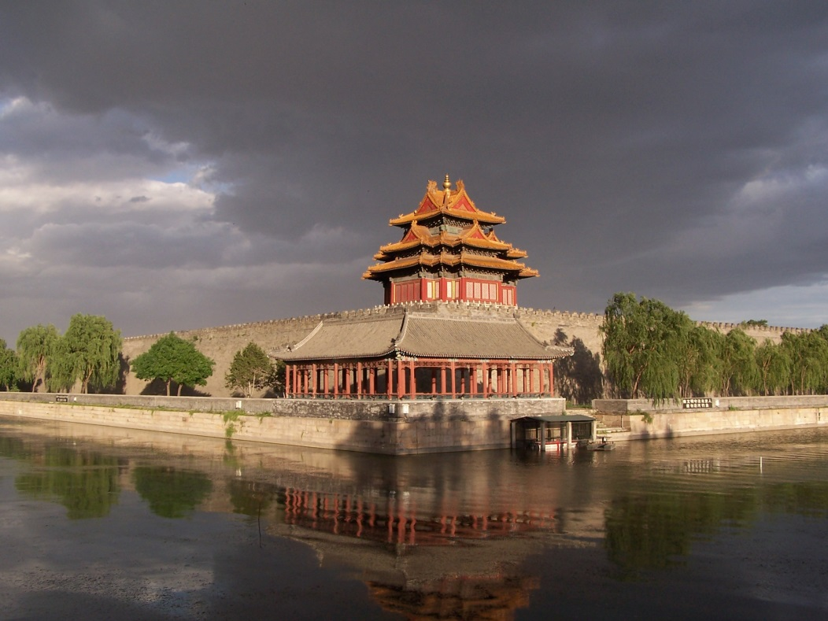
Construction
150 ft. wide Moat.
30ft.X20ft. Walls. 5:00-8:00
  http://www.youtube.com/watch?v=Bgm2JcgGVs4
180 Acres of flooring. 50:00-53:00
  http://www.youtube.com/watch?v=6PqtOo-K-yM

Slide 6
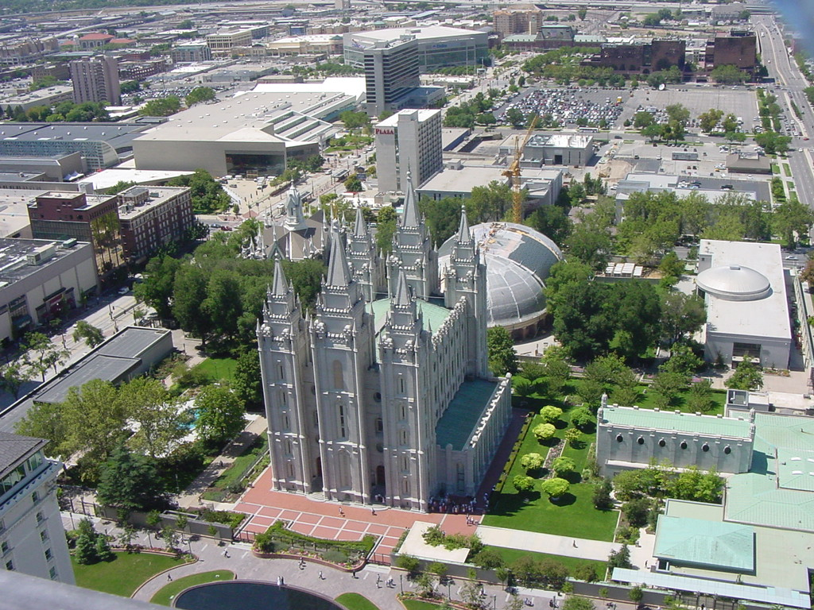
Size is Everything…
10 Acres.

Slide 7
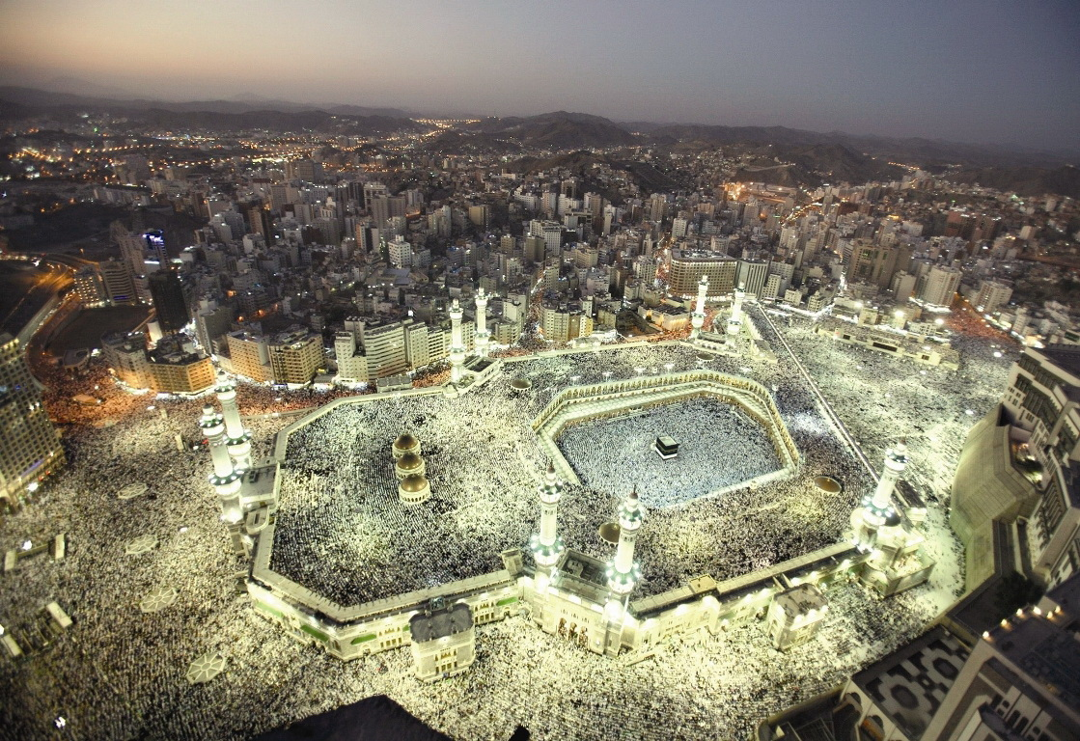
Size is Everything…
88.2 Acres.

Slide 8
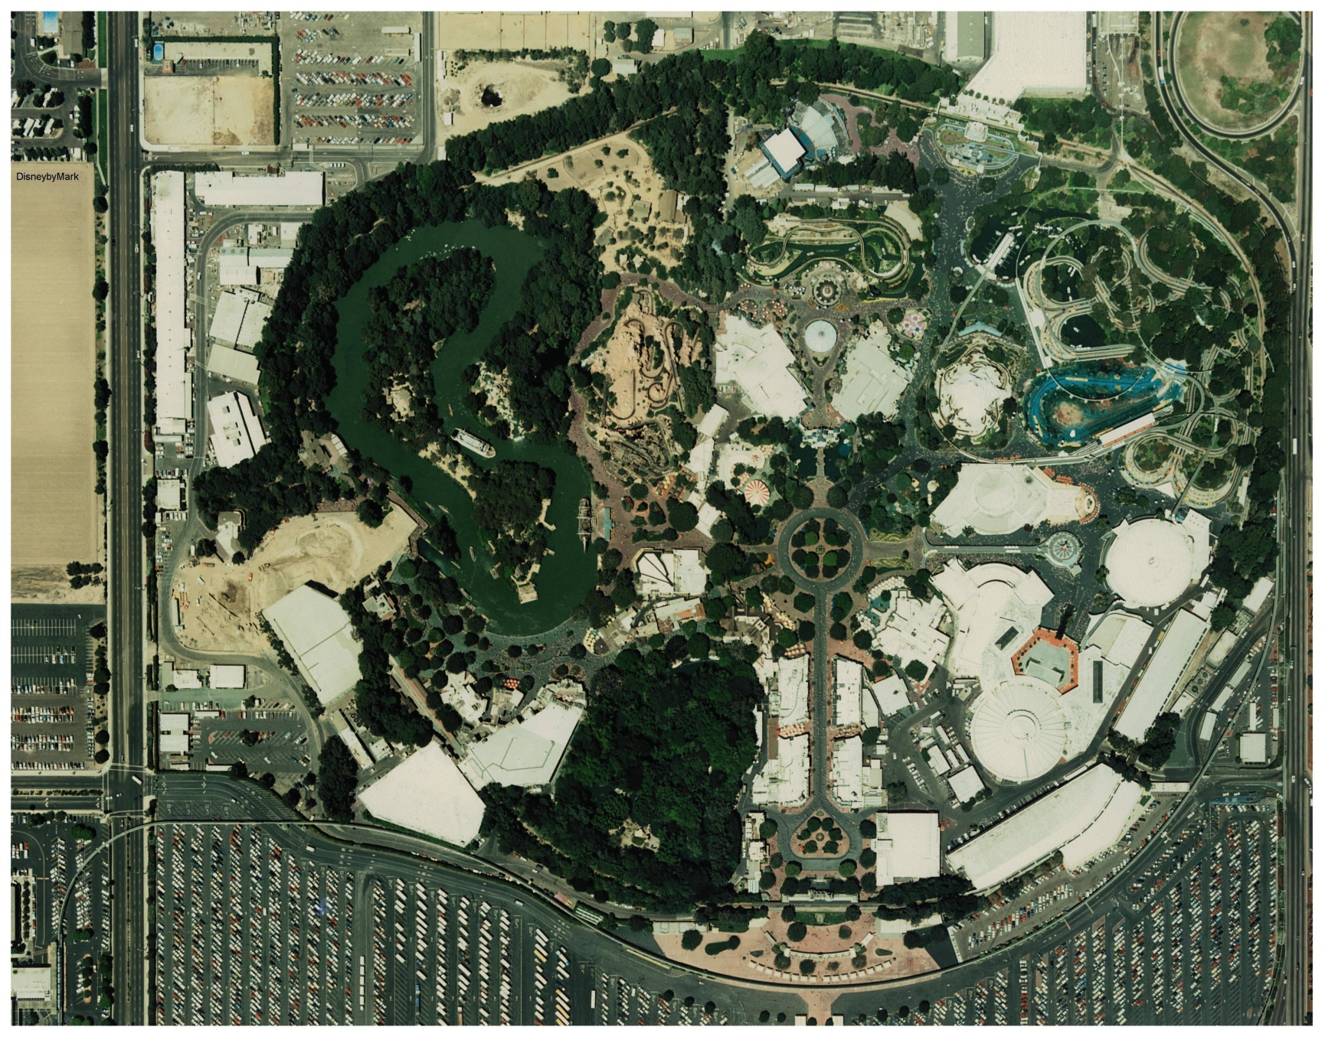
Size is Everything…
160 Acres.

Slide 9
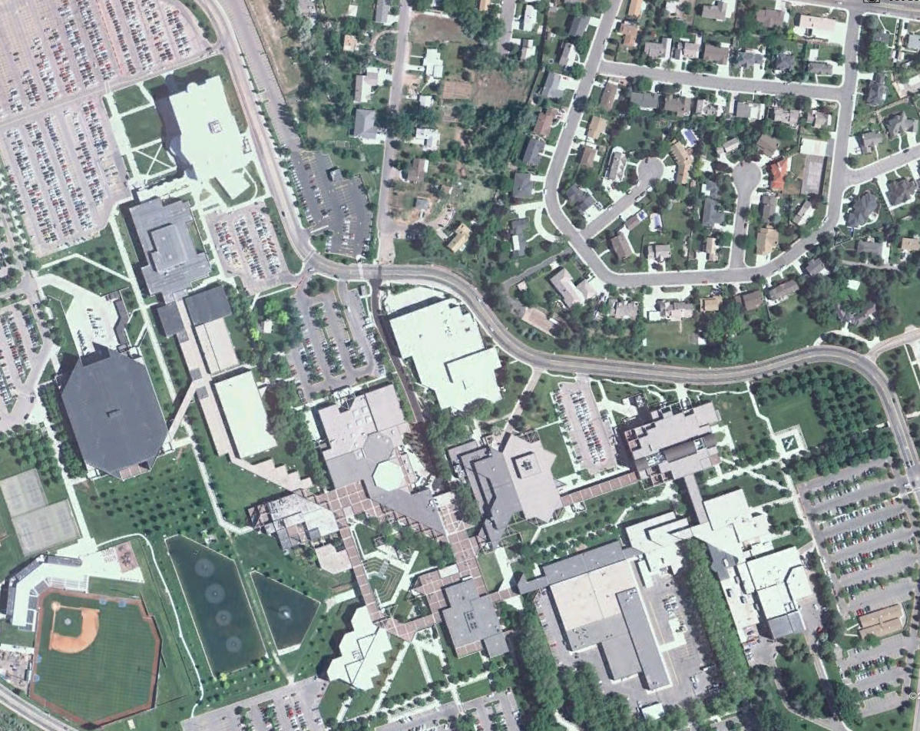
Size is Everything…
228 Acres.

Slide 10
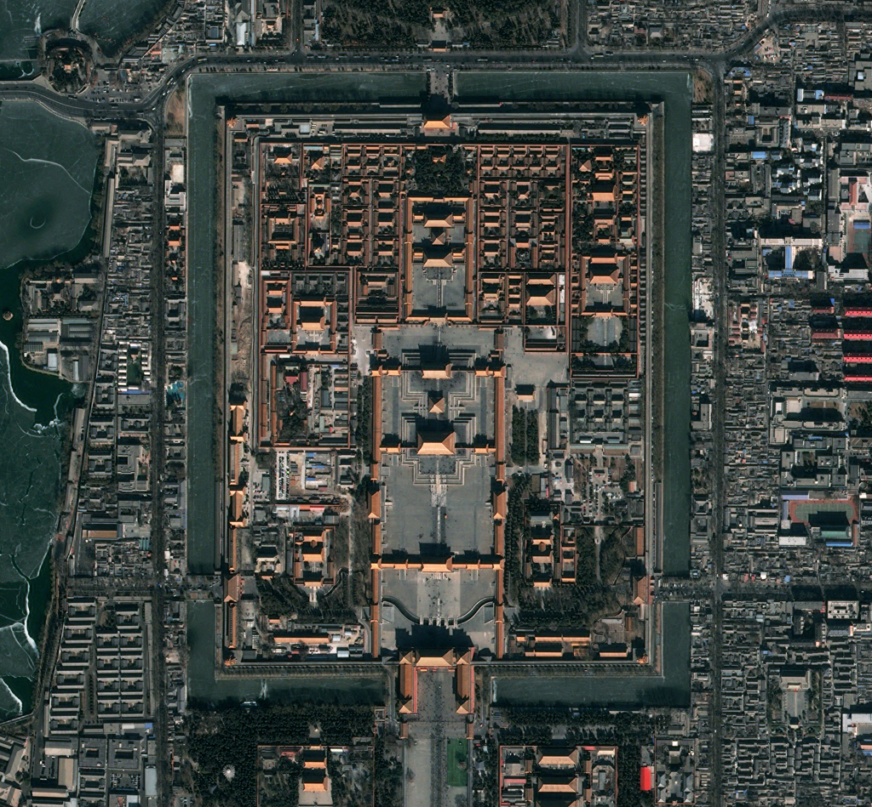
Size is Everything…
180 Acres.

Slide 11
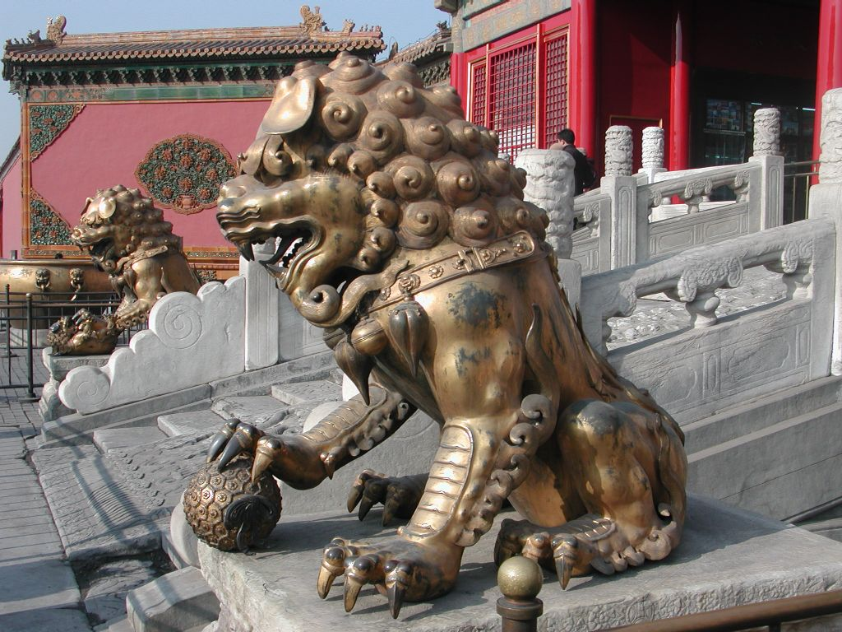
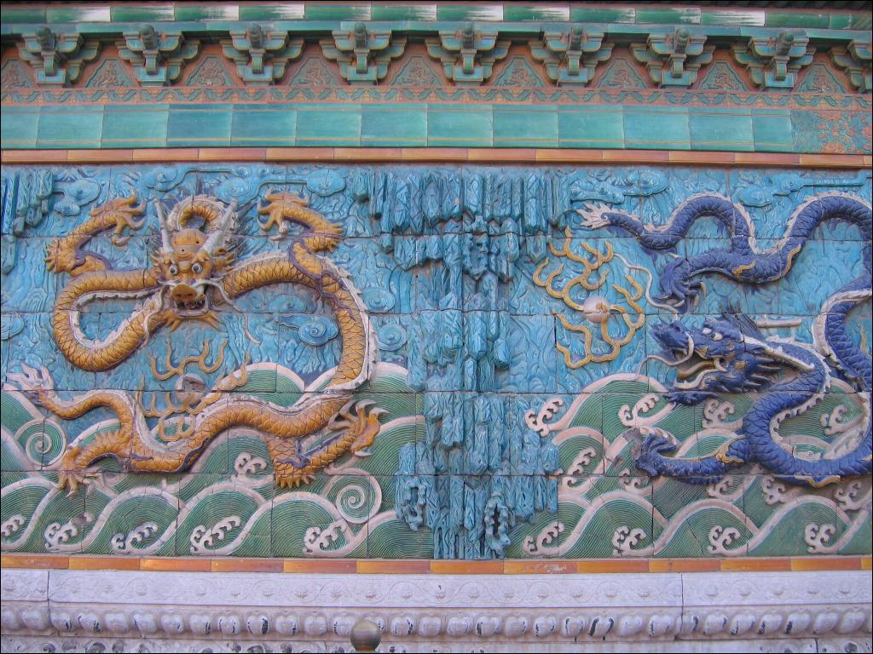
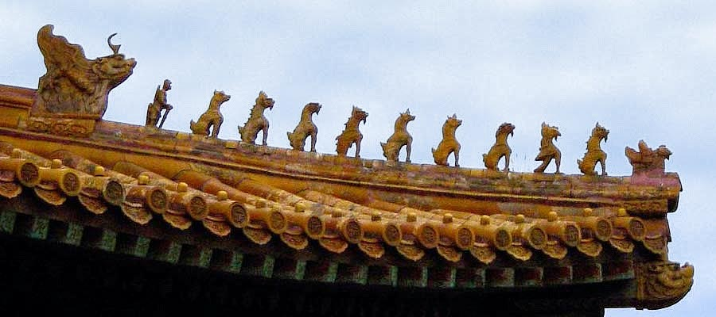
Architecture
Symbolism.
  Red – Good luck & Fire.
  Black – Water.
  Yellow – Emperor & Power.
  Crane – Longevity.
  Lion – Strength.
  Dragon – Authority.

Slide 12
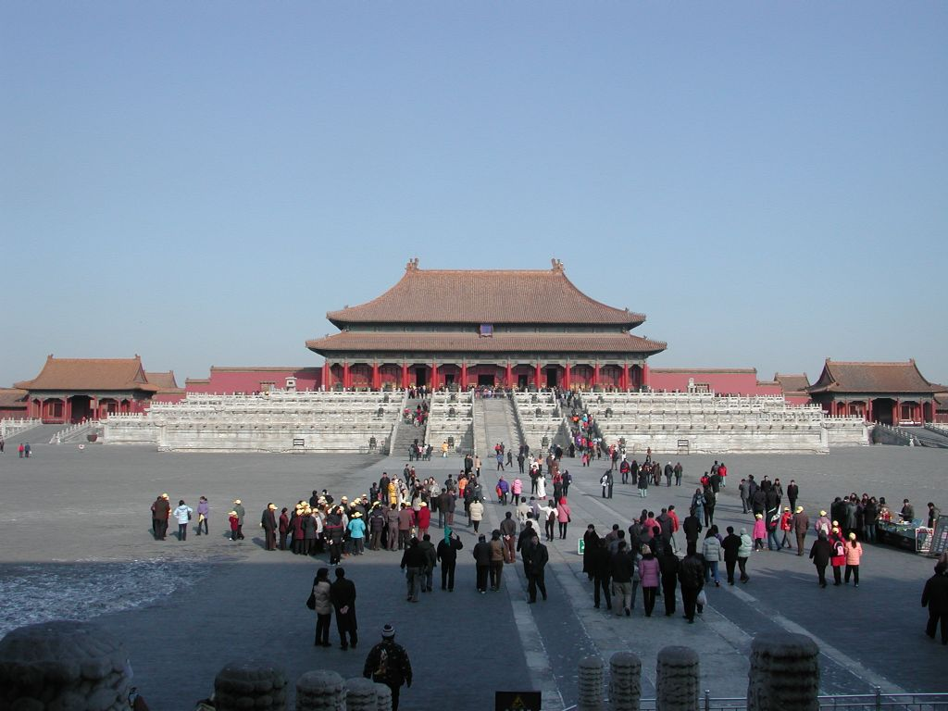
Celestial Connection
Palace Complex aligned with Pole Star.
Blueprint represents Emperor’s connection to the Mandate of Heaven.
  http://www.youtube.com/watch?v=6PqtOo-K-yM
    14:00 – 15:45,
Grand Opening.
    1:01:30 – 1:02:45.

Slide 13
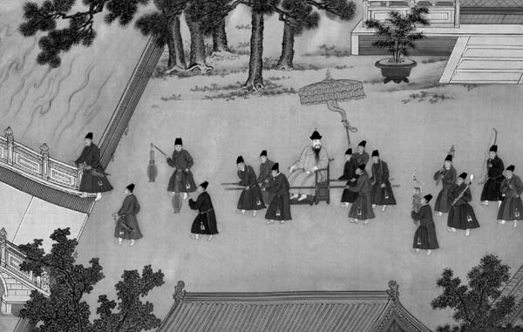
Palace Life
Eunuchs.
  10,000 Volunteer Servants.
  Tended to Concubines, ran Imperial Workshops.
  Became educated and part of Bureaucracy & Politics during Ming Dynasty, but were humbled during Qing Dynasty.

Slide 14
Palace Life
Concubines.
  1408 Trip to Korea.
  Inspected hands, teeth, body odor, sleep habits, foot size, etc.
  300 girls found, 5 were selected.
  Ritual Calendar for intercourse.
    Each Concubine had astrological and Zodiac ties.
  No limit to # of Concubines.
  When Emperor died, they were moved to Garden of Forgotten Favorites.
Eunuchs and Concubines sometimes formed relationships.
  2,800 were murdered by Yongle as a result.

Slide 15
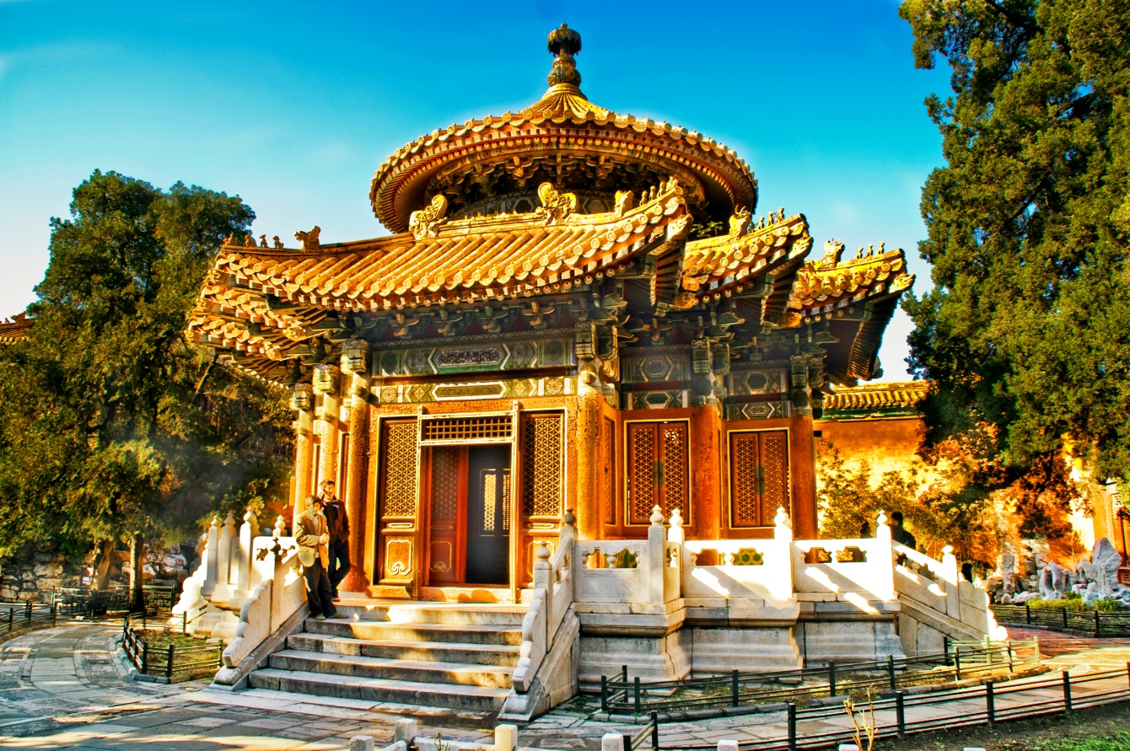
Palace Life
Forbidden City was a Fortress and a Prison.
  Every aspect of life was regulated.
  Extensive rules for conduct and procedure.
  Book of Ancestral Instructions was the official text of laws.

Slide 16
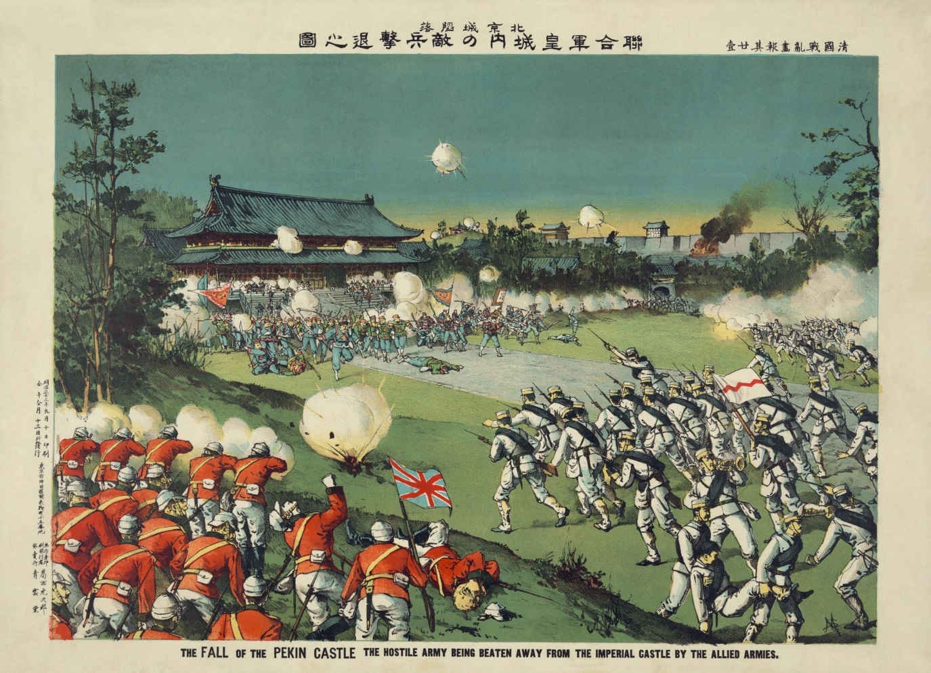
Decline of the Empire
Interactions with “Western Barbarians.”
  Opium War.
  British East India Company.
  Boxer Rebellion.
1925 the final Emperor was evicted.

Slide 17

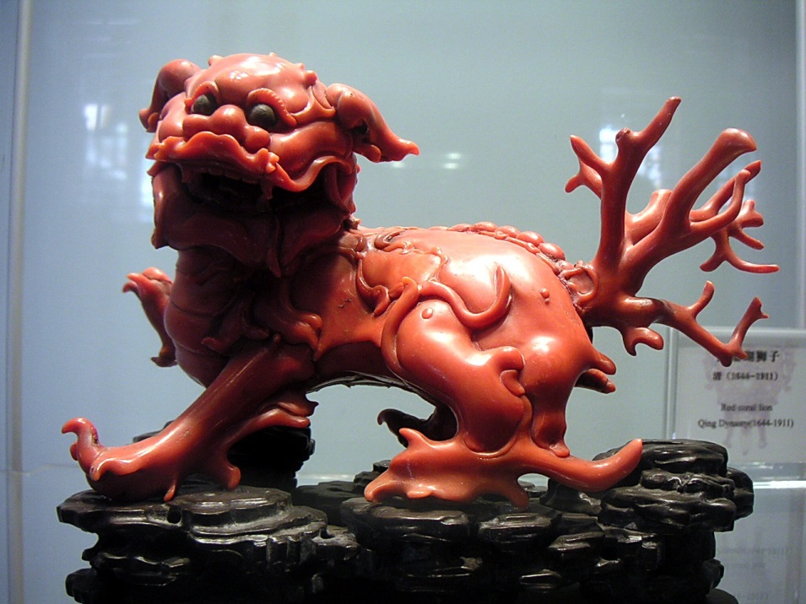
Modernity
The Forbidden City is still representative of National Consciousness.
Represents Historical Greatness and therefore, modern potential.
UNESCO World Heritage Site 1987.
Growth of Beijing reflects power and authority of the nation.
Palace Museum.
  100,000 Treasures.
  10,000,000 Visitors each year.

