Slide 1


The “reference” of Chinese Music
主讲人: 黄泽辰
时间: 2024.11

Slide 2
目录
CONTENTS
01
The History and Current Situation of the Reference
02
Specific Case Analysis of Chinese Music Reference
03
The Importance of Originality in Chinese Music

Slide 3

01
The history and current situation of the reference

Slide 4

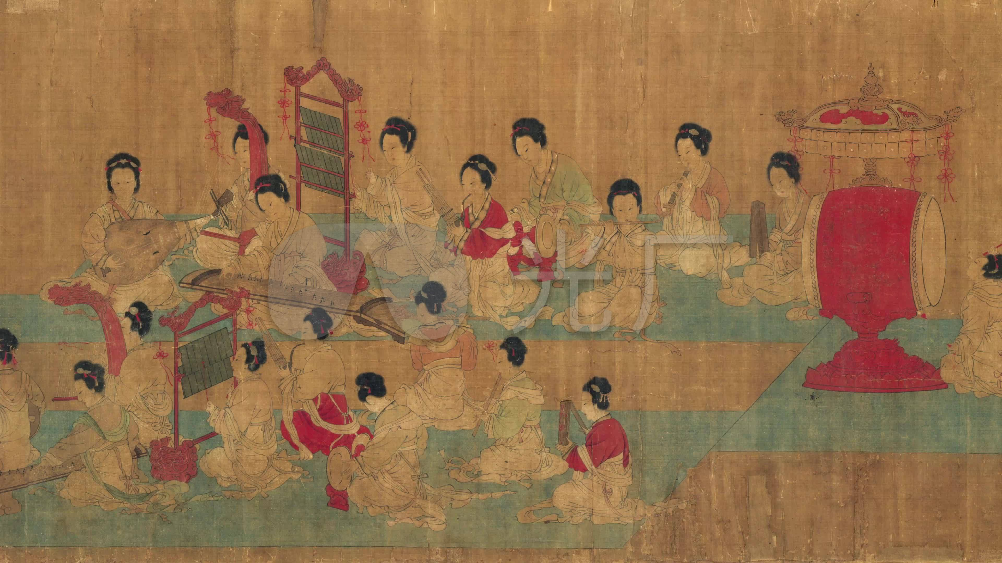
中国音乐借鉴的起源与发展
historical background
Looking back at history, the international dissemination of Chinese music began during the Qin and Han dynasties. Through personnel exchanges, commercial trade, and religious dissemination, ancient Chinese musical instruments such as the Tao Xun, Bronze Duo, and Se have been spread to East Asian countries such as Korea and Japan.
During the Sui and Tang dynasties, Chinese music culture began to spread directly to Japan, laying the foundation for the formation of its modern elegant music. Through the dispatch of envoys to the Sui and Tang dynasties, Japan began to accept Chinese music culture on a large scale and in an organized manner.

Slide 5

中国音乐借鉴的起源与发展
historical background
However, since the last century, many Chinese singers or bands have the experience of "refer" songs from other countries. It is because singers had to release several albums every year, so they had to use other people's songs if they didn't have enough creative ability.
Another reason was that communications at that time were not as developed as they are today, so their "reference" could not be easily detected by the public. So this method became the choice of most singers at that time.

Slide 6

中国音乐借鉴的起源与发展
modern significance
In recent years, due to the development of the Internet, we have access to more songs, and singers will choose more obscure songs to copy, which limits the originality and diversity of Chinese music culture to some extent.
this also arouses heated debate about originality in music and cultural confidence. Some people think that as long as the song sounds good, it doesn't matter whether it is original or not. Others think creation should be encouraged.

Slide 7

Adapation VS Cover VS Plagiarism
What is adaptation?
——Creative reprocessing based on the original work, purchasing the copyright of the original work and signing with the original author’s name.
What is a cover song?
——Reinterpret songs performed by others according to one's own style without changing the original work, purchasing the copyright of the original work and signing with the original author’s name.
What is plagiarism?
——Directly using someone else's work without the original author's authorization or attribution in the work.

Slide 8
02
Specific Case Analysis of Chinese Music Reference

Slide 9
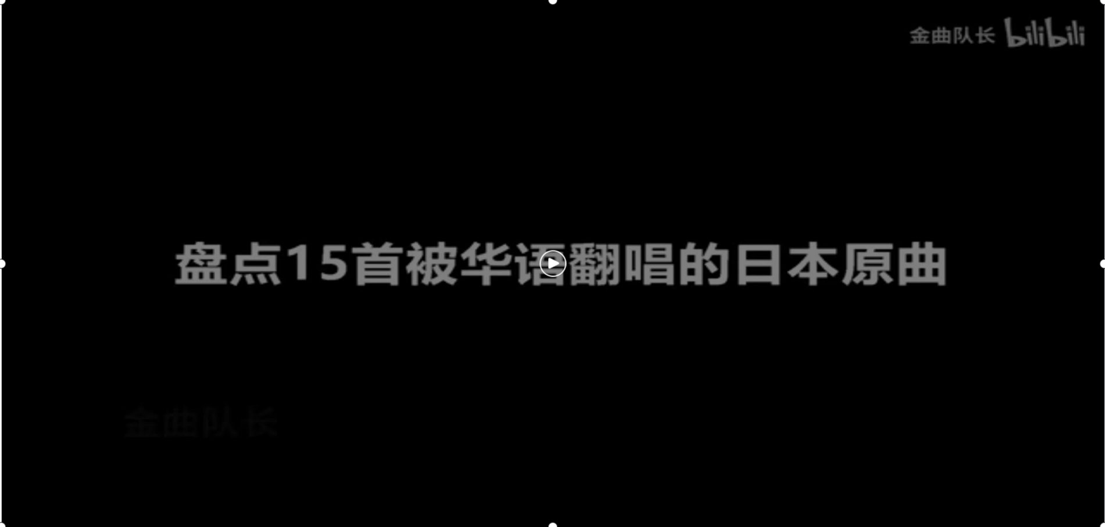
华语乐坛的借鉴现象

Slide 10

华语乐坛的借鉴现象
The adaptation of popular music in Hong Kong and Taiwan is mainly based on "Chinese lyrics and Japanese songs", retaining the original melody and even the music arrangement, and rewriting it with Chinese lyrics.
Japan began to introduce various styles and types of European and American music from the late 18th and early 19th centuries. Since then, Japan has actively learned from Europe and America, and many European and American musicians attach great importance to the Japanese market, which has provided them with a good foundation in external conditions; At the same time, Japanese musicians often engage in various forms of communication, which promotes and drives music creation.

Slide 11

华语乐坛的借鉴现象
Miyuki Nakajima alone supports half of the Hong Kong and Taiwan music industry
According to statistics from the public, since the 1970s, every year there have been adaptations and covers of Miyuki Nakajima's works by singers from Hong Kong and Taiwan. More than 70 songs from Miyuki Nakajima have been adapted into more than 100 Chinese versions, with Mandarin and Cantonese being the majority.

Slide 12
03
The Importance of Originality in Chinese Music

Slide 13

原创音乐的重要性
Although Japan has absorbed a lot of culture from China, many modern Chinese songs are covers of Japanese songs. In terms of pop music culture, China still needs to improve.
Chinese popstar Jay Chou has said, “Don’t let the Korean Pop music become the mainstream, Chinese Pop music should be the best.” Jay Chou’s “confidence” is because his songs are mainly original. When his "In The Name of the Father" premiered, it was broadcast on more than 50 stations across Asia, with an estimated 800 million people online. His ability and fame lend themselves to this statement. There were many original songs appearing in the Chinese music scene at that time. However, in recent years, the Chinese music scene is not as good as before.

Slide 14
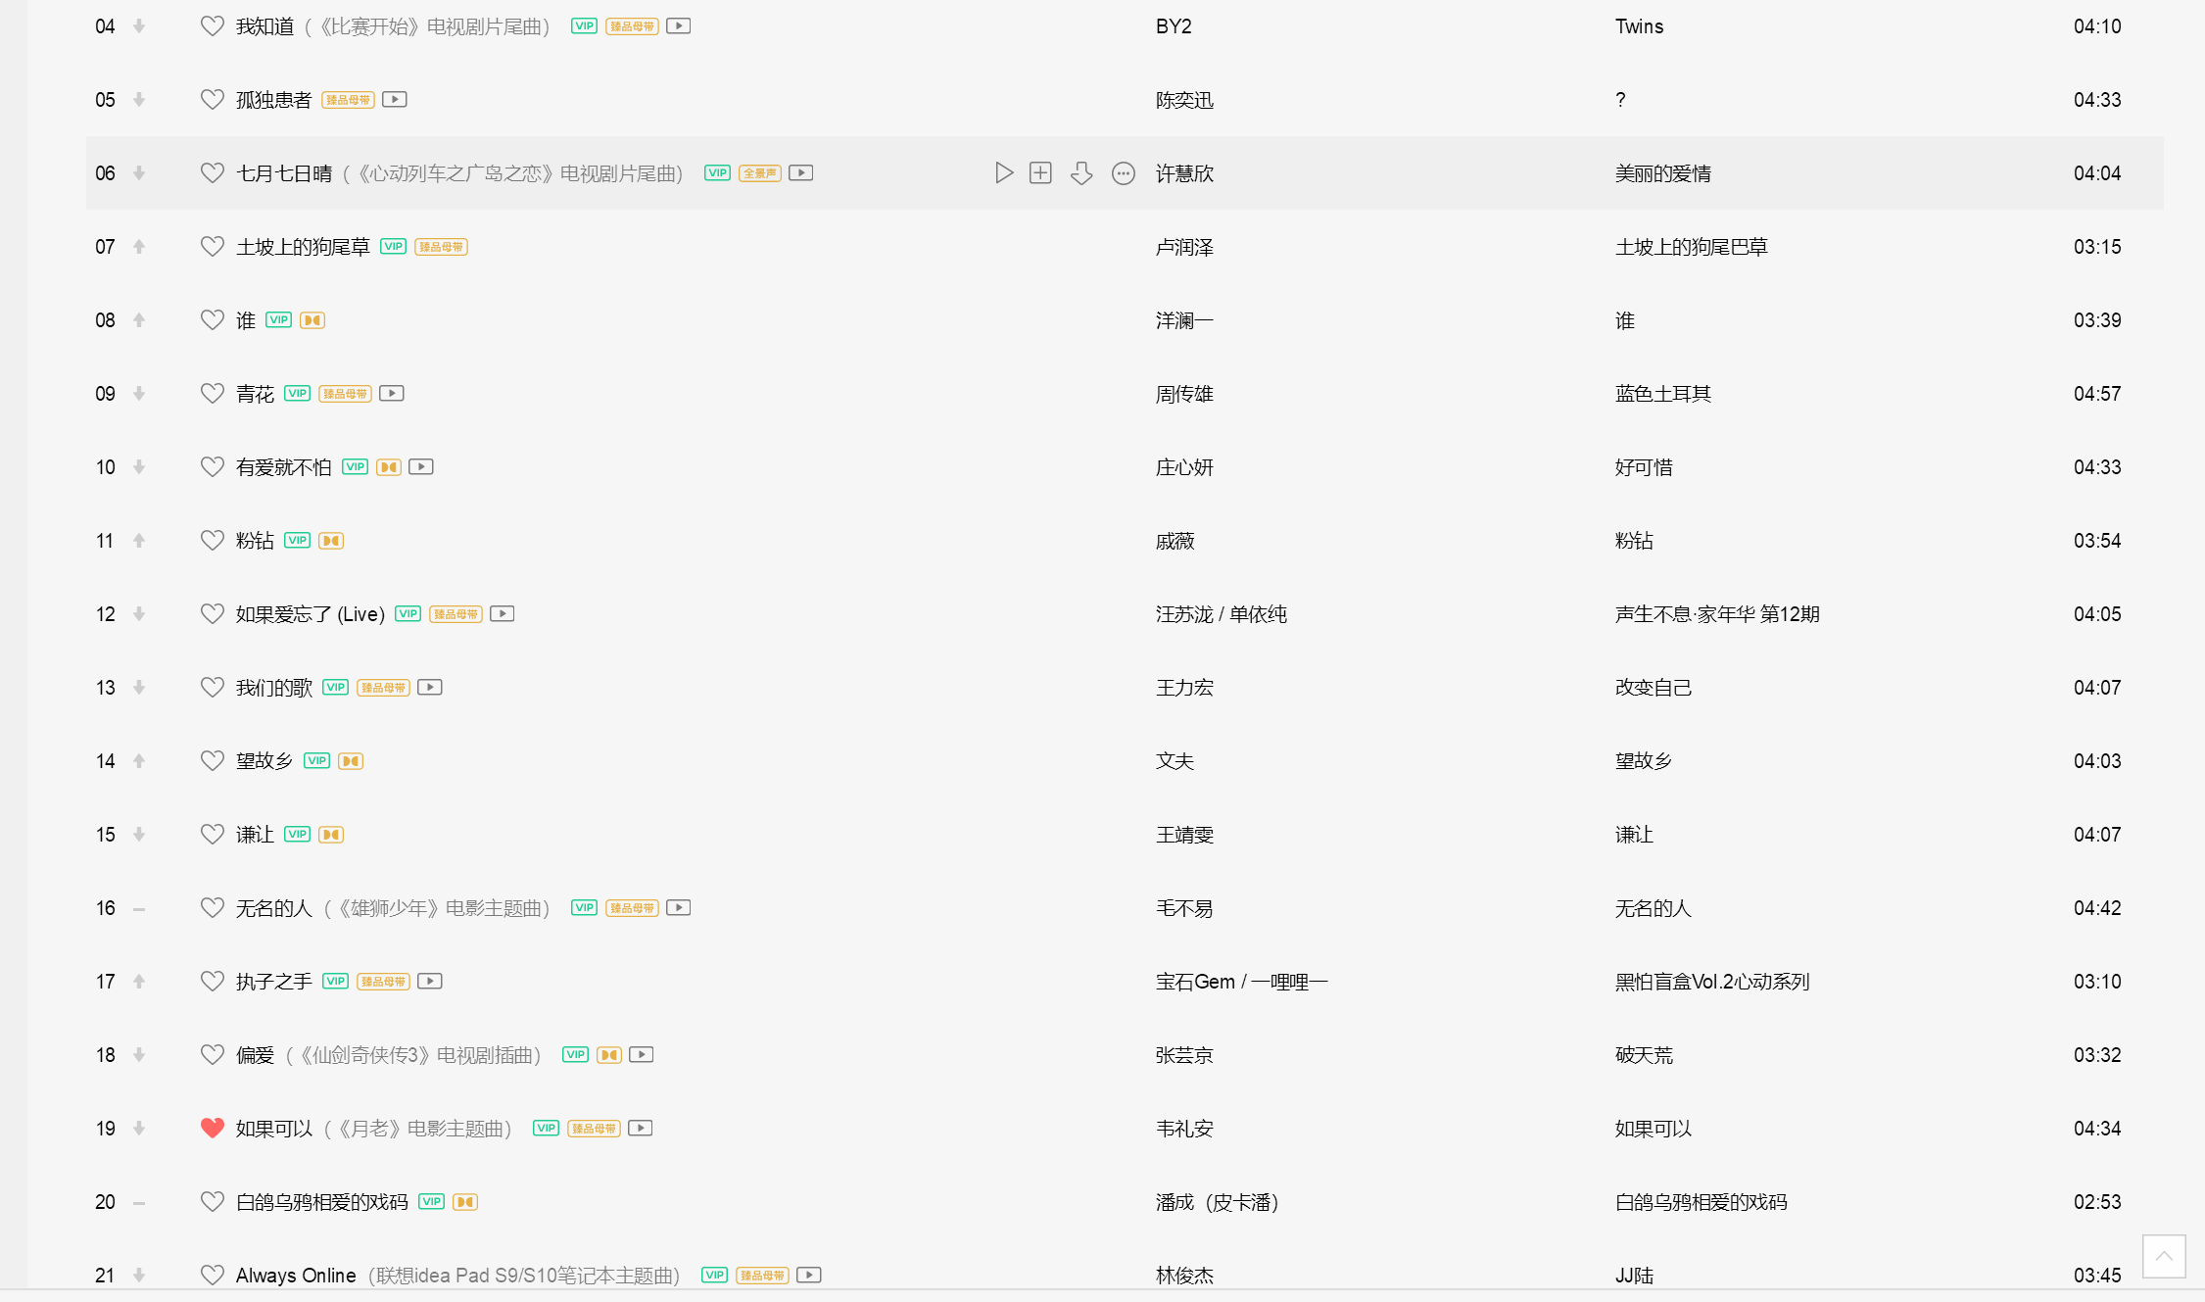

原创音乐的重要性

Slide 15

原创音乐的重要性
In addition, some singers choose to refer songs from their own countries.Therefore, some people lament that the Chinese music industry is falling further and further behind. Chinese pop music culture should present its own content to the world, instead of borrowing others' content.

Slide 16
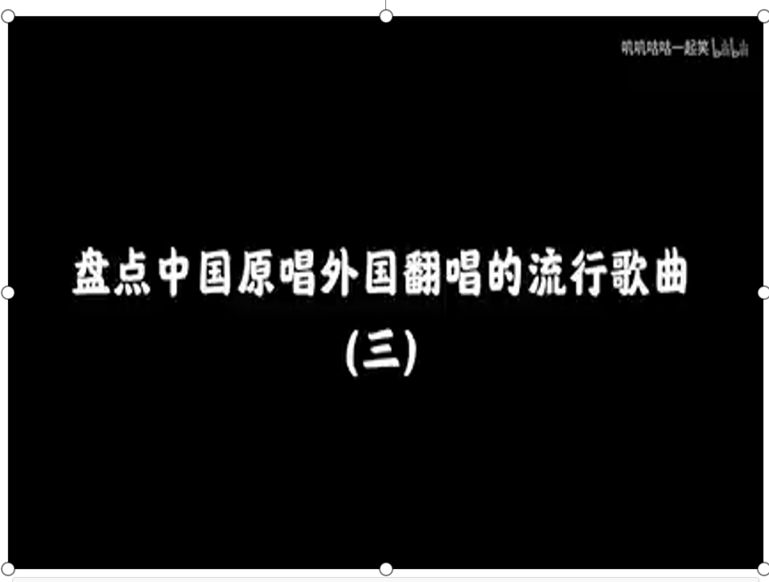
原创音乐的重要性
In fact, famous original Chinese songs are also covered by foreigners.So we should enhance cultural confidence and encourage originality.
"Reference" is indeed a shortcut, but if we want to go further, originality is needed.

Slide 17
谢谢大家

