Slide 1
Translation Theories of
Peter Newmark
PPT: Liu Xiao
Handout: Liu Yue

Slide 2
1. About Peter Newmark
CONTENTS
2. Translation Theories
Classification of Text Types
Translation Approaches
Correlative Theory of the Translation

Slide 3
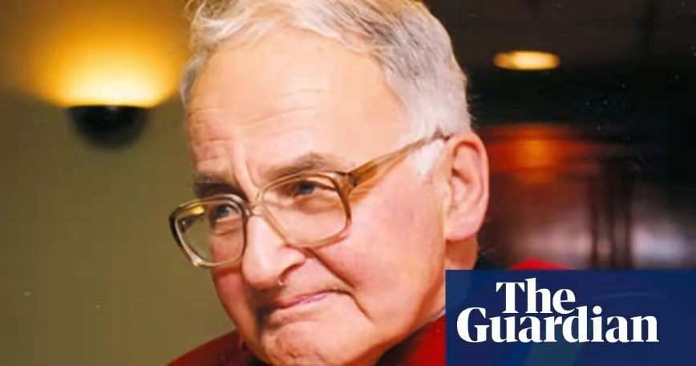
About Peter Newmark
One of the main figures in the founding of Translation Studies in the English-speaking world in 20th century
Peter Newmark (1916-2011)
Teaching experience:
the Royal Polytechnic Institution;
the University of Surrey
Works:
Approaches to Translation, 1981;
About Translation, 1991
Paragraphs on translation, 1993
More paragraphs on Translation, 1998
A Textbook of Translation, 1988

Slide 4
Translation Theories
Classification of
Text Types
Translation
Approaches
Correlative Theory of
the Translation

Slide 5
1. Classification of Text Types
Vocative-Functional texts
Function of Language:
informative function, expressive function, vocative function, phatic function, aesthetic function, metalingual function.
calling on readers to act, think, feel
notices, instructions, ads, etc.
the readability of text
Translation: “reader first”
Informative-Functional texts
Text Types
conveying information to readers
reports, newspaper articles, meeting minutes, etc.
the “authenticity” of the content
Translation: “authenticity first”
Expressive-Functional texts
expressing meaning
novels, poems, autobiography, prose, etc.
authority of the original author
translation: “original author first”

Slide 6

2. Translation Approaches
Source Language
8 Approaches
Target Language
Accuracy
Economy
Accurate reproduction of the meaning of the original text at the level of the grammatical structure of the target language
Production of an effect on the target readers as close as possible to that obtained on the readers of the original.

Slide 7
2. Translation Approaches
Differences
Communicative translation (CT) is firstly loyal to the target language and culture, target text readers, while semantic translation (ST) is subject to the source language and culture, the original author
When there is a conflict between information content and effect, communicative translation attaches more importance to effect than content, while semantic translation does the opposite.
Wet Paint!
Some parts of the same work be translated in a communicative way, and some parts be translated in a semantic way.
× absolute CT
× absolute ST

Slide 8
3. Correlative Theory of the Translation
A New Theory of Translation, 2007
The more serious and important the language of the original or source text, the more closely it should be translated.
Depending on the specific occasion the translation occurs and the target reader

Slide 9
3. Correlative Theory of the Translation
Lexically:
word-to-word translation
transformation,
domestication,
literal translation,
interpretation
Grammatically:
the same structure
adjusted structure
Closeness
7 methods:
component analysis
adjusted translation
descriptive equivalence
functional equivalence
cultural equivalence
synonymous (near-synonymous)
paraphrase
Textually:
lexical closeness + grammatical closeness + the cohesion and coherence of the text
closeness

Slide 10
References
[1] Newmark, Peter. Approaches to translation[M]. Shanghai Foreign Language Education Press,2001.
[2] Newmark, Peter. A New Theory of Translation[J]. Sborník Prací Filozofické Fakulty Brněnské Univerzity,2007(13)
[3]Newmark, Peter. A Textbook of Translation[M]. Shanghai: Shanghai Foreign Language Education Press, 2001.
[4] 方梦之.译学大词典[M].上海：上海外语教育出版社,2009.
[5] 侯莹莹.凯瑟琳娜·莱斯与彼得·纽马克文本类型翻译理论之比较研究[J].海外英语,2020(22):49-50+60.
[6] 李亚秋.试谈纽马克的翻译理论[J].科教文汇(中旬刊),2007(06):181.
[7] 谭载喜.西方翻译简史[M].北京：商务印书馆,2004.

Slide 11
Thank you for listening!

